Slide 1



VIGIL-X
(The Future of Trustworthy Transactions)
Team Name:-
Ace
Team Members:-
  Sneha Grace Kujur
  Pratirupa Toppo
  Abhibita Sanya Priyadarshani
Affiliation:-
  School of Computer Science and Engineering,
  XIM University, Bhubaneswar, Odisha, India

Slide 2
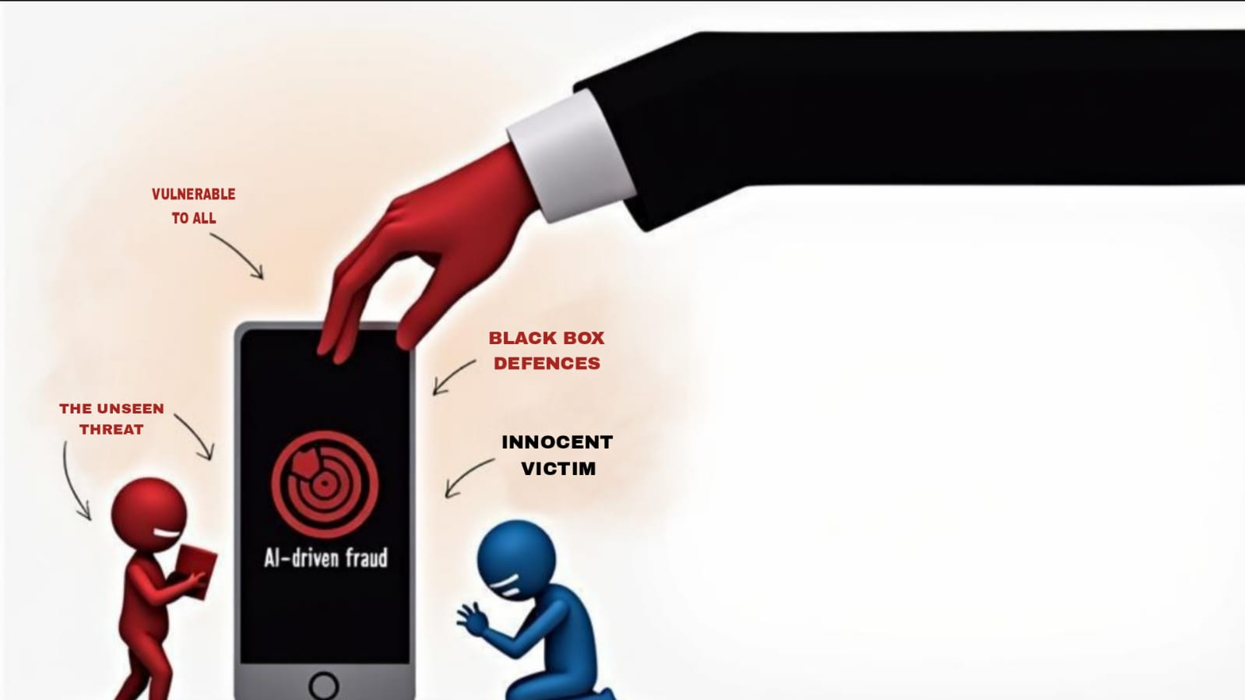
The Problem
NFC's convenience is threatened by a new wave of advanced, AI-driven fraud. But the 'black box' defenses built to fight these threats are creating a second crisis: they unfairly block legitimate users and erode the very trust they are meant to protect. This leaves us with a broken system that is both vulnerable to criminals and hostile to its own honest users.

Slide 3
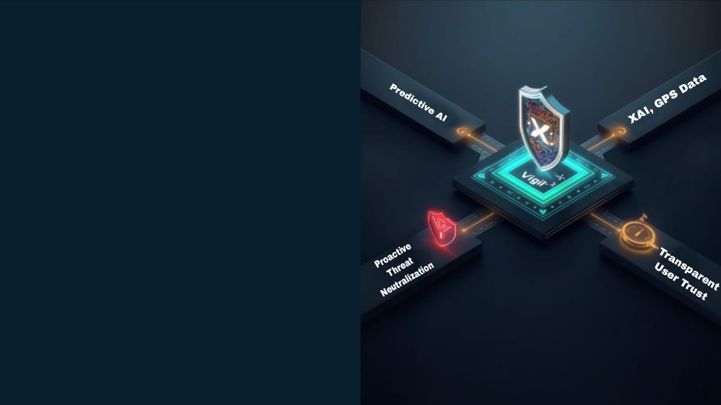
The AI Based Solution
Our solution is a dual-purpose AI framework designed to solve both crises. First, a proactive 'Shield' uses behavioral analysis and GPS data to accurately neutralize advanced threats. Second, a transparent 'Compass' uses Explainable AI to provide clear, simple reasons for any precautionary action. This approach stops criminals while actively rebuilding trust with legitimate users.

Slide 4
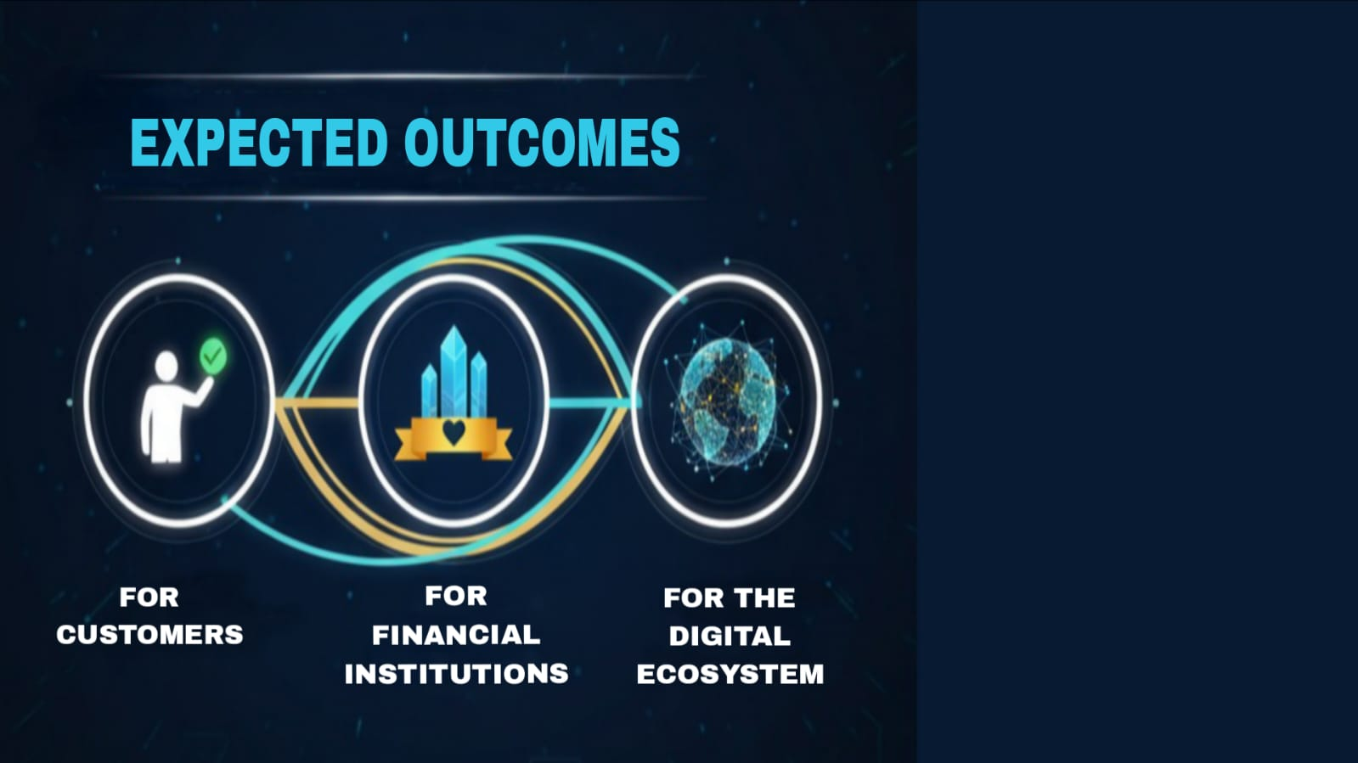
For Customers: We replace their anxiety and frustration with empowerment and control.
For Financial Institutions: We turn security from a cost center into a feature that builds deep customer loyalty.
For the Ecosystem: We set a new ethical standard for finance, proving that security and transparency can and must work together.

