Slide 1
202151160_Lab4

Slide 2
1)
Objective : To write a program to generate multiplication table of any integer read through the keyboard (using while loop).
Software used : Online GDB Compiler and Debugger for C (IDE)
Methodology : The program uses a counter variable (variable b in the code below) to execute the while loop a finite number of times. It’s a counter-controlled loop and executes the compound statements within while loop ten times thereby calculating and displaying the multiplication table of the integer input by the user.
Algorithm :
Step 1) Start
Step 2) take an integer from the user
Step 3) use a counter-controlled while loop to calculate the table of input integer
Step 4) display the multiplication table by using tab spaces and field width specifiers
Step 5) Stop

Slide 3
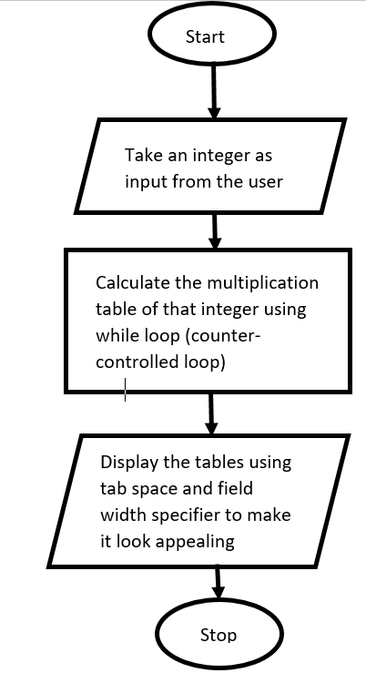
Flowchart :

Slide 4
/* This C program is prepared by Snehal Nalawade
Roll no. : 202151160
Date of preparation : 18/01/2021
This program takes an integer number from the user and prints it's multiplication table using the while loop.
*/
#include <stdio.h>
int main(void)
{
int a, b=1, c; // declaring variables
printf("Enter the number whose multiplication table is to be printed :\t");
scanf("%d", &a); // taking input from the user and store it in variable a
while(b<=10)
{ // opening of wwhile loop
c=a*b;
printf("\n\t%d\tx\t%02d\t=\t%02d\n",a,b,c);
b++; // increment of value of b by one
} // closing of the while loop
return 0;
} // closing of the main function

Slide 5
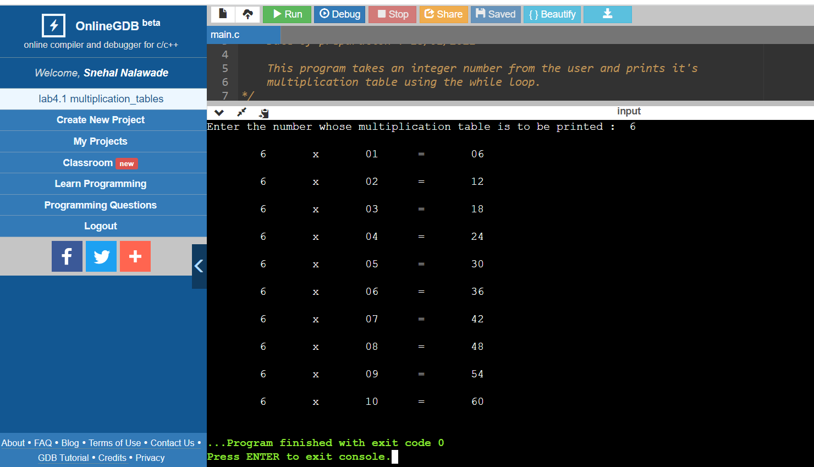
Output :

Slide 6
2)
Objective : To write a program which converts temperature from degree centigrade(C) to Fahrenheit(F) or vice versa. The program should have a provision to let the user choose whether he/she wants to convert C to F or vice versa.
Software used : Online GDB Compiler and Debugger for C (IDE)
Methodology : the program will first ask the user to enter either 1 or 2 from the keyboard in order to choose whether he/she wants to convert temperature from degree centigrade to Fahrenheit or vice versa. According to the input of the user, the program performs the corresponding conversions by using the if statements.
Algorithm :
Step 1) Start
Step 2) take input from user– user should enter 1 for C to F and 2 for F to C
Step 3) use if statements to take input from user perform the temperature conversion in accordance with the former input by the user.
Step 4) display the result
Step 5) Stop

Slide 7
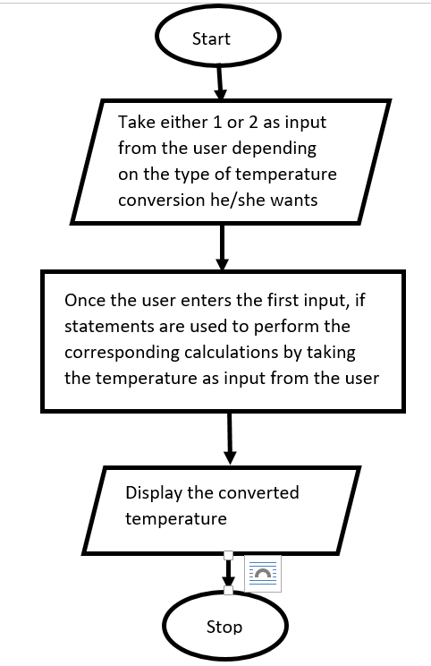
Flowchart :

Slide 8
Source code :
/* This C program is prepared by Snehal Nalawade
Roll no. : 202151160
Date of preparation : 18/01/2021
This program first asks the user to choose whether he/she wants to convert degree centigrade to Fahrenheit or vice versa by entering either 1 or 2 respectively. Once the user enters number according to his choice, the program then asks the user to enter the temperature accordingly and thereafter displays the corresponding output after calculation. This program is written using if statements.
*/
#include <stdio.h>
int main()
{ // opening of the main function
int a; // declare variable a
float c, f;
printf("Enter 1 to convert degree centigrade to fahrenheit\nEnter 2 to convert degree fahrenheit to centigrade\n");
scanf("%d",&a);
if(a==1) // using if statements

Slide 9
{
printf("Enter the temperature in degree centigrade :");
scanf("%f",&c); // take input from the user and store in c
f=((9*c)/5)+32;
printf("The temperature in degree fahreheit is :%0.2f",f);
}
if(a==2)
{
printf("Enter the temperature in degree fahrenheit :");
scanf("%f",&f);
c=(5*(f-32))/9;
printf("The temperature in degree centigrade is :%0.2f",c);
}
if(a!=1 && a!=2)
printf("Invalid input");
return 0;
} // closing of the main function

Slide 10
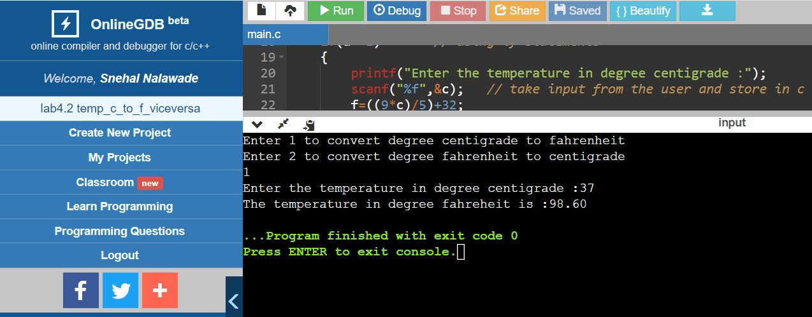
Output :

Slide 11
3)
Objective : To find the greatest number among the three numbers entered by the user.
Software used : Online GDB Compiler and Debugger for C (IDE)
Methodology : the program takes three values as input from the user, finds the greatest one among them by using nested-if statements and then displays the result.
Algorithm :
Step 1) Start
Step 2) take three inputs from the user
Step 3) compare their values by using nested-if statements
Step 4) display the greatest value among them
Step 5) Stop

Slide 12
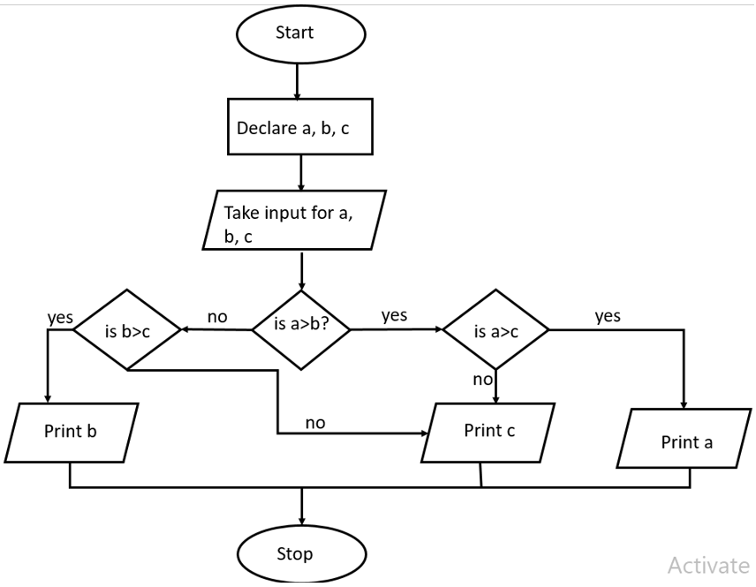
Flowchart :

Slide 13
Source code :
/* This C program is prepared by Snehal Nalawade
Roll no. : 202151160
Date of preparation : 18/01/2021
This program takes three numbers as input from the user and then displays the greatest among
them by using nested if statements.
*/
#include <stdio.h>
int main()
{ // opening of the main function
float a,b,c; // declaring variables
printf("Enter three numbers :\n");
scanf("%f%f%f",&a,&b,&c); // taking input from the user
printf("The greatest number is :");
if(a>b) // start of nested-if statements
{
if(a>=c)
printf("%0.2f",a); // field width specifier used to limit the result upto two decimal values

Slide 14
if(a<c)
printf("%0.2f",c);
}
if(a<=b)
{
if(c<b)
printf("%0.2f",b);
if(c>b)
printf("%0.2f",c);
}
return 0;
} // closing of the main function

Slide 15
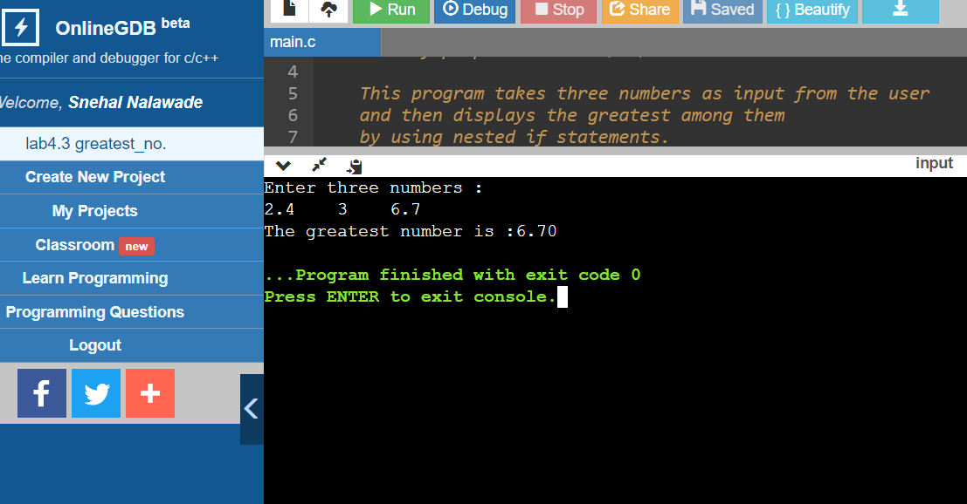
Output :

Slide 16
Thank you

