Slide 1
Sneha Naraniwal
500110027
Batch1

Slide 2
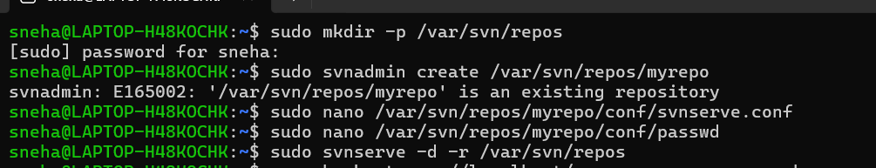
SUBVERSION
Installation
To install Subversion (SVN) on Ubuntu, use the following command:
sudo apt updatesudo sudo apt install subversion
Creating an SVN Repository
Create the repository directory;To create an SVN repository; Edit the configuration file;
sudo mkdir -p /var/svn/repos;
sudo svnadmin create /var/svn/repos/myrepo;
sudo nano /var/svn/repos/myrepo/conf/svnserve.conf

Slide 3
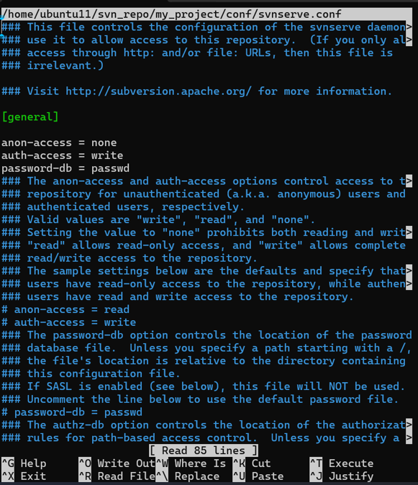
SERVER CONFIG:

Slide 4
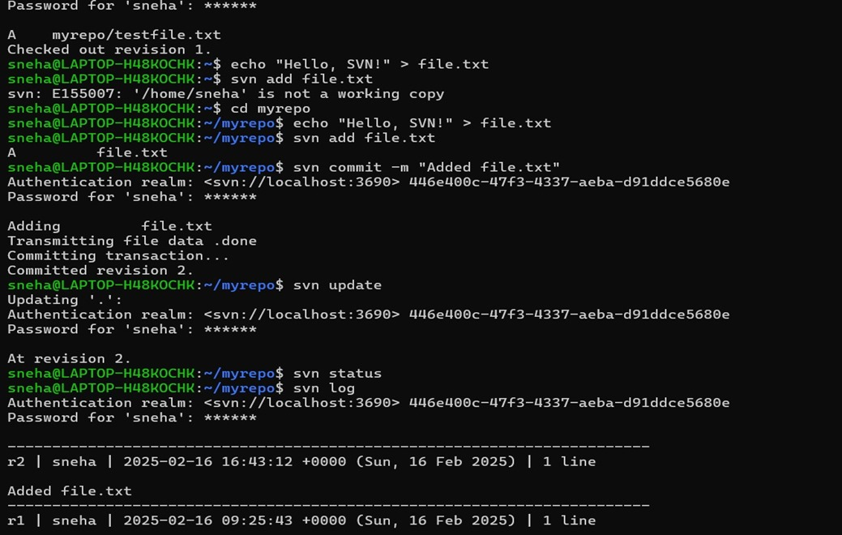
Adding and Committing Files: svn add file.txt To commit changes: svn commit -m "Added test.txt”

Slide 5
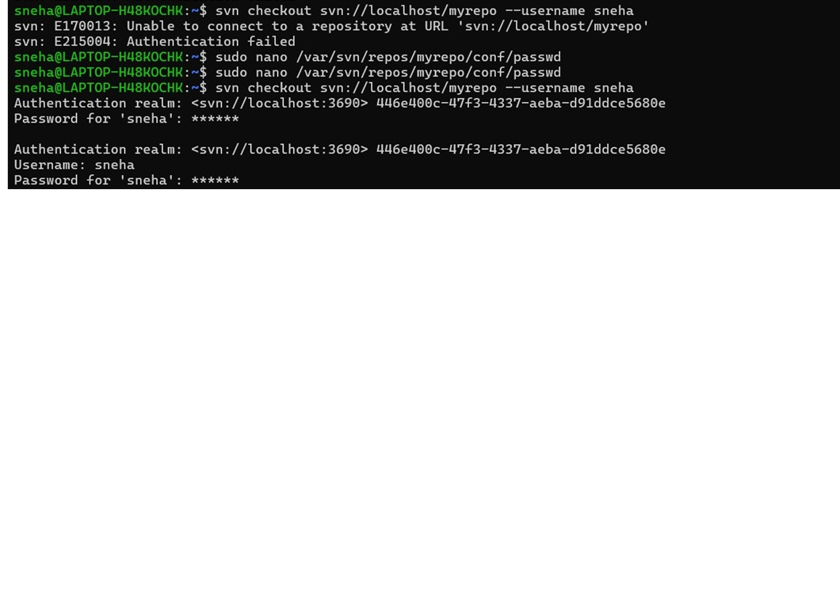
Check the server working in SVN

Slide 6
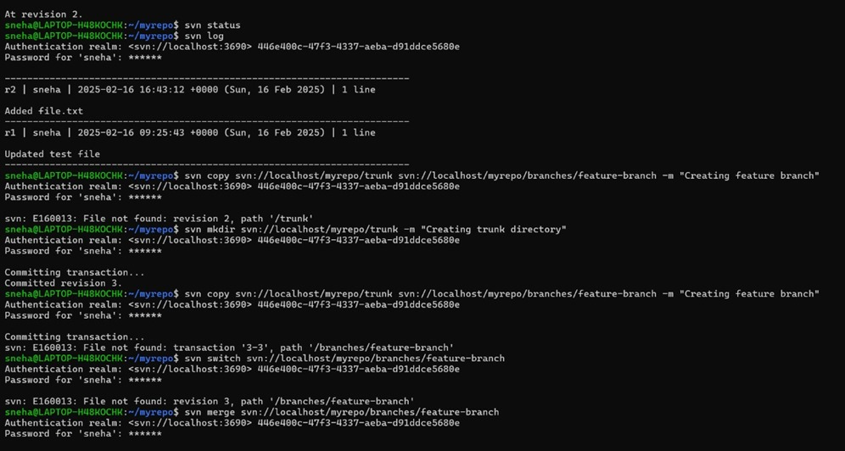
CREATING TRUNK

Slide 7
Creating Branches & MergiNg them

Slide 8
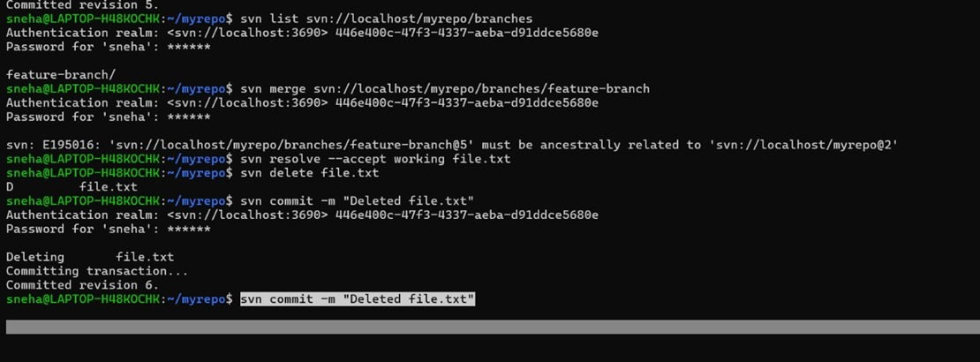

Slide 9
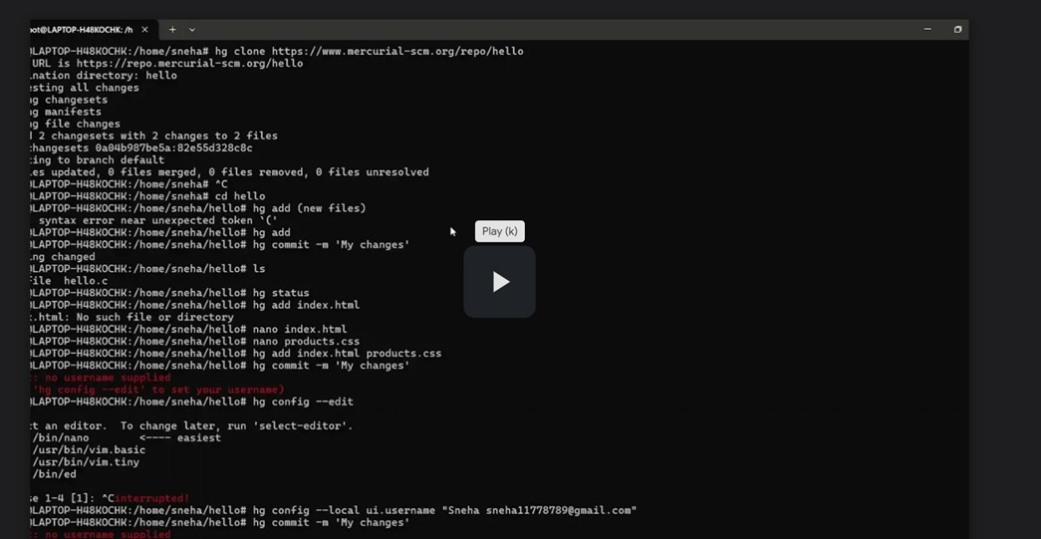
Introduction to mercurial
sudo apt install mercurial
To create a new repository: hg init my_project To add a file to Mercurial: hg add file.txt

Slide 10
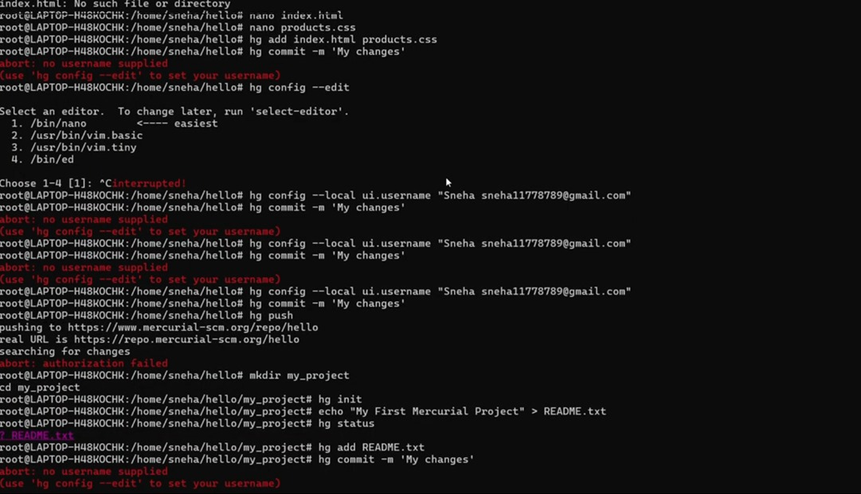

Slide 11
.cd /mnt/c/Users/ISHIKA/feature-x/my_project # Move to your project folder
git init # Initialize Git (if not already done)
git branch -M main # Rename branch to main
git add . # Stage all files
git commit -m "Initial commit" # Commit changes
git remote add origin https://github.com/Is-hika/my_project.git # Add remote
git push -u origin main # Push the code to GitHub
Reinitialized existing Git repository in /mnt/c/Users/ISHIKA/feature-x/my_project/.git/
On branch main

Slide 12
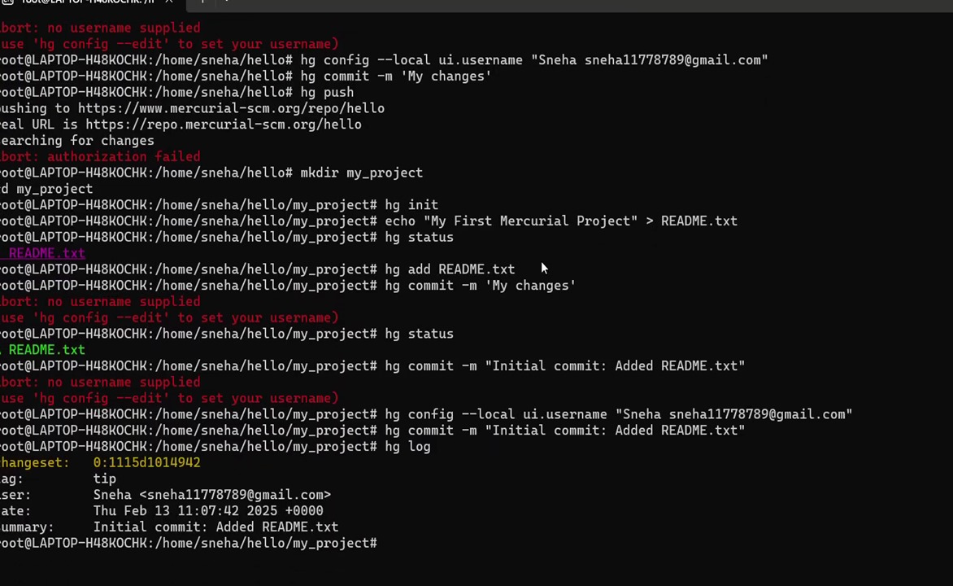

Slide 13
Link for Video: https://drive.google.com/file/d/18Poh-RFh6PN1rbSe5KoJgl8t-q4UVGi1/view?usp=sharing –subversion https://drive.google.com/file/d/1L-iPX98fHW3vtnH8qo4oA6XfuAdPW5k0/view?usp=drivesdk ---mercurial https://github.com/Sneha-Naraniwal/devops1

