Slide 1
Subversion

Slide 2
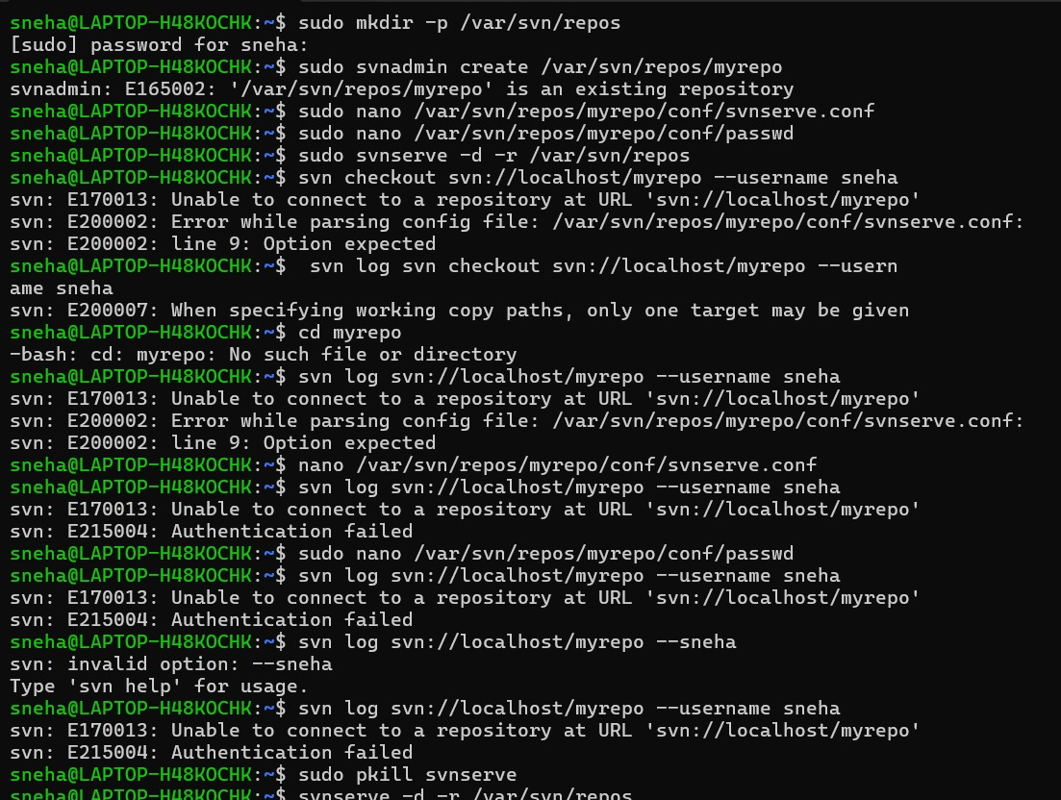
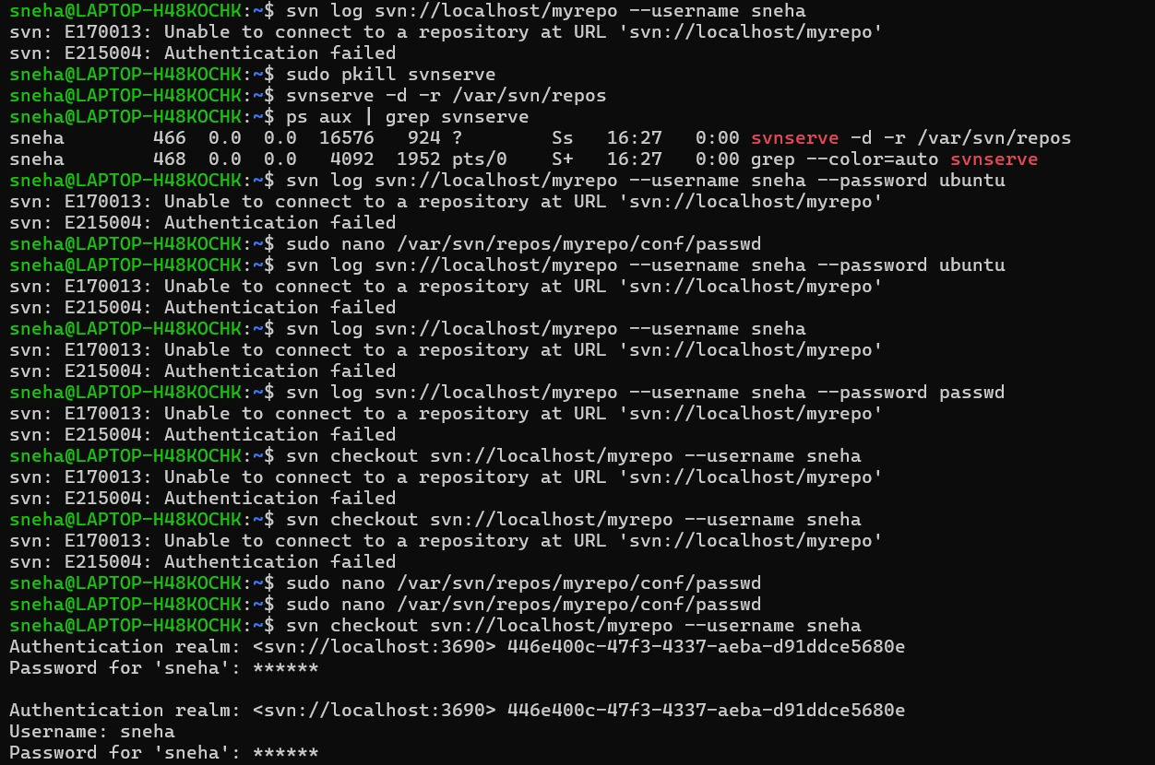

Slide 3
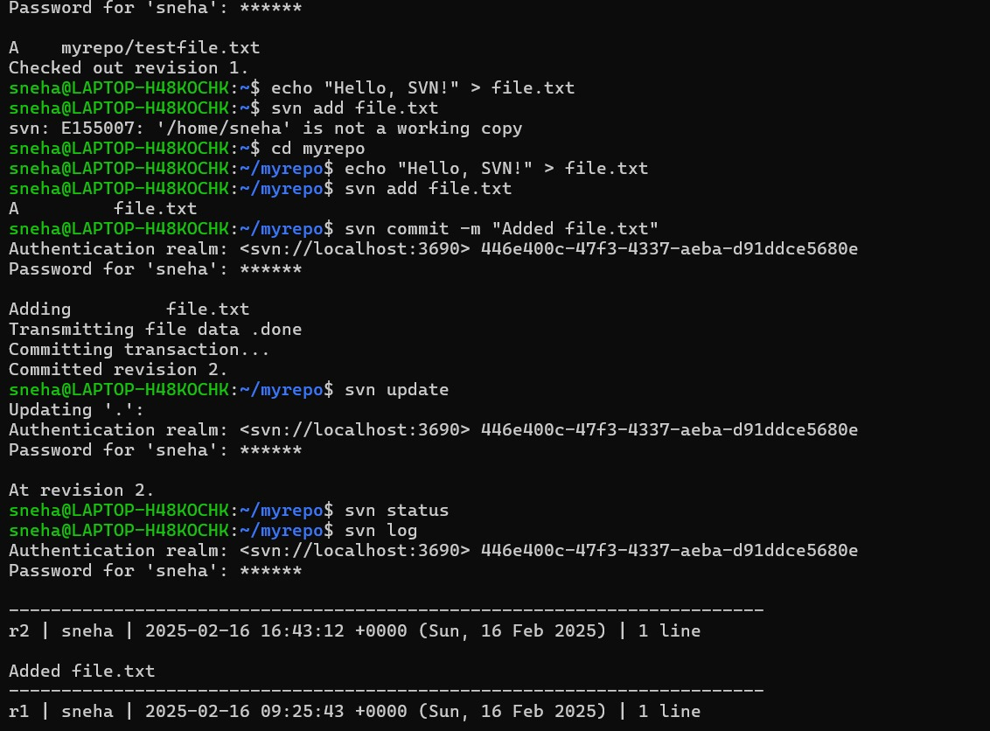

Slide 4
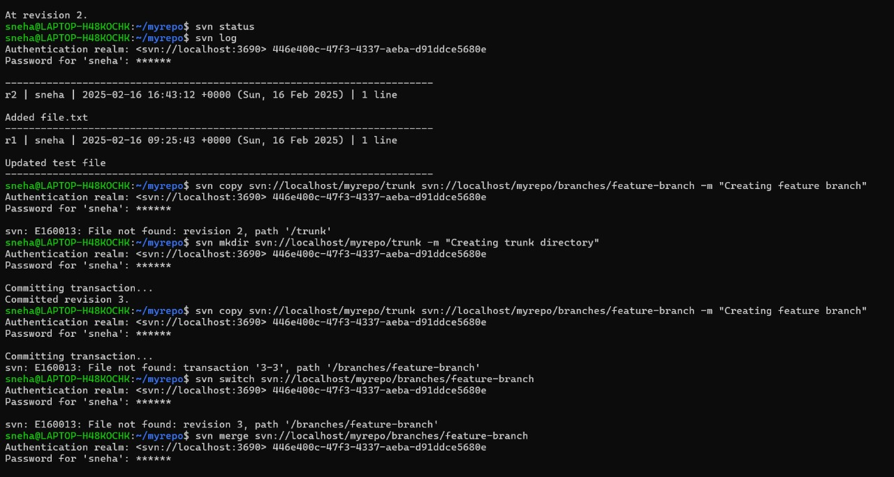

Slide 5
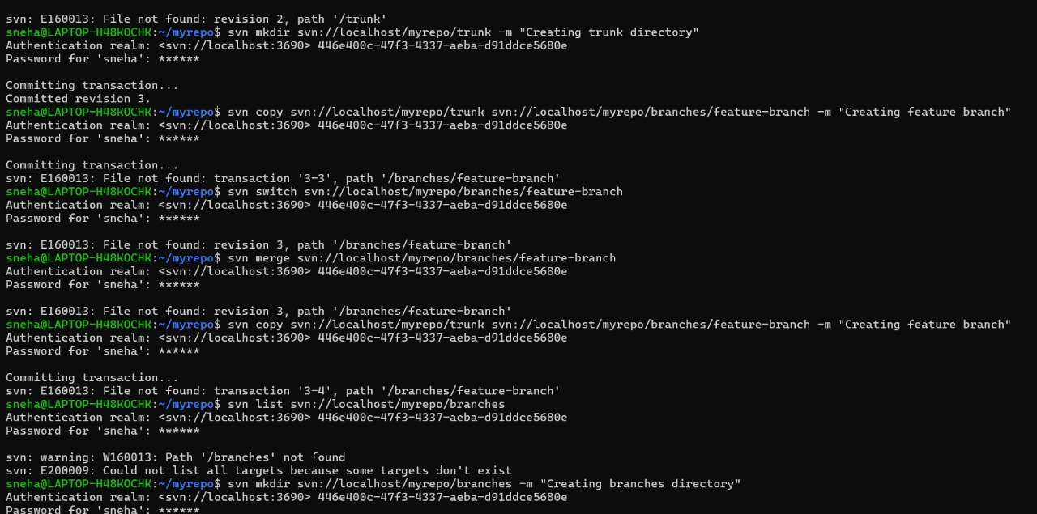

Slide 6
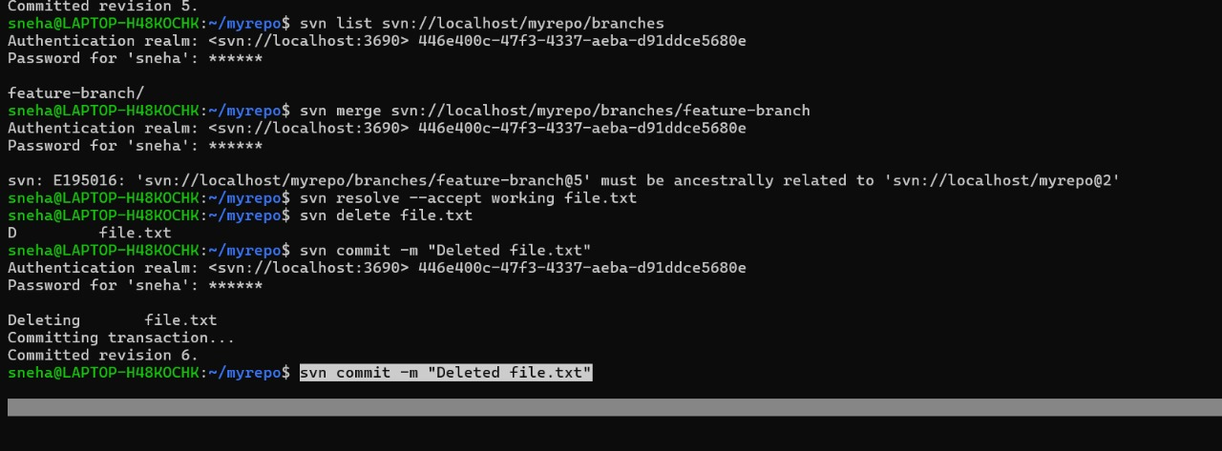

Slide 7
Mercurial

Slide 8
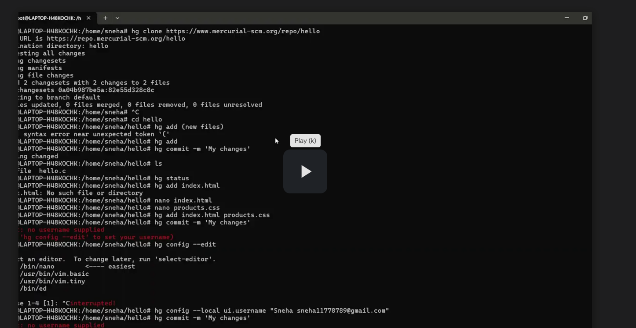

Slide 9
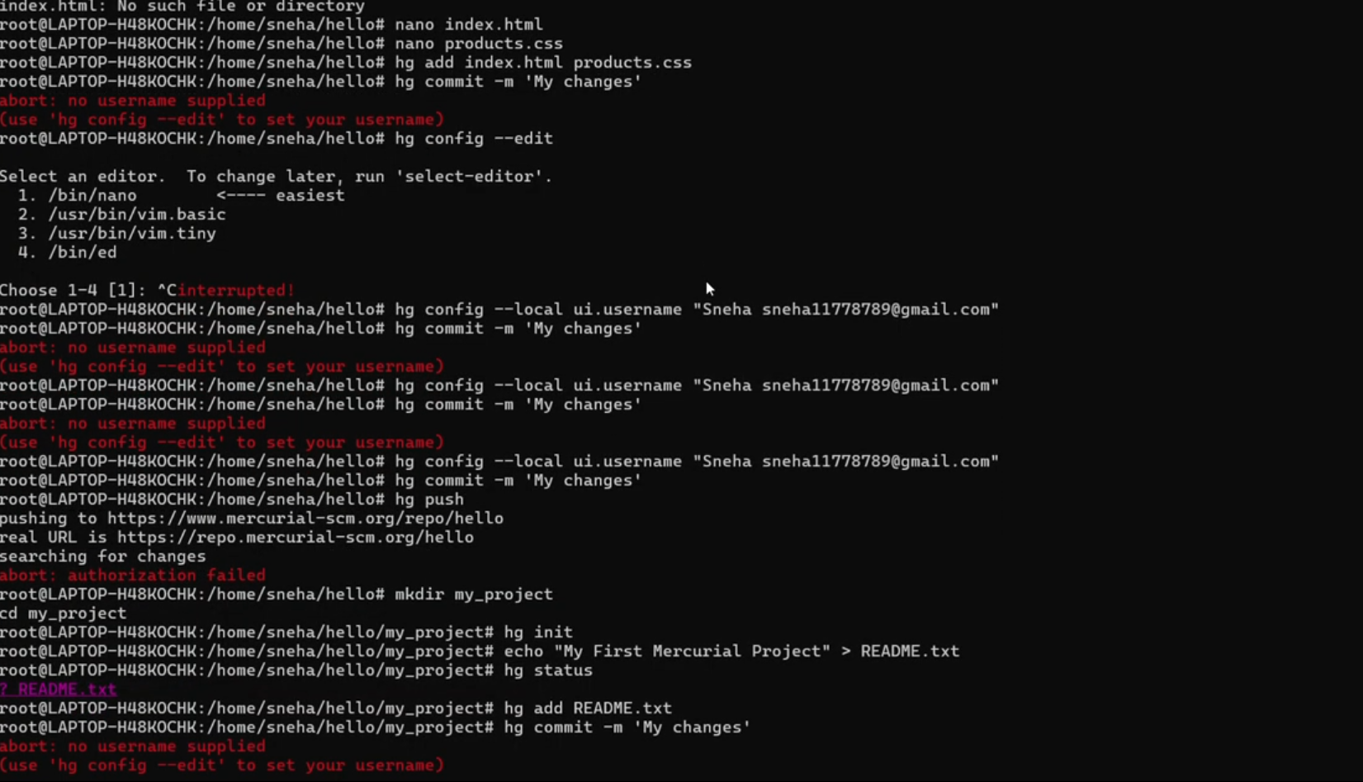

Slide 10
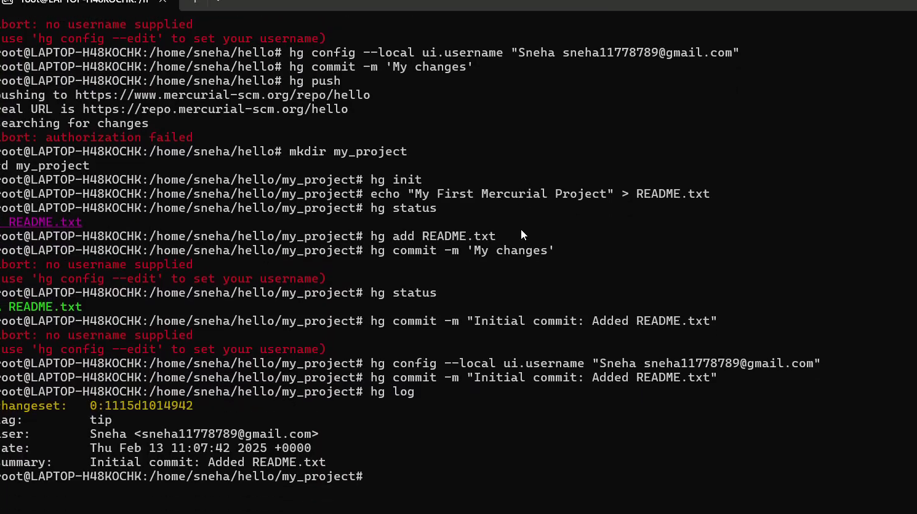

Slide 11
Link for video: https://drive.google.com/file/d/18Poh-RFh6PN1rbSe5KoJgl8t-q4UVGi1/view?usp=sharing --subversion https://drive.google.com/file/d/1L-iPX98fHW3vtnH8qo4oA6XfuAdPW5k0/view?usp=drivesdk ---mercurial

