Slide 1
Diabetes Prediction System
Department of Computer Science)
Christ (Deemed-to-be-University
Banglore, India
anush.verma@msam.christuniversity.in

Slide 2
Introduction
This project aims to develop a Diabetes Prediction Model using four machine learning algorithms: KNN, Decision Tree, Random Forest, and Logistic Regression. Diabetes early detection is crucial in healthcare, making these algorithms valuable tools. The project covers data processing, feature selection, model training, and evaluation, comparing their strengths and limitations. Overall, it aims to improve diabetes risk assessment and personalized care, contributing to better healthcare outcomes.

Slide 3
What is diabetes ?
Acccording to NIH, "Diabetes is a disease that occurs when blood glucose, also called blood sugar, is too high. Blood glucose is the main source of energy and comes from the food you eat. Insulin, a hormone made by the pancreas, helps glucose from food get into the cells to be used for energy. Sometimes our body doesn’t make enough—or any—insulin or doesn’t use insulin well. Glucose then stays in the blood and doesn’t reach the cells.
Over time, having too much glucose in the blood can cause health problems. Although diabetes has no cure, but steps can be taken to manage diabetes and stay healthy.
Sometimes people call diabetes “a touch of sugar” or “borderline diabetes.” These terms suggest that someone doesn’t really have diabetes or has a less serious case, but every case of diabetes is serious.

Slide 4
What are the different types of diabetes?
The most common types of diabetes are type 1, type 2, and gestational diabetes.
Type 1 diabetes is often considered an autoimmune condition. The immune system mistakenly attacks and destroys the insulin-producing beta cells in the pancreas, leading to little or no insulin production. It is usually diagnosed in children and young adults, although it can appear at any age. People with type 1 diabetes need to take insulin every day to stay alive.
Type 2 diabetes is characterized by insulin resistance, where the body's cells do not respond effectively to insulin. Over time, the pancreas may also fail to produce enough insulin. It can develop at any age, even during childhood. However, this type of diabetes occurs most often in middle-aged and older people. Type 2 is the most common type of diabetes.
Gestational diabetes: Gestational diabetes develops in some women when they are pregnant. Most of the time, this type of diabetes goes away after the baby is born...

Slide 5
Problem Statement
“Predicting whether patient has Diabetes or not”
- Significance: Early Detection Saves Lives
- Goal: Determine if a patient has Diabetes
- Life-Saving Potential: Timely intervention and care
- Data-Driven Solution: Utilizing patients data
- Impact: Improved healthcare outcomes

Slide 6
What data is needed for diabetes prediction?
The data needed for diabetes prediction typically includes a variety of medical information such as pregnancies, insulin, glucose, BMI ,etc..
Our dataset has the following features to predict diabetes.
Pregnancies: Number of times pregnant.
Glucose: Plasma glucose concentration.
Blood Pressure: Diastolic blood pressure (mm Hg).
Skin Thickness: Triceps skin fold thickness (mm).
Insulin: 2-Hour serum insulin (mu U/ml).
BMI: Body mass index (weight in kg/(height in m)^2).
Diabetes Pedigree Function: Diabetes pedigree function (a function which scores likelihood of diabetes based on family history).
Age: Age in years.
Outcome: Class variable (0 or 1) where 0 denotes "no diabetes" and 1 denotes "diabetes".

Slide 7
Dataset Exploration
The dataset has 768 rows and 9 columns. No null values.
Outcome variable has 500 (65.1%) no diabetes cases and 268 (34.9) diabetes cases which shows that the data is unbalanced.
In columns like glucose, blood pressure, skin thickness, BMI some data are entered as 0 which is not possible. So it is better to replace zeros with nan which is further imputed with suitable values.
From correlation analysis we can see a relatively strong correlation between the outcome and Glucose, Age and BMI.
The outliers have been handled using interquartile range.
The age group at the highest risk of diabetes is around 52 years.
The dataset is unbalanced in a 2 : 1 ratio for Non-Diabetes : Diabetes cases!
Due to this, predictions will be biased towards Non-Diabetes cases.
Visualizations will also display this bias, thus making it difficult to gain insights.

Slide 8
Dataset Exploration
Mean values of all the features for cases of diabetes and non-diabetes.
Average number of Pregnancies detected for diabetes and non-diabetes cases is 4.87 & 3.30 respectively.
Average Glucose values for diabetes cases, 141.26, is more than those found in non-diabetes cases, 109.98. This feature can form as a good indicator to predict the cases of diabetes.
There is no significant difference in the average values of BloodPressure and SkinThickness between diabetes and non-diabetes cases.

Slide 9
Dataset Exploration
Just like Glucose, diabetes cases have higher average Insulin level, 100.34, than non-diabetes cases, 68.79.
BMI is another feature that has higher values for diabetes cases than non-diabetes cases with 35.14 and 30.30 values respectively.
Average DiabetesPedigreeFunction is slightly higher in diabetes cases, 0.55, than non-diabetes cases, 0.43.
Mean Age values for cases of diabetes is 37.07 whereas that for non-diabetes cases is 31.19.
From these mean values, we can say that some of the features display a clear cut difference between cases of diabetes and non-diabetes, however other features might require more effort to find their relationship with the target variable.

Slide 10
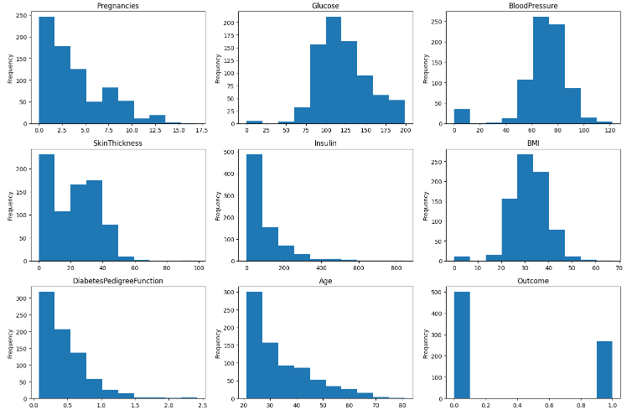
Distribution of the features.

Slide 11
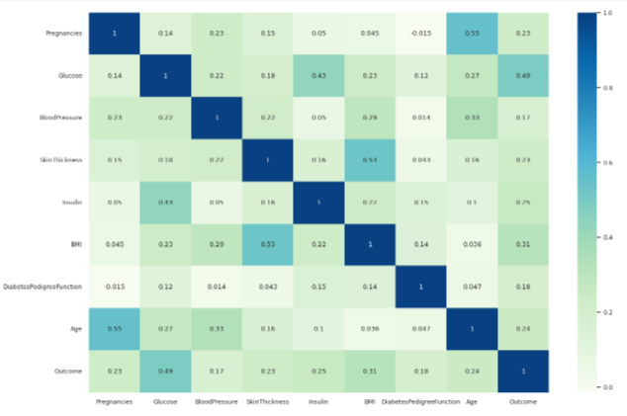
Correlation heatmap showing the correlation among the features.

Slide 12
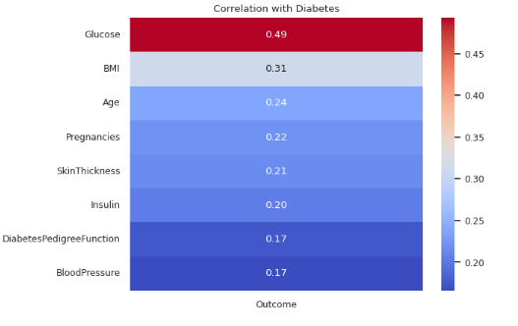
Correlation between the features and the target variable.

Slide 13
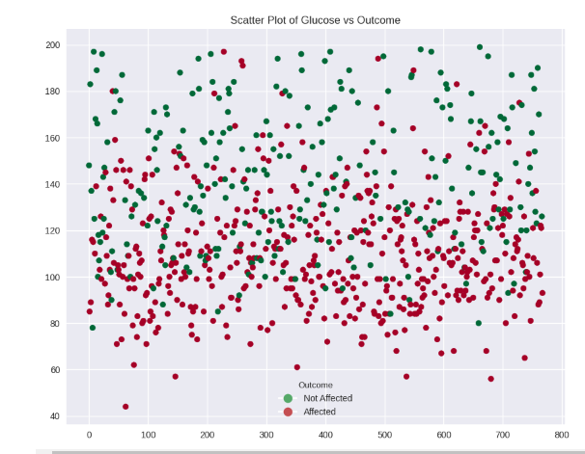
Scatter plot showing the outcome with respect to the blood glucose value.

Slide 14
EDA Summary
Pregnancies with values between 7 - 10 have high chances of diabetes. This range does not display a complete dominance but it has some presence.
Glucose values higher than 125 indicate very high chances of diabetes.
BloodPressure values between 60 - 100 highlight many cases of diabetes coupled with any feature.
When both, BMI and SkinThickness, feature values are between 20 - 50, probability of diabetes is very high.
Insulin values between 0 - 300 increases the risk of diabetes. When above 400, the female has a sure shot chance of being diabetic.
For Age group of 20 - 50 as well as DiabetesPedigreeFunction values ranging from 0 - 1.5 results in a diabetic condition.

Slide 15
The dataset was split into X train, X test, y train and test. The split percent was 80-20%.
Then the dataset was standardized to remove bias.
SMOTE was used to handle the class imbalance.
Performance metrics was used to check the performance of the model. It includes,
Confusion Matrix It is a tabular visualization of the model predictions versus the ground-truth labels.
F1 Score :- It’s the harmonic mean between precision and recall.
Precision Score Precision is the fraction of predicted positives/negatives events that are actually positive/negatives.
Recall Score It is the fraction of positives/negative events that you predicted correctly.

Slide 16
K-NN Algorithm
- KNN is an instance-based learning algorithm that relies on memorizing the training data and making predictions based on the K closest neighbors.
- Selecting the appropriate value of K is crucial in KNN, as it affects the algorithm's sensitivity to noise and model performance.
- KNN uses distance metrics (e.g., Euclidean distance) to measure the similarity between data points, influencing its decision-making process.
- KNN is versatile, capable of handling both classification (assigning class labels) and regression (predicting numeric values) tasks.
-KNN can be memory-intensive and slow for large datasets, necessitating the use of techniques like approximate nearest neighbor search for scalability.
-KNN did not perform well for the diabetes prediction and gave only 68% accuracy.

Slide 17
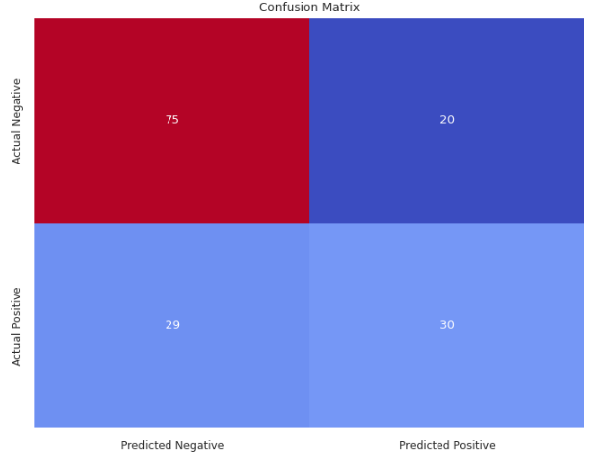
Confusion Matrix-KNN

Slide 18
LOGISTIC REGRESSION
Logistic regression is a supervised learning algorithm, which means that it is trained on a dataset of known input-output pairs. It is used for predicting the categorical dependent variable using a given set of independent variables. It gives the probabilistic values which lie between 0 and 1.
Logistic regression is a simple, interpretable, and efficient algorithm that can be used to predict diabetes with good accuracy.
It is a simple and easy-to-understand algorithm.
It is a fast and efficient algorithm to train and predict.
It is a robust algorithm that can handle noisy data.
Logistic Regression did not perform well for the diabetes prediction and gave only 75% accuracy.

Slide 19
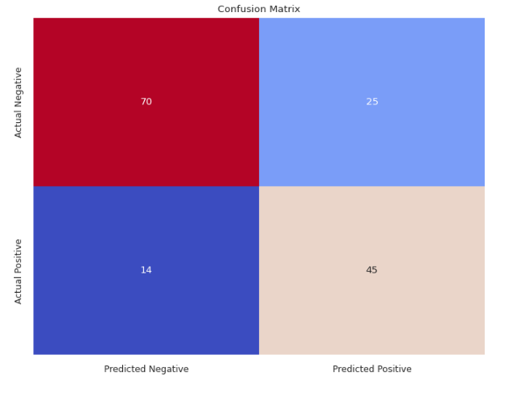
Confusion Matrix-Logistic Regression

Slide 20
DECISION TREE
Decision trees are one of the most interpretable machine learning algorithms, meaning that they are easy to understand and explain how they make predictions.
Decision trees are relatively robust to overfitting, which is a common problem in machine learning where the model learns the training data too well and is unable to generalize to new data. This is because decision trees are trained using a greedy algorithm, which selects the best feature to split on at each node based on the current data. This helps to prevent the model from becoming too complex and overfitting the training data.
Decision trees can be used to train models on high-dimensional data, meaning that they can handle datasets with a large number of features. This is because decision trees split the data into smaller subsets at each node, which reduces the dimensionality of the data.
Decision trees can be used to solve a wide variety of machine learning problems, including classification, regression, and anomaly detection.
Decision tree did not perform well for the diabetes prediction and gave only 62% accuracy.

Slide 21
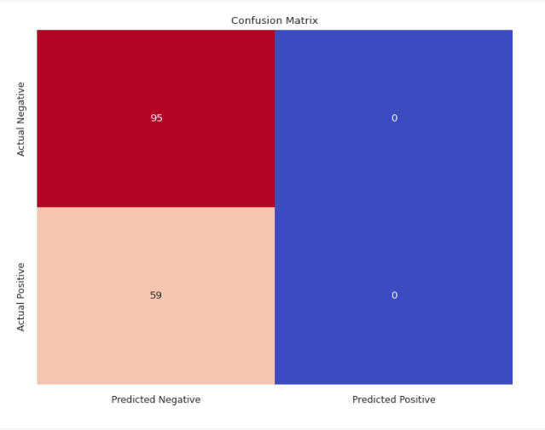
Confusion Matrix – Decision Tree

Slide 22
RANDOM FOREST
Random Forest is a supervised ensemble learning algorithm that uses multiple decision trees to make predictions. It is one of the most popular and powerful machine learning algorithms, and can be used for both classification and regression tasks.
Random forest is a versatile algorithm that can be used for both classification and regression tasks. It is also relatively easy to implement and tune, making it a popular choice for machine learning practitioners.
It is a supervised ensemble learning algorithm that combines the predictions of multiple decision trees to produce a more accurate and stable prediction. It uses bagging to create a set of decision trees, each trained on a random sample of the training data with replacement. This helps to reduce overfitting and improve the generalization performance of the model.
In addition, random forest also uses feature randomness to reduce overfitting. For each split in a decision tree, random forest randomly selects a subset of features to consider. This helps to ensure that the trees are not too correlated and that the model does not rely too heavily on any one feature.

Slide 23
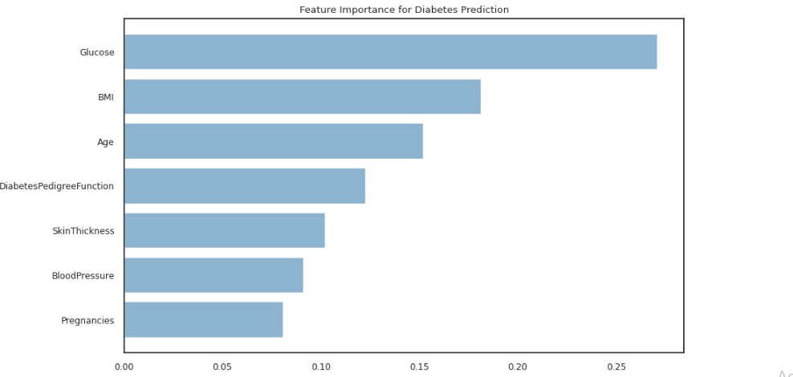
Feature Importance

Slide 24
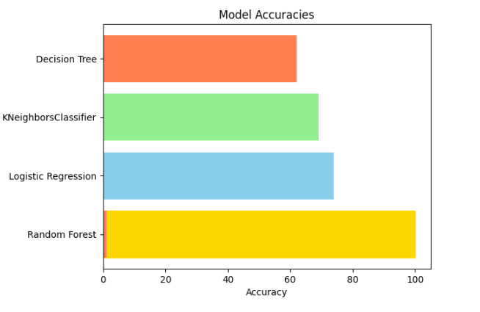
RESULTS OF MODEL
By analysing the accuracy of KNN,decision tree,Random forest and Logistic regression we found Random Forest predicts correctly comparing to other models.

Slide 25
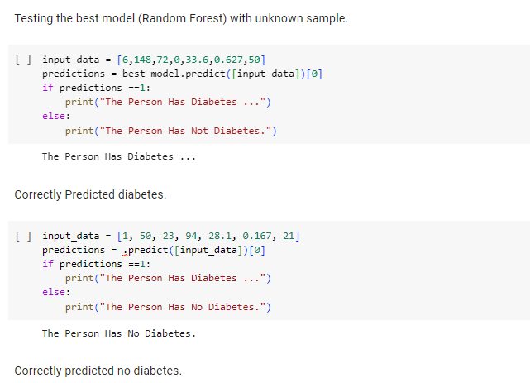
Testing using a random sample

Slide 26
Conclusion
In conclusion, the diabetes prediction system, leveraging various machine learning models, has demonstrated the efficacy of employing advanced techniques in healthcare. Among the models assessed, Random Forest emerged as the most robust and accurate predictor for diabetes. The ensemble nature of Random Forest, combining multiple decision trees, proved particularly beneficial in handling the complexities and nuances of diabetes prediction.
This predictive system holds substantial promise for early detection and intervention in individuals at risk of diabetes, facilitating timely and targeted healthcare interventions. The utilization of Random Forest not only enhances the precision of predictions but also contributes to the overall effectiveness of preventive measures.

