Slide 1


CONVOLUTIONAL NEURAL NETWORK
SNEHA R
INTERNSHIP-JUNE 2023

Slide 2
NEURAL NETWORK
Set of algorithms
inputs large set of data, process the data
draws out the patterns and outputs what it is
Artificial Neural networks(ANN’s)
Artificially mimic the functioning of Neural network

Slide 3
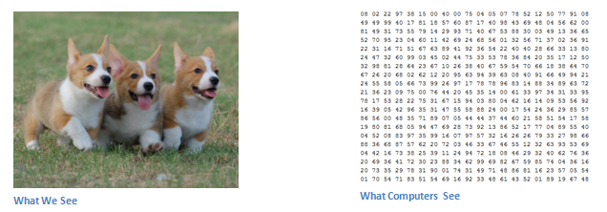
CONVOLUTIONAL NEURAL NETWORK
process images as matrices of numbers
assign importance to its various aspects/features
each input image will pass it through a series of layers
Images recognition & image classifications

Slide 4
WHY CONVOLUTIONAL NEURAL NETWORKS?
Neural Networks are good at Image Recognition
If the image is of Large pixels ➔ no. of parameters increase
Slow and consumes a lot of computational power
PHASES IN CNN
Convolutional Neural Networks have 2 main phases:
Feature learning
Classification

Slide 5
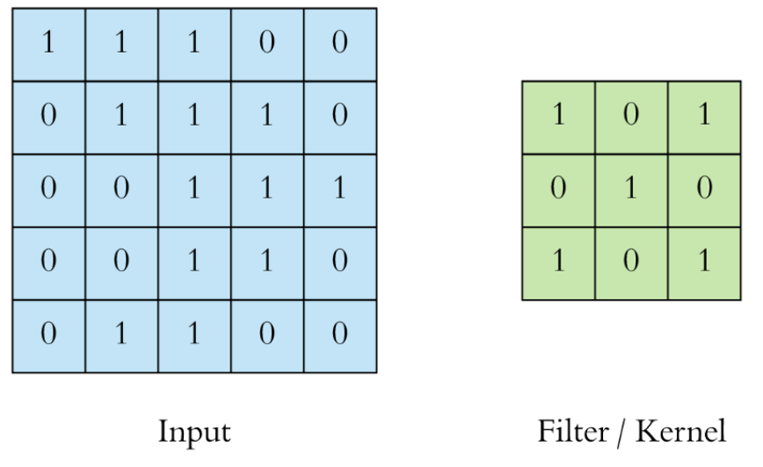
DIFFERENT LAYERS IN CNN
Convolution Layer
Core building block of CNN
Extract features such as edges, colours, corners from the input
Filter/kernel ➔ set of learnable parameters
If the image is RGB then the filter will have height x width x 3 dimension

Slide 6
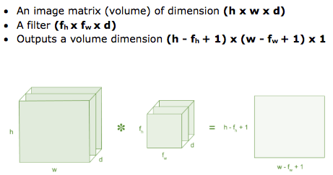
Performs a dot product between filter matrix and the restricted portion of the image
At the end of the convolution process, we have a featured matrix
Has lesser parameters
More clear features than the actual one

Slide 7
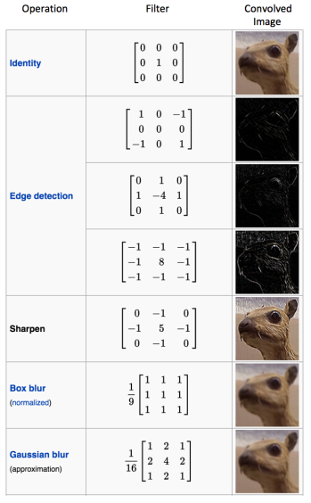
Common filters used :

Slide 8
II.Activation Layer
Activation function
Add non-linearity to the network
ReLU-Rectified Linear Unit
Allow network to learn complex representations
Volume remains unchanged

Slide 9
III.Pooling layer
To reduce the number of parameters
Also called subsampling or downsampling
Solely to decrease the computational power
Extracts the dominant features from a restricted amount of neighborhood

Slide 10
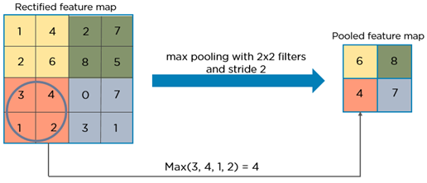
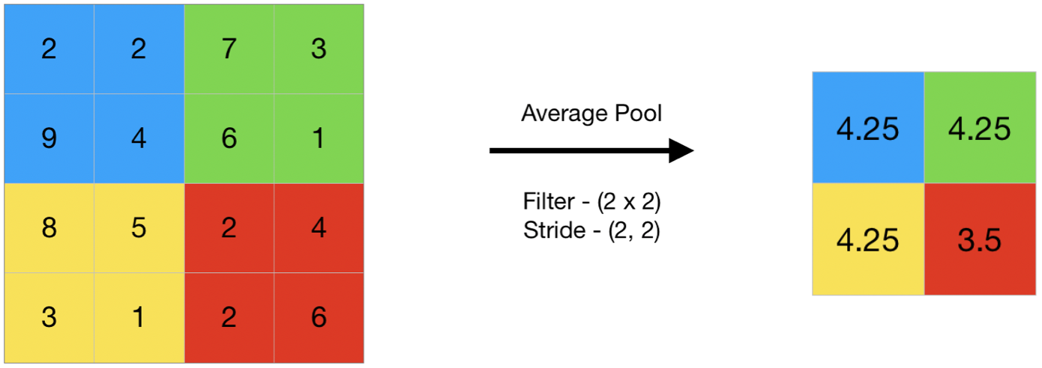
Types of pooling techniques:
AVERAGE-pooling: Take average of all the values of pooling region
MAX- pooling : Take the maximum amongst all the values lying inside the pooling region
SUM - pooling: Sum of all elements in the feature map

Slide 11
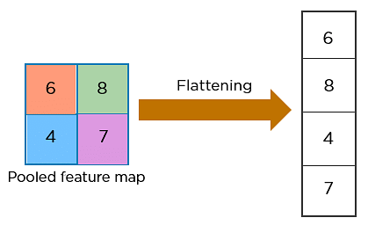
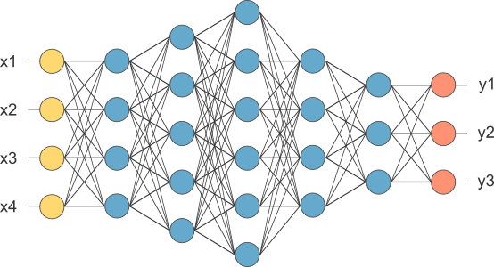
IV.Fully connected layer:
Does the classification process
Flattened the matrix into vector - FLATTENING
Feed it into a fully connected layer

Slide 12
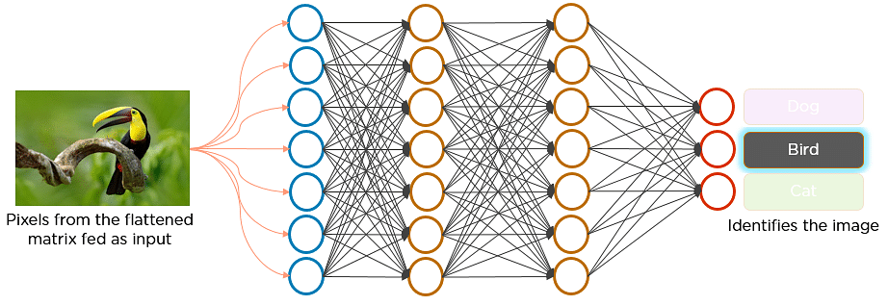
Fully connected layer

Slide 13
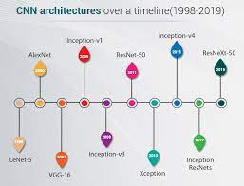
VARIOUS CNN ARCHITECTURES:

Slide 14
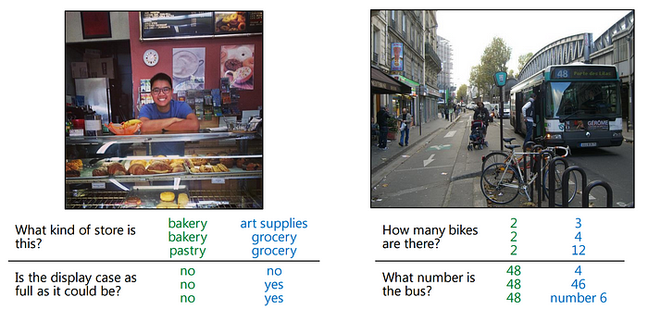
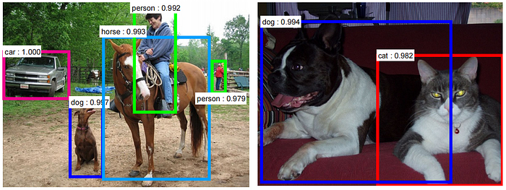
APPLICATIONS:
Question and answering:
Object detection:

Slide 15
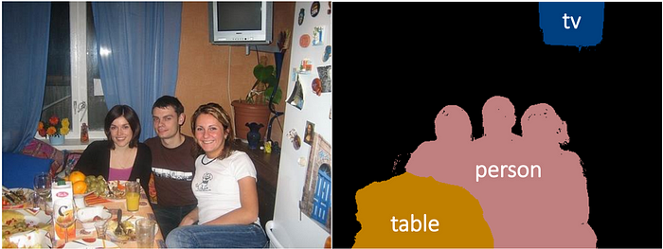
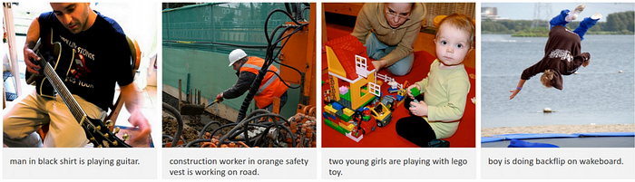
Semantic segmentation:
Image caption:

Slide 16
THANK YOU

