Slide 1
Facebook Marketplace Data Analysis
Analysis of Facebook Live Sellers dataset focusing on engagement, correlation, posting time, and clustering insights.

Slide 2
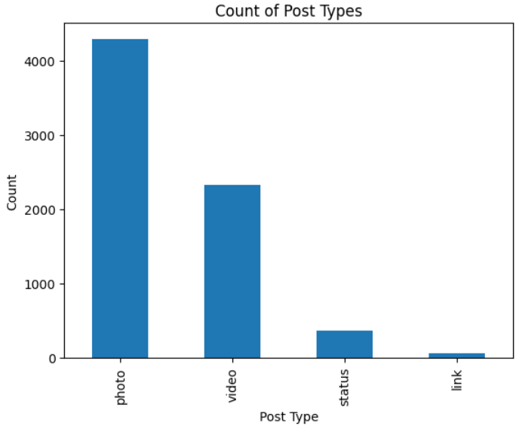
Dataset Overview
Total Posts: 7050
Post Types:
photo: 4288
video: 2334
status: 365
link: 63

Slide 3
Average Engagement by Post Type
 | Number of Reactions(Avg values) | Number of Comments(Avg values) | Number of Shares(Avg values)
Video | 283.409597 | 642.478149 | 115.679949
Photo | 181.290345 | 15.993470 | 2.553871
Status | 438.783562 | 36.238356 | 2.558904
Link | 370.142857 | 5.698413 | 4.396825

Slide 4
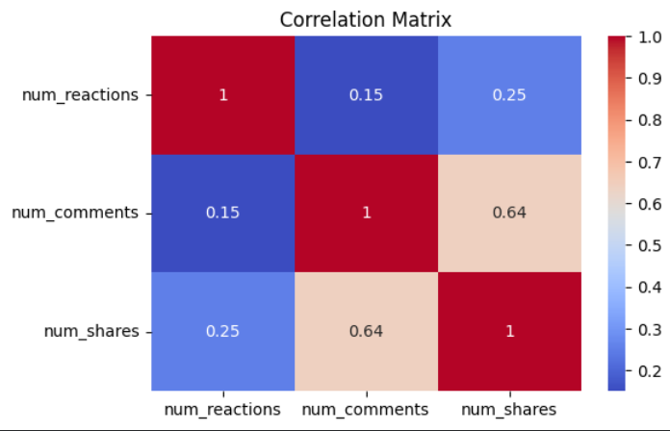
.

Slide 5
Best Time to Post
User activity is highest during early morning and late evening hours, while engagement drops during the afternoon.
Sellers should strategically schedule posts during these peak periods to maximize visibility and interaction.
Posting during low-engagement hours may result in reduced reach and lower overall performance.

Slide 6
Interpretation from K-means method:
Cluster 0 represents posts with [low/moderate] reactions, comments, and shares, indicating low engagement posts. From the status type analysis, this cluster mainly consists of [photos/status] posts.
Cluster 1 shows [higher] values of comments and shares, indicating high interaction posts. These posts are primarily [videos/photos], suggesting that such content encourages user engagement.
Cluster 2 has the highest reactions, representing viral posts. The status type distribution shows that this cluster is dominated by [videos], indicating that video content tends to generate maximum engagement.
Overall, the results indicate that both engagement metrics and post type significantly influence the performance of posts, with video content generally leading to higher engagement.

Slide 7
Key Insights
Reactions strongly correlate with comments and shares.
Some post types receive significantly higher engagement.
Posting time impacts audience interaction levels.

Slide 8
Recommendations
Focus on high-performing post types.
Post during peak engagement hours.
Encourage interaction to boost visibility.
Use clustering insights to segment post strategies.

