Slide 1

Team-name : Flyhigh
team-members:
Nithya R
Sneha K.N.
S.S. Parinitha

Slide 2









AAKRUTI
ELEGANCE FOR EVERY SPACE

Slide 3

AAKRUTI
AAKRUTI comes from a Sanskrit word that means “to give shape.”From raw earth to refined elegance. That is the essence of AAKRUTI, it transforms raw earth into sophisticated ceramic décor. Guided by our mantra, "Elegance for Every Space," we believe artful design belongs in your everyday life. Handcrafted by skilled Indian artisans, our collections seamlessly blend heritage techniques with contemporary aesthetics to infuse your home with warmth, culture, and timeless style.

Slide 4








AAKRUTI

Slide 5
Aa
Aa
PlayFair Display
The Seasons
LOGO
PARAGRAPH
Aa
Aa
Hatton
Anton
TAGLINE
PROMOTION

Slide 7
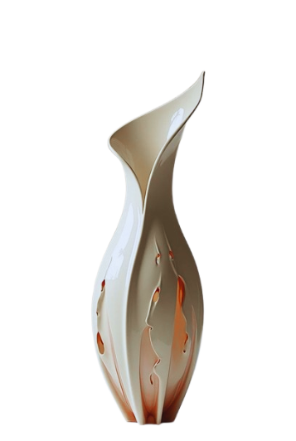

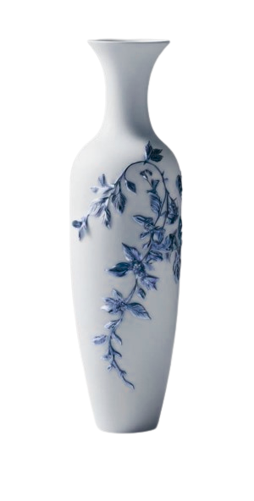
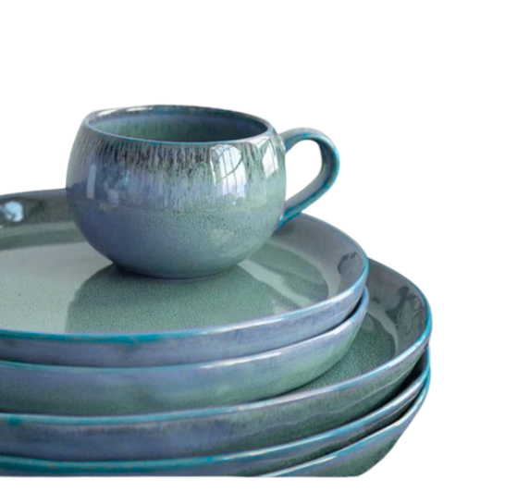
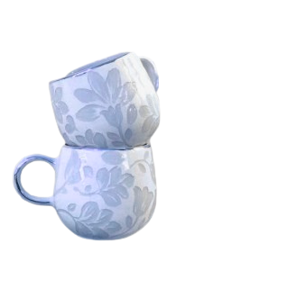
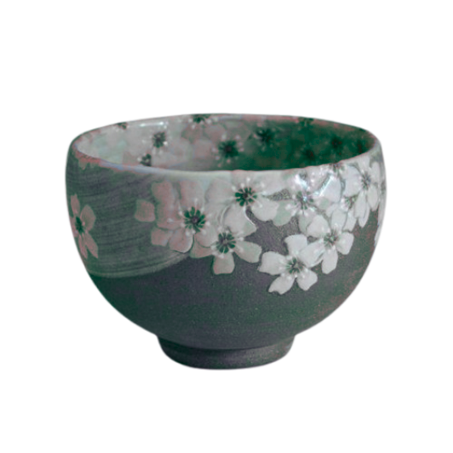
AAKRUTI
ELEGANCE FOR EVERY SPACE

Slide 8

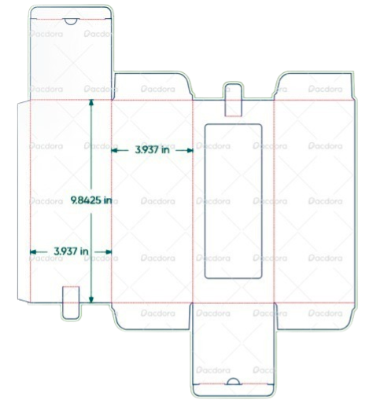
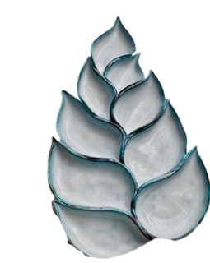
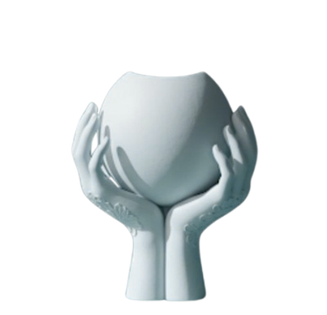

AAKRUTI
AAKRUTI anufactures handcrafted ceramic décor products using high-quality natural clay. Our skilled artisans carefully shape, design, and finish each piece with attention to detail. We combine traditional pottery techniques with modern designs to create elegant and durable décor items. Every product is made to add beauty and elegance to your living space.
ELEGANCE FOR EVERY SPACE

Slide 9

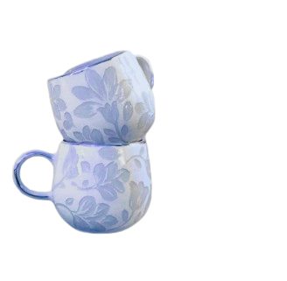
PROMOTION
AAKRUTI
ELEGANCE FOR EVERY SPACE

Slide 10

THANK YOU

