Slide 1
Project Presentation of Industry Oriented Hands on Experience (22CS422)
On
Resume Builder
Sneha Kumari
2211981390
Supervised By
Dr. Rajat Takkar
Department of Computer Science and Engineering,
Chitkara University, Punjab

Slide 2
Index
Introduction
SDG goals
Problem Statement & Solution Statement
Objectives
Technologies Used
Flow Chart
Use Case Diagram
Project Pics (screenshots)
Result
Conclusion
Future Scope
Reference

Slide 3
Introduction
The Resume Builder is a web-based application designed to help users create professional and well-structured resumes easily and efficiently.
It allows users to input their personal information, educational background, skills, certifications and work experience in a simple interface.
The application then generates a clean and formatted resume instantly.
It also provides customizable templates and real-time preview options to improve user experience.
It is especially useful for students and job seekers who want to create attractive resumes quickly without requiring advanced technical or design skills.
3

Slide 4


SDG goals
1. Quality Education (SDG 4)
Helps users learn how to create professional resumes
Improves career readiness and digital skills
Supports students and freshers in job preparation
2. Decent Work and Economic Growth (SDG 8)
Increases employment opportunities
Helps users present skills effectively
Supports job seekers in getting better jobs

Slide 5
Problem Statement & Solution Statement
Problem Statement :
Many students and job seekers face difficulty in creating professional resumes due to a lack of design skills, proper guidance, and access to easy-to-use tools. They often struggle to choose the correct format and structure, resulting in incomplete or ineffective resumes. Additionally, many existing resume-building platforms are complex or require paid subscriptions, which limits accessibility. As a result, users are unable to present their skills effectively, reducing their chances of securing suitable job opportunities.
Solution Statement :
A web application called "Resume Builder" would be designed as a solution to help students and potential candidates to create a resume easily. The software provides an interface where one can put his or her personal information, academic qualifications, skills, and working experience into a form, and as a result, a professionally formatted resume will be generated automatically. The application will consist of some useful options like designing templates and automatic preview, thus minimizing the necessity to possess any design abilities as well as making resume creation much faster and easier.

Slide 6
Objectives
To create a web application for building professional resumes
To simplify and automate resume creation
To provide ready-made templates and proper formatting
To save time and reduce manual effort
To generate clean and attractive resumes for users
To ensure a user-friendly and responsive interface for all devices.

Slide 7
Technologies Used
Frontend Technologies: HTML, Tailwind CSS, JavaScript, React
The frontend is the visible part of the application that users interact with.
React is used to build dynamic and reusable components like forms and templates.
Tailwind CSS helps in designing a clean and responsive UI quickly.
2. Backend Technologies: Node.js, Express.js
The backend handles business logic and data processing.
It receives user data from the frontend and processes it.
3. Database: MongoDB
Used to store user information and resume data.
It allows easy retrieval and updating of resumes.

Slide 8
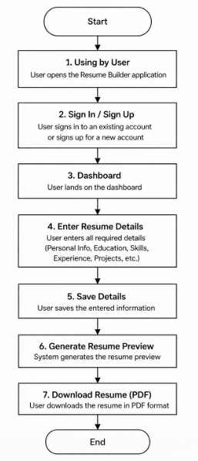
Flow Chart
Starts when the user opens the Resume Builder application
User logs in or signs up
User is redirected to the dashboard
User enters resume details
User saves the entered data
System generates resume preview
User downloads resume in PDF format
Process ends

Slide 9
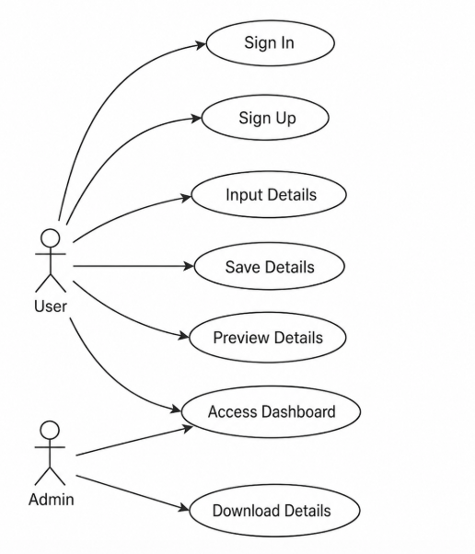
Use Case Diagram

Slide 10
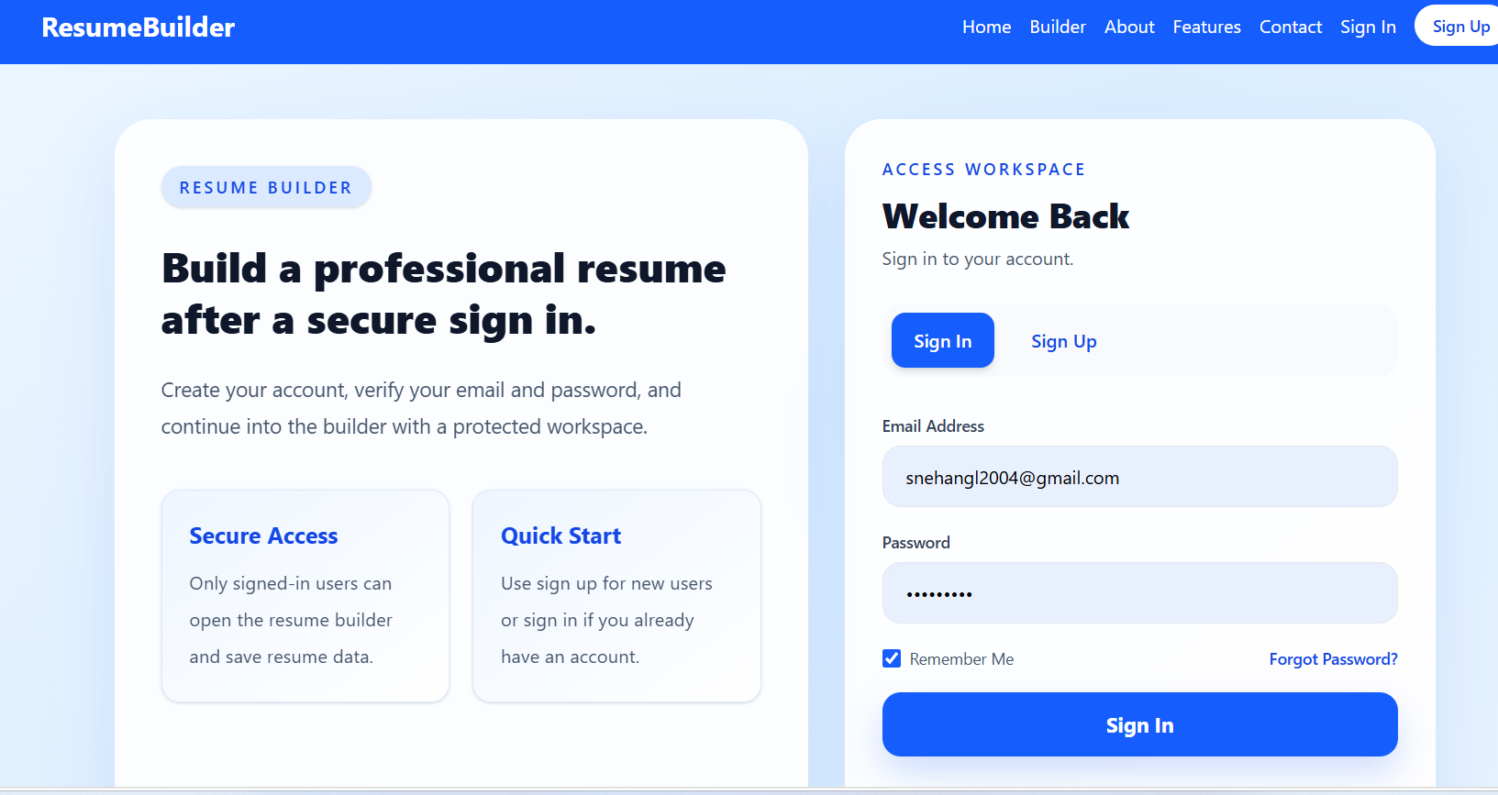
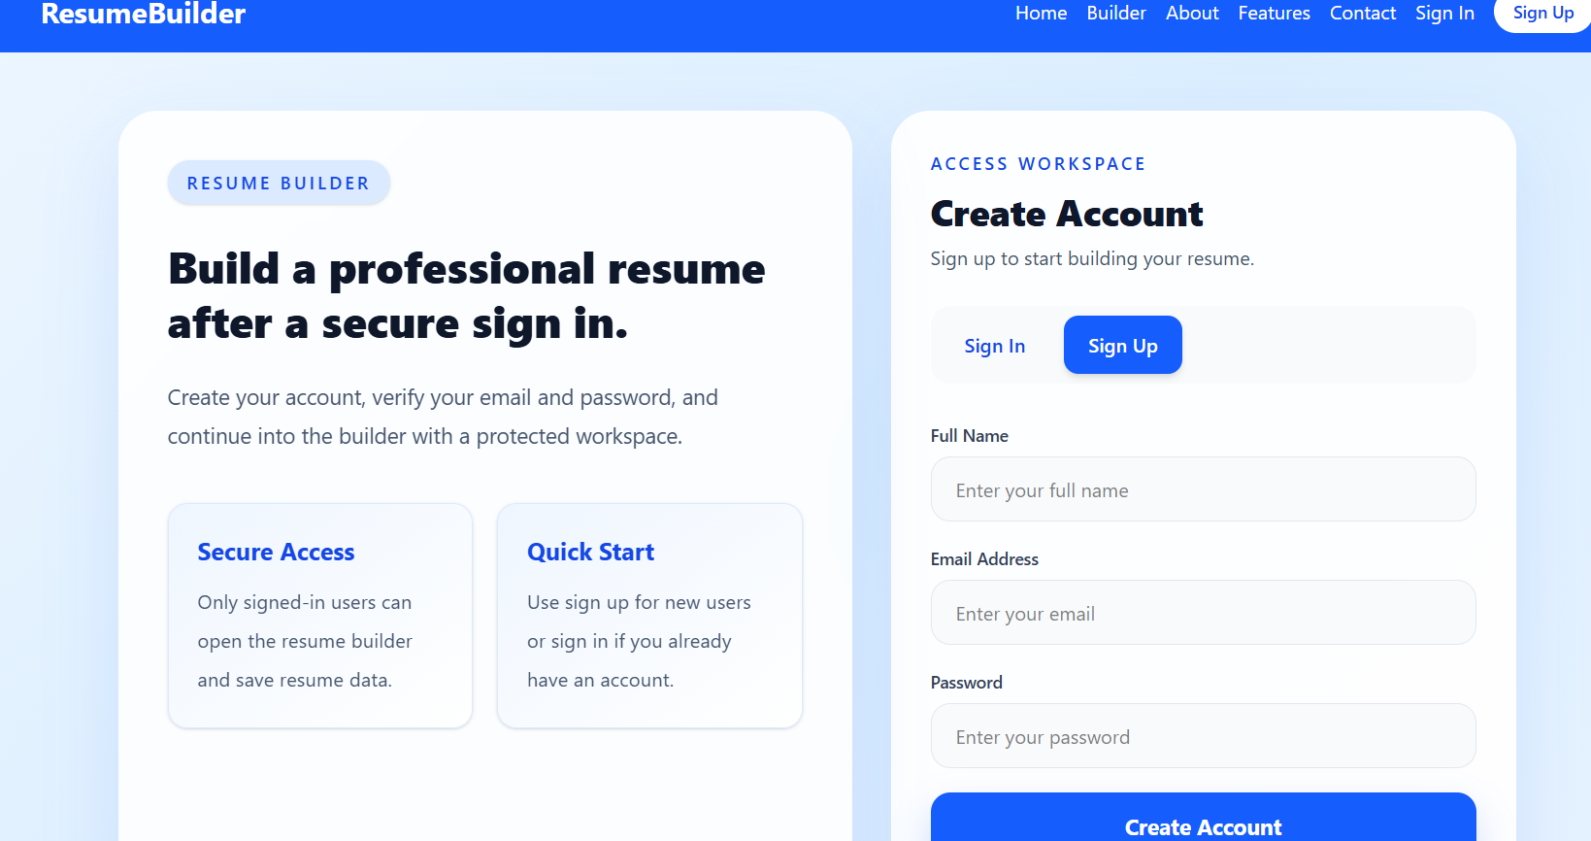
Pics
Sign In Sign Up

Slide 11
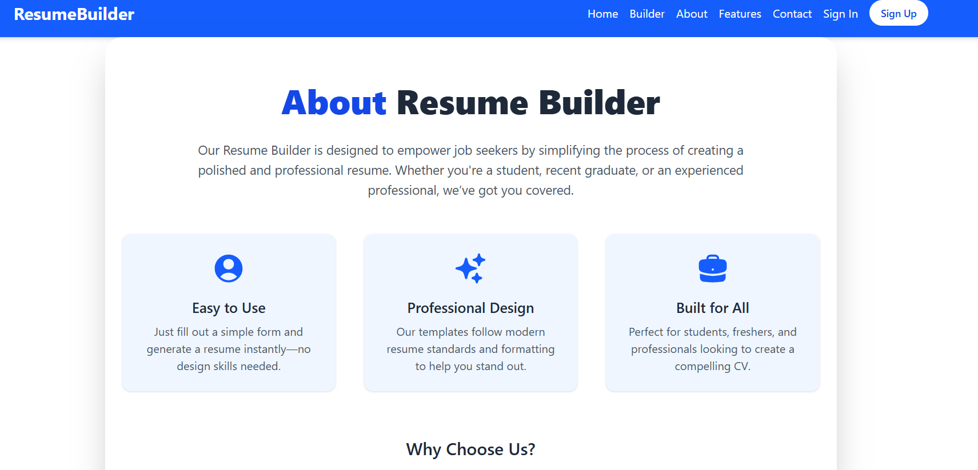
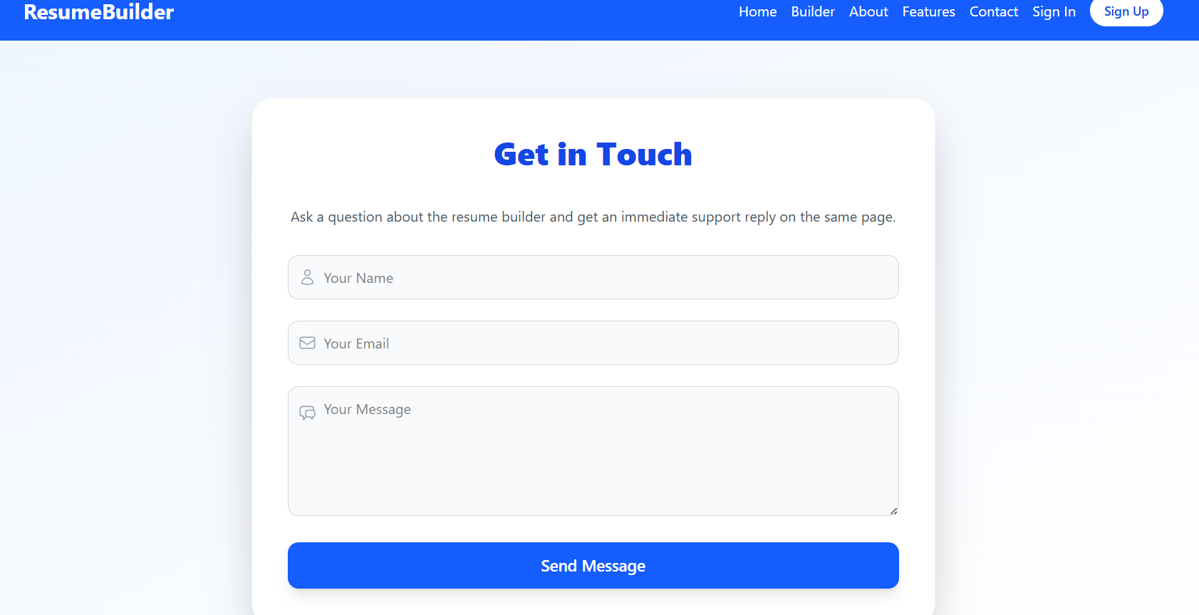
About Page Contact Page

Slide 12
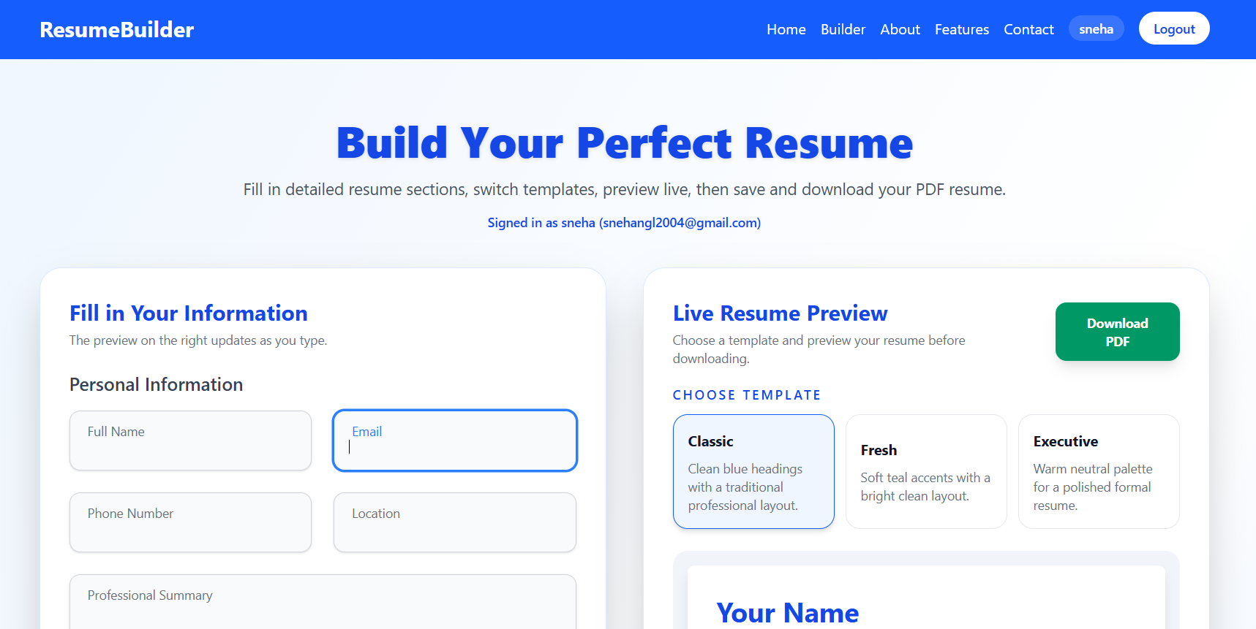
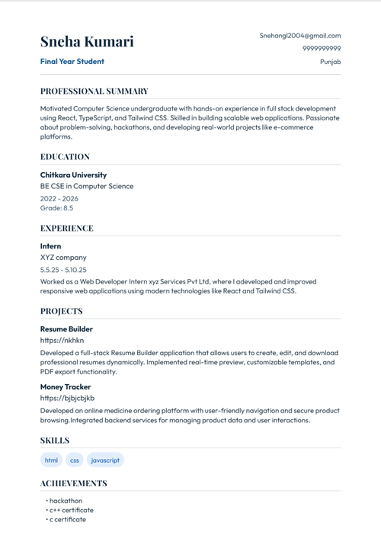
Result
Dashboard Resume

Slide 13
Conclusion
The Resume Builder is a simple and user-friendly application that helps users create professional resumes quickly and easily. It reduces the effort of manual formatting by providing structured templates and organized input fields. This project improves productivity and ensures a clean, well-designed resume.
It is easy to use and does not require any technical knowledge. The application ensures a professional and attractive resume format. Overall, it is a practical and efficient solution for modern resume creation.

Slide 14
Future Scope
In Future , more templates can be included for different job roles.
Users can get suggestions to improve their resume quality.
The system can be made faster and more user-friendly.
Resume sharing through link or email can be added.
More professional and creative templates can be included for different job roles.

Slide 15
References
React Documentation – For building user interface components https://react.dev
Tailwind CSS Documentation – For designing modern and responsive UI https://tailwindcss.com
MongoDB Documentation – https://www.mongodb.com/docs/

Slide 16
Thank You
16

