Slide 1
PennyWise
AI-Powered Personal Finance & Behavioral Economics Platform
Presented by: Sneha | Roll No: 2305495
Bachelor of Technology in Computer Science & Engineering School of Computer Engineering — KIIT Deemed to be University

Slide 2
PENNYWISE PROJECT PRESENTATION
Problem Statement & Project Motivation
Traditional Finance Apps
• Record numbers without explaining behavioral causes.
• Ignore emotional spending triggers (stress, boredom, impulse).
• Fail to quantify long-term impact on savings goals.
• Lack interactive feedback to prevent impulse spending.
PennyWise Solution
• Combines transaction records with behavioral psychology.
• Transparent 6-weight Regret Predictor Engine (0-100 score).
• Impulse Lock cooling-off timer with real-time AI advice.
• Gamification (XP, levels, badges, daily savings missions).

Slide 3
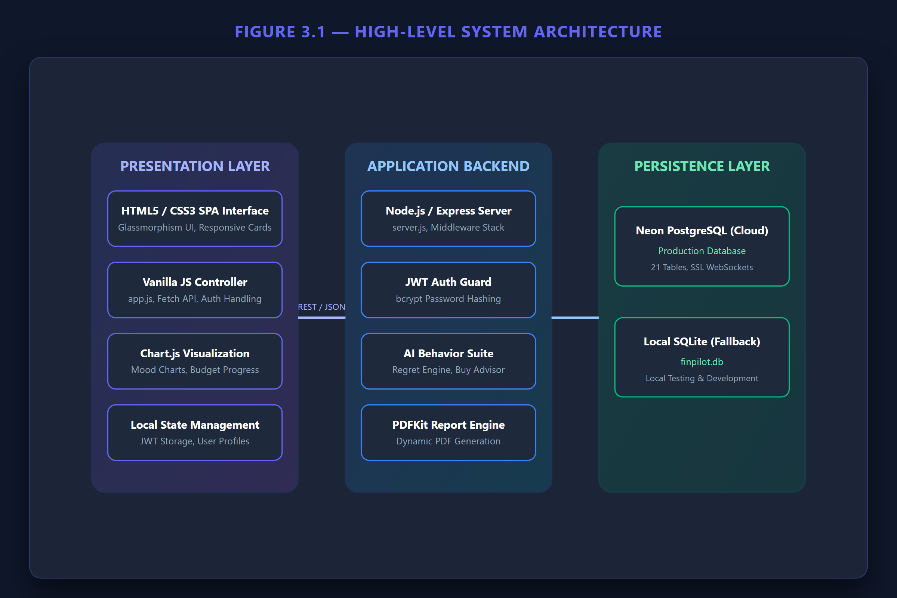
PENNYWISE PROJECT PRESENTATION
System Architecture & Tech Stack

Slide 4
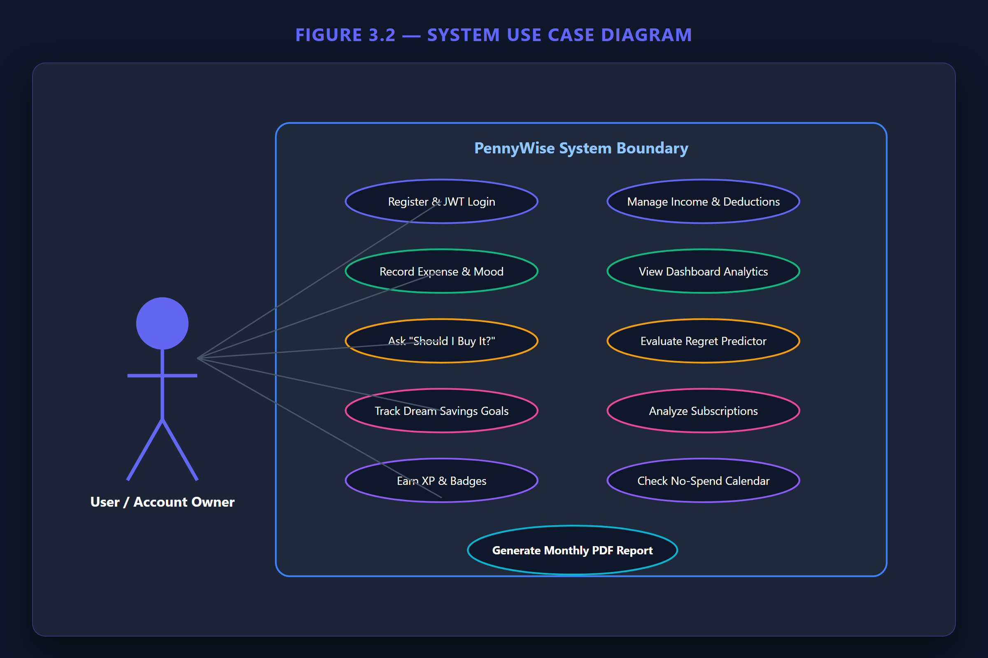
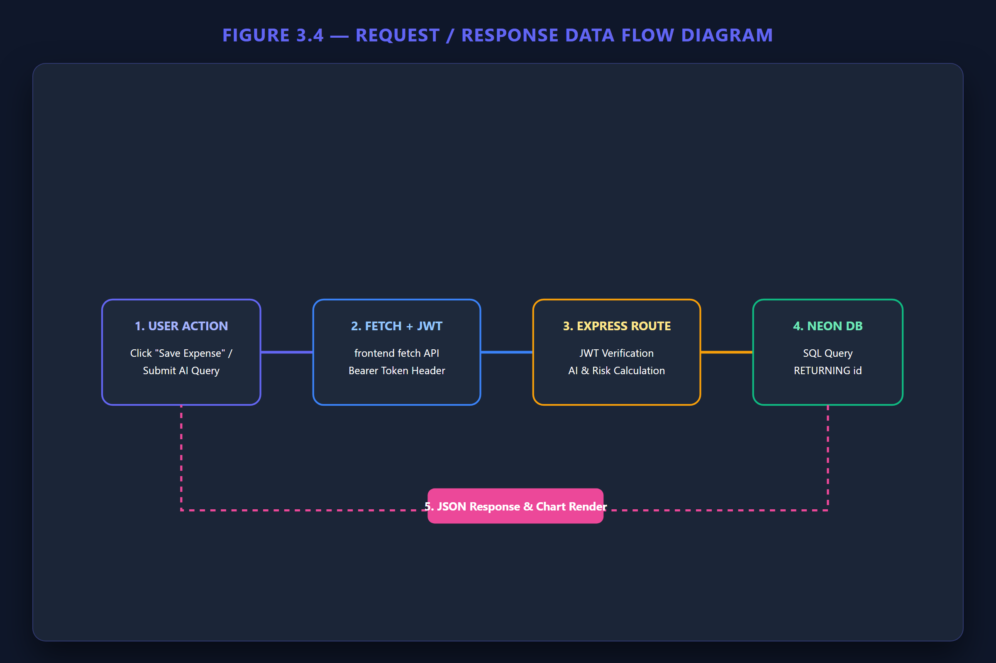
PENNYWISE PROJECT PRESENTATION
Use Case Model & Data Flow Architecture

Slide 5
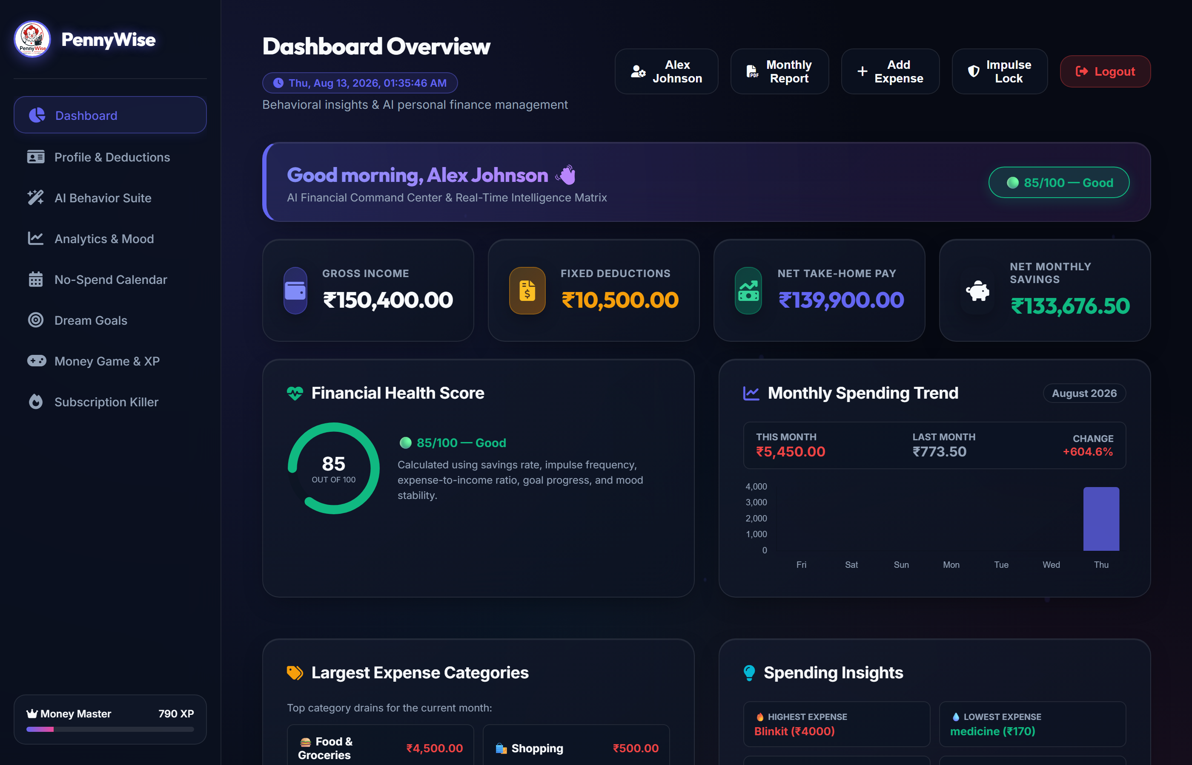
PENNYWISE PROJECT PRESENTATION
Financial Command Center (Dashboard)

Slide 6
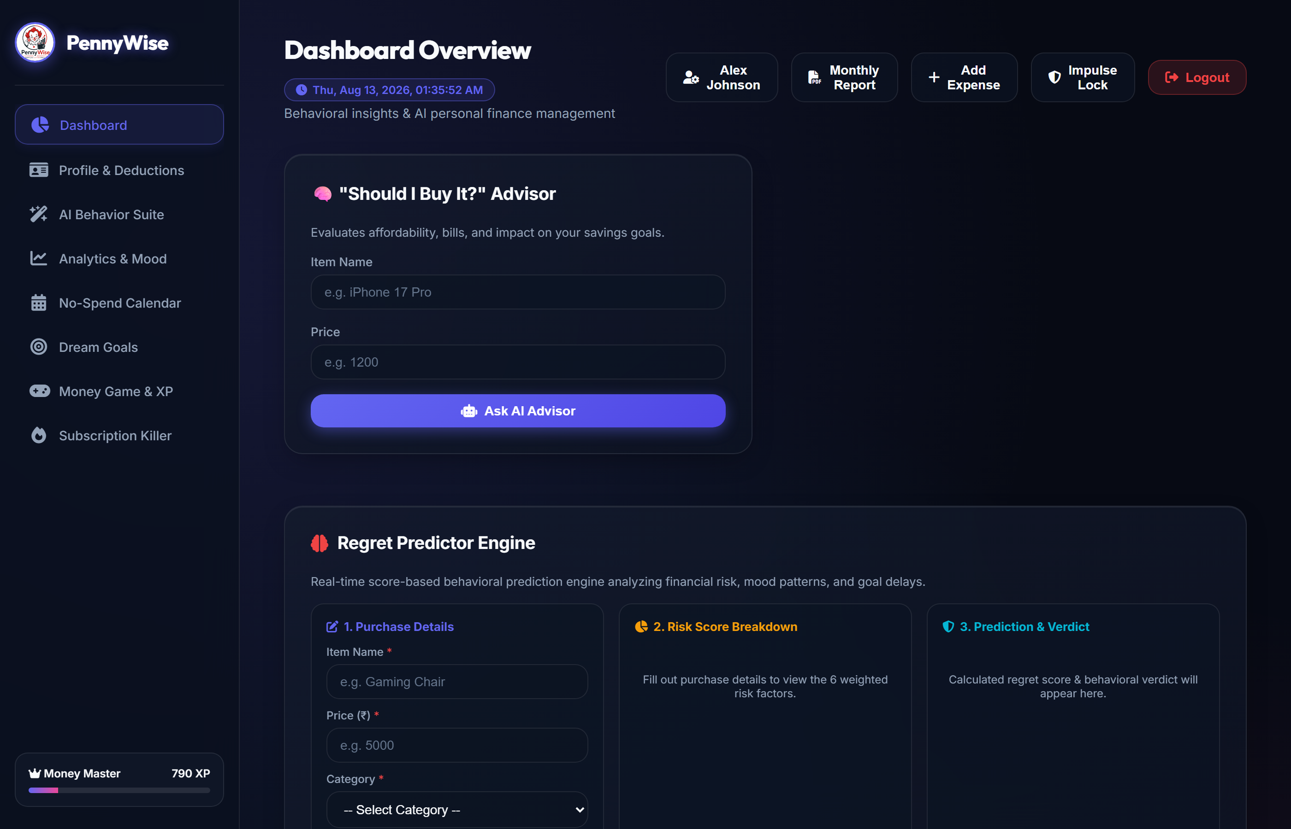
PENNYWISE PROJECT PRESENTATION
AI Behavior Suite & Decision Tools

Slide 7
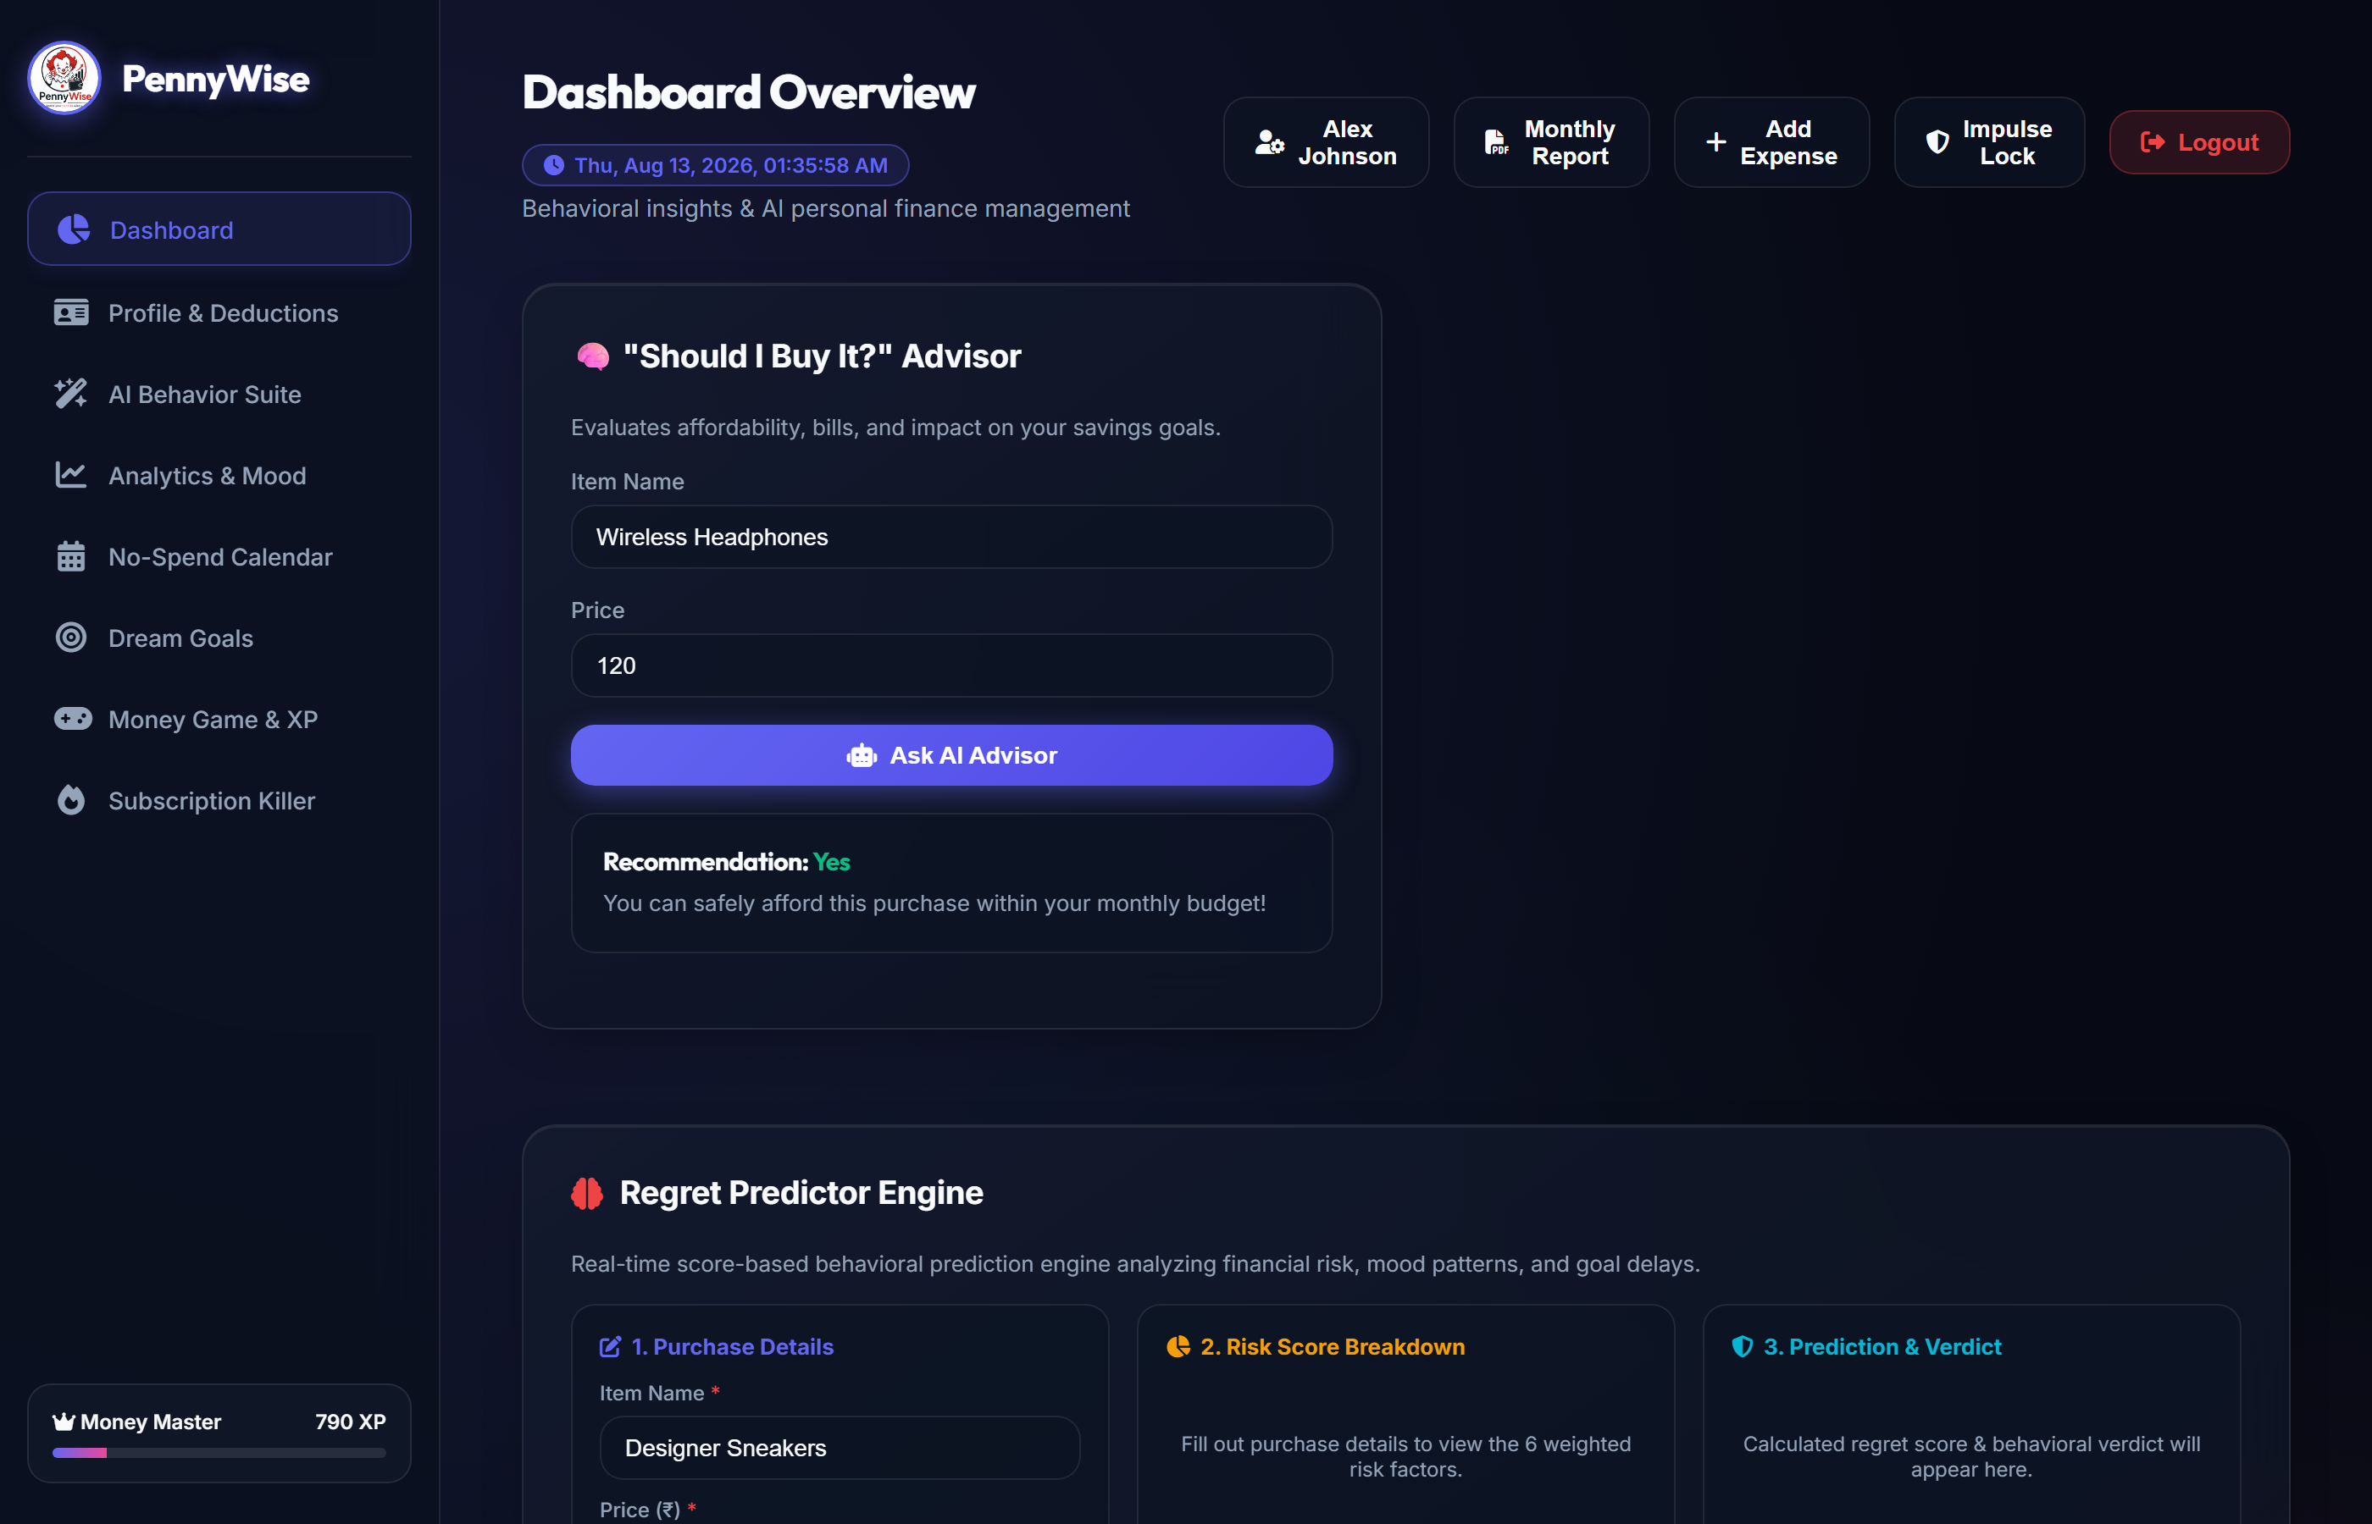
PENNYWISE PROJECT PRESENTATION
3-Panel Regret Predictor Engine

Slide 8
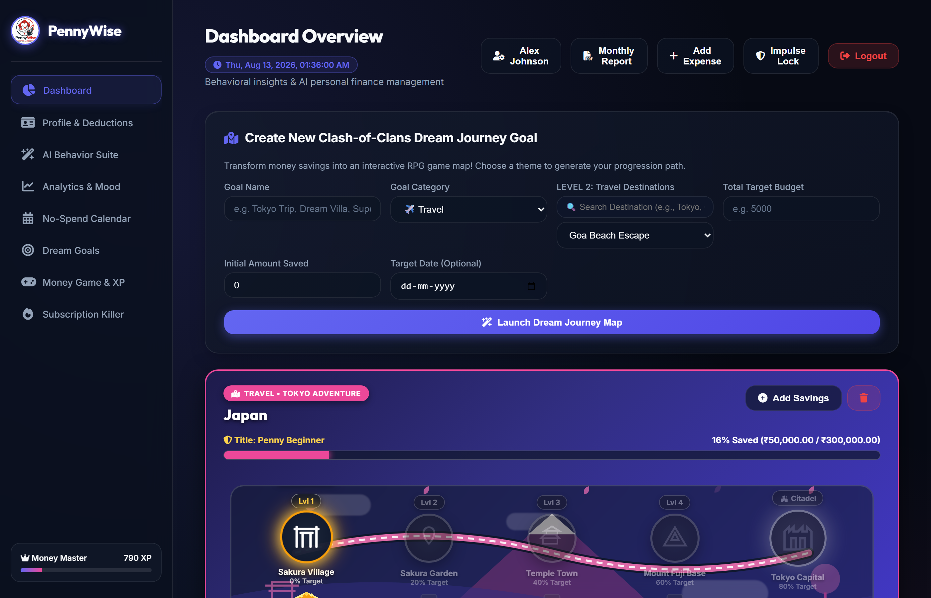
PENNYWISE PROJECT PRESENTATION
Dream Savings Goals & Progression

Slide 9
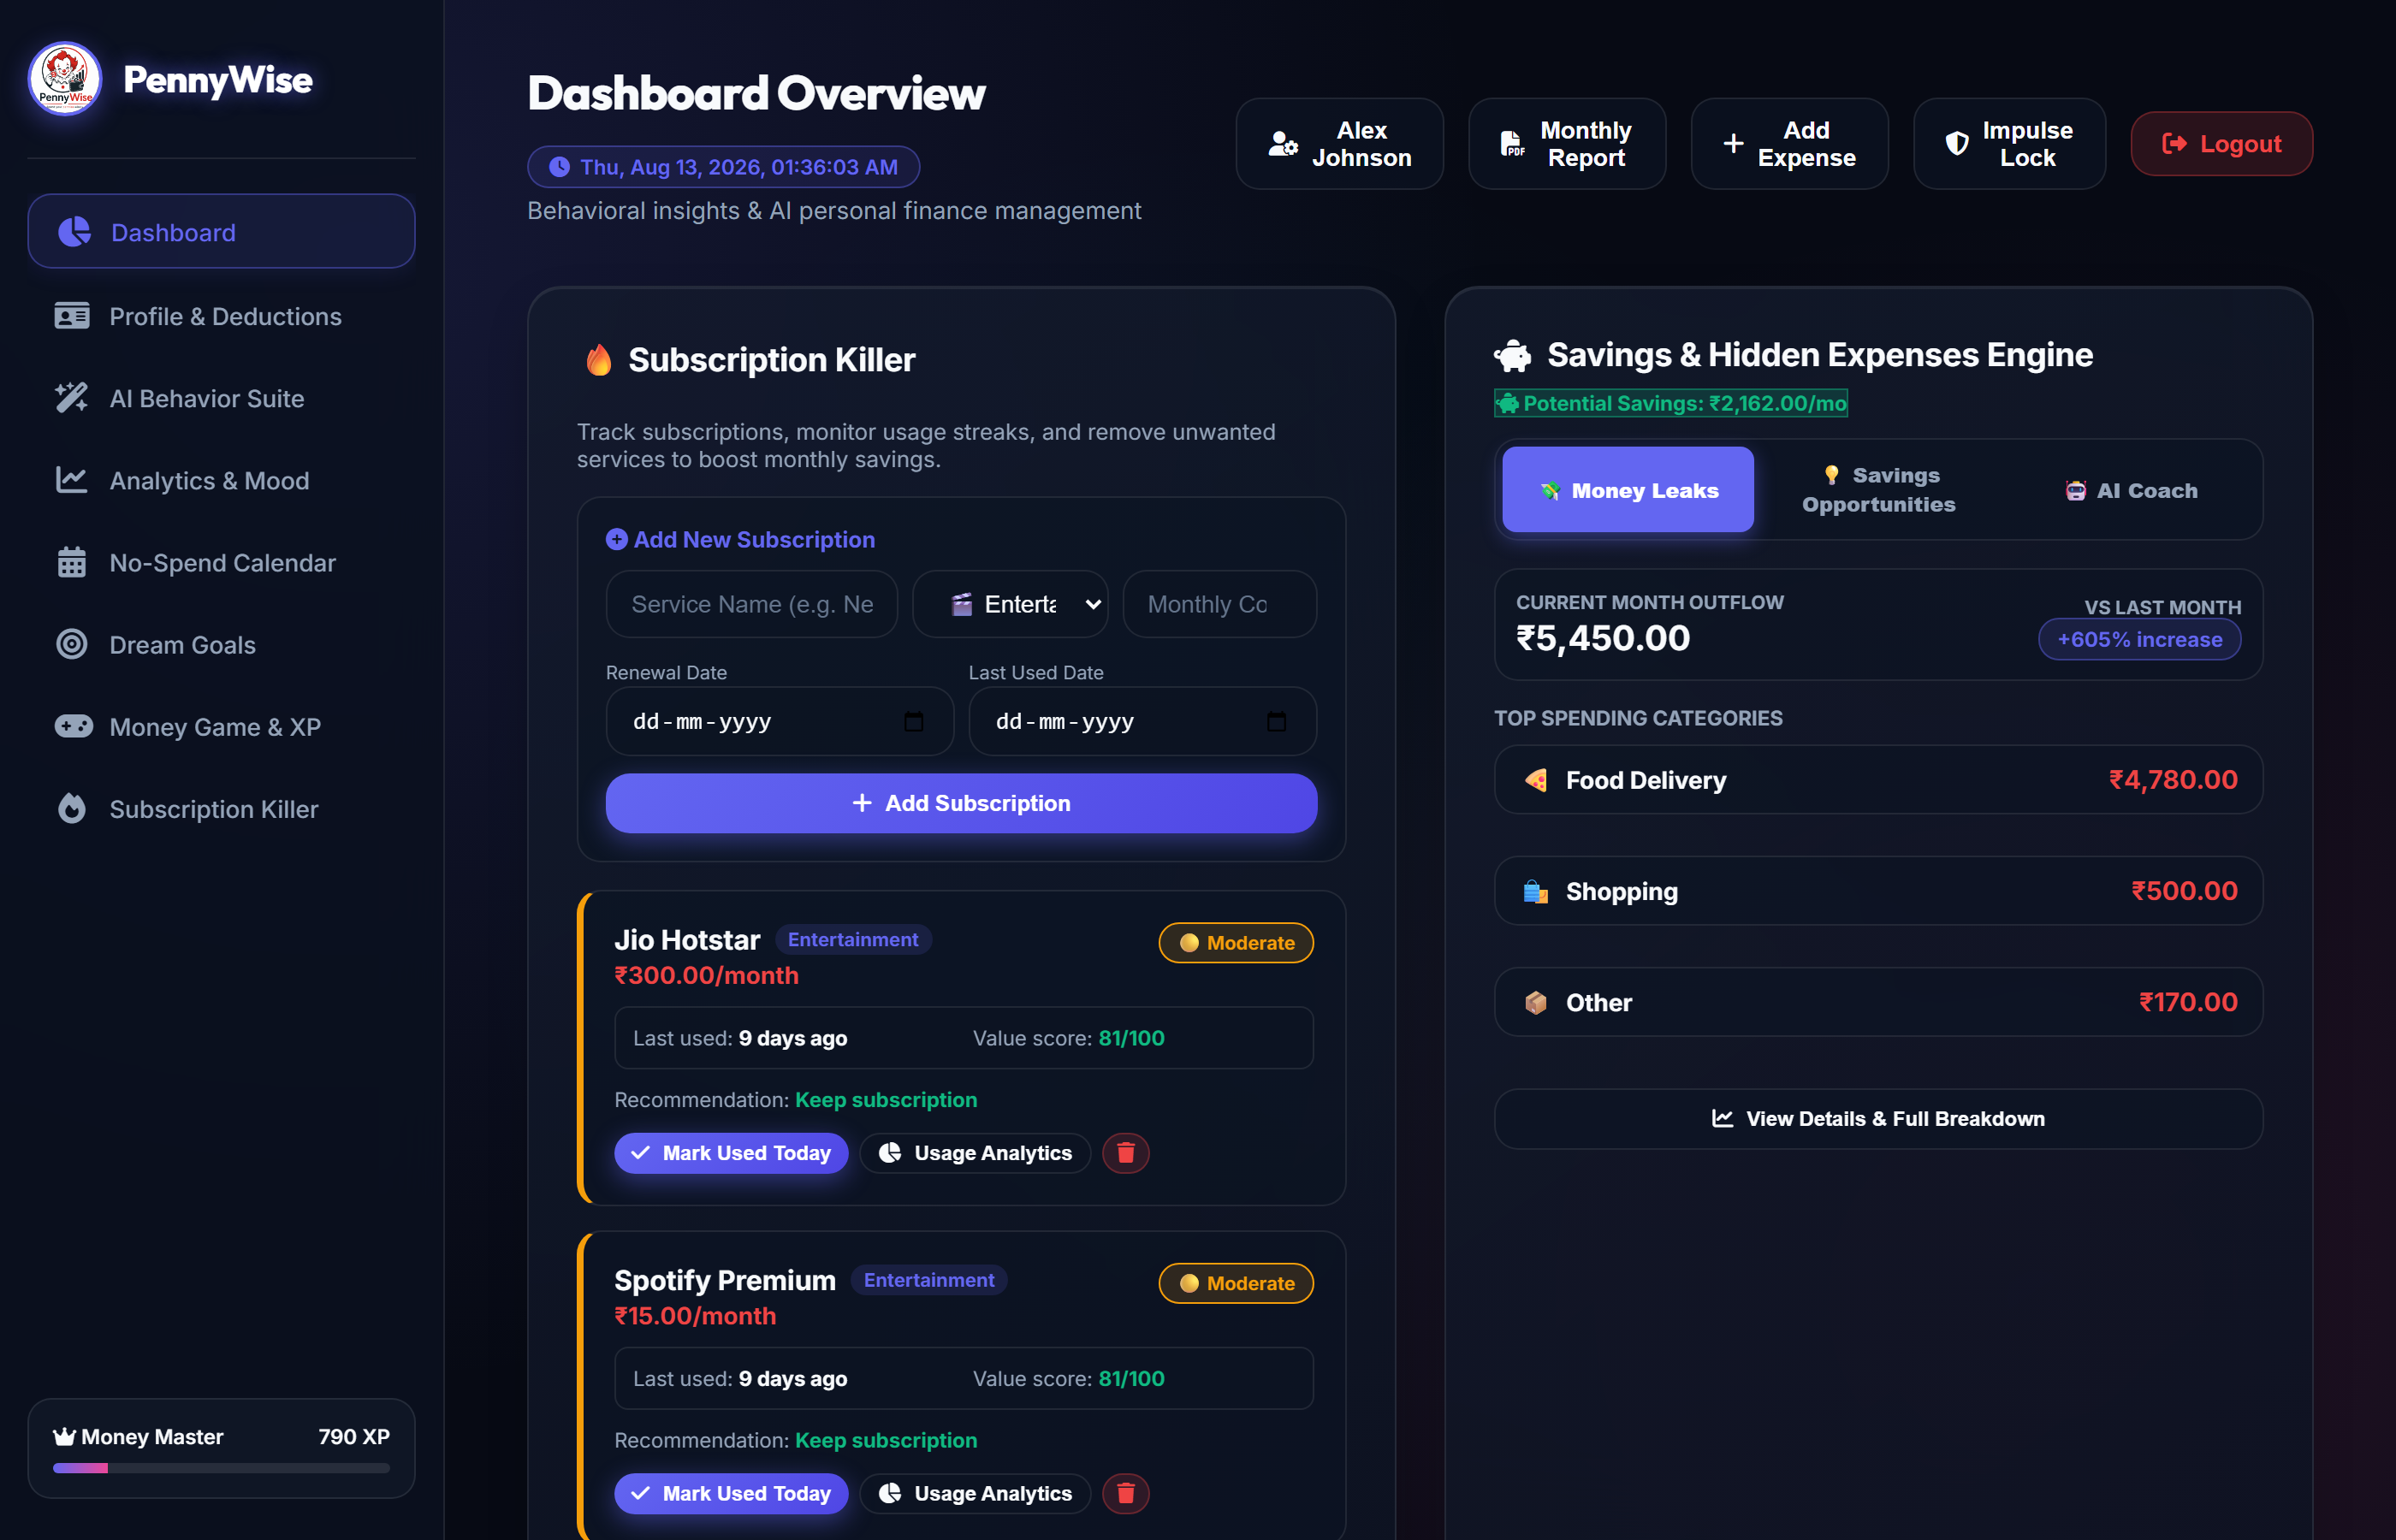
PENNYWISE PROJECT PRESENTATION
Subscription Killer & Usage Analytics

Slide 10
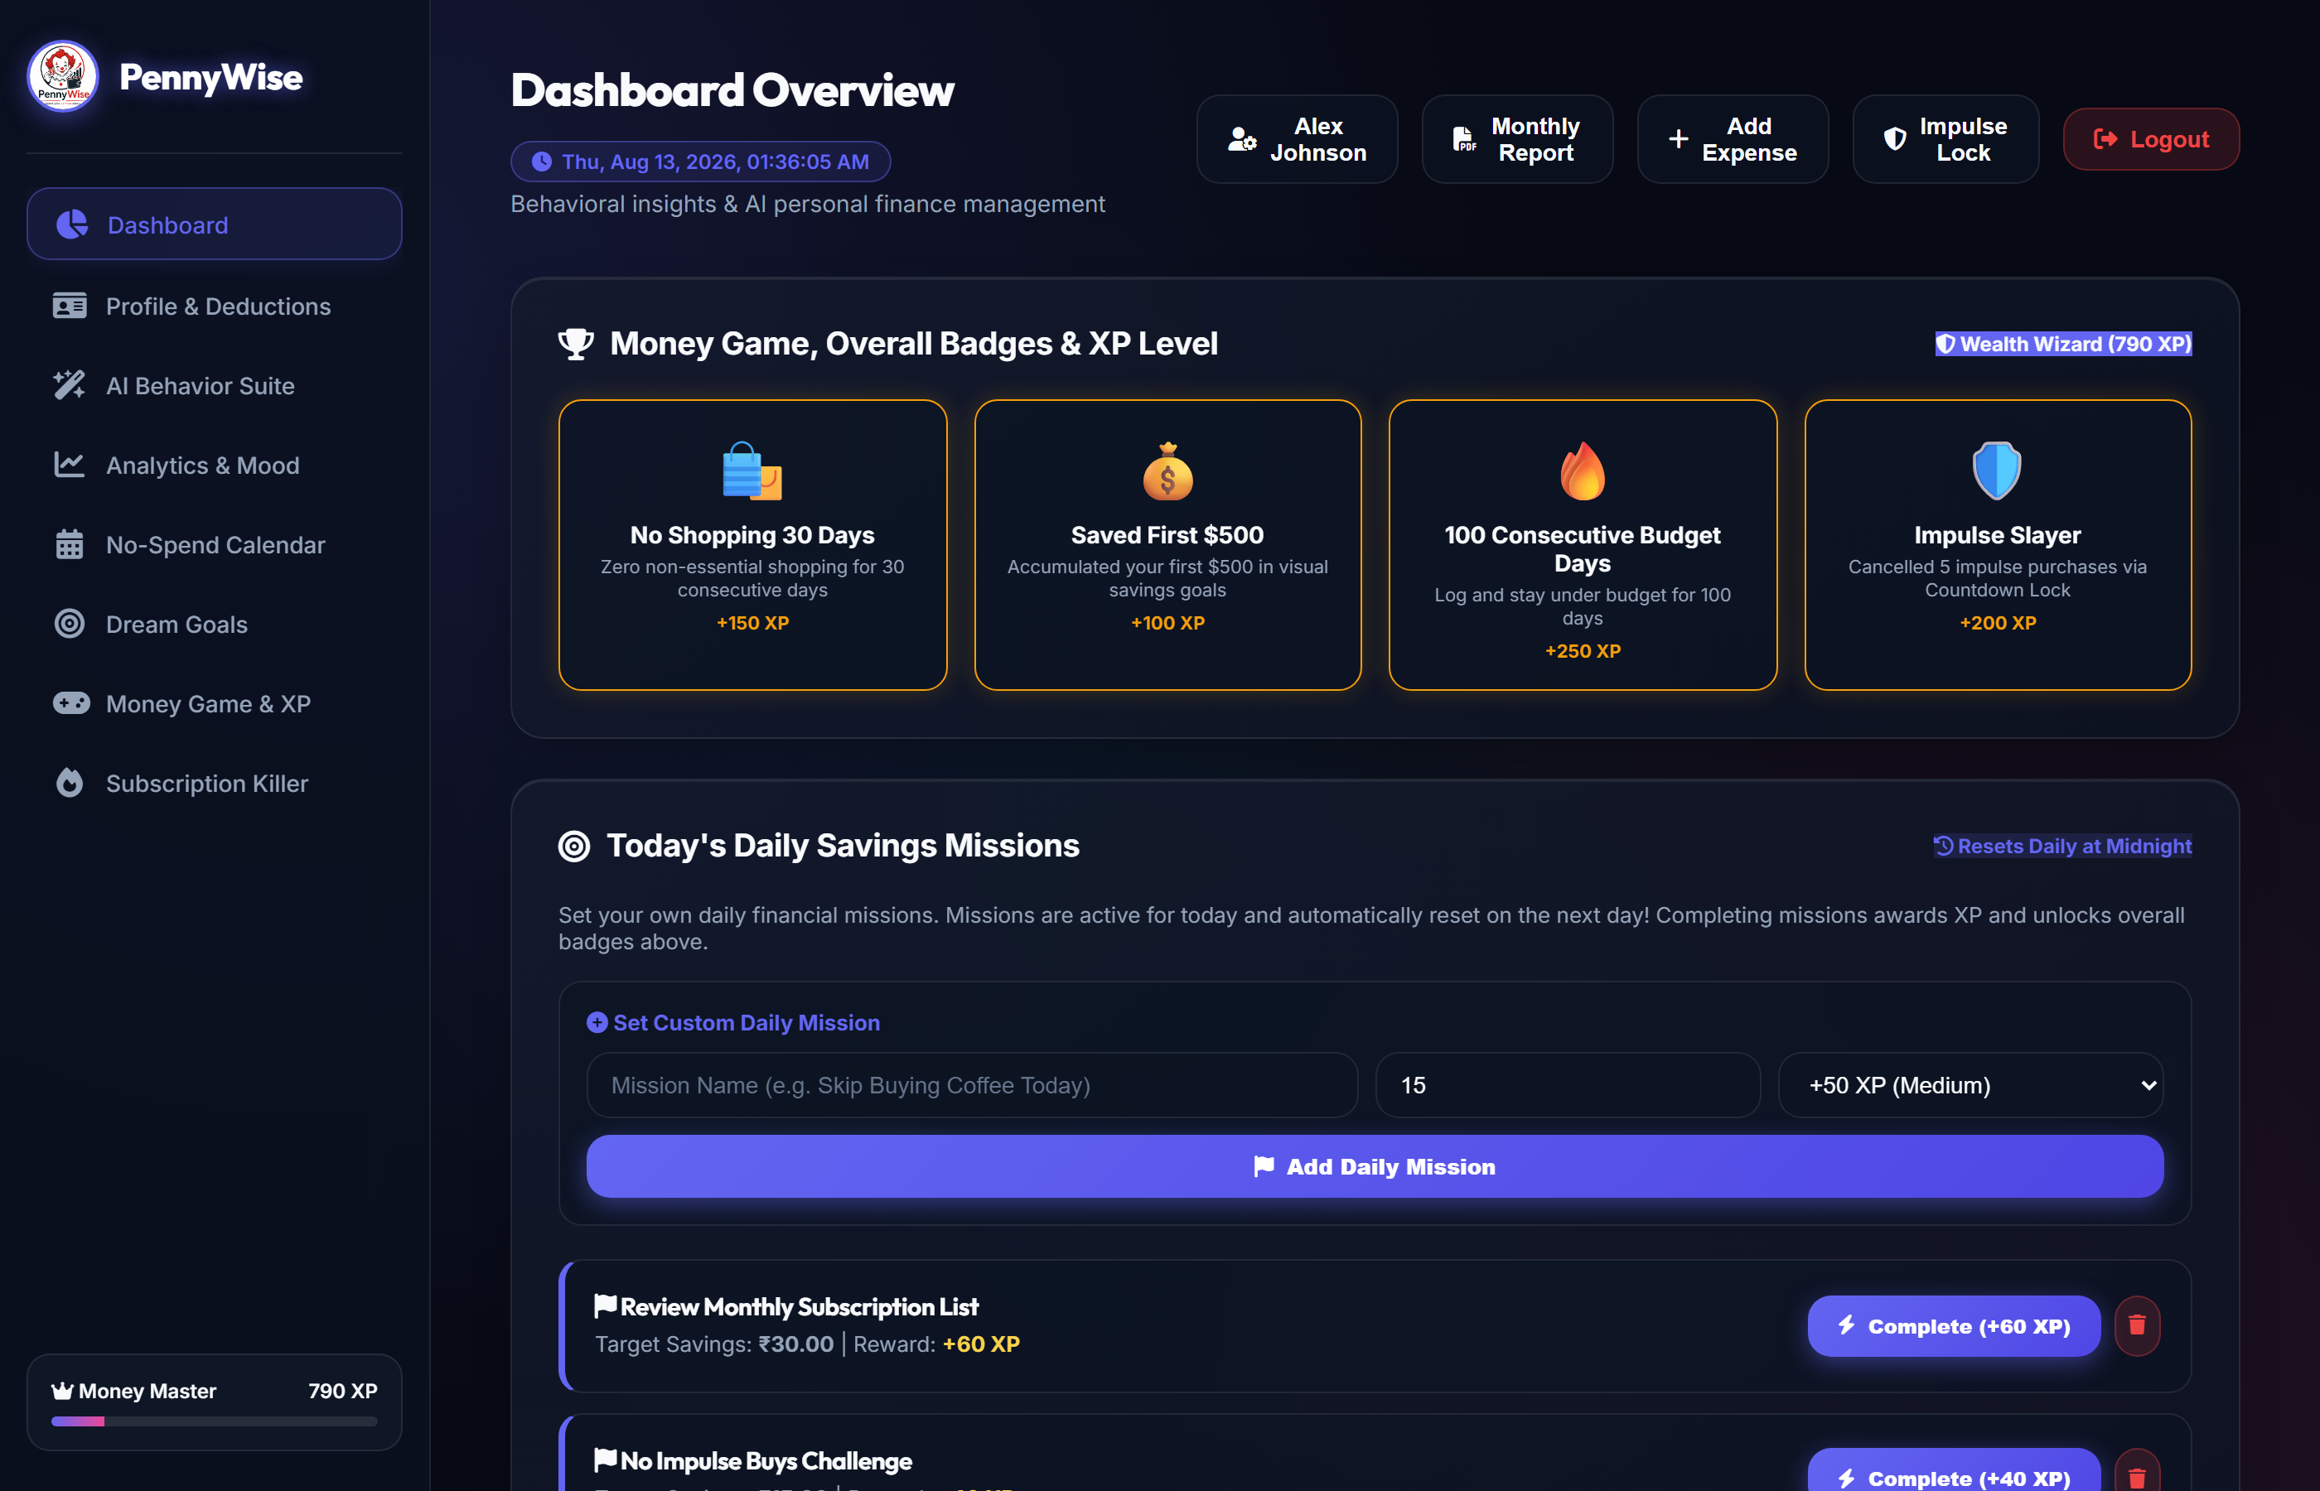
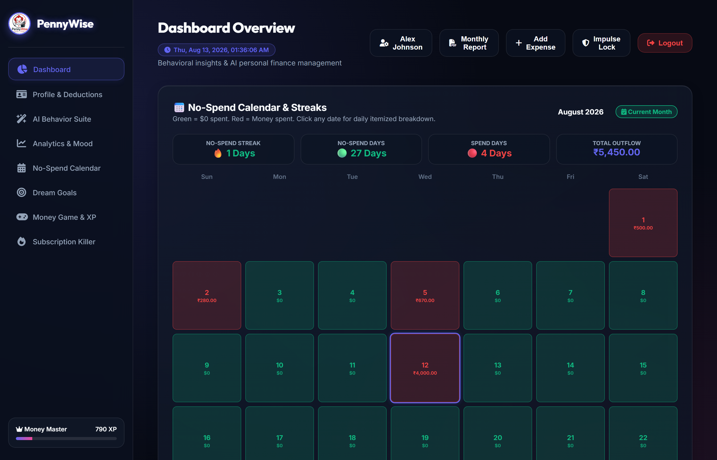
PENNYWISE PROJECT PRESENTATION
Gamification, XP & No-Spend Calendar

Slide 11
PENNYWISE PROJECT PRESENTATION
Testing & Quality Assurance
27 / 27 Automated Tests Passed
• Authentication Tests (8/8 Passed) — bcrypt hashing, JWT validation, token isolation.
• Expenses CRUD Tests (5/5 Passed) — user-scoped expense operations & satisfaction rating.
• Budgeting & Reports Tests (5/5 Passed) — category budget thresholds & PDF output.
• AI Behavior Suite Tests (6/6 Passed) — Regret Predictor score calculations.
• System E2E Workflows (3/3 Passed) — full user lifecycle and account cleanup.
Security & Quality Standards
• JWT Authentication Guarding all REST API routes.
• Bcrypt Password Hashing with multi-round salt.
• Strict User Isolation via parameterized SQL query filters.
• Cascading Foreign Key Deletion to prevent orphaned data.
• Environment Secret Isolation (.env configuration).

Slide 12
Thank You!
PennyWise: AI-Powered Personal Finance Platform
Questions & Answers

