Slide 1
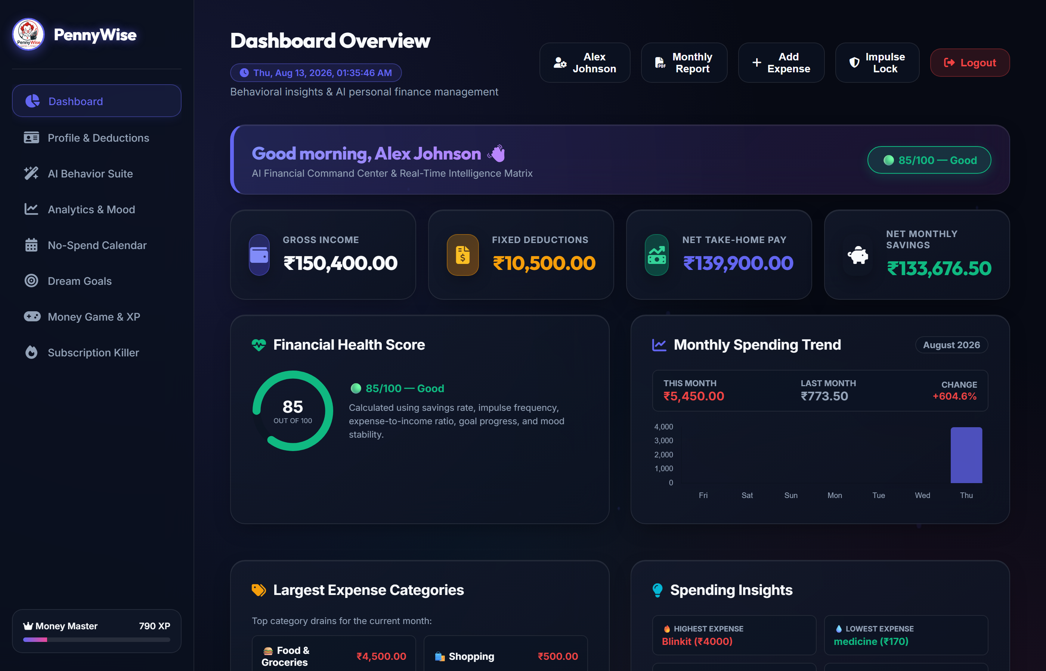
PennyWise
Spend smarter. Think better. Save more.
AI-Powered Personal Finance & Behavioral Economics Platform
Presented by:
Sneha Sinha | Roll No: 2305495
B.Tech Computer Science & Engineering School of Computer Engineering KIIT Deemed to be University

Slide 2
PENNYWISE • AI-POWERED PERSONAL FINANCE & BEHAVIORAL ECONOMICS
02 / 12
The Problem vs. PennyWise Solution
THE PROBLEM
• Static Numbers Only
Traditional finance apps record transactions without explaining underlying behavioral causes.
• Ignored Emotional Triggers
Impulse purchases driven by stress, boredom, or peer pressure are completely overlooked.
• Hidden Goal Impact
Users cannot visualize how small daily expenses delay long-term savings goals.
• No Active Intervention
No real-time cooling off or decision support before an impulse transaction occurs.
PENNYWISE SOLUTION
✓ Behavioral Finance + AI
Combines transaction records with psychological mood tracking & financial health scoring.
✓ Transparent Regret Predictor
Computes a 0–100 risk score based on 6 weighted financial & behavioral components.
✓ Impulse Lock & AI Advisor
Enforces a 30-second cooling-off timer with real-time affordability analysis.
✓ Gamified Progression
Drives savings discipline through XP, levels, badges, and daily savings missions.
➔

Slide 3
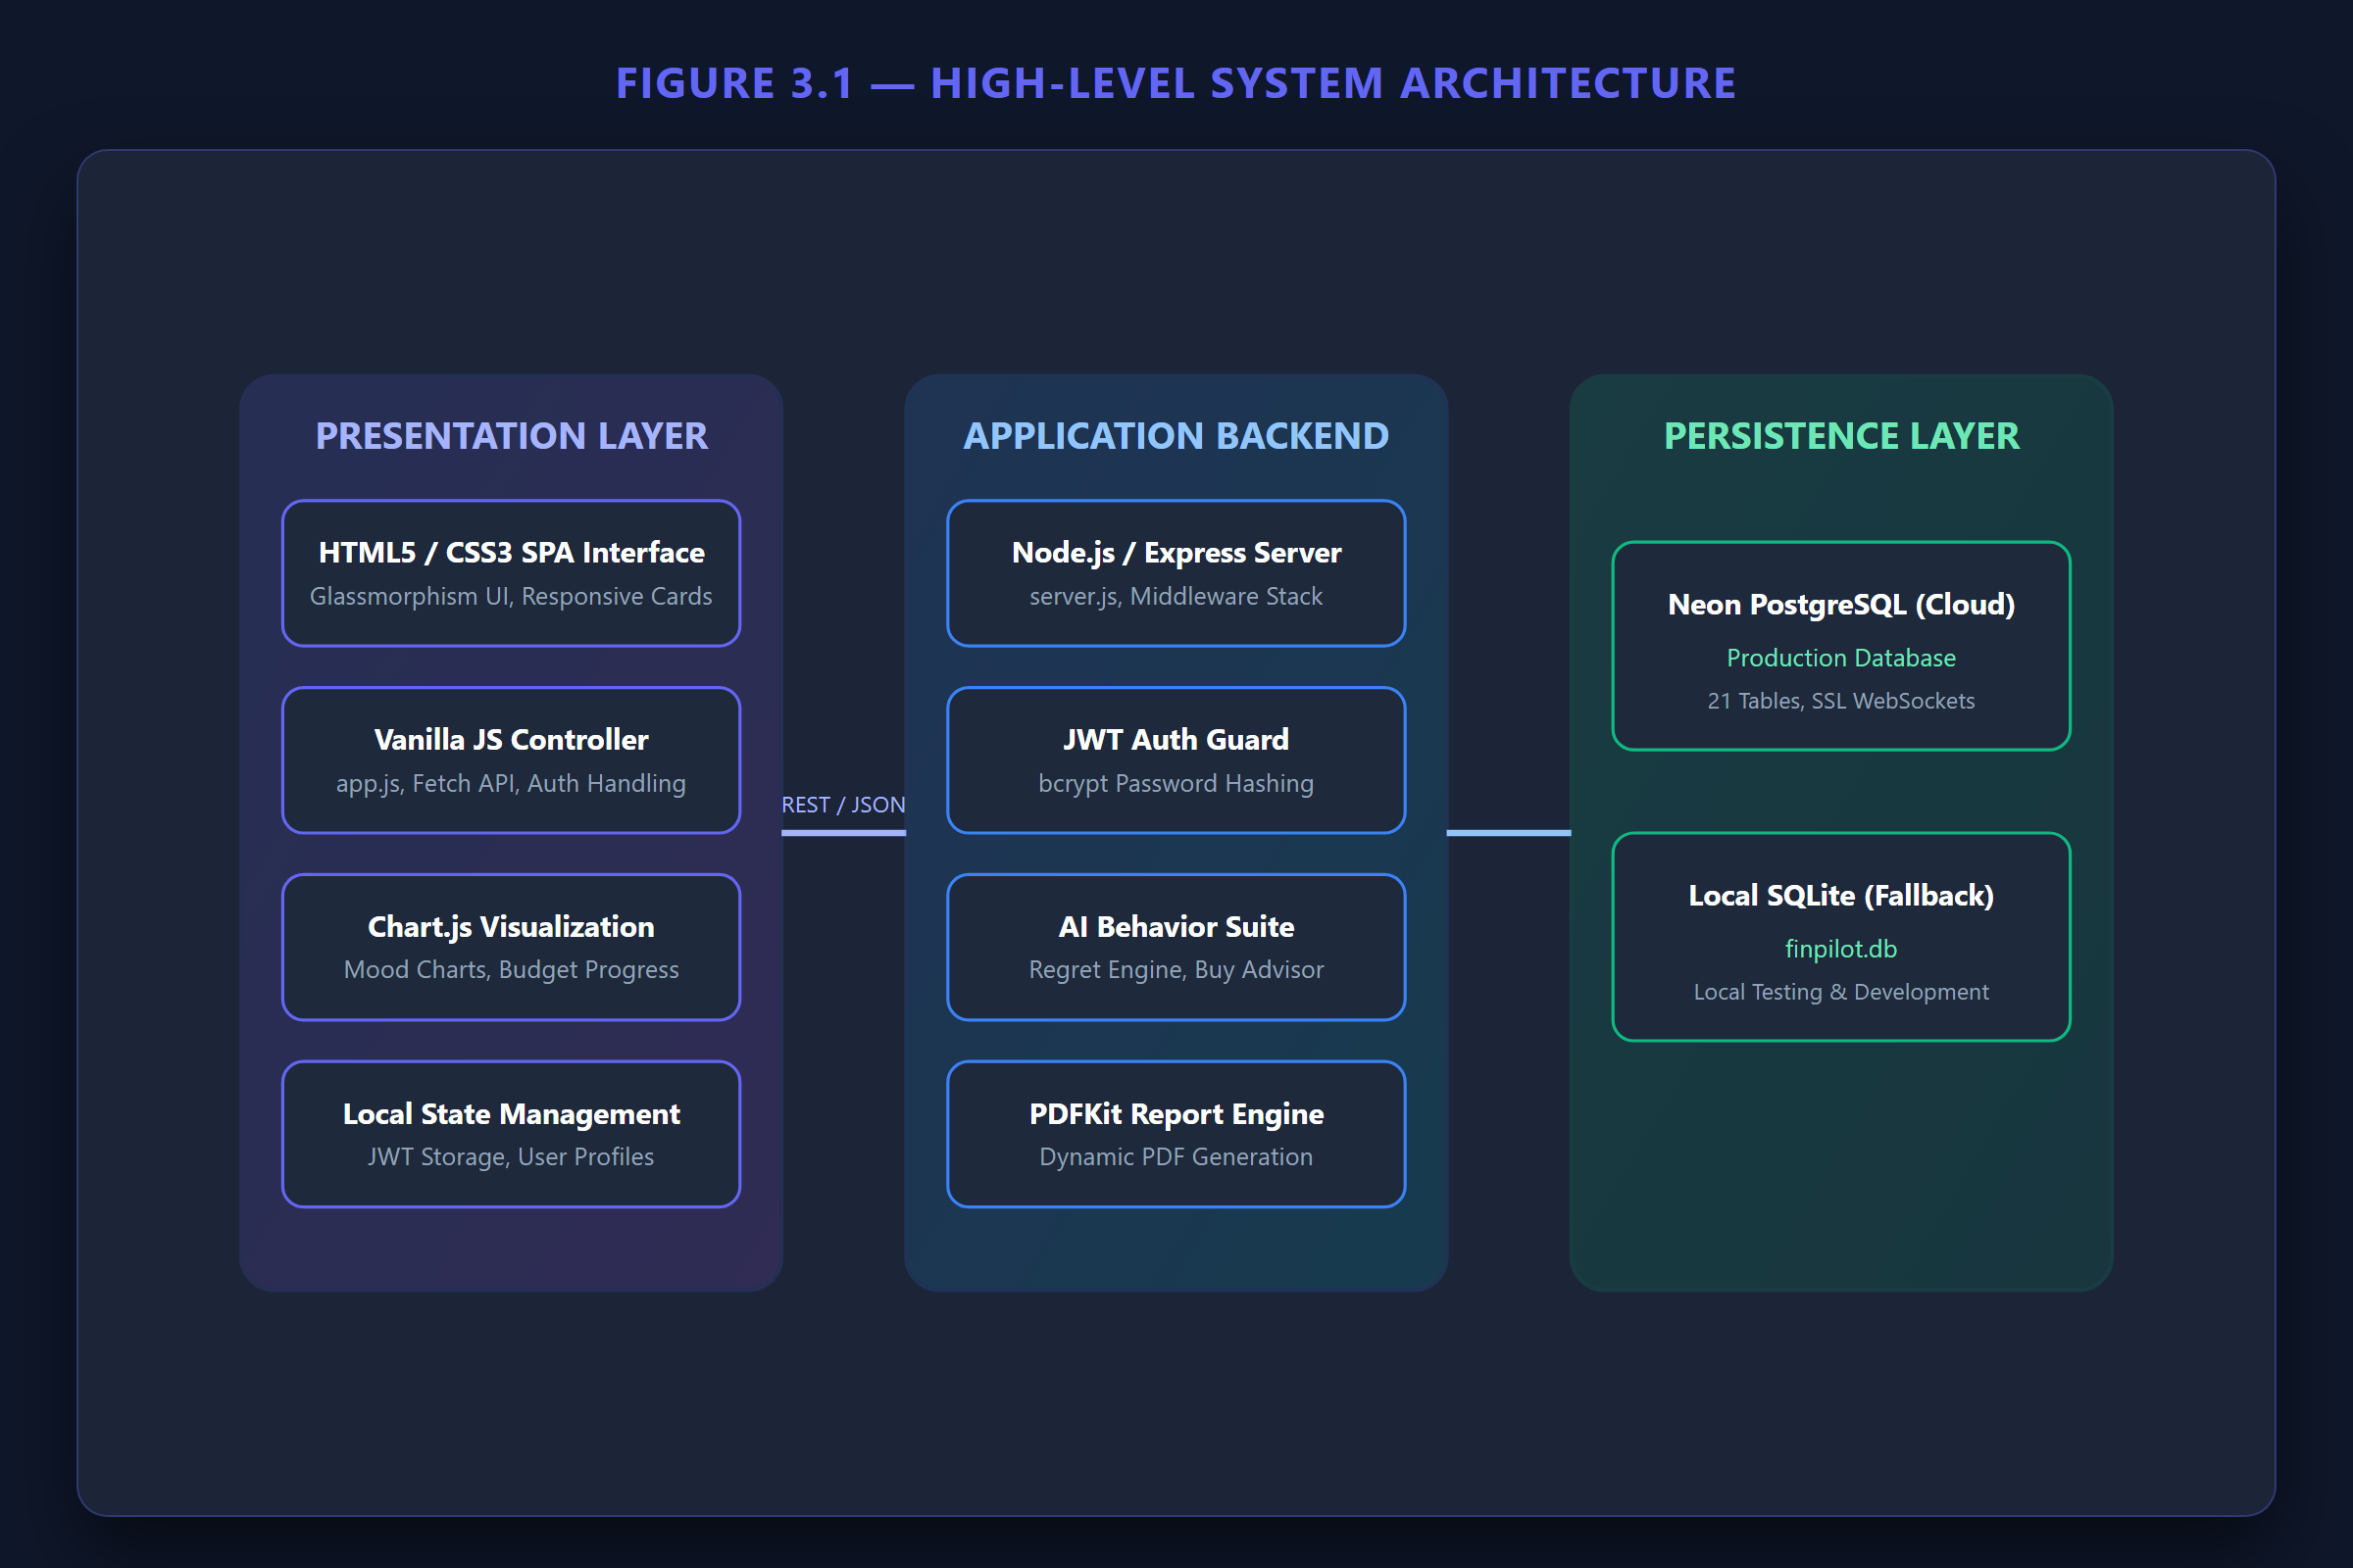
PENNYWISE • AI-POWERED PERSONAL FINANCE & BEHAVIORAL ECONOMICS
03 / 12
System Architecture & Engineering Pipeline
Tech Stack Summary
• Presentation Layer
HTML5, CSS3 Glassmorphic UI, Vanilla JavaScript SPA Controller, Chart.js Visualizations.
• Application Backend
Node.js REST API, Express.js Middleware Stack, JWT Auth Guard, bcrypt Hashing.
• Behavioral AI Engine
6-Weight Regret Risk Engine, Should I Buy It Advisor, Opportunity Cost Simulator.
• Persistence & Reports
SQLite Relational Database (finpilot.db, 21 Tables), PDFKit Report Generator.

Slide 4
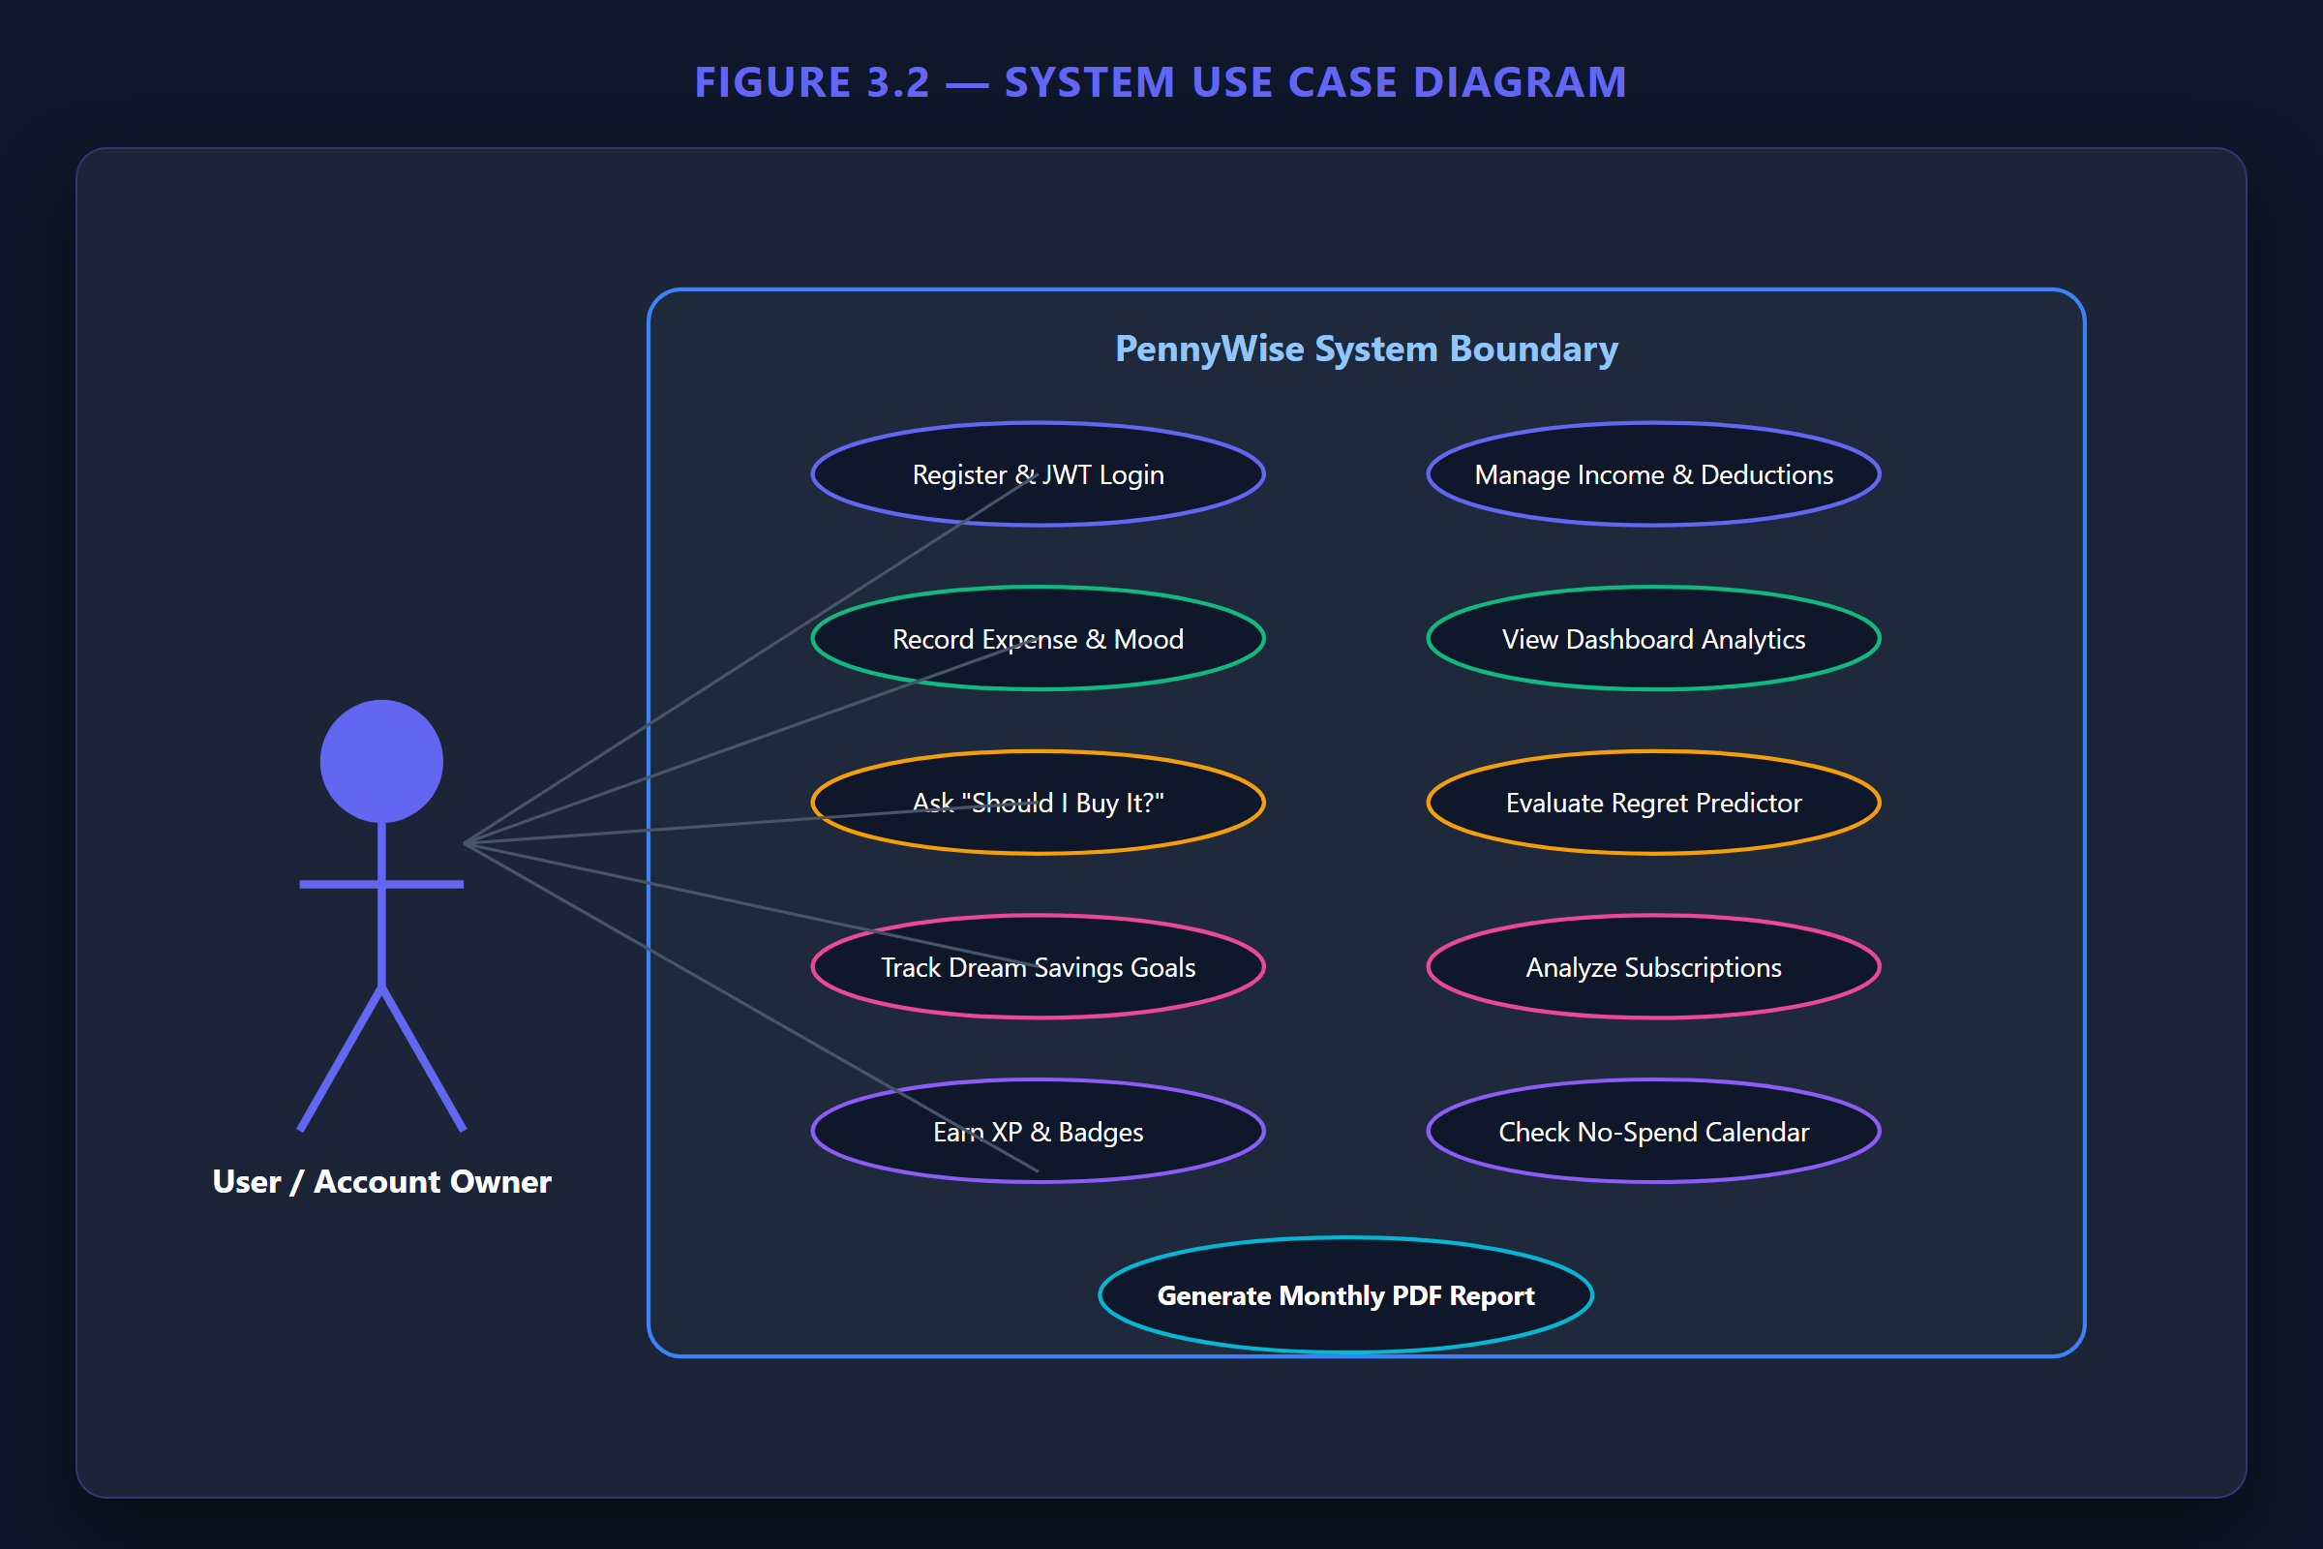
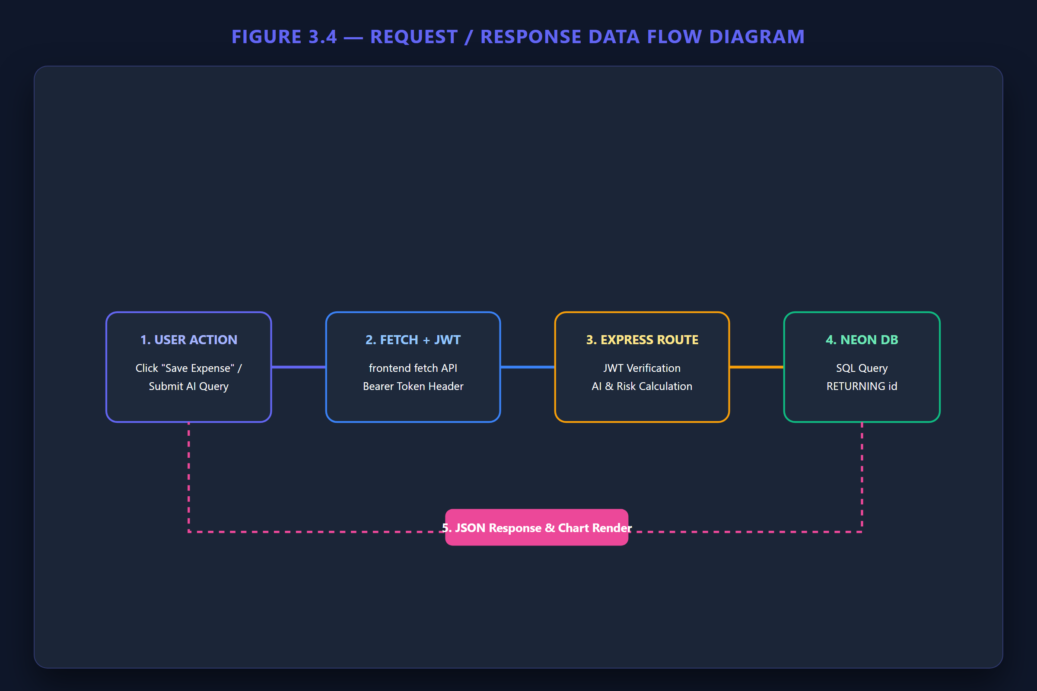
PENNYWISE • AI-POWERED PERSONAL FINANCE & BEHAVIORAL ECONOMICS
04 / 12
Use Case Model & Data-Flow Workflow

Slide 5
PENNYWISE • AI-POWERED PERSONAL FINANCE & BEHAVIORAL ECONOMICS
05 / 12
Financial Command Center & Dashboard
Key Indicators
• Financial Health Score
Calculated 0-100 score from savings rate, impulse frequency & mood stability.
• Take-Home Income
Calculates net balance after fixed payroll & tax deductions.
• Monthly Spending Trend
Compares current vs. previous month expenses by category.
• Impulse & Mood Tracker
Maps spending to emotional states (Happy, Stressed, Bored).

Slide 6
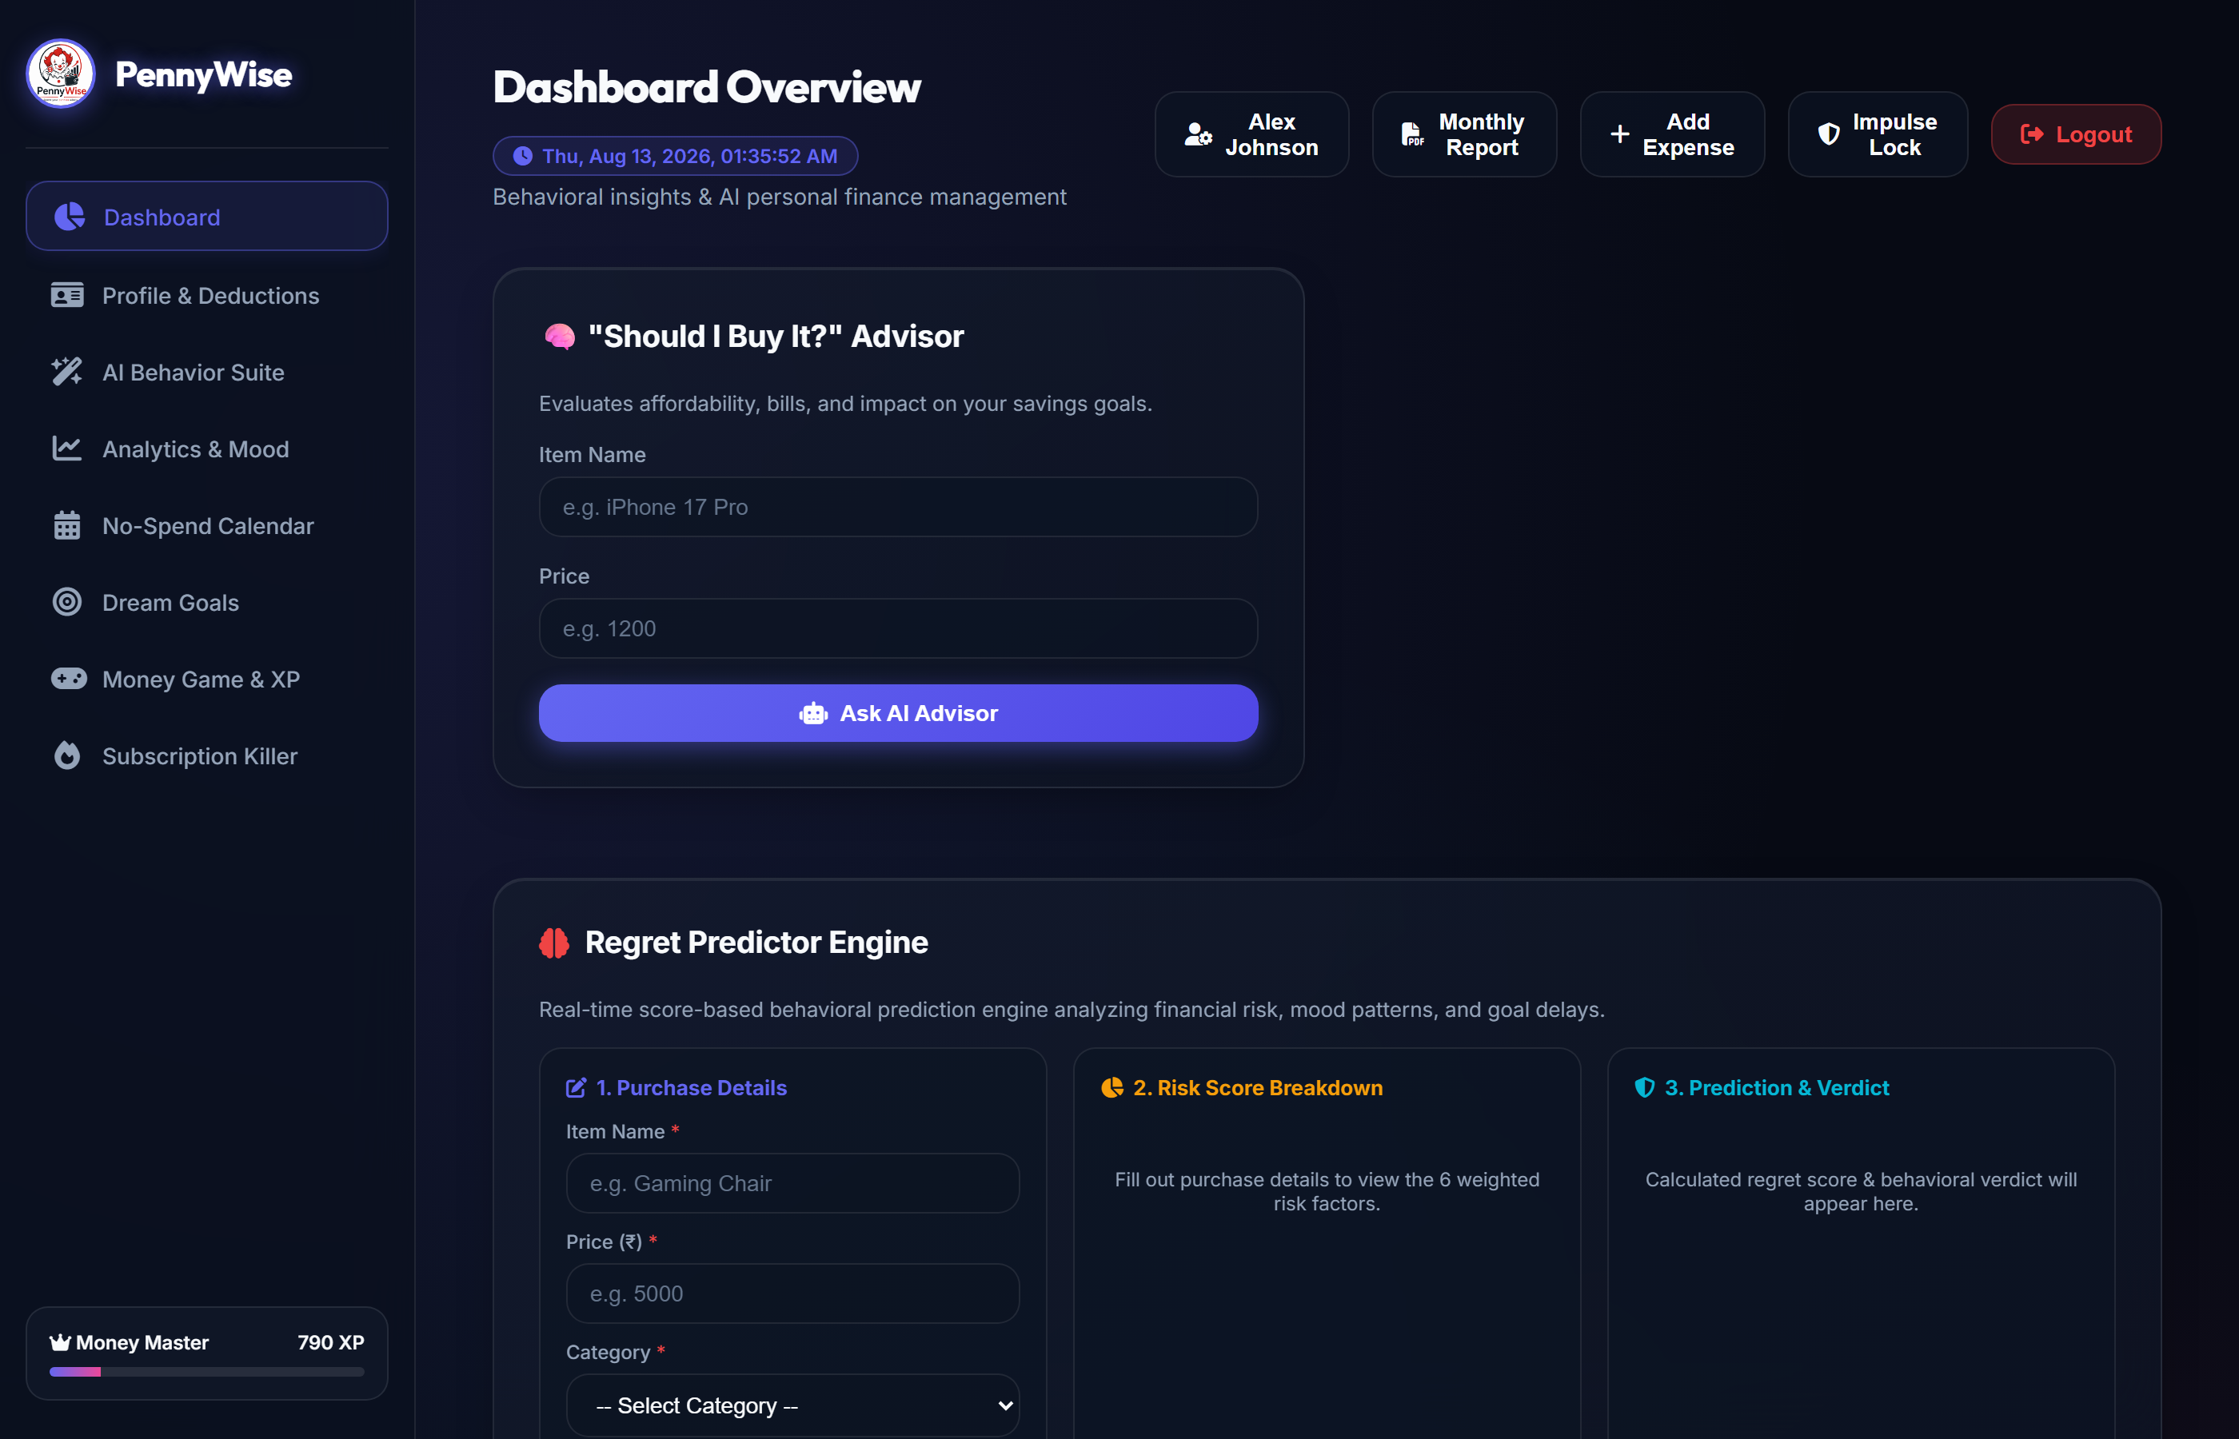
PENNYWISE • AI-POWERED PERSONAL FINANCE & BEHAVIORAL ECONOMICS
06 / 12
AI Behavior Suite & Decision Tools
AI Decision Tools
• Should I Buy It? Advisor
Evaluates affordability against active savings goals.
• Regret Predictor Engine
6-weighted risk score with goal delay estimates.
• Opportunity Cost Tools
Translates price into daily coffee/meal equivalents.
• Future Savings Simulator
Models 1 & 5-year savings from category cutbacks.
• Hidden Expense Detector
Identifies micro-spending accumulation.
• Weekly Spending Roast
Generates humorous behavioral observations.

Slide 7
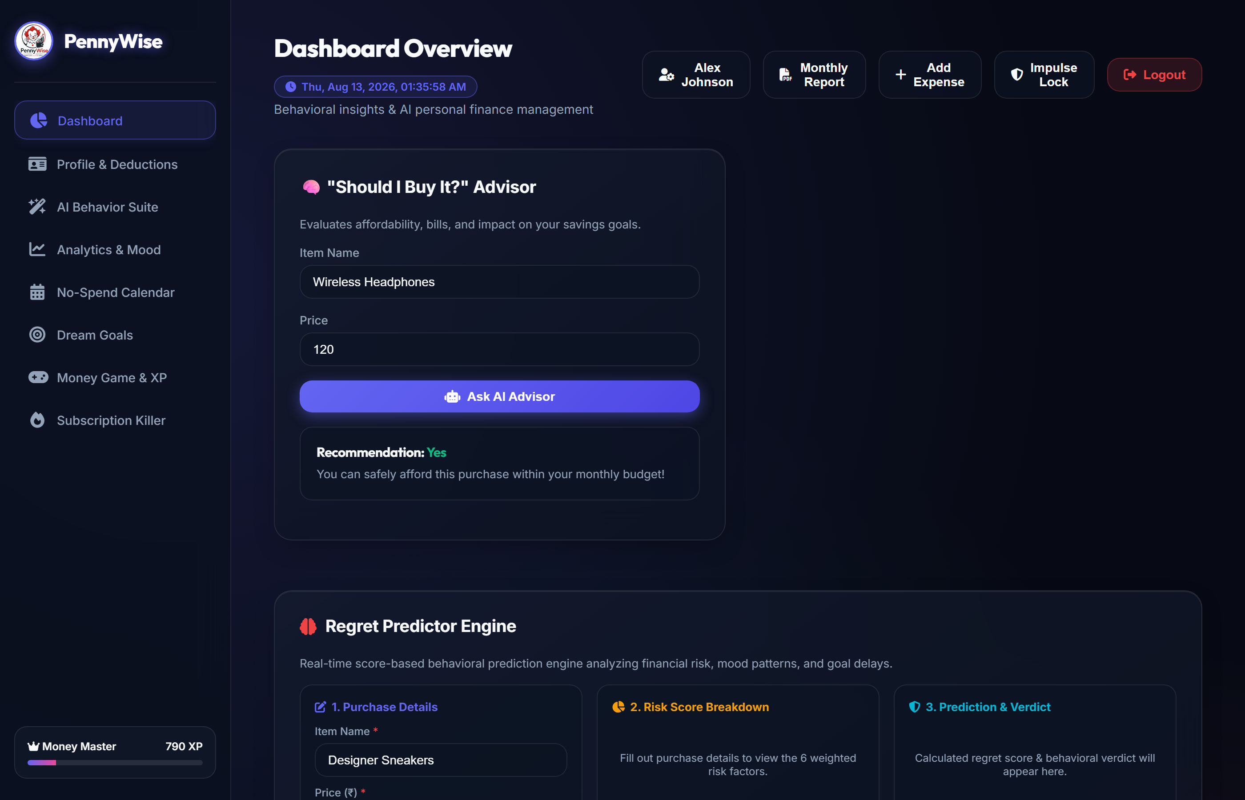
PENNYWISE • AI-POWERED PERSONAL FINANCE & BEHAVIORAL ECONOMICS
07 / 12
Regret Predictor Engine — 6 Weighted Component Analysis
Weighted Risk Model
• Income Risk (25%)
Price vs. monthly take-home pay.
• Category Risk (20%)
Historical category regret rates.
• Mood Risk (15%)
Emotional state (Stressed/Bored).
• Impulse Risk (15%)
Unplanned purchase flag.
• Goal Delay Risk (15%)
Impact on active Dream Goals.
• Purchase History (10%)
Prior satisfaction feedback score.

Slide 8
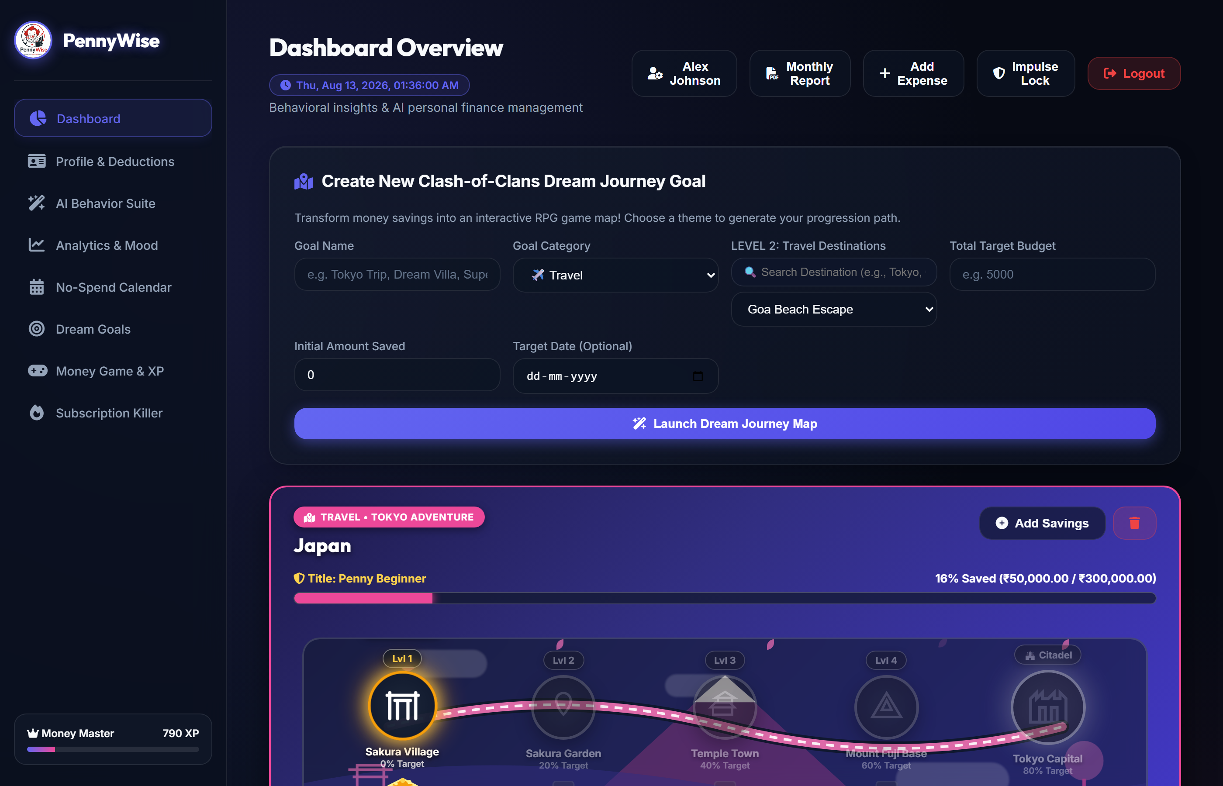
PENNYWISE • AI-POWERED PERSONAL FINANCE & BEHAVIORAL ECONOMICS
08 / 12
Dream Savings Goals & Level Progression
Goal Progression Levels
• Penny Beginner
0% - 19% saved toward target.
• Budget Explorer
20% - 39% saved toward target.
• Treasure Hunter
40% - 59% saved toward target.
• Savings Knight
60% - 79% saved toward target.
• Wealth Wizard
80% - 99% saved toward target.
• Financial Legend
100% Goal Reached & Unlocked!

Slide 9
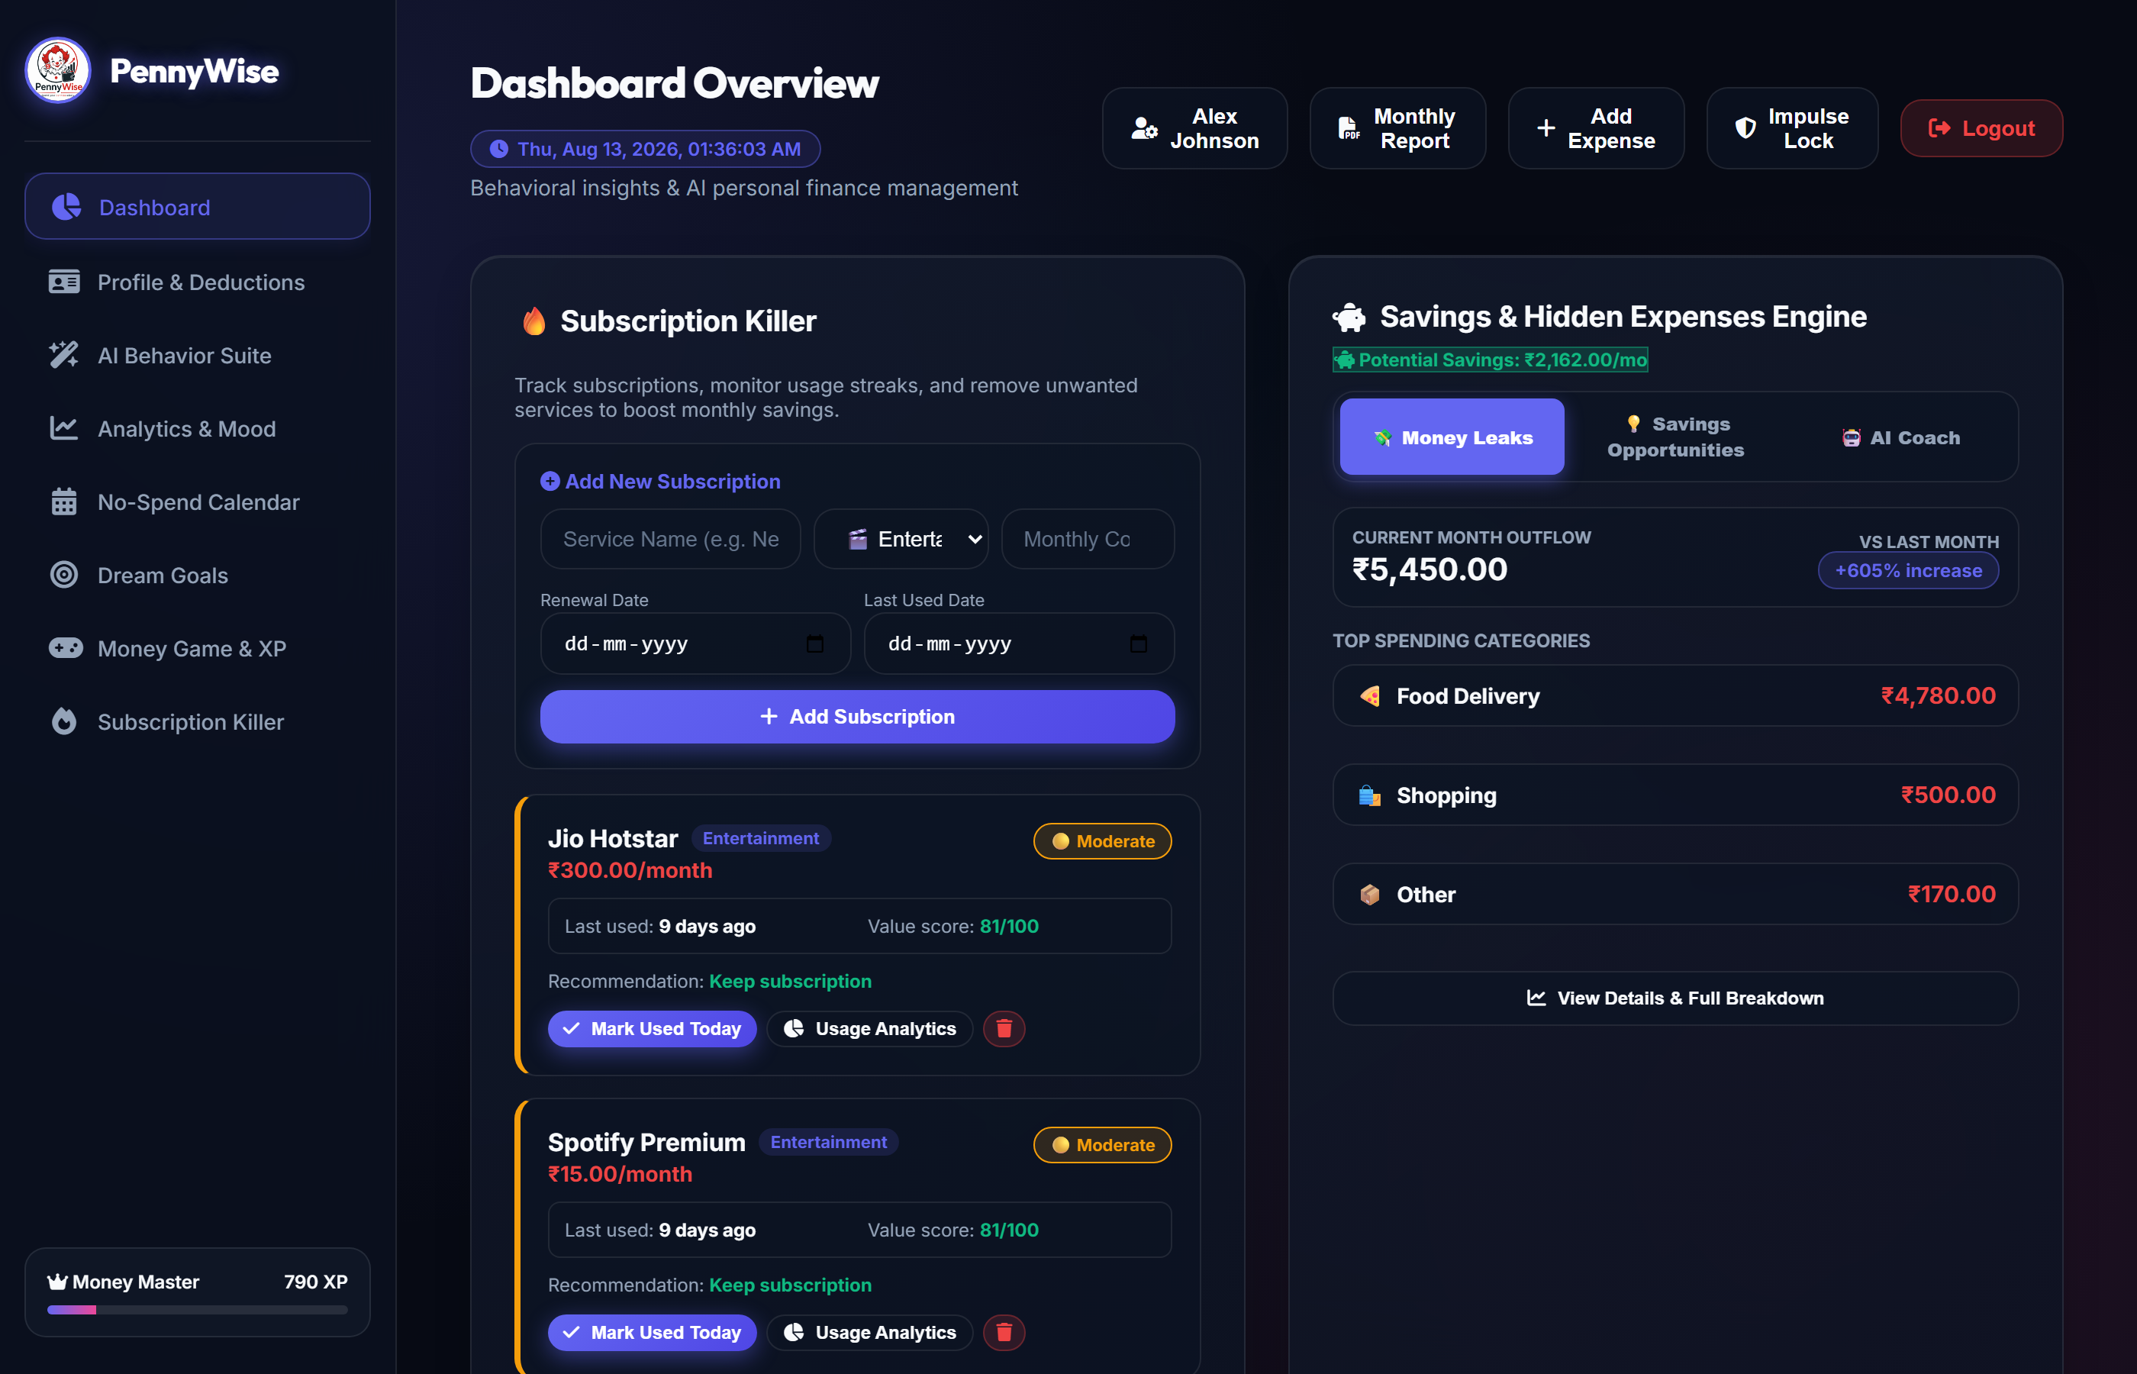
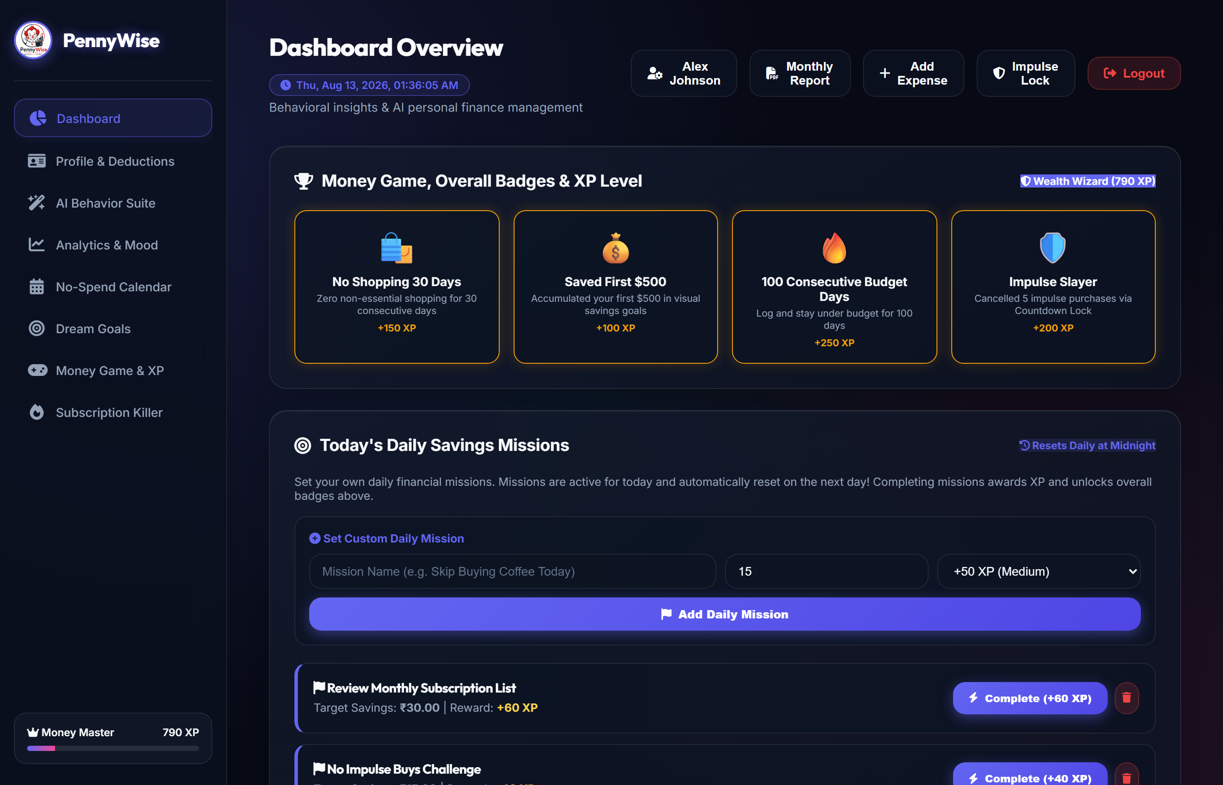
PENNYWISE • AI-POWERED PERSONAL FINANCE & BEHAVIORAL ECONOMICS
09 / 12
Subscription Killer & Gamification Engine

Slide 10
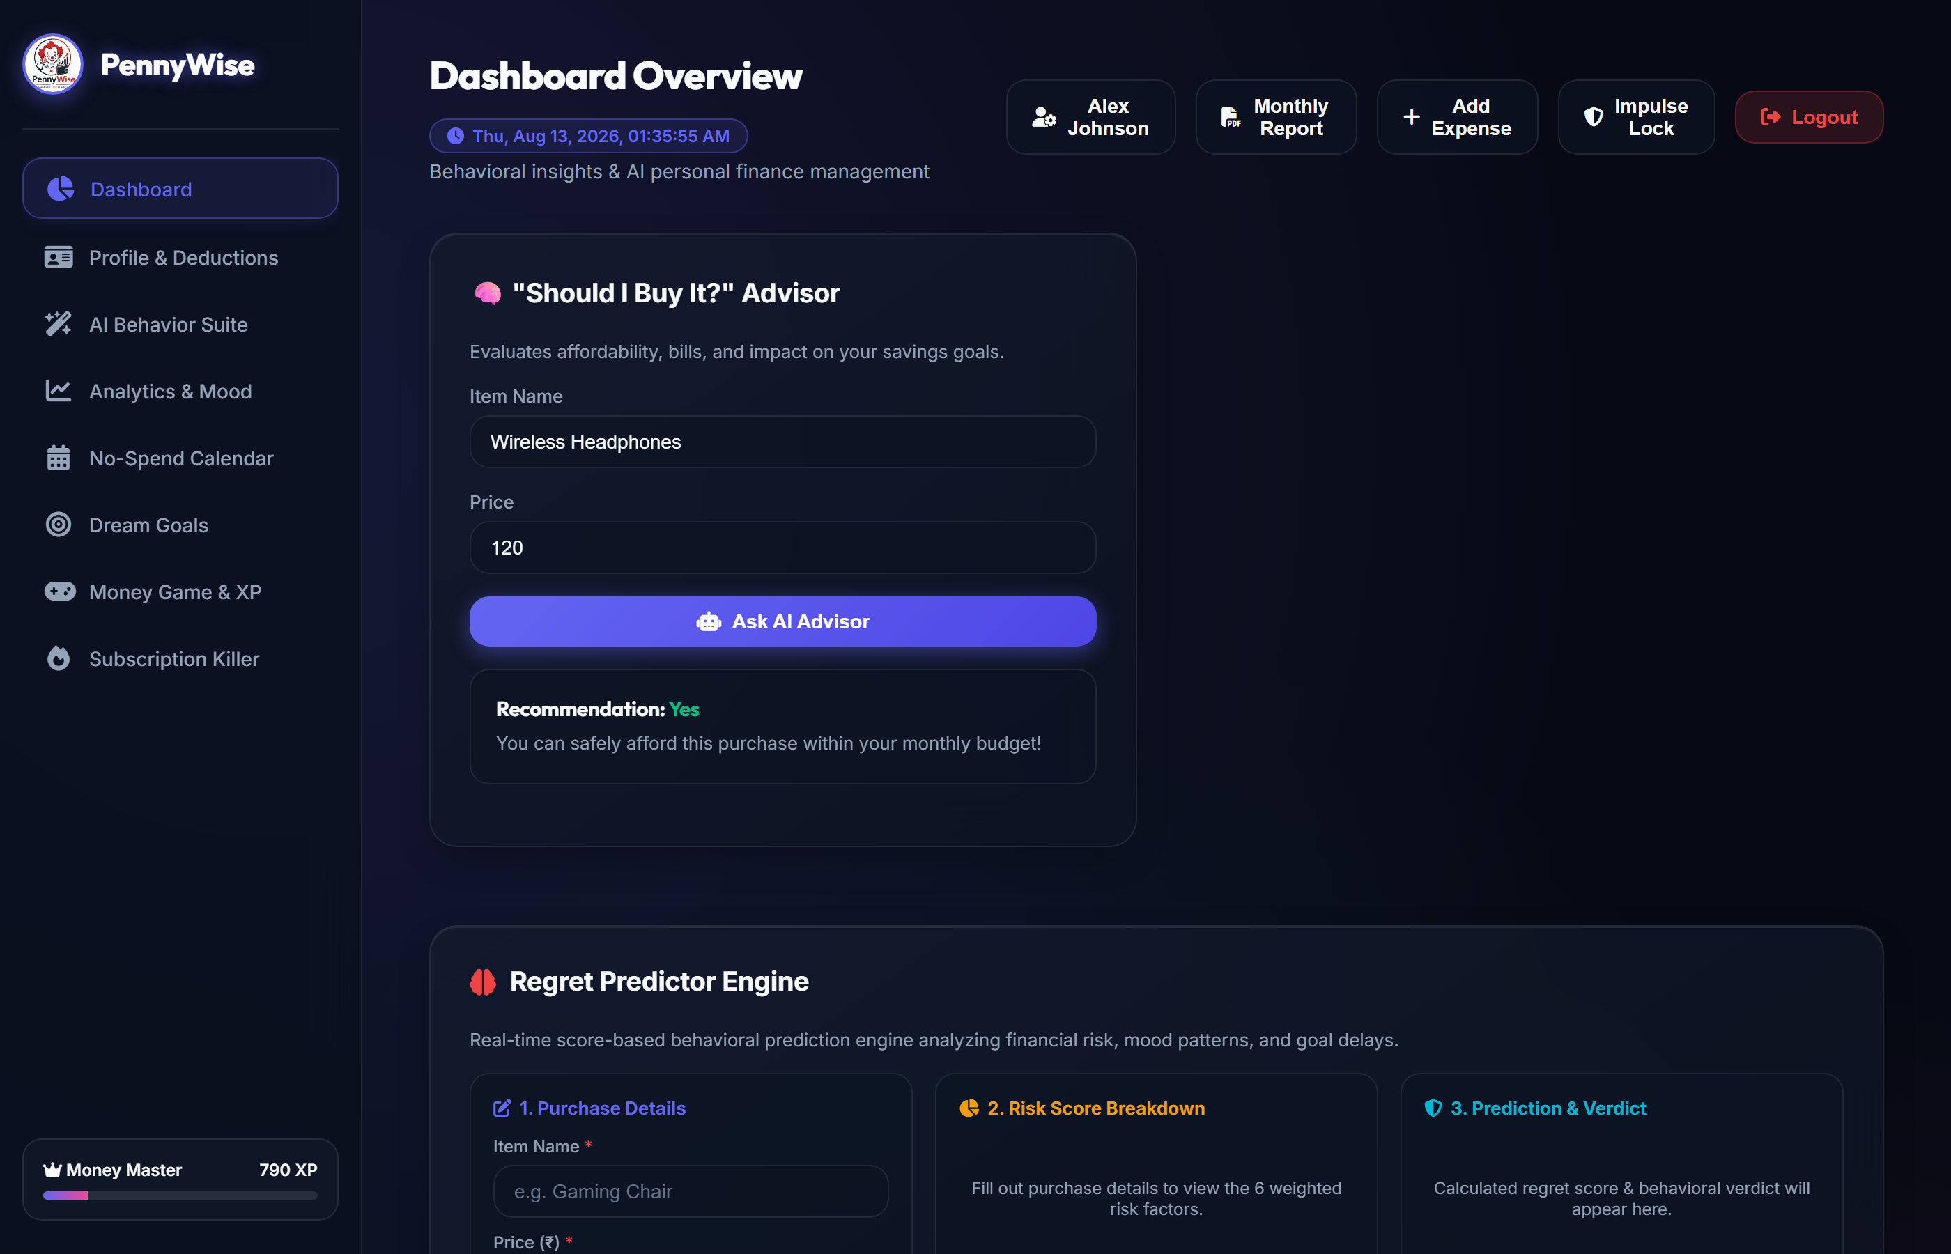
PENNYWISE • AI-POWERED PERSONAL FINANCE & BEHAVIORAL ECONOMICS
10 / 12
PennyWise in Action — End-to-End Decision Flow
1. User Intent
User encounters an unplanned item (e.g. $250 Sneakers).
2. Cooling-Off Lock
Impulse Lock activates a 30-second cooling-off timer.
3. AI Risk Analysis
Regret Predictor evaluates 6 risk weights & affordability.
4. Decision & Savings
User reviews advice, cancels purchase, and earns XP!

Slide 11
PENNYWISE • AI-POWERED PERSONAL FINANCE & BEHAVIORAL ECONOMICS
11 / 12
Quality Assurance and Conclusion
Security & Isolation Standards
• JWT Authentication Guard
Protects all REST API endpoints. Unauthenticated requests are rejected with 401/403.
• Bcrypt Password Encryption
Passwords hashed with multi-round salt. Plaintext passwords never stored.
• Strict User Data Isolation
All SQL queries parameterized with user_id to prevent multi-tenant data leaks.
• Cascading Foreign Keys
Account deletion cascades cleanly across all 21 tables without orphaned records.
• Environment Secret Protection
API secrets and database keys isolated via .env configuration.
Why PennyWise matters?
“PennyWise combines financial management, behavioral intelligence and gamification to help users understand not only where their money goes, but why they spend it — and how today's decisions affect tomorrow's goals."
SPEND → UNDERSTAND → DECIDE → SAVE → ACHIEVE

Slide 12
PennyWise
Spend your Pennies Wisely
Thank You!
Questions & Answers

