Slide 1

GIT AND GITHUB
NAME:-Vikash kumar Sinha
Sneha Sinha

Slide 2
CONTENTS
What is git and GitHub.
Key component’s of git and GitHub.
SSH,Public and Private key.
Basic git commands.
Working with Repository.
Adding , Deleting and updating files.

Slide 3
Introduction to git and GitHub
Git is a distributed version control system (VCS) that tracks changes in source code during software development. It enables multiple developers to collaborate on the same project efficiently.
Track’s code changes
Track’s who made changes
Coding collaboration
What does Git do?
Manage projects with Repositories
Clone a project to work on a local copy
Control and track changes with Staging and Committing
Branch and Merge to allow for work on different parts and versions of a project
Pull the latest version of the project to a local copy
Push local updates to the main project
.

Slide 4
Why Git?
Developers can work together from anywhere in the world.
Developers can see the full history of the project.
Developers can revert to earlier versions of a project.
.

Slide 5
.
GitHub is a platform for hosting and collaborating on software development projects. It uses Git, a version control system, to help developers manage changes to their codebase efficiently.
Key Features of GitHub:
1.⁠ ⁠Code Hosting: Allows developers to store, share, and collaborate on code repositories.
2.⁠ ⁠Version Control: Tracks changes made to files, enabling developers to revert to previous versions if needed.
3.⁠ ⁠Collaboration: Teams can work together on the same project using branches, pull requests, and reviews.
4.⁠ ⁠Issue Tracking: Provides tools to report and manage bugs or feature requests.
5.⁠ ⁠Actions: Automates workflows like building, testing, and deploying applications.
6.⁠ ⁠Open Source Contribution: Enables developers to contribute to open-source projects easily.
7.⁠ ⁠Integration: Supports integration with other tools like CI/CD pipelines, project management software, etc

Slide 6
Common Terms in GitHub:-
Repository (Repo): A storage space for your project files and version history.
Branch: A parallel version of the code where developers can work independently.
Pull Request (PR): A request to merge changes from one branch into another.
Fork: A copy of a repository that you can modify independently.
Commit: A snapshot of changes in your code.
Merge: Combining changes from one branch into another.

Slide 7
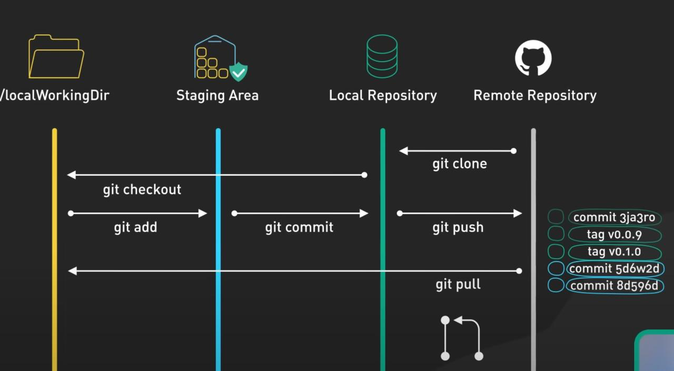
git Workflow

Slide 8
1.Working Directory:
Contains files that you are currently working on.
Changes in this area are untracked until they are staged.
2.⁠ ⁠Staging Area (Index):
A temporary area where you can organize and prepare your changes before committing.
Changes are staged using the git add command.
3.⁠ ⁠Local Repository:
Stores committed changes along with the project’s history.
Committed changes are stored in a local .git directory.
The repository can be either local or remote (e.g., GitHub).
4.⁠ ⁠Remote Repository:
A version of your repository hosted on a remote server (e.g., GitHub, GitLab).
Used to share code with others.
A remote repository is a version of your Git repository that is hosted on a remote server, typically on a platform like GitHub, GitLab, Bitbucket, or a private server. It serves as a central location where developers can collaborate by sharing and syncing their work.

Slide 9
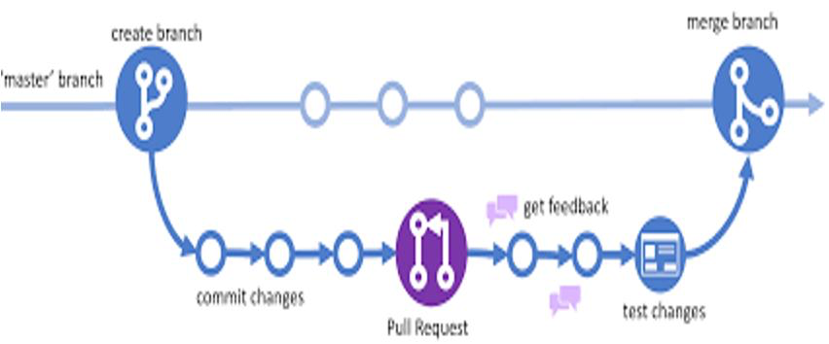
Key Features of a Remote Repository:
1.⁠ ⁠Shared Access: Multiple developers can access and contribute to the project.
2.⁠ ⁠Synchronization: Ensures that all collaborators have up-to-date code by using push and pull operations.
3.⁠ ⁠Backup: Acts as a secure backup of the codebase.
4.⁠ ⁠Centralized Collaboration: Facilitates teamwork by providing a single source of truth for the project.
Git Branching

Slide 10
SSH,Public and Private key.
1.⁠ ⁠SSH (Secure Shell):
SSH is a network protocol used for secure communication over a computer network. It provides a secure channel over an unsecured network by encrypting the communication between your local machine and GitHub.
How it works with GitHub:
SSH is commonly used for authentication when accessing GitHub repositories. Instead of typing your username and password every time you push or pull changes, you use an SSH key to authenticate automatically.
SSH keys consist of a public key (that you upload to GitHub) and a private key (that you keep on your local machine).

Slide 11
SSH Workflow:
1.⁠ Generate an SSH key pair (public and private keys).
2.⁠ ⁠The public key is added to your GitHub account settings.
3.⁠ ⁠The private key remains on your local machine and is used to sign requests.
4.⁠ ⁠When you attempt to interact with GitHub (e.g., push, pull), GitHub checks your public key and allows access if it matches the private key on your machine.
Advantages:
No need to type a password every time.
More secure than HTTPS (because it uses key pairs for authentication).
Allows automatic authentication without exposing your password.

Slide 12
2.⁠ ⁠HTTPS (Hypertext Transfer Protocol Secure):
What it is: HTTPS is a protocol used to secure communications over a computer network. It's the secure version of HTTP, and it encrypts the data transferred between your machine and a web server (like GitHub) using SSL/TLS encryption.
How it works with GitHub:
When using HTTPS, GitHub verifies your identity with a username and password or, for more secure authentication, a Personal Access Token (PAT) (since GitHub no longer accepts password authentication).
It is generally simpler to set up than SSH because it does not require key pair management. However, you need to input your GitHub credentials each time unless you cache the credentials.

Slide 13
3.⁠ ⁠Public and Private Keys:
Public Key:
The public key is part of an SSH key pair and is shared with others, such as GitHub.
It's stored in your GitHub account to allow GitHub to verify that requests made from your local machine are legitimate.
The public key is not confidential and can be shared freely.
Private Key:
The private key is kept on your local machine and is used to authenticate you when you try to interact with a GitHub repository.
It should never be shared or exposed, as it's the key that provides access to your repositories.
The private key is used to sign the connection to GitHub, proving that the request comes from the rightful user.

Slide 14
Summary:
SSH: Uses key-based authentication to securely connect with GitHub.
HTTPS: Uses username and password (or Personal Access Token) for authentication.
Public Key: Shared with GitHub for verification; it’s safe to expose.
Private Key: Stays on your local machine and is used to authenticate you; it must remain secure and private.

Slide 15
Git commands
1.git init
Initializes a new Git repository in the current directory. It creates a .git subdirectory to track version history.
⁠2.git clone <repository-url>
Clones an existing repository from a URL (e.g., GitHub) to your local machine, creating a local copy of the repository.
3.⁠ ⁠git add <file>
Stages a specific file (or files) for commit, meaning it tells Git to track changes to this file.
4.⁠ ⁠git commit -m "<message>"
Records the changes staged by git add into the repository with a commit message describing the changes.
5.⁠ ⁠git status
Displays the current state of the working directory and staging area, showing changes to files, untracked files, and more.
6.⁠ ⁠git push
Pushes local commits to a remote repository, updating the remote branch with your changes.

Slide 16
7.⁠ ⁠git pull
Fetches changes from the remote repository and merges them into your current local branch.
8.⁠ ⁠git branch
Lists all the branches in your repository, and marks the current branch with an asterisk. You can also use it to create or delete branches.
9.⁠ ⁠git checkout <branch>
Switches to the specified branch. If the branch doesn't exist, it can be created using git checkout -b <branch>.
10.⁠ ⁠git merge <branch>
Merges the changes from another branch into the current branch.
11.⁠ ⁠git log
Shows the commit history for the repository, including commit IDs, messages, and authors.
12.⁠ ⁠git remote add <name> <url>
Adds a remote repository URL with a name, typically "origin", for easy reference when pushing or pulling changes.

