Slide 1

Fine Food Reviews - Sentiment Analysis
Krishna Prakash Sankaramanchi
Sreelakshmi Sneha Mulukutla
Ying Deng (Stephanie)
ALY6040 - Data Mining Applications
Final Project
Instructor: Yevgeniy Frenkel

Slide 2

Contents
Problem Statement
Data Source, Prep & Cleaning
Word Embeddings
ML Models
Deployment
Demo

Slide 3


Problem Statement
Identify if a fine-food review is a Positive Review or a Negative review

Slide 4
Data Set
This dataset consists of reviews of fine foods from Amazon taken from Kaggle.
The data span a period of more than 10 years, including all ~500,000 reviews from October 1999 up to October 2012.
Reviews include product and user information, ratings, and a plain text review.
568,454 reviews | 256,059 users | 74,258 products
260 users with > 50 reviews

Slide 5
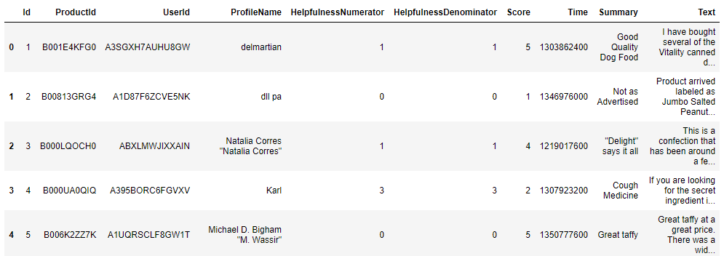
Data Set
Data set snippet

Slide 6
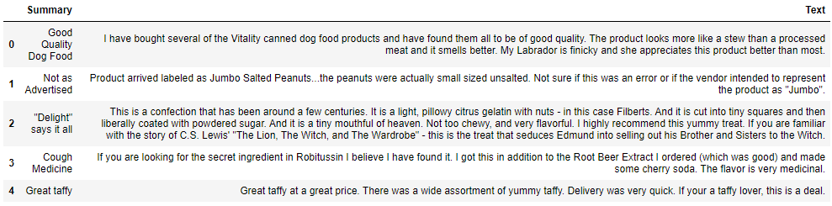
Data Set
A snippet of Summary and Text

Slide 7
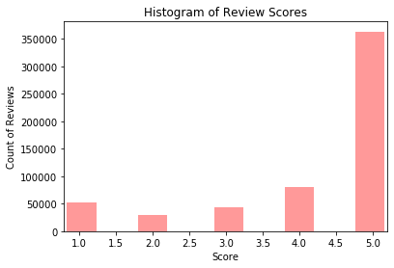
1 | 9.2%
2 | 5.2%
3 | 7.5%
4 | 14.2%
5 | 63.9%
A snippet of how reviews are distributed

Slide 8
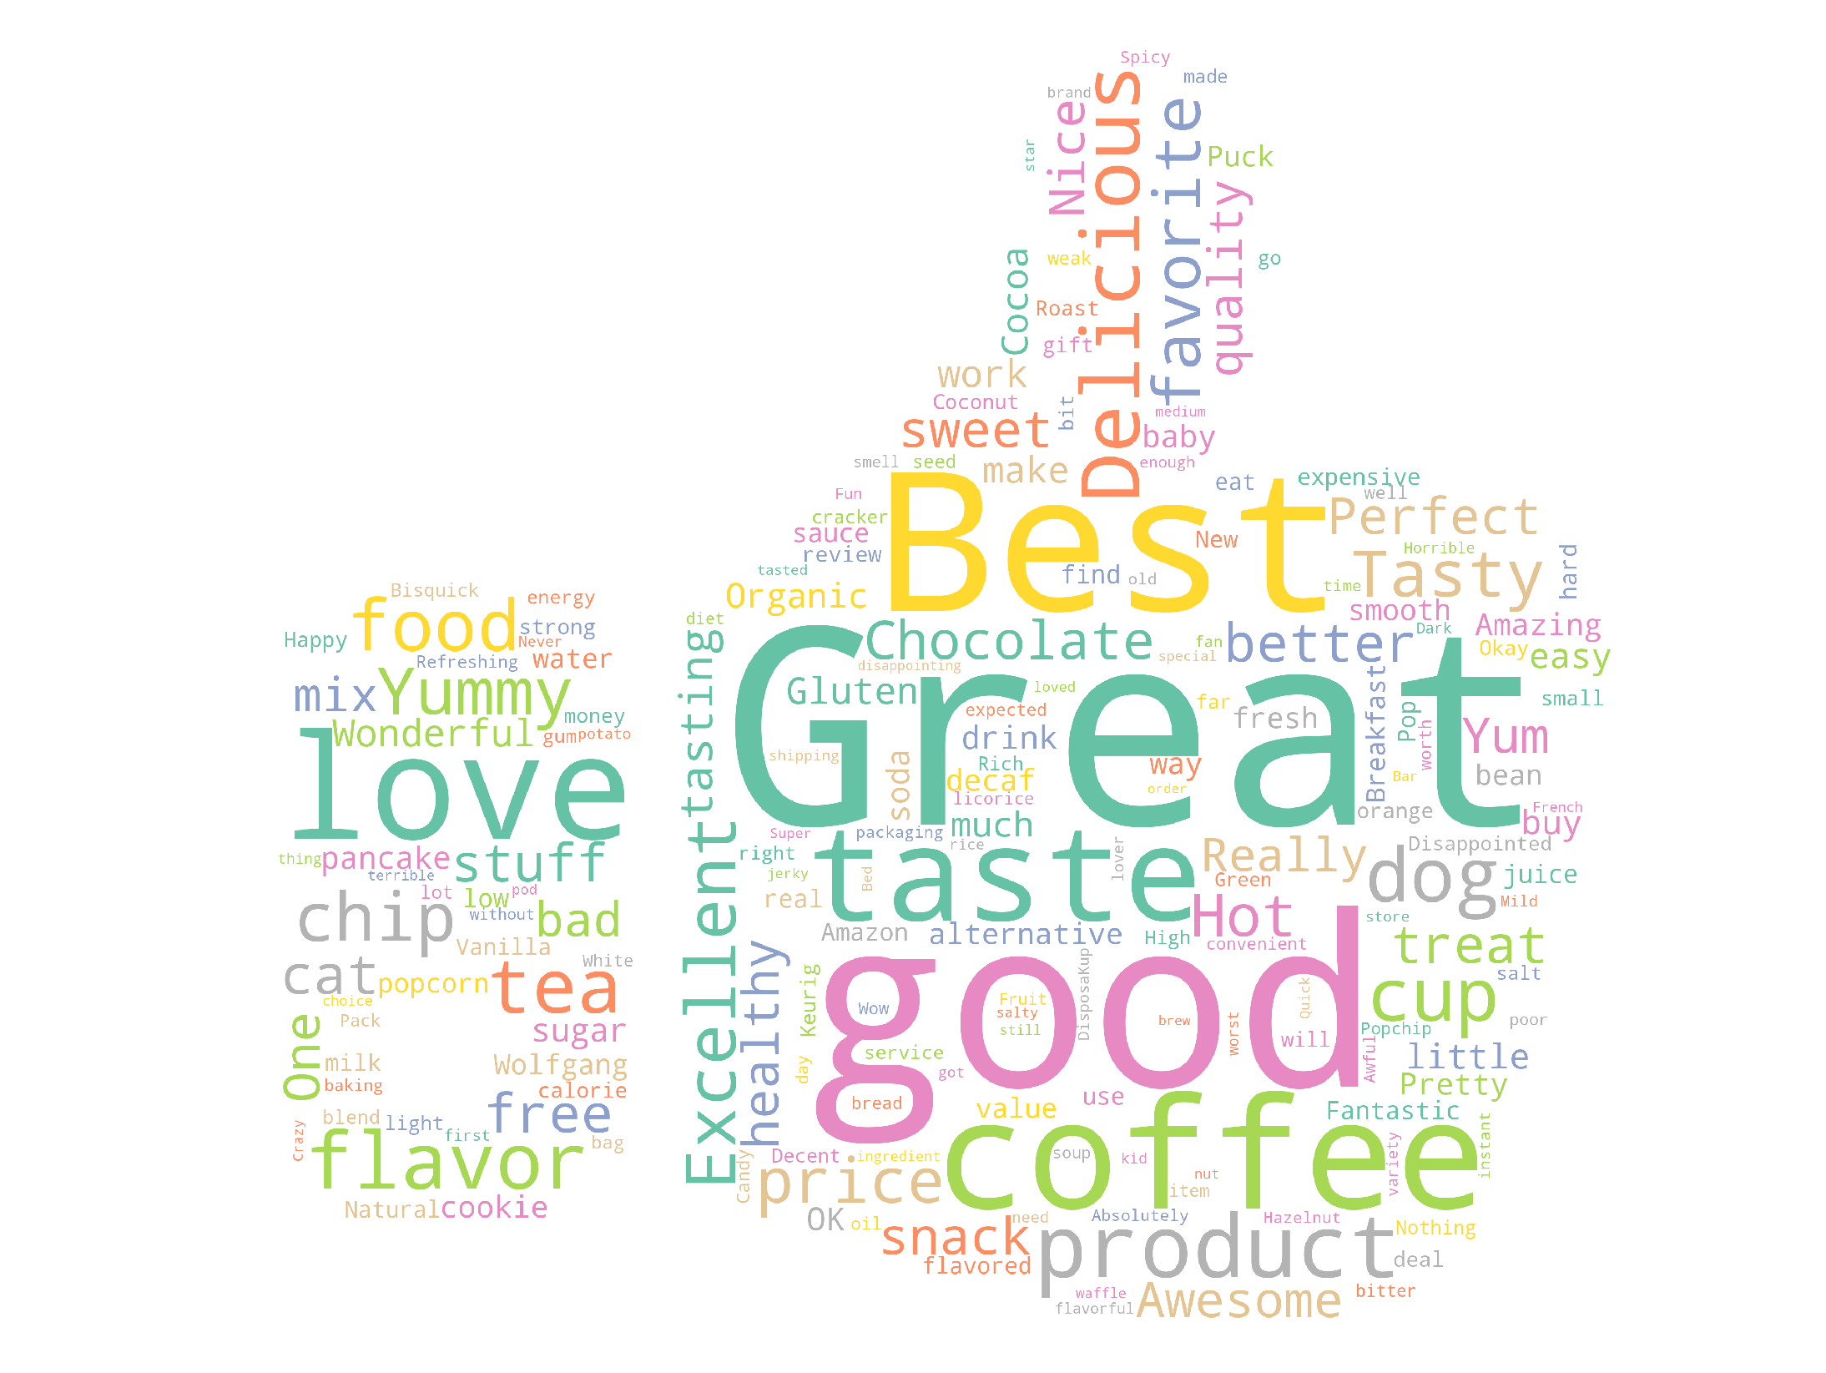
Wordcloud for “Summary” field

Slide 9
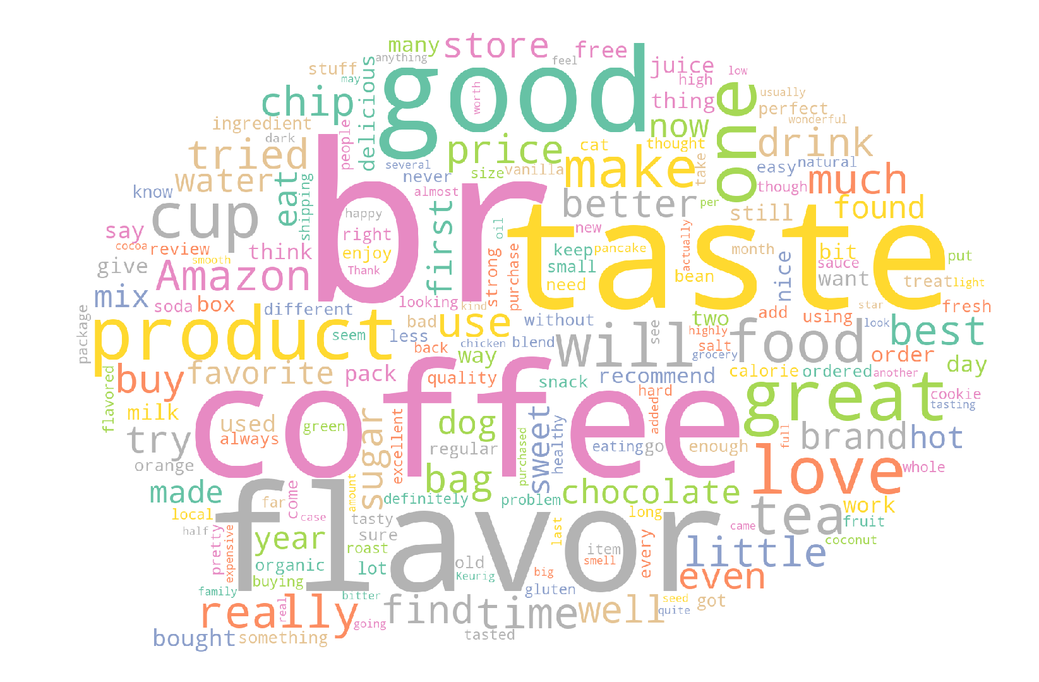
Wordcloud for “Text” field

Slide 10
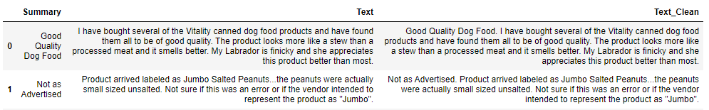
Data Cleaning - 1
Positive | 84.39%
Negative | 15.6%
Combined “Summary” + “Text”
Removed missing values
‘1’, ‘2’ as Negative review and ‘4’, ‘5’ as Positive review. ‘3’ as Neutral. Removed Neutral - 7.5% of the data
Removed duplicate values | Considered only those reviews where they are helpful
Final number of observations are 364,171

Slide 11
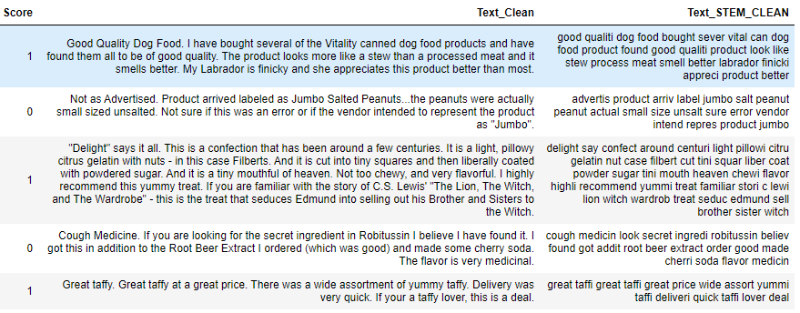
Data Cleaning - 2
Removing Stop Words + Stemming the data to feed it to the ML models

Slide 12
Machine Learning Models

Slide 13
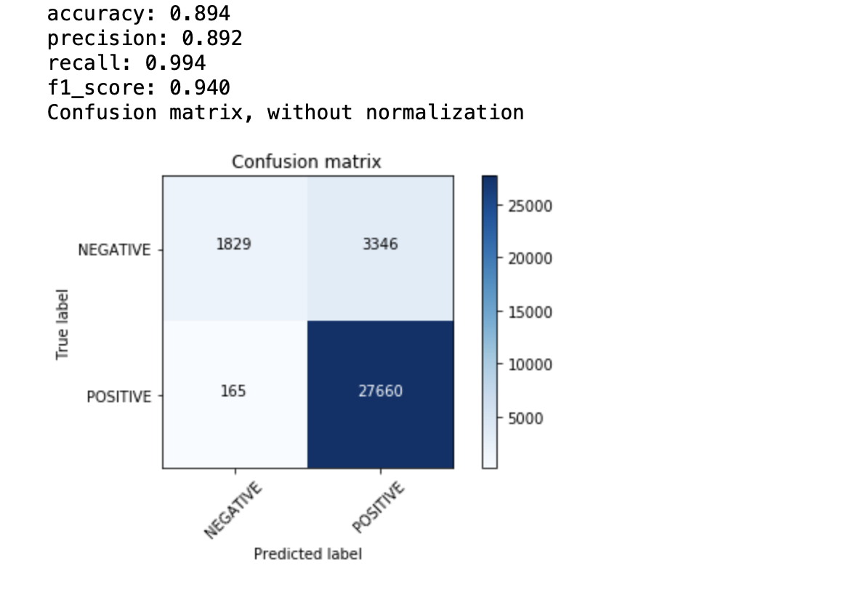
Bag of Words + Multinomial Naive Bayes
To make it Computational Friendly, randomly sampled 30,000 from the dataset and implemented BOW
Bag of Words Shape --
(30000, 5000)
Max Features - 5000
Ngrams - (1,3)

Slide 14
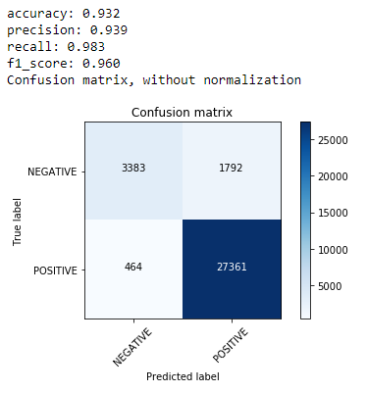
TF-IDF + Weighted Logistic Regression
To make it Computational Friendly, randomly sampled 100,000 from the dataset and implemented TF-IDF
TF-IDF Shape --
(100000, 5000)
Max Features - 5000
Ngrams - (1,3)
Weighted LR
class_weight = balanced
Max Iterations = 200

Slide 15
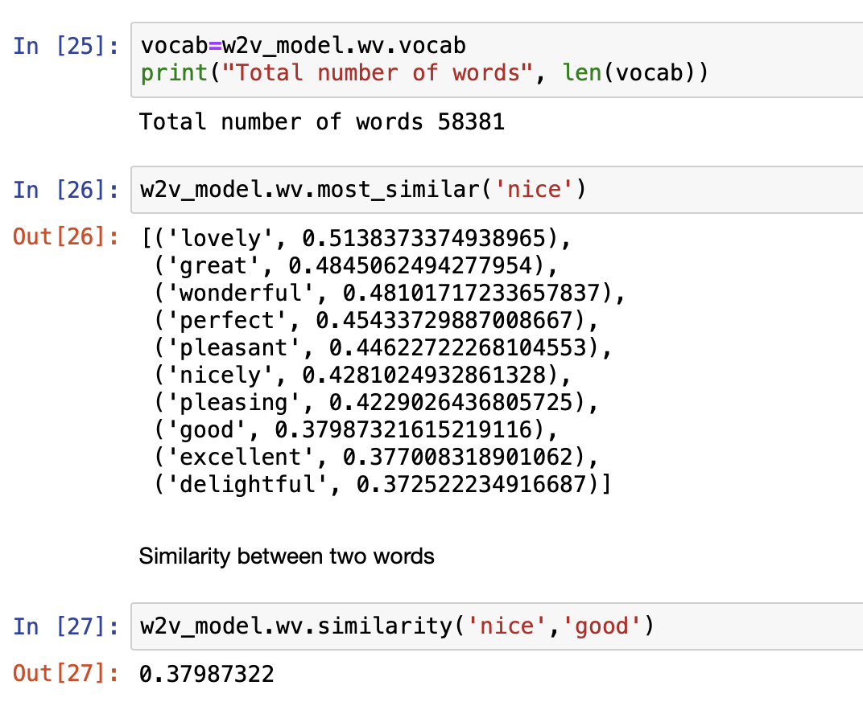
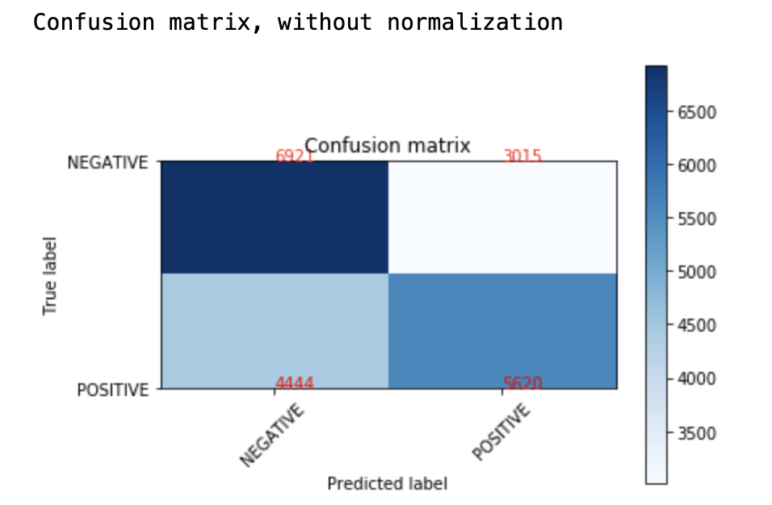
Word2Vec Model + Random Forest

Slide 16
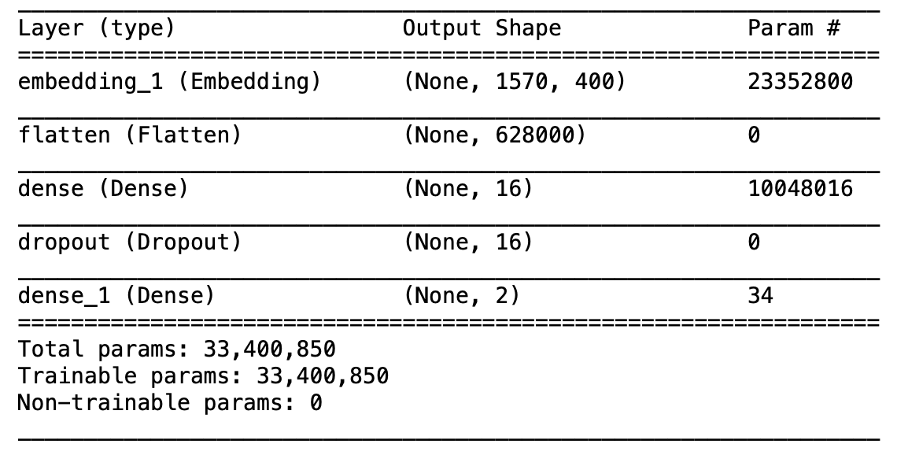
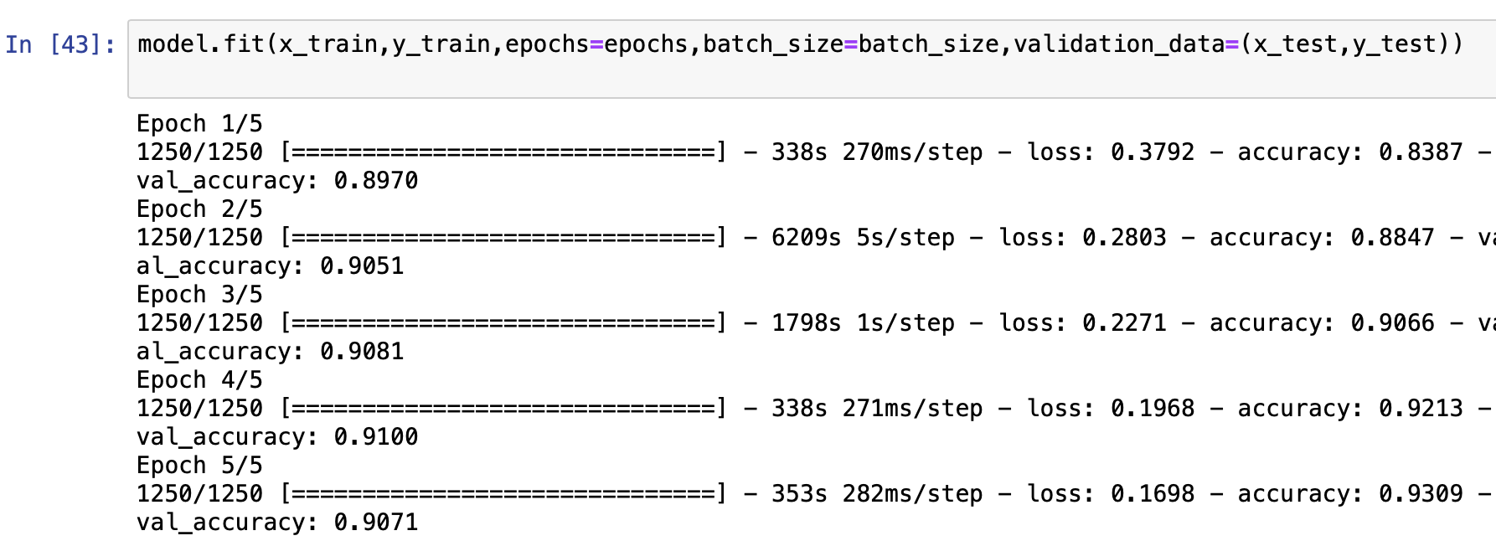
Word2Vec + LSTM classification

Slide 17
Comparison of Models
Model | Parameters | Accuracy | F1-Score
TF-IDF + LR | Class_weight = Balanced, max_iter = 200, C = 1 | 93.2% | 96%
TF-IDF + LR | Class_weight = Balanced, max_iter = 200, C = 0.5 | 92.7% | 95.8%
Word2Vec+ Random Forest | n_estimators = 100 | 60.5% | 63%
Word2Vec + LSTM (Including Embedding layer) | epochs=5 batch_size=64 | 91% | 91.5%

Slide 18
Demo

Slide 19
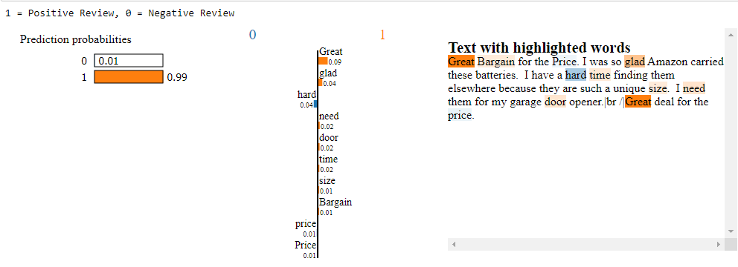
Model Explanation - Positive Review

Slide 20
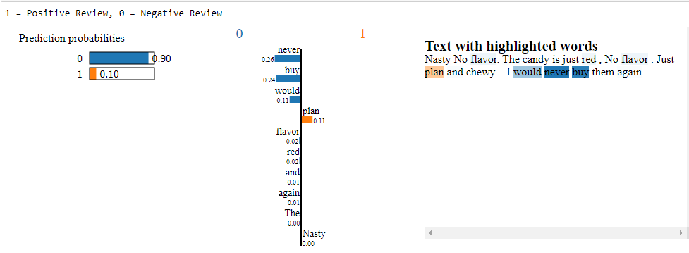
Model Explanation - Negative Review

Slide 21
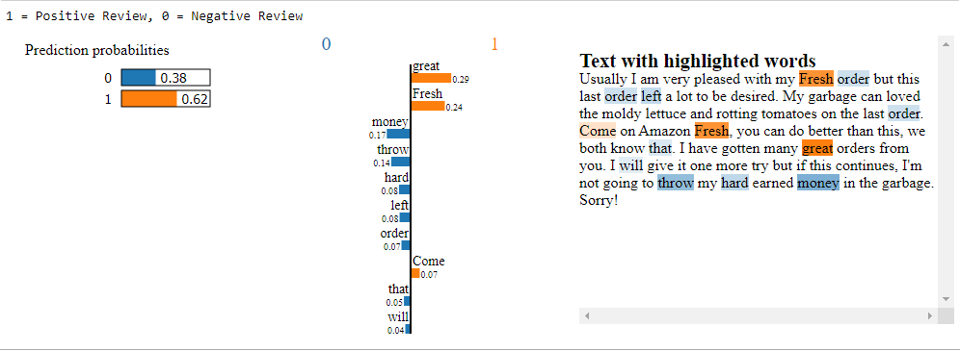
Model Explanation - False Positive

Slide 22
Conclusion, Challenges and Future work
We have seen through our Analysis that TF-IDF + Logistic Regression had better accuracy and the best F-1 Score for classifying reviews into positive and negative.
We have also worked on Hyperparameter tuning techniques for Word2Vec + Random Forest Classification but accuracy remained the same.
Our future work is to work on catching the sarcasm of the reviews and deploying our model into any cloud platform.
We would also work on hyperparameter tunings to improve our accuracy.
The main challenge we have faced was massive dataset took lot of time for modelling, limited computational abilities over our laptops, Bias in our dataset.

