Slide 1
BRAINBYTE🧠
Personal AI Tutor
An AI-powered learning assistant for students
🤖
Learn Smarter • Practice Better • Improve
AI Tutor
Quiz
Progress
Presented by: Sneha
Team Leader
Roll No. 25267531
AI Recommendation
1

Slide 2
02
The Problem
Students often face three problems while learning:
Choosing what to study
Tracking progress
Personal guidance
After a quiz, students may not know which topic should come next.
Weak and strong areas are not always easy to identify.
A general study path may not match a student's current performance.
Problem statement:
Students need a simple tool that connects quiz performance with their next learning step.
PERSONAL AI TUTOR
2

Slide 3
03
The Solution
Personal AI Tutor brings the learning process into one place.
Learn
Practice
Track
Improve
Select a subject, topic and difficulty level.
Take quizzes and check performance.
View quiz scores and topic progress.
Get an AI recommendation for the next topic.
Learning loop
Learn → Practice → Track → Improve
PERSONAL AI TUTOR
3

Slide 4
04
Technology Stack
Python
Streamlit
Main programming language
Web application and interface
Pandas
CSV
Progress data handling
Stores quiz progress
OpenAI Python Client
Groq API
Connects the application to the AI endpoint
LLM inference service
PERSONAL AI TUTOR
4

Slide 5
05
System Architecture
A simple flow connects the student, application, data and AI.
Student
Streamlit App
Progress Data
AI Service
→
→
→
Chooses topic
and takes quiz
Quiz + Dashboard
+ user inputs
Pandas +
progress.csv
Prompt + LLM
recommendation
AI recommendation uses:
Subject + Current Topic + Difficulty + Latest Quiz Score
↓
The AI returns one logical next topic and a short reason.
PERSONAL AI TUTOR
5

Slide 6
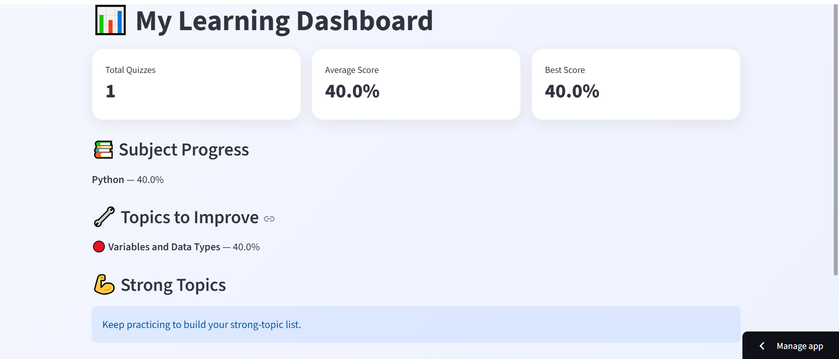
06
Live Demo
The actual application running dashboard
1.
Open the Personal AI Tutor
2.
Select subject / topic / difficulty
INSERT YOUR
3.
Complete a quiz
ACTUAL APP SCREENSHOT
Dashboard / Quiz page
4.
Open the dashboard
5.
Click AI Next Topic
PERSONAL AI TUTOR
6

Slide 7
AI Component
07
AI • Tutor
The AI feature recommends the next topic from recent performance.
Inputs
AI Prompt
Output
• Subject
• Current topic
• Difficulty
• Latest quiz score
These values are placed into a concise tutor prompt.
Next Topic: [topic]
Why: [one short sentence]
Example: the recommendation keeps the student's next practice focused instead of choosing randomly.
PERSONAL AI TUTOR
7

Slide 8
08
Challenges
API integration
Data & session state
Keeping AI output useful
Connecting the AI feature and handling slow responses required careful error handling.
The selected topic and quiz results had to be available when the dashboard requested a recommendation.
The recommendation needed to be short and actionable instead of a long response.
What helped:
Clear prompts + simple data flow + timeout/error handling
PERSONAL AI TUTOR
8

Slide 9
09
My Role
As a Team Leader
Personal contribution to the project
Dashboard
Data handling
Worked on the Streamlit dashboard, metrics and progress sections.
Worked with Pandas and progress.csv for quiz statistics.
AI integration
Testing & debugging
Implemented the next-topic recommendation flow and connected it to the dashboard.
Fixed integration, indentation and API/error-handling issues.
PERSONAL AI TUTOR
9

Slide 10
10
Future Improvements
Adaptive difficulty
Better learning paths
Richer analytics
Automatically change quiz difficulty using performance trends.
Use more history to recommend a sequence of topics, not just one topic.
Add streaks, mastery charts and more detailed learner insights.
Future goal:
Move from a single recommendation to a more complete personalized learning journey.
PERSONAL AI TUTOR
10

Slide 11
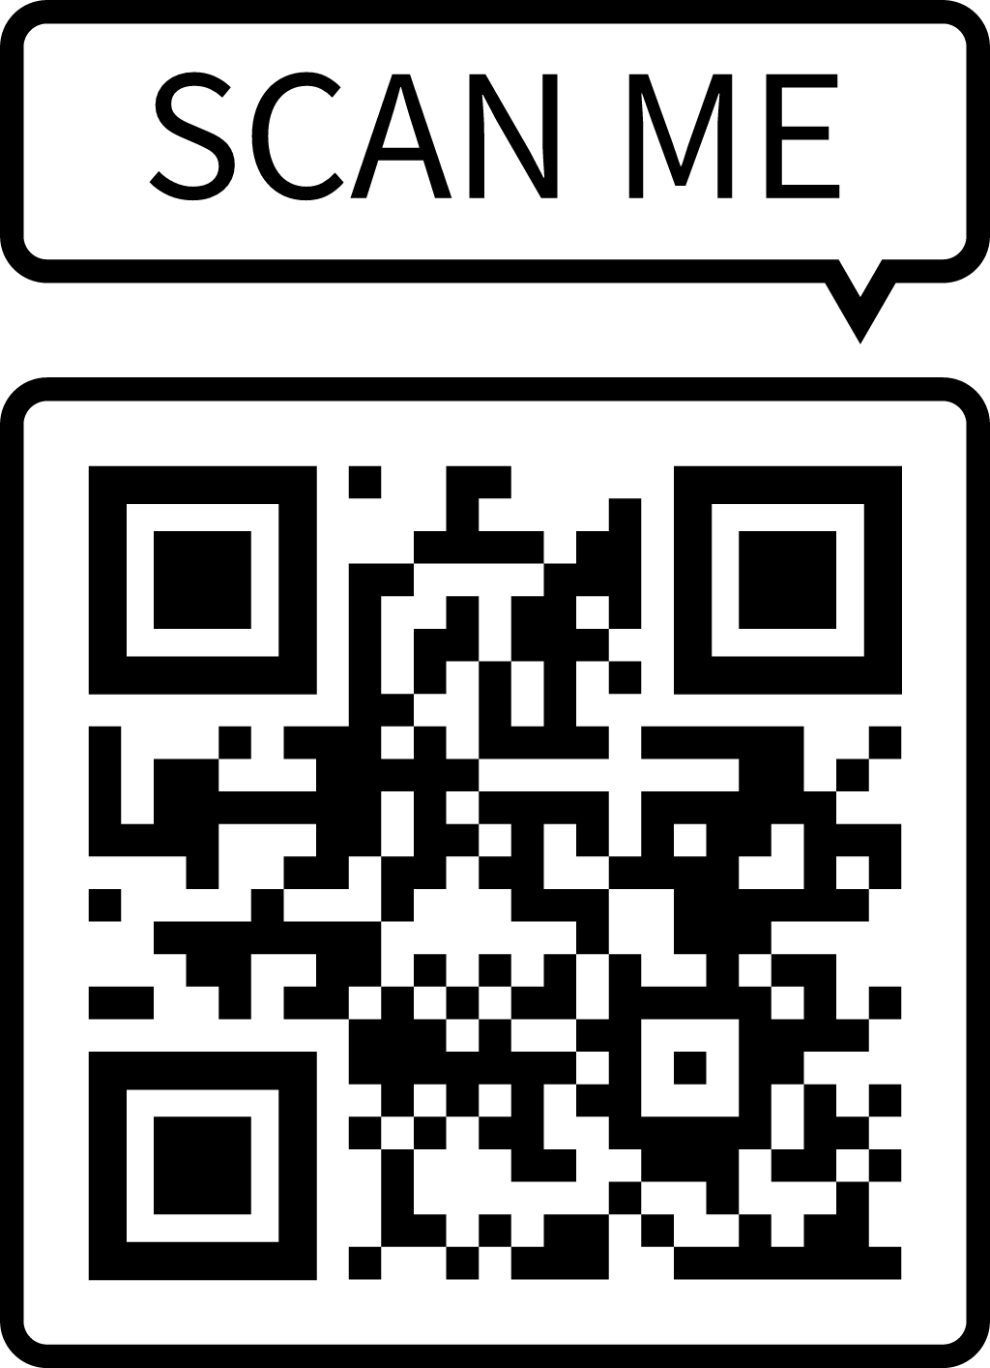
11
GitHub / Project Link
PROJECT LINK
https://ai-tutor-ei2dq9mh7glq4eekux2ngf.streamlit.app/
Scan this QR code to view my Github repository →
PERSONAL AI TUTOR
11

Slide 12
Thank You
Personal AI Tutor
Questions?
Sneha • Team Leader
Roll No.: 25267531
12

