Slide 1
TravelMate
A Web-Based Travel Assistance Platform
Explore India, Experience Wonder
Project Report Submitted in Partial Fulfillment of MCA Degree
Submitted By:
Subhajit Halder | Subhendu Dutta Banik | Sanam Pandit | Sneha Dey | Tanusree Jana
Under the Guidance of: Mr. Anindya Mukherjee
Techno Main Salt Lake | Maulana Abul Kalam Azad University of Technology
2025 – 2027

Slide 2
Introduction
Overview of the TravelMate Platform
• TravelMate is a web-based travel assistance platform designed to help users discover destinations and attractions across India.
• It provides a structured, user-friendly interface for accessing travel-related information, managing profiles, and interacting through reviews.
• The application follows a client-server architecture with React frontend, Spring Boot backend, and MySQL database.
• Includes an administrative area for authorized administrators to manage destinations, attractions, reviews, and users.
• Role-based access control ensures secure administrative operations with password hashing for user safety.

Slide 3
Objectives & Scope
What TravelMate Aims to Achieve
• Provide a centralized platform for discovering destinations and attractions across India.
• Offer a simple, responsive interface for travel-related information and profile management.
• Enable registered users to create profiles, save favorites, and submit reviews.
• Provide administrators with tools to manage destinations, attractions, reviews, and users.
• Implement role-based access control and secure password storage using Password Encoder.
• Demonstrate practical use of REST APIs and modern full-stack development concepts.

Slide 4
Technology Stack
Tools & Technologies Used
Frontend
Backend
Database
• React.js
• Responsive UI Design
• Axios / API Client
• Component-Based Architecture
• Spring Boot
• RESTful APIs
• Spring Data / Repository Layer
• Password Encoder (BCrypt)
• MySQL (MariaDB 10.4.32)
• Relational Data Storage
• Foreign Key Constraints
• InnoDB Engine

Slide 5
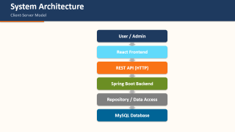
System Architecture
Client-Server Model
User / Admin
React Frontend
REST API (HTTP)
Spring Boot Backend
Repository / Data Access
MySQL Database

Slide 6
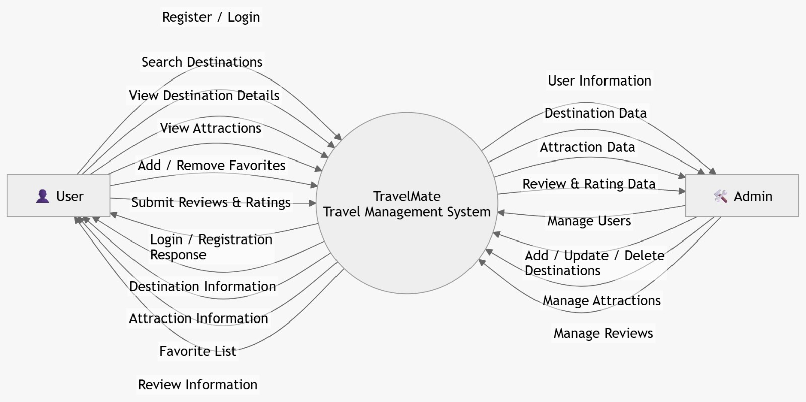
Data Flow Diagram – Level 0
Context Diagram – User & Admin Interaction

Slide 7
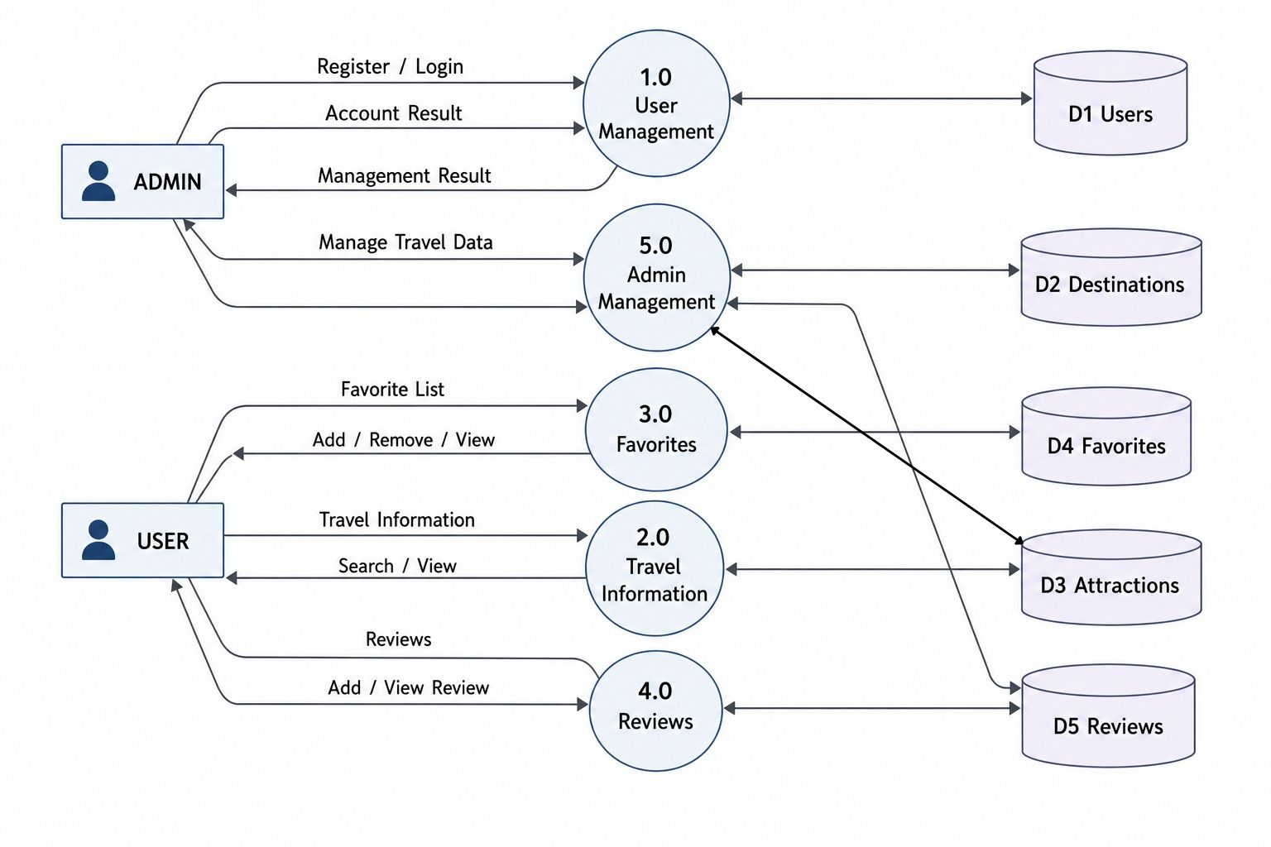
Data Flow Diagram – Level 1
Top-Level Decomposition of Processes

Slide 8
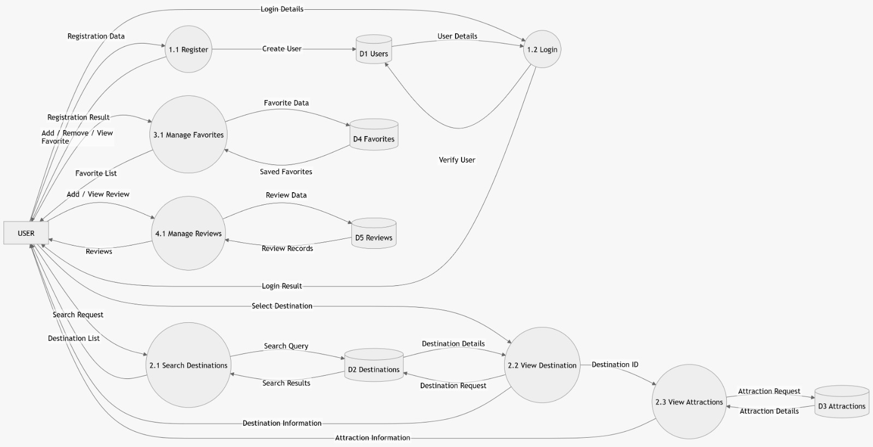
DFD Level 2 – User Processes
Detailed User-Side Data Flow

Slide 9
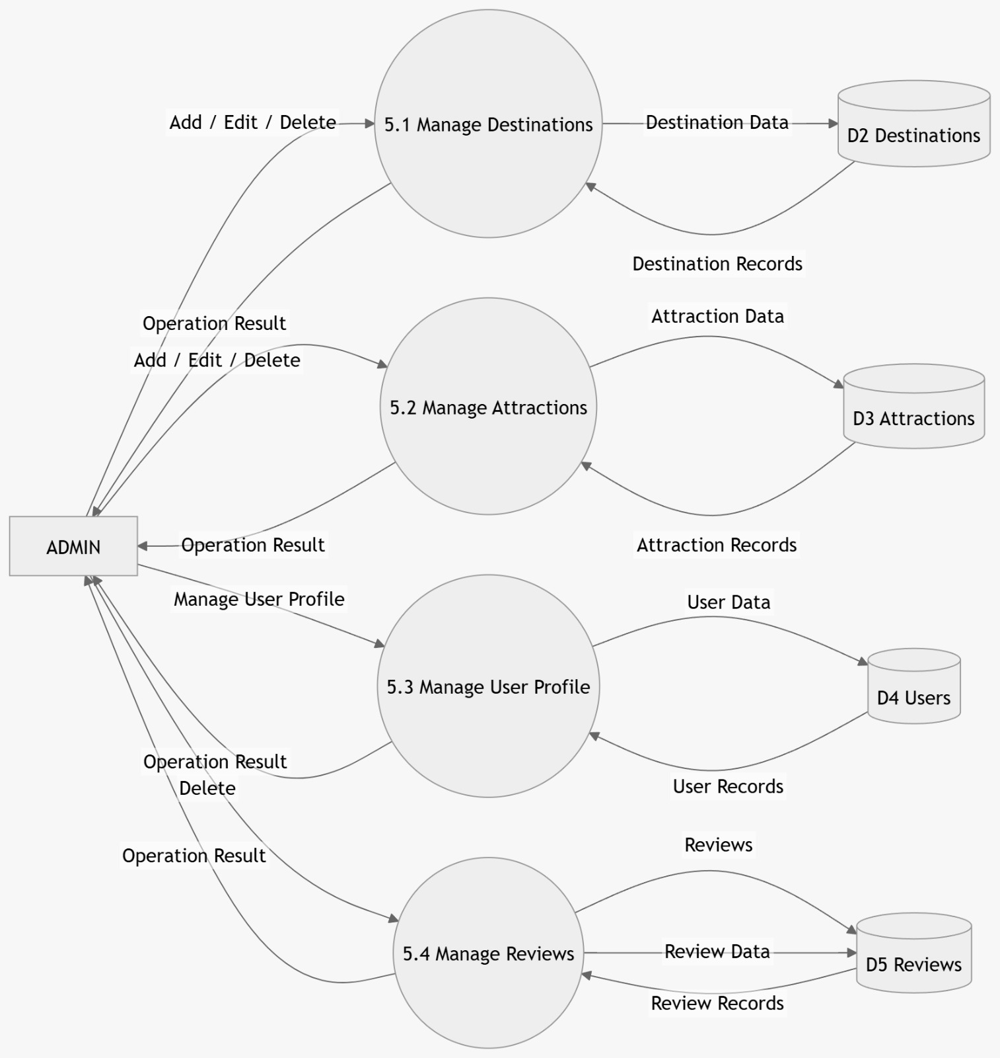
DFD Level 2 – Admin Processes
Detailed Admin-Side Data Flow

Slide 10
Database Schema
MySQL Relational Tables
users
id, email, name, password, role
destinations
id, name, state, description, best_time, budget, image_url
attractions
id, name, location, entry_fee, image_url, lat, lng, destination_id
reviews
id, comment, rating, user_id, destination_id
favorites
id, user_id, destination_id
• destinations 1:M attractions (One destination has many attractions)
• users 1:M reviews (One user can write many reviews)
• destinations 1:M reviews (One destination can receive many reviews)
• users 1:M favorites (One user can save many favorite destinations)
• Passwords stored with BCrypt hashing ($2a$10$...)

Slide 11
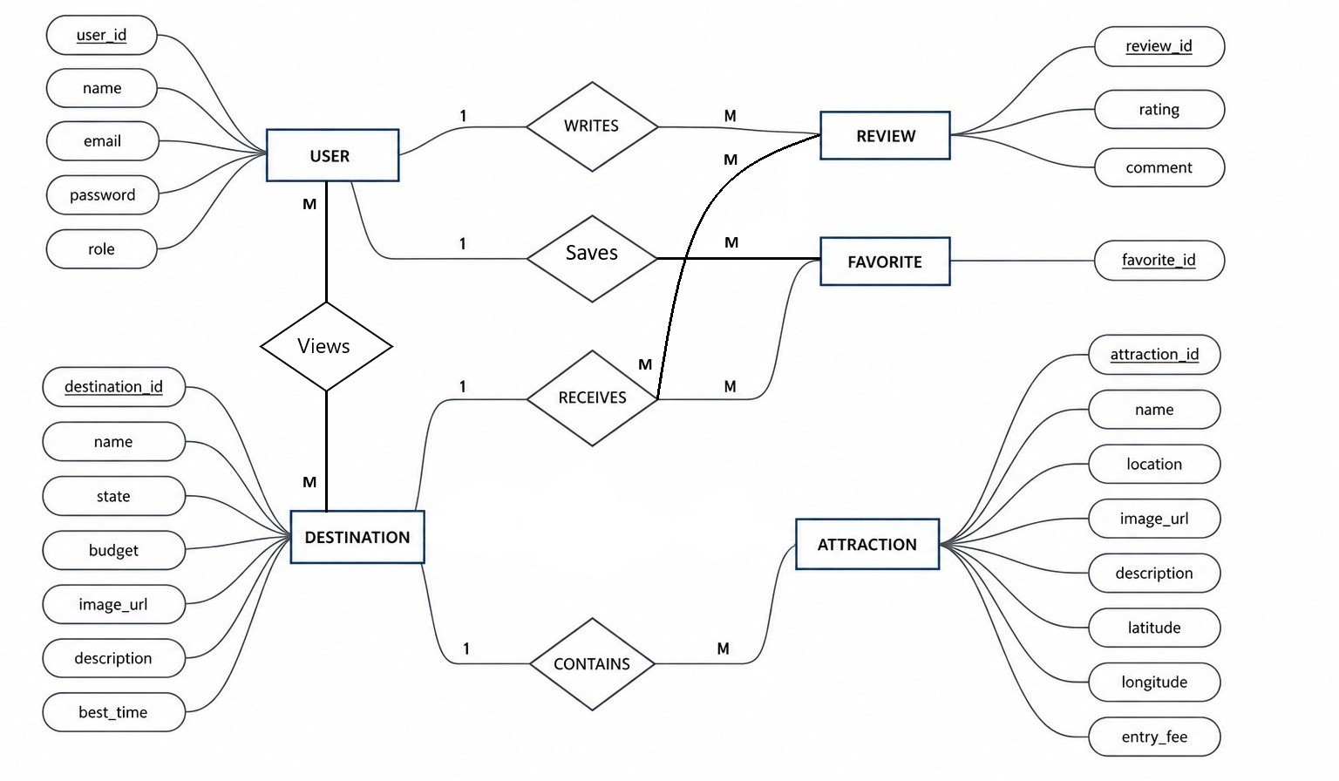
Database Design – ER Diagram
Entity Relationship Diagram

Slide 12
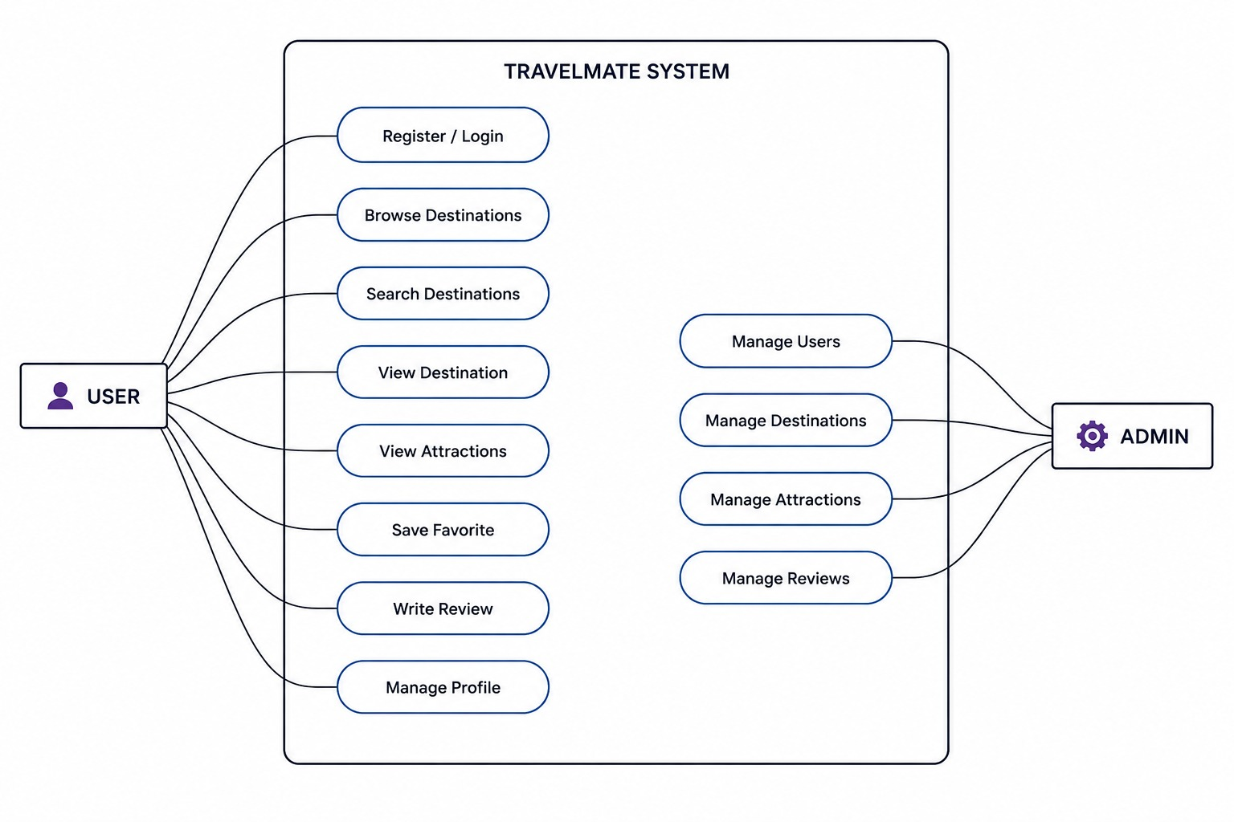
Use Case Diagram
User & Admin Use Cases in TravelMate System

Slide 13
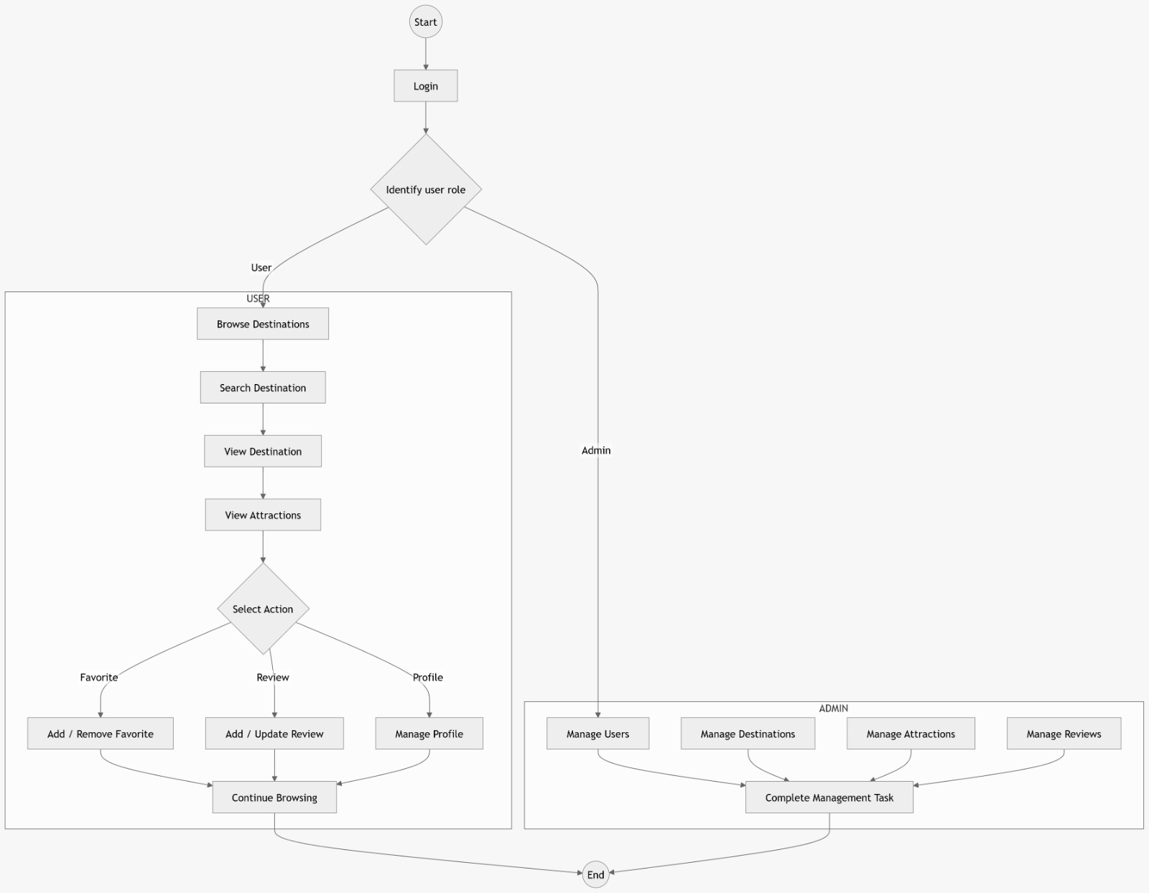
Functional Flowchart
System Flow – From Login to Logout

Slide 14
User Module Features
End-User Functionalities
Authentication
Discovery
• User Registration with email validation
• Secure Login with BCrypt password verification
• Email availability checking before registration
• Forgot Password with OTP verification
• Browse & search destinations by name or state
• View detailed destination information (budget, best time, state)
• Explore associated attractions with images & descriptions
• Interactive route map with distance & driving time
Interaction
Profile
• Add / Remove favorite destinations
• Submit reviews & star ratings (one per destination)
• View traveler reviews from other users
• Open attractions directly in Google Maps
• View personal profile with name & email
• Update profile information
• Manage saved favorites in one place
• Personalized tour plan generation

Slide 15
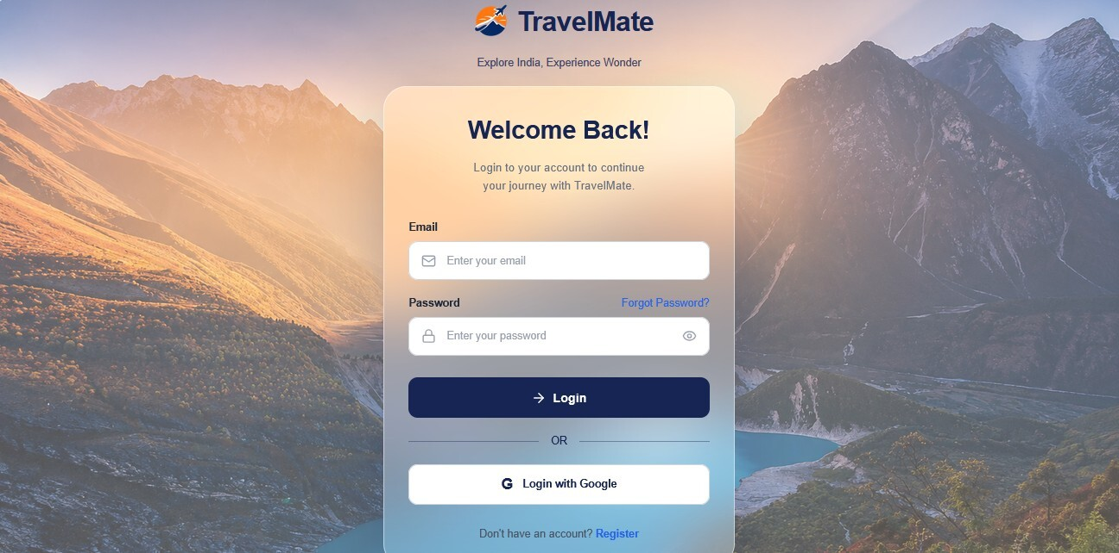
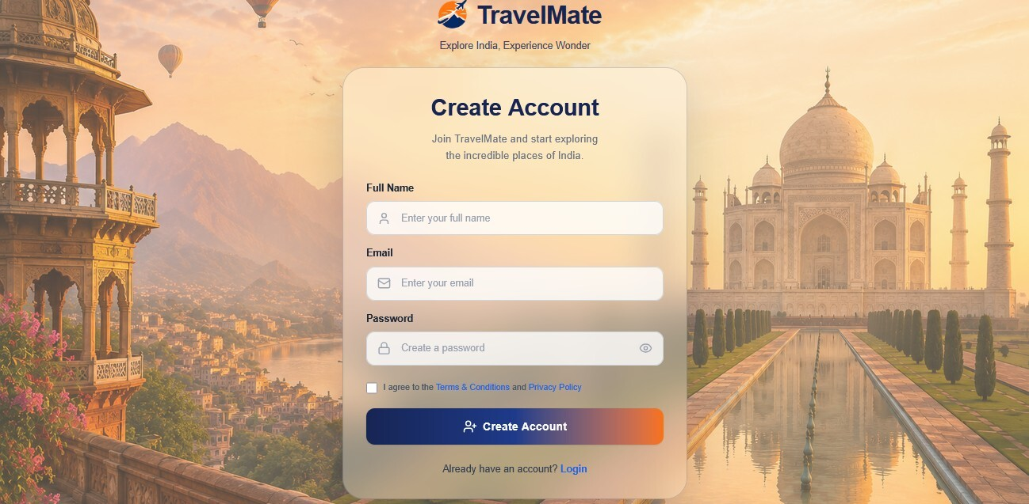
Authentication Screens
Login Page | Registration Page

Slide 16
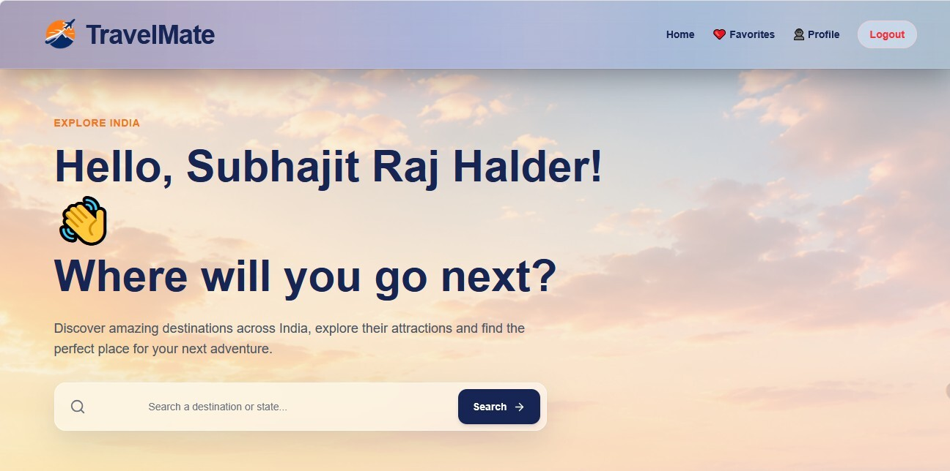
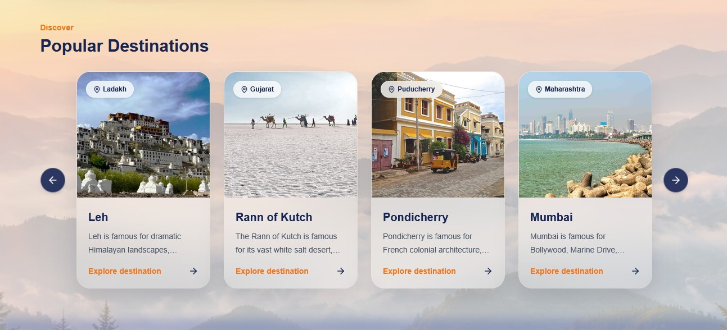
Home & Discover
Welcome Dashboard | Popular Destinations Carousel

Slide 17
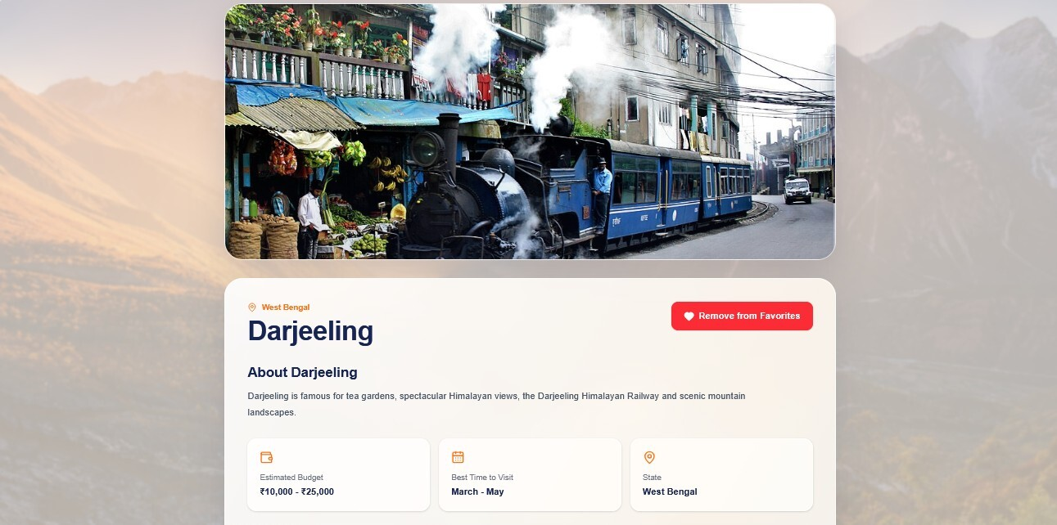
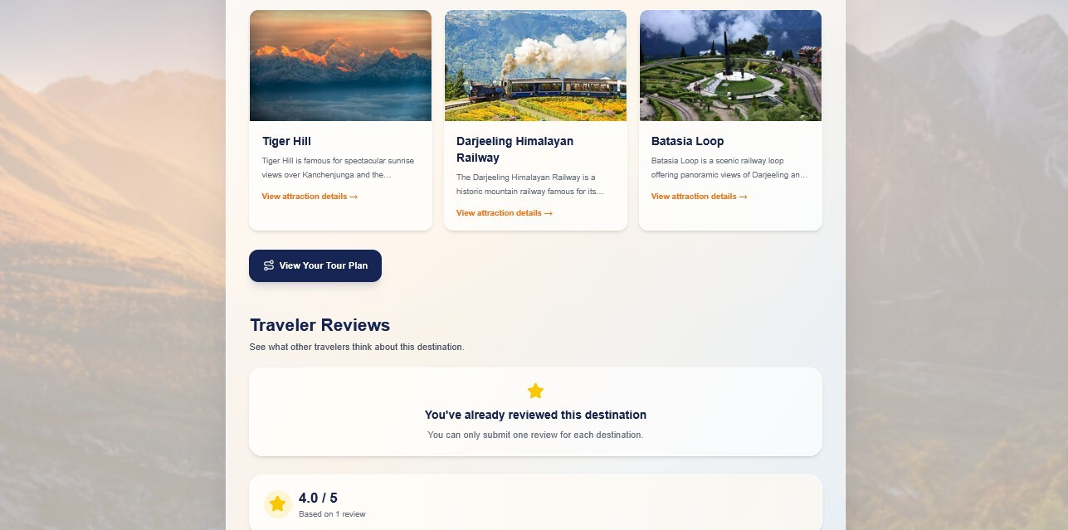
Destination & Attractions
Destination Detail (Darjeeling) | Attractions & Reviews

Slide 18
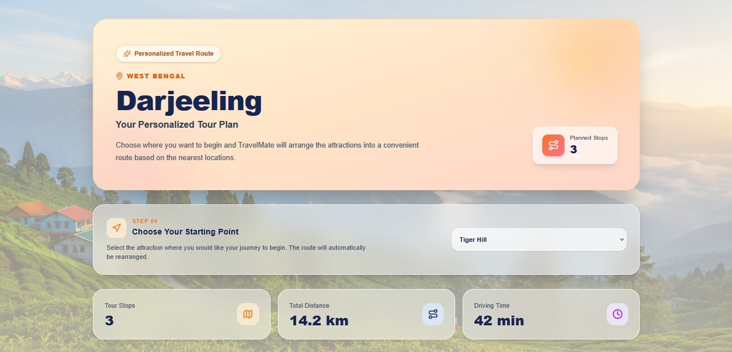
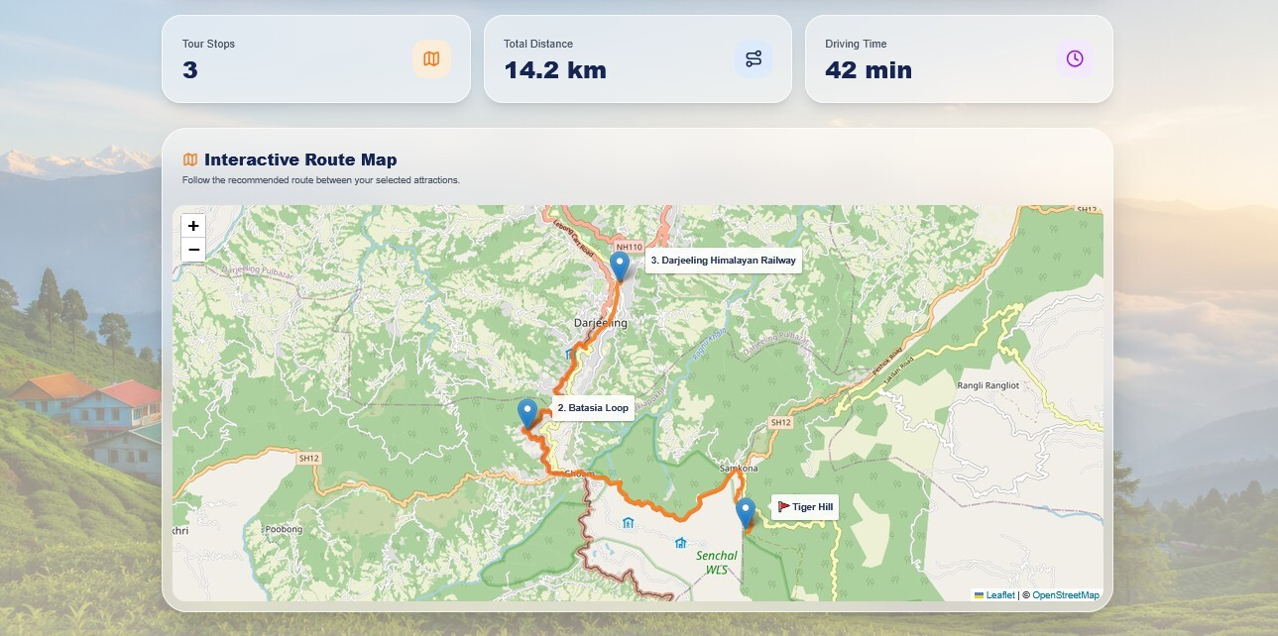
Tour Plan & Interactive Map
Personalised Tour Plan | Interactive Route Map (Leaflet)

Slide 19
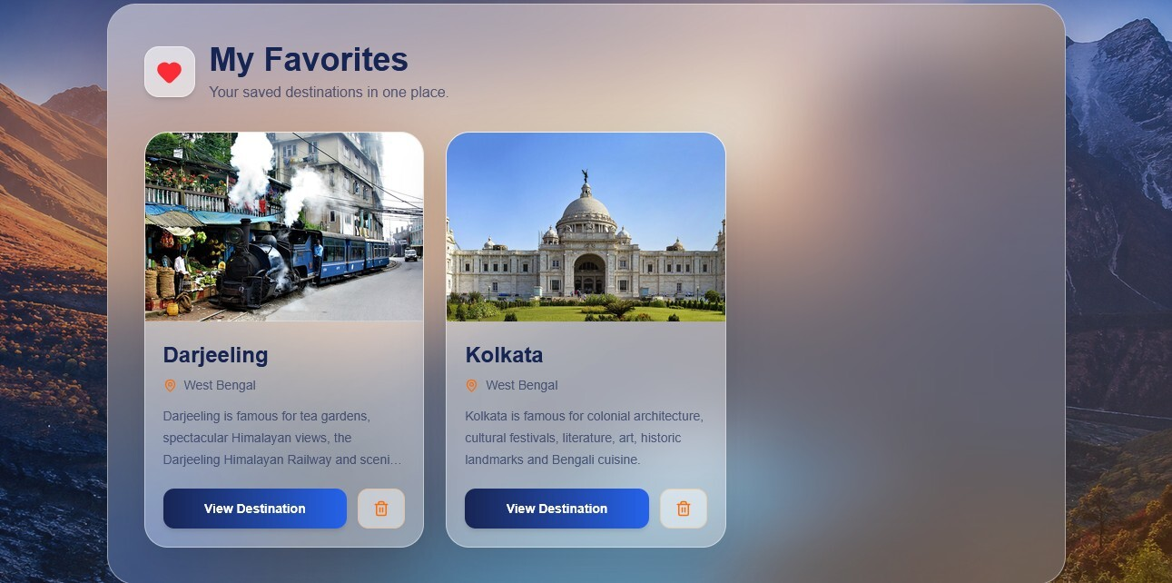
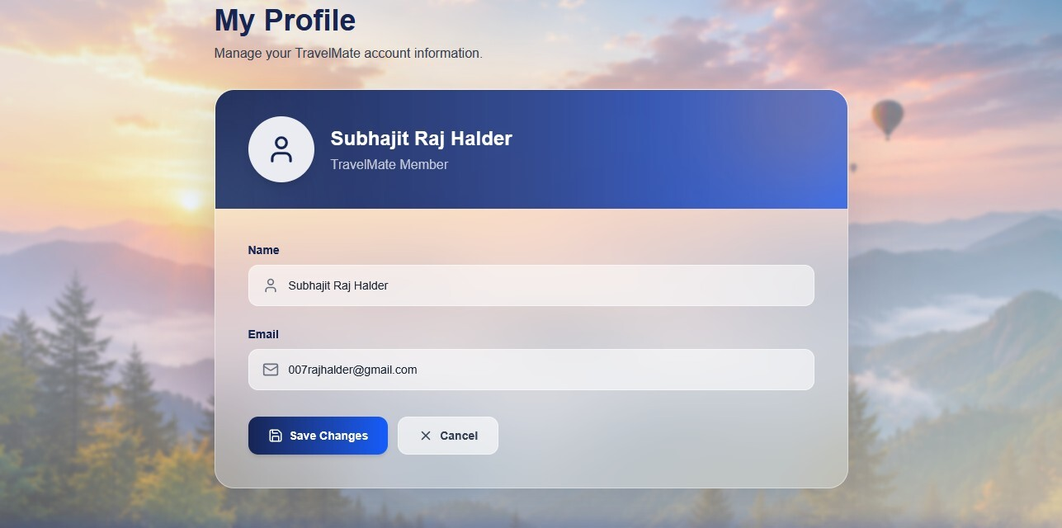
Favorites & Profile
My Favorites | My Profile

Slide 20
Admin Module Features
Administrative Control Panel
Dashboard
• Overview statistics: Registered Users, Total Destinations, Total Attractions, Total Reviews
• Quick access cards to all management sections
• Dark-themed admin interface for better visibility
User Management
• View all registered users with details
• Delete user accounts with safety checks
• Prevent admin self-deletion
• Role-based access enforcement
Content Management
• Add, Edit & Delete Destinations (name, state, description, budget, best time, image)
• Add, Edit & Delete Attractions (name, location, entry fee, coordinates, image)
• Manage Reviews – view and delete inappropriate reviews
• All changes persisted in MySQL database

Slide 21
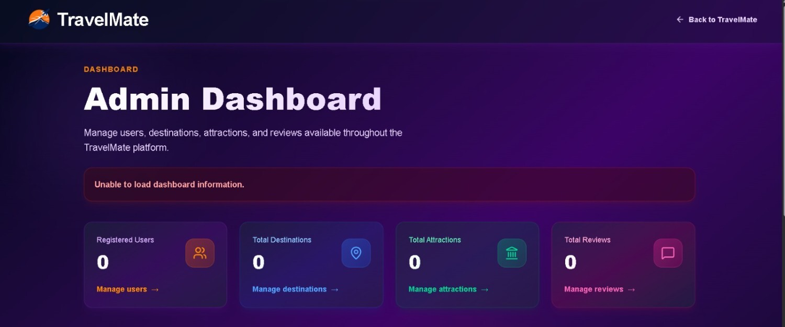
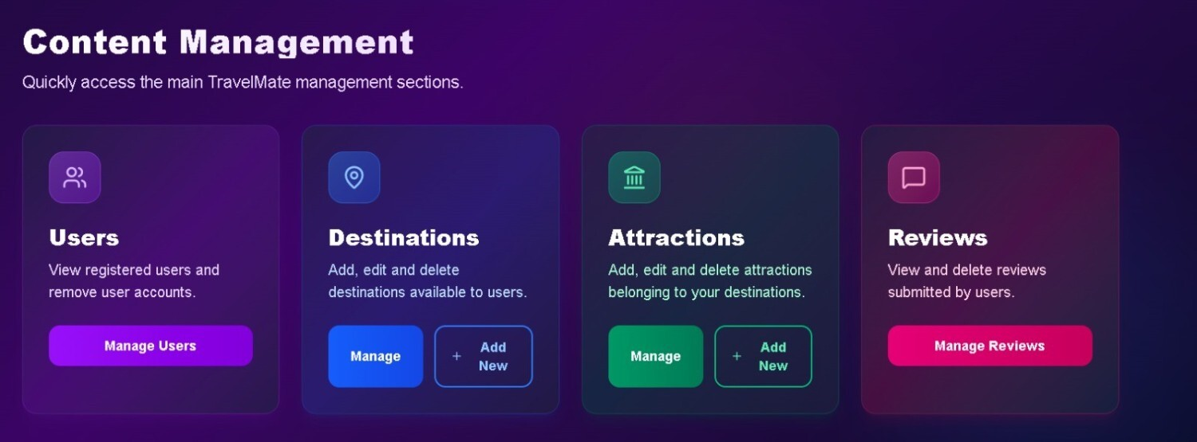
Admin Dashboard & Content Management
Admin Dashboard Overview | Content Management Cards

Slide 22
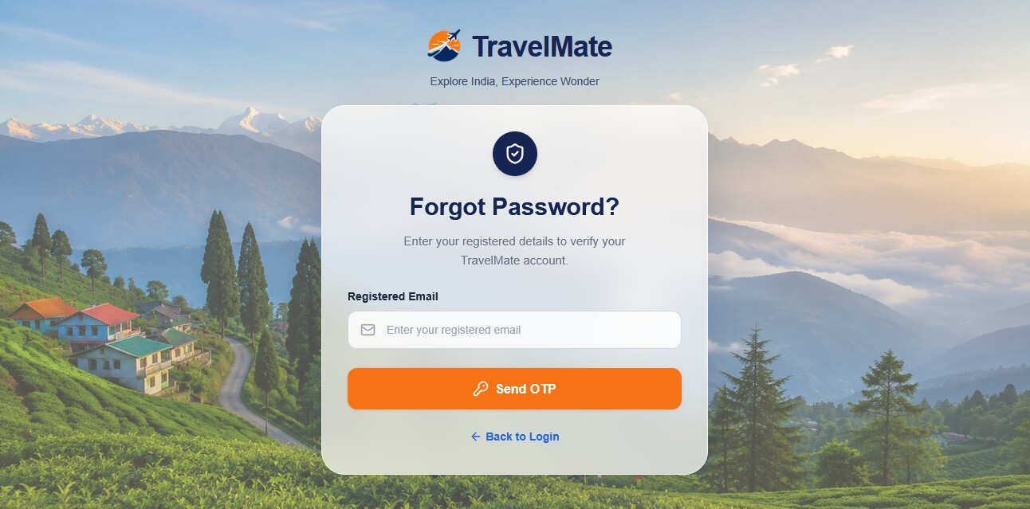

More UI Screens
Forgot Password (OTP) | Attraction Detail (Tiger Hill)

Slide 23
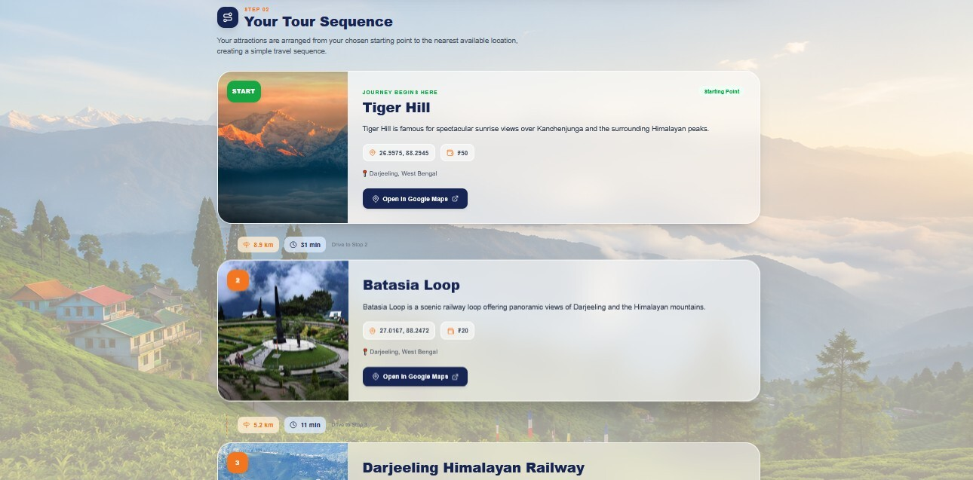
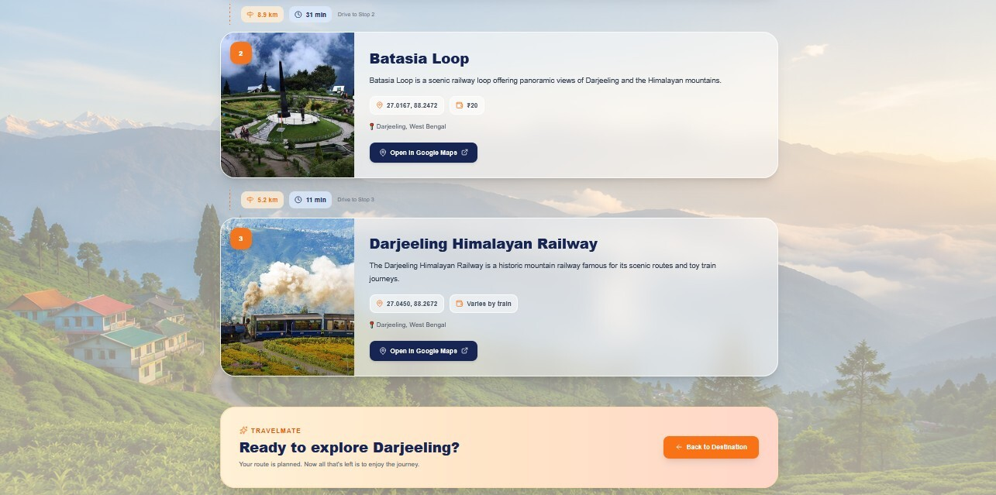
Tour Sequence & Attraction Details
Tour Sequence Steps | Route Completion

Slide 24
Testing & Results
Quality Assurance
Test ID Test Case Expected Result
TC-01 Register with a new email User account created successfully
TC-02 Register with an existing email System returns conflict response
TC-03 Login with invalid credentials System returns unauthorized response
TC-04 Login with valid credentials User profile and role returned
TC-05 Non-admin requests all users System denies access
TC-06 Admin deletes another user User deleted successfully
TC-07 Admin attempts self-deletion Operation is rejected
TC-08 Update profile Profile fields updated successfully
Testing Methods: Unit Testing | Integration Testing | System Testing | Black Box Testing | Validation Testing
Security: Password hashing (BCrypt), Role-based authorization, Server-side validation, Email uniqueness checks

Slide 25
Future Scope
Potential Enhancements & Roadmap
• Online travel booking and reservation support (hotels, transport)
• Transportation and itinerary management with calendar integration
• Advanced map & location services with GPS tracking
• Personalized destination recommendations using ML/AI
• Advanced search, filtering, and sorting capabilities
• Push notifications and email services for trip reminders
• Multi-factor authentication (MFA) and OTP verification
• Social login integration (Google, Facebook, etc.)
• Native mobile application support (Android/iOS)
• Cloud deployment with scalable infrastructure (AWS/Azure)
• Analytics dashboard and administrative reporting and Multilingual support

Slide 26
Conclusion
Project Outcome
TravelMate demonstrates the development of a modern web-based travel platform using industry-standard technologies.
The project successfully integrates a React frontend, Spring Boot backend, REST API communication, and MySQL database storage.
It addresses the need for centralized travel information and structured content management across Indian destinations.
Key features include user registration, profile management, destination discovery, favorites, reviews, and a comprehensive admin panel. Security measures such as BCrypt password hashing and server-side role checks ensure a safe application environment.
The project showcases practical full-stack development: component-based UI design, RESTful communication, repository-based data access, and responsive interfaces.
With further development, TravelMate can evolve into a complete travel ecosystem with booking, itinerary planning, recommendations, and mobile support.

Slide 27
Thank You
Questions & Discussion
Project Team
Subhajit Halder | Subhendu Dutta Banik | Sanam Pandit | Sneha Dey | Tanusree Jana
Guide: Mr. Anindya Mukherjee
Techno Main Salt Lake, Kolkata
Maulana Abul Kalam Azad University of Technology 2025 – 2027

