Slide 1
RELATION EXTRACTION WITH GRAPH NEURAL NETWORKS
S.NO | REG.NO | NAME | SECTION
1 | CB.EN.U4CSE19121 | Kesa Varshitha | CSE - B
2 | CB.EN.U4CSE19135 | N D N Jahnavi | CSE - B
3 | CB.EN.U4CSE19139 | R Sneha Nair | CSE - B
4 | CB.EN.U4CSE19148 | Sithara J P | CSE - B
PROJECT ADVISOR:
BINDU K.R.
ASST. PROFESSOR CSE
AMRITA VISHWA VIDYAPEETHAM
TAG – 5(AI)

Slide 2
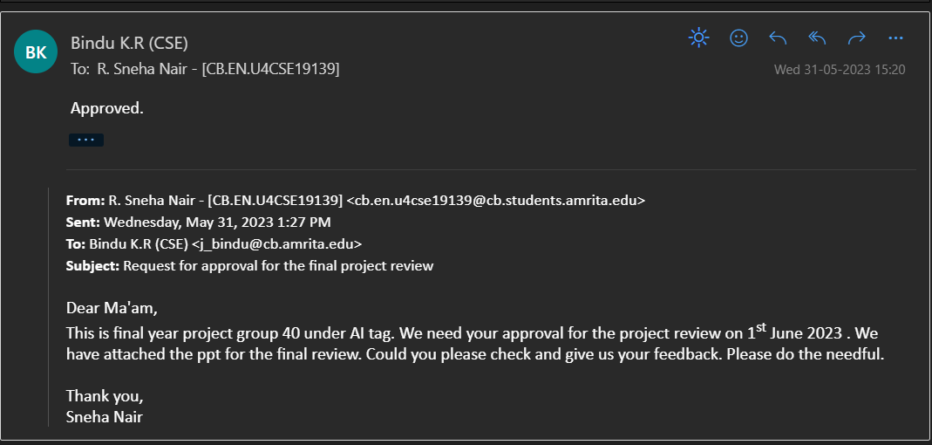
Screen shot of Mail approval from guide

Slide 3
PROBLEM DEFINITION
To implement relation extraction using Graph Neural Networks in semi structured documents.

Slide 4
MOTIVATION
Manual annotation of relationships in large volumes of data is time-consuming and impractical, requiring an automated approach. This could be easily done using relation extraction.
Extracting relationships between entities in semi-structured documents is crucial for applications such as information retrieval, question answering, and knowledge graph construction.
The majority of NLP models are done mainly on three languages. Our main goal is to use an improved version of this methodology for Indian languages.

Slide 5
ABSTRACT
Entity-Relationship Extraction:
Extracts semantic relationships from text
Trains NLP-based AI models for relationship understanding and Enables data analysis of extracted information
Graph Neural Networks (GNN) for NER and Relation Extraction:
Proposed for entity recognition and relation extraction
effectively learns relationships in documents
‘Extracting Entity-Relations via Improved Graph Attention networks":
Addresses poor performance in relation extraction for complex text
GNNs improve entity recognition and enhances relation extraction task
Consistent performance improvements and enables understanding of text relationships
enhances performance without extensive feature engineering or language-specific knowledge

Slide 6
Literature Survey
S.No | PAPER NAME | AUTHOR NAME | ALGORITHM / METHOD USED | OPEN PROBLEM
1. | Graph Neural Networks with Generated Parameters for Relation Extraction (2019) | Hao Zhu, Yankai Lin, Zhiyuan Liu, Jie Fu, Tat-seng Chua, Maosong Sun | Graph neural network with generated parameters (GPGNNs) The parameters in the propagation module are produced by a generator taking natural language sentences as inputs. | The performance of relation extraction could be significantly improved by considering more multi hops in relational reasoning

Slide 7
S.No | PAPER NAME | AUTHOR NAME | ALGORITHM/METHOD USED | OPEN PROBLEM
2. | Graph Convolutional Networks for Named Entity Recognition (2017) | Cetoli, Alberto Bragaglia, Stefano O’Harney, Andrew Daniel Sloan, Marc Context Scout | Bi - Long short-term memory (Bi-LSTM) It enhance the performance of the model on sequence classification problems Bi - Graph Convolutional Networks (Bi-GCN) It binarizes both the network parameters and input node features. | Gating of the components of input vectors Neighbouring word prediction It cconsiders the last word of a particular sentence and predict the next possible word.

Slide 8
S.No | PAPER NAME | AUTHOR NAME | ALGORITHM/METHOD USED | OPEN PROBLEM
4. | Named Entity Recognition and Relation Extraction with Graph Neural Networks in Semi Structured Documents (2021) | Manuel Carbonell, Pau Riba , Mauricio Villegas† , Alicia Fornes´, Josep Llados´ | k-NN graph Edges between words are created using k nearest neighbors (k-NN) based on the distances of the top-left corner of the word bounding boxes. BERT F1 SCORE ARI | Method has been initially designed for administrative document understanding, but it shown that it can be adapted to other domains, as for example historical manuscripts. Further research tuning the method and testing on larger data sets could confirm the feasibility of the approach as a generic solution for extracting structured information from semi-structured documents.

Slide 9
RESEARCH GAP
In future GCNs can be used in conjunction with different techniques. Additional techniques includes gating of the components of input vectors or neighboring word prediction should be tested together with GCNs.
In GP-GNN, the performance of relation extraction could be significantly improved by considering more multi hops in relational reasoning.
It is a generic framework for graph generation problem with unstructured input other than text, e.g. image, audio.
Since most of the NLP models are based on non Indian languages, so we would experiment on Indian language, Hindi.

Slide 10
LANGUAGE & TOOLS
Language
Python
HTML
CSS
JavaScript
Tools
Spacy
NLTK
TensorFlow
Flask
Openie

Slide 11
DATASET
NYT29 dataset
A widely used dataset for Named Entity Recognition tasks, is utilized. The dataset comprises of text documents sourced from the New York Times and is annotated with named entities, including persons, organizations, locations, etc along with their respective labels.
Link to dataset: https://drive.google.com/drive/folders/1adxWb8rRnZPX1bJxFK0sAZ-sl8TK6u6H?usp=drive_link

Slide 12
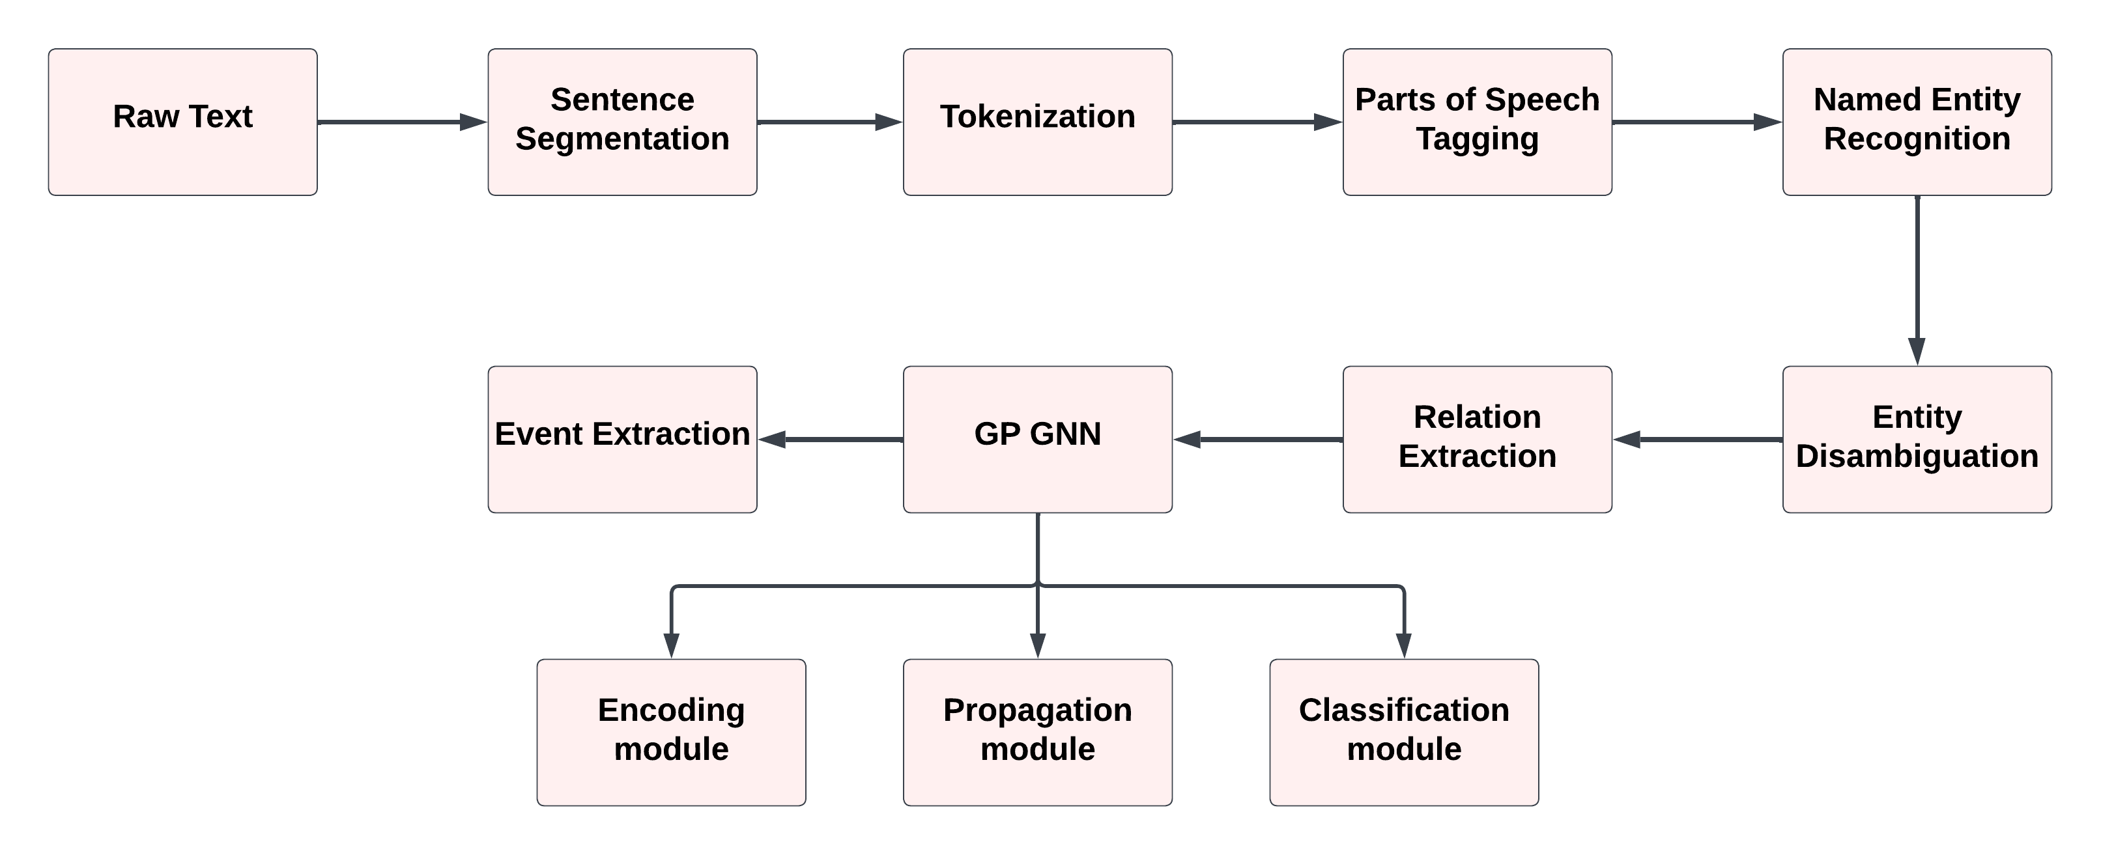
WORK PLAN

Slide 13
MODULES
Dataset preparation and preprocessing
Tokenization
Pos Tagging
NER(Named entity recognition)
GP GNN algorithm
Entity classification: Divides the detected entities into preset categories
Relationship prediction: Find pairing relationship between entities.

Slide 14
GP GNN(graph neural networks with generated parameters) algorithm
Graph neural networks with generated parameters (GP-GNNs) adapt graph neural networks to solve the natural language relational reasoning task. GP-GNNs first constructs a fully connected graph with the entities in the sequence of text. After that, it employs three modules to process relational reasoning: (1) an encoding module (2) a propagation module (3) a classification module. As compared to traditional GNNs, GP-GNNs could learn edge parameters from natural languages, extending it from performing inference on only non-relational graphs or graphs with a limited number of edge types to unstructured inputs such as texts.
A graph neural network with generated parameters (GPGNNs) is one of the most effective approaches for multi-hop relational reasoning in relation extraction.

Slide 15
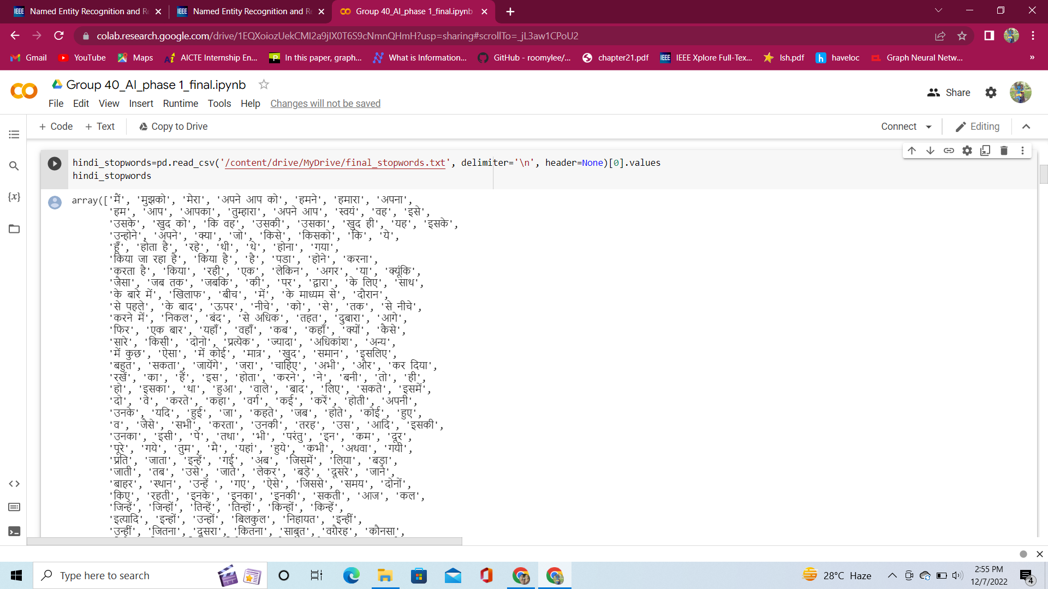
Removing Stop Words

Slide 16
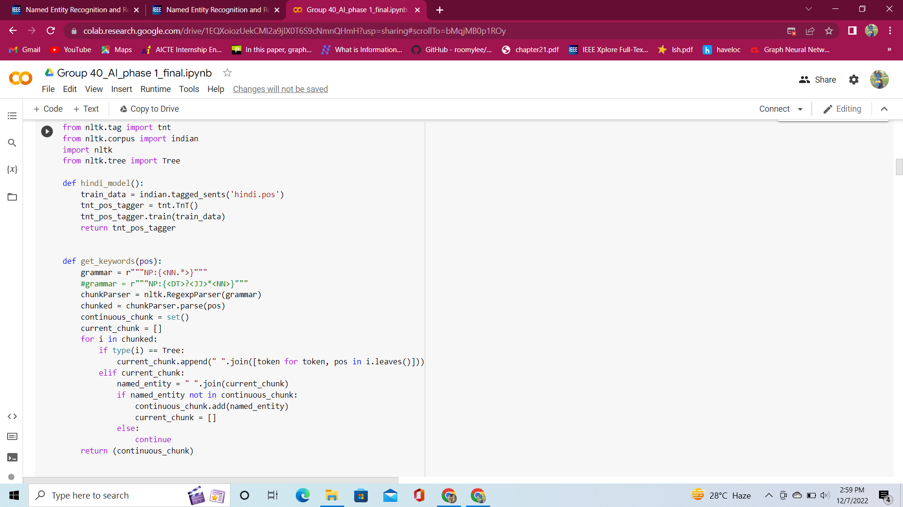
Tokenization and Keyword generation

Slide 17
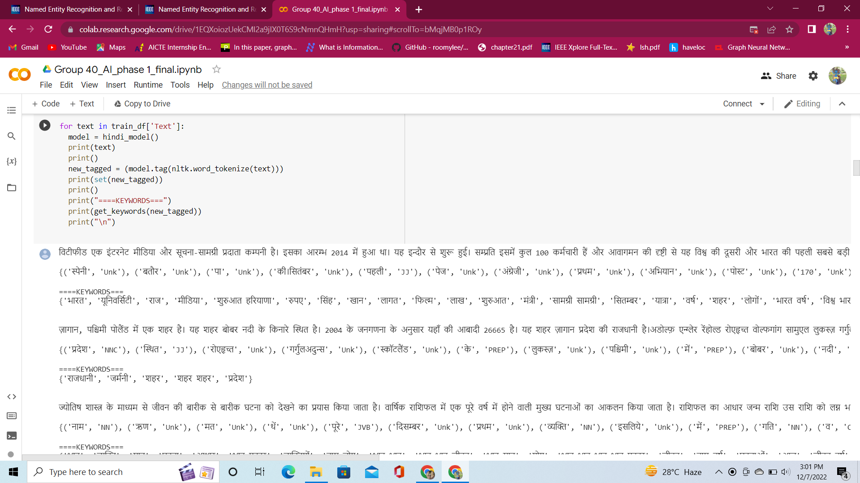

Slide 18
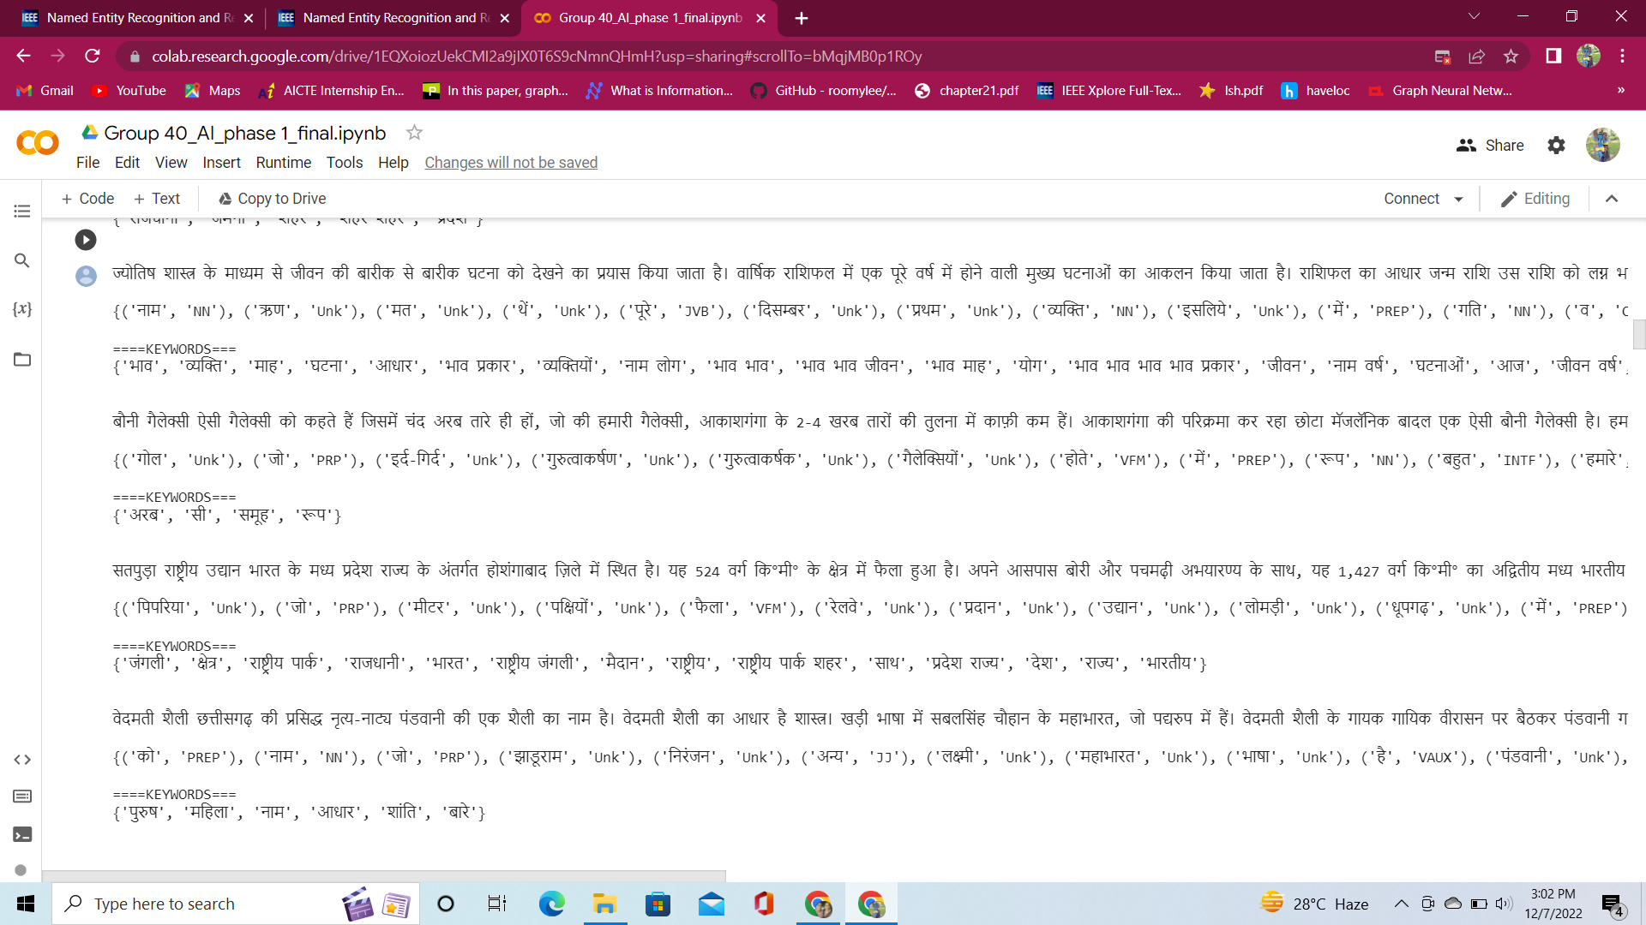

Slide 19
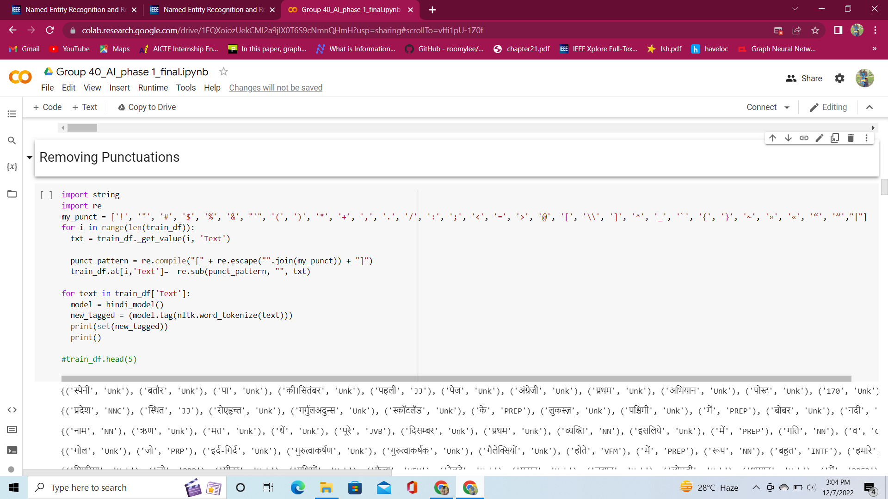
Removing Punctuations from the text

Slide 20
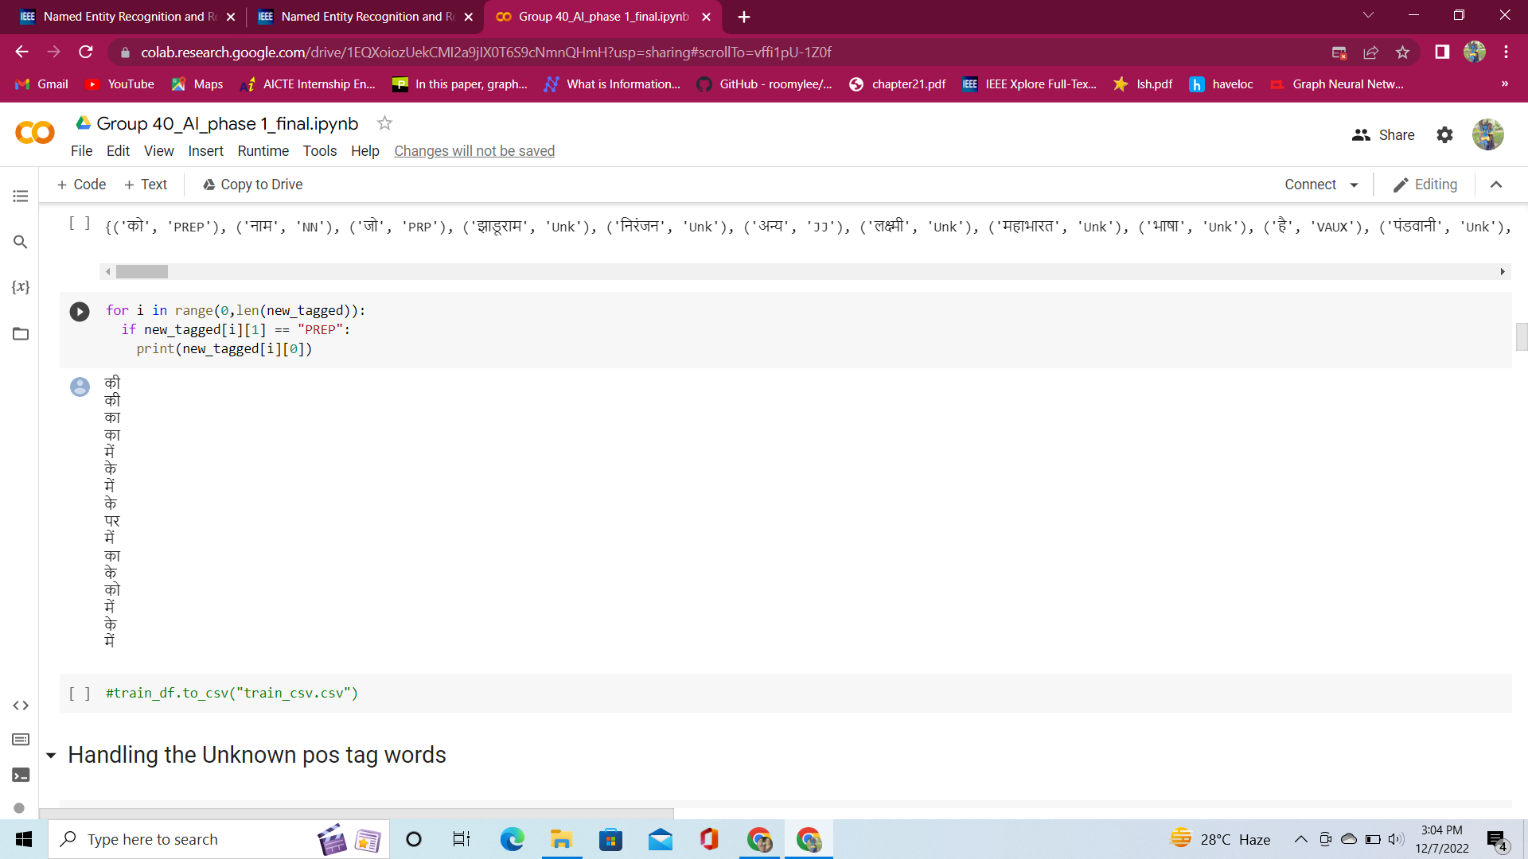

Slide 21
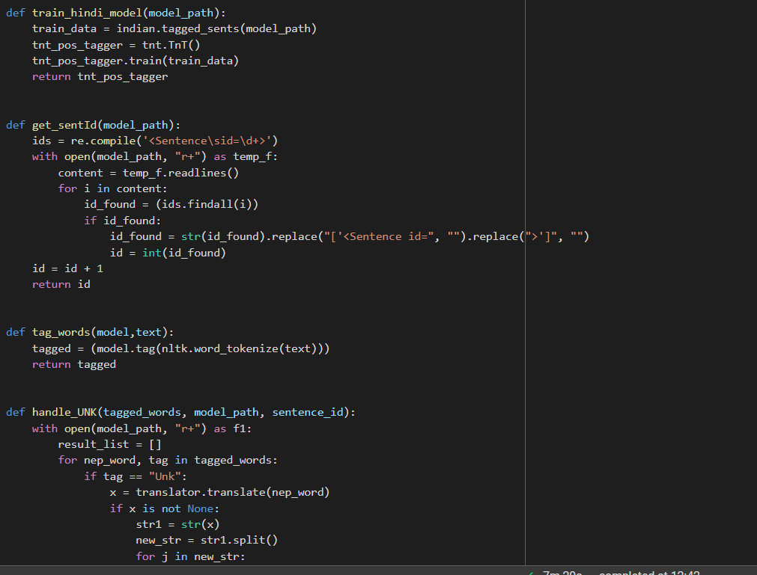
Handling the Unknown post tag words

Slide 22
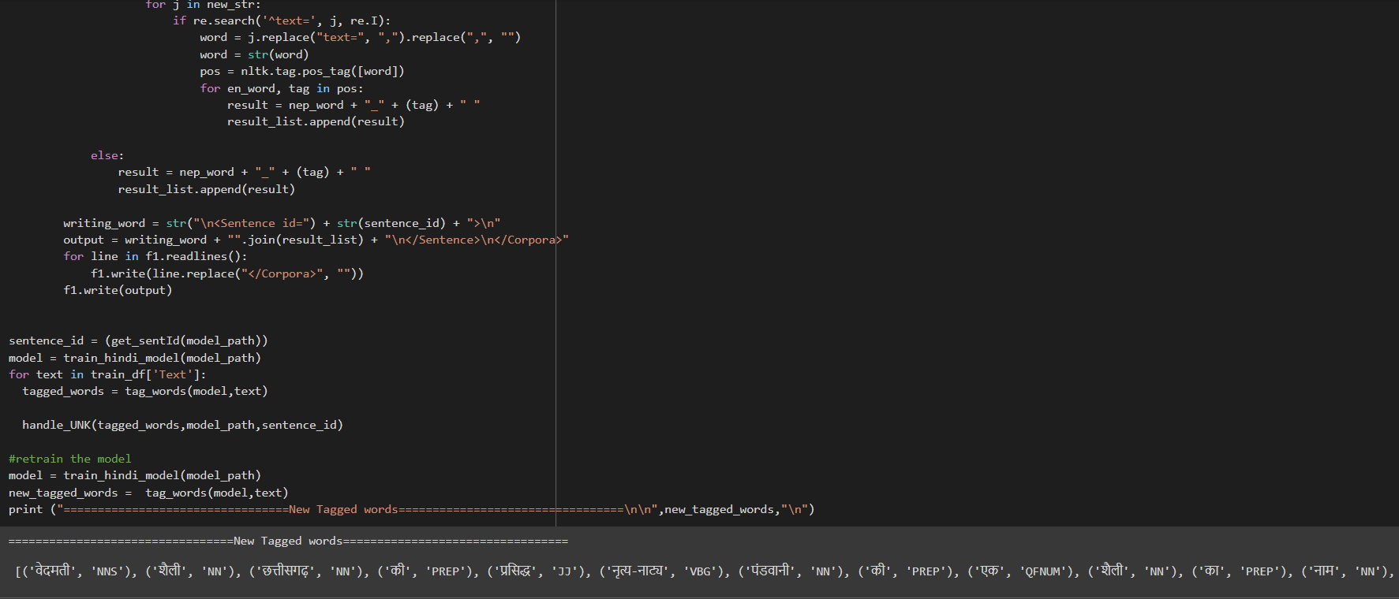

Slide 23
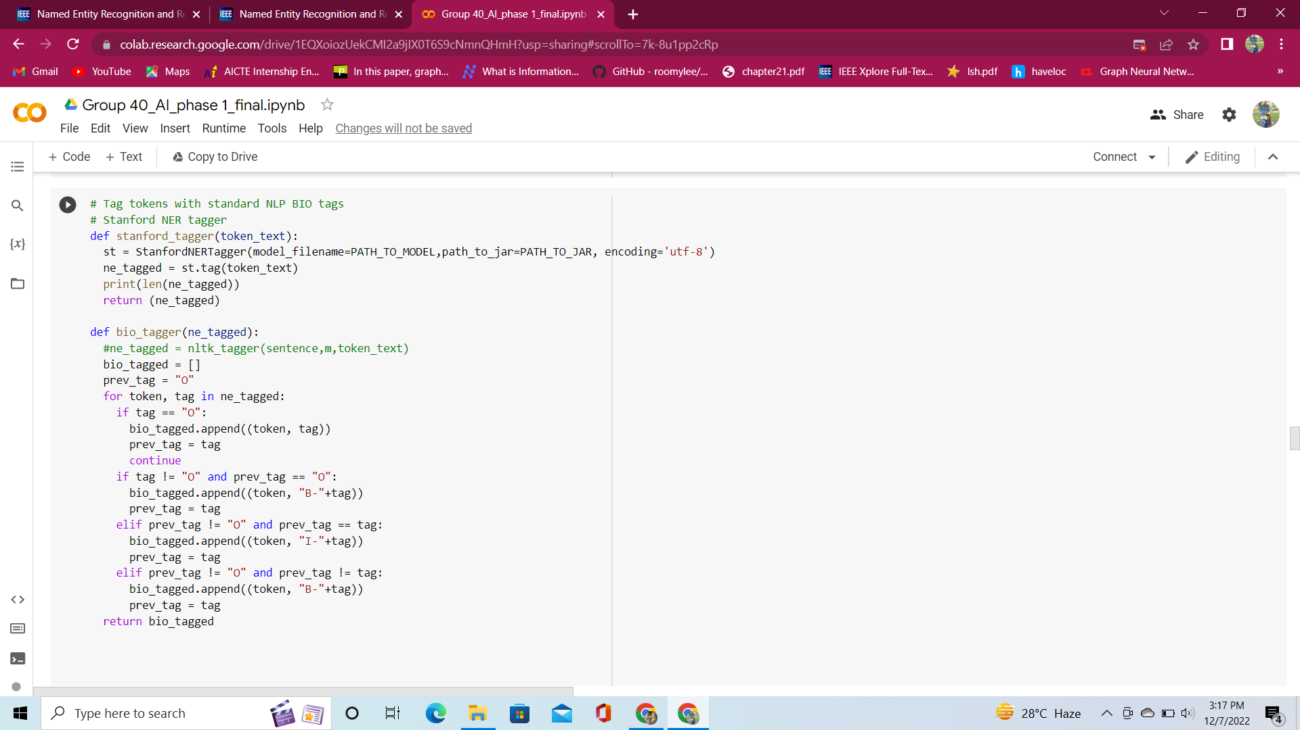
BIO Tagging

Slide 24
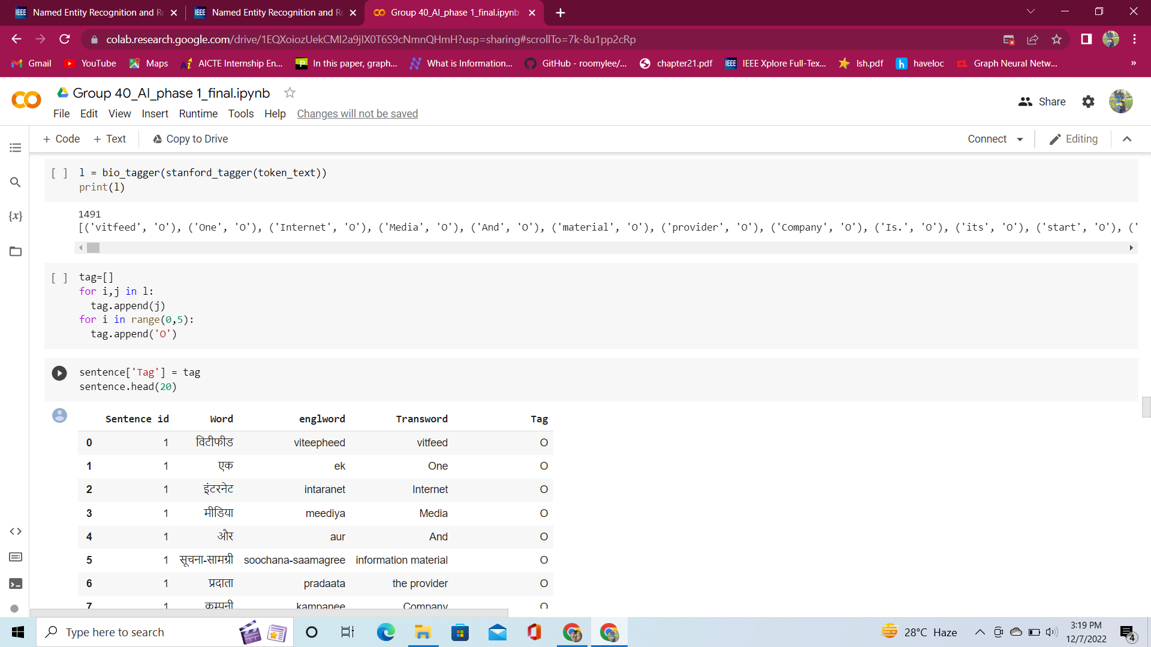

Slide 25
Named Entity Recognition

Slide 26
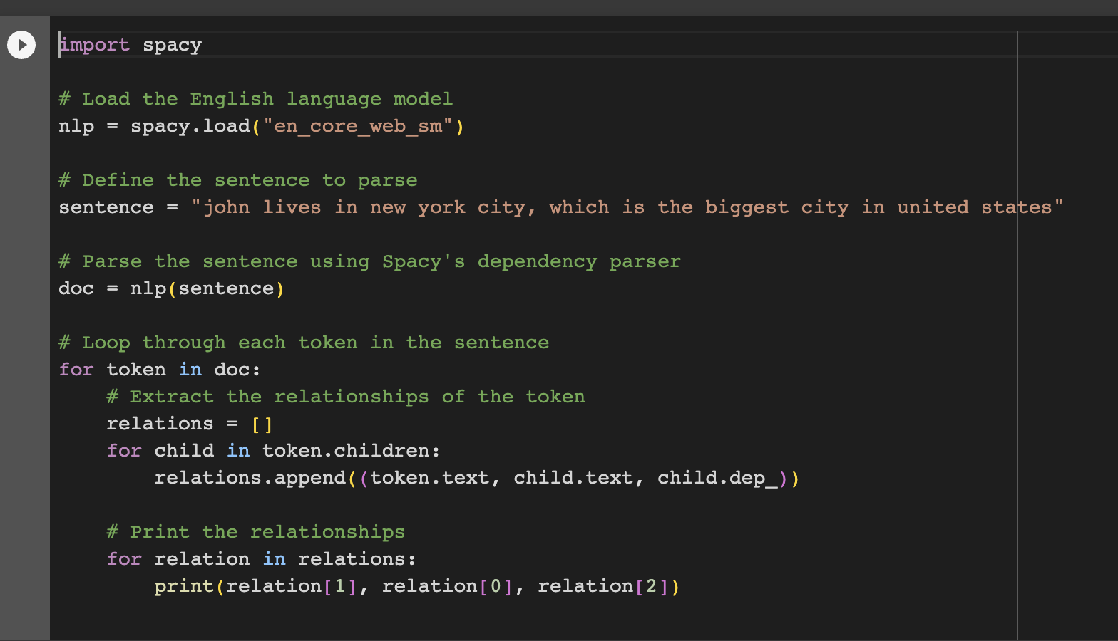
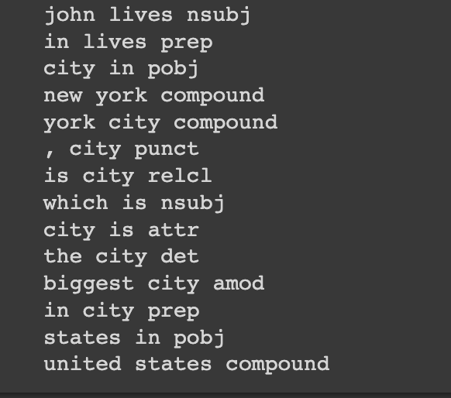

Slide 27
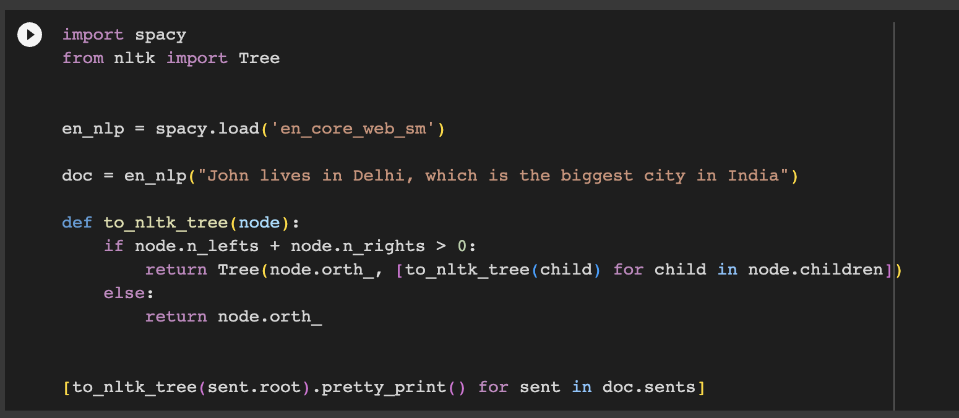
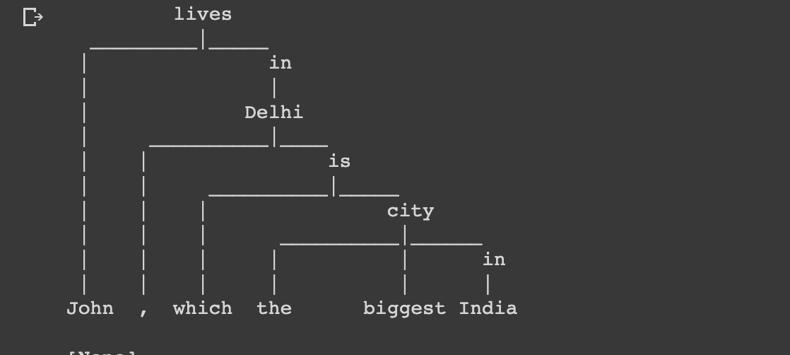

Slide 28
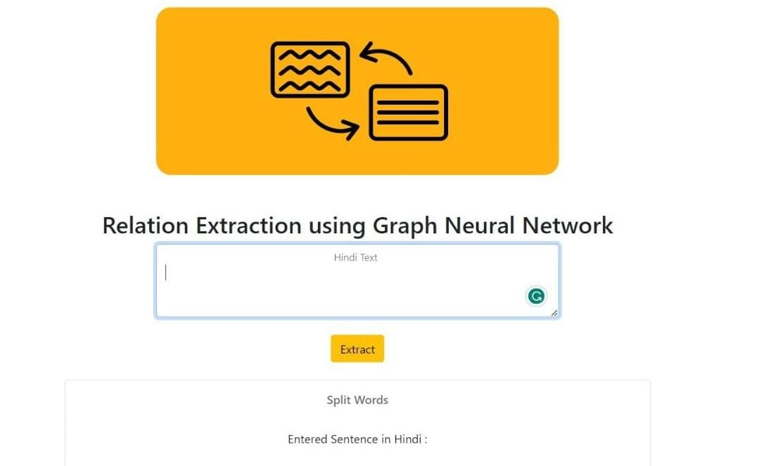
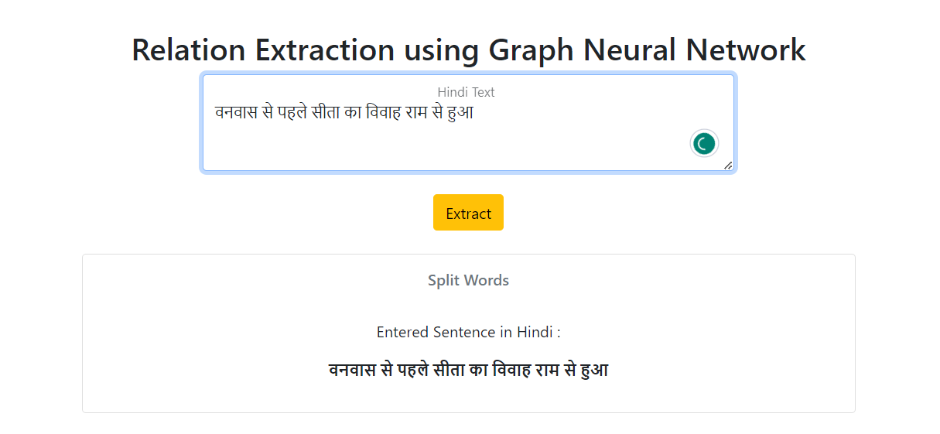
Results and Discussions

Slide 29
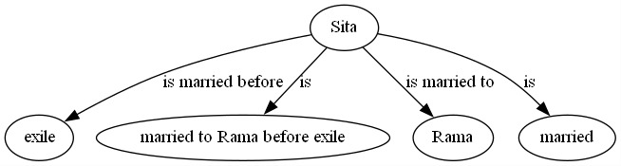
Final Result

Slide 30

Analysis and findings
Analysis and findings
F1 score: 0.763
Precision : 0.602
Recall: 0.673

Slide 31
conclusion
The integration of the GPGNN algorithm, NER techniques for Hindi, and Flask UI has resulted in a powerful and user-friendly natural language processing system.
This system effectively captures semantic connections in Hindi text and enhances accurate entity identification through NER.
The Flask UI offers a convenient platform for users to input text, initiate extraction, and visualize the resulting knowledge graph.
With an in-depth analysis, efficient querying, and knowledge discovery, this system holds practical implications for text understanding, information retrieval, and data analytics across various domains.

Slide 32
REFERENCE
https://developpaper.com/in-this-paper-graph-neural-network-is-applied-to-named-entity-recognition-and-relation-extraction-of-semi-structured-documents/
https://www.researchgate.net/figure/The-taxonomy-of-Information-Extraction-b-Semi-Structured-Data-Semi-structure-means-that_fig1_224351589
https://youtu.be/y7sXDpffzQQ
https://youtu.be/ZKwYitIkSOE
https://www.researchgate.net/publication/352113408_RECON_Relation_Extraction_using_Knowledge_Graph_Context_in_a_Graph_Neural_Network

Slide 33
THANK YOU

