Slide 1

Fake Review Detector
Python + Streamlit Project

Slide 2

Introduction
A powerful AI-based tool to identify fake and manipulated online product reviews using Machine Learning and Natural Language Processing.
• Detects fake and genuine online reviews using ML.
• Built using Python and Streamlit for an interactive interface.

Slide 3

Problem Statement
Fake reviews are everywhere on e-commerce platforms, misleading customers and damaging trust.
• Fake reviews mislead customers.
• Manual detection is slow and unreliable.
• Customers lose trust
• Honest businesses suffer

Slide 4
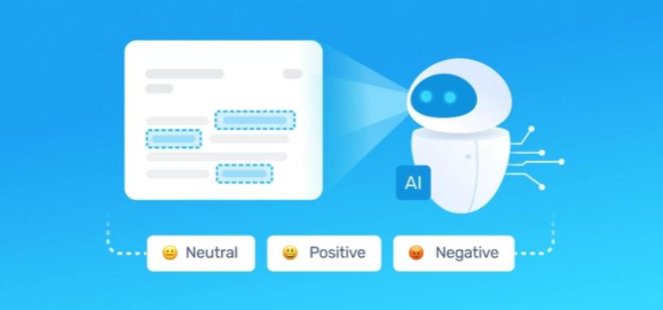
Solution
Real-time fake review detection web app built with Streamlit and advanced Python ML models.
• Use NLP and ML to classify reviews.
• Provide instant predictions through a Streamlit web app.

Slide 5
Key Features
• Real-time review prediction.
• Simple UI, fast processing, and confidence score.
• Text preprocessing & feature extraction
• Multiple classification models
• Interactive Streamlit dashboard
• Confidence scoring & explanations
• Report

Slide 6
Demo
• Enter/paste a review.
• Click Predict to see Genuine/Fake result.

Slide 7
Result & Accuracy
• High classification accuracy on the test dataset.
• Reliable performance with fast response time.
Achieved strong performance on benchmark datasets:
Accuracy: 91%+
Precision & Recall: High

Slide 8

Future Enhancement
• Advanced Transformer models (BERT)
• Multi-lingual support
• API for e-commerce platforms
• Deployment on cloud

Slide 9
Thank You
• Thank you for your time.
• If you have any questions, please ask.

