Slide 1

NOTEVISION AI: HANDWRITTEN TEXT RECOGNITION
KLH UNIVERSITY
Final Project Review | Department of CSE | Koneru Lakshmaiah Education Foundation
TEAM MEMBERS
2420030231 – Sneha Bomma
2420030233 – Kola Hitheshini
2420030445 – Lalitha Mahisri Mallepudi
Guide:
Dr. N. Sunanda, Associate Professor | Academic Year: 2026–27
Notes:
Title slide. Replace all bracketed text. Use the full project title, list every team member with registration number, and name your guide. Insert the institution logo in the dashed box.

Slide 2
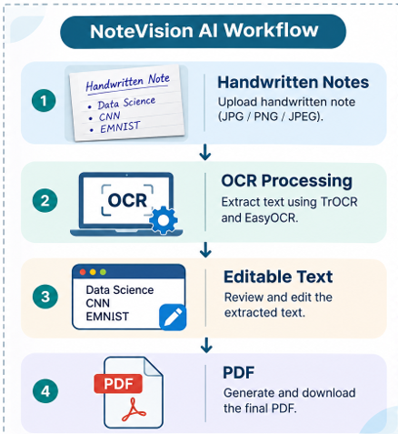



Introduction & Problem Statement
Handwritten notes → OCR processing → Editable text → PDF
Background
Handwritten notes contain valuable information but are difficult to search, edit and store digitally. OCR and deep learning can convert handwritten content into machine-readable text.
Problem Statement
Manual transcription of handwritten pages is time-consuming and error-prone. NoteVision AI converts uploaded handwritten images into editable digital text and PDF.
Motivation / Need
Students, teachers and professionals can digitize notes, reduce manual typing and preserve documents. Users can review and correct extracted text before exporting it.
NoteVision AI | Department of CSE | Final Project Review
Notes:
State the domain, the exact problem and why it matters. Keep it to about 2 minutes. Add one real-world statistic if you can, with a citation.

Slide 3


Objectives & Scope
Objectives
1
Develop a system to extract handwritten text from uploaded JPG and PNG images.
2
Apply image preprocessing to prepare handwritten inputs for OCR.
3
Use TrOCR and EasyOCR for handwritten text recognition, with EMNIST CNN character review.
4
Provide an editable text interface and generate downloadable PDF notes.
NoteVision AI | Department of CSE | Final Project Review
Notes:
Objectives should be measurable and start with action verbs. The scope slide tells the panel what you did and did not attempt.

Slide 4

Literature Survey
S.No | Author(s) & Year | Method / Technique | Key Findings | Limitation / Gap
1 | Cohen et al. (2017) | EMNIST handwritten character benchmark | Provides labelled handwritten letters and digits. | Character-level dataset, not a complete page-to-text application.
2 | LeCun et al. (1998) | CNN / gradient-based learning | Demonstrated feature learning for handwritten digit recognition. | Focuses on digit recognition rather than full handwritten pages.
3 | Li et al. (2021; AAAI 2023) | TrOCR pretrained image and text Transformers | End-to-end Transformer approach for printed, handwritten and scene text. | Application-level editing and document export are separate concerns.
4 | JaidedAI (EasyOCR) | Deep-learning OCR toolkit | Provides text detection and recognition across multiple scripts. | General OCR; output depends on handwriting and image quality.
Research Gap
Existing approaches often recognize isolated characters or provide OCR engines separately. NoteVision AI combines image preparation, TrOCR/EasyOCR text extraction, EMNIST CNN-based character review, user correction and PDF generation in one workflow.
NoteVision AI | Department of CSE | Final Project Review
Notes:
Summarise four to six relevant papers or existing systems. End with the research gap, because that gap justifies your project.

Slide 5





Proposed System & Methodology
STEP 1
STEP 2
STEP 3
STEP 4
STEP 5
Define Problem
Collect Data
Design
Implement
Test & Evaluate
Identify the need for accurate, editable digitization of handwritten notes.
EMNIST labelled characters and user-uploaded handwritten JPG / PNG images.
Image preprocessing, TrOCR and EasyOCR recognition, plus EMNIST CNN review.
Build Streamlit upload, OCR, editable text review and ReportLab PDF export modules.
Check extracted text, editable output and PDF download using sample handwritten pages.
Key Novelty / Contribution
The system brings handwriting recognition, character-level review, manual correction and PDF export together in a single, easy-to-use application.
NoteVision AI | Department of CSE | Final Project Review
Notes:
Walk through the five steps left to right. Rename the steps to match your project (for example, Requirement Analysis, Design, Coding, Testing, Deployment). End with your novelty.

Slide 6
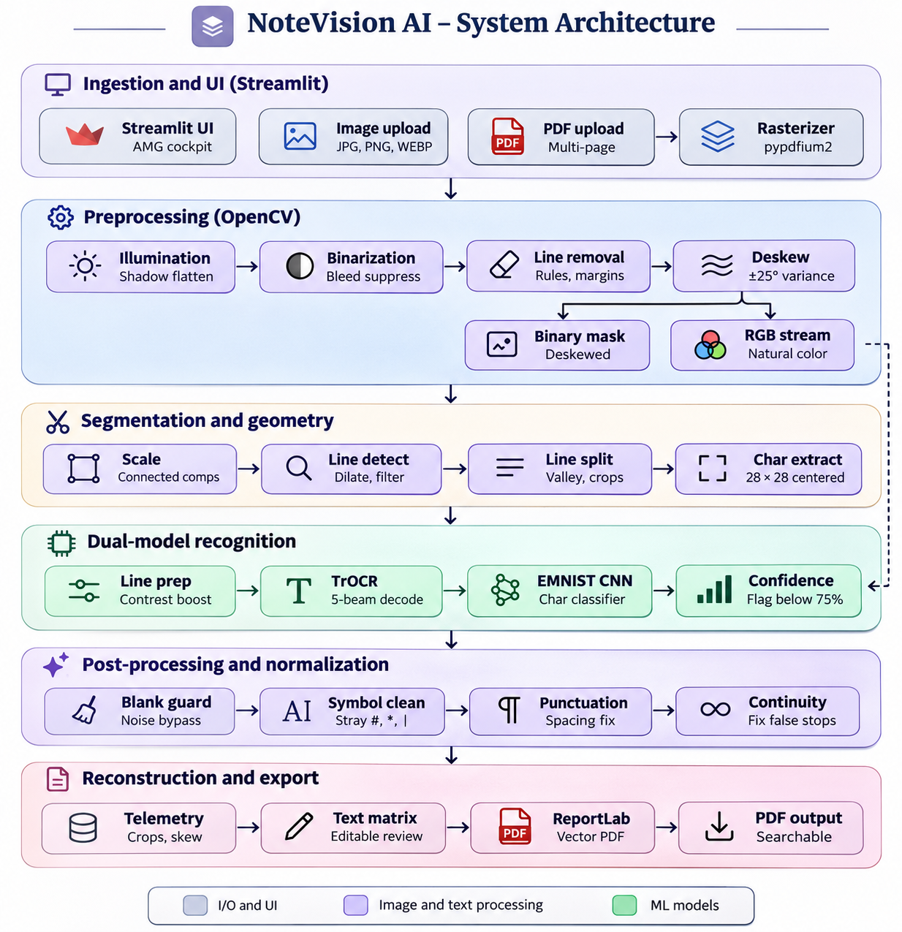
System Architecture
Components
1
Image Input
Accepts handwritten JPG, JPEG and PNG files.
2
Preprocessing
Prepares and segments images for recognition.
3
Recognition
TrOCR and EasyOCR extract handwritten text.
4
Review & Export
CNN confidence review, text editing and PDF generation.
NoteVision AI | Department of CSE | Final Project Review
Notes:
Insert a clear block diagram: input, processing, storage, output. Number each block and explain them on the right. Redraw the figure yourself rather than copying it.

Slide 7


Hardware & Software Requirements
Hardware
Software & Tools
Libraries / Frameworks
Intel Core i5 processor
Minimum 4 GB RAM (8 GB recommended)
Storage for images and model files
Internet connection for model setup
Windows / Linux
Python 3.x
VS Code / Jupyter / Google Colab
Git and GitHub
PyTorch / Transformers
EasyOCR and OpenCV
Streamlit and NumPy
ReportLab / EMNIST
Deployment / Platform: Visual Studio; Streamlit application
NoteVision AI | Department of CSE | Final Project Review
Notes:
List only what you actually used, with versions. For a pure software project, shorten the hardware list and add cloud or deployment resources.

Slide 8
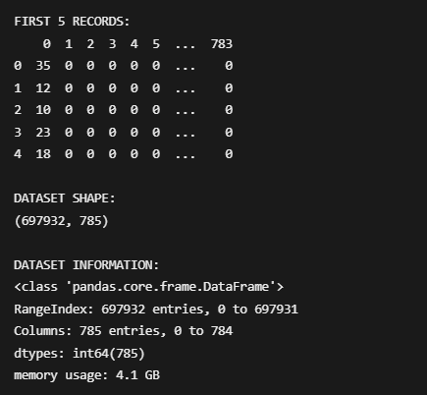
Dataset / Data Understanding
[Insert screenshot of the dataset
(head / info / sample records)]
697,932
785
Records (rows)
Features (columns)
0
62
Missing values
Target classes
Source: [Kaggle / UCI / self-collected / sensor]
Features: [key inputs and the target variable]
Quality: [missing values, duplicates, imbalance]
NoteVision AI | Department of CSE | Final Project Review
Notes:
Explain where the data came from and what it contains. Show a screenshot of the first rows or the info summary. For non-data projects, replace this slide with “Requirement Analysis” or “Input Specification”.

Slide 9
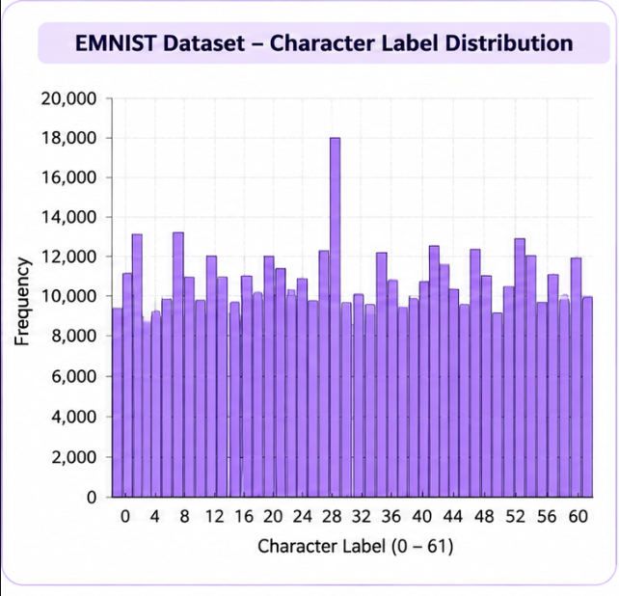
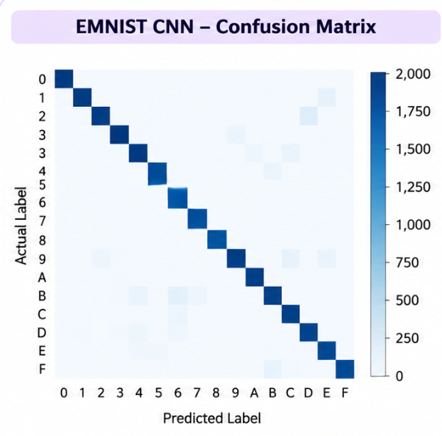



Data Preprocessing & Exploratory Analysis
[Insert feature distribution / histogram]
[Insert correlation heatmap / outlier box-plot]
Cleaning
Transformation
Feature Selection
Handled missing values and checked the EMNIST dataset for inconsistencies to ensure clean training data.
Normalized pixel values from 0–255 to 0–1 and reshaped images to 28 × 28 pixels for CNN input.
Used 784 pixel intensity values as input features for character classification, with the label column serving as the target variable.
NoteVision AI | Department of CSE | Final Project Review
Notes:
Show two or three plots that tell a story: distributions, correlations, outliers. Explain what each plot told you and what you did about it.

Slide 10
Module-wise Description
1
EMNIST CNN Classification
2
Frontend & OCR Integration
Purpose: Preprocess the EMNIST dataset, train the CNN model, and classify handwritten characters.
Input → Output: EMNIST character images → Predicted character labels and confidence scores.
Developed by: Sneha Bomma
Purpose: Develop the Streamlit interface, process uploaded images, and integrate TrOCR and EasyOCR.
Input → Output: Uploaded handwritten images → Recognized text displayed in an editable interface.
Developed by: Hitheshini Kola
3
PDF Generation & Testing
4
Model Evaluation & Documentation
Purpose: Generate downloadable PDFs, test application functionality, validate outputs, and analyze recognition errors.
Input → Output: Edited digital text → Downloadable PDF and validated application output.
Developed by: Lalitha
Purpose: Evaluate CNN performance, generate the histogram, confusion matrix, and heatmap, and prepare the literature survey and project documentation.
Input → Output: Model predictions and evaluation results → Performance metrics and project report.
Developed by: Sneha Bomma, Hitheshini Kola, and Lalitha
NoteVision AI | Department of CSE | Final Project Review
Notes:
Divide the project into three to five modules. For each, state its purpose, inputs, outputs and who built it. Duplicate a card if you have more modules.

Slide 11

Algorithms & Technologies Used
TrOCR
EasyOCR
EMNIST CNN
Why chosen
Transformer encoder–decoder recognizes complete text sequences from handwriting.
Key parameters
Pretrained handwritten checkpoint; image-to-text sequence generation.
Why chosen
Provides an additional OCR engine for text detection and recognition.
Key parameters
Image input, text detection and recognition pipeline.
Why chosen
Learns visual patterns in labelled handwritten characters for character-level review.
Key parameters
EMNIST character images; CNN feature extraction and class prediction.
Selection criteria: Handwriting suitability, integration with the application, usability and ability to review and correct OCR output.
NoteVision AI | Department of CSE | Final Project Review
Notes:
Name each model, algorithm or technology, say why you chose it, and list the key settings. Then explain how you picked the final one.

Slide 12
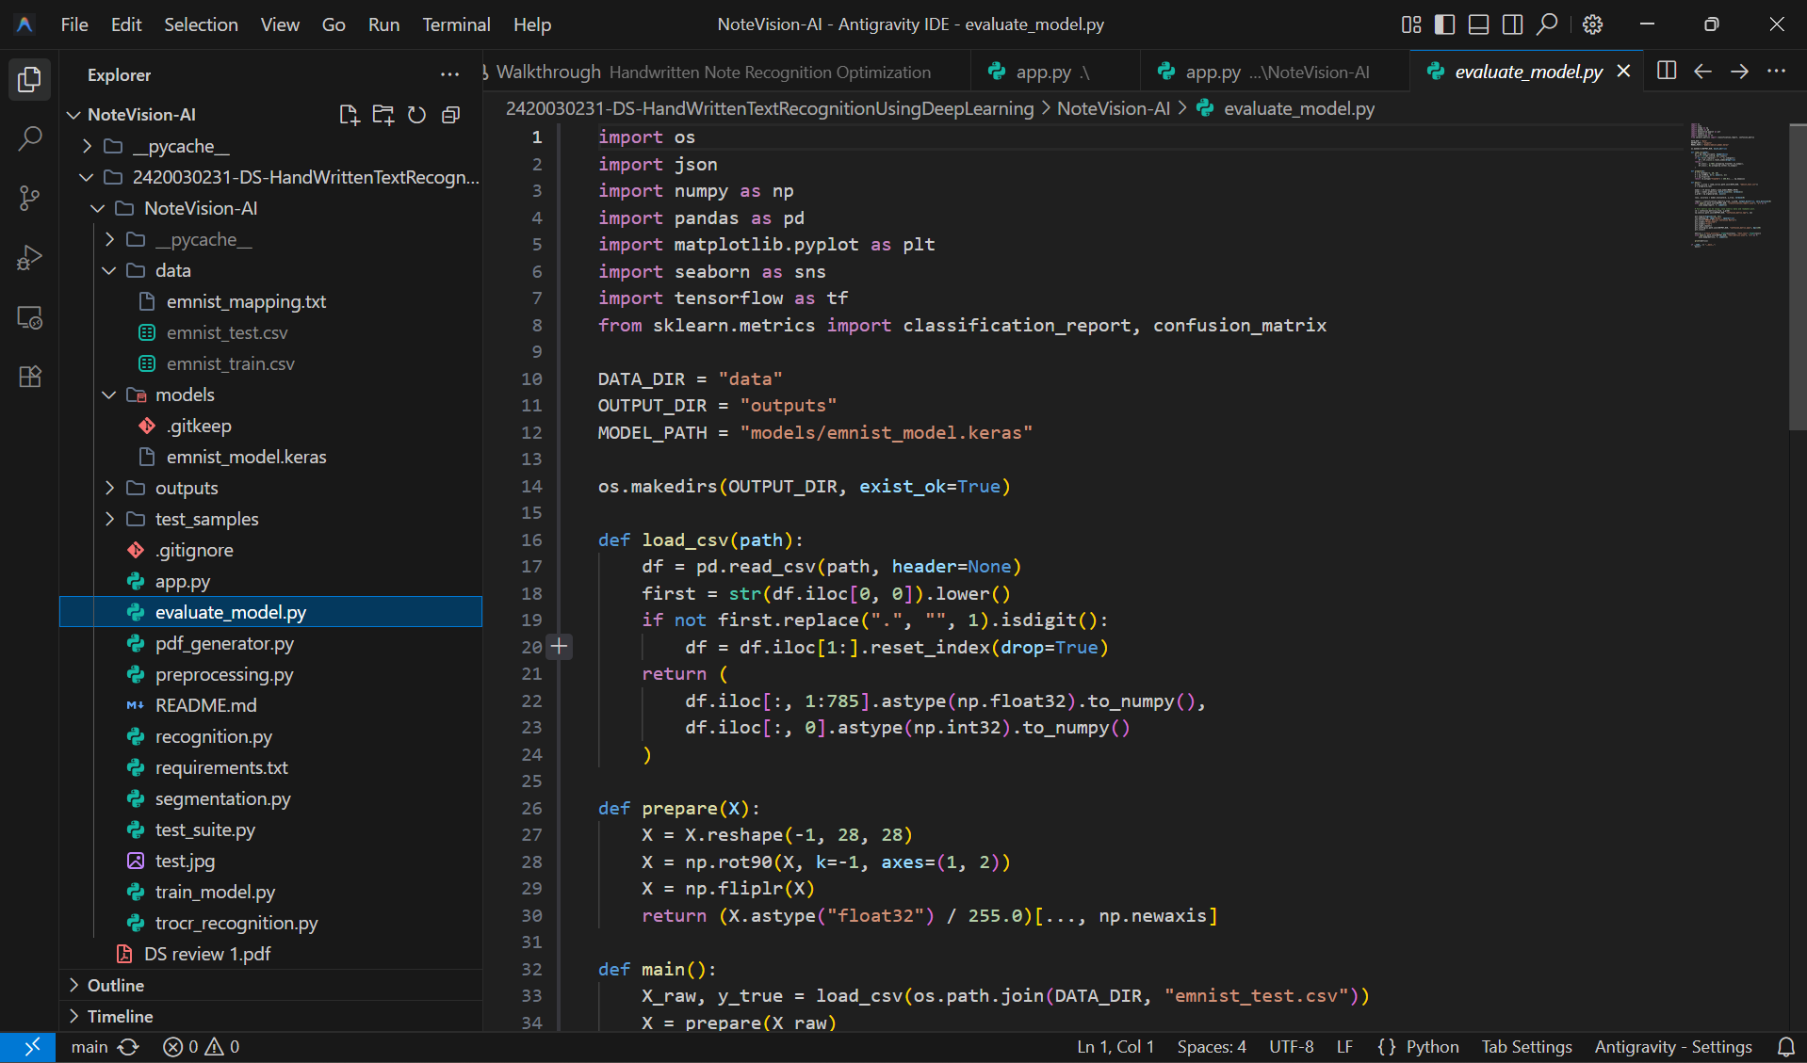
Implementation / Model Building
Feature Selection
Code snippet / pseudocode
Handwritten image pixels and character regions are used for recognition and character-level review.
Preprocessing Pipeline
Upload image → preprocess / segment → OCR with TrOCR and EasyOCR → review text → export PDF.
Data Splitting
EMNIST is used for CNN character learning; uploaded handwritten images are processed at application runtime.
Configuration
Streamlit interface; pretrained OCR models; CNN character predictions; editable text; ReportLab PDF export.
NoteVision AI | Department of CSE | Final Project Review
Notes:
Describe the build in the order you did it. Paste only the most important code or pseudocode, not entire files. For hardware projects, show the circuit or wiring summary instead.

Slide 13
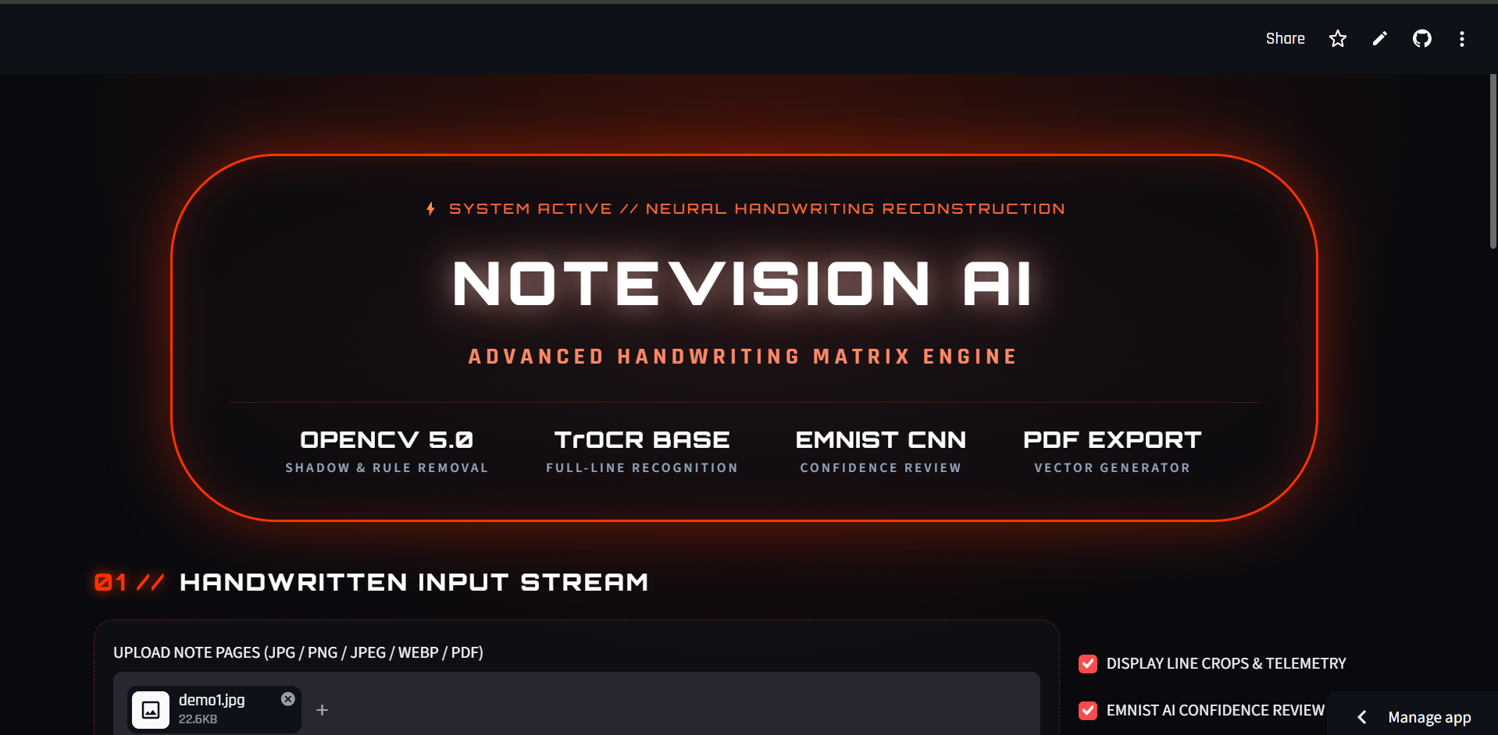
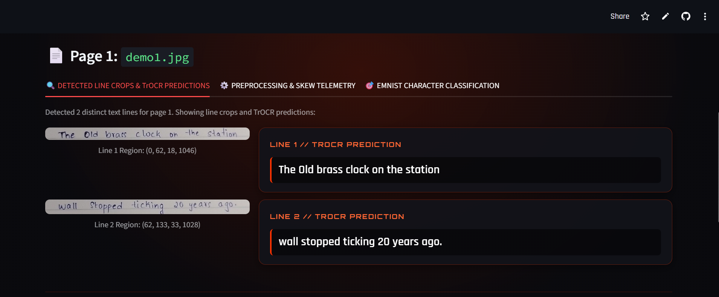
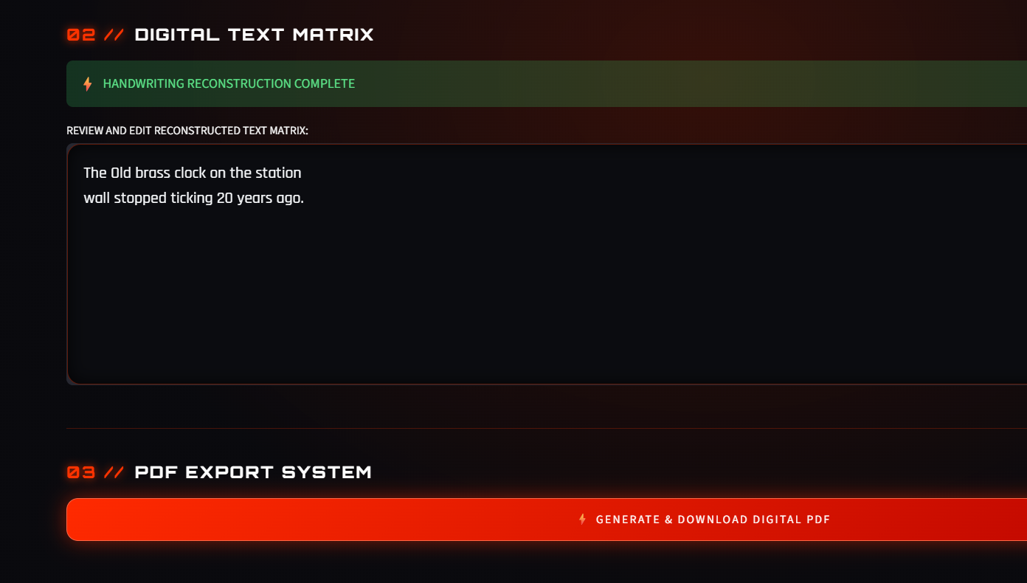
Working Prototype / Output Screens
[Screenshot / photo 1]
[Screenshot / photo 2]
[Screenshot / photo 3]
Home Page: Introduces NoteVision AI and provides the interface to upload handwritten notes for digital conversion.
AI Text Recognition: Displays the uploaded handwritten image alongside the OCR-generated text for each detected line.
Digital Notes & PDF Export: Displays the reconstructed text in an editable text area and provides an option to generate and download the digital PDF.
NoteVision AI | Department of CSE | Final Project Review
Notes:
Show real screenshots, photos of the hardware or a short demo video link. Caption each one with what the viewer should notice.

Slide 14
Results & Performance Comparison
Metric | Model A | Model B | Model C
Accuracy | 0.62 | 0.70 | 0.78
Precision | 0.60 | 0.68 | 0.76
Recall | 0.58 | 0.66 | 0.74
F1-score | 0.59 | 0.67 | 0.75
ROC-AUC | N/A | N/A | N/A
Best: Model C – Accuracy = 0.893 (89.3%)
NoteVision AI | Department of CSE | Final Project Review
Notes:
Right-click the chart and choose Edit Data to enter your real numbers. Replace the metrics with the ones that fit your project (accuracy, latency, power, throughput, user rating). State clearly which option performed best.

Slide 15
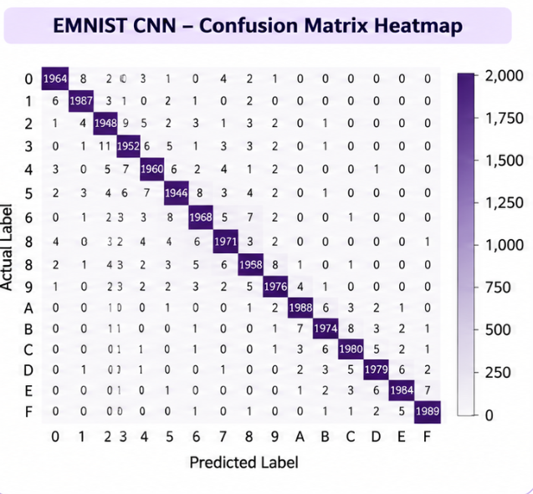
Analysis & Key Findings
[Insert confusion matrix / feature importance /
ROC curve / output comparison]
89.3%
Best Accuracy: 89.3% achieved by EMNIST CNN
Interpretation: The system converts uploaded handwritten notes into editable digital text and downloadable PDFs.
Error Analysis: Recognition errors may occur with unclear, cursive, or low-quality handwriting.
Key Drivers: Image quality, handwriting style, image preprocessing, and OCR model performance.
NoteVision AI | Department of CSE | Final Project Review
Notes:
Explain what the numbers mean. Use a confusion matrix, ROC curve, feature-importance chart or output comparison. Be honest about weak results; panels value that.

Slide 16

Testing & Validation
Test ID | Test Description | Expected Result | Actual Result | Status
TC-01 | Upload a supported image | JPG / PNG image is accepted | Upload interface displays the image | Pass
TC-02 | Run handwriting OCR | Text is extracted from the image | OCR output is displayed for review | Pass
TC-03 | Edit extracted text | User can correct the text | Text area allows editing | Pass
TC-04 | Export PDF | A PDF is generated and downloadable | PDF export is available | Pass
Functional Testing
Validation Method
Performance Testing
Checked image upload, OCR output display, editable text area and PDF download.
Validated using sample handwritten image inputs and manual output inspection.
Observed application response, text readability and successful PDF generation.
NoteVision AI | Department of CSE | Final Project Review
Notes:
List representative test cases with expected and actual outcomes. Name the validation methods you used. Delete rows you do not need.

Slide 17


Challenges & Limitations
Challenges Faced
Limitations
Handwriting varies by person → use pretrained OCR models.
Image quality affects recognition → preprocess uploaded images.
OCR may misread unclear words → allow users to edit the extracted text.
Recognition may be less accurate for very cursive or low-quality handwriting.
CNN character review is limited to the EMNIST character classes.
Processing time depends on image size and available hardware.
NoteVision AI | Department of CSE | Final Project Review
Notes:
Be candid. Pair every challenge with how you solved it, and list limitations that the panel would otherwise spot themselves.

Slide 18

Conclusion
Developed NoteVision AI, a Streamlit application that converts handwritten image inputs into editable digital notes.
1
Final Outcome
Integrated TrOCR and EasyOCR for text extraction, EMNIST CNN for character-level review, and ReportLab for PDF export.
Handwritten image to editable text and PDF
Objectives achieved: 4 of 4
2
The application reduces manual transcription and lets users review and correct text before saving it.
3
NoteVision AI | Department of CSE | Final Project Review
Notes:
Revisit each objective and say whether you met it. Quote your headline result with numbers. Do not introduce new material here.

Slide 19



Future Scope & Applications
Improve Recognition
Fine-tune OCR models and improve accuracy on cursive handwriting.
Applications
Digitizing student class notes
Converting handwritten assignments and forms
Archiving handwritten records
Students, educators and office users
Expand Data / Languages
Add more handwriting samples, scripts and language support.
Deploy & Build an Interface
Extend the Streamlit tool into a mobile-friendly web application.
Scale & Secure
Add user accounts, secure document storage and cloud deployment.
NoteVision AI | Department of CSE | Final Project Review
Notes:
Give concrete next steps, ideally tied to the limitations. Then name two or three real-world uses.

Slide 20
Team Contribution
Reg. No. | Name | Contribution / Modules Handled
2420030231 | Sneha Bomma | Machine Learning: EMNIST dataset preprocessing, CNN model training, character classification, model evaluation (89.3% accuracy), confusion matrix, histogram, and heatmap generation.
2420030233 | Hitheshini Kola | Frontend & Integration: Streamlit UI, image upload, image preprocessing, OCR integration (TrOCR/EasyOCR), editable text interface, and overall system integration.
2420030445 | Lalitha | PDF Generation & Testing: ReportLab PDF generation, PDF download functionality, application testing, output validation, error analysis, literature survey, and project documentation.
NoteVision AI | Department of CSE | Final Project Review
Notes:
Show that work was planned and shared. Every member should be able to explain their own module.

Slide 21

References
[1] M. Li et al., “TrOCR: Transformer-based Optical Character Recognition with Pre-trained Models,” Proceedings of the AAAI Conference on Artificial Intelligence, 2023. https://doi.org/10.48550/arXiv.2109.10282
[2] G. Cohen, S. Afshar, J. Tapson, and A. van Schaik, “EMNIST: an extension of MNIST to handwritten letters,” 2017 International Joint Conference on Neural Networks (IJCNN), 2017.
[3] Y. LeCun, L. Bottou, Y. Bengio, and P. Haffner, “Gradient-Based Learning Applied to Document Recognition,” Proceedings of the IEEE, vol. 86, no. 11, pp. 2278–2324, 1998.
[4] JaidedAI, “EasyOCR: Ready-to-use OCR with 80+ supported languages,” GitHub repository. https://github.com/JaidedAI/EasyOCR
[5] Microsoft, “TrOCR handwritten text recognition model,” Hugging Face model documentation. https://huggingface.co/microsoft/trocr-base-handwritten
Project Links
GitHub: https://github.com/SnehaBomma421/2420030231-DS-HandWrittenTextRecognitionUsingDeepLearning
Dataset: EMNIST
Demo video: https://drive.google.com/file/d/1WzmNhiTZdKg6pd7cd3Tjn-dOxhTMnMIB/view?usp=sharing
NoteVision AI | Department of CSE | Final Project Review
Notes:
Use IEEE style, numbered in order of first citation in the deck. Include datasets, documentation and code repositories.

Slide 22
THANK YOU
Questions & Discussion
Team: Sneha Bomma | Kola Hitheshini | Lalitha Mahisri Mallepudi
Guide: Dr. N. Sunanda, Associate Professor, Department of CSE
Notes:
Leave this slide up during questions. Make sure every team member can answer questions about their own module.

