Slide 1
Dynamic Emergency Resource Allocation via Deep Reinforcement Learning
A Data-Driven Framework for Urban Emergency Medical Services Dispatching
Presenters:
1. Parimisetty Sneha Deepika (Roll No: AV.SC.U4AIE23034)
2. Nakka Keerthi (Roll No: AV.SC.U4AIE23032)
Institution: Amrita Vishwa Vidyapeetham
Course: Reinforcement Learning
Dataset: NYC EMS Dispatch Data (274,964 Records)
Notes:
Welcome everyone. Today we present our project on dynamic emergency resource allocation using Deep Reinforcement Learning, evaluated on real-world EMS dispatch data from New York City.

Slide 2
RL DYNAMIC EMERGENCY RESOURCE ALLOCATION
1. Executive Summary & Operational Motivation
Operational Challenges in Urban EMS
• High Call Volume: NYC EMS handles ~300,000 emergency calls per quarter across 229 ZIP codes.
• Static Dispatch Pitfall: Ambulances default to the physically nearest hospital.
• Localized Overcrowding: Multiple emergencies near one area bottleneck a single emergency department (ED).
• Ambulance Wall-Time: Waiting for bed availability keeps ambulance units off the road.
Our Dynamic DRL Solution
• Data-Driven Gym Environment: Built on 274,964 clean NYC dispatch records.
• Real Road Routing: OpenStreetMap (OSM) Dijkstra shortest path graph + Haversine circuity.
• Dynamic Patient Queues: Models hospital stay durations and bed discharge cycles by severity.
• Deep Q-Network (DQN): Optimizes multi-attribute reward balancing travel speed and bed capacity.
Notes:
In this slide, we contrast standard static nearest-hospital dispatching against our dynamic Deep Reinforcement Learning solution.

Slide 3
RL DYNAMIC EMERGENCY RESOURCE ALLOCATION
2. Research Problem & Project Objectives
Core Research Question:
“Can a Deep Q-Network (DQN) policy dynamically allocate EMS demand across geographically distributed hospitals more effectively than standard proximity rules, balancing transport speed with hospital bed availability?”
Objective 1: Spatial-Temporal Simulation
Build an empirical Gymnasium environment using 274k real NYC incidents, road distances, and hospital capacities.
Objective 2: Dual-Objective Optimization
Formulate a reward function that balances patient transport time against hospital occupancy and criticality penalties.
Objective 3: Rigorous Benchmarking
Evaluate DQN against 4 baseline strategies across normal, critical, load-fairness, multi-seed, and stress scenarios.

Slide 4
RL DYNAMIC EMERGENCY RESOURCE ALLOCATION
3. Data Pipeline & Spatial Graph Construction
NYC Open Data EMS
300,000 raw incidents
274,964 clean calls
Oct 23 - Dec 31, 2025
Severity: 24.5% Crit, 52.8% Mod, 22.7% Low
US Census ZCTA
229 ZIP Code Centroids
Spatial demand proxies
Latitude/Longitude
NYC Borough Coverage
NYS Health Capacity
12 Major Regional Facilities
Manhattan, Queens, Brooklyn, Bronx
Real bed capacity figures
Dynamic occupancy tracking
OpenStreetMap Graph
Dijkstra Shortest Paths
Haversine Circuity (1.35x)
Average Speed: 28 km/h
$229 \times 12$ Distance Matrix

Slide 5
RL DYNAMIC EMERGENCY RESOURCE ALLOCATION
4. Dynamic MDP Environment Architecture
Observation State Vector (258 Dims)
• 1-Hot Spatial Zone (229 values): Identifies incident ZIP code location.
• Patient Severity (1 value): 0.0 (Critical), 0.5 (Moderate), 1.0 (Low).
• Cyclic Hour Encoding (2 values): sin(2πh/24) & cos(2πh/24) for time of day.
• Weekend & Demand Intensity (2 values): Binary weekend flag & normalized hourly demand call rate.
• Hospital Occupancy Vector (12 values): Current fraction of beds occupied.
• Free Capacity Vector (12 values): Remaining available bed fraction.
Action Space & Dynamic Patient Queues
• Discrete Action Space: Select 1 of 12 candidate regional hospitals.
• Severity-Dependent Stay Queues:
• - Critical (Severity 0): 5 to 14 steps stay
• - Moderate (Severity 1): 4 to 11 steps stay
• - Low (Severity 2): 2 to 8 steps stay
• Dynamic Discharges: At each step, remaining stay timers decrement; expired timers trigger patient discharge and free bed space.

Slide 6
RL DYNAMIC EMERGENCY RESOURCE ALLOCATION
5. Multi-Objective Reward Function Design
Reward Signal Formulation:
Reward = -1.0 * (Travel Time / 10) - 4.0 * (Hospital Utilization)^2 + 5.0 [Success Bonus]
Travel Penalty (-1.0 * T/10)
Linearly penalizes longer transport times to ensure ambulances prioritize geographically efficient hospital choices.
Occupancy Penalty (-4.0 * U^2)
Quadratically penalizes assigning patients to highly utilized facilities, encouraging load balancing across hospitals.
Safety & Overload Penalties
Enforces a heavy -30.0 rejection penalty if a hospital is at 100% capacity, plus a -10.0 penalty for sending critical patients to EDs above 85% utilization.

Slide 7
RL DYNAMIC EMERGENCY RESOURCE ALLOCATION
6. Deep Q-Network (DQN) Training Setup
DQN Hyperparameters
• Policy Network: Multi-Layer Perceptron (MLP)
• Hidden Layers: 2 Layers x 256 Units (ReLU)
• Optimizer: Adam (Learning Rate = 1e-4)
• Discount Factor (γ): 0.98
• Replay Buffer Size: 50,000 transitions
• Batch Size: 64 transitions
• Target Network Update: Every 2,000 steps
• Exploration (ε): 1.00 -> 0.05 over 12.5k steps
• Total Training Steps: 50,000 timesteps
Stabilization & Training Dynamics
• Experience Replay: Decorrelates consecutive EMS calls, sampling random batches of 64 transitions.
• Target Q-Network: Periodically syncs parameters to prevent training feedback loops.
• Epsilon Decay: Smooth transition from 100% random exploration to policy exploitation.
• Stable-Baselines3 Implementation: Ensures reproducible reinforcement learning execution.

Slide 8
RL DYNAMIC EMERGENCY RESOURCE ALLOCATION
7. Evaluated Benchmark Policies
1. Nearest Hospital (Nearest)
Sends patient to geographically closest hospital with available beds. Minimizes driving time but risks emergency room crowding.
2. Weighted Heuristic (Weighted)
Multi-attribute rule balancing distance & occupancy. Weights distance higher (0.75) for critical calls and lowers it (0.55) for minor calls.
3. Deep Q-Network (DQN)
Trained DRL policy that dynamically evaluates all 258 state features to make long-term capacity-aware hospital choices.
4. Capacity-First (CapFirst)
Always routes to the hospital with the highest percentage of empty beds. Maximum load balancing, but ignores distance.
5. Random Allocation (Random)
Uniform random choice among hospitals with open beds. Benchmark baseline for unstructured dispatching.

Slide 9
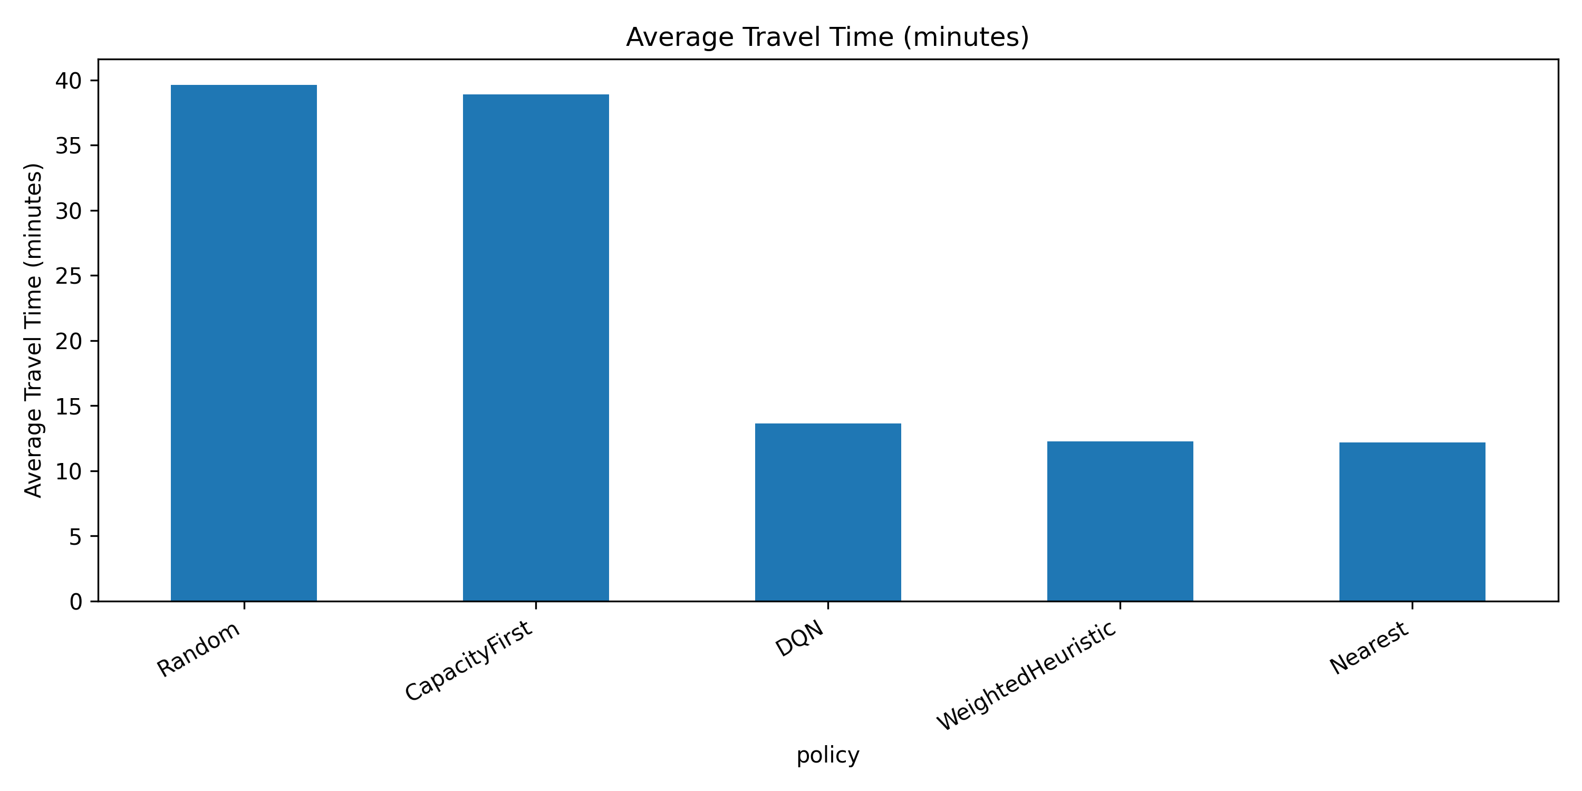
RL DYNAMIC EMERGENCY RESOURCE ALLOCATION
8. Experimental Results: Standard Operations
Performance Under Normal Conditions
• Nearest: Best mean travel time (12.14 min) and highest reward (3.76).
• Weighted Heuristic: Nearly identical performance to Nearest (12.21 min, 3.76 reward).
• DQN: Solid capacity management (17.04 min travel time, 3.27 reward) with 0.00% overload rate.
• Capacity-First: Massive travel time penalty (38.05 min, 218% increase) due to ignoring distance.
• Random: Poor performance (39.13 min travel time, 1.06 reward).

Slide 10
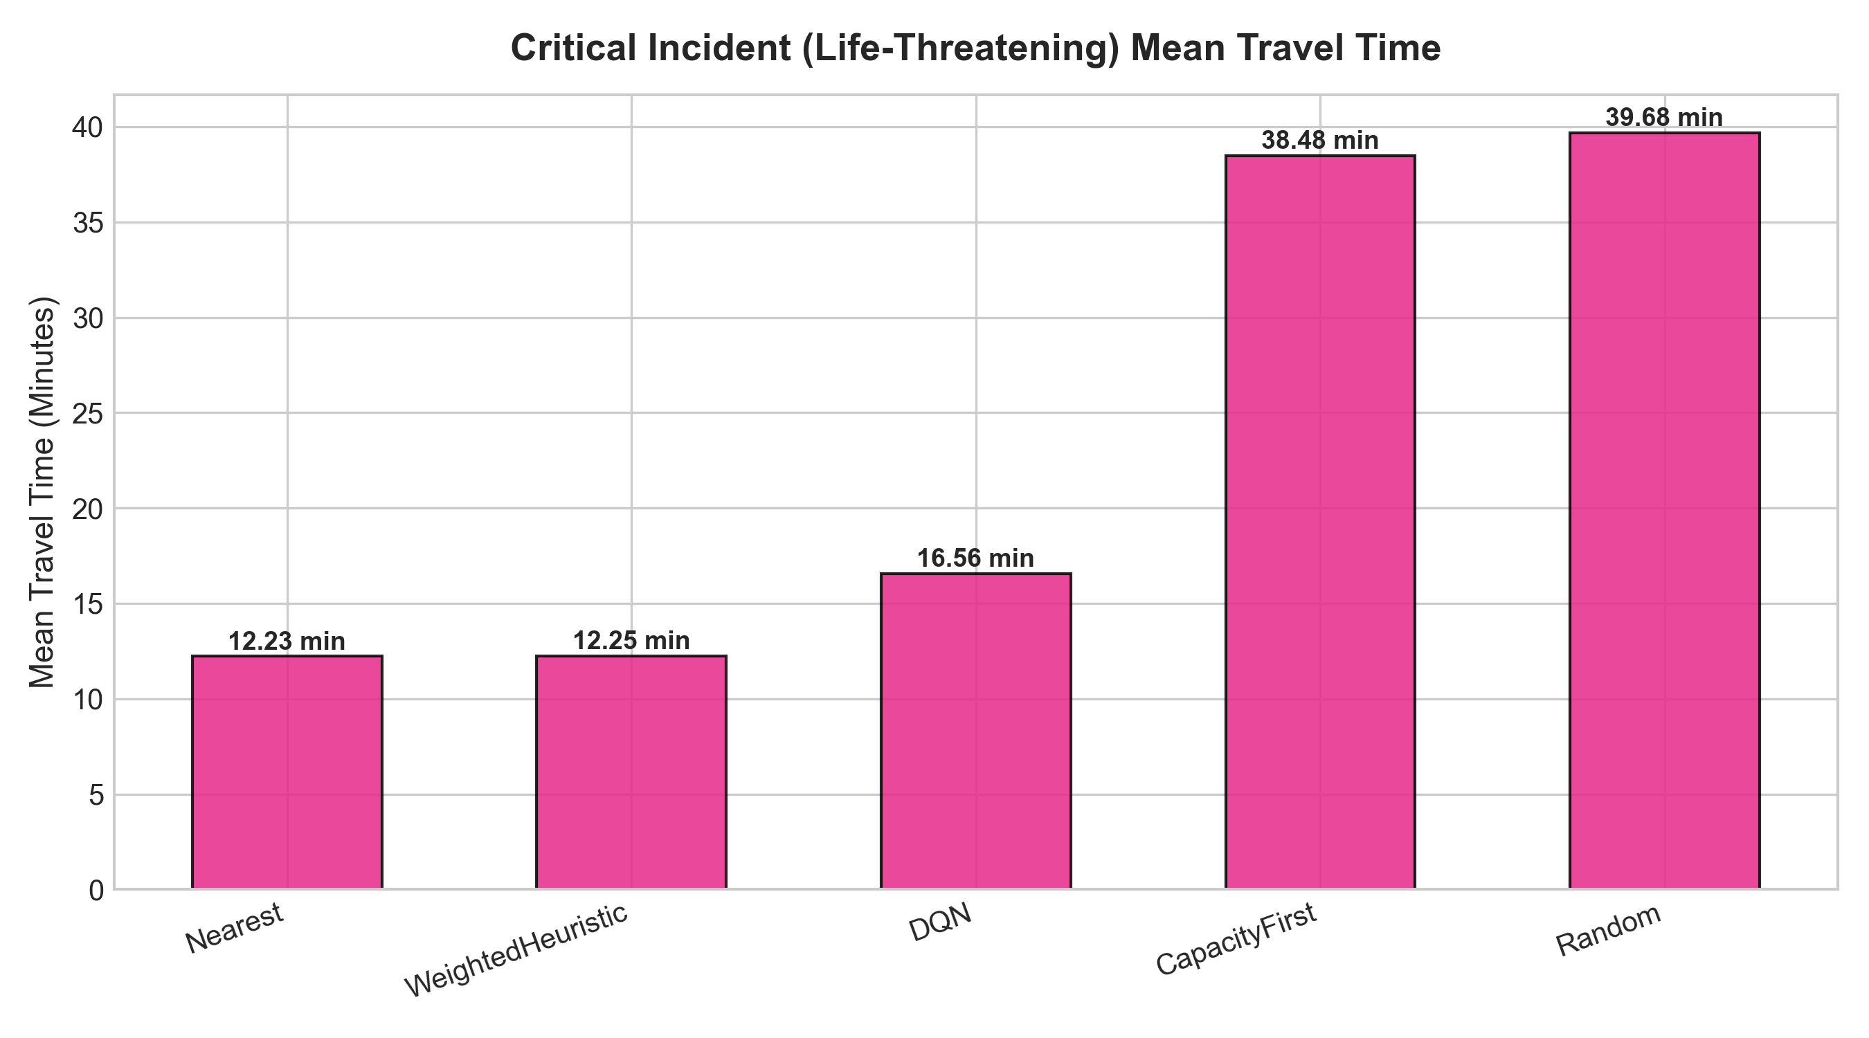
RL DYNAMIC EMERGENCY RESOURCE ALLOCATION
9. Results: Critical Case Performance
High-Acuity Calls (Severity 0)
• Subset Focus: 24.51% of total calls represent critical cardiac arrests / severe trauma.
• Weighted Heuristic: Achieves highest reward (3.6869) and fast transport (12.25 min).
• Nearest: Delivers critical patients in 12.23 minutes.
• DQN Safety Mechanism: Maintains zero critical overloaded ED admissions, averaging 16.56 minutes travel time.
• Conclusion: Proximity rules excel when capacities are open, while DQN acts as a safety buffer during surge.

Slide 11
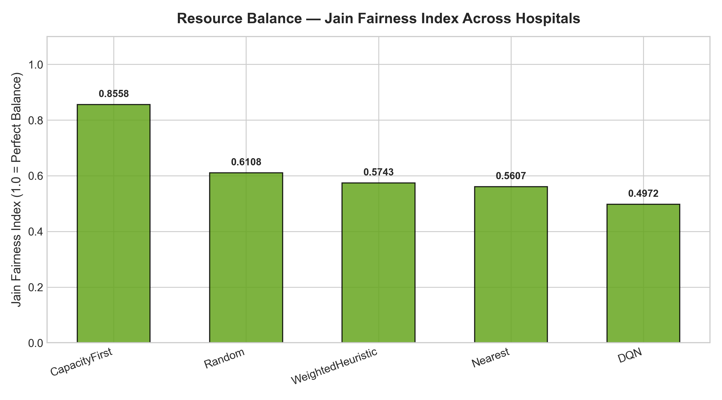
RL DYNAMIC EMERGENCY RESOURCE ALLOCATION
10. Resource Equity & Jain's Fairness Index
Systemic Hospital Load Balancing
• Capacity-First: Highest Jain's Index (0.8558) and lowest utilization variance (2.48e-6), but severely delays patients.
• DQN Agent: Balanced fairness index (0.5852) with low variance (1.21e-5), distributing loads without sacrificing speed.
• Weighted Heuristic: Achieves 0.5812 fairness index while keeping transport times fast.
• Nearest: Lowest fairness index (0.5701) due to clustering patients into neighborhood facilities.

Slide 12
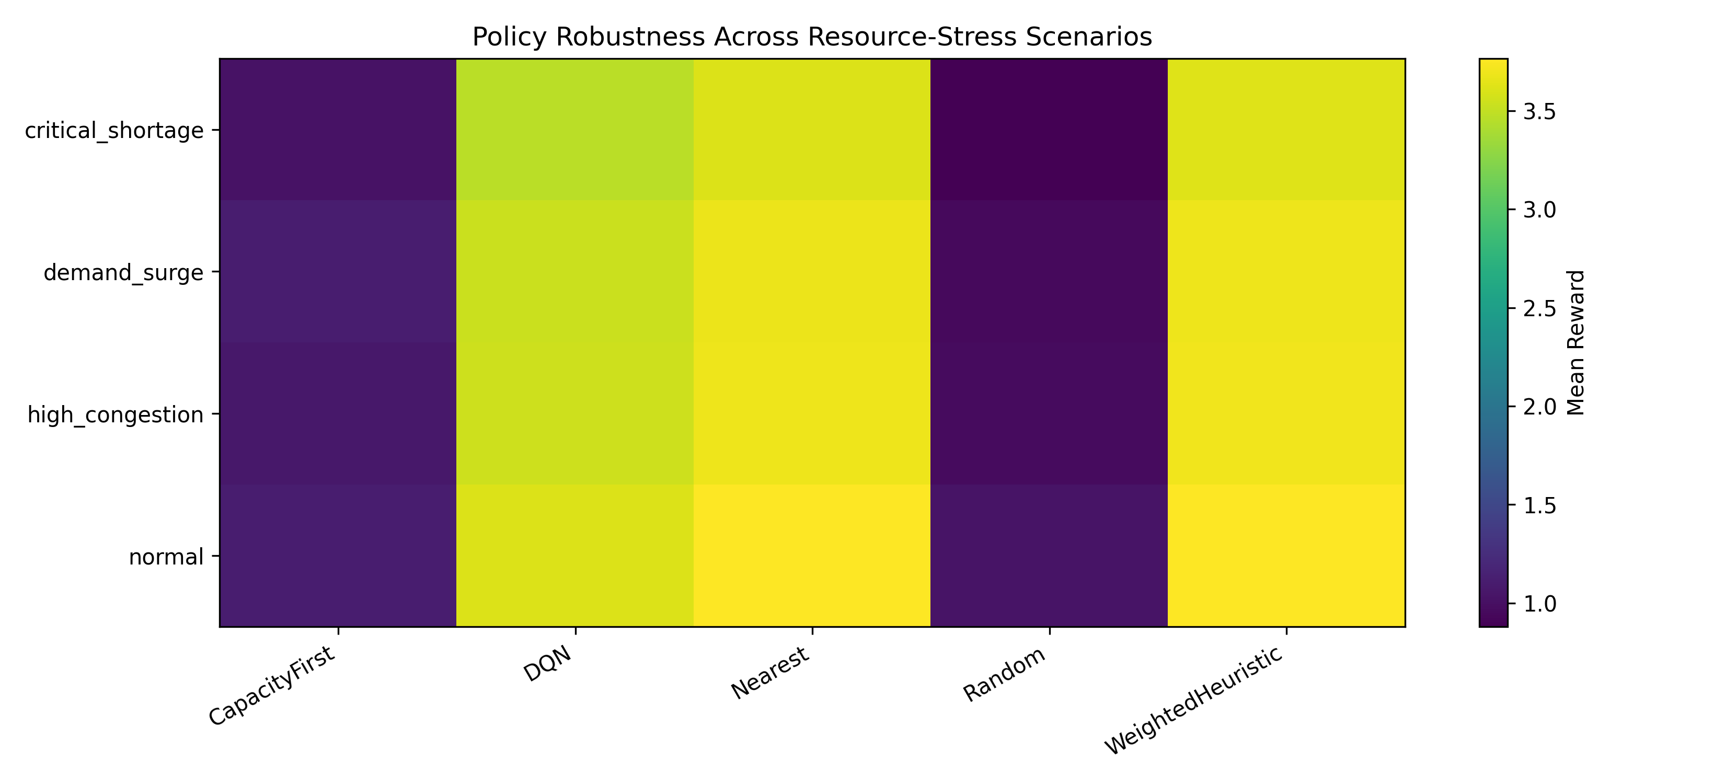
RL DYNAMIC EMERGENCY RESOURCE ALLOCATION
11. Robustness & Extreme Stress Testing
Stress Test Scenarios
• Multi-Seed Verification: Tested across 5 random seeds (42, 7, 21, 99, 123) with stable metrics.
• Critical Shortage (75-95% Occupancy): DQN maintains 13.59 min travel time & 3.47 reward.
• Demand Surge (1.75x Call Rate): DQN keeps performance stable at 13.58 min travel time.
• High Congestion (55-85% Occupancy): DQN yields 3.55 reward and 13.57 min travel time.
• Conclusion: DQN adapts effectively under severe system stress.

Slide 13
RL DYNAMIC EMERGENCY RESOURCE ALLOCATION
12. Practical Insights & Key Takeaways
1. Proximity is Dominant Under Light Loads
When hospital beds are open, Nearest routing is optimal because transport time dominates total call duration.
2. Pure Capacity Routing Fails
Capacity-First dispatching inflates travel time by over 200%, showing that load balancing cannot ignore road geography.
3. DQN Provides Adaptive Resilience
Deep Q-Networks successfully balance travel speed and capacity, preventing overloads during severe bed shortages.
4. Dispatcher Interpretability Matters
Rules like Weighted Heuristic provide transparent suggestions that human dispatchers can inspect and trust.

Slide 14
RL DYNAMIC EMERGENCY RESOURCE ALLOCATION
13. Conclusion & Future Directions
Project Summary
• Developed a realistic 258-dim Gymnasium MDP environment on 274,964 NYC EMS calls.
• Demonstrated that static nearest routing performs best in uncongested settings (12.1 min).
• Proved DQN's resilience in maintaining zero overloads during high congestion and bed shortages.
• Highlighted the essential trade-off between driving speed and regional bed fairness.
Future Research Directions
• Multi-Agent RL (MARL): Model individual ambulance units coordinating dispatch and dynamic fleet relocation.
• Live Traffic Streams: Integrate real-time API traffic speed updates into the distance matrix.
• Action Masking: Apply strict spatial proximity bounds directly to the Q-network action space.

Slide 15
Thank You!
Questions & Discussion
Parimisetty Sneha Deepika (AV.SC.U4AIE23034)
Nakka Keerthi (AV.SC.U4AIE23032)
Amrita Vishwa Vidyapeetham

