Slide 1
BranchLab
BCSE307P COMPILER DESIGN LAB · PROJECT REVIEW III
Lightweight AST-Guided Boundary Test Generation for C, Java and Python
Complete
Live online
Manuscript
Sneha Geevargis · 24BCB0149 · Vellore Institute of Technology
Notes:
Introduce yourself and the project. BranchLab reads a program's syntax tree, finds the conditions that decide each branch, and generates and runs tests aimed at the boundary of every condition, for C, Java and Python. At Review III the project is complete, deployed online, and written up as a research manuscript.

Slide 2
Three things to show today
REVIEW III
Completion & demo
Individual contribution
Research manuscript
Every objective met, a wider evaluation, and the tool running live online.
Slides 4–9
What I built, when, and the design decisions I can explain.
Slides 10–11
An IEEE-style paper: approach, 15-program evaluation, statistics and limits.
Slide 12
Notes:
Review III is marked on three parts, and this talk follows them. First, completion and a working demo: every objective is done, and the tool runs live online. Second, my individual contribution and technical understanding: what I built and the design decisions behind it. Third, the project outcome: a research manuscript with a full evaluation, which carries the most marks.

Slide 3
Tests read straight from the syntax tree
RECAP
Parse
Analyze
Generate
Deliver
Execute
Measure
Source to AST
Find conditions
Boundary values
Read map per path
Probed, isolated run
Coverage, faults
age >= 18
(age,>=,18)
17, 18, 19
stdin: 17
__probe(…)
branch 2/2
No solver, no search, no language model: generation takes milliseconds, and every test traces back to one condition on one line.
Notes:
A quick recap. Bugs cluster at the edge of conditions, and random inputs almost never land on that edge. BranchLab parses the program, finds each comparison like age >= 18, and generates the boundary values 17, 18 and 19. A read map delivers each value to the input read it belongs to, along that test's own path. For C and Java, probes inserted into the source measure branch and statement coverage. No constraint solver, no search, no language model: generation takes milliseconds and every test traces back to one condition.

Slide 4
Every Review I objective is done
PROJECT COMPLETION
Objective (Review I) | Final status
Parse C programs and build an AST | Done, plus Python and Java
Find branches, conditions and boundary cases | Done: if, while, switch, match
Generate targeted test cases | Done, plus invalid-input and fuzz tests
Branch, statement coverage and fault detection | Done in all three languages
Compare with random generation | Done on 15 programs, with a significance test
Beyond the plan: three languages · web interface · Docker deployment · live at branchlab-ggon.onrender.com
Notes:
These are the five objectives from Review I. All five are complete. The one item Review II listed as in progress, a wider evaluation, is now done too: the benchmark grew from 9 to 15 programs. The project goes beyond the plan with Java and Python support, a web interface, and a public deployment.

Slide 5
From prototype to finished study
SINCE REVIEW II
Wider benchmark
Statistics
15 programs (was 9): six lab exercises, three chosen to expose the method's limits
Exact Wilcoxon signed-rank test across programs, plus wins, ties and losses
Deployed
Manuscript
Docker image with GCC and a JDK, live at branchlab-ggon.onrender.com
IEEE conference-style paper with the full evaluation
Notes:
Four things changed since Review II. The benchmark grew to 15 programs, adding six common lab exercises; three of them were chosen because they contain conditions the tool cannot target, so the study shows the method's limits as well as its strengths. The comparison now has a statistical test. The tool is deployed: a Docker image with GCC and a JDK runs on Render, so anyone can use it from a browser. And the work is written up as a research manuscript.

Slide 6
Four runs that show everything
LIVE DEMO
Python starter
Tests 17, 18, 19 · 100% branch and statement coverage
1
C bank system
Every menu option runs · coverage tab shows what was missed
2
nested_login.py, 1 test
One verified and one not-reached suggestion
3
benchmarks/c/triangle.c
An honest limit: no targeted values for a + b <= c
4
Live: branchlab-ggon.onrender.com · Backup: run locally from the repository
Notes:
Open branchlab-ggon.onrender.com two minutes early, since the free server sleeps when idle. Run 1: the Python starter shows tests 17, 18 and 19 and full coverage. Run 2: paste the C bank program; every menu option runs, and the coverage tab shows what was missed and why. Run 3: set the maximum tests to 1 on nested_login.py to show a verified and a not-reached suggestion. Run 4: the triangle benchmark, to show an honest limit: the tool generates no targeted values for a + b <= c. If the network fails, run it locally as the backup.

Slide 7
Targeted beats random where it counts
RESULTS · 15 PROGRAMS · SAME NUMBER OF TESTS
BRANCH COVERAGE
STATEMENT COVERAGE
FAULTS DETECTED
90.0%
93.4%
91.0%
AST-targeted
AST-targeted
AST-targeted
Random: 57.6%
Random: 70.1%
Random: 14.1%
≈ 4 ms to generate a suite · 153 boundary mutants · random = mean of 3 seeds
Notes:
Across all 15 programs, with exactly as many tests on both sides: branch coverage 90.0% against 57.6%, statement coverage 93.4% against 70.1%, and boundary faults detected 91.0% against 14.1%. The fault-detection gap is the largest because covering a branch is not enough: a random suite can run both sides of age >= 18 without ever testing 17, 18 or 19. Generation takes about 4 milliseconds per program; 153 mutants were used in total.

Slide 8
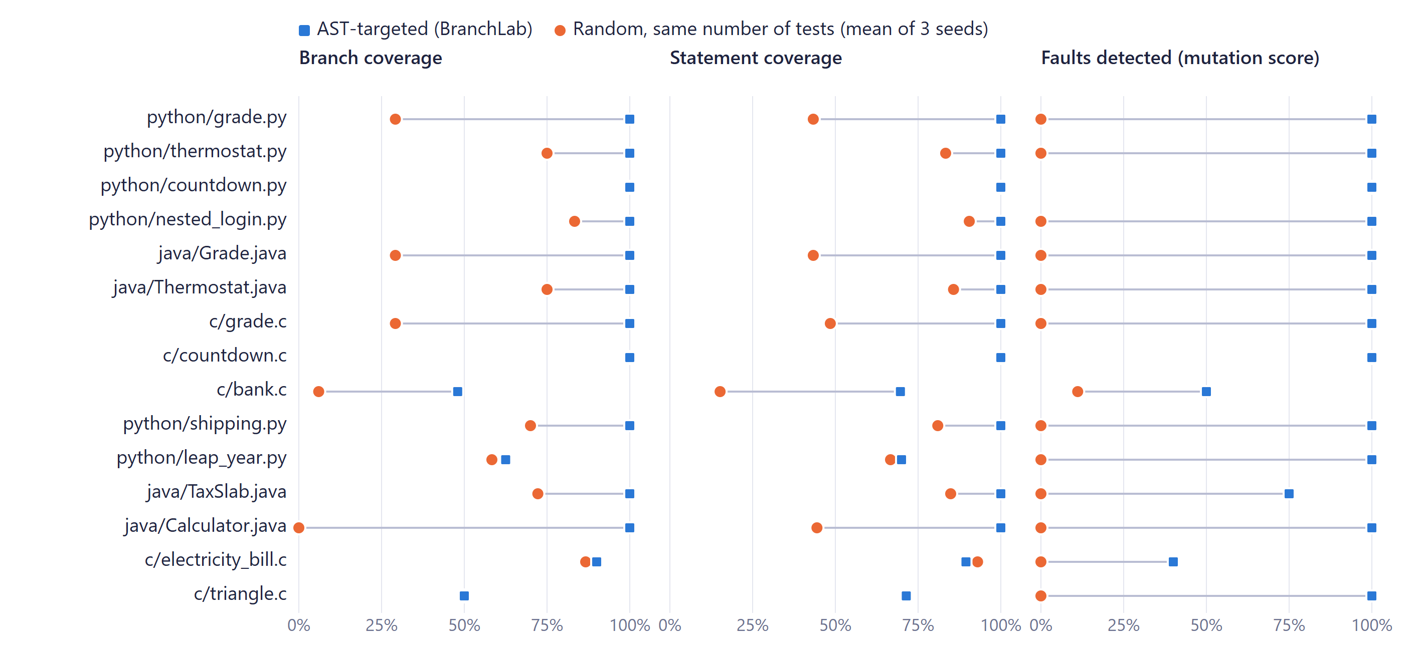
Never worse on branches or faults
PER PROGRAM
Notes:
Each row is one program; squares are BranchLab, circles are random suites of the same size. A square to the right of its circle means BranchLab did better; where only a square shows, both scored the same. On branch coverage and fault detection it is never worse. The one place random wins is statement coverage on the electricity bill, explained on the next slide.

Slide 9
Where the approach stops
HONEST LIMITS
Variable vs variable
Arithmetic in conditions
Computed values
Action sequences
triangle.c:
a + b <= c
leap_year.py:
year % 400 == 0
electricity_bill.c:
bill > 1000
bank.c:
create, then deposit
NEXT STEP
NEXT STEP
NEXT STEP
NEXT STEP
Light constraint handling
Solve simple forms like x % n == 0
Propagate boundaries back to inputs
Generate multi-step input sequences
Notes:
The benchmark deliberately includes programs where the method fails. Triangle: a + b <= c compares variables with each other, so both approaches tie at 50.0% branch coverage. Leap year: year % 400 == 0 has arithmetic in the condition. Electricity bill: the surcharge depends on bill, which is computed from the input; random wins on statements here, 93.0% against 89.5%. Bank: many branches need several actions in one run. Each of these points to future work.

Slide 10
Sole member: designed, built and evaluated
INDIVIDUAL CONTRIBUTION
6–7 Oct
16–21 Oct
23–27 Oct
28 Oct
Foundation
Three languages
Engine and UI
Finish
Python AST parser, boundary value generator
Tree-sitter for Java and C, multi-language runner, invalid and fuzz tests
Source probes, read map, statement coverage, React UI, evaluation
Benchmarks, statistics, Docker deployment, manuscript
49
252
3
15
commits
automated tests
languages
benchmark programs
Notes:
I am the only team member, so every part is my work: the analysis, generation, execution and coverage engine, the web interface, the evaluation, the deployment and the manuscript. The Git history records 49 commits from 6 to 28 October. The phases: first the Python AST parser and boundary generator; then Tree-sitter support for Java and C and the multi-language runner; then probes, the read map, statement coverage, the interface and the evaluation; and finally the benchmarks, deployment and manuscript. 252 automated tests check the tool, always against real outputs rather than reported coverage.

Slide 11
Design decisions and why
TECHNICAL UNDERSTANDING
Decision | Why
Boundary values c−1, c, c+1 | Off-by-one faults change behaviour only at the edge
Read map from the AST | Programs read by position; each test's path decides its reads
Source probes for C and Java | No tracer for compiled code; hits survive exit, crash, timeout
Compile once per run | Compiling dominates the cost; tests reuse one build
Pin Tree-sitter 0.25.2 | 0.26.0 crashed on large switches; regression test added
Equal-size random baseline | Isolates which values are chosen, not how many
Notes:
These are the decisions I would expect questions on. Boundary values: off-by-one faults only show at the edge. The read map: programs read by position, so values must follow each test's path. Probes: compiled programs cannot be traced like Python, so the source is instrumented; outcomes are written immediately so they survive crashes. Compile once: compiling is the slow part. Pinning Tree-sitter 0.25.2: version 0.26.0 corrupted memory on large switch statements, which was reproduced and turned into a regression test. Equal test counts: the comparison with random isolates which values are chosen, not how many.

Slide 12
A paper on the approach and its limits
PROJECT OUTCOME · RESEARCH MANUSCRIPT
CONTRIBUTIONS
STRUCTURE AND STATUS
AST-guided boundary test generator for C, Java and Python
Path-aware input delivery through a read map
Probe-based branch and statement coverage for compiled code
Comparison with random testing on 15 programs, with statistics
Part | Status
Introduction, related work (22 refs) | Written
Approach, implementation | Written
Evaluation: RQ1–RQ4, statistics | Written
Threats, limitations, conclusion | Written
Guide review, venue, submission | Next
Notes:
The project outcome is a research manuscript in IEEE conference format, titled BranchLab: Lightweight AST-Guided Boundary Test Generation for C, Java and Python. It has four contributions: the AST-guided generator, path-aware input delivery, probe-based coverage for compiled languages, and the empirical comparison on 15 programs with four research questions on coverage, fault detection, cost and limits. Every number in it comes from the reproducible evaluation script, and it reports threats to validity, including that the mutation operators match the faults the method targets. Next steps: review with my guide, then choose a venue and submit.

Slide 13
Questions?
THANK YOU
Then a live run of BranchLab.
LINKS
Live demo: branchlab-ggon.onrender.com
Source: github.com/SnehaGEE/ast-test-generator
Notes:
Take questions, then demo. Open https://branchlab-ggon.onrender.com two minutes before the review; the free server sleeps when idle and takes about a minute to wake. If the network fails, run it locally: python -m uvicorn api:app, and npm run dev in the frontend folder, then open localhost:5173.

