Slide 1
BranchLab
BCSE307P COMPILER DESIGN LAB · PROJECT REVIEW II
AST-Based Targeted Test Case Generation Using Program Analysis
Python
Java
C
Sneha Geevargis · 24BCB0149 · Vellore Institute of Technology
Notes:
Introduce yourself and the project: Compiler-Based Automatic Test Case Generation Using AST and Program Analysis, implemented as BranchLab. It reads a program’s syntax tree, finds the conditions that choose each path, and generates and runs tests aimed at both sides of every condition — for C, as planned in Review I, and also for Python and Java.

Slide 2
Bugs hide in the branch nobody tested
THE PROBLEM
Random inputs
Hand-written tests
Targeted tests
For age >= 18, a random age like 4,812 tests one side and almost never the edge.
Slow to write, and nobody can say which paths were never run.
Read the condition from the code, then test 17, 18 and 19: both sides and the boundary.
Notes:
Most bugs sit at boundaries and in branches that never ran. Random inputs rarely land on the boundary; hand-written tests take time and give no picture of what was missed. BranchLab takes the targeted route: it reads each condition from the program itself and picks values on both sides of it and exactly on it.

Slide 3
All five objectives are met
OBJECTIVES FROM REVIEW I
Objective (Review I) | Status at Review II
Parse C programs and build an AST | Done, plus Python and Java
Find branches, conditions and boundary cases | Done: if, while, switch
Generate targeted test cases | Done, plus invalid-input and fuzz tests
Branch, statement coverage and fault detection | Done, all three measured
Compare with random test generation | Done: results on slide 13
Working prototype: the BranchLab web interface for C, Java and Python.
Notes:
These are the five objectives from the Review I report and where each stands now. Parsing and the AST are done for C, as planned, and extended to Python and Java. Conditions are found in if, while and switch statements. Targeted tests are generated, plus invalid-input and fuzz tests. All three evaluation measures are implemented: branch coverage, statement coverage, and fault detection through mutation testing. And the comparison with random testing is done; the results are on slide 13. Everything is demonstrable in the working web prototype.

Slide 4
Targeted tests without a solver, search or LLM
NOVELTY
Approach | Relies on | Trade-off
KLEE, CUTE | symbolic execution, constraint solver | path explosion, solver cost
EvoSuite, DynaMOSA | evolutionary search | many iterations, mostly Java
STRUT, ChatUniTest | large language models | tests need checking and repair
BranchLab | only the AST | milliseconds, every test explained
Each test traces to one condition on one line
Probe-based coverage for compiled C and Java
Inputs follow each path; suggestions are verified
Notes:
The literature from Review I falls into three heavy-weight families. Symbolic execution tools like KLEE and CUTE reach high coverage but need constraint solvers and suffer path explosion. Search-based tools like EvoSuite and DynaMOSA need many optimisation iterations and are mostly Java. Recent LLM tools like STRUT and ChatUniTest depend on large models whose tests need checking and repair. BranchLab takes the lightweight route: it reads the conditions straight from the abstract syntax tree, so generation takes milliseconds and every test can be traced to the exact condition and line it targets. What is new beyond that: coverage for compiled C and Java through inserted probes, input delivery that follows each program path, and suggestions that are executed before they are shown.

Slide 5
One pipeline for three languages
ARCHITECTURE
Parse
Analyze
Generate
Execute
Measure
Python ast; Tree‑sitter for Java, C
if, while, switch conditions
boundary, invalid, fuzz inputs
isolated runs, one build
coverage and suggestions
React UI sends the program to a FastAPI backend: POST /api/run
Each language plugs in through one adapter: parse, analyze, execute
Notes:
Every request follows the same five stages. Parsing uses Python’s built-in ast module, and Tree-sitter grammars for Java and C. Analysis collects if, while and switch conditions. Generation picks boundary values, and optionally invalid and fuzz inputs. Execution runs each test in its own process; Java and C are compiled once per run. Measurement reports branch and statement coverage and suggests tests for missing outcomes. The React interface talks to a FastAPI backend, and each language is a small adapter behind one interface.

Slide 6
From one condition to three tests
AST ANALYSIS
SOURCE
AST NODE
TESTS RUN
age = int(input())
if age >= 18:
print("Adult")
else:
print("Minor")
If(
test=Compare(
Name('age'),
GtE(),
Constant(18)))
age | output
17 | Minor
18 | Adult
19 | Adult
Condition: age >= 18
Both sides covered
Also understood: and / or / not, reversed 10 <= x, literals -5, 0x1F, 5L, and switch / match cases.
Notes:
The analyzer walks the syntax tree. Here the If node’s test is a Compare of the name age, the operator greater-or-equal, and the constant 18. That becomes the condition age >= 18, and the boundary generator picks 17, 18 and 19. These are the real outputs: 17 is Minor, 18 and 19 are Adult, so both outcomes of the condition ran. The same works with and, or and not, reversed comparisons, negative, hex and suffixed literals, and switch or match cases, where case 2 means choice == 2.

Slide 7
Each test answers the reads on its own path
DELIVERING INPUTS
A MENU PROGRAM IN C
WHAT EACH TEST RECEIVES
scanf("%d", &choice);
switch (choice) {
case 1: scanf no, name, amount
case 2: scanf no, amount
}
test | stdin, in order
choice 1 | 1 · 1 · test · -1
choice 2 | 2 · 1 · 1
Values no condition needs get a typed placeholder: 1, 1.0 or test.
Follows switch, match and if branches, with C/Java fall-through
Includes reads inside helper functions the program calls
Handles Java’s nextLine() after nextInt()
Notes:
Generated values are keyed by variable name, but programs read them by position: the first scanf, the next Scanner call, the next input. BranchLab turns the program into a read map from its syntax tree and, for each test, follows the branches that test’s values choose. Option 1 of this menu reads the account number, name and amount; option 2 reads only number and amount, so each test gets exactly those answers. Values that no condition uses, like the name, get a placeholder of the right type so later values still land in the right variable. This was a real bug we found and fixed: before, values were shifted into the wrong variables.

Slide 8
Every test runs on its own, with a time limit
EXECUTION
Python
Java
C
A fresh Python process per test
Answers input() calls in order
Killed after 3 seconds if it hangs
Output capped at 100,000 characters
Compiled once per run, not once per test
Values on stdin, argv / args, or properties
10-second limit per test run
Compile errors shown on every result
Each result records its output, error, exit code or timeout, so a crash in one test never hides the others.
Notes:
Python programs run in a separate Python process per test, which can be killed if it hangs; the tool answers input calls itself and caps output. Java and C are compiled once per analysis run and then executed once per test, which made runs much faster than compiling per test. Values reach the program on standard input and, where the program uses them, on the command line; Java also gets them as system properties. One honest note: this isolation contains hangs and crashes but is not a security sandbox, so the tool should only be used on trusted code.

Slide 9
Every condition has two outcomes. Which ones ran?
COVERAGE
Python
Java
C
A tracer records the value of each if / while condition as the program really runs.
Each condition is wrapped in a probe that records the outcome and returns the value unchanged:
if (x > 5)
if (probe(3, (x > 5)))
while: true = the body ran, false = the loop ended
Outcomes survive exit(), crashes and timeouts
Statement coverage too: a line probe before every statement
Notes:
Coverage here means branch outcomes: every tracked condition can be true or false, and the percentage is the share of those outcomes the tests actually produced. Python is measured with a tracer while the program runs. Java and C cannot be traced that way, so the source is instrumented: every condition is wrapped in a probe call that records whether it was true or false and passes the value through unchanged, so the program behaves exactly as before. Each new outcome is written to a file immediately, so it is kept even if the program calls exit, crashes or times out. Statement coverage is measured the same way: a small probe before every statement records that it ran; a statement written without braces, like if (x) return 1, is wrapped as { probe; return 1; } so it can be counted without changing behaviour.

Slide 10
Suggestions are run before they are shown
SUGGESTIONS
PROGRAM · 1 TEST: AGE 17, SCORE 40
SUGGESTED TESTS
1 if age >= 18:
2 if score < 40:
3 print("Fail")
line | missing | inputs | check
1 | true | age 18, score 40 | Verified
2 | true | age 17, score 39 | Not reached
2 | false | age 17, score 40 | Not reached
Coverage: 25%. The inner if never ran.
With age at 17, changing score cannot reach line 2, so it is marked Not reached.
Notes:
For every missing outcome the tool proposes a boundary value, fills in the other variables, and then actually runs the suggestion once. Only if the missing outcome really happens is it marked Verified. In this real example with a single test, the suggestion for line 1 works. The suggestions for the inner condition cannot work on their own, because age stays 17 and the inner if is never reached, so they are honestly marked Not reached rather than presented as fixes.

Slide 11
Invalid-input and fuzz testing
ROBUSTNESS
Invalid input
REAL RUN · GRADE.JAVA
Text, empty values, None, symbols and huge numbers.
score | what happened
"garbage" | NumberFormatException
"" (empty) | NumberFormatException
10^100 | overflows int: exception
-999999 | Invalid score
Fuzz
Seeded random and extreme values, so every run is reproducible.
Shown as Input rejected or Exit code N, never as a silent pass.
Each strategy uses about 20% of the test budget.
Notes:
Beyond boundary tests, two optional strategies check how a program handles bad input. Invalid-input tests send values like text, empty strings, None and very large numbers. Fuzz tests send seeded random and extreme values, so results are reproducible. These are real results from the Java grade example: non-numeric text and a number too large for an int all crash Integer.parseInt, which the report shows clearly, while minus 999,999 is correctly reported as an invalid score.

Slide 12
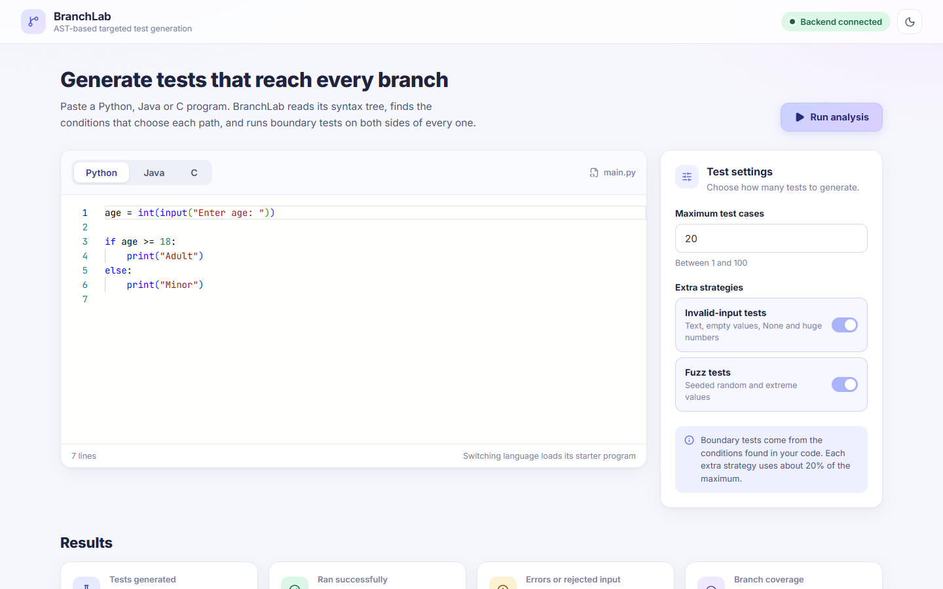
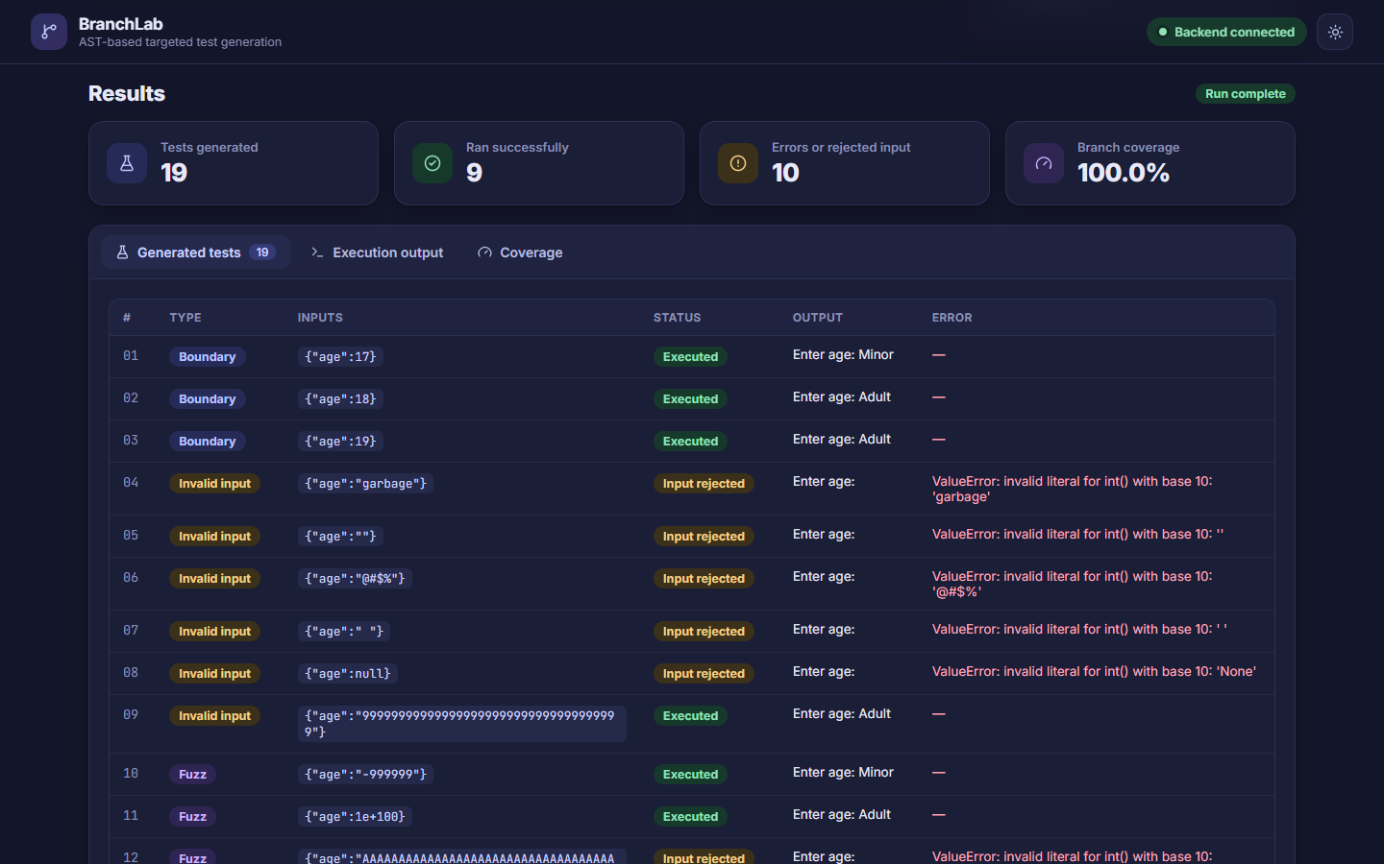
BranchLab in the browser
THE PROTOTYPE
Write or paste code, pick the language and how many tests
Results, output and coverage tabs, in light or dark mode
Notes:
The web interface is built with React and talks to the FastAPI backend. On the left, the workspace: language tabs for Python, Java and C, a code editor, the maximum number of tests, and switches for invalid-input and fuzz testing. On the right, the results in dark mode: summary cards, then tabs for the generated tests, the raw execution output, and branch and statement coverage with suggestions. A live indicator shows whether the backend is connected.

Slide 13
Same number of tests, four times the faults found
RESULTS · AST-TARGETED VS RANDOM
9
programs in C, Java and Python
81
injected boundary faults
< 25 ms
to generate each suite
Random: same test count, 3 seeds,
uniform values in [-1000, 1000].
Notes:
This is the comparison promised in Review I. Each program gets BranchLab’s targeted tests and random tests of exactly the same size, uniform integers between minus 1,000 and 1,000, averaged over three fixed seeds. Fault detection is measured by mutation testing: at every comparison we inject three boundary bugs, the operator off by one and the constant plus or minus one, 81 faults in total, and count how many each suite catches. Averaged over nine programs, the targeted tests caught 94.4 percent of the faults against 23.7 percent for random, with 94.2 versus 58.5 percent branch coverage and 96.6 versus 67.8 percent statement coverage. Generating the tests took under 25 milliseconds per program. The full table is in the report and in docs/evaluation/results.md, and anyone can reproduce it with one command.

Slide 14
A menu-driven bank system in C
CASE STUDY · BRANCH COVERAGE
12%
44%
58%
before
switch cases tested
each path gets its own inputs
22 of 25
All 8 options
107 of 145
conditions saw an outcome (was 3)
of the menu run, plus invalid choices
statements ran: 73.8% statement coverage
Notes:
A real case study: a 280-line menu-driven bank management system in C with a binary search tree, linked lists and file output. On the first run, BranchLab reached only 12 percent branch coverage, because menu options were never selected and values landed in the wrong variables. Treating switch cases as conditions raised it to 44 percent, and giving each path exactly the inputs it reads raised it to 58 percent, with 22 of 25 conditions exercised and every menu option run. In that run, with 20 tests including invalid and fuzz inputs, 107 of 145 statements executed, 73.8 percent statement coverage. The remaining branches need two actions in one run, such as creating an account and then depositing, which is a known limitation.

Slide 15
A 100% display is never taken as proof
TESTING THE TESTER
242
REAL BUGS THESE CHECKS CAUGHT
found | fixed by
Python values swapped between variables | read order from the AST
Java Scanner programs hung on every test | always supplying stdin
C scanf read garbage yet showed as passed | values on stdin per path
Parser library crashed on large switches | pinned tree-sitter 0.25.2
automated tests, all passing
Every output is compared with a reference program, and expected coverage is recomputed from the real inputs.
Notes:
We treated the tool itself as something to test. There are 242 automated tests. They do not trust the coverage number: every program output is compared with a reference implementation, and the expected true and false outcomes are recomputed independently from the actual generated inputs. Each fix was written test-first: a failing test, then the change. These checks caught real bugs that a percentage alone would have hidden: Python values swapped between variables, Java Scanner programs hanging, C programs reading uninitialised memory while showing as passed, and a crash inside the tree-sitter parser library that we traced to version 0.26.0 and fixed by pinning 0.25.2.

Slide 16
What BranchLab does not do yet
LIMITS AND FUTURE WORK
Today
Next
One run, one set of values: no multi-step sequences
Conditions like x > y or strlen(s) > 5 are not analyzed
for, switch and ?: run but are not counted in branch coverage
Isolation contains crashes, but is not a security sandbox
Input sequences for stateful programs
Symbolic execution for variable-to-variable conditions
Coverage for loops and switch cases
Container sandboxing for untrusted code
Unreached branches are reported as missing, never hidden behind a higher number.
Notes:
Honest limits. Each test is a single run with one set of values, so behaviour that needs a sequence of actions, like creating an account and then depositing, is not generated. Only comparisons between a variable and a number produce targeted inputs. Loops and switch statements run normally but are not counted in the branch coverage percentage. And the process isolation contains hangs and crashes but is not a security sandbox. Future work: generating input sequences, symbolic execution for richer conditions, coverage for loops and switch cases, and container-based sandboxing. Importantly, whatever is not reached is shown as missing, never hidden.

Slide 17
Thank you
LIVE DEMO
Questions, then a live run of the bank system in BranchLab.
RUN IT YOURSELF
python -m uvicorn api:app --reload
cd frontend && npm run dev
Live demo: branchlab-ggon.onrender.com
Source: github.com/SnehaGEE/ast-test-generator
Notes:
Thank the audience and take questions. For the demo: open https://branchlab-ggon.onrender.com about two minutes early, since the free server sleeps when idle. As a backup, run it locally: start the backend with python -m uvicorn api:app --reload, and the frontend with npm run dev in the frontend folder, then open localhost:5173. Suggested flow: run the Python starter to show 17, 18 and 19 and full coverage; then paste examples/c/bank.c with 20 tests and show that every menu option runs, the coverage tab with branch and statement coverage, and the suggestions marked not reached for deposit and withdraw; finally toggle dark mode. Fill in the repository link before presenting.

