Slide 1
LINE-1 ORF1p and L1TD1 Binding Sites
Sneha Gummadi

Slide 2
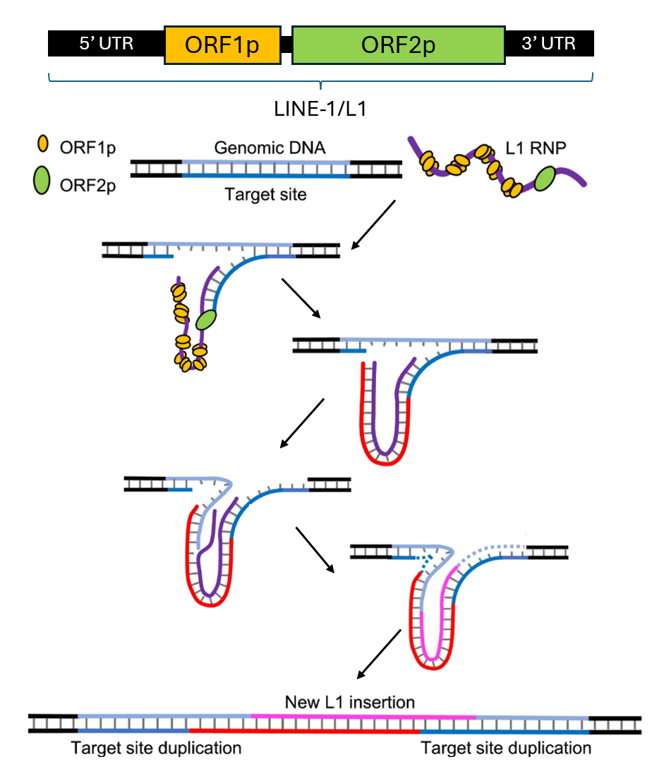
Transposable Elements and LINE-1
Transposable elements are genetic parasites, that either appeared naturally through evolution or through a viral integration.¹
They have been co-opted as regulatory gene elements and been implicated in diseases such as cancer
Long Interspersed Nuclear Elements 1 (LINE-1) are transposable elements that operate in a copy-and-paste mechanism. They are the only transposons that are capable to retrotransposoning on their own.¹
This is due to an intact LINE-1 coding for two proteins: ORF1p and ORF2p. ORF1p is an RNA-binding protein that preferentially binds to LINE-1 transcripts. ORF2p is responsible for facilitating the insertion of LINE-1 into the host’s genome.
Fig 1²

Slide 3
Question
What binding sites does ORF1p preferentially bind to?
Do these binding sites differ from L1TD1’s binding sites?
Why L1TD1?
L1TD1 is the domesticated version of ORF1p that was co-opted to function as a post-transcriptional silencer and modulate RNA processing.
L1TD1 contains two segments that share high identify with ORF1p.

Slide 4
Data
RIP-seq of L1TD1³
RIP-seq of ORF1p⁴
Pre-Processing:
Alignment to Transcriptome using Salmon
Differential expression using DESeq2 to determine bound vs. unbound sequences.
Full Transcript bound to protein

Slide 5
Model Architecture
Convolutional Layer 1
Batch Normalization + GELU activation
Max Pooling
kernel_size = 2
Training:
Optimizer: Stochastic Gradient Descent with Nesterov momentum of 0.95 because data is noisy.
Loss Function: Binary Cross-Entroy Loss with Logits (BCEWithLogitsLoss).
combines sigmoid layer with BCELoss
Learning Rate Scheduler: ReduceLROnPlateau()
Hyperparameters:
Learning rate: 0.001
Kernel size: 15
Convolutional Layer 2
Batch Normalization + GELU activation
Max Pooling
kernel_size = 2
Dropout1d
Convolutional Layer 3
Batch Normalization + GELU activation
Dropout1d
Adaptive Max Pooling
Dense

Slide 6
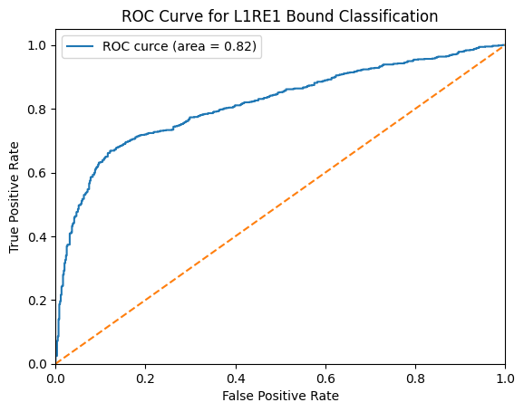
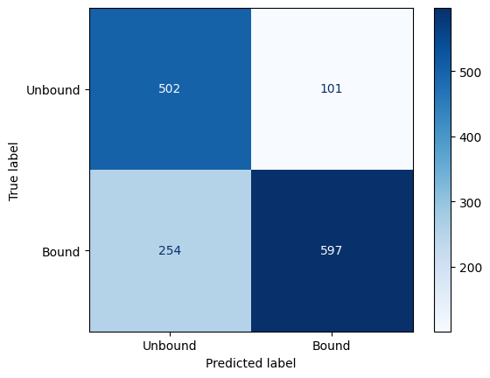
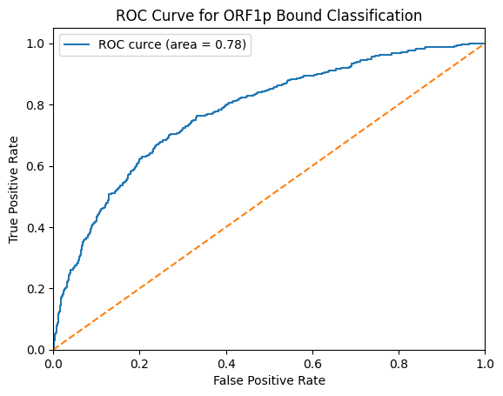
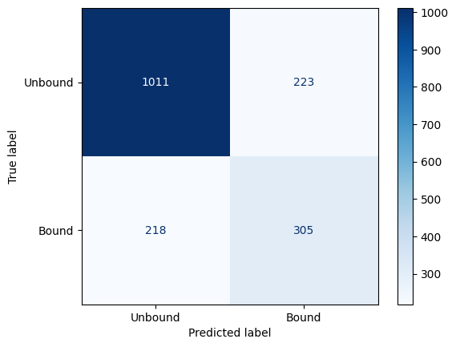
Results
Test Results
Accuracy | 75.58%
F1-Score | 77.08%
Precision | 85.53%
Recall | 70.15%
L1TD1
Test Results
Accuracy | 74.90%
F1-Score | 58.04%
Precision | 57.77%
Recall | 58.32%
ORF1p

Slide 7
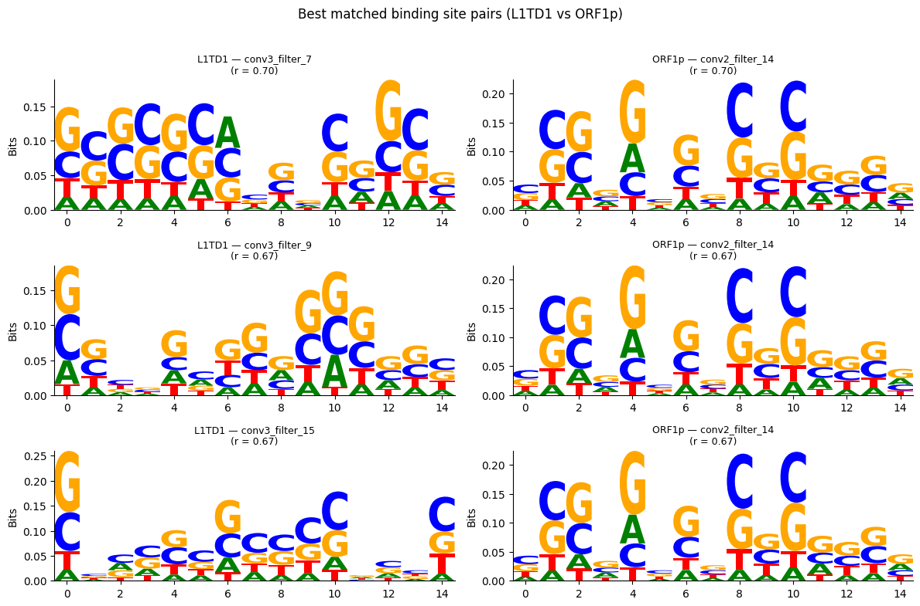
Comparing Top Binding Sites Learned
Extracted binding sites from filters
Pearson correlation comparing the similarity between the binding site sequences
Those with an R > 0.6 are plotted

Slide 8
Discussion
Limitations
Data originates from two different cell lines, potentially biasing the comparison of binding sites between the two proteins
There is a significant room for improvement in the model
Future Directions
Using transfer learning on an RNA foundation model to predict the binding sites

Slide 9
References
Hayward, A., & Gilbert, C. (2022). Transposable elements. Current Biology, 32(17), R904–R909. https://doi.org/10.1016/j.cub.2022.07.044
Naufer, M. N., Furano, A. v., & Williams, M. C. (2019). Protein-nucleic acid interactions of LINE-1 ORF1p. Seminars in Cell & Developmental Biology, 86, 140–149. https://doi.org/10.1016/J.SEMCDB.2018.03.019
Kavaklioglu, G., Podhornik, A., Vcelkova, T., Marjanovic, J., Beck, M. A., Phan-Canh, T., Mair, T., Miccolo, C., Drino, A., Doni, M., Egger, G., Chiocca, S., Modic, M., & Seiser, C. (2025). The domesticated transposon protein L1TD1 associates with its ancestor L1 ORF1p to promote LINE-1 retrotransposition. eLife, 13. https://doi.org/10.7554/ELIFE.96850
You, E., Patel, B. K., Rojas, A. S., Sun, S., Danaher, P., Ho, N. I., Phillips, I. E., Raabe, M. J., Song, Y., Xu, K. H., Kocher, J. R., Richieri, P. M., Shin, P., Taylor, M. S., Nieman, L. T., Greenbaum, B. D., & Ting, D. T. (2025). LINE-1 ORF1p Mimics Viral Innate Immune Evasion Mechanisms in Pancreatic Ductal Adenocarcinoma. Cancer Discovery, 15(5), 1063–1082. https://doi.org/10.1158/2159-8290.CD-24-1317/751680/AM/LINE-1-ORF1P-MIMICS-VIRAL-INNATE-IMMUNE-EVASION

Slide 10
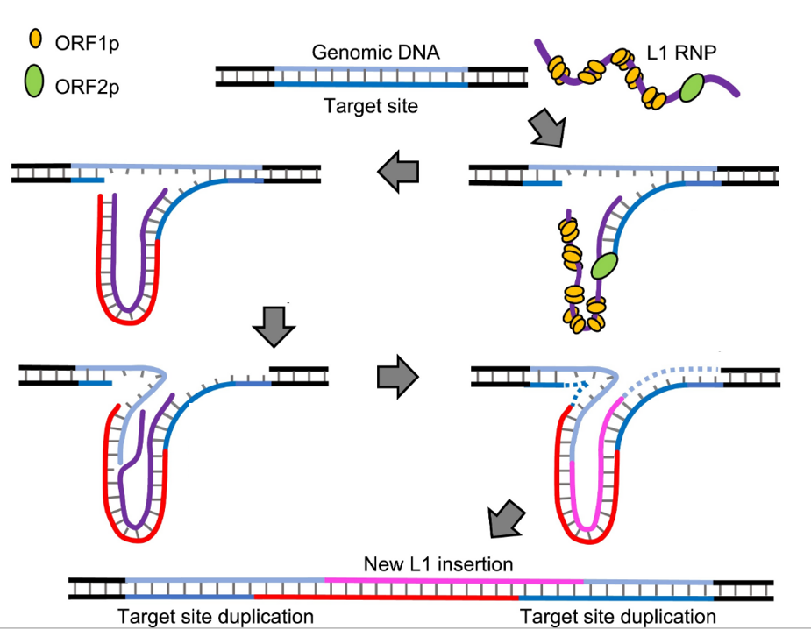
5’ UTR
ORF1p
ORF2p
3’ UTR
LINE-1/L1

