Slide 1
Optimizing Customer Retention
Capstone Business Analysis | 2026

Slide 2
Business Problem Statement
- Current Churn Rate is impacting revenue growth.
- Cost of acquisition is 5x more than retention cost.

Slide 3
Key Churn Drivers
A. Contract Structure
B. Customer Tenure
C. Service Pricing

Slide 4
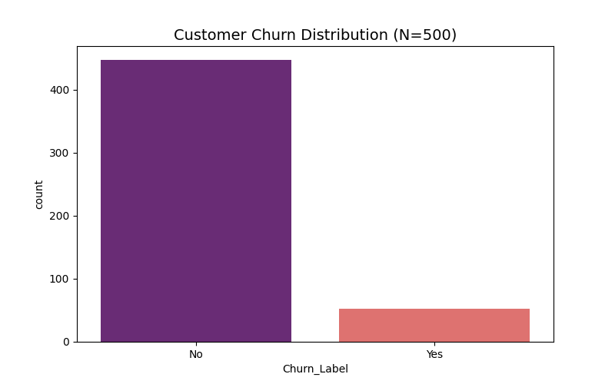
Visualizing the Churn Trend

Slide 5
Actionable Recommendations
1. Loyalty Rewards for New Customers
2. Discounted Annual Migrations

