Slide 1
LENDING CLUB CASE STUDY
By : Sneha Bajaj
Varun Mohite

Slide 2
Contents
Business Objective
Data Information
Analysis Approach
Exploratory Data Analysis
Insights
Recommendations

Slide 3
Business Objective
The objective is to identify the driving factors (or driver variables) behind loan default. Identification of the variables can be used for taking actions such as denying the loan, reducing the amount of loan, lending (to risky applicants) at a higher interest rate, etc.
Analyze data and generate insights and recommendations which will help Lending Club for its portfolio and risk assessment.

Slide 4
Data Information
Historical data containing the loan details for all loans issued.
The data contains 111 columns and 39717 rows.
The primary attribute in data is ‘loan_status’ which has 3 distinct data values:
Fully-Paid: Signifies customers who have successfully repaid their loans.
Charged-Off: Indicates customers who have been labeled as "Charged-Off" or have defaulted on their loans.
Current: Represents customers whose loans are presently in progress and, thus, cannot provide conclusive evidence regarding future defaults.
For the purposes of this case study, rows with a "Current" status will be excluded from the analysis.

Slide 5
Analysis Approach
Understanding business KPIs - Studying data dictionary and data to understand variables and identify target variable.
Data Preprocessing - Data Cleaning (remove Null values, single value and duplicates, outlier treatment etc.)
Data Transformation(converting the data into a suitable format)
Data Reduction(selecting required KPIs for analysis)
Data Discretization(binning ,clustering)
Univariate Analysis - Check distributions and frequencies of various numerical and categorical variables
Create derived variables if required
Segmented Univariate Analysis - Analyze variables against segments of other variables.
Bivariate Analysis - Analysis of two variables for determining the empirical relationship between them.
Summarization - Publish insights and observations

Slide 6
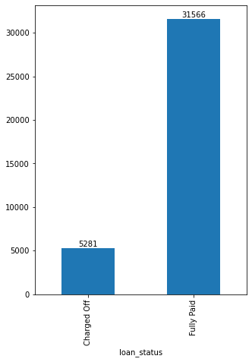
Analysis - Overall Loan Status
The overall loan default rate is 14%
The overall non-default rate is 86%

Slide 7
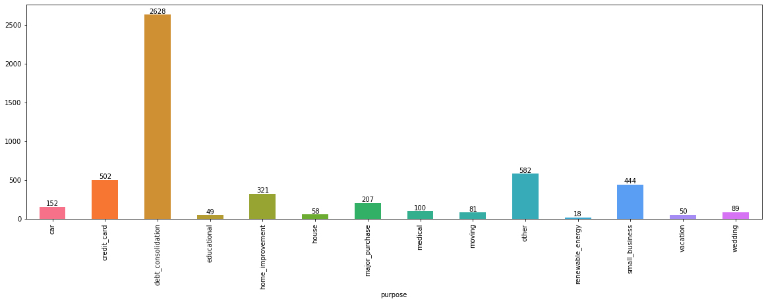
Analysis : Purpose & Default Loan Status
50% of the “Charged off” loan was due to Debt consolidation. The lending company needs to exercise caution when approving loans for debt consolidation purposes, as it has maximum number of defaults.

Slide 8
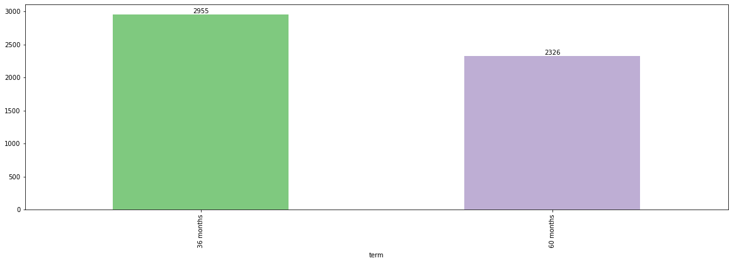
Analysis : Term & Default Loan Status
57% “Charged off” was due to Short-term loans with a duration of 36 months. This suggests that a significant portion of applicants who experienced loan default chose shorter repayment terms.

Slide 9
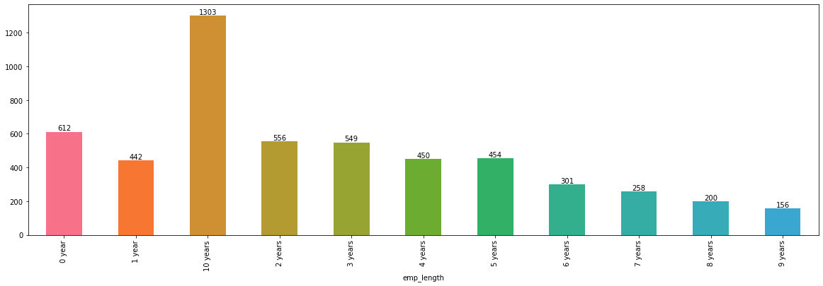
Analysis : Employment Length & Default Loan Status
Applicants who had been employed for 10 years or more than 10 years accounted for the highest number of "Charged off". This indicates that long-term employment history did not necessarily guarantee successful loan repayment.

Slide 10
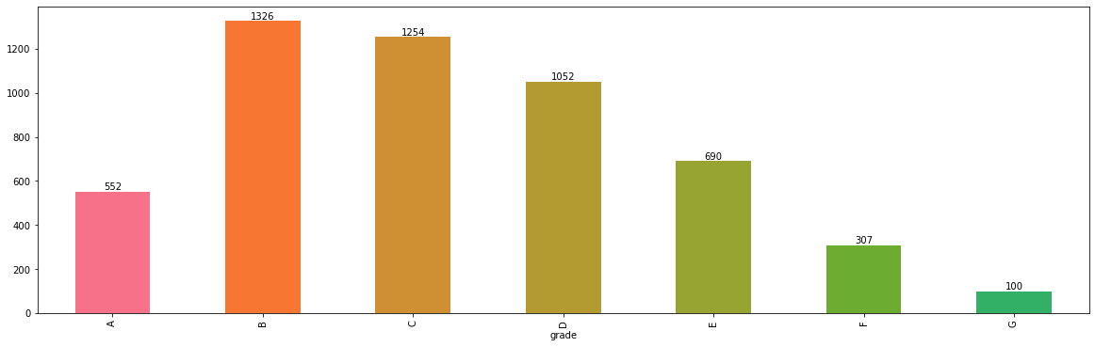
Analysis : Grade & Default Loan Status
Grade B & Grade C applicants constitutes ~50% of the defaulters.
Significant increase (58%) in default rate is observed from Grade A to Grade B while a declining trend is observed from Grade C to Grade G.

Slide 11
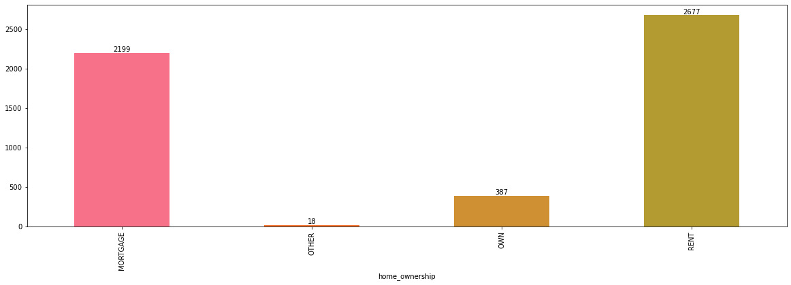
Analysis : Home ownership & Default Loan Status
50% of "Charged off" loan consumer lived in rented houses followed closed by mortgage houses.

Slide 12
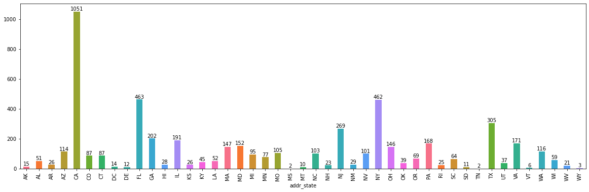
Analysis : State & Default Loan Status
California observes high default rate followed by Florida & New York.

Slide 13
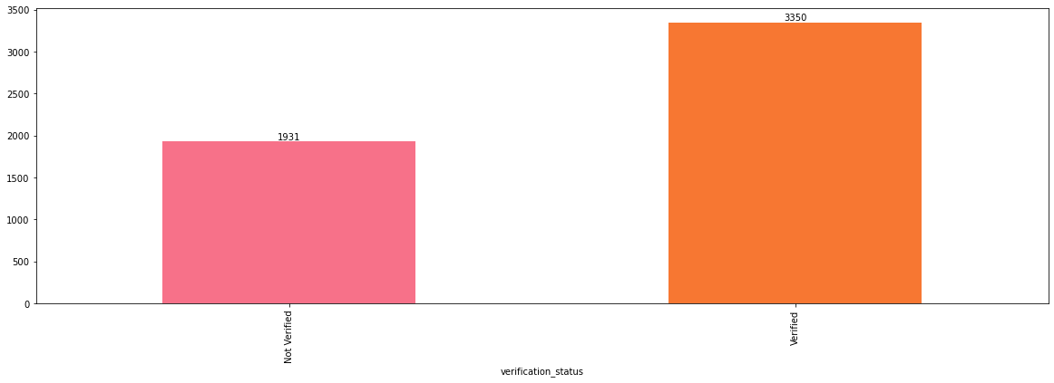
Analysis : Verification status & Default Loan Status
Significant number of loan applicants who have been verified are defaulting than those not verified.

Slide 14
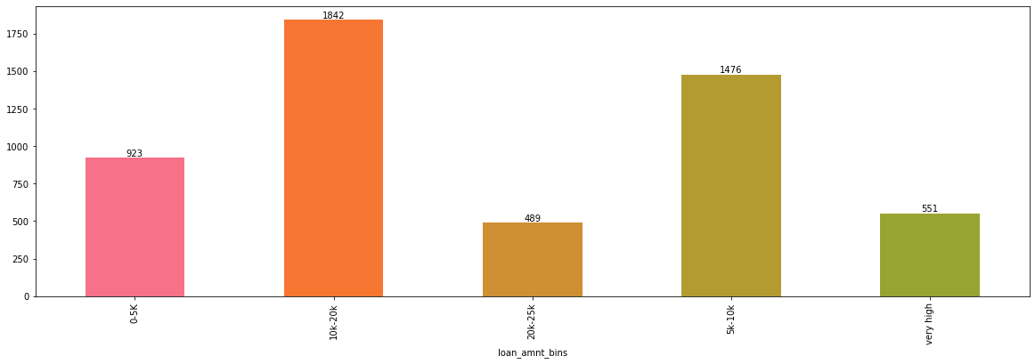
Analysis : Loan Amount & Default Loan Status
Consumers who take loan in the range of 10k to 20k default most

Slide 15
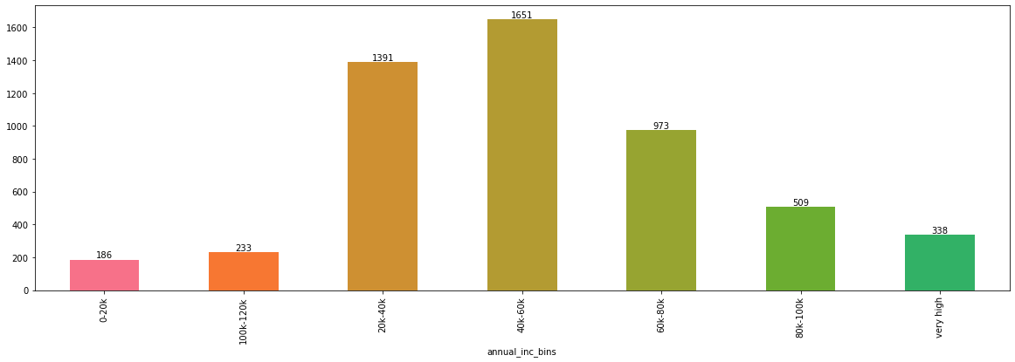
Analysis : Annual Income & Default Loan Status
Consumers who have annual income in the range of 40-60k defaults most followed by consumers with annual income of 20-40k

Slide 16
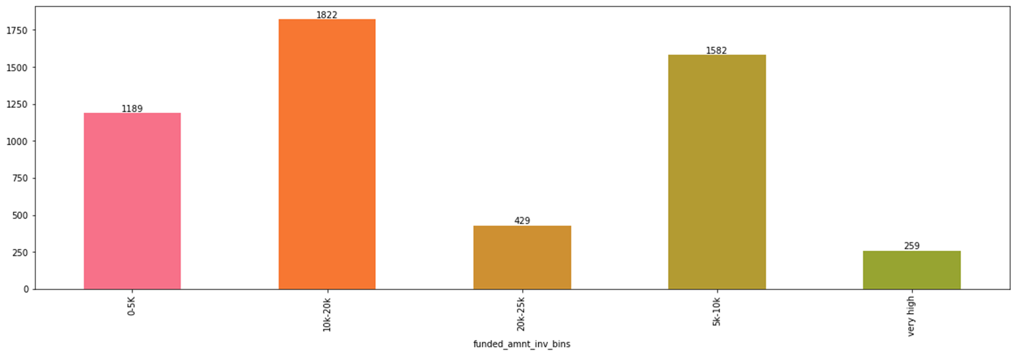
Analysis : Funded Amount Invested & Default Loan Status
Consumers in the range of 10-20k defaults most

Slide 17
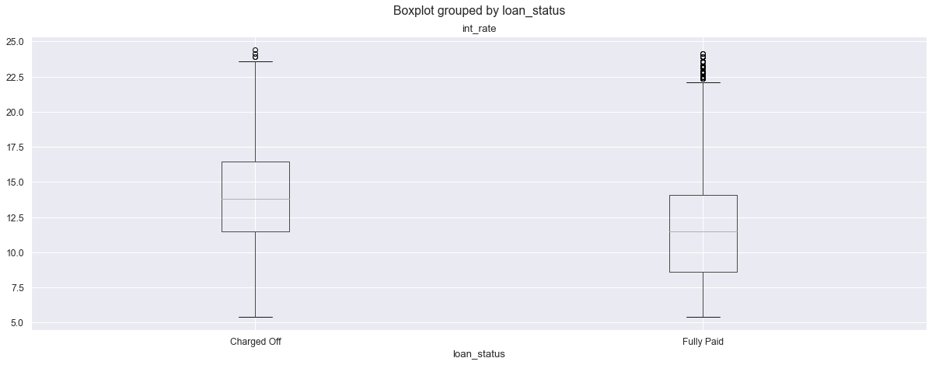
Analysis of Interest Rate and Loan Status
Loans at a higher interest rate are more likely to be Charged Off.

Slide 18
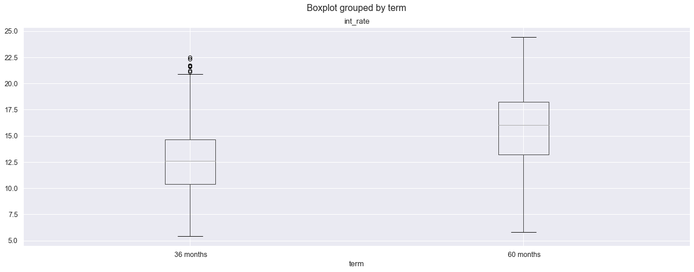
Analysis of Interest Rate and Term for Loan_status = Charged_off
Larger interest rate were given for higher term i.e. tenure of 5 years for Charged_off loan status

Slide 19
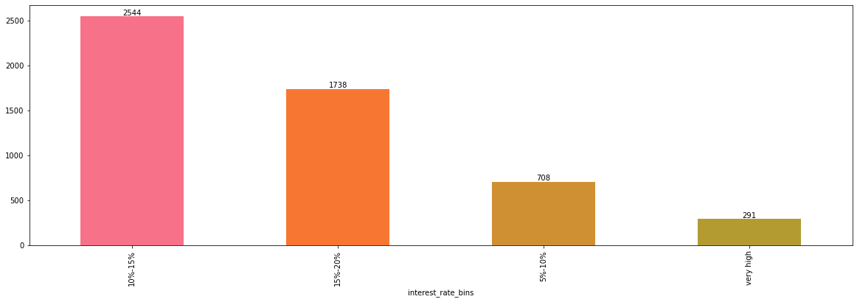
Analysis : Interest Rate & Default Loan Status
Consumers who have interest rate in the range of 10-15% default the most

Slide 20
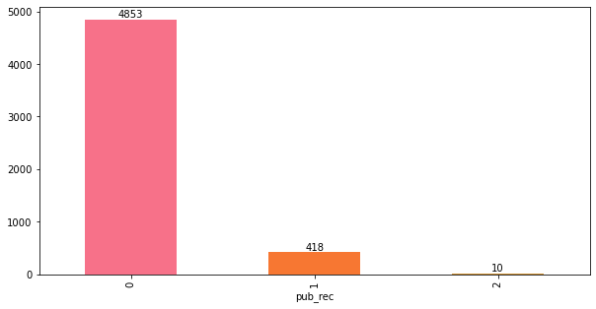
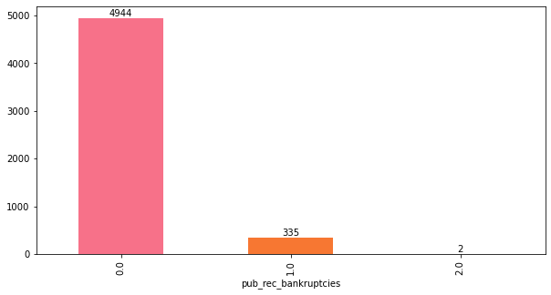
Analysis : Public Records & Default Loan Status
Greater than 90% of the consumers don't have public record bankruptcies or derogatory public records still they default while less than 10 % of consumers have public record bankruptcies and derogatory public records and they default which is obvious

Slide 21
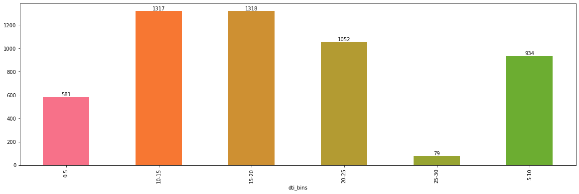
Analysis : Dti* & Default Loan Status
*A ratio calculated using the borrower’s total monthly debt payments on the total debt obligations, excluding mortgage and the requested LC loan, divided by the borrower’s self-reported monthly income.
Consumers having Dti in the range of 10-20% are highest defaulters.

Slide 22
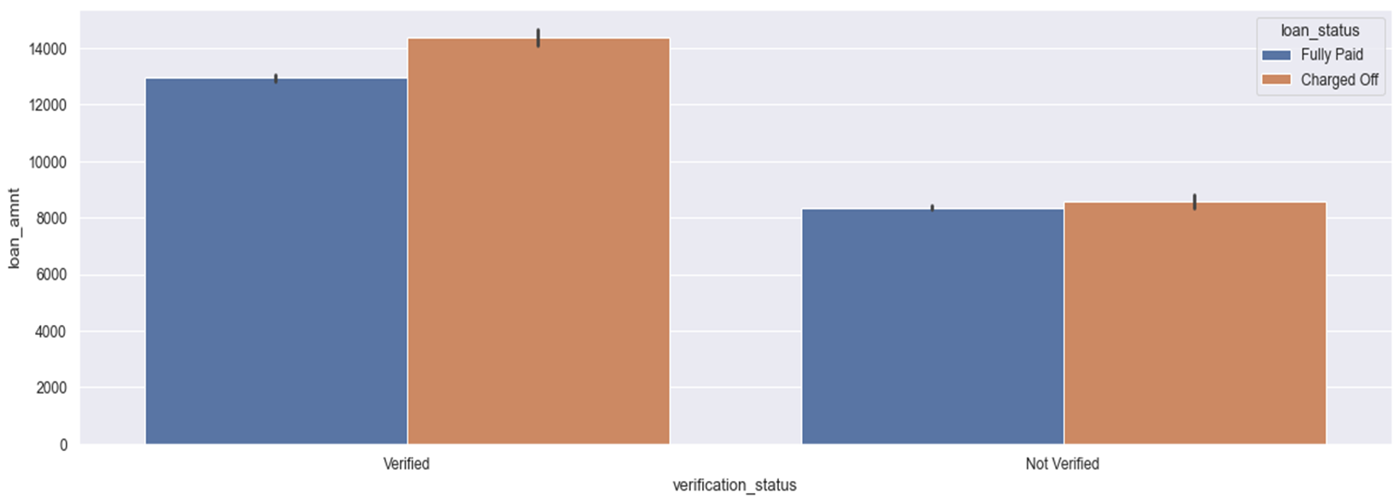
Analysis of Loan amount, Verification status & Loan status
Higher loan amounts are Verified more often and also higher loan amounts charges off most. This, explains why higher loan amounts are verified most.

Slide 23
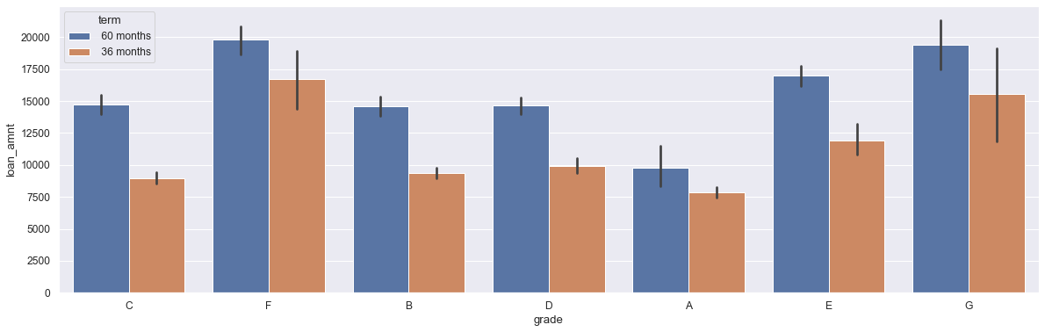
Analysis of Loan amount, Grade and Term
Higher loan amount are associated with lower grade for longer terms for Charged_off loan status

Slide 24
Insights:
50% of the “Charged off” loan was due to Debt consolidation.
2. 57% “Charged off” was due to Short-term loans with a duration of 36 months. This suggests that a significant portion of applicants who experienced loan default chose shorter repayment terms.
3. Increase in default rate is observed from Grade A to Grade B while a declining trend is observed from Grade C to Grade G.
4. Significant number of loan applicants who have been verified are defaulting than those not verified. Higher loan amounts are Verified more often and also higher loan amounts charges off most. This, explains why higher loan amounts are verified most.
5. Applicants who had been employed for 10 years or more than 10 years accounted for the highest number of "Charged off".

Slide 25
Insights (contd..) :
6. 50% of "Charged off" loan consumer lived in rented houses followed closed by mortgage houses
7. California observes high default rate followed by Florida & New York.
8. The borrowers who are in lower income groups have maximum tendency to default the loan and it generally decreases with the increase in the annual income.
9. The tendency to default the loan is increasing with increase in the interest rate.

Slide 26
Recommendations :
Exercise caution when approving loans for debt consolidation purposes
Exercise caution before granting loans who stay in rented & mortgaged homes.
Stop approving loans to people with derogatory public records and bankruptcies record.
Exercise caution when approving higher loan amount to lower grade (particularly G,E,F) for longer terms.
Exercise caution while granting loans in states like California, Florida & New York.
Exercise caution while granting loan to borrowers who are in lower income groups (particularly in range of 20 -60k)
Exercise caution while granting loan for short tenure.

Slide 27
GitHub Repository Link:
https://github.com/SnehaJain09/Lending_Club_Case_Study

Slide 28
Thank You

