Slide 1
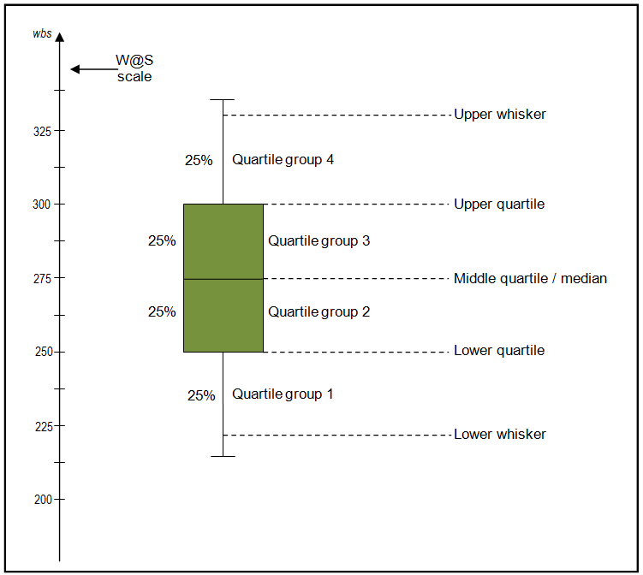

Slide 2
Understanding Box Plots
Median
The median (middle quartile) marks the mid-point of the data and is shown by the line that divides the box into two parts. Half the scores are greater than or equal to this value and half are less.
Inter-quartile range
The middle “box” represents the middle 50% of scores for the group. The range of scores from lower to upper quartile is referred to as the inter-quartile range. The middle 50% of scores fall within the inter-quartile range.
Upper quartile
Seventy-five percent of the scores fall below the upper quartile.
Whiskers
The upper and lower whiskers represent scores outside the middle 50%. Whiskers often (but not always) stretch over a wider range of scores than the middle quartile group

Slide 3
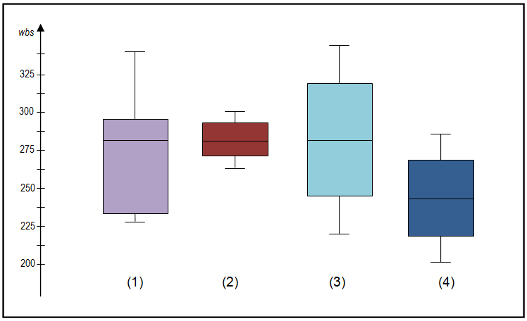
Box Plots on students score of 4 groups

Slide 4
The box plot is comparatively short – see example (2). This suggests that observations in group 2 have very low variance.
One box plot is much higher or lower than another – compare (3) and (4) – This could suggest a difference between groups.
Same median, different distribution – See examples (1), (2), and (3). The medians (which generally will be close to the average) are all at the same level. However the box plots in these examples show very different distributions of views.
It always important to consider the pattern of the whole distribution of responses in a box plot.
Interpreting Box Plots

