Slide 1
Block Ciphers (DES)
Lecture-5

Slide 2
Block Ciphers and the Data Encryption Standard
All the afternoon Mungo had been working on Stern's code, principally with the aid of the latest messages which he had copied down at the Nevin Square drop. Stern was very confident. He must be well aware London Central knew about that drop. It was obvious that they didn't care how often Mungo read their messages, so confident were they in the impenetrability of the code.
—Talking to Strange Men, Ruth Rendell

Slide 3
Modern Block Ciphers
will now look at modern block ciphers
one of the most widely used types of cryptographic algorithms
provide secrecy and/or authentication services
in particular will introduce DES (Data Encryption Standard)
Notes:
Modern block ciphers are widely used to provide encryption of quantities of information, and/or a cryptographic checksum to ensure the contents have not been altered. We continue to use block ciphers because they are comparatively fast, and because we know a fair amount about how to design them.

Slide 4
Block vs Stream Ciphers
block ciphers process messages into blocks, each of which is then en/decrypted
like a substitution on very big characters
  64-bits or more
stream ciphers process messages a bit or byte at a time when en/decrypting
many current ciphers are block ciphers
Notes:
Block ciphers work a on block / word at a time, which is some number of bits. All of these bits have to be available before the block can be processed. Stream ciphers work on a bit or byte of the message at a time, hence process it as a “stream”.

Slide 5
Block Cipher Principles
most symmetric block ciphers are based on a Feistel Cipher Structure
needed since must be able to decrypt ciphertext to recover messages efficiently
block ciphers look like an extremely large substitution
would need table of 2⁶⁴ entries for a 64-bit block
instead create from smaller building blocks
using idea of a product cipher
Notes:
An arbitrary reversible substitution cipher for a large block size is not practical, however, from an implementation and performance point of view. In general, for an n-bit general substitution block cipher, the size of the key is n x 2^{n}. For a 64-bit block, which is a desirable length to thwart statistical attacks, the key size is 64 x 2⁶⁴ = 2⁷⁰ = 10²¹ bits.

Slide 6
Claude Shannon and Substitution-Permutation Ciphers
in 1949 Claude Shannon introduced idea of substitution-permutation (S-P) networks
  modern substitution-transposition product cipher
these form the basis of modern block ciphers
S-P networks are based on the two primitive cryptographic operations we have seen before:
  substitution (S-box)
  permutation (P-box)
provide confusion and diffusion of message
Notes:
Claude Shannon’s 1949 paper has the key ideas that led to the development of modern block ciphers. Critically, it was the technique of layering groups of S-boxes separated by a larger P-box to form the S-P network, a complex form of a product cipher. He also introduced the ideas of confusion and diffusion, notionally provided by S-boxes and P-boxes (in conjunction with S-boxes).

Slide 7
Confusion and Diffusion
cipher needs to completely obscure statistical properties of original message
a one-time pad does this
more practically Shannon suggested combining elements to obtain:
diffusion – dissipates statistical structure of plaintext over bulk of ciphertext
confusion – makes relationship between ciphertext and key as complex as possible
Notes:
Every block cipher involves a transformation of a block of plaintext into a block of ciphertext, where the transformation depends on the key. The mechanism of diffusion seeks to make the statistical relationship between the plaintext and ciphertext as complex as possible in order to thwart attempts to deduce the key. confusion seeks to make the relationship between the statistics of the ciphertext and the value of the encryption key as complex as possible, again to thwart attempts to discover the key.
So successful are diffusion and confusion in capturing the essence of the desired attributes of a block cipher that they have become the cornerstone of modern block cipher design.

Slide 8
Feistel Cipher Structure
Horst Feistel devised the feistel cipher
  based on concept of invertible product cipher
partitions input block into two halves
  process through multiple rounds which
  perform a substitution on left data half
  based on round function of right half & subkey
  then have permutation swapping halves
implements Shannon’s substitution-permutation network concept
Notes:
Horst Feistel, working at IBM Thomas J Watson Research Labs devised a suitable invertible cipher structure in early 70's.
One of Feistel's main contributions was the invention of a suitable structure which adapted Shannon's S-P network in an easily inverted structure. Essentially the same h/w or s/w is used for both encryption and decryption, with just a slight change in how the keys are used. One layer of S-boxes and the following P-box are used to form the round function.

Slide 9
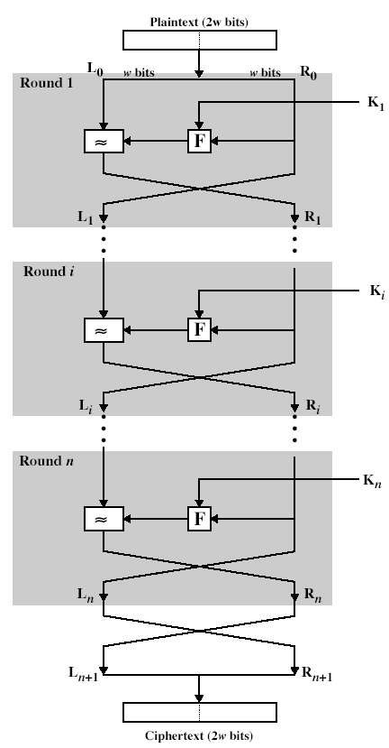
Feistel Cipher Structure

Slide 10
Feistel Cipher Design Principles
block size
  increasing size improves security, but slows cipher
key size
  increasing size improves security, makes exhaustive key searching harder, but may slow cipher
number of rounds
  increasing number improves security, but slows cipher
subkey generation
  greater complexity can make analysis harder, but slows cipher
round function
  greater complexity can make analysis harder, but slows cipher
fast software en/decryption & ease of analysis
  are more recent concerns for practical use and testing

Slide 11
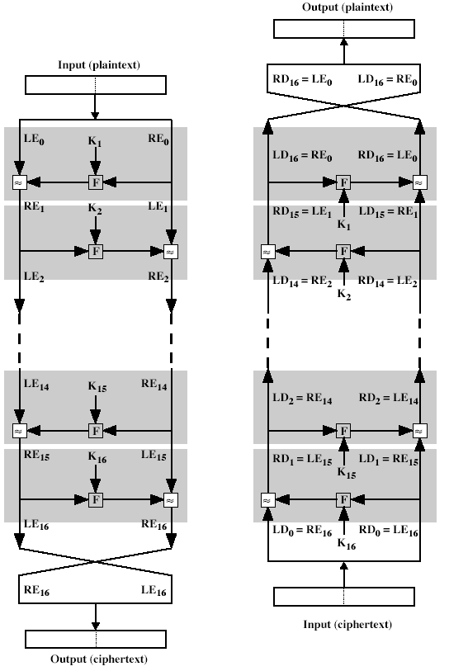
Feistel Cipher Decryption
Notes:
The process of decryption with a Feistel cipher is essentially the same as the encryption process. The rule is as follows: Use the ciphertext as input to the algorithm, but use the subkeys Ki in reverse order. That is, use Kn in the first round, Kn–1 in the second round, and so on until K1 is used in the last round. This is a nice feature because it means we need not implement two different algorithms, one for encryption and one for decryption.

Slide 12
Data Encryption Standard (DES)
most widely used block cipher in world
adopted in 1977 by NBS (now NIST)
  as FIPS PUB 46
encrypts 64-bit data using 56-bit key
has widespread use
has been considerable controversy over its security

Slide 13
DES History
IBM developed Lucifer cipher
  by team led by Feistel
  used 64-bit data blocks with 128-bit key
then redeveloped as a commercial cipher with input from NSA and others
in 1973 NBS issued request for proposals for a national cipher standard
IBM submitted their revised Lucifer which was eventually accepted as the DES

Slide 14
DES Design Controversy
although DES standard is public
was considerable controversy over design
  in choice of 56-bit key (vs Lucifer 128-bit)
  and because design criteria were classified
subsequent events and public analysis show in fact design was appropriate
DES has become widely used, especially in financial applications
Notes:
Recent analysis has shown despite this controversy, that DES is well designed. DES is theoretically broken using Differential or Linear Cryptanalysis
but in practise is unlikely to be a problem yet. Also rapid advances in computing speed though have rendered the 56 bit key susceptible to exhaustive key search, as predicted by Diffie & Hellman. Have demonstrated breaks:
- 1997 on a large network of computers in a few months
- 1998 on dedicated h/w (EFF) in a few days
- 1999 above combined in 22hrs!

Slide 15
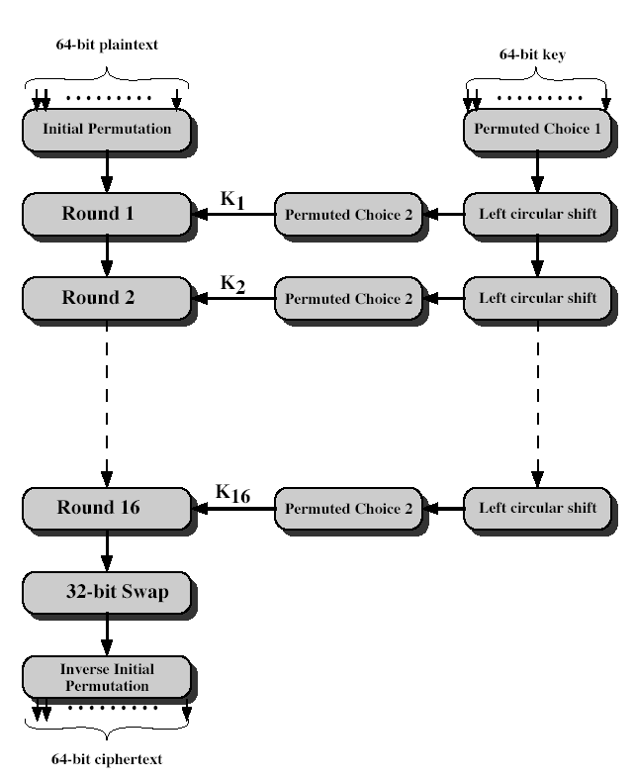
DES Encryption
Notes:
Stallings Fig 3-7.
The basic process in enciphering a 64-bit data block using the DES, shown on the left side, consists of:
- an initial permutation (IP)
- 16 rounds of a complex key dependent round function involving substitution and permutation functions
- a final permutation, being the inverse of IP
The right side shows the handling of the 56-bit key and consists of:
- an initial permutation of the key (PC1) which selects 56-bits in two 28-bit halves
- 16 stages to generate the subkeys using a left circular shift and a permutation

Slide 16
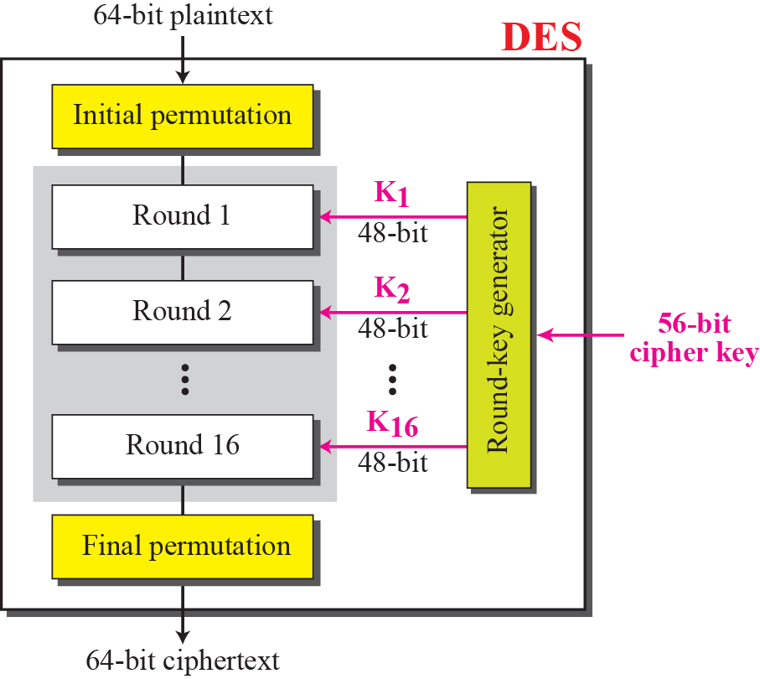
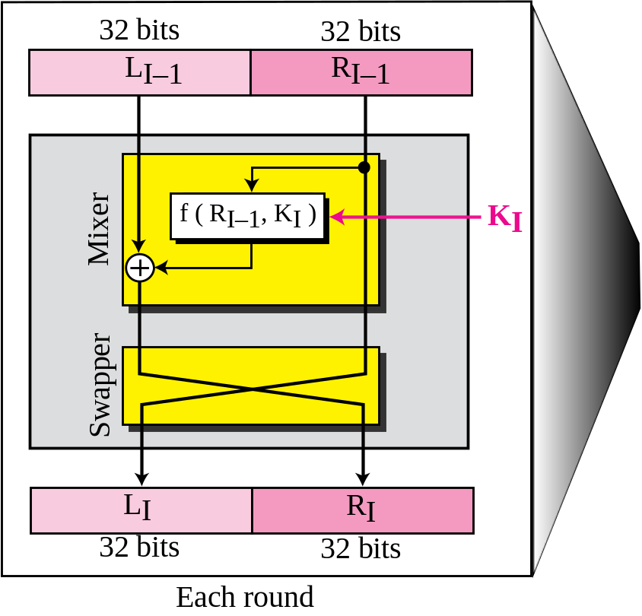
General structure of DES

Slide 17
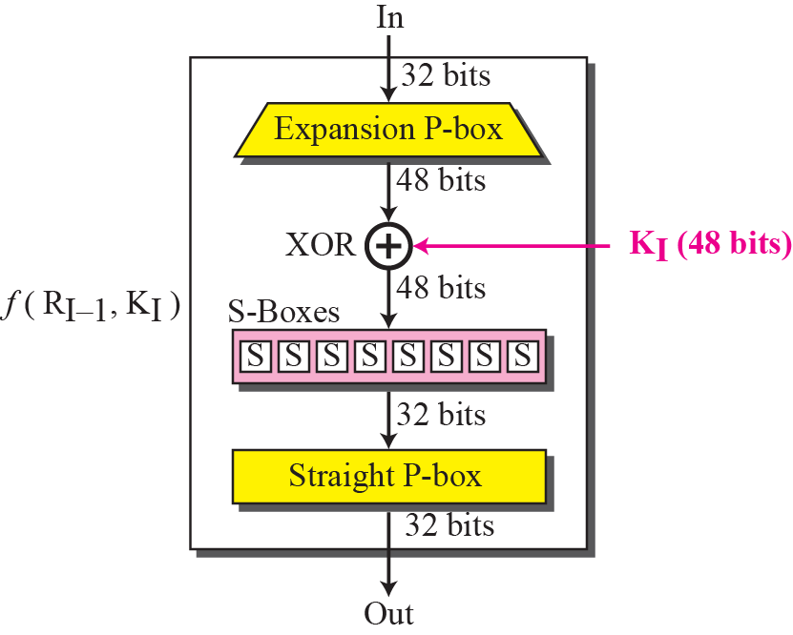
DES function

Slide 18
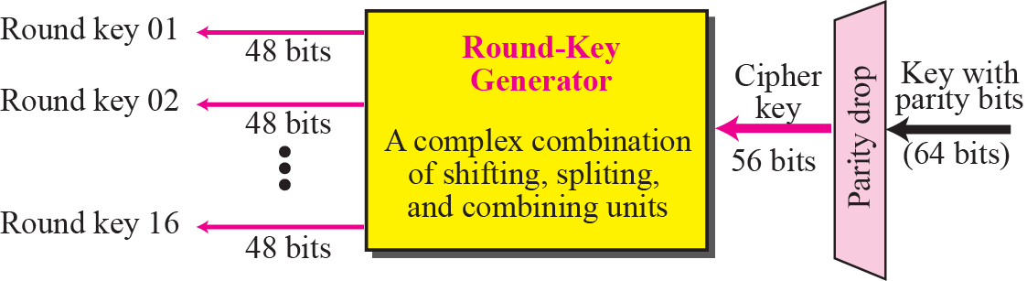
Key generation

Slide 19
We choose a random plaintext block, a random key, and a computer program to determine what the ciphertext block would be (all in hexadecimal):

Slide 20
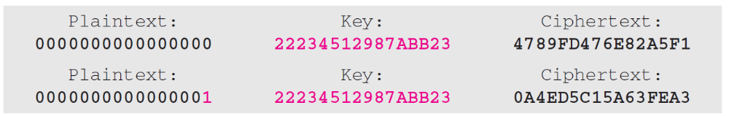
To check the effectiveness of DES, when a single bit is changed in the input, let us use two different plaintexts with only one single bit difference. The two ciphertexts are completely different without even changing the key:
Although the two plaintext blocks differ only in the rightmost bit, the ciphertext blocks differ in 29 bits.

Slide 21
Initial Permutation IP
first step of the data computation
IP reorders the input data bits
even bits to LH half, odd bits to RH half
quite regular in structure (easy in h/w)
see text Table 3.2
example:
IP(675a6967 5e5a6b5a) = (ffb2194d 004df6fb)
Notes:
The initial permutation and its inverse are defined by tables, as shown in Tables 3.2a and 3.2b, respectively. The tables are to be interpreted as follows. The input to a table consists of 64 bits numbered from 1 to 64. The 64 entries in the permutation table contain a permutation of the numbers from 1 to 64. Each entry in the permutation table indicates the position of a numbered input bit in the output, which also consists of 64 bits.
Note that the bit numbering for DES reflects IBM mainframe practice, and is the opposite of what we now mostly use - so be careful! Numbers from Bit 1 (leftmost, most significant) to bit 32/48/64 etc (rightmost, least significant).
Note that examples are specified using hexadecimal.

Slide 22
DES Round Structure
uses two 32-bit L & R halves
as for any Feistel cipher can describe as:
  L_{i} = R_{i–1}
  R_{i} = L_{i–1} xor F(R_{i–1}, K_{i})
takes 32-bit R half and 48-bit subkey and:
  expands R to 48-bits using perm E
  adds to subkey
  passes through 8 S-boxes to get 32-bit result
  finally permutes this using 32-bit perm P
Notes:
Note that the s-boxes provide the “confusion” of data and key values, whilst the permutation P then spreads this as widely as possible, so each S-box output affects as many S-box inputs in the next round as possible, giving “diffusion”.

Slide 23
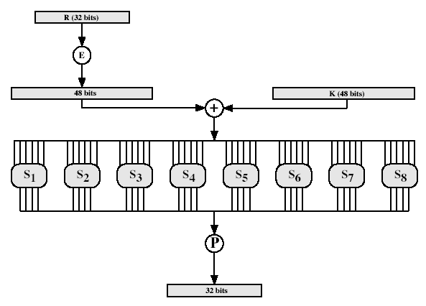
DES Round Structure
Notes:
Stallings Fig 3-9.

Slide 24
Substitution Boxes S
have eight S-boxes which map 6 to 4 bits
each S-box is actually 4 little 4 bit boxes
  outer bits 1 & 6 (row bits) select one rows
  inner bits 2-5 (col bits) are substituted
  result is 8 lots of 4 bits, or 32 bits
row selection depends on both data & key
  feature known as autoclaving (autokeying)
example:
S(18 09 12 3d 11 17 38 39) = 5fd25e03
Notes:
The substitution consists of a set of eight S-boxes, each of which accepts 6 bits as input and produces 4 bits as output. These transformations are defined in Table 3.3, which is interpreted as follows: The first and last bits of the input to box Si form a 2-bit binary number to select one of four substitutions defined by the four rows in the table for Si. The middle four bits select one of the sixteen columns. The decimal value in the cell selected by the row and column is then converted to its 4-bit representation to produce the output. For example, in S1, for input 011001, the row is 01 (row 1) and the column is 1100 (column 12). The value in row 1, column 12 is 9, so the output is 1001.

Slide 25
DES Key Schedule
forms subkeys used in each round
consists of:
  initial permutation of the key (PC1) which selects 56-bits in two 28-bit halves
  16 stages consisting of:
    selecting 24-bits from each half
    permuting them by PC2 for use in function f,
    rotating each half separately either 1 or 2 places depending on the key rotation schedule K
Notes:
The 56 bit key size comes from security considerations as we know now. It was big enough so that an exhaustive key search was about as hard as the best direct attack (a form of differential cryptanalysis called a T-attack, known by the IBM & NSA researchers), but no bigger. The extra 8 bits were then used as parity (error detecting) bits, which makes sense given the original design use for hardware communications links. However we hit an incompatibility with simple s/w implementations since the top bit in each byte is 0 (since ASCII only uses 7 bits), but the DES key schedule throws away the bottom bit! A good implementation needs to be cleverer!
Details of these permutations and the key rotation schedule are given in text Table 3.4.

Slide 26
DES Decryption
decrypt must unwind steps of data computation
with Feistel design, do encryption steps again
using subkeys in reverse order (SK16 … SK1)
note that IP undoes final FP step of encryption
1st round with SK16 undoes 16th encrypt round
….
16th round with SK1 undoes 1st encrypt round
then final FP undoes initial encryption IP
thus recovering original data value

Slide 27
Avalanche Effect
key desirable property of encryption algorithm
where a change of one input or key bit results in changing approx half output bits
making attempts to “home-in” by guessing keys impossible
Completeness Effect- each bit of CT needs to depend on many bits of PT

Slide 28
DES Weakness
Design in S Box
Design in D Box
Design in Key
Six pair of Semi weak key, 48 possible weak key

Slide 29
Strength of DES – Key Size
56-bit keys have 2⁵⁶ = 7.2 x 10¹⁶ values
brute force search looks hard
recent advances have shown is possible
  in 1997 on Internet in a few months
  in 1998 on dedicated h/w (EFF) in a few days
  in 1999 above combined in 22hrs!
still must be able to recognize plaintext
now considering alternatives to DES
Notes:
DES finally and definitively proved insecure in July 1998, when the Electronic Frontier Foundation (EFF) announced that it had broken a DES encryption using a special-purpose "DES cracker" machine that was built for less than $250,000. The attack took less than three days. The
EFF has published a detailed description of the machine, enabling others to build their own cracker [EFF98].

Slide 30
Strength of DES – Timing Attacks
attacks actual implementation of cipher
use knowledge of consequences of implementation to derive knowledge of some/all subkey bits
specifically use fact that calculations can take varying times depending on the value of the inputs to it
particularly problematic on smartcards
Notes:
AES analysis process has highlighted this attack approach, and is a concern.

Slide 31
Differential analysis
Propagation ratio is the probability that output diff. is y′ given that input diff. is x′
R_{p} = N_{d} (x′, y′)/ 2^{m}
In the class example
N_{D}( 0100, 0110)= 1/2
  R_{p} = 1/2 ×1/8×1/8×1/8×1/8

Slide 32
Block Cipher Design Principles
basic principles still like Feistel in 1970’s
number of rounds
  more is better, exhaustive search best attack
function f:
  provides “confusion”, is nonlinear, avalanche
key schedule
  complex subkey creation, key avalanche

Slide 33
Modes of Operation
block ciphers encrypt fixed size blocks
e.g. DES encrypts 64-bit blocks, with 56-bit key
need way to use in practice, given usually have arbitrary amount of information to encrypt
four were defined for DES in ANSI standard ANSI X3.106-1983 Modes of Use
subsequently now have 5 for DES and AES
have block and stream modes
Notes:
DES (or any block cipher) forms a basic building block, which en/decrypts a fixed sized block of data. However to use these in practise, we usually need to handle arbitrary amounts of data, which may be available in advance (in which case a block mode is appropriate), and may only be available a bit/byte at a time (in which case a stream mode is used).

Slide 34
Electronic Codebook Book (ECB)
message is broken into independent blocks which are encrypted
each block is a value which is substituted, like a codebook, hence name
each block is encoded independently of the other blocks
  C_{i} = DES_{K1} (P_{i})
uses: secure transmission of single values
Notes:
ECB is the simplest of the modes, where each block is en/decrypted independently of all the other blocks, and is used when only a single block of info needs to be sent (eg. a session key encrypted using a master key).

Slide 35
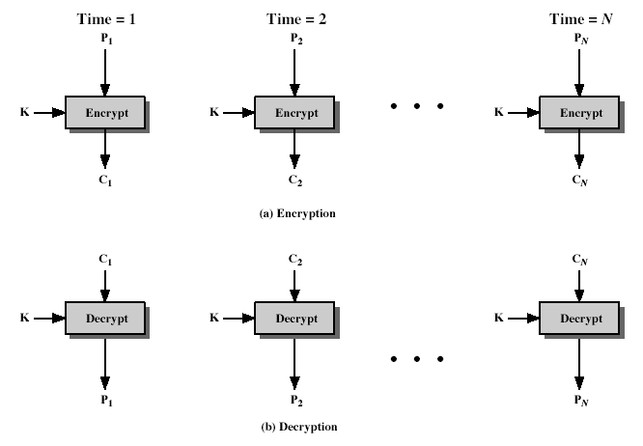
Electronic Codebook Book (ECB)
Notes:
Stallings Fig 3-11.

Slide 36
Electronic Codebook Book (ECB)
Notes:
Stallings Fig 3-11.

Slide 37
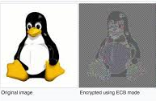
Electronic Codebook Book (ECB)
Notes:
Stallings Fig 3-11.

Slide 38
Advantages and Limitations of ECB
repetitions in message may show in ciphertext
  if aligned with message block
  particularly with data such as graphics
  or with messages that change very little, which become a code-book analysis problem
weakness due to encrypted message blocks being independent
main use is sending a few blocks of data
Notes:
ECB is not appropriate for any quantity of data, since repetitions can be seen, esp. with graphics, and because the blocks can be shuffled/inserted without affecting the en/decryption of each block.

Slide 39
Cipher Block Chaining (CBC)
message is broken into blocks
but these are linked together in the encryption operation
each previous cipher blocks is chained with current plaintext block, hence name
use Initial Vector (IV) to start process
  C_{i} = DES_{K1}(P_{i} XOR C_{i-1})
  C₋₁ = IV
uses: bulk data encryption, authentication
Notes:
To overcome the problems of repetitions and order independence in ECB, want some way of making the ciphertext dependent on all blocks before it. This is what CBC gives us, by combining the previous ciphertext block with the current message block before encrypting. To start the process, use an Initial Value (IV), which is usually well known (often all 0's), or otherwise is sent, ECB encrypted, just before starting CBC use. CBC mode is applicable whenever large amounts of data need to be sent securely, provided that its available in advance (eg email, FTP, web etc)

Slide 40
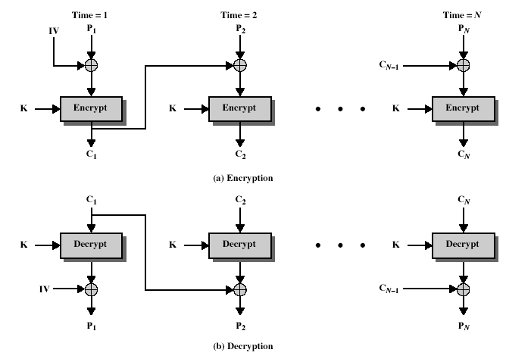
Cipher Block Chaining (CBC)
Notes:
Stallings Fig 3-12.

Slide 41


Cipher Block Chaining (CBC)
Original image Encrypted image
Notes:
Stallings Fig 3-12.

Slide 42
Advantages and Limitations of CBC
each ciphertext block depends on all message blocks
thus a change in the message affects all ciphertext blocks after the change as well as the original block
need Initial Value (IV) known to sender & receiver
  however if IV is sent in the clear, an attacker can change bits of the first block, and change IV to compensate
  hence either IV must be a fixed value or it must be sent encrypted in ECB mode before rest of message
at end of message, handle possible last short block
  by padding either with known non-data value (eg nulls)
  or pad last block with count of pad size
    eg. [ b1 b2 b3 0 0 0 0 5] <- 3 data bytes, then 5 bytes pad+count
Notes:
CBC is the generally used block mode. The chaining provides an avalanche effect, which means the encrypted message
cannot be changed or rearranged without totally destroying the subsequent data.
One issue is how to handle the last block, which may well not be complete. In general have to pad this block (typically with 0's), and then must recognise padding at other end - may be obvious (eg in text the 0 value should usually not occur), or otherwise must explicitly have the last byte as a count of how much padding was used (including the count). Note that if this is done, if the last block IS an even multiple of 8 bytes, will have to add an extra block, all padding so as to have a count in the last byte.

Slide 43
Cipher FeedBack (CFB)
message is treated as a stream of bits
added to the output of the block cipher
result is feed back for next stage (hence name)
standard allows any number of bit (1,8 or 64 or whatever) to be feed back
  denoted CFB-1, CFB-8, CFB-64 etc
is most efficient to use all 64 bits (CFB-64)
  C_{i} = P_{i} XOR DES_{K1}(C_{i-1})
  C₋₁ = IV
uses: stream data encryption, authentication
Notes:
If the data is only available a bit/byte at a time (eg. terminal session, sensor value etc), then must use some other approach to encrypting it, so as not to delay the info. Idea here is to use the block cipher essentially as a pseudo-random number generator (see stream cipher lecture later) and to combine these "random" bits with the message. Note as mentioned before, XOR is an easily inverted operator (just XOR with same thing again to undo). Again start with an IV to get things going, then use the ciphertext as the next input. As originally defined, idea was to "consume" as much of the "random" output as needed for each message unit (bit/byte) before "bumping" bits out of the buffer and re-encrypting. This is wasteful though, and slows the encryption down as more encryptions are needed. An alternate way to think of it is to generate a block of "random" bits, consume them as message bits/bytes arrive, and when they're used up, only then feed a full block of ciphertext back. This is CFB-64 mode, the most efficient. This is the usual choice for quantities of stream oriented data, and for authentication use.

Slide 44
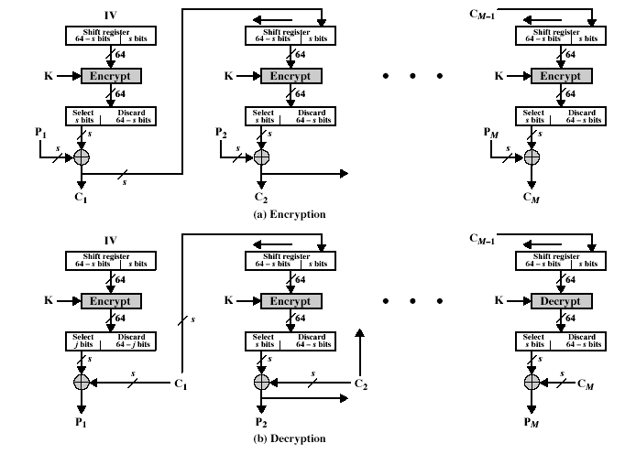
Cipher FeedBack (CFB)
Notes:
Stallings Fig 3-13.

Slide 45
Advantages and Limitations of CFB
appropriate when data arrives in bits/bytes
most common stream mode
limitation is need to stall while do block encryption after every n-bits
note that the block cipher is used in encryption mode at both ends
errors propagate for several blocks after the error
Notes:
CFB is the usual stream mode. As long as can keep up with the input, doing encryptions every 8 bytes. A possible problem is that if its used over a "noisy" link, then any corrupted bit will destroy values in the current and next blocks (since the current block feeds as input to create the random bits for the next). So either must use over a reliable network transport layer (pretty usual) or use OFB.

Slide 46
Output FeedBack (OFB)
message is treated as a stream of bits
output of cipher is added to message
output is then feed back (hence name)
feedback is independent of message
can be computed in advance
  C_{i} = P_{i} XOR O_{i}
  O_{i} = DES_{K1}(O_{i-1})
  O₋₁ = IV
uses: stream encryption over noisy channels
Notes:
The alternative to CFB is OFB. Here the generation of the "random" bits is independent of the message being encrypted. The advantage is that firstly, they can be computed in advance, good for bursty traffic, and secondly, any bit error only affects a single bit. Thus this is good for noisy links (eg satellite TV transmissions etc).

Slide 47
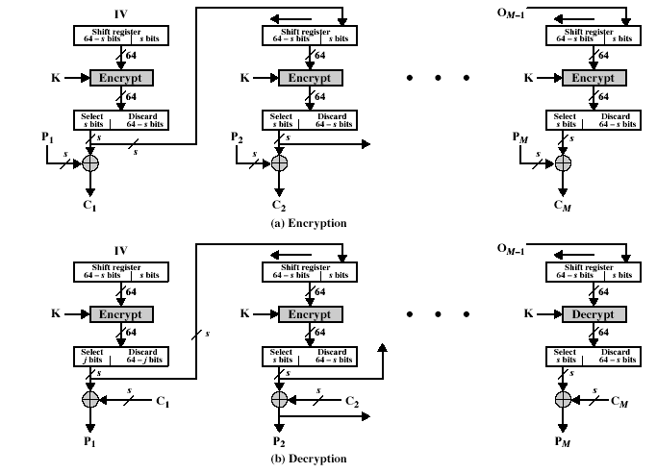
Output FeedBack (OFB)
Notes:
Stallings Fig 3-14.

Slide 48
Advantages and Limitations of OFB
used when error feedback a problem or where need to encryptions before message is available
superficially similar to CFB
but feedback is from the output of cipher and is independent of message
a variation of a Vernam cipher
  hence must never reuse the same sequence (key+IV)
sender and receiver must remain in sync, and some recovery method is needed to ensure this occurs
originally specified with m-bit feedback in the standards
subsequent research has shown that only OFB-64 should ever be used
Notes:
Because the "random" bits are independent of the message, they must never ever be used more than once (otherwise the 2 ciphertexts can be combined, cancelling these bits, and leaving a "book" cipher to solve). Also, as noted, should only ever use a full block feedback ie OFB-64 mode.

Slide 49
Counter (CTR)
a “new” mode, though proposed early on
similar to OFB but encrypts counter value rather than any feedback value
must have a different key & counter value for every plaintext block (never reused)
  C_{i} = P_{i} XOR O_{i}
  O_{i} = DES_{K1}(i)
uses: high-speed network encryptions

Slide 50
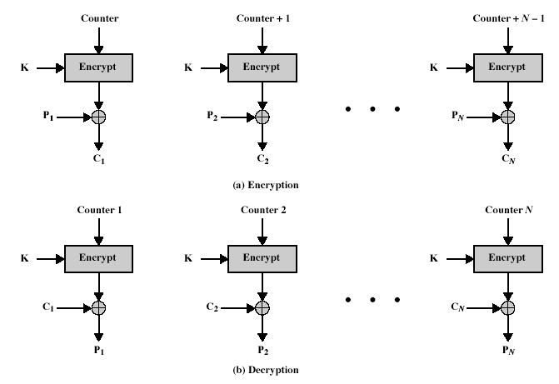
Counter (CTR)
Notes:
Stallings Fig 3-15.

Slide 51
Advantages and Limitations of CTR
efficiency
  can do parallel encryptions
  in advance of need
  good for bursty high speed links
random access to encrypted data blocks
provable security (good as other modes)
but must ensure never reuse key/counter values, otherwise could break (cf OFB)

Slide 52
Summary
have considered:
  block cipher design principles
  DES
    details
    strength
  Modes of Operation
    ECB, CBC, CFB, OFB, CTR

