Slide 1
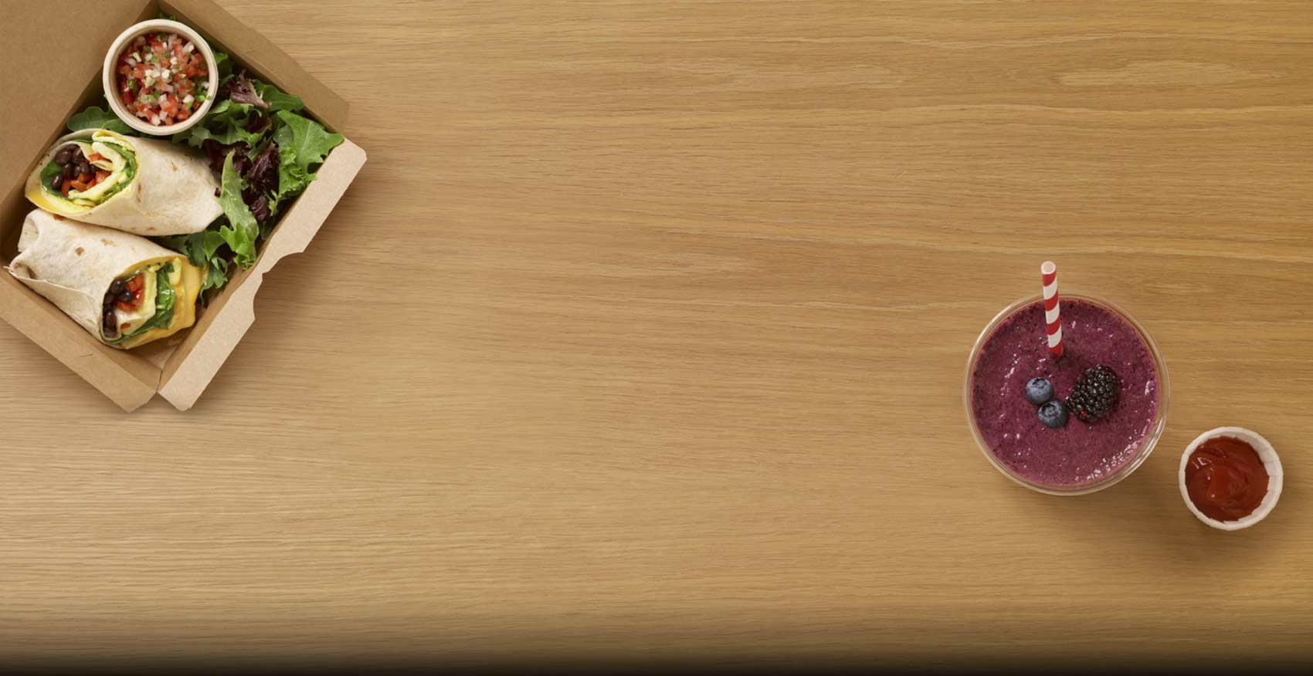

Foodies Find the ideal offers online

Slide 2

Project Walkthrough
Objective
Problem Formulation
Tools & Technologies Used
Workflow
Challenges Faced
Conclusion

Slide 3

Objective
To compare the offers given by the food ordering sites(Zomato/Swiggy)on different cuisines

Slide 4
Abstract of the project
There are many online websites which provides online & dining offers on food to the users
The whole idea of this project is to help user find a single place where the best option available to him/her is whether online or offline food, on which particular cuisine etc
For this we extract the available offers on the websites and we display them based on the date, cuisine & restaurant

Slide 5
Tools & Technologies
Django
Pycharm
Jupyter Notebook
Html
Pandas, Matplotlib, Beautiful Soup

Slide 6
Workflow(User)
Search by Cuisine
Scrap Webpage for the Offers
Storing the Data in Excel
Display the offers available

Slide 7
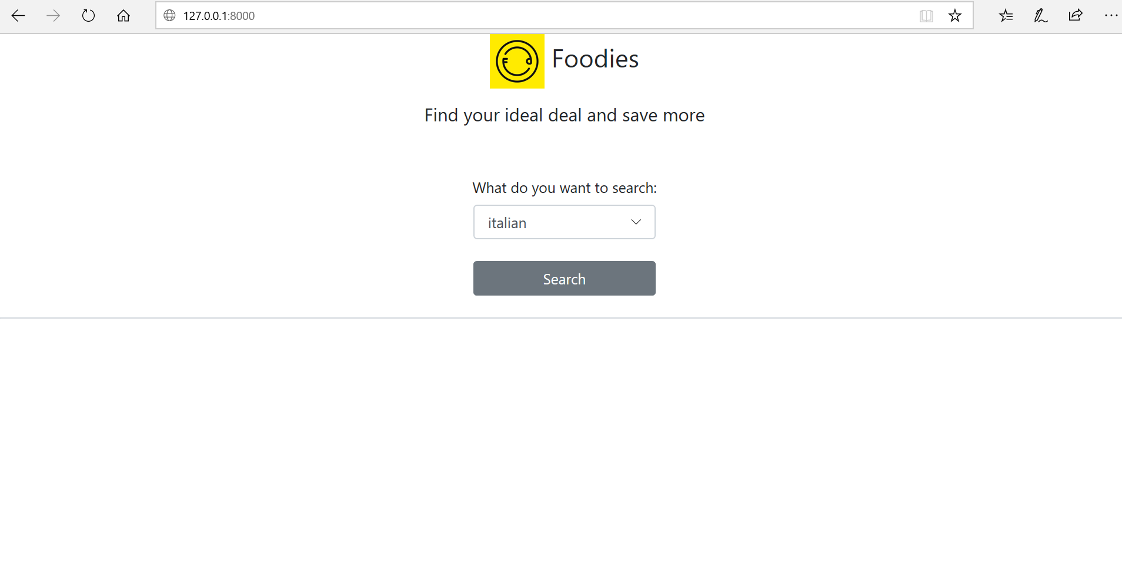

Slide 8
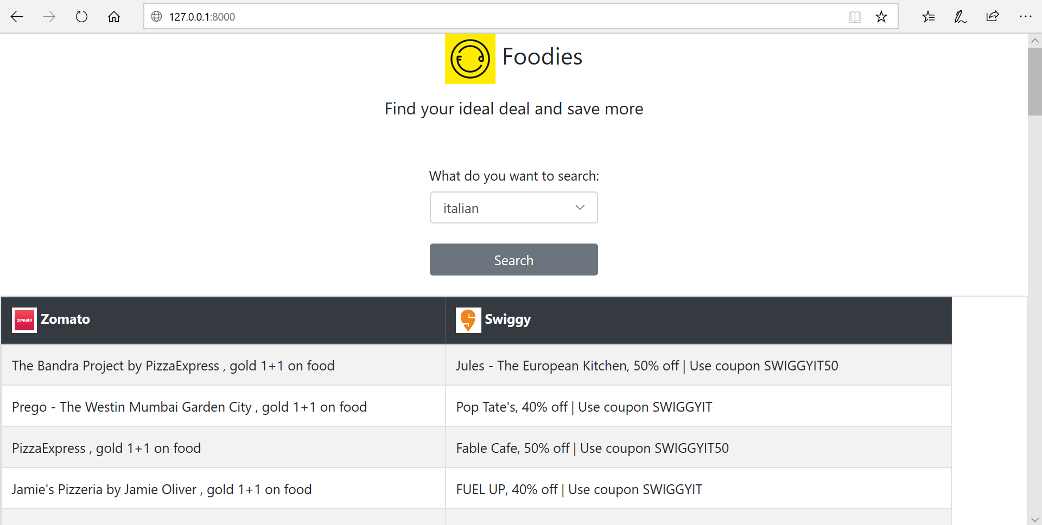

Slide 9

The Backend Thing
Downloading the Webpages
Scraping for the Offer
Store in Excel
Perform EDA

Slide 10
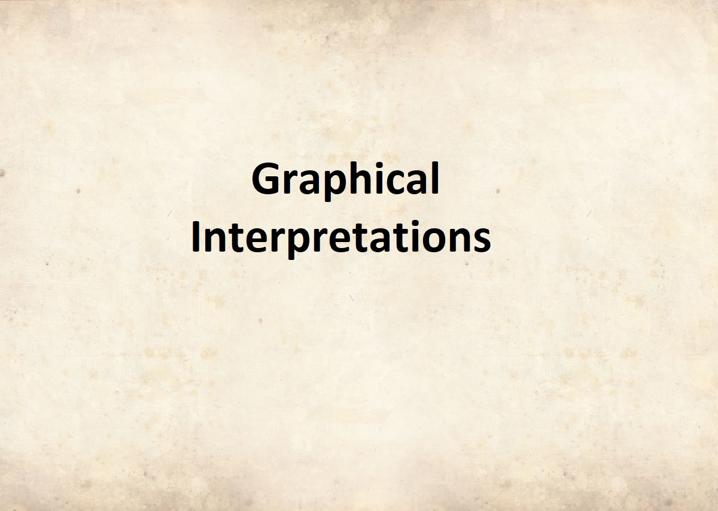

Slide 11
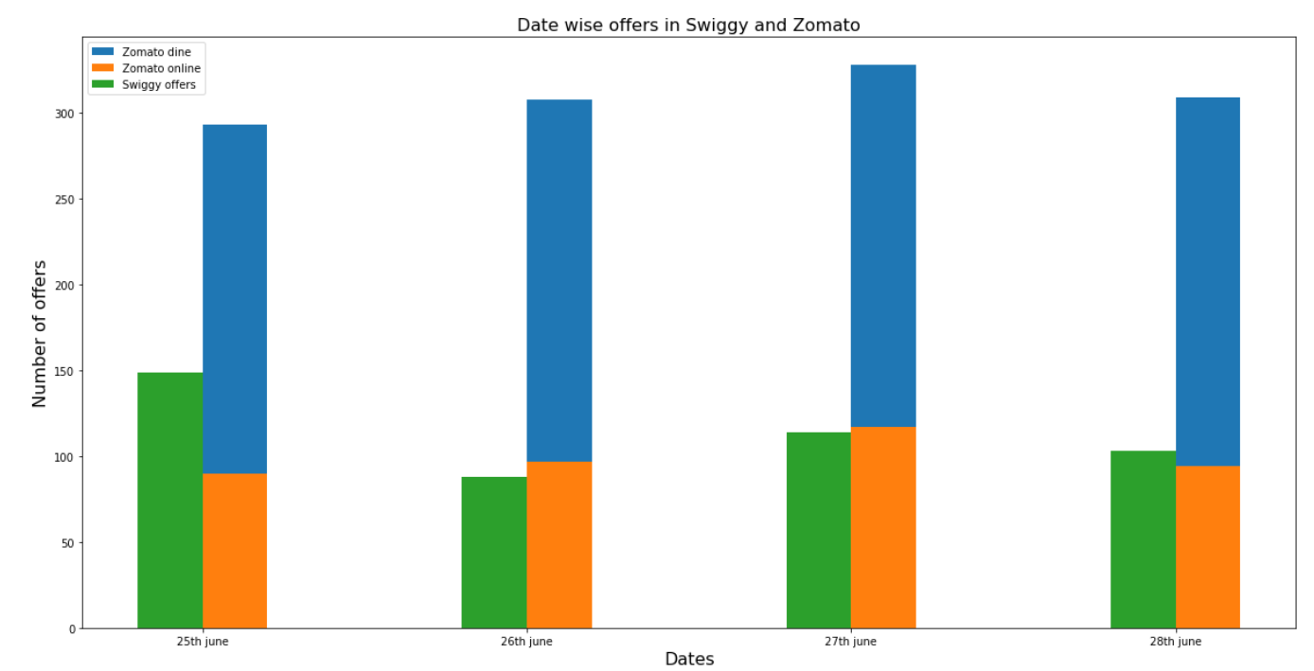

Slide 12
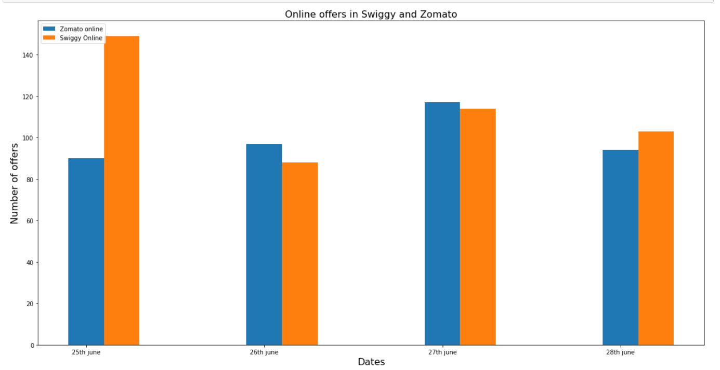

Slide 13
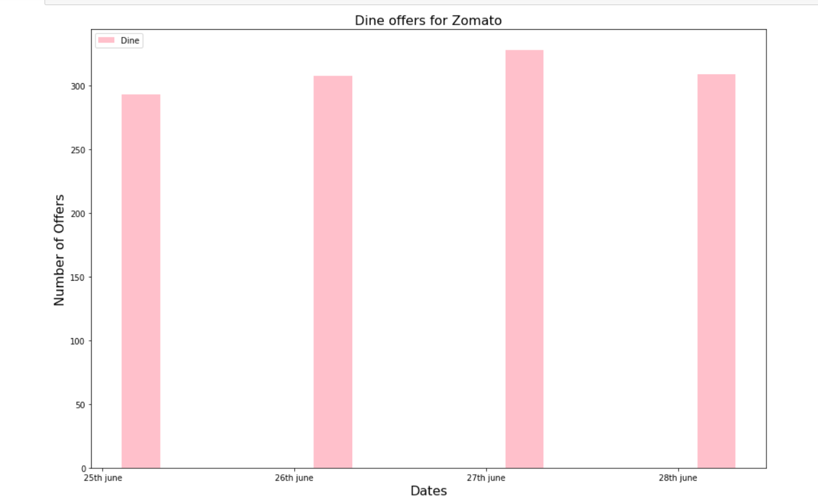

Slide 14
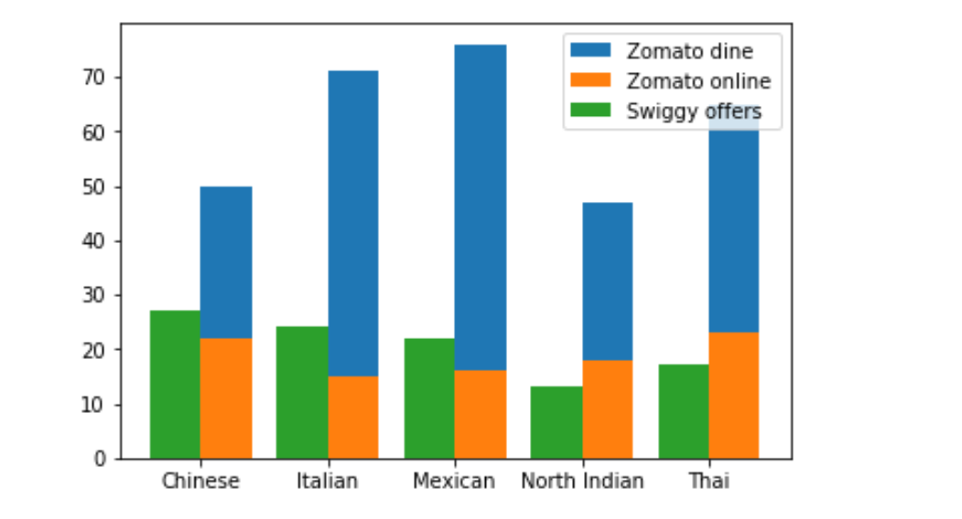
Based on Cuisine

Slide 15
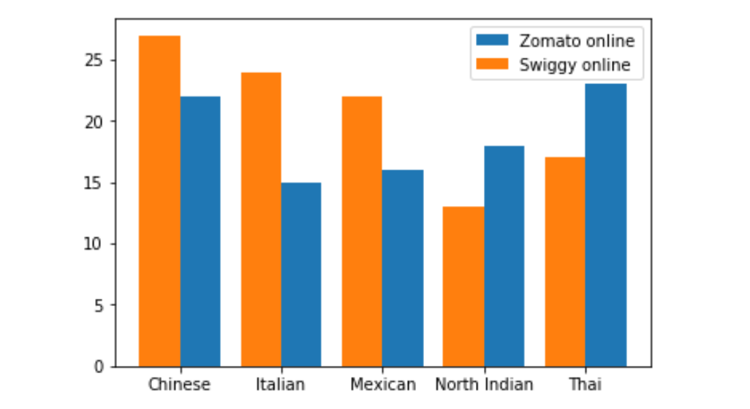

Slide 16
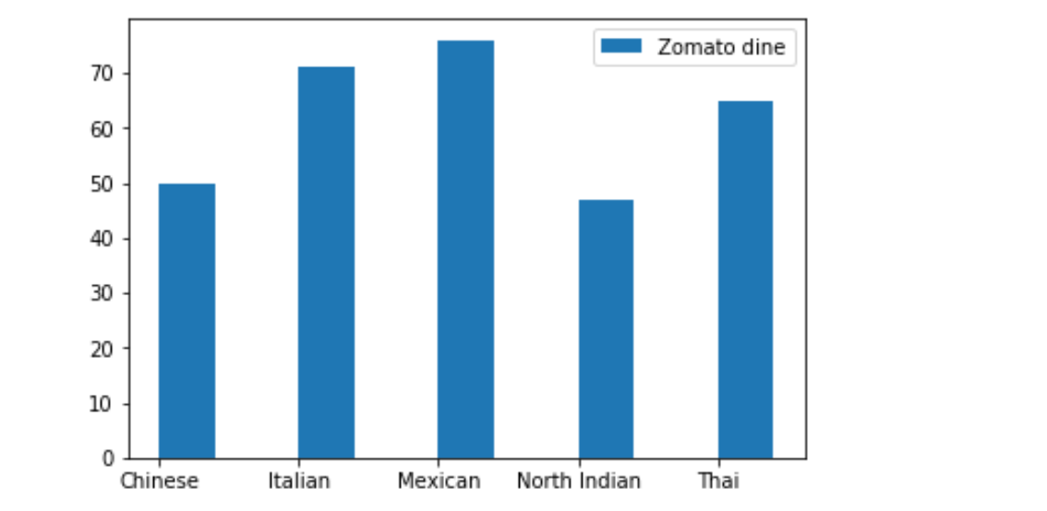
Cuisine With Dine

Slide 17
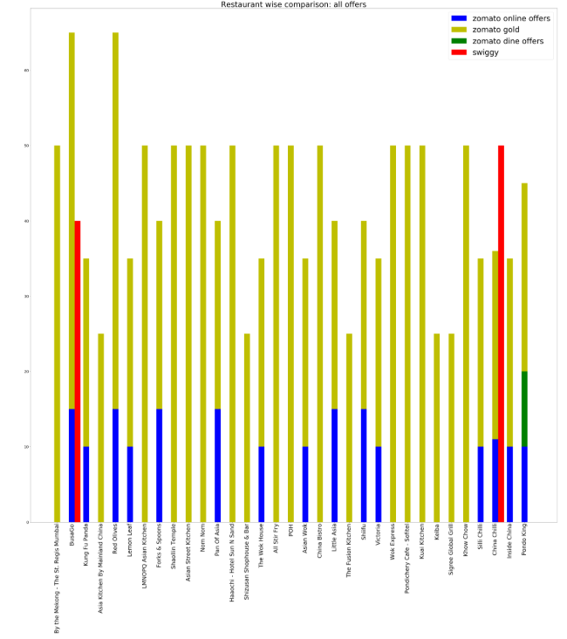
Restaurant Wise(All Offers)

Slide 18
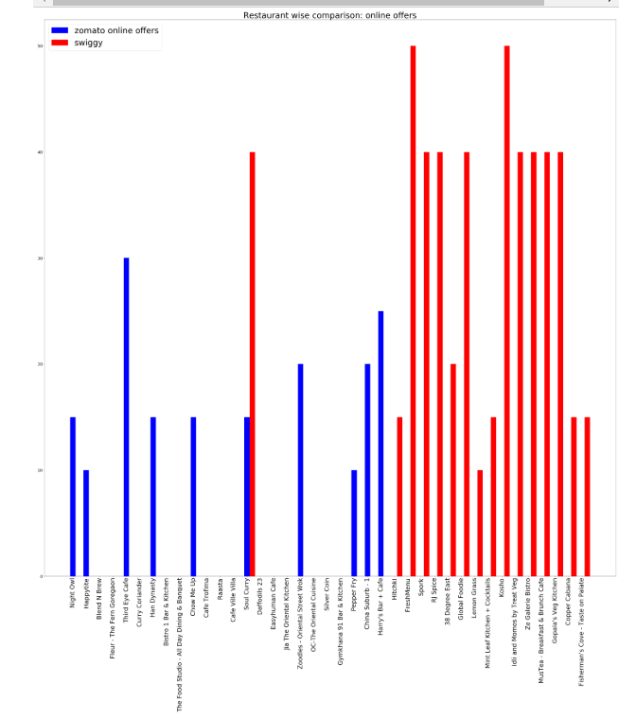
Restaurant (online offers)

Slide 19
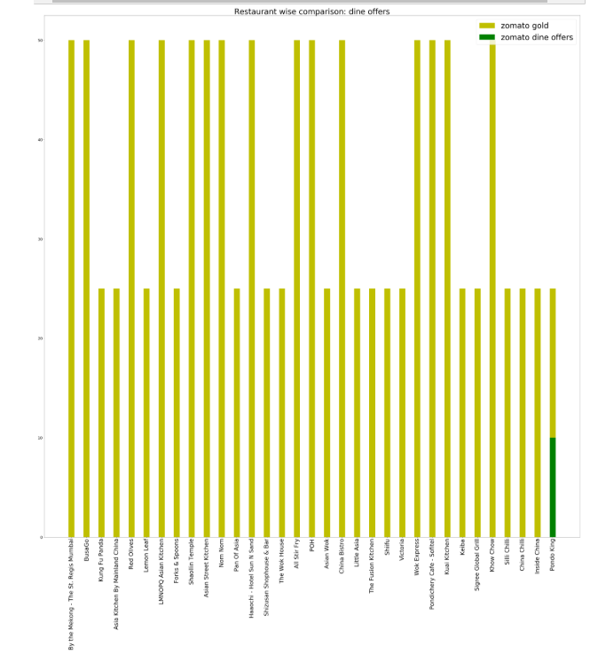
Restaurant(Dine Offers)

Slide 20
Challenges Faced
Initially when trying to access the Zomato offers page the access was denied
We were not able to not access the main HTML page in Swiggy
Offers were in percentage so we had to segregate first

Slide 21
Conclusion
To conclude with we are able to show the user different offers on different cuisine on Zomato & Swiggy
We found out that Swiggy has more online offers than Zomato online offers
Also, we concluded that Zomato Gold (Dine in) offers are more than Swiggy. In fact we found that Swiggy has almost no Dine in offers

Slide 22


