Slide 1
Telecom Customer Churn Analysis
Project Report
By Sneha Maheshwari

Slide 2
Project Overview
Objective: Predict churn and derive actionable strategies to retain users.
Tools Used: SQL Server, Python (Jupyter Notebook), Power BI, Excel

Slide 3
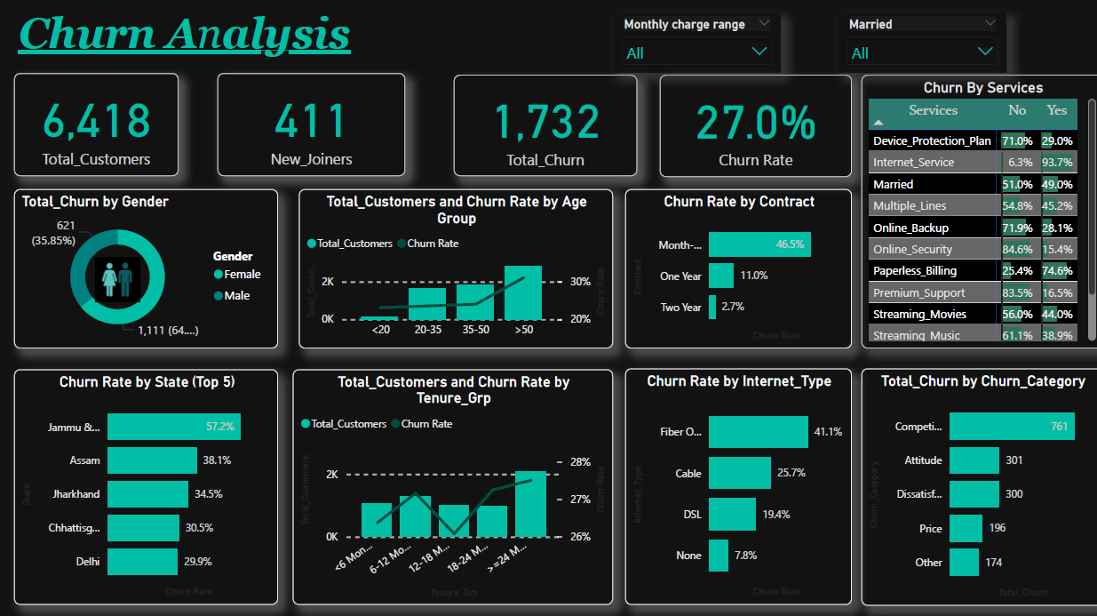

Slide 4
Summary Dashboard Insights
• Fiber optic customers showed the highest churn rate.
• Month-to-month contracts contributed most to attrition.
• Senior citizens were more prone to churn.

Slide 5
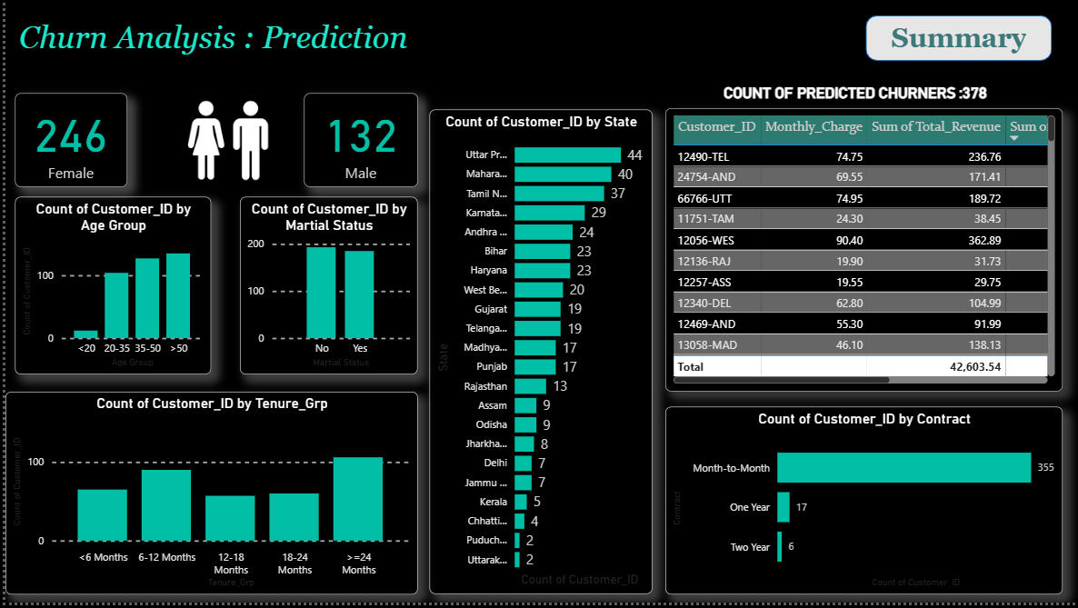

Slide 6
Prediction Dashboard Insights
• High churn risk for senior citizens with fiber optic internet.
• Customers on month-to-month contracts are at maximum risk.
• Payment issues strongly correlated with churn.

Slide 7
Key Findings
• DSL users churned less compared to Fiber optic users.
• Long-term contracts significantly reduce churn.
• Single-line and senior citizen customers are high risk.

Slide 8
Recommendations
• Provide loyalty programs and discounts for month-to-month customers.
• Offer bundled packages and better support for fiber optic customers.
• Proactive retention strategies for senior citizens and payment-issue customers.
• Encourage auto-payment options to reduce involuntary churn.

