Slide 1
SENTIMENT ANALYSIS BASED REVIEW CLASSIFICATION FOR A LEADING RESTAURANT CHAIN

Slide 2
ABSTRACT
This project focuses on sentiment analysis and review classification for a leading restaurant chain. The goal is to develop a robust system that can automatically categorize customer reviews into positive, negative, or neutral sentiments based on the content of the review. By harnessing natural language processing (NLP) techniques and machine learning algorithms, this project aims to provide valuable insights to the restaurant chain regarding customer feedback, enabling them to improve customer satisfaction and make data-driven decisions.

Slide 3
INTRODUCTION
In today's digital age, online reviews play a crucial role in shaping the reputation and success of businesses, especially in the hospitality industry. Customer feedback posted on platforms like social media, review websites, and mobile apps
can significantly influence potential customers' perceptions and decisions. For a leading restaurant chain, managing and analyzing a large volume of reviews manually can be overwhelming and time-consuming. Therefore, there is a growing need for automated sentiment analysis and review classification systems to extract actionable insights from this wealth of unstructured data.

Slide 4
MOTIVATION OF WORK
The motivation behind this project stems from the desire to leverage advanced technology to enhance the customer experience and operational efficiency of a leading restaurant chain. By implementing a sentiment analysis and review classification system, the restaurant chain can be:
Gain real-time insights into customer sentiments and preferences.
Identify areas of improvement and address customer concerns promptly.

Slide 5
Build a positive online reputation by responding effectively to both positive and negative feedback.
Track trends and patterns in customer Feedback to make informed business decisions.
Enhance marketing strategies by understanding what resonates with customers and what needs I
improvement.

Slide 6
PROBLEM STATEMENT
The project will involve the following key components:
Data Collection: Gathering a diverse dataset of customer reviews from various online platforms.
Data Preprocessing: Cleaning, tokenizing, and normalizing the text data to prepare it for analysis.
Feature Extraction: Using techniques like TF-IDF or word embeddings to represent the reviews numerically.
Model Selection: Choosing and training a machine learning model (e.g.,NaïveBayes, Logistic REGRESSION, RANDOM FOREST) for sentiment analysis and review classification.

Slide 7
Evaluation and Validation: Assessing the model's performance using metrics like accuracy, precision, recall, and F1-score.
Deployment: Deploying the trained model to classify new reviews in real-time and integrating it into the restaurant chain's feedback management system.

Slide 8
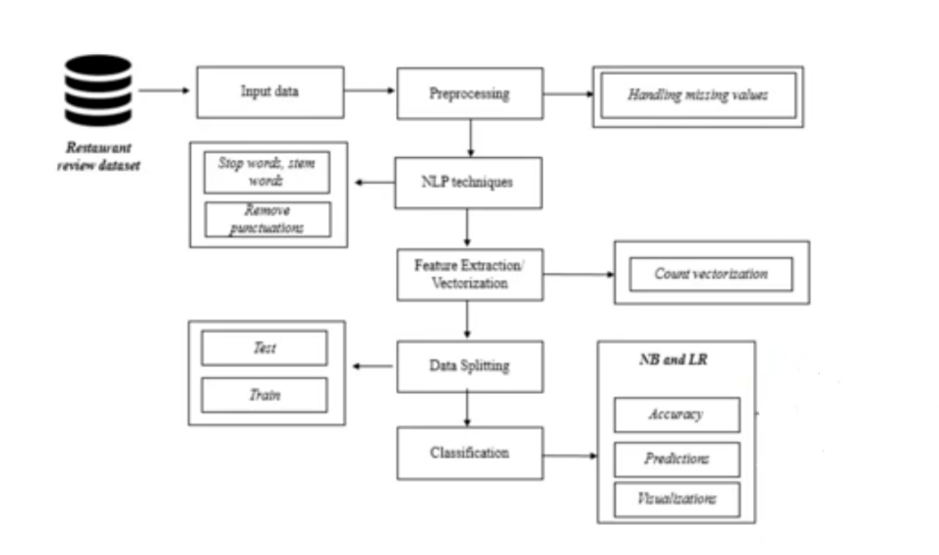
PROPOSED ARCHITECTURE DIAGRAM

Slide 9
DATASET DESCRIPTION
The data consists of textual reviews accompanied by sentiment labels indicating whether the feedback is positive or negative.By examining these reviews, we aim to understand the factors contributing to customer satisfaction and dissatisfaction in the restaurant industry.
Each review contains subjective opinions about various aspects of dining experiences, such as food quality, service, ambiance, and value for money. Positive reviews often highlight enjoyable aspects like delicious food, great service, and pleasant ambiance, while negative reviews typically point out issues like poor food quality, bad service, and unsatisfactory experiences

Slide 10
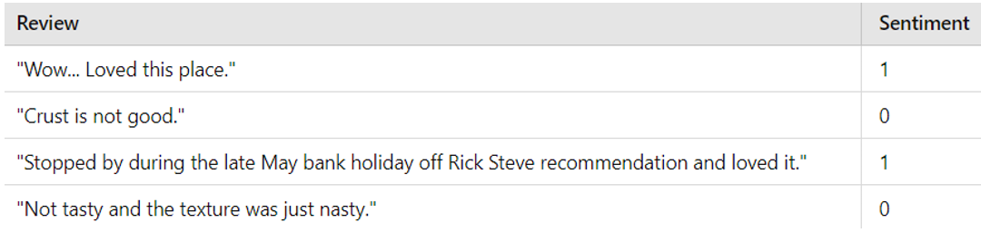
The dataset comprises 901 reviews, each with an associated sentiment label:
Positive Sentiment (1): Indicates a favorable review.
Negative Sentiment (0): Indicates an unfavorable review.
Sample Data:

Slide 11
Data Characteristics:
Review Content: Varies from brief statements to detailed descriptions.
Aspects Covered: Food quality, service, ambiance, pricing, and specific dish reviews.
Sentiment Polarity: Binary classification (positive or negative).

Slide 12
EVALUATION METRICS
Evaluation metrics are crucial in assessing the performance of a sentiment analysis and review classification system. For your project on sentiment analysis-based review classification for a leading restaurant chain, the following evaluation metrics should be considered:
1. Accuracy
Definition: The ratio of correctly predicted instances to the total instances.
Formula:
Accuracy =TP + TN/TP + TN + FP + FN
​Explanation: Measures the overall correctness of the model.
2. Precision
Definition: The ratio of correctly predicted positive observations to the total predicted positives.
Formula:
Precision=TP/TP + FP
​Explanation: Indicates the accuracy of positive predictions.

Slide 13
3. Recall (Sensitivity)
Definition: The ratio of correctly predicted positive observations to the all observations in actual class.
Formula:
Recall=TP/TP + FN
​Explanation: Measures the ability of the model to identify positive instances.
Confusion Matrix: A confusion matrix provides a detailed breakdown of true positive, true negative, false positive, and false negative predictions. It helps in understanding the model's performance in differentiating between positive and negative reviews.

Slide 14
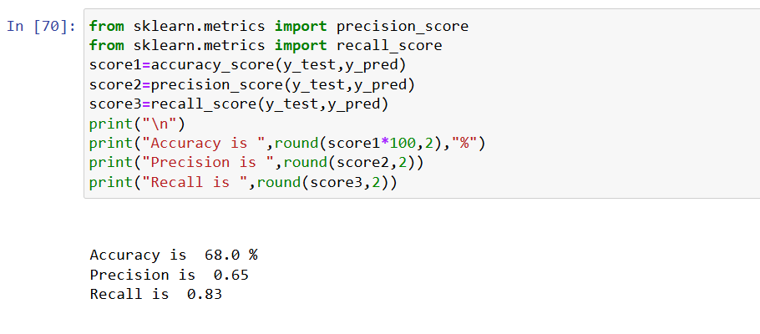
RESULTS AND DISCUSSION
1.NAIVE BAYE’S:

Slide 15
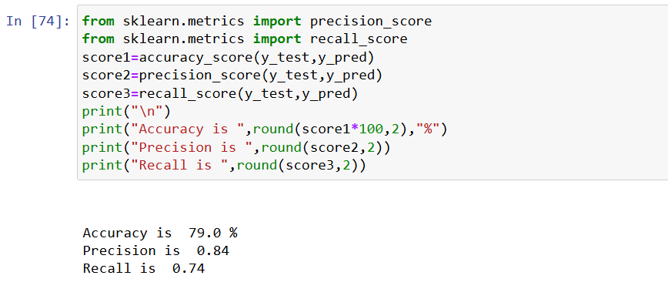
2.LOGISTIC REGRESSION:

Slide 16
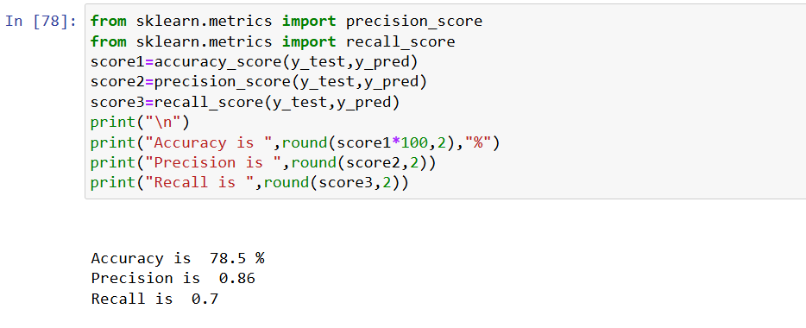
3.RANDOM FOREST:

Slide 17
CONCLUSION
By successfully implementing this sentiment analysis and review classification system, the restaurant chain can enhance customer satisfaction ,improve operational efficiency and ultimately strengthen its competitive position in the market.

Slide 18


