Slide 1
Template Method Design pattern
Submitted by : Team 11
Ruthvic Punyamurtula – 30
Cameron L’Ecuyer – 17
Sneha Mishra – 21
Navya Ramya Sirisha - 26

Slide 2
Introduction
Behavioral Design Pattern
Defines the skeleton of an algorithm in a method
Defers some steps to subclasses where “Template” Method lets subclasses redefine certain steps of an algorithm
Does not change the algorithm structure
The AbstractClass contains the templateMethod(), which should be made final so that it cannot be overridden
When to use : When behavior of an algorithm can vary, you let subclasses implement the behavior through overriding

Slide 3
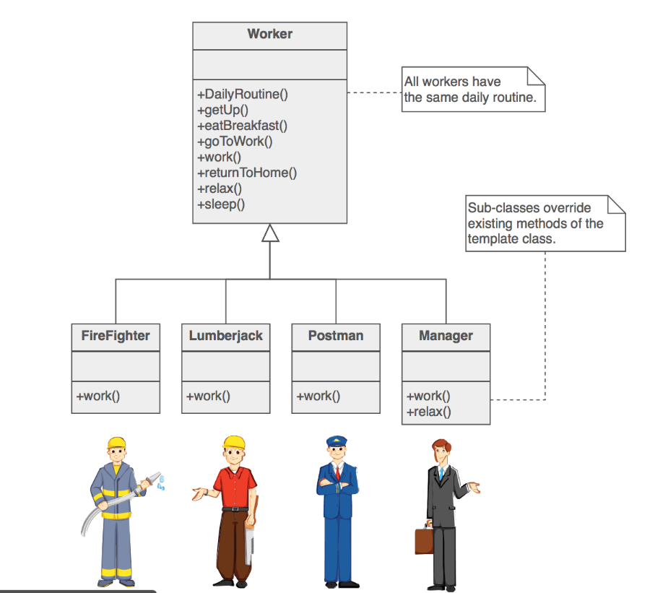
UML – Template design pattern
https://sourcemaking.com/design_patterns/template_method

Slide 4
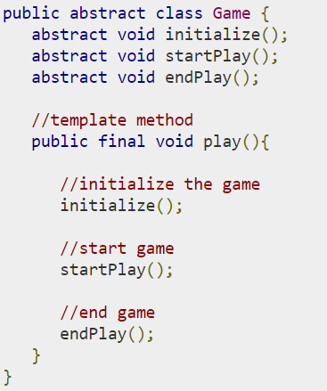
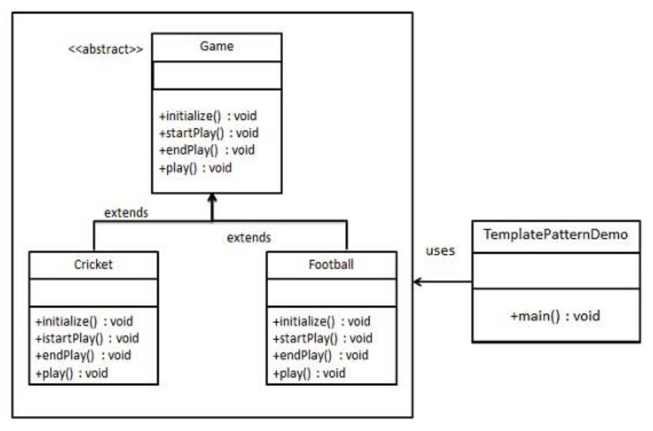
Code and UML
https://www.tutorialspoint.com/design_pattern/template_pattern.htm

Slide 5
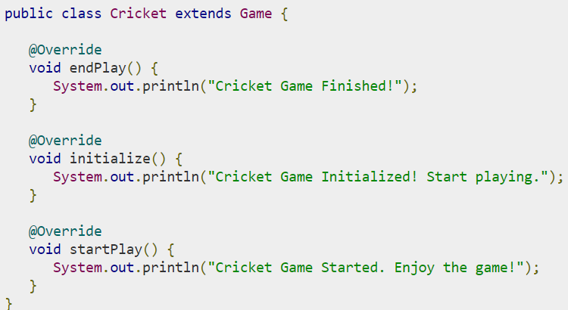
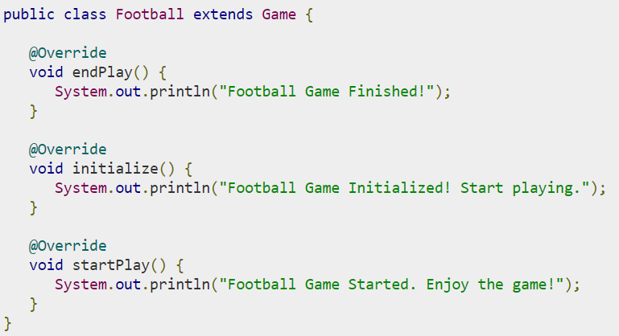
Code – Sub classes
https://www.tutorialspoint.com/design_pattern/template_pattern.htm

Slide 6
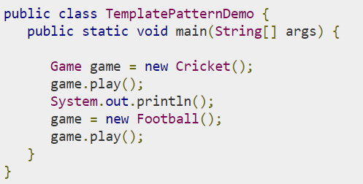
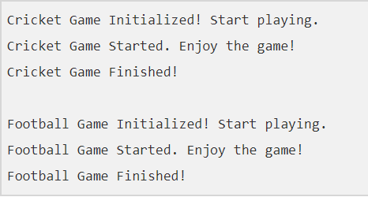
Main class and result
https://www.tutorialspoint.com/design_pattern/template_pattern.htm

Slide 7
Questions
When to use Template design pattern ?
What are the limitations of this pattern ?
What is the difference between factory method and template method design patterns ?

