Slide 1
Presco!
Application by : Team “The Trio”
Members :
Sneha Mishra
Harshini Medikonda
Kaza, Vidyullatha Lakshmi
Use Case : Prescription drug claims analysis
Provided By : RxSavings

Slide 2
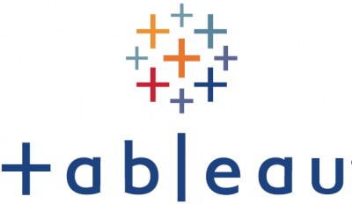
Architecture
Unix Server
REST API Call
Medicaid Server (Datasets)
Response JSON
Get the Data Exploration
Different Data for Graphs
Output
JAVA Program
User Interface (Web Page)
Display

Slide 3
User Interface & Statistics

Slide 4
UseCase & Features
To understand and predict prescription drug usage of medic-aid population, which will enable the local government and health plans to reduce spend.
Prediction of drug usage for 2019
Analysis of the provided datasets
Integration of different web technologies to create a website for the information
Implementation of different predictive models
Visualization of data.

Slide 5
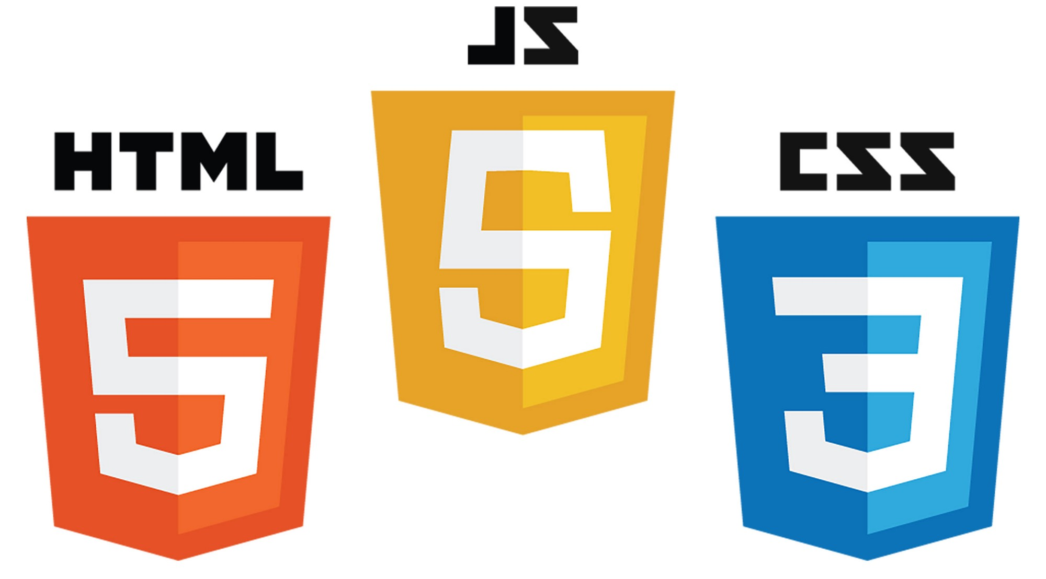
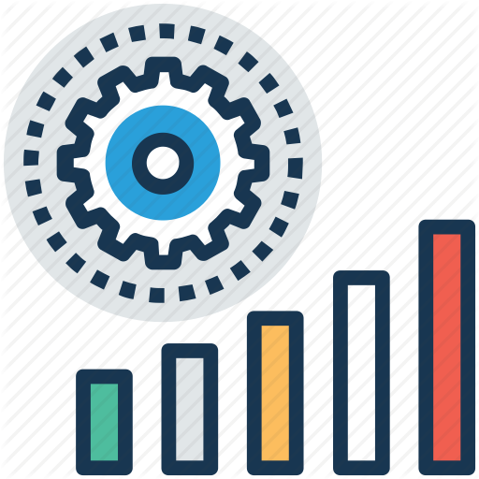
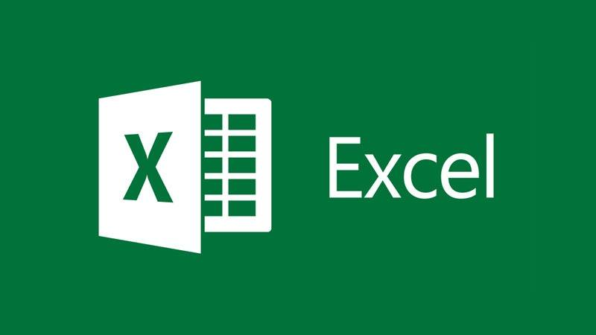
Technologies & Tools

