Slide 1
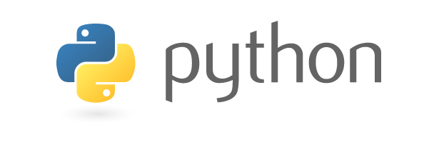
COMP-SCI 5590 - 0001 Special Topics
Introduction To Python
A readable, dynamic, pleasant, flexible, fast and powerful language

Slide 2
General Information
Unlike C/C++ or Java, Python statements do not end in a semicolon
In Python, indentation is the way you indicate the scope of a conditional, function, etc.
Look, no braces!
Python is interpretive.
You can just enter statements into the Python environment and they’ll execute

Slide 3
Why do people use Python…?
The following primary factors cited by Python users seem to be these:
Python is object-oriented
Structure supports such concepts as polymorphism, operation overloading, and multiple inheritance.
Indentation
Indentation is one of the greatest feature in Python.
It's free (open source)
Downloading and installing Python is free and easy
Source code is easily accessible

Slide 4
It's powerful
- Dynamic typing
- Built-in types and tools
- Library utilities
- Third party utilities (e.g. Numeric, NumPy, SciPy)
- Automatic memory management
It's portable
- Python runs virtually every major platform used today
- As long as you have a compatible Python interpreter installed, Python programs will run in exactly the same manner, irrespective of platform.

Slide 5
It's mixable
Python can be linked to components written in other languages easily
Linking to fast, compiled code is useful to computationally intensive problems
Python/C integration is quite common
It's easy to use
No intermediate compile and link steps as in C/ C++
Python programs are compiled automatically to an intermediate form called bytecode, which the interpreter then reads
This gives Python the development speed of an interpreter without the performance loss inherent in purely interpreted languages
It's easy to learn
Structure and syntax are pretty intuitive and easy to grasp

Slide 6
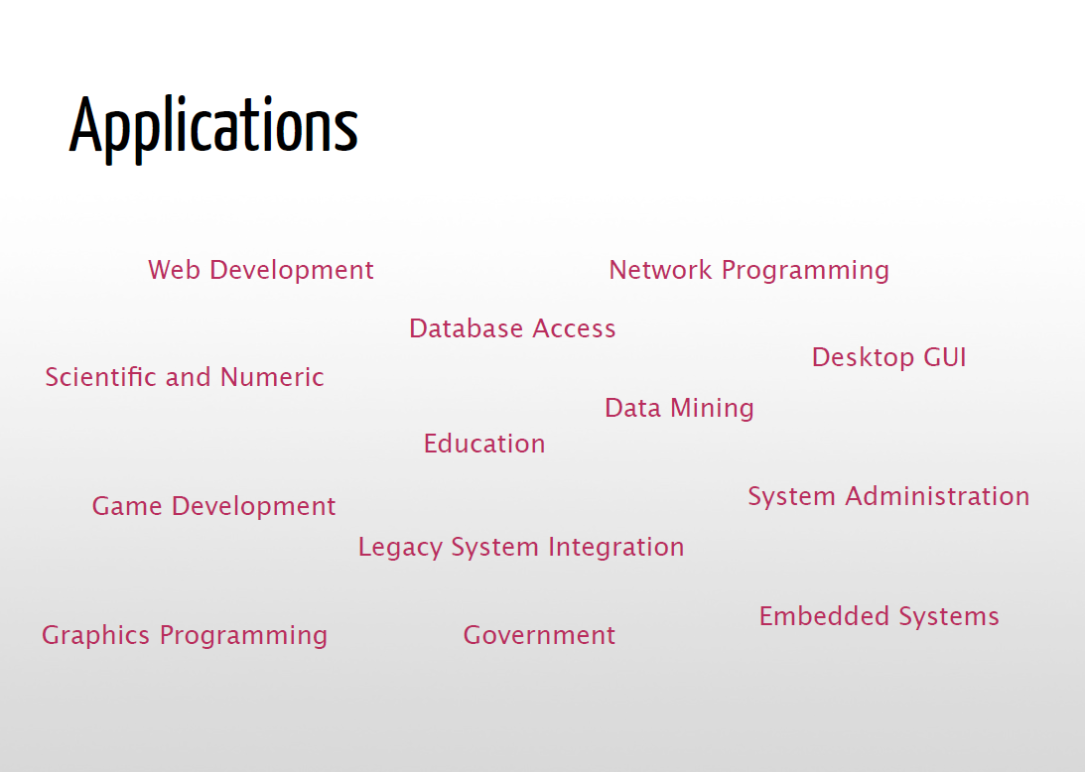
Applications
Science
- Bioinformatics
System Administration
-Unix
-Web logic
-Web sphere
Web Application Development
-CGI
-Jython – Servlets
Testing scripts

Slide 7
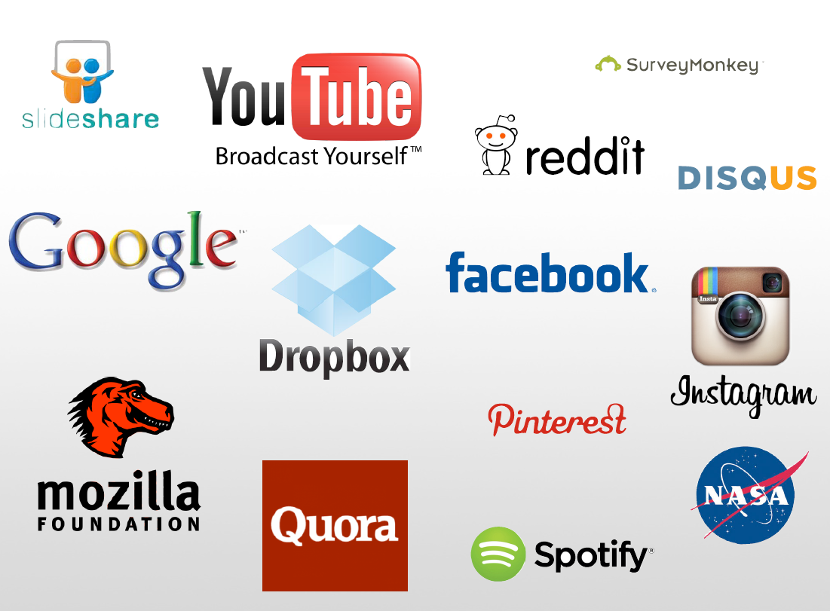
Who uses python today…
Python is being applied in real revenue-generating products by real companies. For instance:
Google makes extensive use of Python in its web search system, and employs Python’s creator.
Intel, Cisco, Hewlett-Packard, Seagate, Qualcomm, and IBM use Python for hardware testing.
ESRI uses Python as an end-user customization tool for its popular GIS mapping products.
The YouTube video sharing service is largely written in Python
The list goes on…….

Slide 8
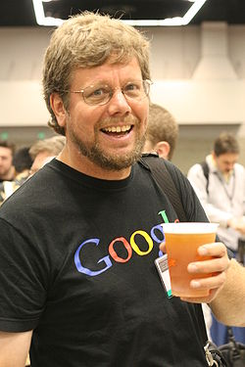
Who created Python?
"My original motivation for creating Python was the perceived need for a higher level language in the Amoeba [Operating Systems] project.
I realized that the development of system administration utilities in C was taking too long. Moreover, doing these things in the Bourne shell wouldn't work for a variety of reasons. ...
So, there was a need for a language that would bridge the gap between C and the shell”
Guido Van Rossum
-The Creator

Slide 9
Installation ??

Slide 10
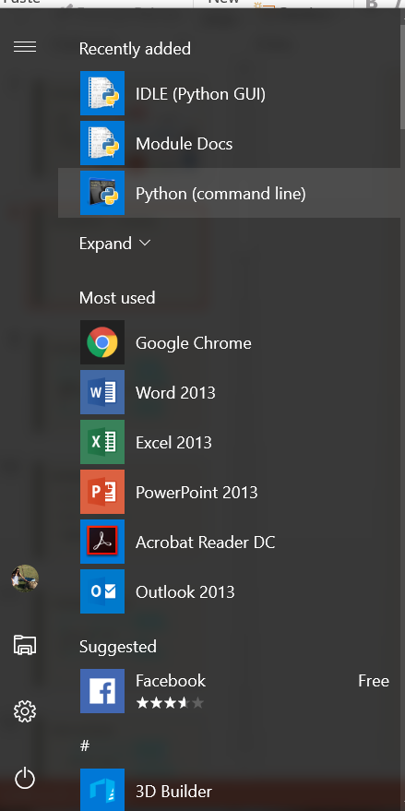
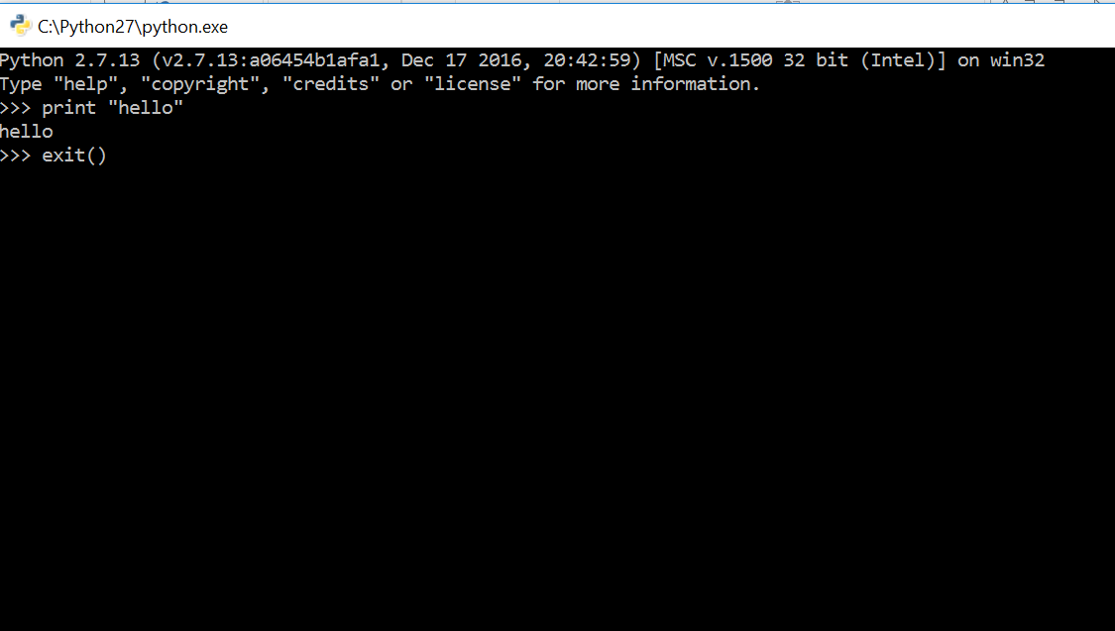
Running Python ― 1 (Windows)
Notes:
Now, the Unix interpreter prompts you to give it a Unix command with a short bit of text that ends with a dollar. In the slides this will be represented simply as a dollar.
This is a Unix prompt asking for a Unix command.
The Unix command we are going to give is “python3”. Please note that trailing “3”. The command “python” gives you either Python 2 or Python 3 depending on what system you are on. With this command we are insisting on getting a version of Python 3.
The Python interpreter then runs, starting with a couple of lines of blurb. In particular it identifies the specific version of Python it is running. (3.2.3 in this slide.)
Then it gives a prompt of its own, three “greater than” characters. The Python 3 program is now running and it is prompting us to give a Python command.
You cannot give a Unix command at a Python prompt (or vice versa).

Slide 11
Running Python ― 2 ( UNIX)
Unix prompt
Unix command
Introductory blurb
$
python3
Python
3.2.3
(default, May 23 2017, 15:54:42)
[GCC 4.6.3] on linux2
>>>
Python version
Python prompt
Notes:
Now, the Unix interpreter prompts you to give it a Unix command with a short bit of text that ends with a dollar. In the slides this will be represented simply as a dollar.
This is a Unix prompt asking for a Unix command.
The Unix command we are going to give is “python3”. Please note that trailing “3”. The command “python” gives you either Python 2 or Python 3 depending on what system you are on. With this command we are insisting on getting a version of Python 3.
The Python interpreter then runs, starting with a couple of lines of blurb. In particular it identifies the specific version of Python it is running. (3.2.3 in this slide.)
Then it gives a prompt of its own, three “greater than” characters. The Python 3 program is now running and it is prompting us to give a Python command.
You cannot give a Unix command at a Python prompt (or vice versa).

Slide 12
Quitting Python
>>>
exit()
Any one
of these
>>>
quit()
>>>
Ctrl
+
D
Notes:
There are various ways to quit interactive Python. There are two commands which are equivalent for our purposes: quit() and exit(), but the simplest is the key sequence [Ctrl]+[D].

Slide 13
A first Python command
Python prompt
Python command
>>>
print('Hello, world!')
Hello, world!
Output
>>>
Python prompt
Notes:
There is a tradition that the first program you ever run in any language generates the output “Hello, world!”.
I see no reason to buck tradition. Welcome to your first Python command; we are going to output “Hello, world!”.
We type this command at the Python prompt. The convention in these slides is that the typewriter text in bold face is what you type and the text in regular face is what the computer prints.
We type “print” followed by an opening round brackets and the text “Hello, world!” surrounded by single quotes, ending with a closing round bracket and hitting the Return key, [↲], to indicate that we are done with that line of instruction.
The computer responds by outputting “Hello, world!” without the quotes.
Once it has done that it prompts us again asking for another Python command with another Python prompt, “>>>”.

Slide 14
Python commands
Python “function”
Round brackets
― “parentheses”
print
(
(
'Hello, world!'
)
Function’s “argument”
print
≠
PRINT
“Case sensitive”
https://help.uis.cam.ac.uk/help-support/training/downloads/course-files/programming-student-files/python-courses/pythonab/pythonab-files/python3-slides.pdf
Notes:
This is our first Python “function”. A function takes some input, does something with it and (optionally) returns a value. The nomenclature derives from the mathematics of functions, but we don’t need to fixate on the mathematical underpinnings of computer science in this course.
Our function in this case is “print” and the command necessarily starts with the name of the function.
The inputs to the function are called its “arguments” and follow the function inside round brackets (“parentheses”).
In this case there is a single argument, the text to print.
Note that Python, as with many but not all programming languages, is “case sensitive”. The word “print” is not the same as “Print” or “PRINT”.

Slide 15
Python text
Quotation marks
'
Hello, world!
'
The body
of the text
!
The quotes are not
part of the text itself.
https://help.uis.cam.ac.uk/help-support/training/downloads/course-files/programming-student-files/python-courses/pythonab/pythonab-files/python3-slides.pdf
Notes:
The text itself is presented within single quotation marks. (We will discuss the choice of quotation marks later.)
The body of the text comes within the quotes.
The quotes are not part of the text; they merely indicate to the Python interpreter that “hey, this is text!”
Recall that the the printed output does not have quotes.

Slide 16
Quotes?
print
Command
'print'
Text
https://help.uis.cam.ac.uk/help-support/training/downloads/course-files/programming-student-files/python-courses/pythonab/pythonab-files/python3-slides.pdf
Notes:
So what do the quotes “do”?
If there are no quotes then Python will try to interpret the letters as something it should know about. With the quotes Python simply interprets it as literal text.
For example, without quotes the string of characters p-r-i-n-t are a command; with quotes they are the text to be printed.

Slide 17
Python scripts
File in home directory
print('Hello, world!')
Run from Unix prompt
hello1.py
Unix prompt
Unix command
to run Python
$
python3
hello1.py
Python script
Hello, world!
Python script’s output
$
Unix prompt
Notes:
So we understand the “hello, world” command and how to run it from an interactive Python. But serious Python programs can’t be typed in live; they need to be kept in a file and Python needs to be directed to run the commands from that file.
These files are called “scripts” and we are now going to look at the Python script version of “hello, world”.
In your home directories we have put a file called “hello1.py”. It is conventional that Python scripts have file names ending with a “.py” suffix. Some tools actually require it. We will follow this convention and you should too.
This contains exactly the same as we were typing manually: a single line with the print command on it.
We are going to make Python run the instructions out of the script. We call this “running the script”.
Scripts are run from the Unix command line. We issue the Unix command “python3” to execute Python again, but this time we add an extra word: the name of the script, “hello1.py”.
When it runs commands from a script, python doesn’t bother with the lines of blurb and as soon as it has run the commands (hence the output) it exists immediately, returning control to the Unix environment, so we get a Unix prompt back.

Slide 18

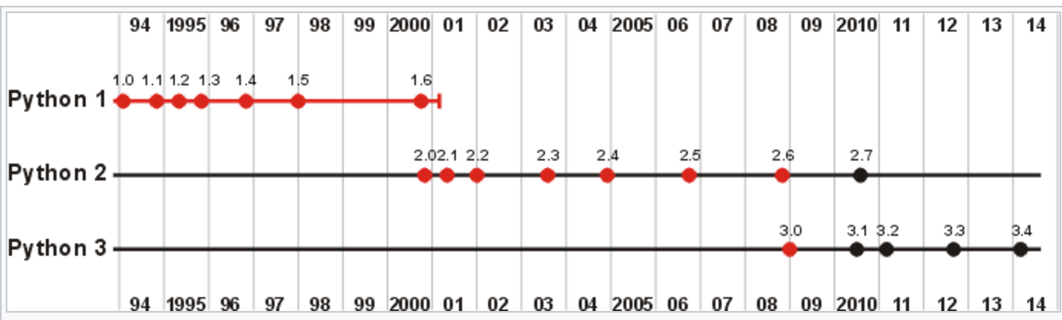
4 Major Versions of Python
“Python” or “CPython” is written in C/C++
- Version 2.7 came out in mid-2010
- Version 3.4 came out in early 2014
“Jython” is written in Java for the JVM
“IronPython” is written in C# for the .Net environment
https://help.uis.cam.ac.uk/help-support/training/downloads/course-files/programming-student-files/python-courses/pythonab/pythonab-files/python3-slides.pdf

Slide 19
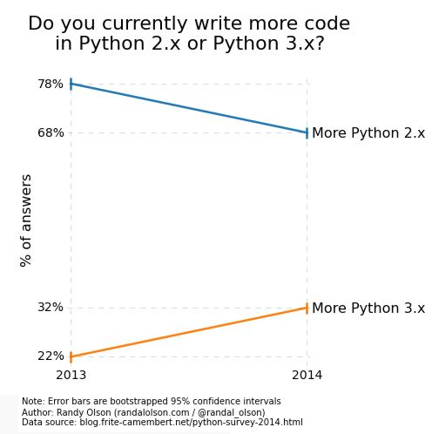
Python 2 vs 3
Learn more from below link:
http://learntocodewith.me/programming/python/python-2-vs-python-3/

Slide 20
Development Environments what IDE to use? http://stackoverflow.com/questions/81584
PyDev with Eclipse
Komodo
Emacs
Vim
TextMate
Gedit
Idle
PIDA (Linux)(VIM Based)
NotePad++ (Windows)
BlueFish (Linux)
PyCharm
Our choice of IDE !!
https://help.uis.cam.ac.uk/help-support/training/downloads/course-files/programming-student-files/python-courses/pythonab/pythonab-files/python3-slides.pdf

Slide 21
Pydev with Eclipse

Slide 22
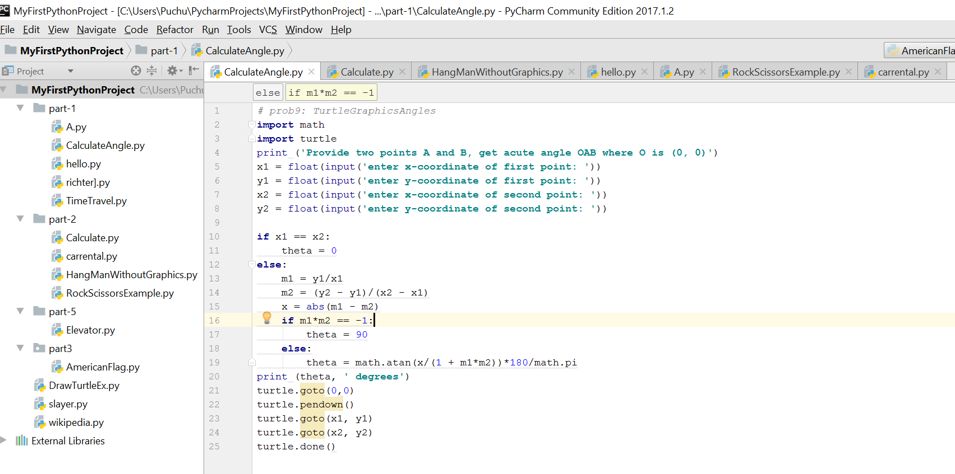
Pycharm IDE
Python File Name
Project Name

Slide 23
Start >>>

Slide 24
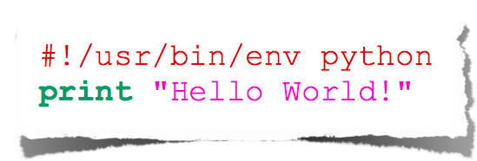
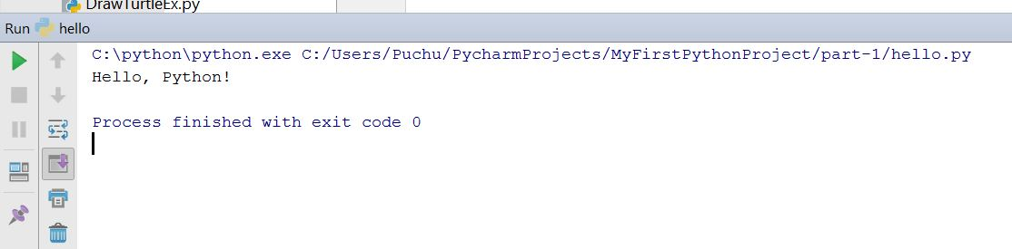
Usecase 1 - Hello World
Output
hello_world.py
Input Sample Program

Slide 25
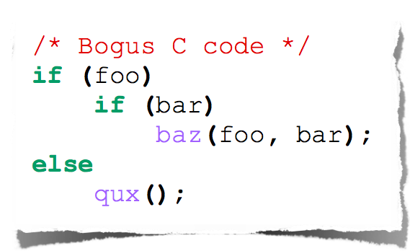
Indentation
Most languages don’t care about indentation
Most humans do
We tend to group similar things together
The else here actually belongs to the 2nd if statement

Slide 26
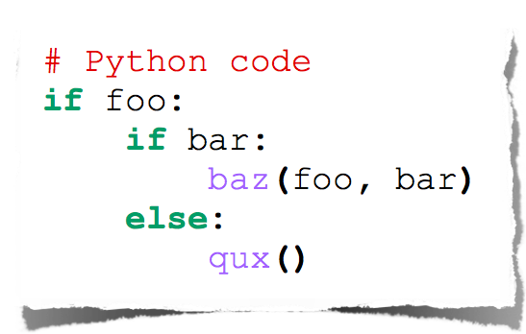
Indentation
Text
Python embraces indentation

Slide 27
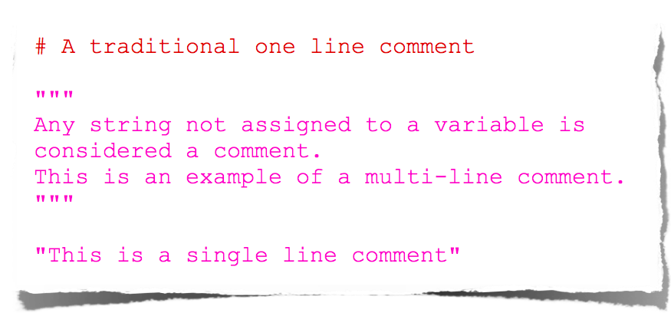
Comments

Slide 28
Types

Slide 29
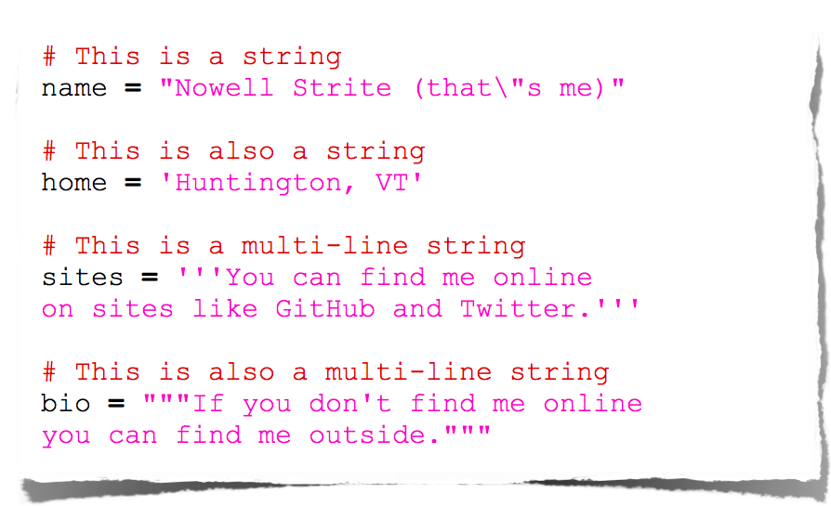
Strings

Slide 30
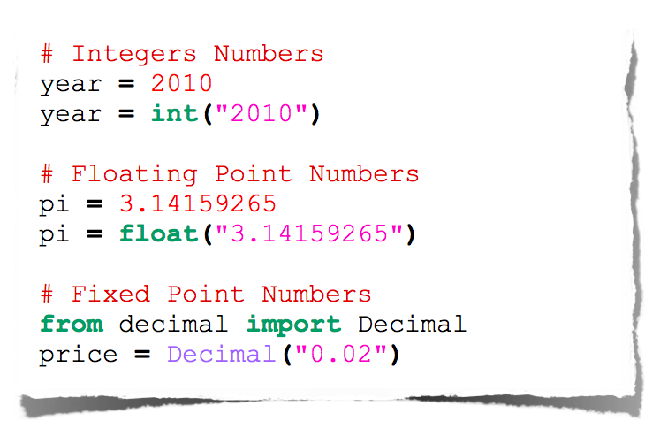
Numbers

Slide 31
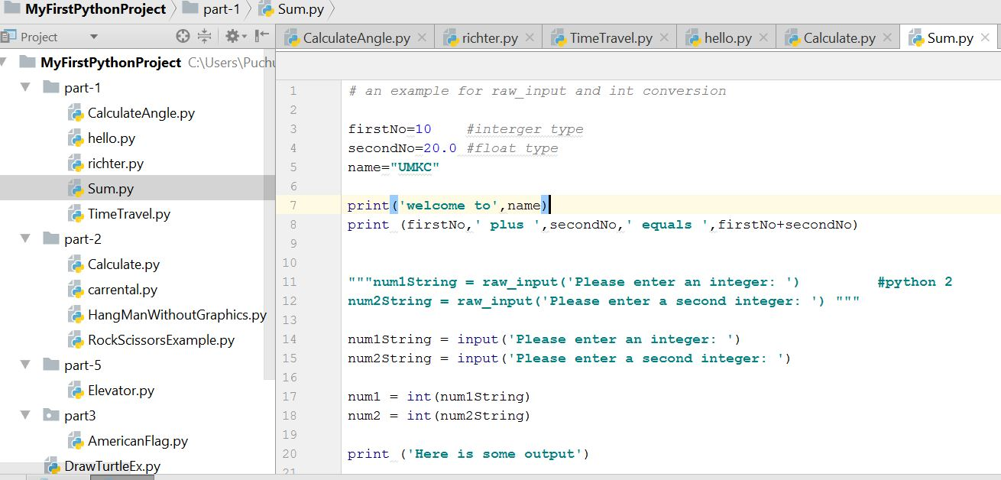
Use case 2- Add two numbers
Variable declaration
Print statement
Python 2 way
Taking Input from user

Slide 32
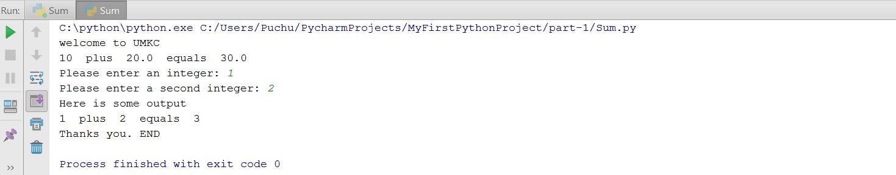
Use case 2- Output

Slide 33
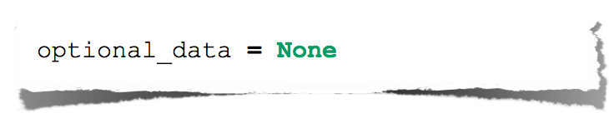
Null

Slide 34
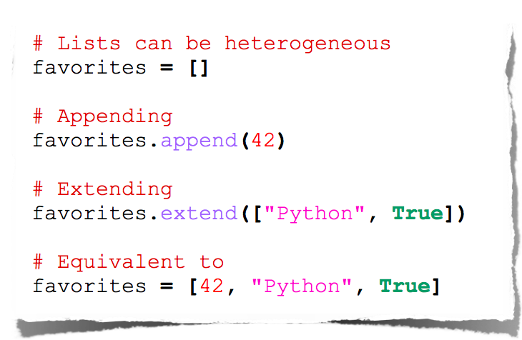
Lists

Slide 35
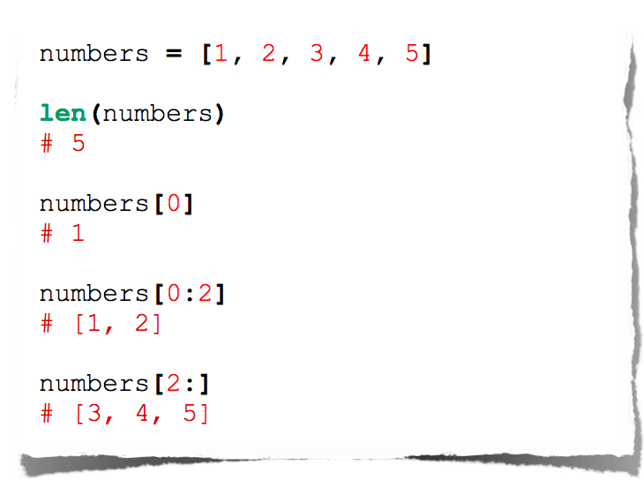
Lists

Slide 36
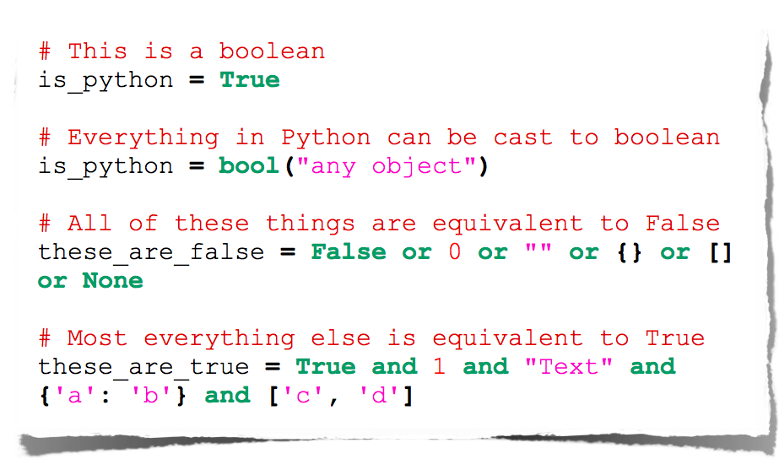
Booleans

Slide 37
Operators

Slide 38
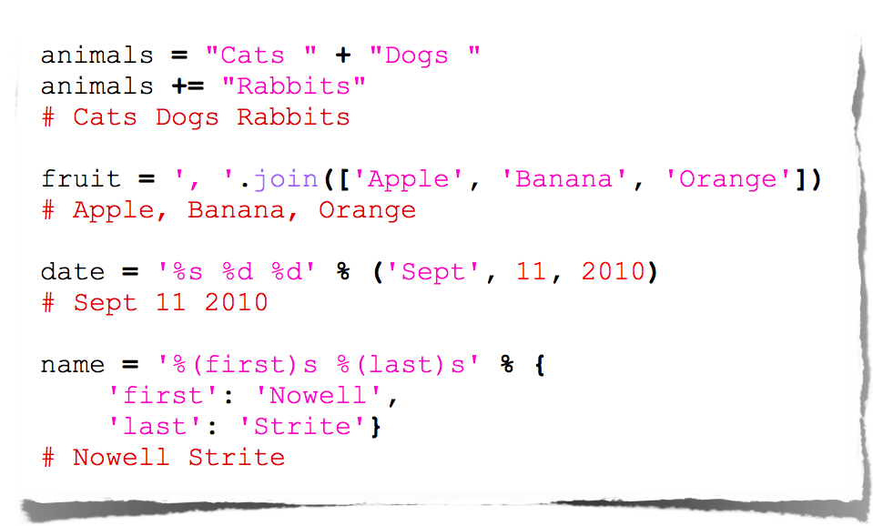
String Manipulation

Slide 39
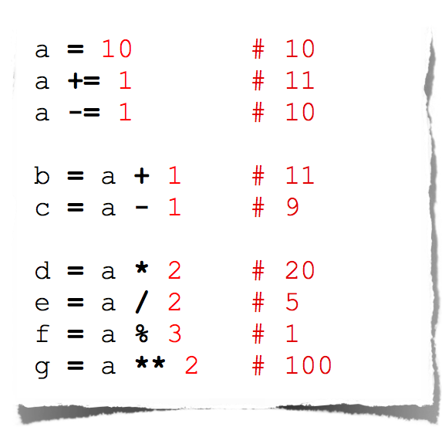
Arithmetic

Slide 40
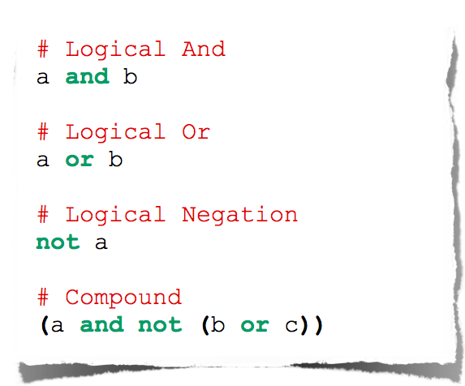
Logical Comparison

Slide 41
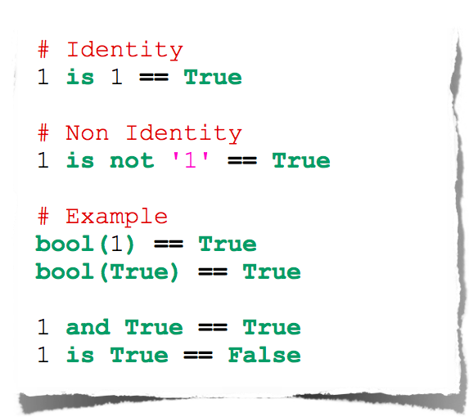
Identity Comparison

Slide 42
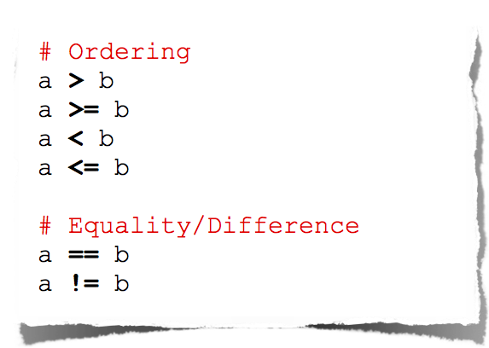
Arithmetic Comparison

Slide 43
Operators Precedence
Operator | Description
** | Exponentiation (raise to the power)
~ + - | Complement, unary plus and minus (method names for the last two are +@ and -@)
* / % // | Multiply, divide, modulo and floor division
+ - | Addition and subtraction
>> << | Right and left bitwise shift
& | Bitwise 'AND'
^ | | Bitwise exclusive `OR' and regular `OR'
<= < > >= | Comparison operators
<> == != | Equality operators
= %= /= //= -= += *= **= | Assignment operators
is is not | Identity operators
in not in | Membership operators
not or and | Logical operators
The order in which operators are executed in any expression

Slide 44
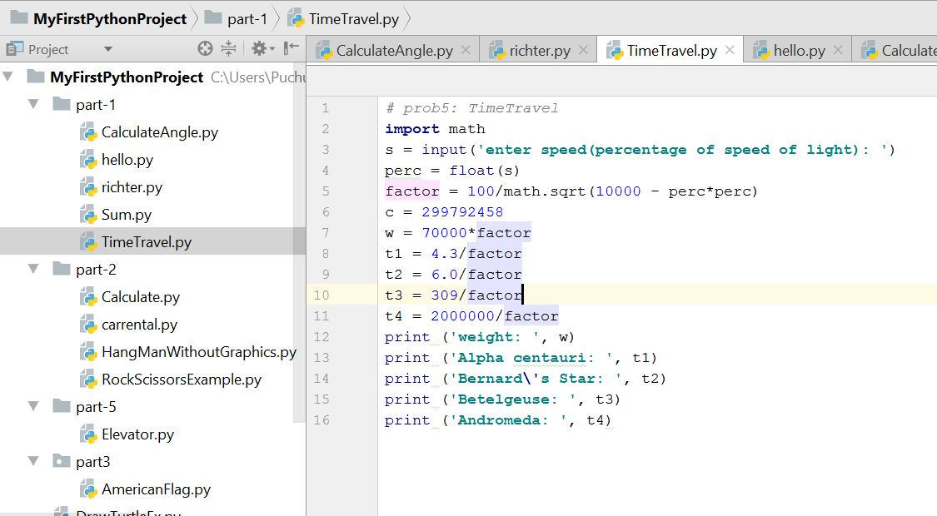
Use case 3- Basic operations
Basic Operations

Slide 45
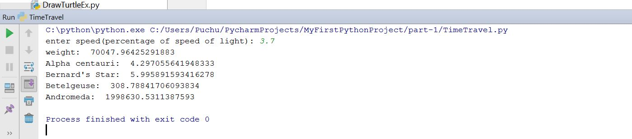
Use case 3- Output

Slide 46
Importing and Modules
Use classes & functions defined in another file to get additional functionality
A Python module is a file with the same name (plus the .py extension)
Like Java import, C++ include
modules have private symbol tables
Three formats of the command:
import somefile
from somefile import *
from somefile import className
When a Python program starts it only has access to a basic functions and classes.
(“int”, “dict”, “len”, “sum”, “range”, ...)

Slide 47
import …
import somefile
Everything in somefile.py gets imported.
To refer to something in the file, append the text “somefile.” to the front of its name:
somefile.className.method(“abc”)
somefile.myFunction(34)

Slide 48
from … import *
from somefile import *
Everything in somefile.py gets imported
To refer to anything in the module, just use its name. Everything in the module is now in the current namespace.
Take care! Using this import command can easily overwrite the definition of an existing function or variable!
className.method(“abc”)
myFunction(34)

Slide 49
from … import …
from somefile import className
Only the item className in somefile.py gets imported.
After importing className, you can just use it without a module prefix. It’s brought into the current namespace.

Slide 50
import the math module
>>> import math
>>> math.pi
3.1415926535897931
>>> math.cos(0)
1.0
>>> math.cos(math.pi)
-1.0
>>> dir(math)
['__doc__', '__file__', '__name__', '__package__', 'acos', 'acosh',
'asin', 'asinh', 'atan', 'atan2', 'atanh', 'ceil', 'copysign', 'cos',
'cosh', 'degrees', 'e', 'exp', 'fabs', 'factorial', 'floor', 'fmod',
'frexp', 'fsum', 'hypot', 'isinf', 'isnan', 'ldexp', 'log', 'log10',
'log1p', 'modf', 'pi', 'pow', 'radians', 'sin', 'sinh', 'sqrt', 'tan',
'tanh', 'trunc']

Slide 51
Basic Statements: The If Statement (1)
If statements have the following basic structure:
# inside the interpreter # inside a script
>>> if condition: if condition:
... action action
...
>>>
Subsequent indented lines are assumed to be part of the if statement. The same is true for most other types of python statements. A statement typed into an interpreter ends once an empty line is entered, and a statement in a script ends once an unindented line appears. The same is true for defining functions.
If statements can be combined with else if (elif) and else statements as follows:
if condition1: # if condition1 is true, execute action1
action1
elif condition2: # if condition1 is not true, but condition2 is, execute
action2 # action2
else: # if neither condition1 nor condition2 is true, execute
action3 # action3

Slide 52
Basic Statements: The If Statement (2)
Conditions in if statements may be combined using and & or statements
if condition1 and condition2:
action1
# if both condition1 and condition2 are true, execute action1
if condition1 or condition2:
action2
# if either condition1 or condition2 is true, execute action2
Conditions may be expressed using the following operations:
<, <=, >, >=, ==, !=, in
Somewhat unrealistic example:
>>> x = 2; y = 3; L = [0,1,2]
>>> if (1<x<=3 and 4>y>=2) or (1==1 or 0!=1) or 1 in L:
... print 'Hello world'
...
Hello world
>>>

Slide 53
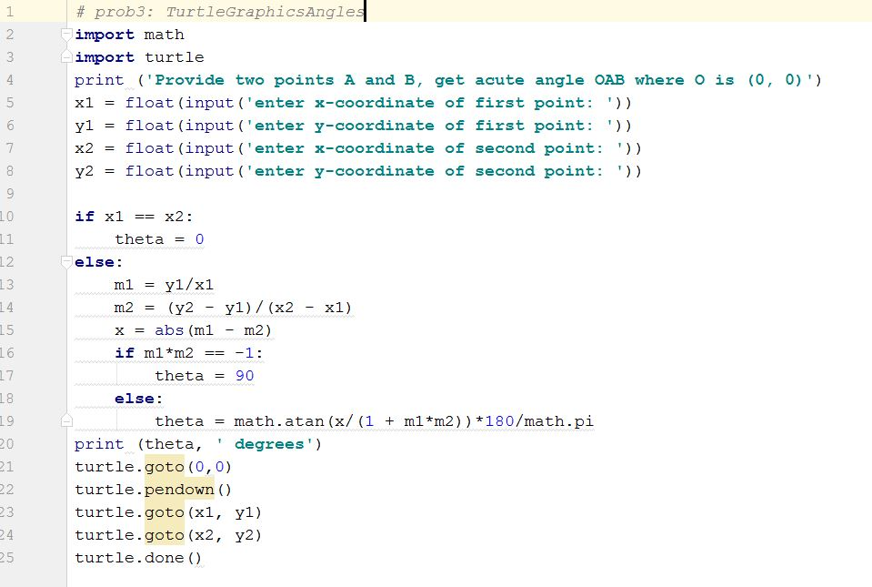
Use Case 4 – Import Turtle Graphics and create the two lines. Also calculate angle between them
Import statements
If block

Slide 54
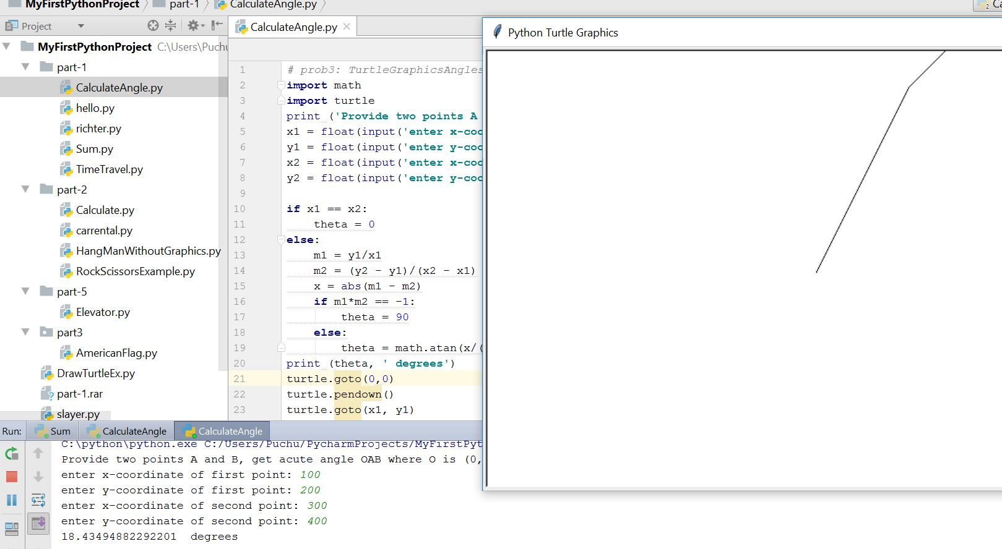
Use Case 4 -Output

Slide 55
Loops: break, continue, else
break and continue like C
else after loop exhaustion
for n in range(2,10):
for x in range(2,n):
if n % x == 0:
print n, 'equals', x, '*', n/x
break
else:
# loop fell through without finding a factor
print n, 'is prime'

Slide 56
Basic Statements: The While Statement (1)
While statements have the following basic structure:
# inside the interpreter # inside a script
>>> while condition: while condition:
... action action
...
>>>
As long as the condition is true, the while statement will execute the action
Example:
>>> x = 1
>>> while x < 4: # as long as x < 4...
... print x**2 # print the square of x
... x = x+1 # increment x by +1
...
1 # only the squares of 1, 2, and 3 are printed, because
4 # once x = 4, the condition is false
9
>>>

Slide 57
Basic Statements: The While Statement (2)
Pitfall to avoid:
While statements are intended to be used with changing conditions. If the condition in a while statement does not change, the program will be stuck in an infinite loop until the user hits ctrl-C.
Example:
>>> x = 1
>>> while x == 1:
... print 'Hello world'
...
Since x does not change, Python will continue to print “Hello world” until interrupted
Do nothing : pass does nothing
syntactic filler
while 1:
pass

Slide 58
Basic Statements: The For Statement (1)
For statements have the following basic structure:
for item i in set s:
action on item i
# item and set are not statements here; they are merely intended to clarify the relationships between i and s
Example:
>>> for i in range(1,7):
... print i, i**2, i**3, i**4
...
1 1 1 1
2 4 8 16
3 9 27 81
4 16 64 256
5 25 125 625
6 36 216 1296
>>>

Slide 59
Basic Statements: The For Statement (2)
The item i is often used to refer to an index in a list, tuple, or array
Example:
>>> L = [0,1,2,3] # or, equivalently, range(4)
>>> for i in range(len(L)):
... L[i] = L[i]**2
...
>>> L
[0,1,4,9]
>>>
Of course, we could accomplish this particular task more compactly using arrays:
>>> L = arange(4)
>>> L = L**2
>>> L
[0,1,4,9,]

Slide 60
Range
The range function specifies a range of integers:
range(start, stop) - the integers between start (inclusive)
and stop (exclusive)
It can also accept a third value specifying the change between values.
range(start, stop, step) - the integers between start (inclusive)
and stop (exclusive) by step

Slide 61
Basic Statements: Combining Statements
The user may combine statements in a myriad of ways
Example:
>>> L = [0,1,2,3] # or, equivalently, range(4)
>>> for i in range(len(L)):
... j = i/2.
... if j – int(j) == 0.0:
... L[i] = L[i]+1
... else: L[i] = -i**2
...
>>> L
[1,-1,3,-9]
>>>

Slide 62
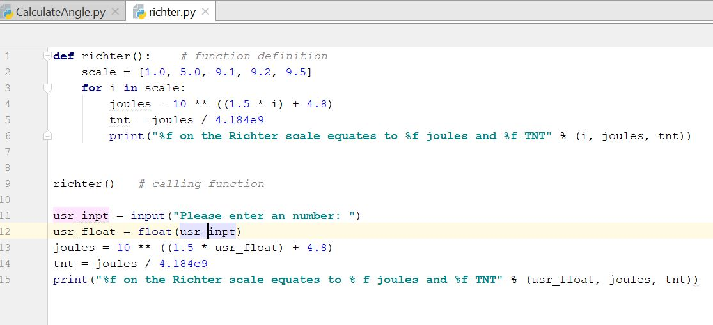
Use Case 5 – Basic for loop
For loop

Slide 63
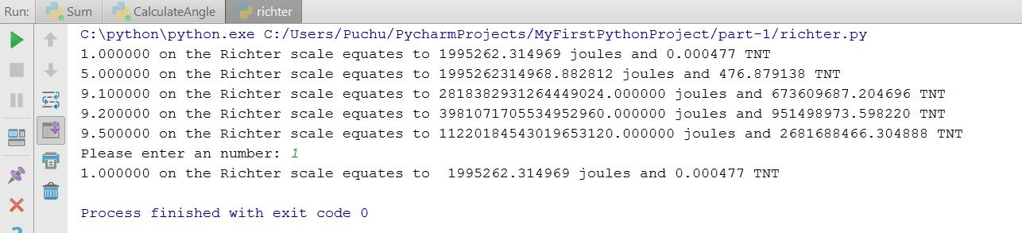
Use Case 5 – Output

Slide 64
Lets start with In class Exercise
List the differences between Python 2 and Python 3?
2. Write a python program for the following:
Take the user first name and last name and print it in reversed form
Take two numbers from user and perform arithmetic operations on them.
3. Write a program that accepts a sentence and prints the number of letters and digits in
sentence.

Slide 65
In Class Exercise
Sample input:
Firstname: George Lastname: Thorpe
Sample output:
egroeG eprohT
-----------------------------------------------------
Sample input:
Python CS 5590
Sample output:
Letters: 8 Digits: 4

Slide 66
References
https://www.slideshare.net/nowells/introduction-to-python-5182313
https://www.slideshare.net/sujithkumar9212301/introduction-to-python-36647807
https://github.com/galactocalypse/python
http://www.cse.msu.edu/~cse231/PracticeOfComputingUsingPython/
https://ocw.mit.edu/courses/electrical-engineering-and-computer-science/6-189-a-gentle-introduction-to-programming-using-python-january-iap-2011/download-course-materials/

