Slide 1

Python Programming
Sets, Dictionaries and Web Scraping

Slide 2
Feedback is greatly appreciated!

Slide 3

Objective
Sets: Union, Intersection, Difference
Dictionaries: Update, Delete, Add
Web scraping
Notes:
3

Slide 4
SETS

Slide 5
Sets
Set: object that stores a collection of data in same way as mathematical set
All items must be unique
Set is unordered
Elements can be of different data types
Sets are mutable and it contains immutable elements
e.g.:
>>> aset = {11, 22, 33}
>>> bset = aset
>>> aset = aset | {55}
>>> aset {33, 11, 22, 55}
>>> bset {33, 11, 22}

Slide 6
Creating a Set
set function: used to create a set
For empty set, call set()
For non-empty set, call set(argument) where argument is an object that contains iterable elements
{'Alice', 'Bob', 'Carol'}
{'Dean'} is a singleton
argument can be a list, string, or tuple
If argument is a string, each character becomes a set element
If argument contains duplicates, only one of the duplicates will appear in the set

Slide 7
Len, add, update function
len function: returns the number of elements in the set
>>> myset = {'Apples', 'Bananas', 'Oranges'}
>>> len(myset) → 3
add method: adds an element to a set
>>> myset.add(‘strawberry’)
>>> print(myset) -> {'Apples', 'Bananas', 'Oranges’, ‘strawberry’}
update method: adds a group of elements to a set
Argument must be a sequence containing iterable elements,
and each of the elements is added to the set
>>> myset.update(‘1’,’2’)
>>> print(myset) -> {'Apples', 'Bananas', 'Oranges’,’1’,’2’}

Slide 8
Deleting Elements From a Set
Remove and discard methods: remove the specified item from the set
The item that should be removed is passed to both methods as an argument
Behave differently when the specified item is not found in the set
remove method raises a KeyError exception
discard method does not raise an exception
>>> myset.remove(‘Apples’)
>>> print(myset) -> {'Bananas', 'Oranges’)}
clear method: clears all the elements of the set

Slide 9
For Loop, in, and not in Operators With a Set
A for loop can be used to iterate over elements in a set
General format: for item in set:
The loop iterates once for each element in the set
The in operator can be used to test whether a value exists in a set
Similarly, the not in operator can be used to test whether a value does not exist in a set

Slide 10
Sets do not support indexing
>>> myset = {'Apples', 'Bananas', 'Oranges'}
>>> myset {'Bananas', 'Oranges', 'Apples'}
>>> myset[0] Traceback (most recent call last): File "<pyshell#2>", line 1, in <module> myset[0] TypeError: 'set' object does not support indexing

Slide 11
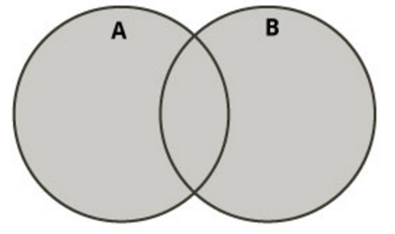
Boolean operations on sets (I)
Union of two sets
Contains all elements that are in set A or in set B
>>> aset = {11, 22, 33}
>>> bset = {12, 23, 33}
Union of two sets
>>> aset | bset {33, 22, 23, 11, 12}

Slide 12
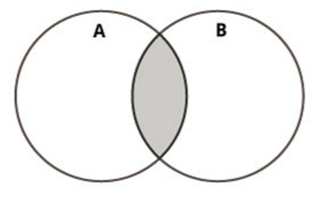
Boolean operations on sets (II)
Intersection of two sets
Contains common elements that are in both sets A and B
>>> aset = {11, 22, 33}
>>> bset = {12, 23, 33}
Intersection of two sets:
>>> aset & bset {33}

Slide 13
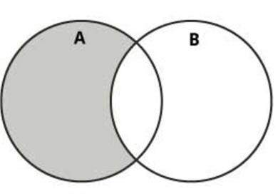
Boolean operations on sets (III)
Difference of two sets
Contains all elements that are in A but not in B
>>> aset = {11, 22, 33}
>>> bset = {12, 23, 33}
Difference:
>>> aset – bset {11, 22}

Slide 14
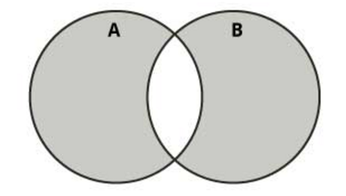
Boolean operations on sets (IV)
Symmetric difference of two sets
Contains all elements that are either
in set A but not in set B or
in set B but not in set A
>>> aset = {11, 22, 33}
>>> bset = {12, 23, 33}
Symmetric difference:
>>> aset ^ bset {11, 12, 22, 23}

Slide 15
DICTIONARIES

Slide 16
Dictionaries
A dictionary is a container that keeps associations between keys and values.
Keys are unique, but a value may be associated with several keys.
Values
Keys
John
$15,000
Ann
$12,000
Mike
Mary
$30,000

Slide 17

Creating Dictionaries
Each key/value pair is separated by a colon.
You enclose the key/value pairs in braces.
To create an empty dictionary:
Use {}
Use built-in function dict()
Use a for loop to iterate over a dictionary
General format: for key in dictionary:

Slide 18
Sets and dictionaries
When the braces contain key/value pairs, they denote a dictionary, not a set. The only ambiguous case is an empty {}. By convention, it denotes an empty dictionary, not an empty set. You can create a duplicate copy of a dictionary using the dict function:
oldSalaries = dict(salaries)
salaries = { “John": 15000, “Ann": 30000, “Mike": 12000, “Mary": 15000 }

Slide 19
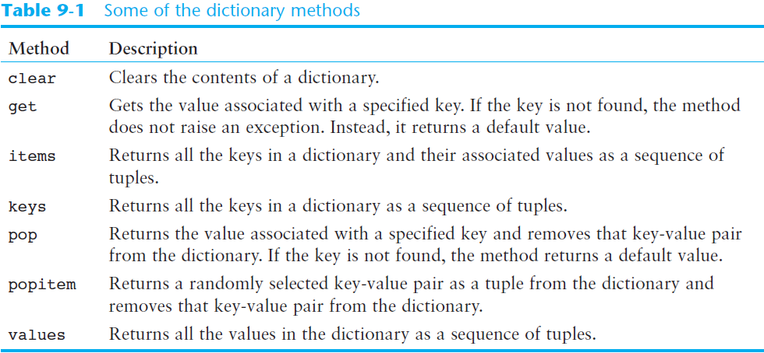
Some Dictionary Methods (cont’d.)

Slide 20

Accessing Dictionary Values
The subscript operator [] is used to return the value associated with a key.
The statement:
print(“Ann’s salary is", salaries[“Ann"])
prints 30000
Note that the dictionary is not a sequence-type container like a list.
Even though the subscript operator is used with a dictionary, you cannot access the items by index or position.
A value can only be accessed using its associated key

Slide 21
Searching For Keys
The key supplied to the subscript operator must be a valid key in the dictionary or a KeyError exception will be raised.
To find out whether a key is present in the dictionary, use the in (or not in) operator:
if “Ann" in salaries : print(“Ann’s salary is", salaries[“Ann”]) else : print(“Ann’s salary is not in my list.”)

Slide 22
Dictionaries are mutable
>>> age = {'Alice' : 25, 'Bob' : 28}
>>> saved = age
>>> age['Bob'] = 29
>>> age {'Bob': 29, 'Alice': 25}
>>> saved {'Bob': 29, 'Alice': 25}

Slide 23
Adding Elements to an Existing Dictionary
To add a new key-value pair:
dictionary[key] = value
If key exists in the dictionary, the value associated with it will be changed

Slide 24
Displaying Contents
>>> age = {'Alice' : 25, 'Carol': 'twenty-two’}
>>> age.items() dict_items([ ('Alice', 25), ('Carol', 'twenty-two')])
>>> age.keys() dict_keys([ 'Alice', 'Carol'])
>>> age.values() dict_values([25, 'twenty-two'])

Slide 25
Updating Dictionaries
>>> age = {'Alice': 26 , 'Carol' : 22}
>>> age.update({'Bob' : 29})
>>> age {'Bob': 29, 'Carol': 22, 'Alice': 26}
>>> age.update({'Carol' : 23})
>>> age {'Bob': 29, 'Carol': 23, 'Alice': 26}

Slide 26
Returning a value
>>> age = {'Bob': 29, 'Carol': 23, 'Alice': 26}
>>> age.get('Bob') 29
>>> age['Bob'] 29

Slide 27
Removing a specific item
>>> a = {'Alice' : 26, 'Carol' : 'twenty-two’}
>>> a {'Carol': 'twenty-two', 'Alice': 26}
>>> a.pop('Carol’) 'twenty-two’
>>> a {'Alice': 26}

Slide 28
Remove a random item
>>> age = {'Bob': 29, 'Carol': 23, 'Alice': 26}
>>> age.popitem() ('Bob', 29)
>>> age
{'Carol': 23, 'Alice': 26}
>>> age.popitem() ('Carol', 23)
>>> age {'Alice': 26}

Slide 29

Avoiding Removal Errors
If the key is not in the dictionary, the pop method raises a KeyError exception.
To prevent the exception from being raised, you can test for the key in the dictionary:
if "Mike" in salaries : salaries.pop("Mike")

Slide 30
Number of Elements and Mixing Data Types
len function: used to obtain number of elements in a dictionary
clear method: deletes all the elements in a dictionary, leaving it empty
Format: dictionary.clear()
Values stored in a single dictionary can be of different types

Slide 31

Different Ways Of Doing The Same Thing
Lists
prerequisites = ["COP 2271c", "Introduction to Computation and Programming", 3]
print(prerequisites[2]) # Prints the element at index 2
Sets
cheesePizza = {"Creamy garlic", "Parmesan sauce", "Cheese", "Toasted Parmesan"}
if "Toasted Parmesan" in cheesePizza:
Dictionaries
salaries = {"John": 15000, "Ann": 30000, "Mike": 12000, "Mary": 15000 }
print("Ann’s salary is", salaries["Ann"])

Slide 32
Web Scraping
A computer software technique of extracting information from websites. (Wikipedia)
for business, hobbies, research...
Look for right URLs to scrap.
Look for right content from webpages.
Saving data into data store.

Slide 33
Web Scraping
This technique mostly focuses on the transformation of unstructured data (HTML format) on the web into structured data

Slide 34
BeautifulSoup library
Python third-party library for extracting data from html and xml files
Works with html.parser, lxml, html5lib
Provides ways to navigate, search and modify the parse tree based on the position in the parse tree, tag name, tag attributes, CSS classes using regular expressions, user defined functions etc.
Excellent tutorial with examples at http://www.crummy.com/software/BeautifulSoup/bs4/doc/
Supports Python 2.7 and 3

Slide 35
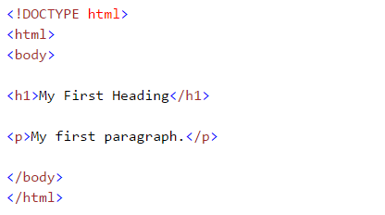
Get familiar with HTML (Tags)
While performing web scarping, we deal with html tags.
Thus, we must have good understanding of them

Slide 36
Get familiar with HTML (Tags)
This syntax has various tags as elaborated below:
<!DOCTYPE html> : HTML documents must start with a type declaration
HTML document is contained between <html> and </html>
The visible part of the HTML document is between <body> and </body>
HTML headings are defined with the <h1> to <h6> tags
HTML paragraphs are defined with the <p> tag

Slide 37
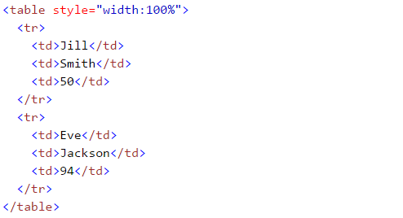
Get familiar with HTML (Tags)
HTML links are defined with the <a> tag, “<a href=“http://www.test.com”>This is a link for test.com</a>”
HTML tables are defined with<Table>, row as <tr> and rows are divided into data as <td>

Slide 38
Installation
pip install beautifulsoup4 or easy_install beautifulsoup4
See: http://www.crummy.com/software/BeautifulSoup/
On installing libraries: http://docs.python.org/2/install/

Slide 39
Example
import Requests
from bs4 import BeautifulSoup
html = requests.get("http://sampleshop.pl")
bsObj = BeautifulSoup(html.content, "html.parser")
print(bsObj.h1)

Slide 40


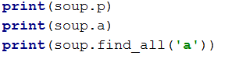


Simple ways to navigate data structure

Slide 41
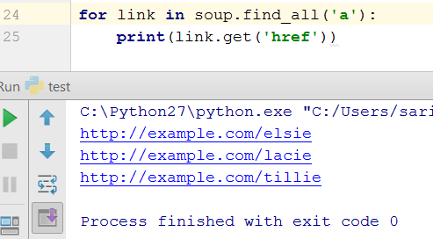
Extracting all the URLs found within a page’s <a> tags
.
<a> tag defines a hyperlink which is used to link from one page to another page
href attribute indicates the link destination

Slide 42
Basic functions: Getting headers, titles, body
soup.text
soup.head
soup.title
soup.body
soup.findall(‘a’)
soup.final(‘div’,{‘class’:’noprint’})

Slide 43
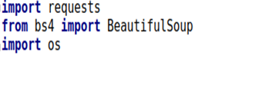
Use case: Wikipedia
The goal here is to extract all the data related to a keyword from Wikipedia, then save those data in a file.
Libraries to be imported:

Slide 44
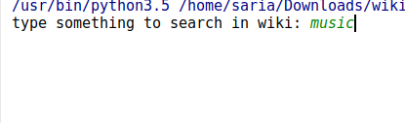
.
Keyword for searching in the wiki
search = input('type something to search in wiki: ') limit = input('how many results do you want to get?: ') if not os.path.exists(search): print("Creating file " + search) file2 = open(search+'.txt','a+',encoding='utf-8') search_spider(search, limit)
1. Create a file in the project with the keyword being searched
2. This function call the search api in wiki to find all the pages with the keyword that user has identified

Slide 45
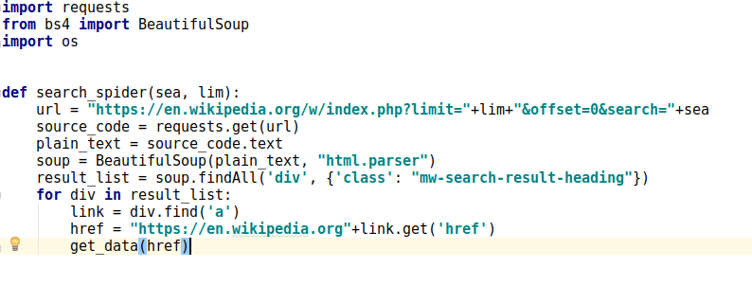
Search the wiki with specified keyword
1. Search the wiki for the keyword
2. Using BeautifulSoap to parse the html
3. Including all the div with this class in the result
4. Analyzing the first result

Slide 46
Get the data and save the result in the file
1. Get the url of the result, ex: Barack Obama
def get_data(url): source_code = urllib.request.urlopen(url) plain_text = source_code soup = BeautifulSoup(plain_text, "html.parser") body = soup.find('div', {'class': 'mw-parser-output'}) file2.write(str(body.text)) print(body.text)
2. Parse the html page using BeautifulSoup
3. Open the created text file
4. Finding all the div with this class name
5. Writing the cleaned text in the file

Slide 47
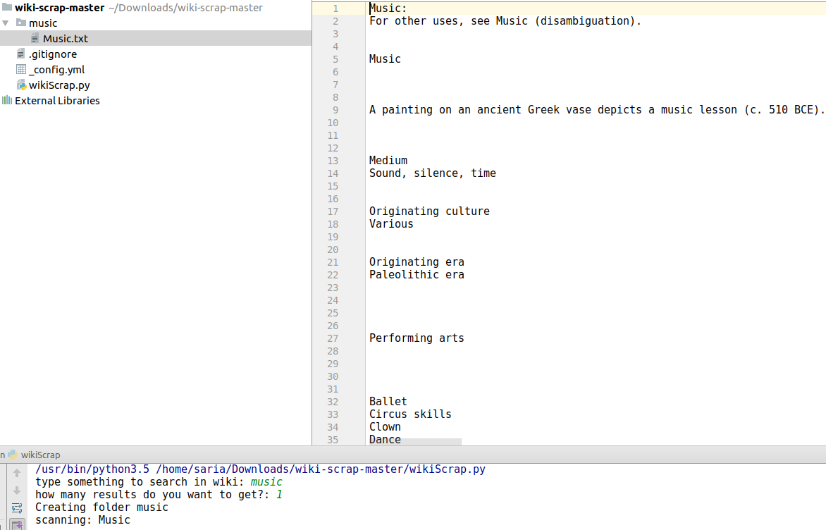
Result

Slide 48
References
https://github.com/saria85/PythonProgramming-summer2017
https://beautiful-soup-4.readthedocs.io/en/latest/
http://www.w3resource.com/pythonexercises/https://www.slideshare.net/milkers/beautiful-soup?qid=64c9989d-94f7-4811-b3102cd7cfcb272e&v=&b=&from_search=6
https://www.learnpython.org/

