Slide 1


TensorFlow Ops
Tensor Flow for Deep Learning Research

Slide 2
Feedback is greatly appreciated!

Slide 3

Overview
Bag of Words
Word Embeddings (representation of text data)
word2vec model

Slide 4
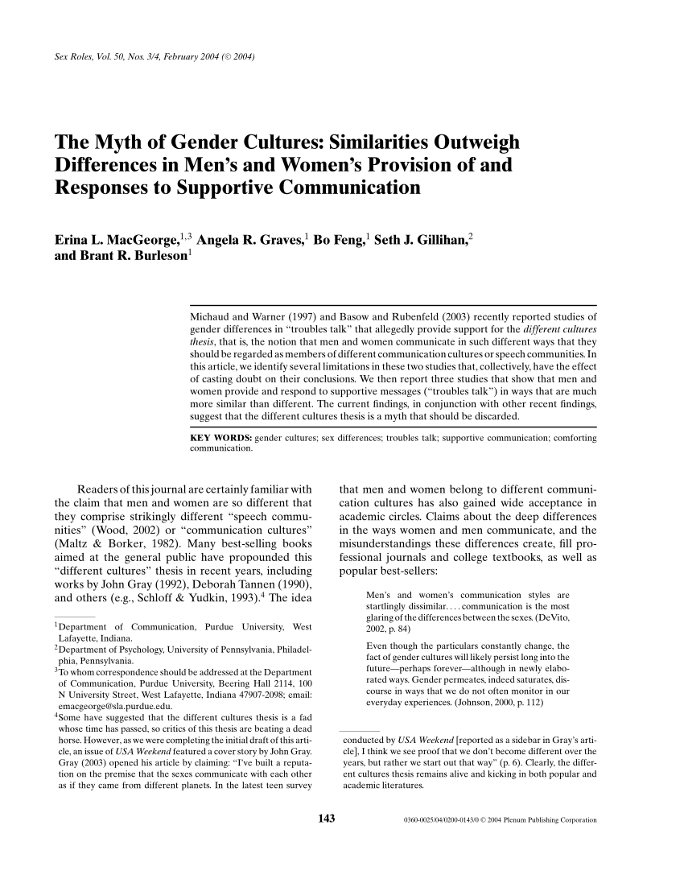
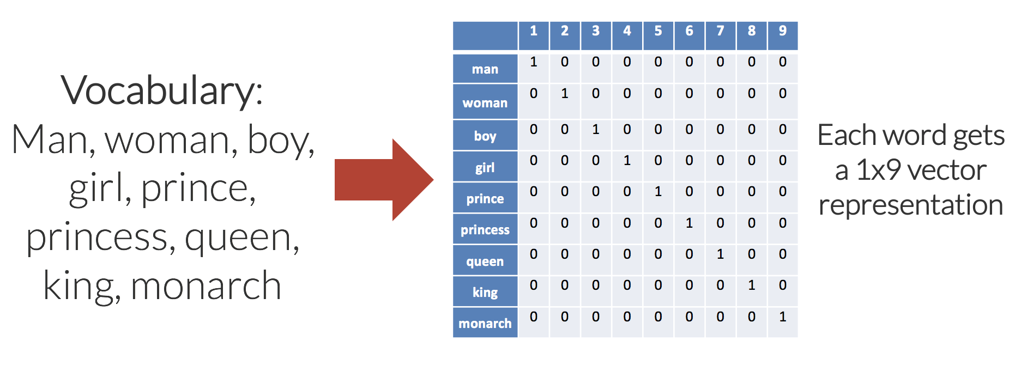
Word Embeddings
In very simplistic terms, Word Embeddings are the texts converted into numbers and there may be different numerical representations of the same text.
man = [1, 0, 0, 0, 0, 0, 0, 0, 0]
Vocabulary
Word Embedding for given vocabulary
Corpus (e.g. Text document)
Source: https://en.wikipedia.org/wiki/Word_embedding, https://www.analyticsvidhya.com/blog/2017/06/word-embeddings-count-word2veec/

Slide 5
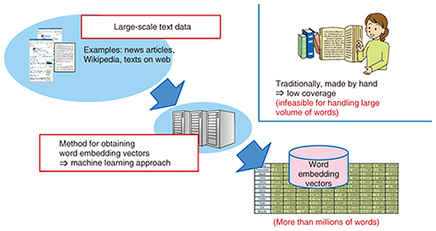
Why Word Embeddings: Essential for text processing with DL
It is an essential part of text processing with Deep Learning because Machine Learning algorithms, and almost all Deep Learning architectures, are incapable of processing strings or plain text in their raw form.
TEXT processing
Source: https://www.analyticsvidhya.com/blog/2017/06/word-embeddings-count-word2veec/
https://www.ntt-review.jp/archive/ntttechnical.php?contents=ntr201711fa4.html

Slide 6
Types of Word Embeddings
Word embeddings can be broadly classified into two categories
Frequency based Embedding
Count Vector
TF-IDF Vector
Co-Occurrence Vector
Prediction based Embedding
word2vec
CBOW (Continuous Bag of words)
Skip-Gram Model
GloVe: Global Vectors for Word Representation
Source: https://www.analyticsvidhya.com/blog/2017/06/word-embeddings-count-word2veec/

Slide 7
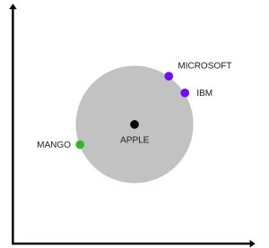
Frequency vs. Prediction Embedding
In particular, it is a difficult problem for computers to correctly understand semantic relationships between words.
With frequency based embedding we loose semantic relationship or context between the words
But with prediction bases embedding we will retain the semantic relationship or context between the words
representation of word vectors in 2 dimension, two contexts of apple have been captured. One is a fruit and the other company
Source: https://www.analyticsvidhya.com/blog/2017/06/word-embeddings-count-word2veec/

Slide 8
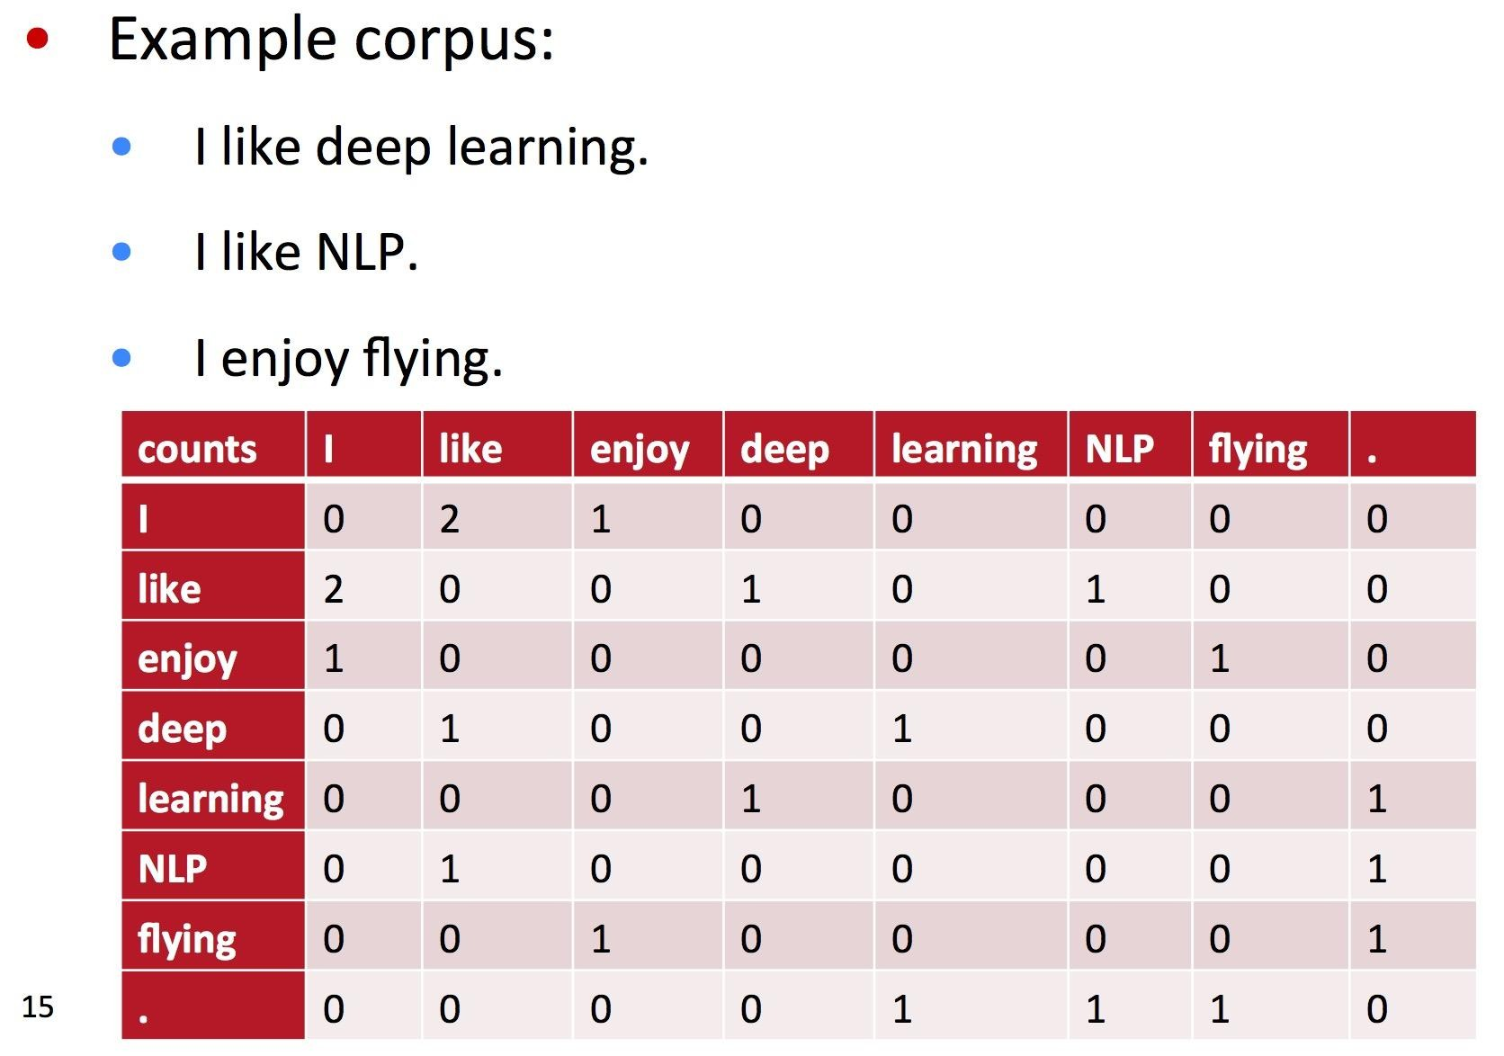
Count Vector

Slide 9
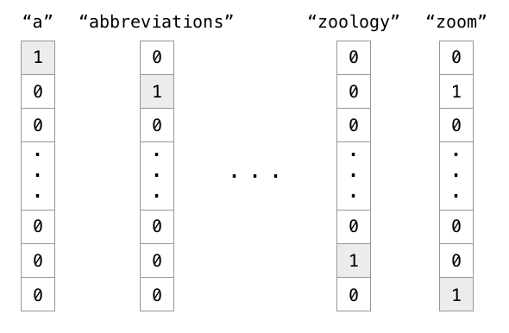
One-hot encoding
One-Hot Encoding: if there have 1000 mutual words, and 'cat' is in the index of 50, then vector[50] = 1, other is 0.

Slide 10
word2vec
huge splash in NLP world

Slide 11
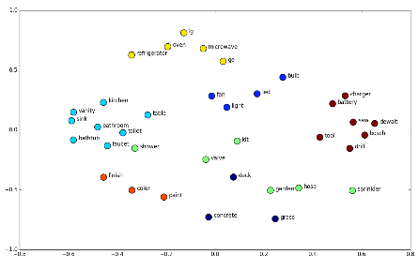
What is word2vec
word2vec is a two-layer neural net that processes text.
Its input is a text corpus and its output is a set of vectors: feature vectors for words in that corpus.
word2vec is not a deep neural network.
word2vec is a method that use a vector to represent a word, because calculating word in the network directly is difficult.
The purpose and usefulness of word2vec is to group the vectors of similar words together in vector space
The output of the word2vec neural net is a vocabulary in which each item has a vector attached to it, which can be fed into a deep-learning net or simply queried to detect relationships between words

Slide 12
Neural Word Embeddings
The vectors we use to represent words are called neural word embeddings
neural word embedding represents a word with numbers
word2vec trains words against other words that neighbor them in the input corpus

Slide 13
Two different architecture for word2vec
CBOW: The input to the model is the preceding and following words of the current word we are at and The output of the neural network will be wi
Skip-gram: The input to the model is wi and the output could be the words around it

Slide 14
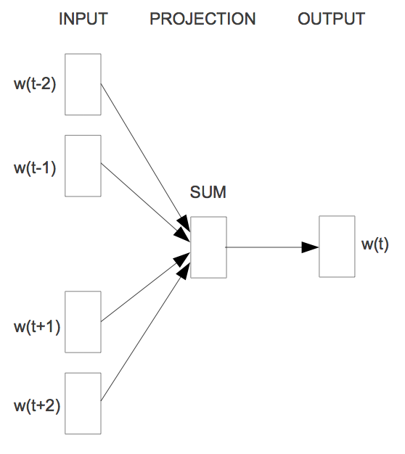
Word2vec - CBOW (Continuous Bag of words)
The way CBOW work is that it tends to predict the probability of a word given a context.
Let us start with an example (Tweet):
"When your dream becomes reality"
One approach is to treat ("When", "your", "becomes", "reality“) as a context and from these words, be able to predict or generate the center word "dream".
When
your
dream
becomes
reality
window size: 5
Source: https://www.analyticsvidhya.com/blog/2017/06/word-embeddings-count-word2veec/

Slide 15
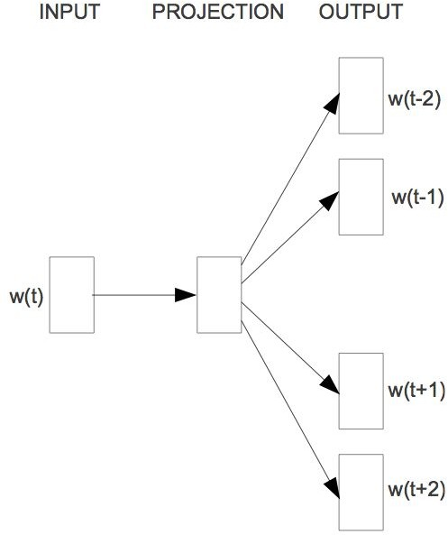
Word2vec - Skip-Gram Model
The aim of skip-gram is to predict the context given a word.
Let us check with same example (Tweet):
"When your dream becomes reality"
The approach is to create a model such that given the center word "dream", the model will be able to predict or generate the surrounding words ("When", "your", "becomes", "reality"). Here we call the word "dream" the context.
When
your
dream
becomes
reality
window size: 5
Source: https://www.analyticsvidhya.com/blog/2017/06/word-embeddings-count-word2veec/

Slide 16
Skip-Gram Model

Slide 17
Skip-Gram Model
Set up an objective function
Randomly initialize vectors
Do gradient descent

Slide 18
Skip-Gram Model
learn word vector v_{in} from it’s surrounding context
"The fox jumped over the lazy dog"
Maximize the likelihood of seeing the words given the word over
P(the|over)
P(fox|over)
P(jumped|over)
P(the|over)
P(lazy|over)
P(dog|over)
…instead of maximizing the likelihood of co-occurrence counts.

Slide 19
Skip-Gram Model
What should this be?
P(fox|over)
Should depend on the word vectors
P(fox|over)
P(vfox|vover)

Slide 20
Skip-Gram Model
A context window around every input word
P(v_{OUT}|v_{IN})
"The fox jumped over the lazy dog"
v_{OUT}
v_{IN}

Slide 21
Skip-Gram Model
A context window around every input word
P(v_{OUT}|v_{IN})
"The fox jumped over the lazy dog"
v_{OUT}
v_{IN}

Slide 22
Skip-Gram Model
A context window around every input word
P(v_{OUT}|v_{IN})
"The fox jumped over the lazy dog"
v_{OUT}
v_{IN}

Slide 23
Skip-Gram Model
A context window around every input word
P(v_{OUT}|v_{IN})
"The fox jumped over the lazy dog"
v_{IN}
v_{OUT}

Slide 24
Skip-Gram Model
A context window around every input word
P(v_{OUT}|v_{IN})
"The fox jumped over the lazy dog"
v_{IN}
v_{OUT}

Slide 25
Skip-Gram Model
A context window around every input word
P(v_{OUT}|v_{IN})
"The fox jumped over the lazy dog"
v_{IN}
v_{OUT}

Slide 26
Skip-Gram Model
A context window around every input word
P(v_{OUT}|v_{IN})
"The fox jumped over the lazy dog"
v_{OUT}
v_{IN}

Slide 27
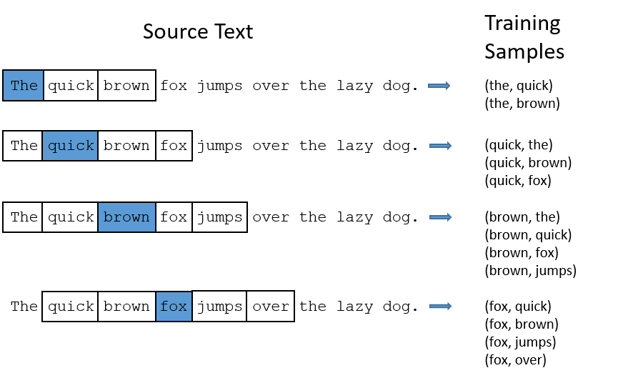
Skip-Gram Model

Slide 28
Skip-Gram Model
How should we define P(v_{OUT}|v_{IN})?
Measure loss between
v_{IN} and v_{OUT}
v_{IN} . v_{OUT}

Slide 29
v_{in} . v_{out} ~ 1
Skip-Gram Model
vin
vout

Slide 30
v_{in} . v_{out} ~ 0
Skip-Gram Model
vin
vout

Slide 31
v_{in} . v_{out} ~ -1
Skip-Gram Model
vin
vout

Slide 32
Skip-Gram Model
v_{in} . v_{out} ∈ [-1,1]
But we'd like to measure a probability
softmax(v_{in} . v_{out} ) ∈ [0,1]
Probability of choosing 1 of N discrete items
Mapping from vector space to a multinomial over words

Slide 33
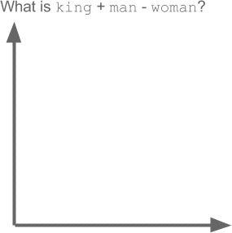

Slide 34
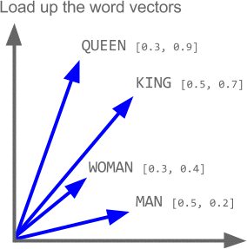

Slide 35
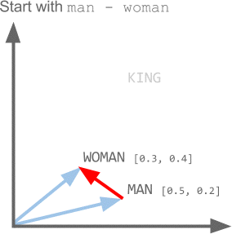

Slide 36
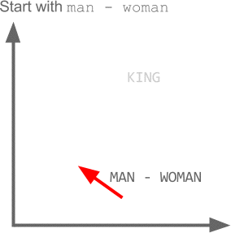

Slide 37
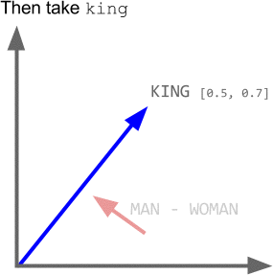

Slide 38
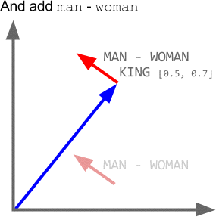

Slide 39
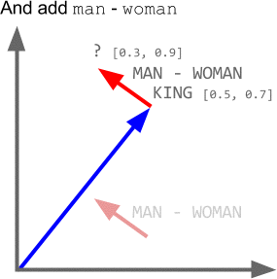

Slide 40
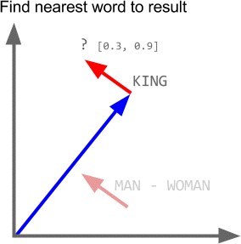

Slide 41
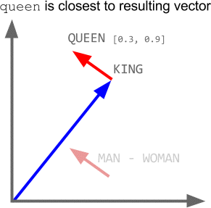

Slide 42
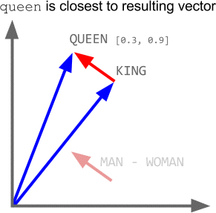

Slide 43
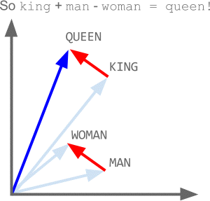

Slide 44
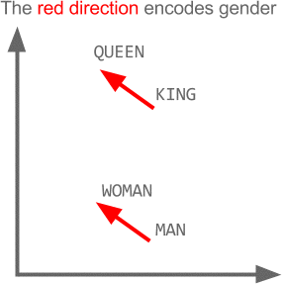

Slide 45
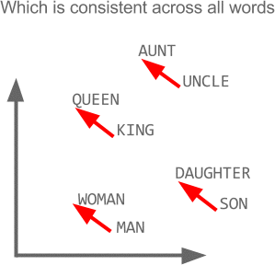

Slide 46
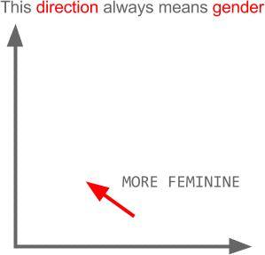

Slide 47
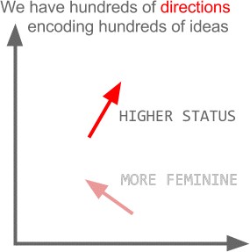

Slide 48



Dropout
Training:
Each time before updating the parameters
Each neuron has p% to dropout

Slide 49


Dropout
Training:
Thinner!
Each time before updating the parameters
Each neuron has p% to dropout
The structure of the network is changed.
Using the new network for training
For each mini-batch, we resample the dropout neurons

Slide 50




Dropout
Testing:
No dropout
If the dropout rate at training is p%, all the weights times (1-p)%
Assume that the dropout rate is 50%.
If a weight w = 1 by training, set 𝑤 = 0.5 for testing.

Slide 51






Dropout - Intuitive Reason
When teams up, if everyone expect the partner will do the work, nothing will be done finally.
However, if you know your partner will dropout, you will do better.
When testing, no one dropout actually, so obtaining
good results eventually.

Slide 52
Dropout - Intuitive Reason
Why the weights should multiply (1-p)% (dropout rate) when testing?
Training of Dropout
Assume dropout rate is 50%
Testing of Dropout
No dropout
Weights from training
𝑤₁
𝑤₂
𝑤₃
𝑤₄
0.5 ×
𝑤₁
𝑧′ ≈ 2𝑧
0.5 × 𝑤₂
_{𝑧}′
𝑧
0.5 × 𝑤₃
0.5 × 𝑤₄
Weights multiply (1-p)%
𝑧′ ≈ 𝑧

Slide 53








Dropout is a kind of ensemble.
Training
Ensemble
Set
Set 1
Set 2
Set 3
Set 4
Network 1
Network 2
Network 3
Network 4
Train a bunch of networks with different structures

Slide 54




Dropout is a kind of ensemble.
Ensemble
Testing data x
Network 1
Network 4
Network 2
Network 3
y₁
y₂
y₃
y₄
average

Slide 55
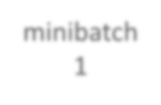
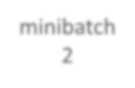
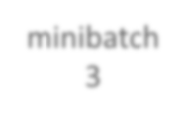
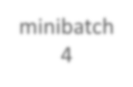





Dropout is a kind of ensemble.
minibatch
1
minibatch 2
minibatch
3
minibatch 4
Training of Dropout
M neurons
2^{M} possible networks
Using one mini-batch to train one network
Some parameters in the network are shared
……

Slide 56
Dropout is a kind of ensemble.
Testing of Dropout
testing data x
All the weights multiply (1-p)%
……
y₁
y₂
y₃
?????
≈
average
y

Slide 57

















Let’s try it
……
500
……
model.add( dropout(0.8) )
500
……
model.add( dropout(0.8) )
Softmax
y₁
y₂
^{y}10
……

Slide 58
Programming

Slide 59
callbacks
A callback is a set of functions to be applied at given stages of the training procedure
You can use callbacks to get a view on internal states and statistics of the model during training
keras.callbacks.Callback()

Slide 60
Tensorboard
Tensorflow, the deep learning framework from Google comes with a great tool to debug
It hosts a website on your local machine in which you can monitor things like accuracy, cost functions
and visualize the computational graph that Tensorflow is running based on what you defined in Keras
Pip install tensorboard

Slide 61
Tensorboard
tensorboard = TensorBoard(log_dir="logs/{}".format(time())) model.fit(x_train, y_train, verbose=1, callbacks=[tensorboard])
You need to create a new TensorBoard instance and point it to a log directory where data should be collected.
Next you need to modify the fit call so that it includes the tensorboard callback.
Then the following command in the separate terminal
tensorboard --logdir=logs/
http://localhost:6006/

Slide 62
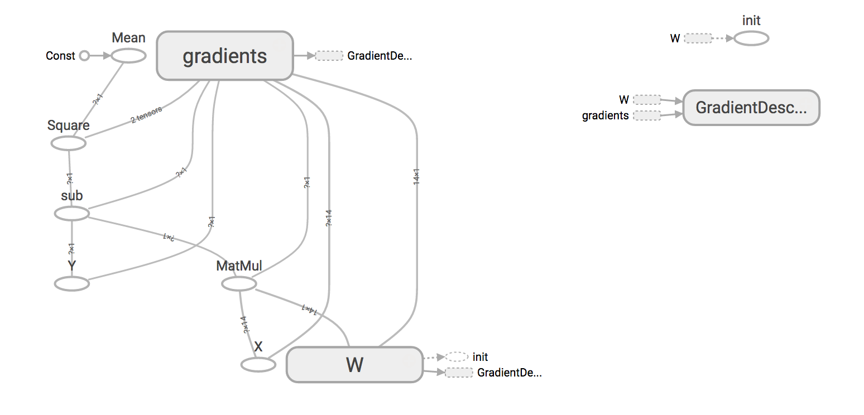
Tensorboard

Slide 63
References
https://deeplearning4j.org/word2vec.html
https://towardsdatascience.com/tagged/word2vec
https://medium.com/@Aj.Cheng/word2vec-3b2cc79d674
https://medium.com/tag/word2vec
https://www.analyticsvidhya.com/blog/2017/06/word-embeddings-count-word2veec/
http://mccormickml.com/2016/04/19/word2vec-tutorial-the-skip-gram-model/
https://becominghuman.ai/how-does-word2vecs-skip-gram-work-f92e0525def4

