Slide 1


Keras
Keras for Deep Learning Research

Slide 2
Feedback is greatly appreciated!

Slide 3

Overview
Difference between Feedforward Neural Network (FNN) and Recurrent Neural Network (RNN)
The importance of context
RNN
LSTM
Use case

Slide 4
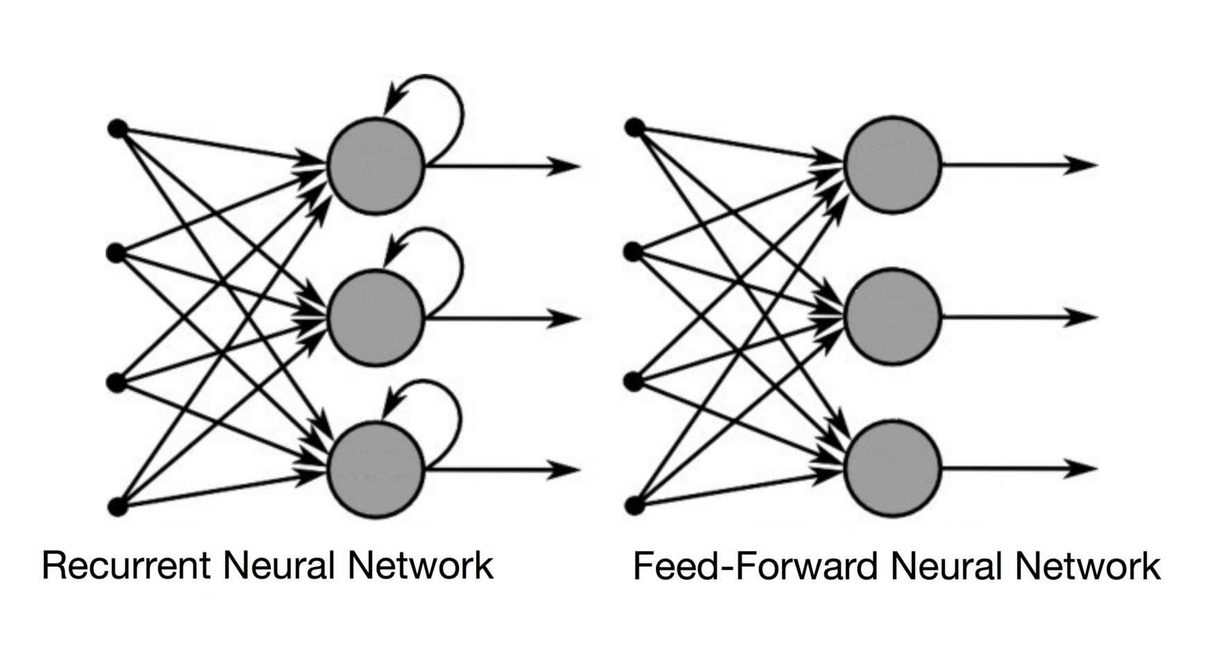
Difference between RNN and feed forward
Source: https://towardsdatascience.com/recurrent-neural-networks-and-lstm-4b601dd822a5
Notes:
In a Feed-Forward NN, the information only moves in one direction, from the input layer, through the hidden layers, to the output layer. The information moves straight through the network. Because of that, the information never touches a node twice.
In a RNN, the information cycles through a loop. When it makes a decision, it takes into consideration the current input and also what it has learned from the inputs it received previously.

Slide 5
The importance of context
Recall the 5th digit of your phone number
Sing your favorite song beginning at third sentence
Recall 10th character of the alphabet
Probably you went straight from the beginning of the stream in each case…
because in sequences, order matters!
Idea: retain the information preserving the importance of order

Slide 6
Recurrent Neural Network (RNN)

Slide 7
Recurrent Neural Network (RNN)
Good for Sequential data, or ordered data
Internal memory: remember important things about input
Produces output, copies and output, loop it back into input

Slide 8
Recurrent Neural Network (RNN)
"Unrolled" layer
Output at t=0
Output at t+1
Output at t+2
Input
at t=0
Input at t+1
Input at t+2
Time

Slide 9
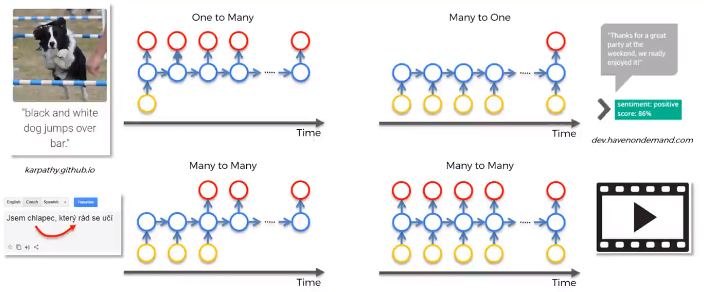
Different kind of RNN

Slide 10
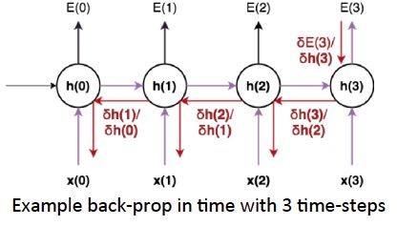
Recurrent Neural Network (RNN)
Back Propagation Through Time (BPTT): The training method has to take into account the time operations → a cost function E is defined to train our RNN, and in this case the total error at the output of the network is the sum of the errors at each time-step

Slide 11
Recurrent Neural Network (RNN)
Main problems:
Exploding Gradients: weights assigns high importance
Vanishing Gradients: values of gradients are too small. model stops learning

Slide 12
Recurrent Neural Network (RNN)
Main problems:
Sometimes, we only need to look at recent information to perform the present task - "the clouds are in the sky"
But there are also cases where we need more context - "I grew up in France… I speak fluent French."
Source: http://colah.github.io/posts/2015-08-Understanding-LSTMs/

Slide 13
Long Short Term Memory (LSTM)

Slide 14
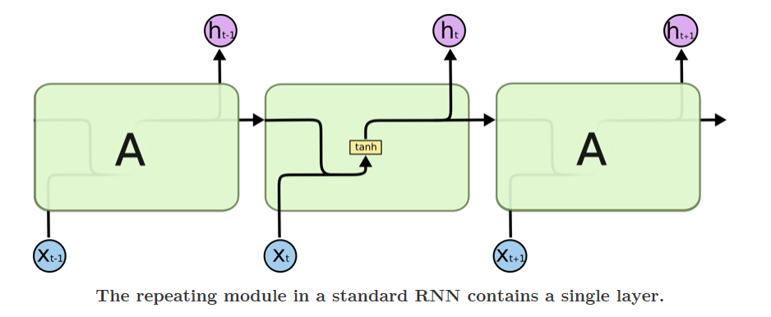
RNN vs LSTM
Source: http://colah.github.io/posts/2015-08-Understanding-LSTMs/

Slide 15
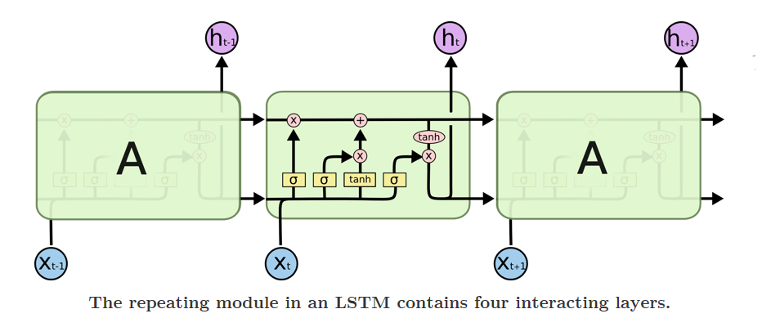
RNN vs LSTM
Source: http://colah.github.io/posts/2015-08-Understanding-LSTMs/

Slide 16
An LSTM Cell
h_{t}
C_{t-1}
C_{t}
Here we can see the entire LSTM cell.
An LSTM cell is defined by two groups of neurons plus the cell state (memory unit)
Let's go through the process!
X
+
tanh
X
X
σ
σ
tanh
σ
h_{t-1}
h_{t}
x_{t}

Slide 17
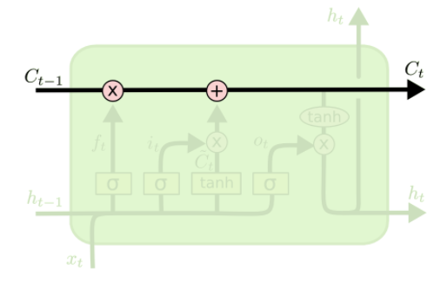
Core idea behind LSTM
The key to LSTMs is the cell state, the horizontal line running through the top of the diagram.
The LSTM does have the ability to remove or add information to the cell state, carefully regulated by structures called gates.
Source: http://colah.github.io/posts/2015-08-Understanding-LSTMs/

Slide 18
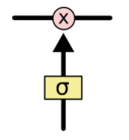
Gate
Gates are a way to optionally let information through.
They are composed out of a sigmoid neural net layer and a pointwise multiplication operation
The sigmoid layer outputs numbers between zero and one, describing how much of each component should be let through.
A value of zero means "let nothing through," while a value of one means "let everything through!"
An LSTM has three of these gates, to protect and control the cell state.
Source: http://colah.github.io/posts/2015-08-Understanding-LSTMs/

Slide 19
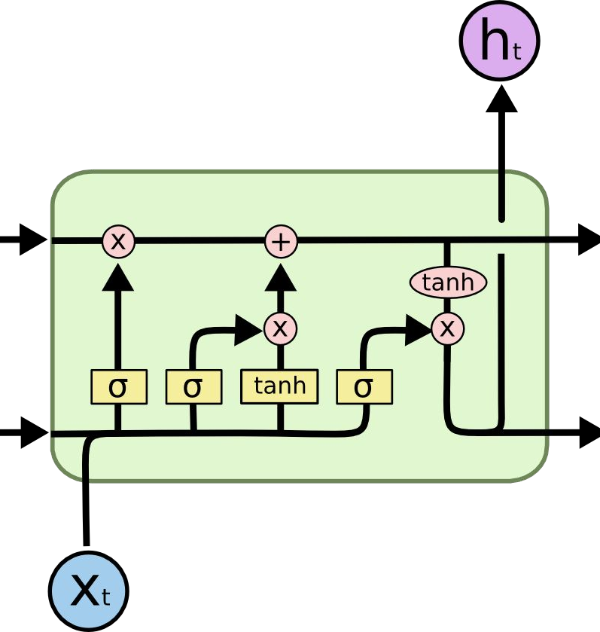
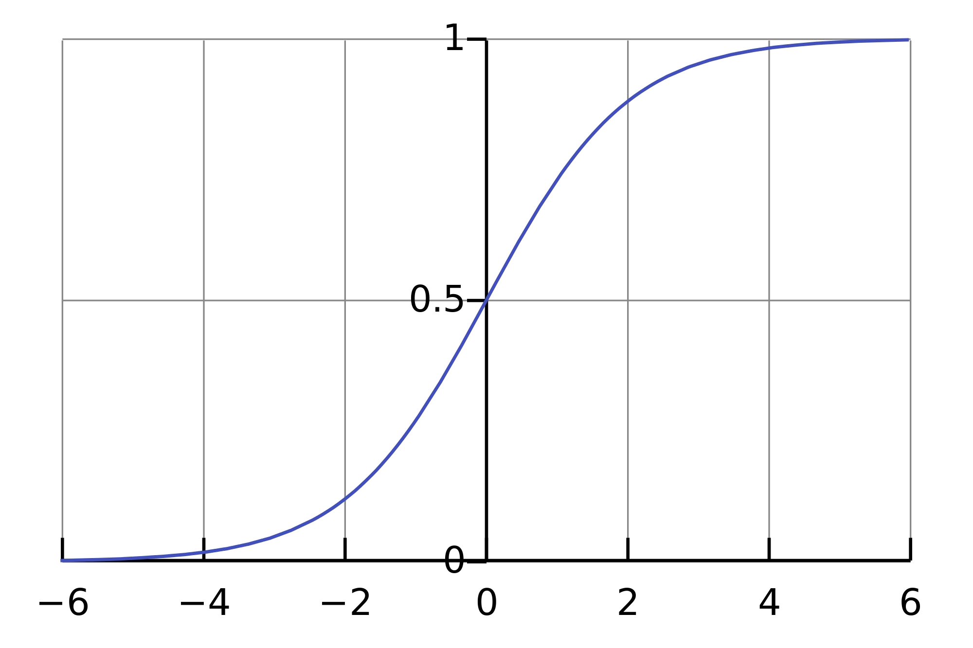
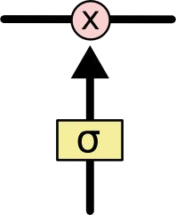
Long Short Term Memory (LSTM)
Source: http://colah.github.io/posts/2015-08-Understanding-LSTMs/

Slide 20
Meaning Of the Symbols
+ : Adding information
σ : Sigmoid layer
tanh: tanh layer
h(t-1) : Output of last LSTM unit
c(t-1) : Memory from last LSTM unit
X(t) : Current input
c(t) : New updated memory
h(t) : Current output

Slide 21
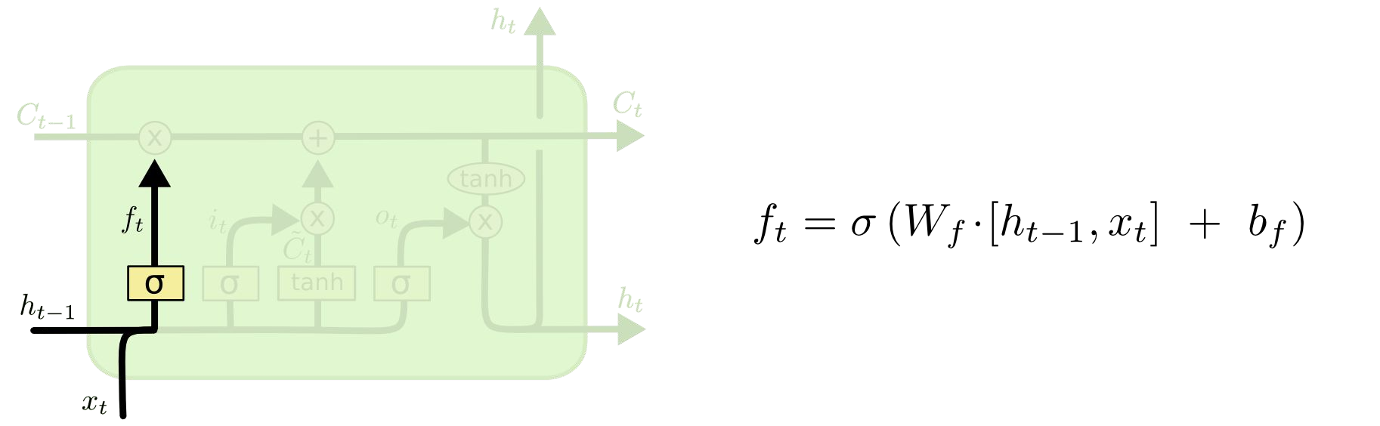
Long Short Term Memory (LSTM)
Forget Gate Layer
Source: http://colah.github.io/posts/2015-08-Understanding-LSTMs/
Notes:
The first step in our LSTM is to decide what information we’re going to throw away from the cell state.

Slide 22
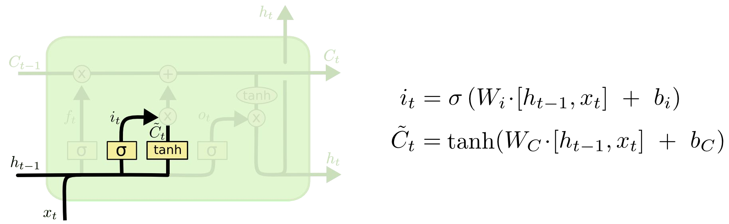
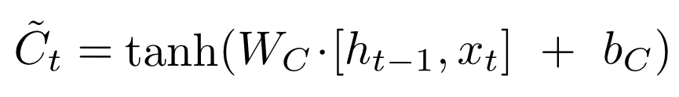
Long Short Term Memory (LSTM)
Input Gate Layer
New contribution to cell state
Source: http://colah.github.io/posts/2015-08-Understanding-LSTMs/
Notes:
The next step is to decide what new information we’re going to store in the cell state.

Slide 23
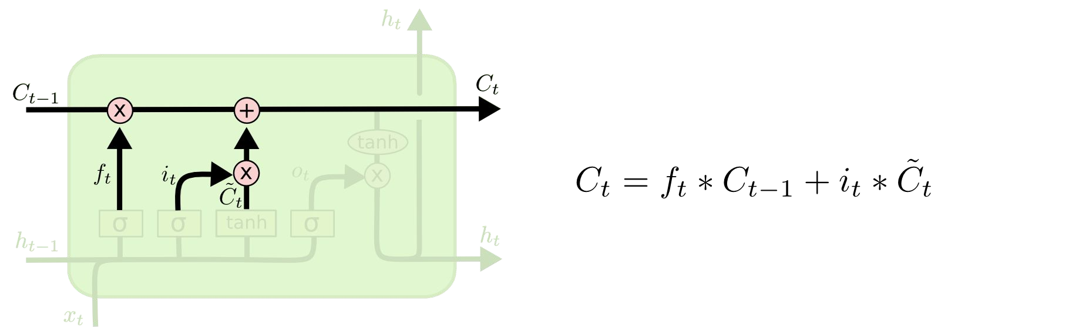
Long Short Term Memory (LSTM)
Update Cell State (memory)
Source: http://colah.github.io/posts/2015-08-Understanding-LSTMs/
Notes:
It's now time to update the old cell state Ct−1, into the new cell state Ct. The previous steps already decided what to do, we just need to actually do it.

Slide 24
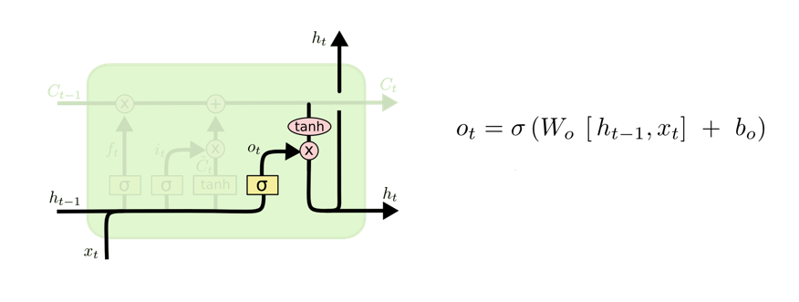

Long Short Term Memory (LSTM)
Output Gate Layer
Output to next layer
Source: http://colah.github.io/posts/2015-08-Understanding-LSTMs/
Notes:
Finally, we need to decide what we're going to output. This output will be based on our cell state, but will be a filtered version.

Slide 25

Long Short Term Memory (LSTM)
Source: http://colah.github.io/posts/2015-08-Understanding-LSTMs/

Slide 26
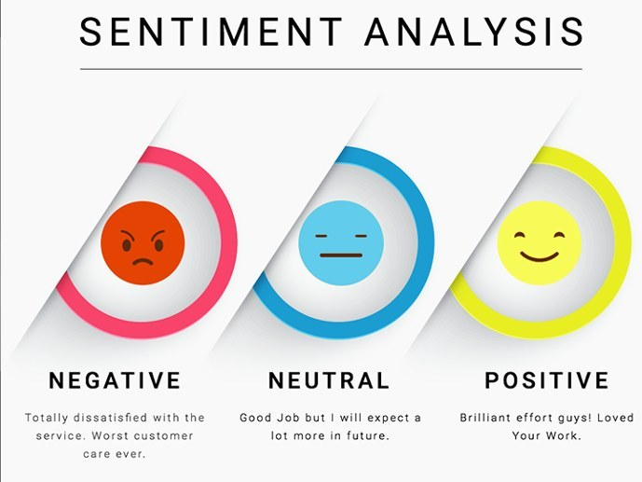
Use case: Sentiment Analysis using LSTM

Slide 27
Sentiment Classification
the process of computationally identifying and categorizing opinions expressed in a piece of text
especially in order to determine whether the writer's attitude towards a particular topic, product, etc. is positive, negative, or neutral.

Slide 28
Loading the documents
imdb_df = pd.read_csv('./labeledTrainData.tsv', sep = '\t')

Slide 29
Data Tokenization
num_words = 10000 tokenizer = Tokenizer(num_words = num_words) tokenizer.fit_on_texts( imdb_df.review ) sequences = tokenizer.texts_to_sequences(imdb_df.review) y = np.array(imdb_df.sentiment)

Slide 30
Encoding the documents
Count vectors
sequences = tokenizer.texts_to_sequences(imdb_df.review)
Trim X
max_review_length = 552 pad = 'pre' X = pad_sequences(sequences, max_review_length, padding=pad, truncating=pad)

Slide 31
Output of Trim
X[0:1]
array([[ 0, 0, 0, 0, 0, 0, 0, 0, 0, 0, 0, 0, 0, 0, 0, 0, 0, 0, 0, 0, 0, 0, 0, 0, 0, 0, 0, 0, 0, 0, 0, 0, 0, 0, 0, 0, 0, 0, 0, 0, 0, 0, 0, 0, 0, 0, 0, 0, 0, 0, 0, 0, 0, 0, 0, 0, 0, 0, 0, 0, 0, 0, 0, 0, 0, 0, 0, 0, 0, 0, 0, 0, 0, 0, 0, 0, 0, 0, 0, 0, 0, 0, 0, 0, 0, 0, 0, 0, 0, 0, 0, 0, 0, 0, 0, 0, 0, 0, 0, 0, 0, 0, 0, 0, 0, 0, 0, 0, 0, 0, 0, 0, 0, 0, 0, 0, 0, 0, 0, 0, 0, 0, 0, 0, 0, 0, 0, 0, 0, 0, 0, 0, 0, 0, 0, 0, 0, 0, 0, 0, 0, 0, 0, 0, 16, 29, 11, 535, 167, 177, 30, 1, 558, 16, 204, 642, 2615, 5, 24, 225, 146, 1, 1028, 659, 130]],dttype=int32)

Slide 32
Split the dataset
X_train, X_test, y_train, y_test = train_test_split(X, y, test_size = 0.2)
Print(x_train.shape)
(20000,552)
input_shape = X_train.shape

Slide 33
Model: RNN and Embeddings
rnn_model = Sequential()
rnn_model.add(Embedding(num_words, 8, input_length=max_review_length))
rnn_model.add(SimpleRNN(32))
rnn_model.add(Dense(1))
rnn_model.add(Activation('sigmoid’))
rnn_model.summary()

Slide 34
Calling Callback
callbacks_list = [ReduceLROnPlateau(monitor='val_loss', factor=0.1, patience=3), EarlyStopping(monitor='val_loss', patience=4), ModelCheckpoint(filepath='imdb_rnn_model.h5', monitor='val_loss', save_best_only=True), TensorBoard("./imdb_rnn_logs")]

Slide 35
Fit the model
rnn_model.compile(optimizer="adam", loss='binary_crossentropy', metrics=['accuracy’])
rnn_history = rnn_model.fit(X_train, y_train, epochs=10, batch_size=32, callbacks=callbacks_list, validation_split=0.3)

Slide 36
References
https://medium.com/the-theory-of-everything/understanding-activation-functions-in-neural-networks-9491262884e0
https://towardsdatascience.com/lstm-by-example-using-tensorflow-feb0c1968537
https://medium.com/@erikhallstrm/hello-world-rnn-83cd7105b767
https://towardsdatascience.com/exploring-activation-functions-for-neural-networks-73498da59b02
https://medium.com/lingvo-masino/introduction-to-recurrent-neural-network-d77a3fe2c56c
http://colah.github.io/posts/2015-08-Understanding-LSTMs/
https://www.slideshare.net/ashraybhandare/deep-learning-cnn-and-rnn?qid=0f39b4da-a290-4e9e-9d31-ed21816598e3&v=&b=&from_search=27
https://medium.freecodecamp.org/how-to-become-a-data-scientist-2d829fa33aba
https://machinelearningmastery.com/truncated-backpropagation-through-time-in-keras/
https://stats.stackexchange.com/questions/270546/how-does-keras-embedding-layer-work

