Slide 1

COMP-SCI 5590 - 0001 Special Topics
Loop structures, conditional statements, strings, List, Tuples, Functions

Slide 2
Objective
If conditions statements
String formatting
loops: for and while statements.
interactive loop and sentinel loop: implementations using while statement
Nested loop
Reading from a file in loop
Tuples
Functions
Use case

Slide 3
String Formatting
uses C-style string formatting to create new, formatted strings
The "%" operator is used to format
Let's say you have a variable called "name" with your user name in it, and you would then like to print

Slide 4
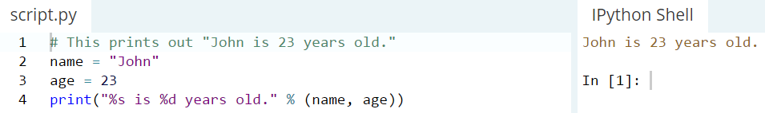
String Formatting: Example

Slide 5
Basic String Operations
we have variable astring = “Hello World!”
print(len(astring)) => 12
print(astring.index("o")) => 4
print(astring.count("l")) => 3

Slide 6
Basic String Operations
print(astring[3:7]) => lo w
print(astring.startswith("Hello")) => true
print(astring.endswith("asdfasdfasdf")) => false
There is no function to reverse a string but we can do like this:
print(astring[::-1]) => !dlrow olleH

Slide 7
The If-Statement
Syntax if <condition> : <list of statements> else : <list of statements>olon after else
Both lists must be indented.

Slide 8
If-Else-Statement examples
if yearsWorked > 10 :
bonus = 1000 else : bonus = 500
if age >= 65 : price = 0.85 * price numSeniors = numSeniors + 1 else : nonSeniors = nonSeniors + 1

Slide 9
For Loops: A Quick Review
Suppose we want to write a program that can compute the average of a series of numbers entered by the user.
A series of numbers could be handled by some sort of loop. If there are n numbers, the loop should execute n times.
We need a running sum. This will use an accumulator.

Slide 10
For Loops
n = eval(input("How many numbers do you have? "))
sum = 0.0
for i in range(n):
x = int(input("Enter a number >> "))
sum = sum + x
print("\nThe average of the numbers is", sum / n)
Note that sum is initialized to 0.0 so that sum/n returns a float!

Slide 11
For Loops: Expected Result
How many numbers do you have? 5
Enter a number >> 32
Enter a number >> 45
Enter a number >> 34
Enter a number >> 76
Enter a number >> 45
The average of the numbers is 46.4

Slide 12
Indefinite Loops
We can’t use a definite loop unless we know the number of iterations ahead of time. We can’t know how many iterations we need until all the numbers have been entered.
The indefinite or conditional loop keeps iterating until certain conditions are met.

Slide 13
Indefinite Loop: Example
Here’s an example of a while loop that counts from 0 to 10:
i = 0 while i <= 10: print(i) i = i + 1

Slide 14
Interactive Loops
One good use of the indefinite loop is to write interactive loops. Interactive loops allow a user to repeat certain portions of a program on demand.

Slide 15
Interactive Loops: Example
moredata = "yes"
sum = 0.0
count = 0
while moredata[0] == 'y':
x = int(input("Enter a number >> "))
sum = sum + x
count = count + 1
moredata = input("Do u have more numbers(yes or no)? ")
print("\nThe average of the numbers is", sum / count)

Slide 16
File Loops
Many languages don’t have a mechanism for looping through a file like this. Rather, they use a sentinel!
We could use readline in a loop to get the next line of the file.
At the end of the file, readline returns an empty string, “”

Slide 17
File Loops: Example
fileName = input("What file are the numbers in? ")
infile = open(fileName,'r')
sum = 0.0
count = 0
line = infile.readline()
while line != "":
sum = sum + eval(line)
count = count + 1
line = infile.readline()
print("\nThe average of the numbers is", sum / count)

Slide 18
Nested Loops
At the top level, we will use a file-processing loop that computes a running sum and count.
In the next level in we need to update the sum and count in the body of the loop.
Since each line of the file contains one or more numbers separated by commas, we can split the string into substrings, each of which represents a number.
Then we need to loop through the substrings, convert each to a number, and add it to sum.
We also need to update count.

Slide 19
Nested Loops: Example
fileName = input("What file are the numbers in? ")
infile = open(fileName,'r')
sum = 0.0
count = 0
line = infile.readline()
while line != "":
for xStr in line.split(","):
sum = sum + eval(xStr)
count = count + 1
line = infile.readline()
print("\nThe average of the numbers is", sum / count)

Slide 20
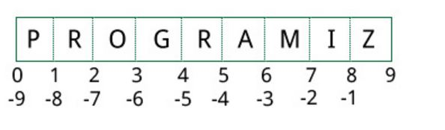
Lists
CHANGEABLE Sequences of Data
Syntax:
list_name = [item1, item2]
Lists are created by using square brackets:
breakfast = [ “coffee”, “tea”, “toast”, “egg” ]
Indexing mechanism:
It starts from 0
From back it starts from -1

Slide 21
Basic Operations
Python Expression | Results | Description
len([1, 2, 3]) | 3 | Length
[1, 2, 3] + [4, 5, 6] | [1, 2, 3, 4, 5, 6] | Concatenation
['Hi!'] * 4 | ['Hi!', 'Hi!', 'Hi!', 'Hi!'] | Repetition
3 in [1, 2, 3] | True | Membership
for x in [1, 2, 3]: print x, | 1 2 3 | Iteration

Slide 22
Python List Methods
append() | Add an element to the end of the list
extend() | Add all elements of a list to the another list
insert() | Insert an item at the defined index
remove() | Removes an item from the list
pop() | Removes and returns an element at the given index
clear() | Removes all items from the list
index() | Returns the index of the first matched item
count() | Returns the count of number of items passed as an argument
sort() | Sort items in a list in ascending order
reverse() | Reverse the order of items in the list
copy() | Returns a shallow copy of the list

Slide 23
Built-In Functions
Function | Description
all() | Return True if all elements of the list are true (or if the list is empty).
any() | Return True if any element of the list is true. If the list is empty, return False.
enumerate() | Return an enumerate object. It contains the index and value of all the items of list as a tuple.
len() | Return the length (the number of items) in the list.
list() | Convert an iterable (tuple, string, set, dictionary) to a list.
max() | Return the largest item in the list.
min() | Return the smallest item in the list
sorted() | Return a new sorted list (does not sort the list itself).
sum() | Return the sum of all elements in the list.

Slide 24
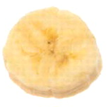
The Repetition Operator and Iterating over a List
Repetition operator: makes multiple copies of a list and joins them together
The * symbol is a repetition operator when applied to a sequence and an integer
Sequence is left operand, number is right
General format: list * n
You can iterate over a list using a for loop
Format: for x in list:

Slide 25
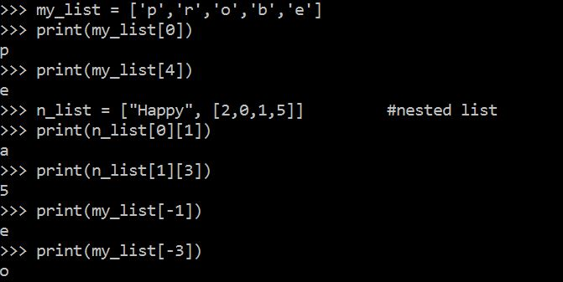
Indexing
Index: a number specifying the position of an element in a list
Enables access to individual element in list
Index of first element in the list is 0, second element is 1, and n’th element is n-1
Negative indexes identify positions relative to the end of the list
The index -1 identifies the last element, -2 identifies the next to last element, etc.

Slide 26
List Slicing
Slice: a span of items that are taken from a sequence
List slicing format: list[start : end]
Span is a list containing copies of elements from start up to, but not including, end
If start not specified, 0 is used for start index
If end not specified, len(list) is used for end index
Slicing expressions can include a step value and negative indexes relative to end of list

Slide 27
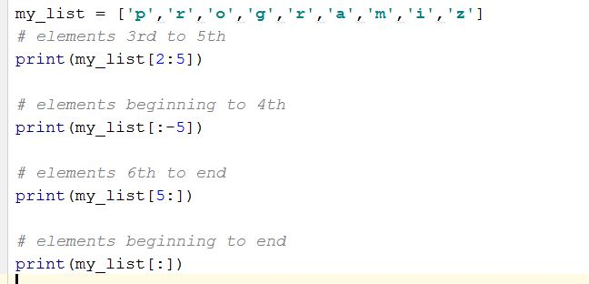
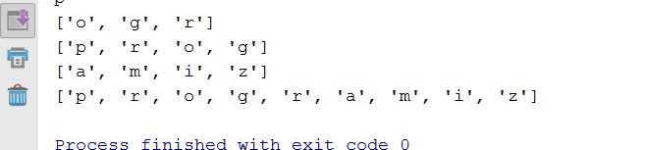
Slicing Examples
Output
Input

Slide 28
List Methods and Useful Built-in Functions (cont’d.)
insert(index, item): used to insert item at position index in the list
sort(): used to sort the elements of the list in ascending order
remove(item): removes the first occurrence of item in the list
reverse(): reverses the order of the elements in the list
del statement: removes an element from a specific index in a list
General format: del list[i]
min and max functions: built-in functions that returns the item that has the lowest or highest value in a sequence
The sequence is passed as an argument

Slide 29
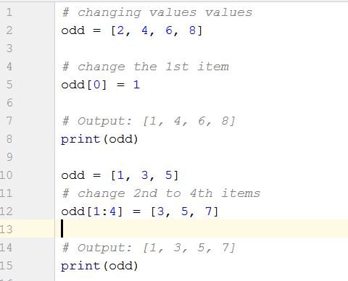

Changing Elements
List are mutable, meaning, their elements can be changed tuple.
We can use assignment operator (=) to change an item or a range of items.
list[1] = new_value can be used to assign a new value to a list element
Must use a valid index to prevent raising of an IndexError exception
Output

Slide 30
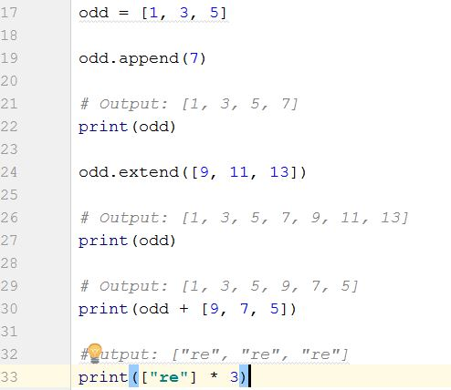
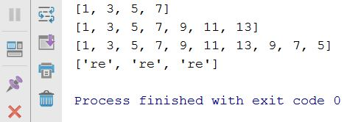
Addition
We can add one item to a list using append() method or add several items using extend()method
Output
We can also use + operator to combine two lists. This is also called concatenation.

Slide 31
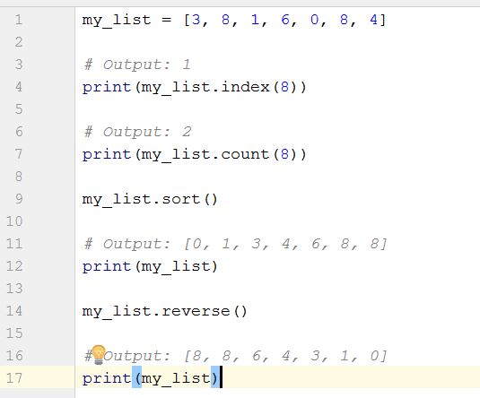
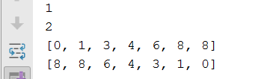
Other built in function Examples
Output

Slide 32
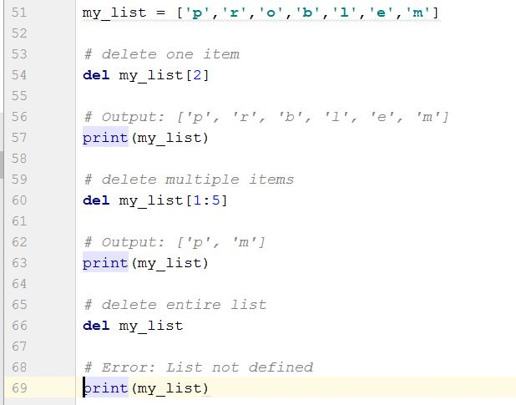
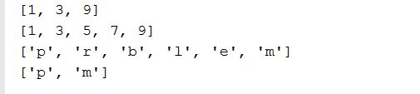
Deletion
Output

Slide 33
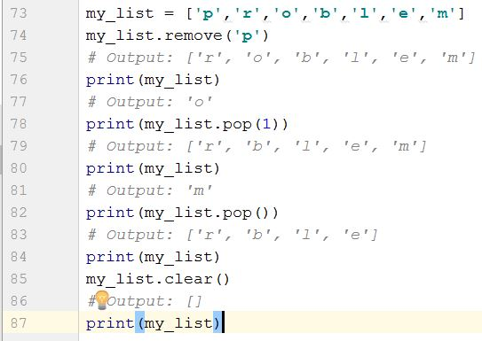
Continued…
We can use remove() method to remove the given item
or pop() method to remove an item at the given index.
The pop() method removes and returns the last item if index is not provided.
This helps us implement lists as stacks (first in, last out data structure).
We can also use the clear() method to empty a list.

Slide 34
Finding Items in Lists with the in Operator
You can use the in operator to determine whether an item is contained in a list
General format: item in list
Returns True if the item is in the list, or False if it is not in the list
Similarly you can use the not in operator to determine whether an item is not in a list

Slide 35
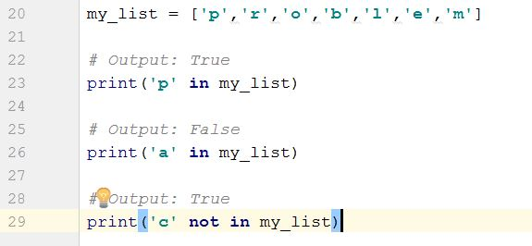

Continued…
Output

Slide 36
Two-Dimensional Lists
Two-dimensional list: a list that contains other lists as its elements
Also known as nested list
Common to think of two-dimensional lists as having rows and columns
Useful for working with multiple sets of data
To process data in a two-dimensional list need to use two indexes
Typically use nested loops to process

Slide 37
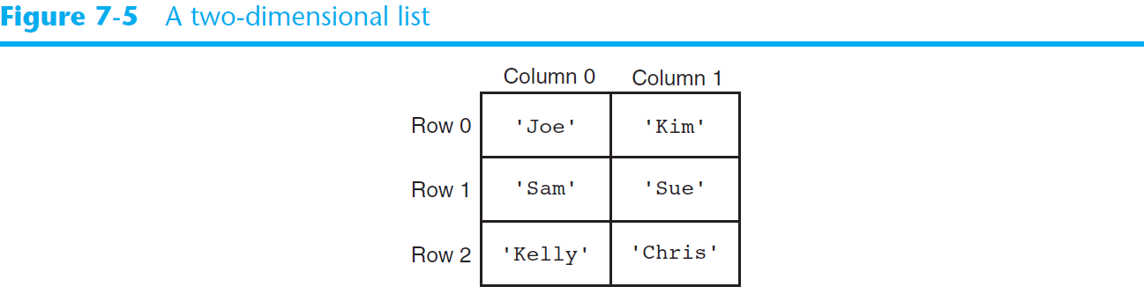
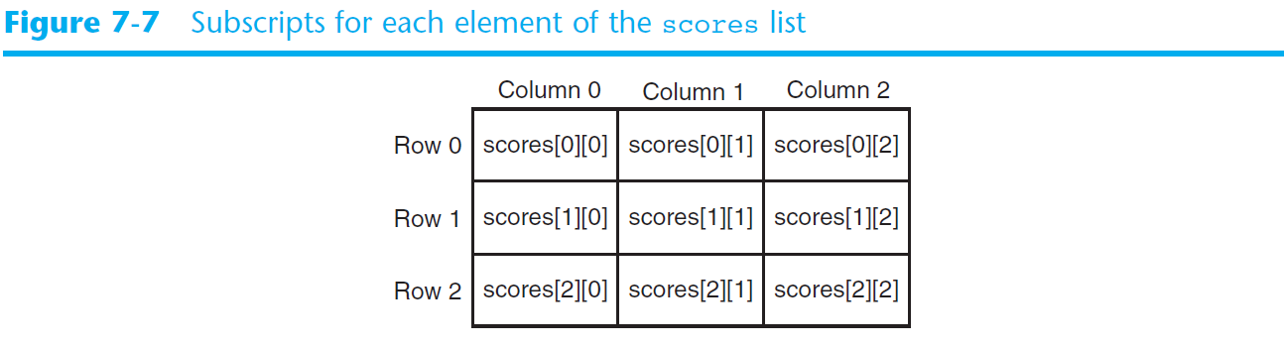
Two-Dimensional Lists (cont’d.)

Slide 38
Tuples
UNCHANGABLE Sequences of Data
Syntax:
tuple_name = (item1, item2)
Enclosed in parentheses:
Example: tuple1 = (“This”, “is”, “a”, “tuple”)
They have elements which are indexed starting at 0
A tuple with a single element must have a comma inside the parentheses:
a = (11,)

Slide 39
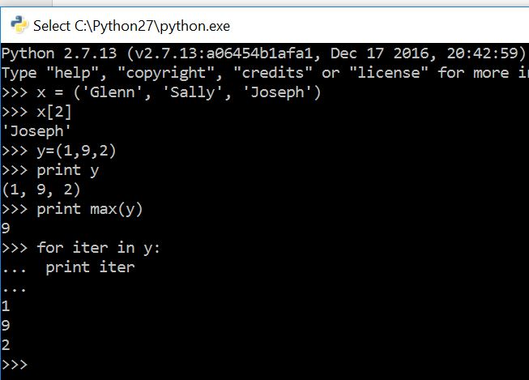
Tuples
X[2] prints the third element in the tuple
Notice max function

Slide 40
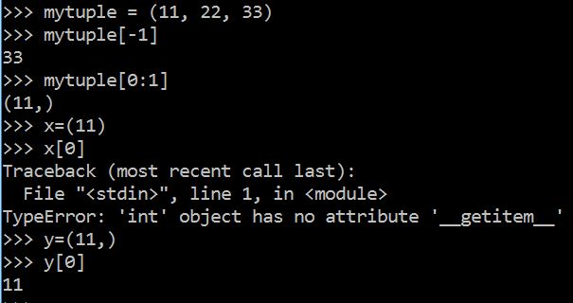
More examples
Notice -1 index
(11) Acts as integer whereas (11,) acts as sequence

Slide 41
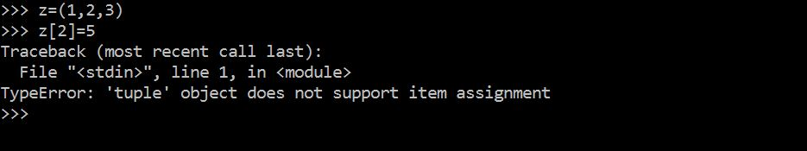
..but.. Tuples are "immutable"
Unlike a list, once you create a tuple, you cannot alter its contents - similar to a string

Slide 42
Operations
Tuples support operations as lists
Subscript indexing for retrieving elements
Methods such as index
Built in functions such as len, min, max
Slicing expressions
The in, +, and * operators
Tuples do not support the methods:
Append, remove, insert, reverse, sort

Slide 43
Basic Operations
Suppose
>>> tup1=(1,2,3)
>>>>tup2=(4,5,6)
>>>tup3=(‘Hi’,)
Python Expression | Results | Description
len(tup1) | 3 | Length
tup1 + tup2 | (1, 2, 3, 4, 5, 6) | Concatenation
tup3* 4 | ('Hi!', 'Hi!', 'Hi!', 'Hi!') | Repetition
3 in tup1 | True | Membership
for x in tup1: print x, | 1 2 3 | Iteration

Slide 44
Indexing, Slicing
Suppose
>>> L=(‘welcome’ , ’to’ , ’python’)
Python Expression | Results | Description
L[2] | ‘python’ | Offsets start at zero
L[-2] | ‘to' | Negative: count from the right
L[1:] | [‘to', ‘python'] | Slicing fetches sections
Same as String

Slide 45
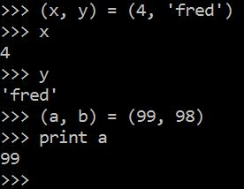
Tuples and Assignment
We can also put a tuple on the left hand side of an assignment statement
We can even omit the parenthesis

Slide 46
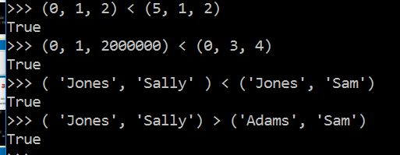
Tuples are Comparable
The comparison operators work with tuples and other sequences If the first item is equal, Python goes on to the next element, and so on, until it finds elements that differ.

Slide 47
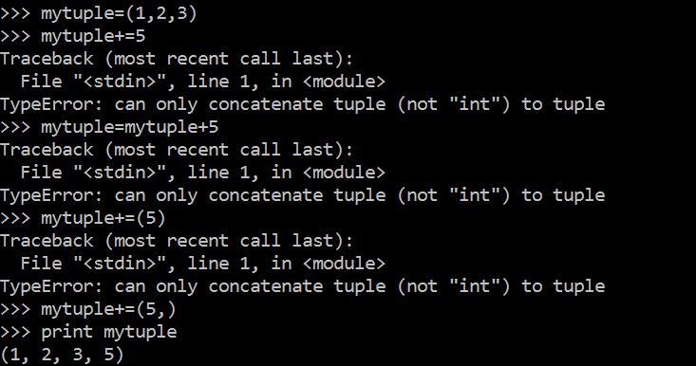
Concatenation
This is how concatenation works

Slide 48
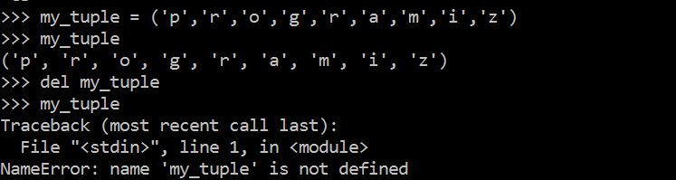
Deleting Tuple
As tuple is already deleted

Slide 49
Built In Functions
Function | Description
all() | Return True if all elements of the tuple are true (or if the tuple is empty).
any() | Return True if any element of the tuple is true. If the tuple is empty, return False.
enumerate() | Return an enumerate object. It contains the index and value of all the items of tuple as pairs.
len() | Return the length (the number of items) in the tuple.
max() | Return the largest item in the tuple.
min() | Return the smallest item in the tuple
sorted() | Take elements in the tuple and return a new sorted list (does not sort the tuple itself).
sum() | Retrun the sum of all elements in the tuple.
tuple() | Convert an iterable (list, string, set, dictionary) to a tuple.

Slide 50
Tuples are more efficient than lists
We generally use tuple for heterogeneous (different) datatypes and list for homogeneous (similar) datatypes.
Since tuple are immutable, iterating through tuple is faster than with list. So there is a slight performance boost. They are more simpler in nature.
Tuples that contain immutable elements can be used as key for a dictionary. With list, this is not possible.
If you have data that doesn't change, implementing it as tuple will guarantee that it remains write-protected.

Slide 51
Python Functions
A function is a piece of code that performs a task of some kind.
A function has a name that is used when we need for the task to be executed. Asking that the task be executed is referred to as “calling” the function.
Some functions need one or more pieces of input when they are called. Others do not.
Some functions give back a value; others do not. If a function gives back a value, this is referred to as “returning” the value.

Slide 52
Defining Functions
Function definition begins with “def.”
Function name and its arguments.
def get_final_answer(filename):
“““Documentation String””” line1
line2
return total_counter
The indentation matters…
First line with less indentation is considered to be outside of the function definition.
The keyword ‘return’ indicates the value to be sent back to the caller.
No header file or declaration of types of function or arguments

Slide 53
Calling a Function
The syntax for a function call is:
>>> def myfun(x, y):
return x * y
>>> myfun(3, 4)
12
Parameters in Python are Call by Assignment
Old values for the variables that are parameter names are hidden, and these variables are simply made to refer to the new values
All assignment in Python, including binding function parameters, uses reference semantics.

Slide 54
Functions without returns
All functions in Python have a return value, even if no return line inside the code
Functions without a return return the special value None
None is a special constant in the language
None is used like NULL, void, or nil in other languages
None is also logically equivalent to False

Slide 55
Function overloading? No.
There is no function overloading in Python
Python function is specified by its name alone
The number, order, names, or types of arguments cannot be used to distinguish between two functions with the same name
Two different functions can’t have the same name, even if they have different arguments

Slide 56
Default Values for Arguments
You can provide default values for a function’s arguments
These arguments are optional when the function is called
>>> def myfun(b, c=3, d=“hello”): return b + c
>>> myfun(5,3,”hello”)
>>> myfun(5,3)
>>> myfun(5)
All of the above function calls return 8

Slide 57
Use case: Car Rental

Slide 58
Use case: Car Rental
The goal of this use case is to calculate the money one should pay when renting a car.
Surely this money will be affected by the kind of car, distance, kind of petrol, number of days…
So in this use case, there is a couple of questions that a user answers then the amount of money one should pay will be printed.

Slide 59
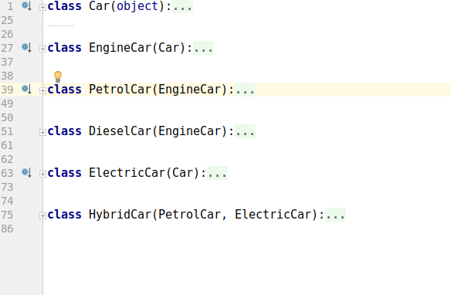
Module cars
It contains six classes which helps to choose various features of a car for hiring

Slide 60
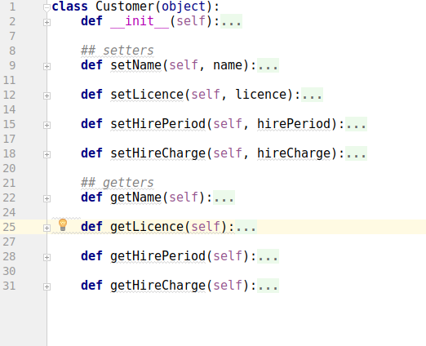
Module customer
This module includes some classes about the detailed information of the customer

Slide 61
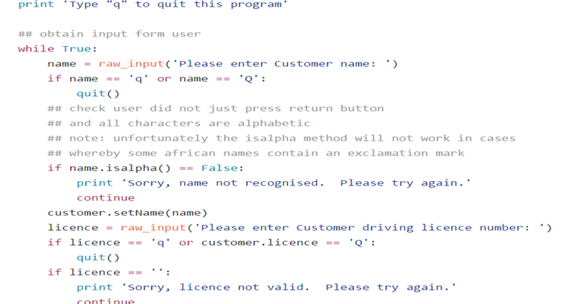
Getting information of the customer

Slide 62
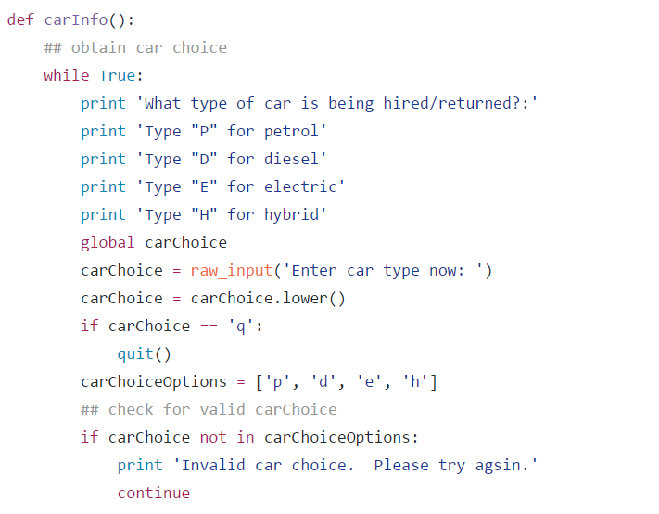
Choosing one of the car options available

Slide 63
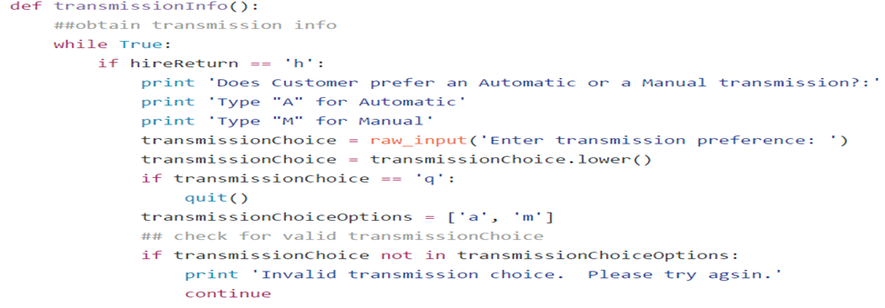
Automatic or Manual car

Slide 64
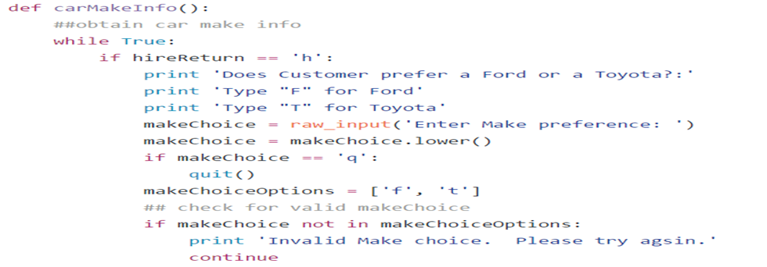
Ford Or Toyota

Slide 65
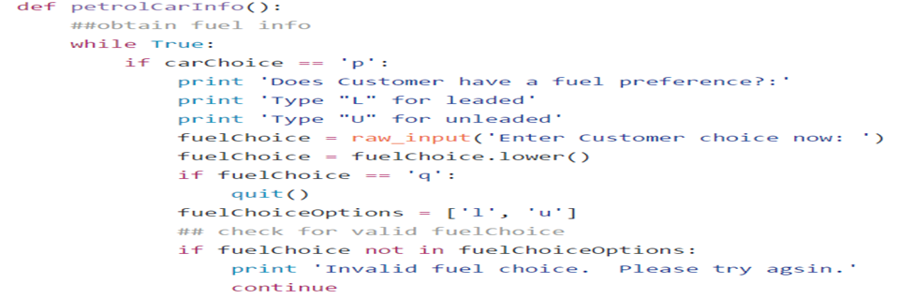
Fuel Preference

Slide 66
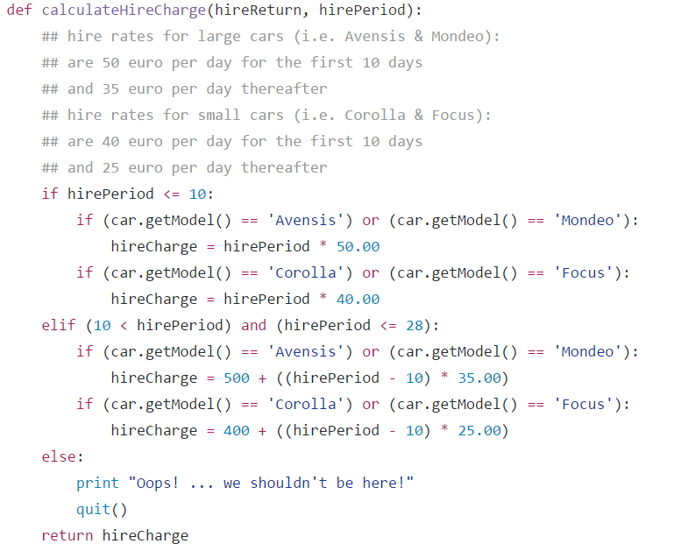
Rates of hiring

Slide 67
References
https://github.com/wade12/ProgrammingForBigDataCA2CarRental/blob/master/carRentalApp.py
http://www.w3resource.com/python-exercises/python-conditional-statements-and-loop-exercises.php
https://www.learnpython.org/

Slide 68
Thank you

