Slide 1

Python Programming
Regression and Clustering

Slide 2
Feedback is greatly appreciated!

Slide 3

Objective
What is machine learning
Regression
Clustering
Scientific packages

Slide 4
What is Machine Learning?

Slide 5
Machine Learning
Subfield of Artificial Intelligence (AI)
Building blocks to make computers learn to behave more intelligently
It is a theoretical concept. There are various techniques with various implementations

Slide 6
Types of Algorithms
Supervised Learning
Unsupervised Learning
Semi-Supervised Learning
Reinforcement Learning

Slide 7
Supervised Learning
The correct classes of the training data are known

Slide 8
Unsupervised Learning
The correct classes of the training data are not known

Slide 9
Semi-Supervised Learning
A mix of Supervised and Unsupervised learning

Slide 10
Reinforcement Learning
Allows the machine or software agent to learn its behavior based on feedback from the environment.
This behavior can be learnt once and for all, or keep on adapting as time goes by.

Slide 11
What is it used for?
Fraud detection.
Web search results.
Real-time ads on web pages
Credit scoring and next-best offers.
Prediction of equipment failures.
New pricing models.
Network intrusion detection.
Recommendation Engines.
Customer Segmentation.
Text Sentiment Analysis.
Predicting Customer Churn.
Pattern and image recognition.
Email spam filtering.
Financial Modeling.

Slide 12
Terminology
Features
The number of features or distinct traits that can be used to describe each item in a quantitative manner.
Samples
A sample is an item to process (e.g. classify). It can be a document, a picture, a sound, a video, a row in database or CSV file, or whatever you can describe with a fixed set of quantitative traits.
Feature vector
an n-dimensional vector of numerical features that represent some object.
Feature extraction
Preparation of feature vector .
Transforms the data in the high-dimensional space to a space of fewer dimensions.
Training/Evolution set
Set of data to discover potentially predictive relationships.

Slide 13
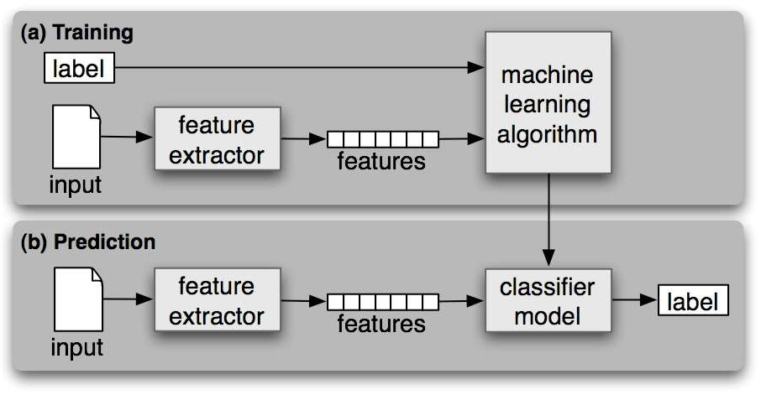
Workflow

Slide 14
Machine Learning Techniques

Slide 15
Techniques
classification: predict class from observations
clustering: group observations into "meaningful" groups
regression (prediction): predict value from observations

Slide 16
Machine Learning project
It has a number of well known steps:
Define Problem.
Prepare Data.
Evaluate Algorithms.
Improve Results.
Present Results.

Slide 17
Regression

Slide 18
Regression
Regression is a form of supervised machine learning.
The scientist teaches the machine by showing it features and then showing it what the correct answer is, over and over, to teach the machine.
Once the machine is taught, the scientist will usually "test" the machine on some unseen data, where the scientist still knows what the correct answer is, but the machine doesn't.
The machine's answers are compared to the known answers, and the machine's accuracy can be measured.
If the accuracy is high enough, the scientist may consider actually employing the algorithm in the real world.

Slide 19
Types
Linear Regression
Logistic Regression
Polynomial Regression
Stepwise Regression
Ridge Regression
Lasso Regression
Elastic Net Regression

Slide 20
Linear Regression

Slide 21
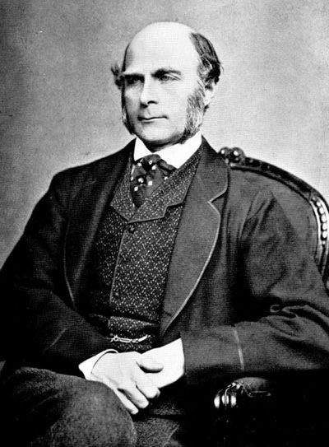
History
This all started in the 1800s with a guy named Francis Galton. Galton was studying the relationship between parents and their children. In particular, he investigated the relationship between the heights of fathers and their sons.
https://www.udemy.com/python-for-data-science-and-machine-learning-bootcamp/learn/v4/overview

Slide 22
History
What he discovered was that a man's son tended to be roughly as tall as his father.
However Galton's breakthrough was that the son's height tended to be closer to the overall average height of all people.
https://www.udemy.com/python-for-data-science-and-machine-learning-bootcamp/learn/v4/overview

Slide 23
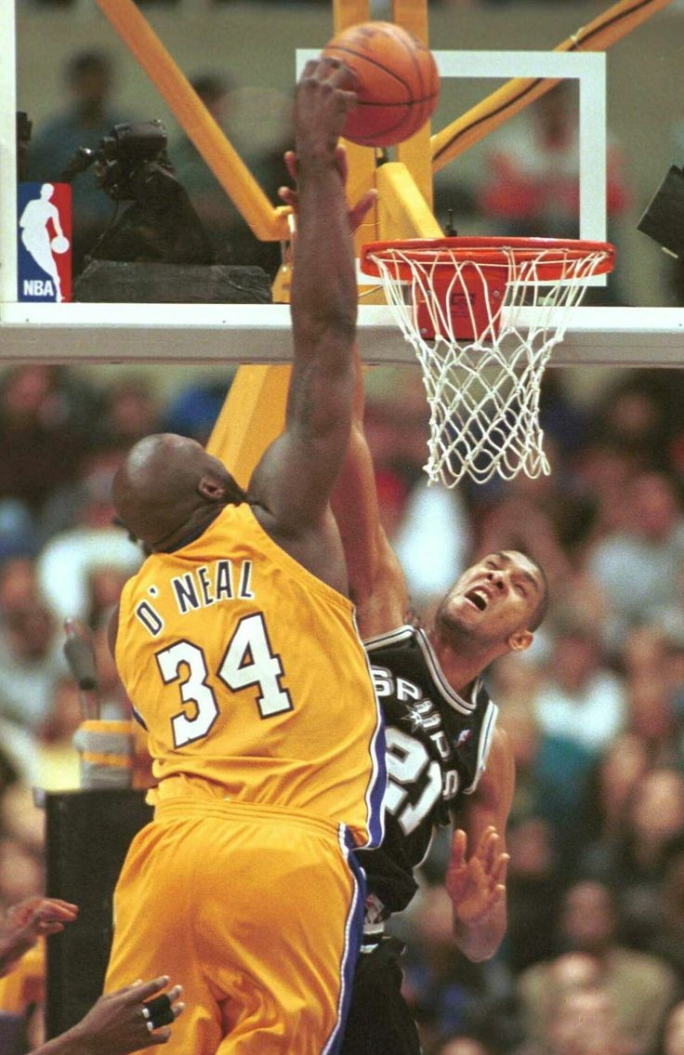
Example
Let's take Shaquille O'Neal as an example. Shaq is really tall:7ft 1in (2.2 meters).
If Shaq has a son, chances are he'll be pretty tall too. However, Shaq is such an anomaly that there is also a very good chance that his son will be not be as tall as Shaq.
https://www.udemy.com/python-for-data-science-and-machine-learning-bootcamp/learn/v4/overview

Slide 24
Example
Turns out this is the case: Shaq's son is pretty tall (6 ft 7 in), but not nearly as tall as his dad.
Galton called this phenomenon regression, as in "A father's son's height tends to regress (or drift towards) the mean (average) height."
https://www.udemy.com/python-for-data-science-and-machine-learning-bootcamp/learn/v4/overview

Slide 25
Linear Regression
Linear regression analysis means "fitting a straight line to data" also called linear modelling
It's a widely used technique to help model and understand real-world phenomena
easy to use
easy to understand intuitively
Allows prediction
We want to model our data as follows: y = B0 + B1 * x

Slide 26
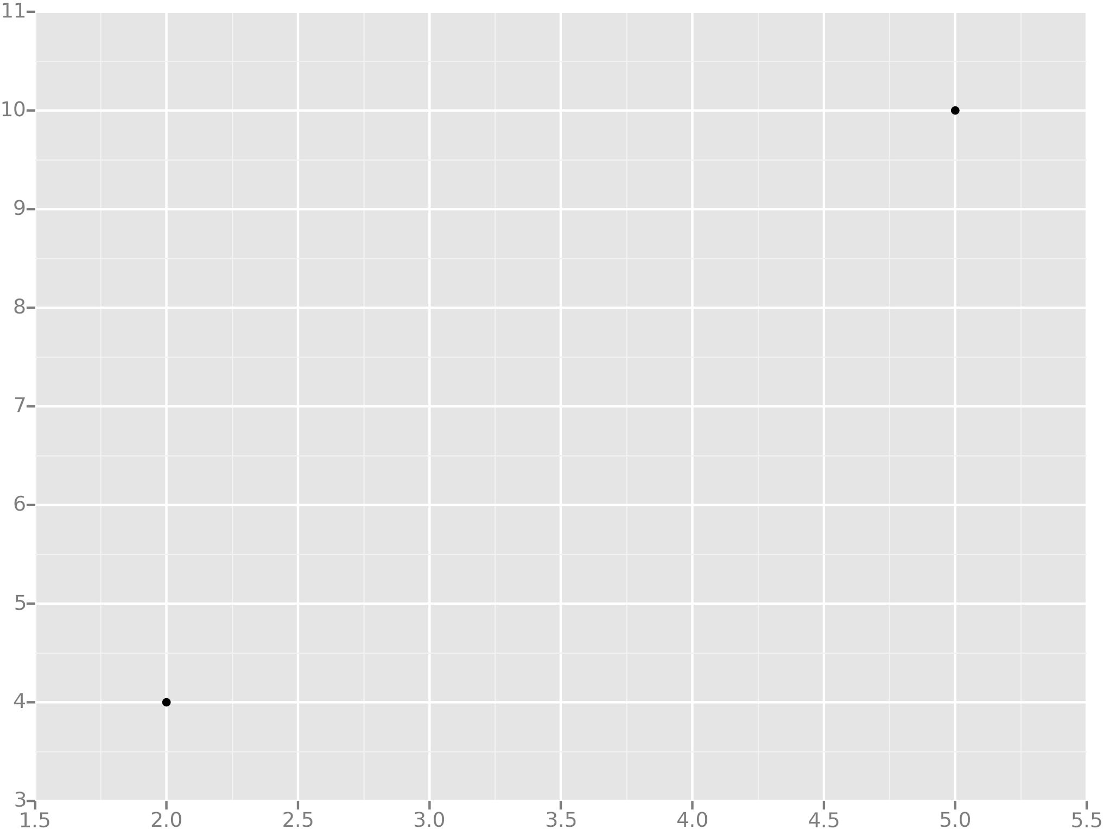
Example
Let's take the simplest possible example: calculating a regression with only 2 data points.
https://www.udemy.com/python-for-data-science-and-machine-learning-bootcamp/learn/v4/overview

Slide 27
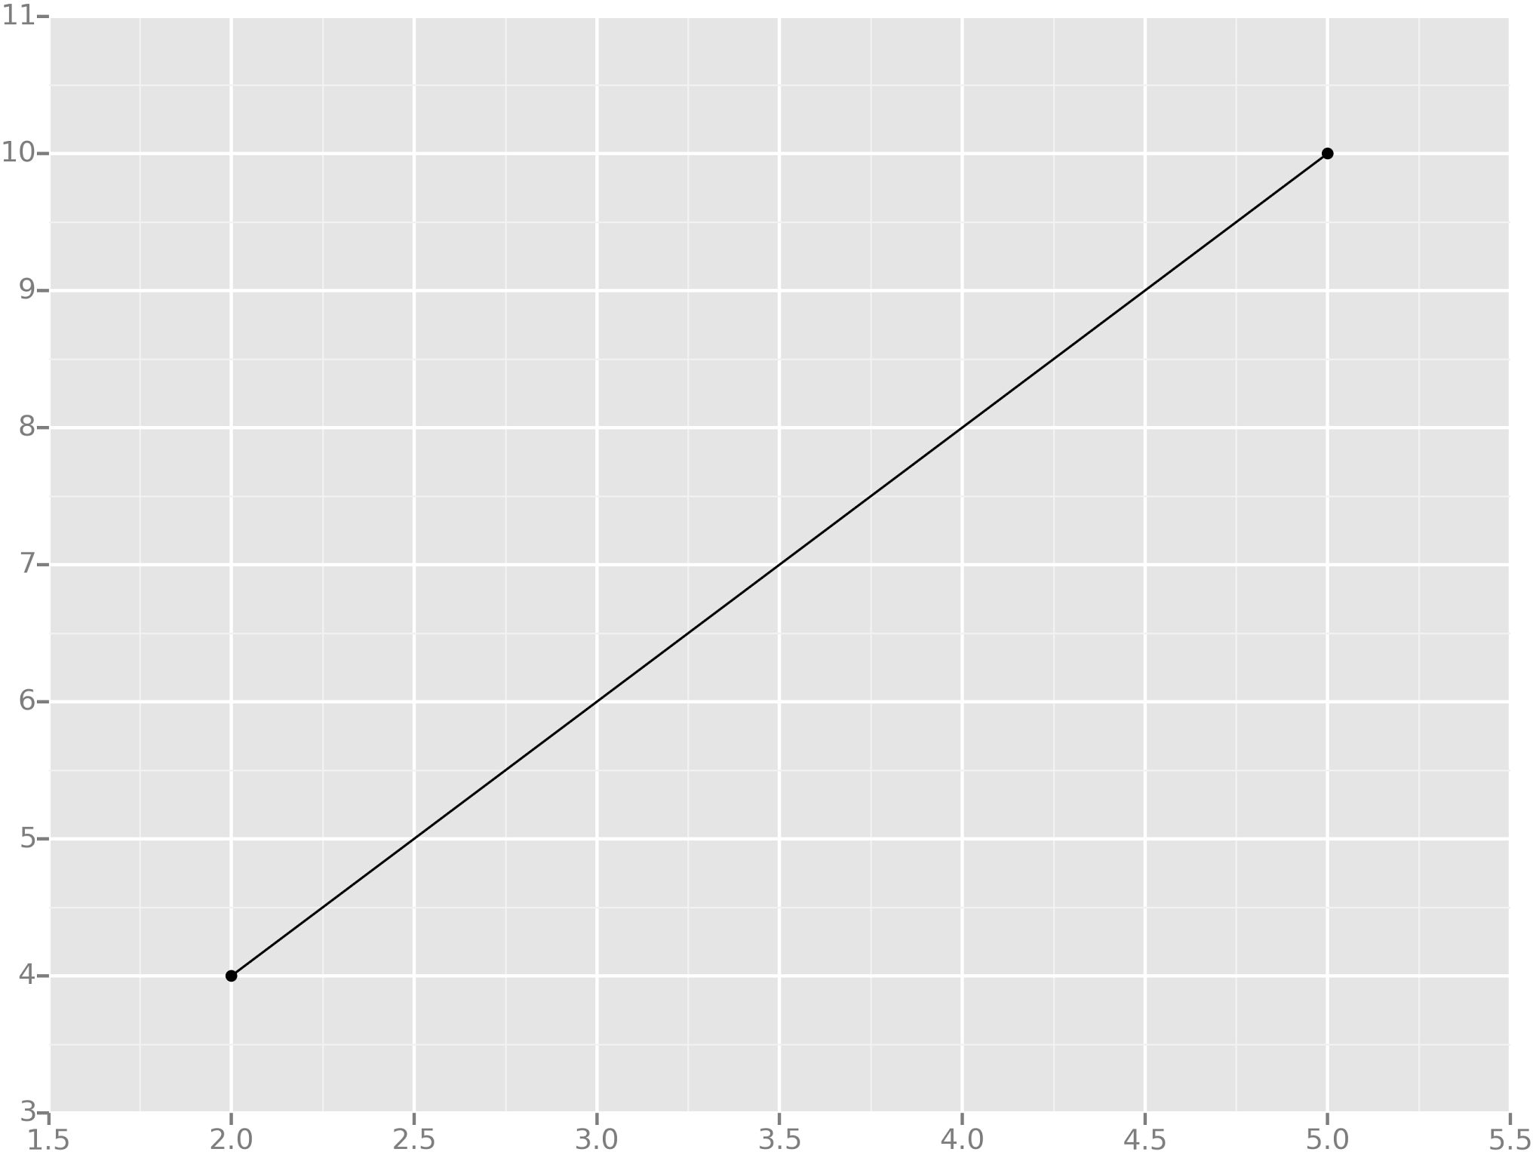
Example
All we're trying to do when we calculate our regression line is draw a line that's as close to every dot as possible.
For classic linear regression, or "Least Squares Method", you only measure the closeness in the "up and down" direction
https://www.udemy.com/python-for-data-science-and-machine-learning-bootcamp/learn/v4/overview

Slide 28
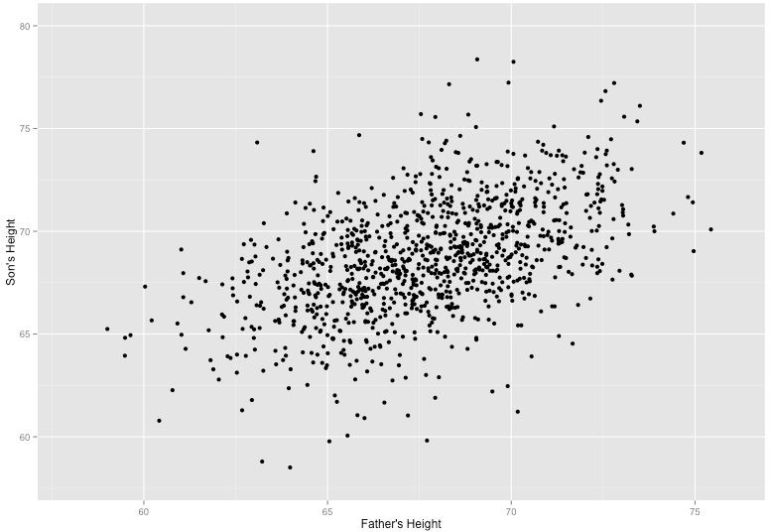
Example
Now wouldn't it be great if we could apply this same concept to a graph with more than just two data points?
By doing this, we could take multiple men and their son's heights and do things like tell a man how tall we expect his son to be...before he even has a son!
https://www.udemy.com/python-for-data-science-and-machine-learning-bootcamp/learn/v4/overview

Slide 29
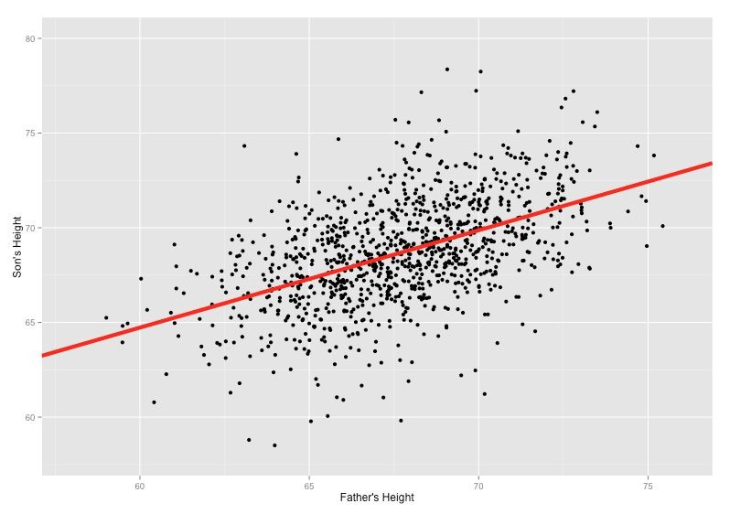
Example
Our goal with linear regression is to minimize the vertical distance between all the data points and our line.
So in determining the best line, we are attempting to minimize the distance between all the points and their distance to our line.
https://www.udemy.com/python-for-data-science-and-machine-learning-bootcamp/learn/v4/overview

Slide 30




Example
We’ll use the Least Squares Method, which is fitted by minimizing the sum of squares of the residuals.
The residuals for an observation is the difference between the observation (the y-value) and the fitted line.
https://www.udemy.com/python-for-data-science-and-machine-learning-bootcamp/learn/v4/overview

Slide 31
Linear Regression
Linear regression assumes that…
1. The relationship between X and Y is linear
2. Y is distributed normally at each value of X
3. The variance of Y at every value of X is the same (homogeneity of variances)
4. The observations are independent

Slide 32
Linear Regression

Slide 33
Calculations For
Estimating The Slope (B1)
Calculate mean(X) = 3
Calculate mean(Y) = 2.8
Estimating The Intercept (B0)
1 2 3 4 5 6 | x y 1 1 2 3 4 3 3 2 5 5
Raw Data

Slide 34
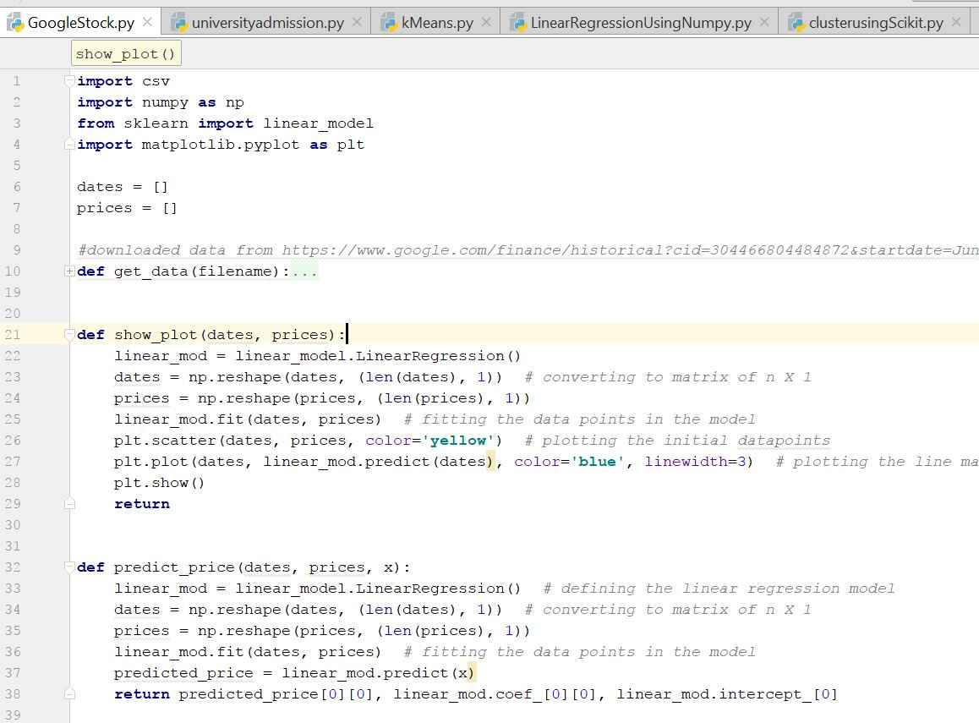
Use Case 1- Stock Prediction
Importing packages
Loading linear model
Independent variable date and dependent variable price for prediction

Slide 35
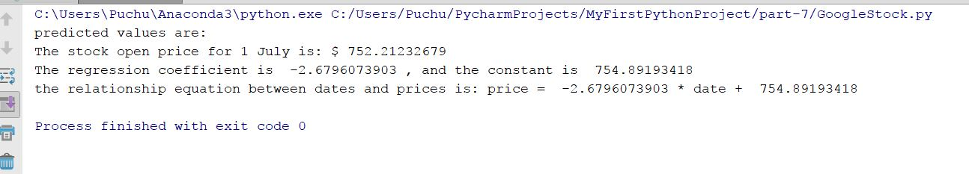
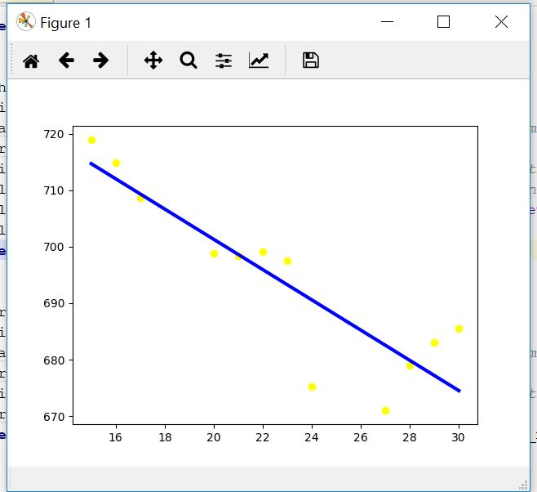
Output

Slide 36
Clustering

Slide 37
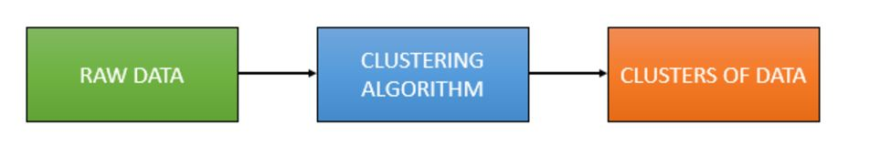
Clustering
Clustering is the grouping of objects together so that objects belonging in the same group (cluster) are more similar to each other than those in other groups (clusters)

Slide 38
Clustering
Clustering is an unsupervised learning algorithm that will attempt to group similar clusters together in your data.
So what does a typical clustering problem look like?
Cluster Similar Documents
Cluster Customers based on Features
Market Segmentation
Identify similar physical groups

Slide 39
Contd.
Method name | Parameters | Scalability | Use case | Geometry (metric used)
K-Means | number of clusters | Very large n_samples, medium n_clusterswith MiniBatch code | General-purpose, even cluster size, flat geometry, not too many clusters | Distances between points
Affinity propagation | damping, sample preference | Not scalable with n_samples | Many clusters, uneven cluster size, non-flat geometry | Graph distance (e.g. nearest-neighbor graph)
Mean-shift | bandwidth | Not scalable with n_samples | Many clusters, uneven cluster size, non-flat geometry | Distances between points
Spectral clustering | number of clusters | Medium n_samples, small n_clusters | Few clusters, even cluster size, non-flat geometry | Graph distance (e.g. nearest-neighbor graph)
Ward hierarchical clustering | number of clusters | Large n_samples and n_clusters | Many clusters, possibly connectivity constraints | Distances between points
Agglomerative clustering | number of clusters, linkage type, distance | Large n_samples and n_clusters | Many clusters, possibly connectivity constraints, non Euclidean distances | Any pairwise distance
DBSCAN | neighborhood size | Very large n_samples, medium n_clusters | Non-flat geometry, uneven cluster sizes | Distances between nearest points
Gaussian mixtures | many | Not scalable | Flat geometry, good for density estimation | Mahalanobis distances to centers
Birch | branching factor, threshold, optional global clusterer. | Large n_clustersand n_samples | Large dataset, outlier removal, data reduction. | Euclidean distance between points

Slide 40
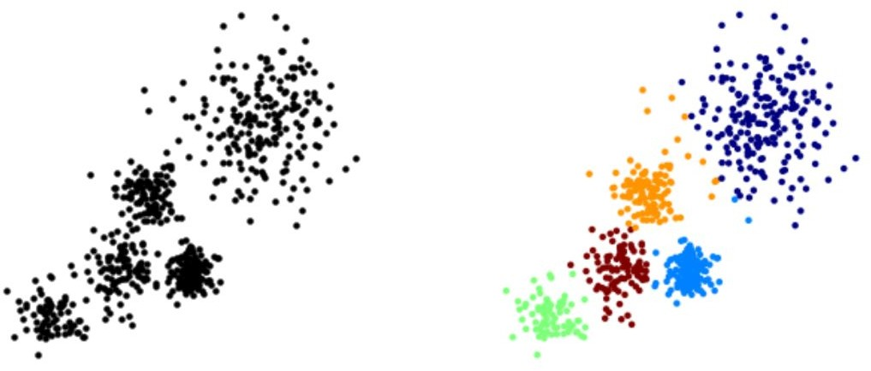
Clustering
The overall goal is to divide data into distinct groups such that observations within each group are similar

Slide 41
K Means Clustering

Slide 42
K Means Clustering
The K Means Algorithm
Choose a number of Clusters “K”
Randomly assign each point to a cluster
Until clusters stop changing, repeat the following:
For each cluster, compute the cluster centroid by taking the mean vector of points in the cluster
Assign each data point to the cluster for which the centroid is the closest

Slide 43
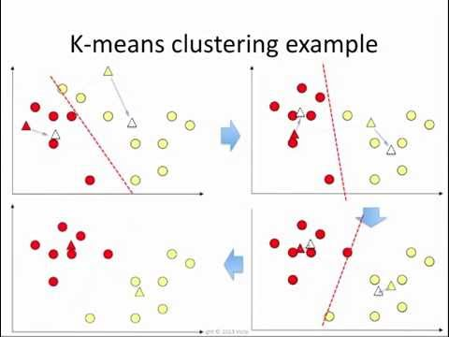
K Means Clustering

Slide 44
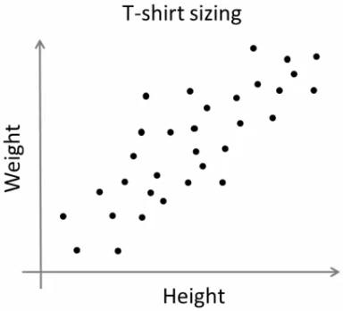
K-Means
T-shirt size problem
Consider a company, which is going to release a new model of T-shirt to market.
Obviously they will have to manufacture models in different sizes to satisfy people of all sizes.
So the company make a data of people’s height and weight, and plot them on to a graph.
Company can’t create t-shirts with all the sizes. Instead, they divide people to Small, Medium and Large, and manufacture only these 3 models which will fit into all the people.

Slide 45
As a first step in finding a sensible initial partition(k=2)
Subject | A | B
1 | 1.0 | 1.0
2 | 1.5 | 2.0
3 | 3.0 | 4.0
4 | 5.0 | 7.0
5 | 3.5 | 5.0
6 | 4.5 | 5.0
7 | 3.5 | 4.5
 | Individual | Mean Vector (centroid)
Group 1 | 1 | (1.0, 1.0)
Group 2 | 4 | (5.0, 7.0)

Slide 46
Steps to do clustering
The remaining individuals are now examined in sequence and allocated to the cluster to which they are closest, in terms of Euclidean distance to the cluster mean.
The mean vector is recalculated each time a new member is added.
 | Cluster 1 |  | Cluster 2
Step | Individual | Mean Vector (centroid) | Individual | Mean Vector (centroid)
1 | 1 | (1.0, 1.0) | 4 | (5.0, 7.0)
2 | 1, 2 | (1.2, 1.5) | 4 | (5.0, 7.0)
3 | 1, 2, 3 | (1.8, 2.3) | 4 | (5.0, 7.0)
4 | 1, 2, 3 | (1.8, 2.3) | 4, 5 | (4.2, 6.0)
5 | 1, 2, 3 | (1.8, 2.3) | 4, 5, 6 | (4.3, 5.7)
6 | 1, 2, 3 | (1.8, 2.3) | 4, 5, 6, 7 | (4.1, 5.4)

Slide 47
Steps to do clustering
Now the initial partition has changed, and the two clusters at this stage having the following characteristics
 | Individual | Mean Vector (centroid)
Cluster 1 | 1, 2, 3 | (1.8, 2.3)
Cluster 2 | 4, 5, 6, 7 | (4.1, 5.4)

Slide 48
Steps to do clustering
But we cannot yet be sure that each individual has been assigned to the right cluster. So, we compare each individual’s distance to its own cluster mean and to that of the opposite cluster.
Individual | Distance to mean (centroid) of Cluster 1 | Distance to mean (centroid) of Cluster 2
1 | 1.5 | 5.4
2 | 0.4 | 4.3
3 | 2.1 | 1.8
4 | 5.7 | 1.8
5 | 3.2 | 0.7
6 | 3.8 | 0.6
7 | 2.8 | 1.1

Slide 49
Steps to do clustering
Only individual 3 is nearer to the mean of the opposite cluster (Cluster 2) than its own (Cluster 1).
In other words, each individual's distance to its own cluster mean should be smaller that the distance to the other cluster's mean (which is not the case with individual 3).
Thus, individual 3 is relocated to Cluster 2
 | Individual | Mean Vector (centroid)
Cluster 1 | 1, 2 | (1.3, 1.5)
Cluster 2 | 3, 4, 5, 6, 7 | (3.9, 5.1)

Slide 50
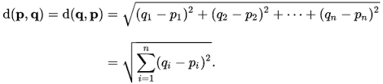
Example
Suppose, D2, D5 & D7 are chosen as initial centroids
Distance formula to calculate minimum distance from initial centroids and the do clustering

Slide 51
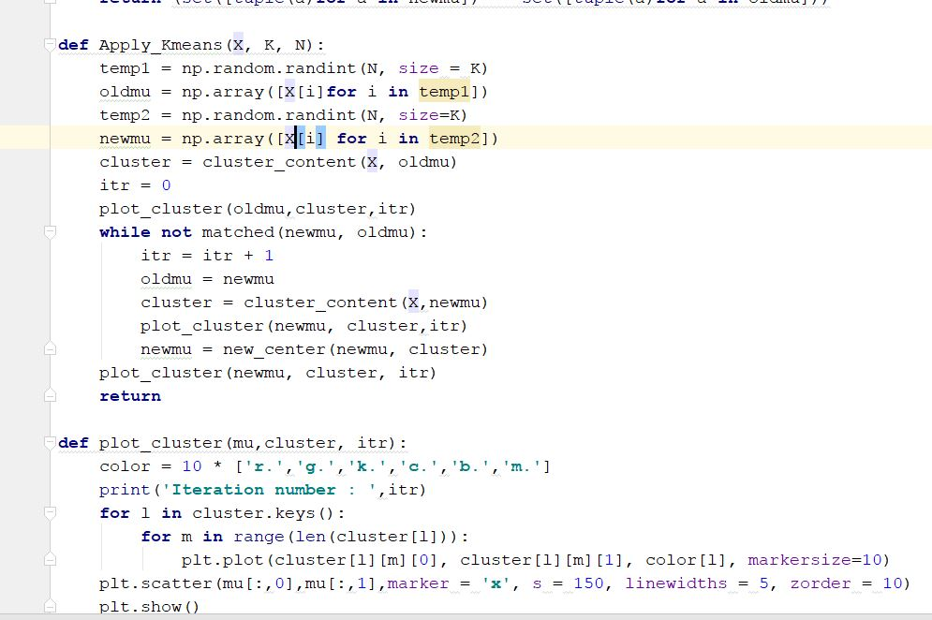
Use Case 2 - k-means
k-means algorithm

Slide 52
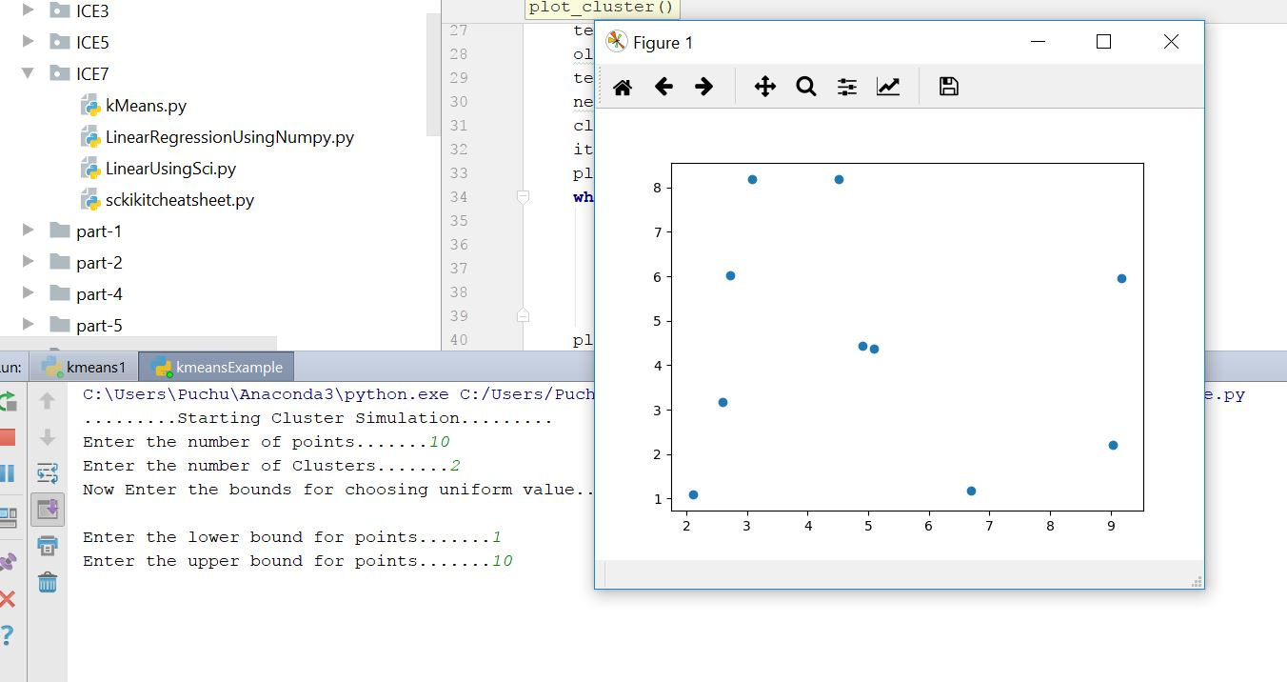
Output
Initial data points

Slide 53
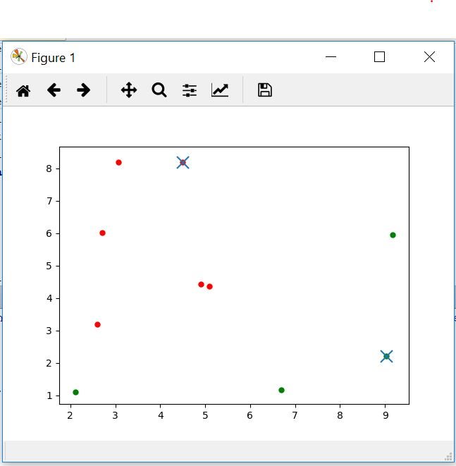
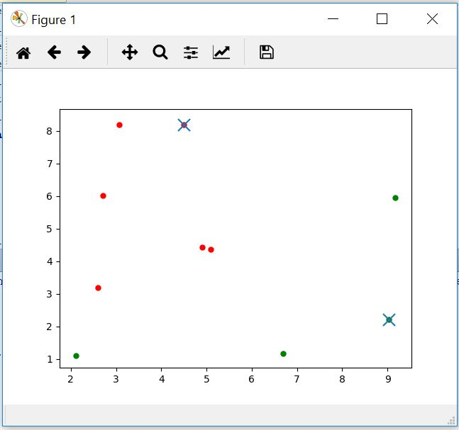
Different Iterations

Slide 54
What is Scikit-Learn?
Extensions to SciPy (Scientific Python) are called Scikit. Scikit-Learn provides Machine Learning algorithms.
Algorithms for supervised & unsupervised learning
Built on SciPy and NumPy
Standard Python API interface
Sits on top of c libraries, LAPACK, LibSVM, and Cython
Open Source: BSD License (part of Linux)
Probably the best general ML framework out there.

Slide 55

Where did it come from?
Started as a Google Summer of Code project in 2007 by David Cournapeau, then used as a thesis project by Matthieu Brucher.
In 2010, INRIA pushed the first public release, and sponsors the project, as do Google, Tinyclues, and the Python Software Foundation.

Slide 56
Primary Features
Generalized Linear Models
SVMs, kNN, Bayes, Decision Trees, Ensembles
Clustering
Cross Validation
Grid Search
Pipelining
Model Evaluations
Dataset Transformations
Dataset Loading

Slide 57
K means clustering in scikit-learn
From sklearn.cluster import Kmeans
Import numpy as np
X= np.array([[1,2], [1,4]
[4,2],[4,4]])
Kmeans = Kmeans(n_clusters =2)
k.means.labels_ → [0,0,1,1]
Kmeans.predict([[0,0], [4,4]] → [0,1]
Kmeans.cluster_centers_ → [[2. 3.] [4. 3.]]

Slide 58
Pandas library
Good for data analytics
Import pandas as pd
Df1= pd.read_csv(‘test.csv’)
PassengerId Survived Sex Age
0 1 0 male 22
1 2 1 female 38
2 3 1 female 26
3 4 1 female 35
4 5 0 male 35
5 6 0 male 29

Slide 60
What is matplotlib?
Plotting library for Python
Works well with NumPy
Syntax similar to MATLAB

Slide 61
Scatter Plot
import numpy as np
import matplotlib . pyplot as plt
x = np. linspace (0 , 10, 1000)
y = np.power(x , 2)
plt . plot (x , y)
plt .show()

Slide 62
References
http://www-bcf.usc.edu/~gareth/ISL/ISLR%20Sixth%20Printing.pdf
https://web.stanford.edu/~schmit/cme193/lec/lec5.pdf
http://machinelearningmastery.com/machine-learning-in-python-step-by-step/
http://scikit-learn.org/stable/auto_examples/linear_model/plot_ols.html
https://www.analyticsvidhya.com/blog/2015/08/comprehensive-guide-regression/
http://scikit-learn.org/stable/modules/clustering.html
http://scikit-learn.org/stable/auto_examples/cluster/plot_kmeans_digits.html
http://www.kdnuggets.com/2015/11/seven-steps-machine-learning-python.html/2
http://beancoder.com/linear-regression-stock-prediction/
http://opencv-python-tutroals.readthedocs.io/en/latest/py_tutorials/py_ml/py_kmeans/py_kmeans_understanding/py_kmeans_understanding.html
https://github.com/tarlen5/coursera_ml/blob/master/unit6/ex2_sklearn

