Slide 1
Comparative study of Speaker Identification techniques
Sneha Nagaraj Bangalore
sb3889

Slide 2
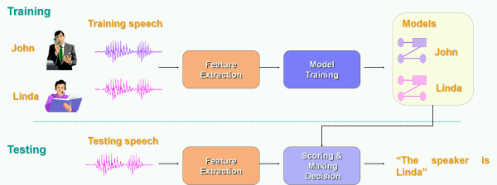

Speaker identification determines which registered speaker provides a given utterance from amongst a set of known speakers.

Slide 3
MFCC + GMM
Feature extraction using Mel Frequency Cepstral Coefficients.
Modeling using Universal Background Model and Gaussian Mixture Model.

Slide 4
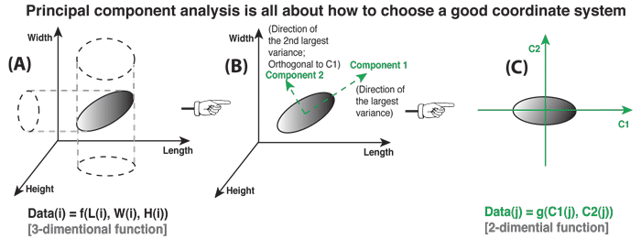
PCA on MFCC
PCA generates a linear orthogonal transformation matrix which will transform the original feature vector to a lower-dimensional space through a built in rotation and projection.

Slide 5
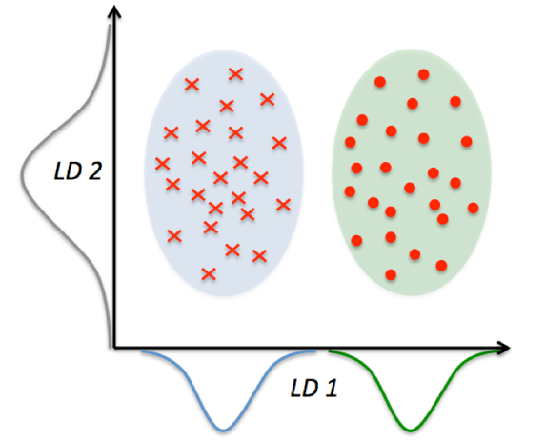
LDA on features
LDA is a linear transformation of n-dimensional feature vectors (or samples) into m-dimensional space (m < n), so that samples belonging to the same class are close together but samples from different classes are far apart from each other.

Slide 6
PLDA on features
PLDA provides a powerful mechanism to distinguish between-speaker variability which characterizes speaker information from all other sources of undesired variability that characterize distortions.

Slide 7
Kaldi
Kaldi SRE08 implements Speaker Identification.
Data Preparation
SRE 2008 training set: LDC2011S05
SRE 2008 test set: LDC2011S08

Slide 8
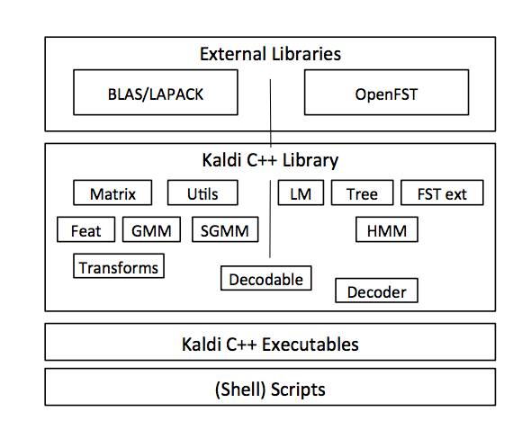
Kaldi
Feature extraction using MFCC
UBM GMM model training
i-Vector extraction
Estimate PCA
Reduce dimension with LDA and demonstrate PLDA scoring

Slide 9
References
Douglas A. Reynolds, “Automatic Speaker Recognition: Current Approaches and Future Trends”.
Douglas Reynolds, “Universal Background Models∗”.
Qin Jin and Alex Waibel, “Application of LDA to Speaker Recognition”.
Daniel Povey, et.al, “The Kaldi Speech Recognition Toolkit”.
Simon J.D. Prince and James H. Elder, “Probabilistic Linear Discriminant Analysis for Inferences About Identity”.
Cemal Hanilci and Figen Ertas, “Principal Component Based Classification for Text-Independent Speaker Identification”.

