Slide 1
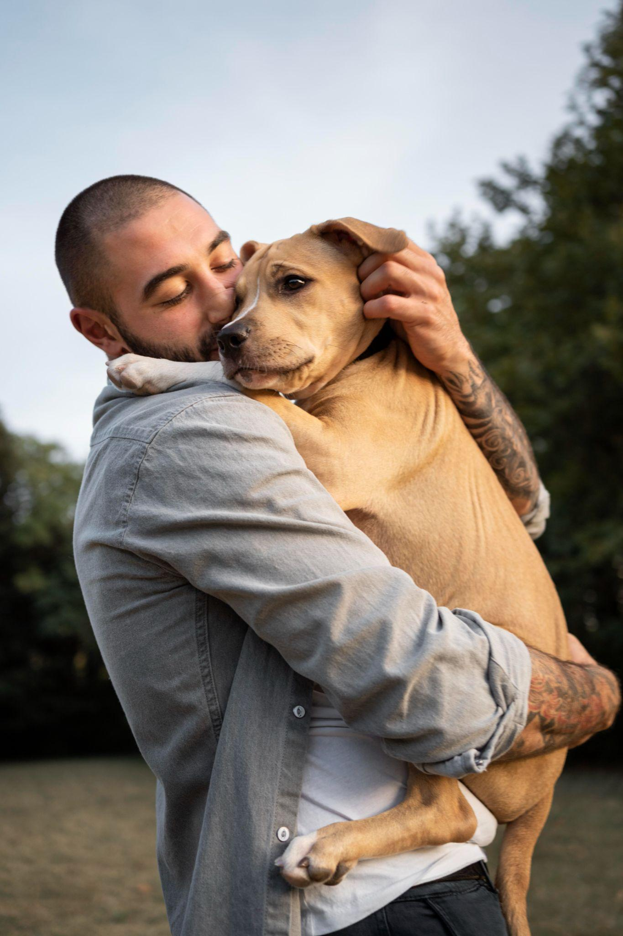

Happy Pet Application Development

Slide 2

Introduction
Happy Pet is a pet care companion app designed to simplify pet management.
Features include biometric authentication, appointment scheduling, weight tracking, and Firebase-powered data management.

Slide 3

Agile Development Process
The development was structured into five sprints, emphasizing flexibility, incremental progress, and continuous feedback.
Each sprint delivered specific features.

Slide 4
Sprint 1: Biometric Authentication
Goal
Establish secure access control.
Key Activities
Implemented BioLockActivity with Android Biometric API.
Outcome
Delivered a functional biometric login feature.

Slide 5

Sprint 2: User Authentication
Goal: Develop registration and login functionality.
Key Activities: Integrated Firebase Authentication with email, password, and Google sign-in.
Outcome: Enabled secure user account creation and login.

Slide 6
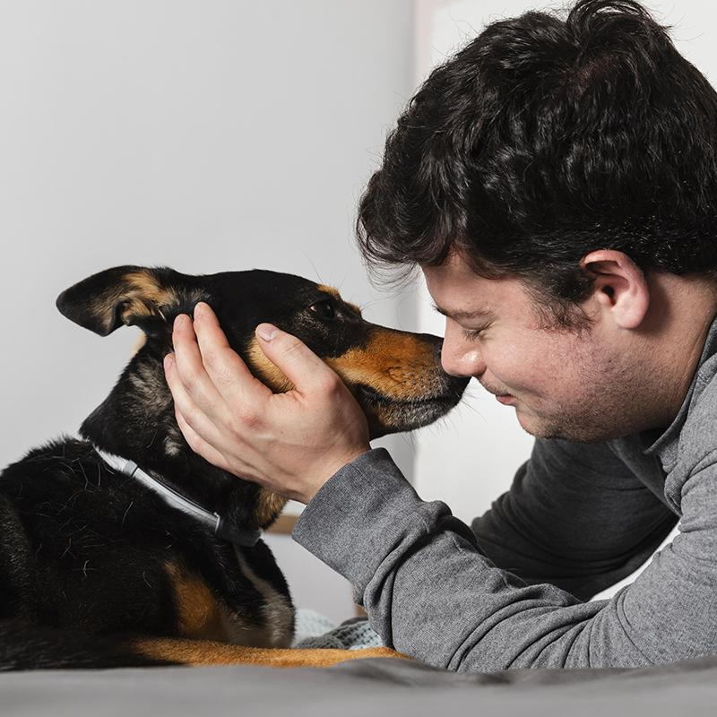
Sprint 3: Appointment Management
Goal: Allow users to schedule and manage appointments.
Key Activities: Designed database schema, developed UI for appointment management.
Outcome: Real-time appointment scheduling with Firebase.

Slide 7

Sprint 4: Weight Tracking
Goal: Implement pet health monitoring.
Key Activities: Built UI for weight logging, integrated Firebase Storage for images.
Outcome: Users can log weight and track progress visually.

Slide 8

Sprint 5: UI/UX Refinement
Goal: Improve app usability and fix bugs.
Key Activities: Incorporated feedback, and resolved performance issues.
Outcome: Delivered a polished, user-friendly application.

Slide 9
Sprint Reviews
Achievements
Delivered functional modules.
Challenges
Managed API delays, refined features.
Improvements
Adjusted timelines, enhanced collaboration.

Slide 10
Agile Methodology Evaluation
Benefits
Challenges
Continuous feedback, incremental improvements, flexibility.
Managing scope creep, aligning external dependencies.

Slide 11
Tools and Environment
Android Studio
Firebase
Development
Authentication and database
GitHub
Trello
Version control
Sprint management

Slide 12
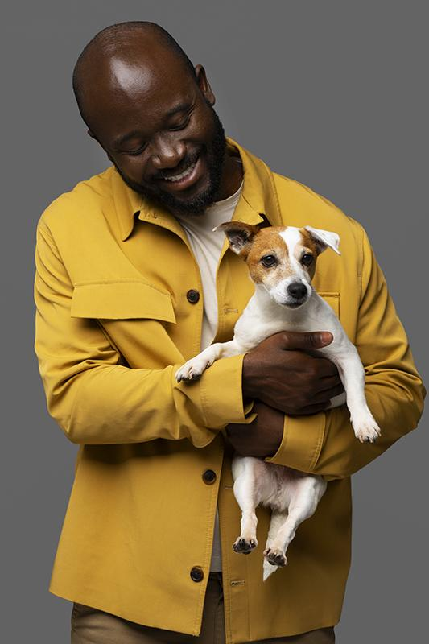
Recommendations for Future Enhancements
Advanced analytics, localization, offline capabilities.
Gamification features, wearable device integration, and accessibility improvements.

Slide 13

Key Challenges
- Managing scope creep.
- Ensuring feature completeness within sprints.
- Addressing user feedback efficiently.

Slide 14

Social and Ethical Considerations
Compliance with GDPR.
Transparent data handling practices.
Accessibility-focused design for inclusivity.

Slide 15
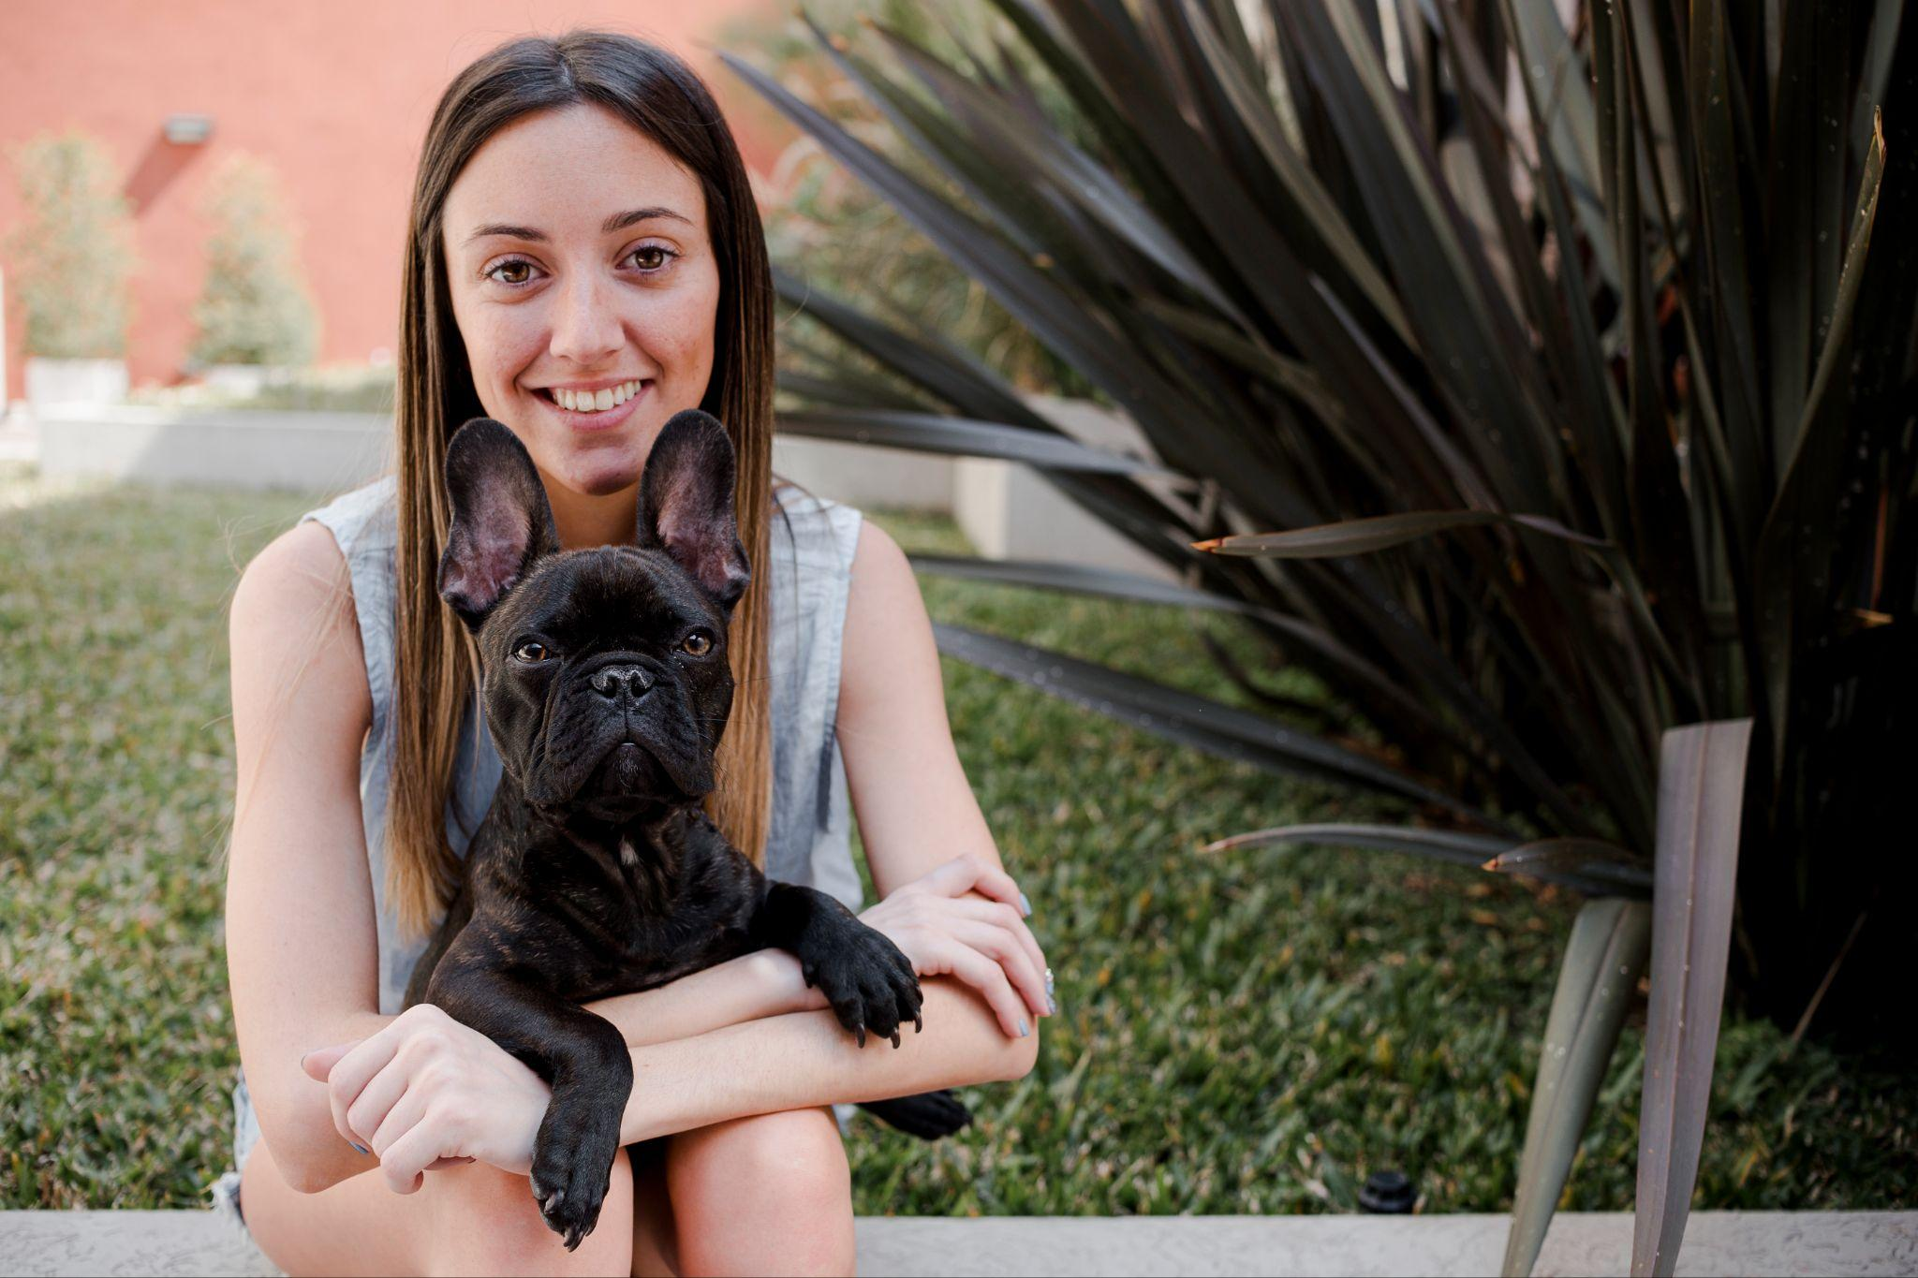
Conclusion
Happy Pet app combines user-centric design, robust features, and ethical development practices. Agile methodology ensured iterative success and adaptability.

