Slide 1
♻️
Smart Waste Classifier
AI-Powered Waste Identification & Disposal Guidance
Computer Vision · CNN Transfer Learning (MobileNetV2)
[Batch] · [Group No.] · [Team Member Names]
AI Project Competition — 4th Week of September 2026
Notes:
Opening: greet judges, introduce team and batch/group. State the one-line pitch: 'We built an AI system that identifies waste from a photo and tells you exactly how to dispose of it correctly.' Keep this under 20 seconds — the goal is to set up the problem you're about to explain.

Slide 2
01
Problem Identified
Manual sorting is slow & inconsistent
People routinely misjudge which bin an item belongs to, especially for mixed materials.
~2.1B
Recyclables get contaminated
tonnes of municipal solid
waste generated globally
every year
One wrong item (food, liquid, wrong material) can spoil an entire batch of otherwise recyclable waste.
Landfill overflow
(World Bank, approx.)
Recyclable material that isn't sorted correctly ends up in landfills instead of being reused.
A large share never gets
recycled — mostly due to
poor sorting at the source.
Health risk to waste workers
Manually sorting unsegregated, sometimes hazardous waste puts workers at risk.
♻ Smart Waste Classifier
2
Notes:
Explain the real-world problem before mentioning AI at all — judges want to see you understand the problem, not just the tech. Emphasize contamination: one wrong item can spoil a whole batch of recyclables, which is why *consistent* sorting (something AI is good at) matters.

Slide 3
02
AI Concept & Technique Used
Image Classification via Computer Vision
👁
🧠
⚡
Computer Vision
Convolutional Neural
Network (CNN)
Transfer Learning
The AI "sees" the waste item through its camera-captured image.
Learns visual patterns — shape, texture, color — that distinguish waste types.
Reuses MobileNetV2, pretrained on 1.4M ImageNet images, instead of training from scratch.
Model Pipeline
Input
Image
→
MobileNetV2
(pretrained)
→
Custom
Classifier Head
→
Predicted
Category
Why transfer learning? Training a CNN from scratch needs huge datasets and compute. Reusing a pretrained backbone gets strong accuracy from a much smaller dataset and a short training time — realistic for a class project.
♻ Smart Waste Classifier
3
Notes:
If asked 'why not train your own CNN from zero': explain that transfer learning lets us start from features already learned on 1.4M images, so we only need to train a small classifier head on our (much smaller) waste dataset. This is standard practice in real-world computer vision, not a shortcut — it's the efficient approach.

Slide 4
03
Input & Data Required
Dataset: Kaggle Garbage Classification
Preprocessing Steps
12 raw classes, consolidated to match the brief's "plastic, paper, metal, organic waste, etc." — images resized to 224×224 and normalized before being fed to the model. Augmentation (flips, rotation, color jitter) applied during training to improve robustness.
1
Resize image to 224 × 224 px
Core categories (per brief)
2
Normalize using ImageNet mean/std
Plastic
Paper
Metal
Organic
Glass
Cardboard
Trash
3
Augment (train only): random crop, flip, rotation, color jitter
Bonus "etc." categories
Battery
Clothes
Shoes
4
Split 85% train / 15% validation, stratified by class
♻ Smart Waste Classifier
4
Notes:
If asked about dataset size: mention the Kaggle Garbage Classification dataset has roughly 15,000 images across 12 raw classes before consolidation. Be ready to state your actual final per-class counts from the notebook's Section 2 output.

Slide 5
04
Working of the AI System
End-to-end flow, from photo to disposal guidance
→
→
→
→
→
📷
🔧
🧠
🏷️
♻️
✅
Capture /
Upload Photo
Preprocess
(resize, normalize)
CNN Feature
Extraction
Classification
+ Confidence
Disposal
Guidance Lookup
Show Result
to User
The disposal-guidance step is what turns this from a plain image classifier into a decision-support system: the predicted category is looked up in a rules table that returns the correct bin and a practical tip.
Example
Input: photo of a plastic bottle → Prediction: "Plastic" (94% confidence) → Output: "Dry / Recyclable Waste (Blue Bin) — rinse before disposing."
♻ Smart Waste Classifier
5
Notes:
Walk through this flow left to right while narrating in plain language — avoid jargon overload here, this slide is where non-technical judges need to follow along. Point out the last two steps are what make it a *system*, not just a classifier: confidence score + a real disposal recommendation.

Slide 6
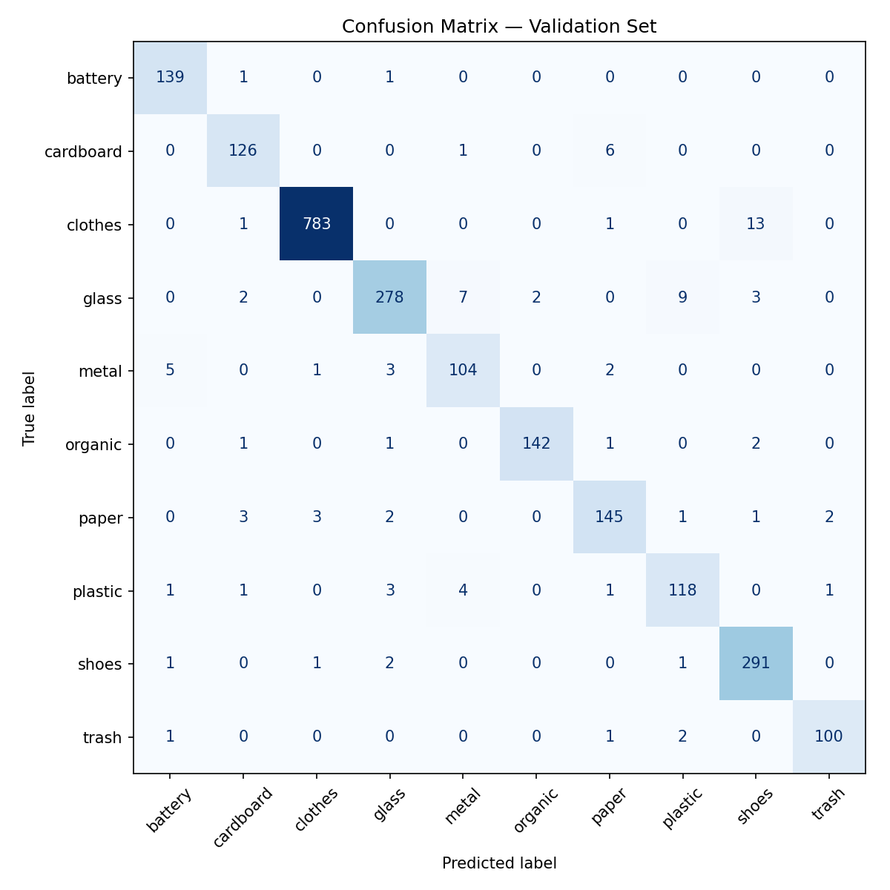
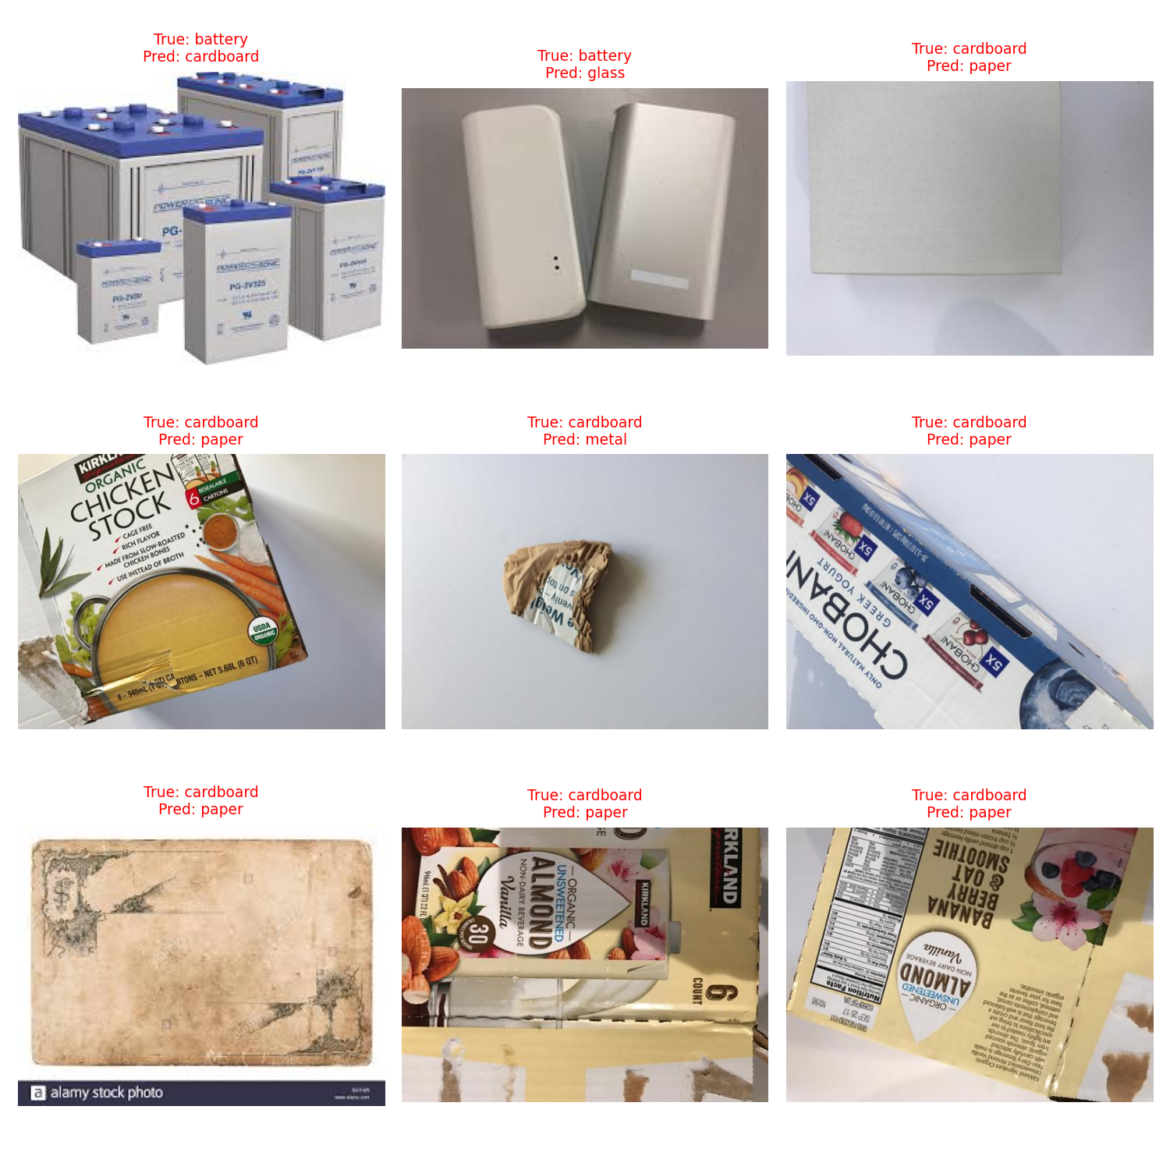
05
Output & Result
Real results from our trained model (Colab Section 5 — Evaluate)
95.9%
10
~14 MB
<1 sec
Validation
Accuracy
Waste
Categories
Model Size
(MobileNetV2)
Inference Time
per Image
♻ Smart Waste Classifier
6
Notes:
Before presenting: run Section 5 (Evaluate) in the Colab notebook, then replace the [XX.X]%, [N], and both dashed placeholder boxes with your real confusion matrix and misclassified-examples screenshots from eval_results/. Judges respond much better to real numbers and real failure cases than to claims without evidence.

Slide 7
06
Live Demo
Streamlit web app — upload or camera input
Paste a screenshot of the running
Streamlit app here
(or switch to the live app during
the actual presentation)
01
Upload or capture
User uploads a photo, or takes one live with the camera tab.
02
Model runs instantly
The trained CNN classifies the image in under a second.
03
Confidence shown
A probability bar chart shows how confident the model is across all categories.
04
Disposal guidance appears
The correct bin and a practical tip are shown immediately.
♻ Smart Waste Classifier
7
Notes:
Live-demo risk mitigation: have the app already running in a browser tab before you're called up, and have 2-3 test photos ready on your phone (one of each: a confident-correct case, and one trickier case) so you control the demo instead of fumbling for a subject in the room. If venue wifi fails, fall back to a short screen-recording video instead of live.

Slide 8
07
Real-Life Application
🗑️
🏭
Smart Recycling Bins
Municipal Sorting Centers
Deployed in campuses, malls, and offices — camera-equipped bins that guide correct sorting at the point of disposal.
Assists (not replaces) human sorters at recycling facilities, flagging items for review.
🏫
📱
Educational Tool
Household Mobile App
Teaches students correct waste segregation habits interactively, in schools and colleges.
Lets anyone check disposal instructions for an item before throwing it out, right from their phone.
♻ Smart Waste Classifier
8
Notes:
Pick one application to describe in a bit more depth if asked — smart bins is usually the strongest answer since it maps most directly to what you actually built and demoed.

Slide 9
08
Advantages & Limitations
✅ Advantages
⚠️ Limitations
•
Fast and consistent — no human fatigue or judgment variance
•
Accuracy depends on image quality and lighting conditions
•
Scales to many locations at low marginal cost
•
Struggles with multiple overlapping items in one frame
•
Reduces recyclable contamination at the source
•
Limited to categories seen during training
•
Works from any phone camera — no special hardware needed
•
Can't detect contamination inside opaque containers
•
Gives actionable guidance, not just a label
•
Needs periodic retraining as waste-stream patterns change
♻ Smart Waste Classifier
9
Notes:
Being upfront about limitations is a strength in front of judges, not a weakness — it shows you understand the system's real boundaries rather than overselling it. The 'multiple overlapping items' limitation connects directly to your future-scope slide (YOLO multi-item detection).

Slide 10
09
Future Scope
🎯
🎥
📶
Multi-item Detection
Real-time Video Sorting
IoT-Integrated Smart Bins
Add YOLO-based object detection to identify several items in one messy bin photo, not just one at a time.
Classify items live on a conveyor belt for industrial-scale recycling facilities.
Connect the model to a bin with automated sorting mechanisms — no human handling needed.
💬
📲
🌍
AI-Generated Eco Tips
Mobile App Deployment
Expanded Category Coverage
Use an LLM to generate personalized, context-aware disposal and sustainability tips.
Convert the model to TensorFlow Lite / ONNX for fast on-device inference, no internet required.
Train on more diverse, region-specific waste types and local recycling rules.
♻ Smart Waste Classifier
10
Notes:
If time is short, prioritize mentioning multi-item detection and mobile deployment — these are the two most concrete and understandable next steps for a judge to grasp quickly.

Slide 11
10
Tech Stack
Tools and technologies used to build this project
🐍
PyTorch
📷
torchvision
Model definition & training
MobileNetV2 pretrained weights
📊
scikit-learn
🖥️
Streamlit
Evaluation metrics
Interactive demo web app
☁️
Google Colab
🗂️
Kaggle Dataset
Free GPU training environment
Garbage Classification (12 classes)
♻ Smart Waste Classifier
11
Notes:
Keep this slide quick — 20-30 seconds. It exists mainly so judges see the project uses real, current, industry-standard tools rather than a black box.

Slide 12
♻️
Thank You
Questions & Discussion
[Team Member Names] · [Batch] · [Group No.]
Notes:
Common judge questions to prepare for: (1) 'Why MobileNetV2 and not a bigger model?' — efficiency/deployability tradeoff. (2) 'How does it handle an item it's never seen?' — it'll misclassify into the closest learned category; mention this as a limitation. (3) 'What's your actual accuracy?' — have your real number from Section 5 memorized. (4) 'Could this be fooled?' — yes, e.g. an item photographed at an unusual angle or in poor lighting; that's honest and shows depth of understanding.

