Slide 1

BHAGWAN MAHAVEER COLLEGE OF COMPUTER APPLICATION, SURAT M.Sc.IT (Integrated) TY B.Sc. (Information Technology) Semester 5 Subject : 1020406503 Internet Of Things
GROUP : 12
SMART ROAD
Team:-
Enrollment No:- | Name:-
20020406074 | Sneha Raval
20020406075 | Vishva Sakariya
20020406076 | Vraz Sakariya
20020406077 | Romil Sanghani

Slide 2
PROJECT OVERVIEW
“We can build a future where transportation is both significantly safer and more efficient”.
This Project is for Smart Road System which include some of smart Technology such as Smart Street Light, Smart Traffic Signals and Smart Waste Management System technology with the help of IOT(Internet of Things).

Slide 3
What are Smart Roads?
Smart Roads are roads enabled with technological tools that interact with the environment (people and nature) to enable safe and efficient transportation. They combine physical infrastructures (such as sensors and solar panels) with software infrastructure.

Slide 4
The Problem: Traffics in Mega cities Increased accidents rates People Throwing trash anywhere Potholes: Severe accidents can occur when blacktop or asphalt are missing in large chunks from road.
The goal:
Make road smart with used of these advanced technology
Provide smart traffic signals
Smart waste management system for reduce man power and clean environment

Slide 5
Abstract :-
Smart roads built on IOT and information and communications technology can make it possible for cities and transportation authorities to collect analyse data to improve day-to-day traffic management.
Smart Road with IOT based traffic management, So IOT can help the traffic system to be automated and monitor the traffic status using the internet. Automatic street light system is smart and provides a safe night time environment for all road users including pedestrians.
Smart waste management system : In this system, a 24*7 monitoring system is designed for monitoring dumpsters.

Slide 6
2. Introduction :-
Roads are the arteries through which the economy pulses. By linking producers to markets, workers to jobs, students to school, and the sick to hospitals, roads are vital to any development agenda. Since 2002, the World Bank has constructed or rehabilitated more than 260,000 km of roads. It lends more for roads than for education, health, and social services combined. However, while roads bring economic and social benefits, they can also come with social costs such as pollution or deforestation. Roads are the main source which connects all the villages, cities, states and countries and enhances communication among all parts of the world.
On an average, 2 billion people use roads for their transport everyday. The present roads which we are using are the age old ones and have not been developed in any aspect. Now a days, there is up gradation in all aspects of life but roads are the only ones which have not been modernised in our country. Roads have been technologically developed in all other parts of the world based on their requirements. Infrastructure has always mattered. The industrial revolution was not just the story of cotton mills and iron foundries. It was about canals, railways and roads. Big changes to the way people and goods could move around the country boosted growth and transformed the economy. The roads which are now in practice in all parts of the world are the ones which not only provide transport but also support us by providing power by using wind energy and solar energy. These roads are called SMART ROADS.

Slide 7
3. Project Profile :-
3.1 Goals of Project :-
It aims to create a better smart road that offers a variety of smart features including smart traffic signals, smart street lights, smart garbage monitoring system and smart alert button.
Electricity can be save with the help of smart street lights.
Environments or quality time also can be save with the help of smart traffic signals.
Health and other social issues can be save or reduce with help of garbage monitoring system and smart alert button.
3.2 Project Team :-
Enrollment No: Name
20020406074 : Sneha Raval
20020406075 : Vishva Sakariya
20020406076 : Vraz Sakariya
20020406077 : Romil Sanghani

Slide 8
3.3 Gantt Chart :-

Slide 9
4. System Analysis :-
Used Items :-
Ultra sonic sensor
Wires
Male to female, Male to male, Female to female
LED lights
Battery
Breadboard
Arduino UNO
Servo motor & Motor
Registers
Piezo
Buttons & Switches
Stationary items : Cardboard sheet, Thermocol sheet, Straws, Glue, Matchbox, Colour etc…
4.1 Requirement Analysis :-
This project is mostly required in mega cities because the number of vehicles and population increasing day to day that create a traffic problem, air or noise pollution, and other social and health issues as well.

Slide 10
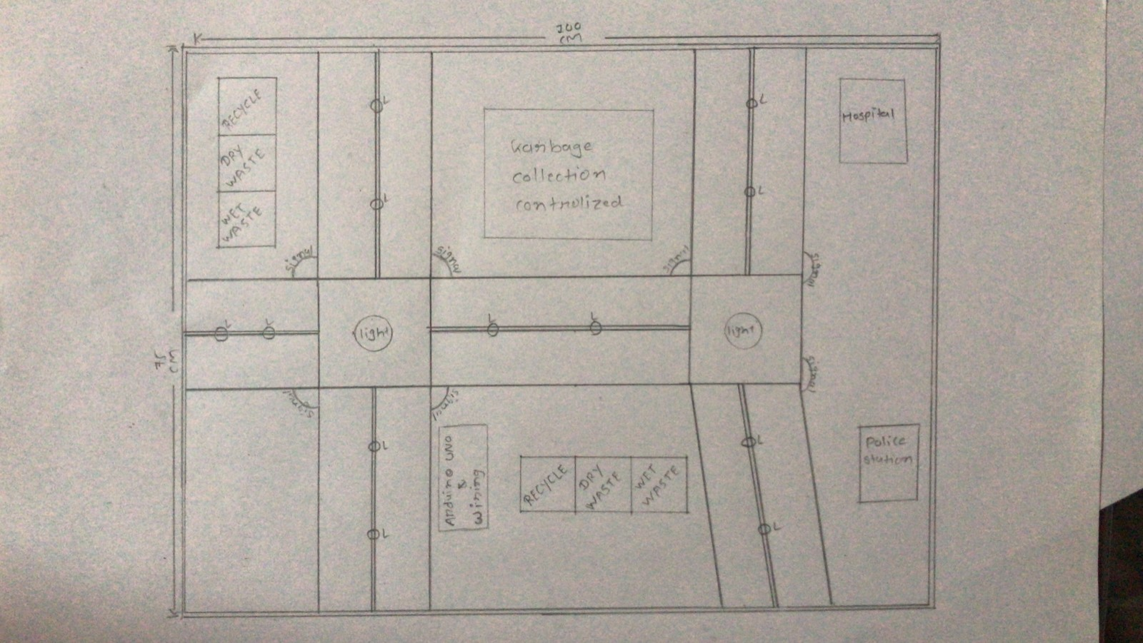
5. System Design :-
5.1 Architecture Diagram :-
This Design is to measure road Architecture

Slide 11
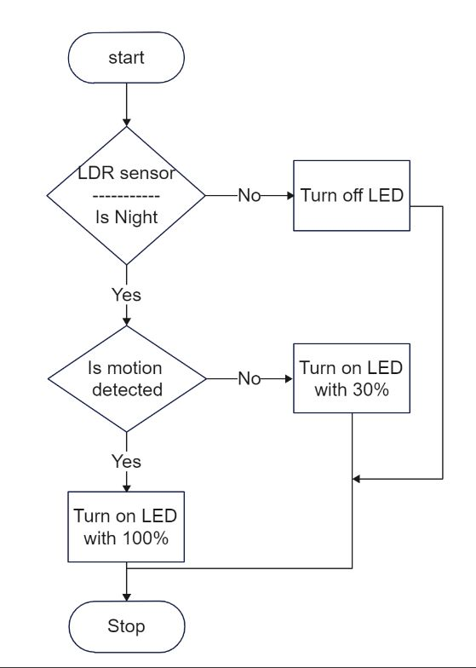
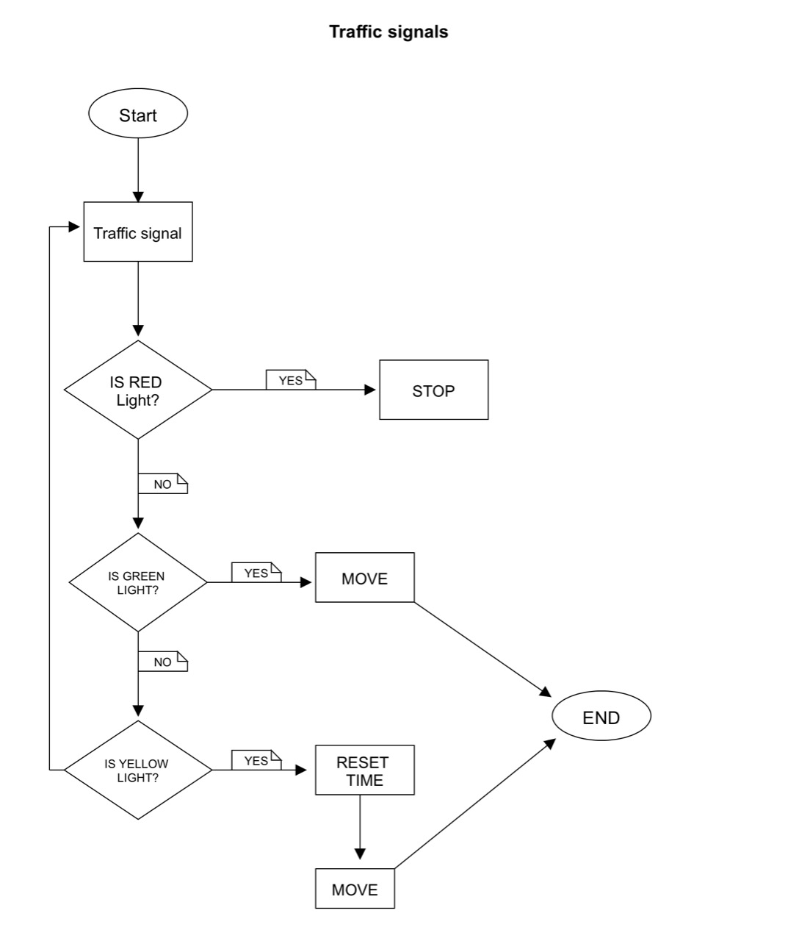
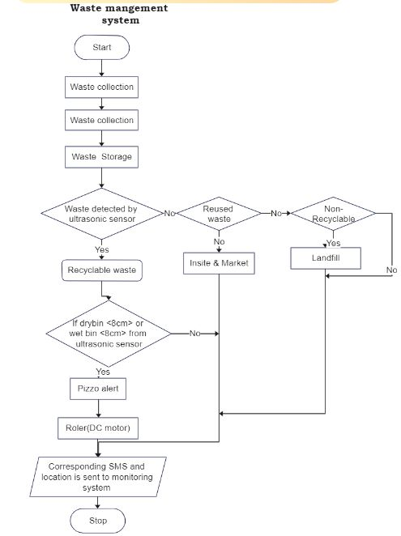
5.2 Flow Chart :-

Slide 12
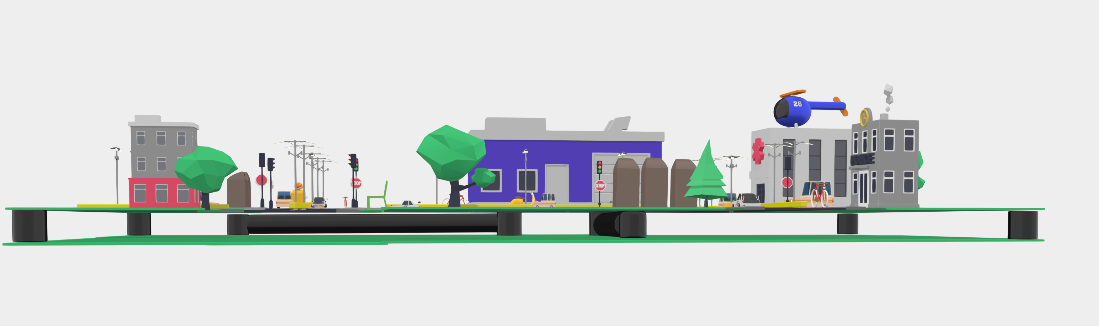
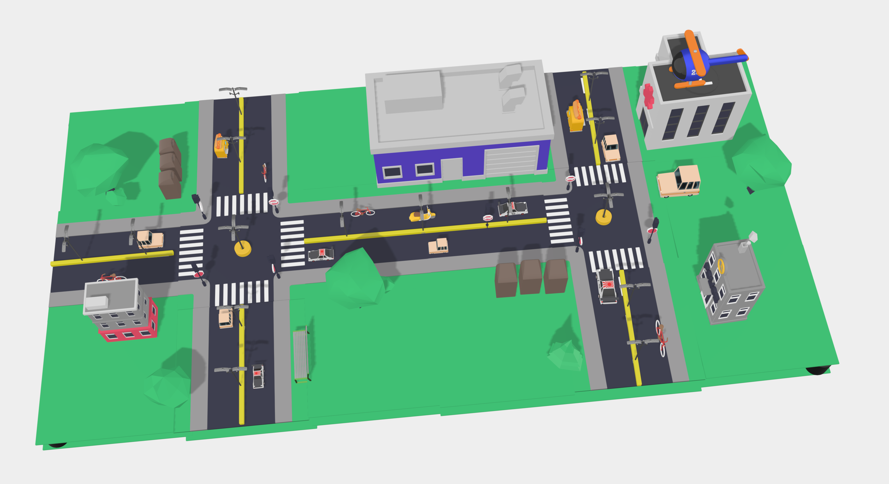
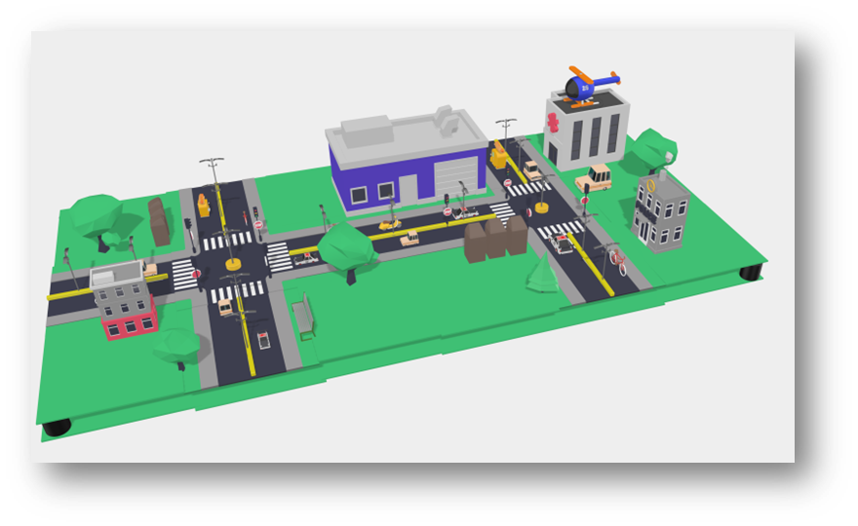
5.3 Blue Print :-
3D Design (Top View)
With the help of this 3D model we can get every small details of Our Project. The Model is very simple and informative. So, anyone can understand easily.

Slide 13
6. Implementation :-
To increase the road usability.
Improvement of lighting in road which saves a lot of electricity and money.
Use of digital media to transfer information.
Follow Smart Traffic Light signals.
Use Smart Waste Management System for Pollution Control or Clean Roads.
Use All Smart Road Technologies.

Slide 14
What are the Problems Faced in Road Transport in India?
Most of the Indian roads are unsurfaced (42.65%) and are not suitable for use of vehicular traffic.
One major problem on the Indian road is the mixing of traffic.
There are multiple check-posts, toll tax and octoroon duties collection points on the roads.
There is very attention on road safety and traffic laws are willfully violated.
There has been no stability in policy relating to highway.

Slide 15
7. Benefits & Challenges :-
Benefits :-
Interactive lights: These lights are so helpful that they are 10 times brighter than the lights which we are using now.
Huge reduction of Energy and maintenance cost
Increased public Safety from improved lighting
Traffic Light timing in real-time
Safety from Road Accidents
Reduction in pollution
Smart Waste Management System: It can be useful for reduce man effort, pollution, fuelling or many more. Waste disposal truck driver wants to visit all the bins and check that which bins are full or and which are empty. The garbage monitoring system that contains these all the facilities are automatically.
Challenges:-
Lack of awareness
Transportation and Traffic
Other Social and Health issues
Risk in Road Construction
Cost Overrun and Failed Estimates
Increased accident rates due to the non-maintenance of damaged parts of the road.
Proper Construction of Road

Slide 16
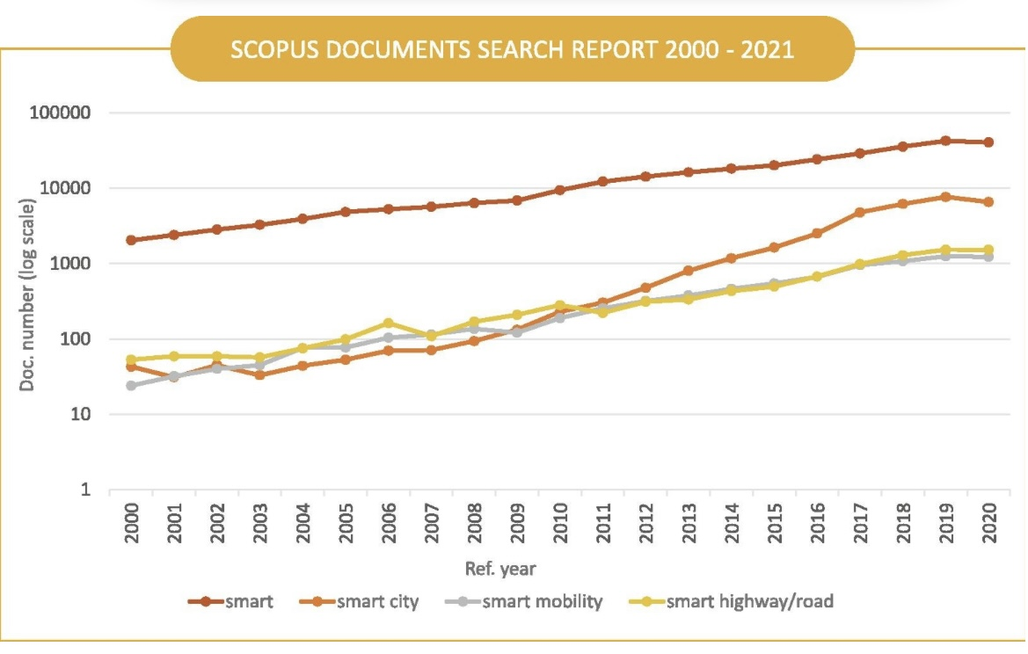
8. Smart Road Technologies of the future :-
Glow in the dark
Interactive Light
Wind-Powered Lights
Electric Priority Lane
Solar Roadways
Weather Detection
Traffic Detection
Safety & Smart Mobility

Slide 17
9. Bibliography :-
For successfully completing my project, I have taken help from following websites or links:
www.goggle.com
www.wikipedia.com
YouTube
https://create.arduino.cc/projecthub/sagnik2017ghosh/iot-based-smart-street-light-system-8e9929
https://www.researchgate.net/publication/360620242_ACCIDENT_DETECTION_AND_ALERT_SYSTEM
https://www.pantechsolutions.net/iot-based-smart-waste-management-system-for-smart-city

Slide 18
What we learnt from this project ?
There are so many problems that we are appearance in some cities such as pollution, traffic problems, safety, other social and health issues, mob crowding on roads, some mannerless activities.. or many more. So learnt that, we can do something for this type of city or roads with the help of IOT(“Internet Of Things”).
Our role:-
we should doing something better and make a good management system with smart technology for roads.

