Slide 1

FRIENDLINK
VIDEO CHAT WEBSITE
Sneha Ramesh Sumbe
sumbesneha@gmail.com

Slide 2

Contents
Introduction
Existing Method
Proposed method
Methodology
Tech Stacks used
Implementation
Conclusion

Slide 3
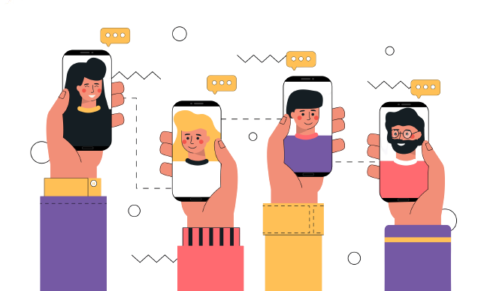
Introduction
FriendLink is a dynamic platform for interactive video chats among friends and social groups. With group and one-to-one video chat options, users enjoy seamless connectivity without boundaries. Personalized virtual rooms with random names ensure quick connections, promoting convenience and spontaneity. The screen sharing feature enhances collaboration, facilitating seamless content sharing and joint activities. A playful chatting bot adds vibrancy, sparking lively conversations. Friendlink fosters genuine connections and enriches social interactions, creating an enjoyable video chat experience for all.

Slide 4

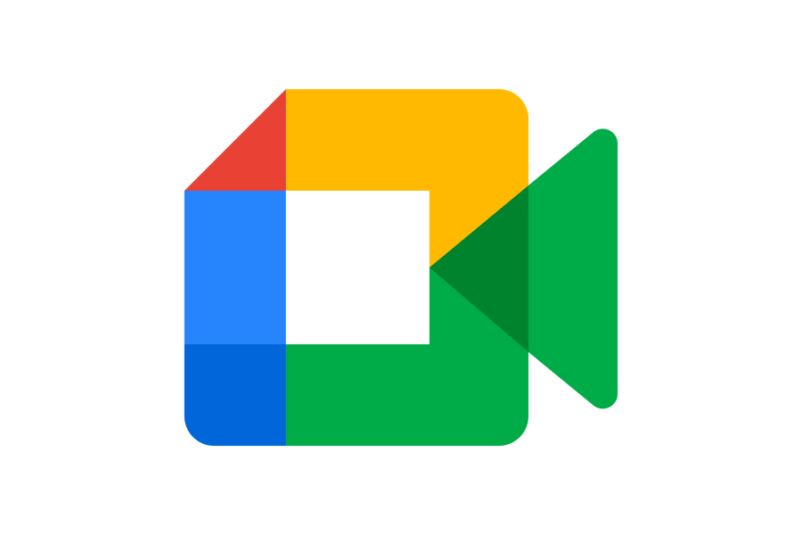

Existing
Method
WhatsApp
Google Meet
Zoom
They typically requries user authentication or registreation

Slide 5
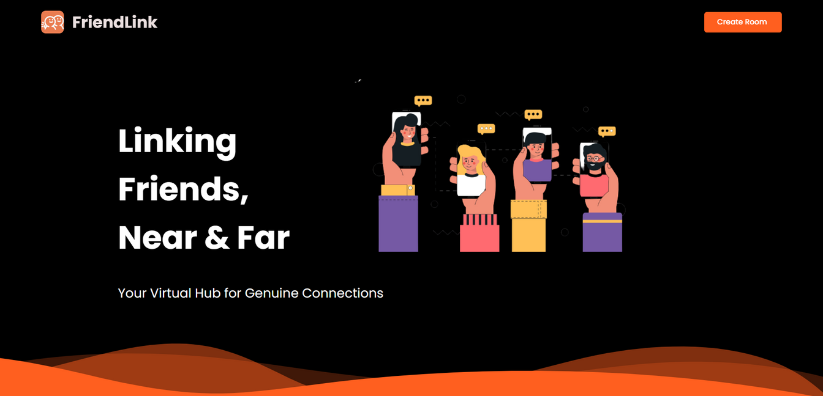
Proposed System
User-friendly approach
Both one-on-one conversations and group interactions
Screen sharing
An interactive chatting bot

Slide 6

Methodology
Requirement analysis
UI/UX Design
Development and Implementation of WebRTC
Adding functionalities 1)Screen Sharing 2)Chat Bot
Additional improvements
Continuous improvement depending upon feedback

Slide 7

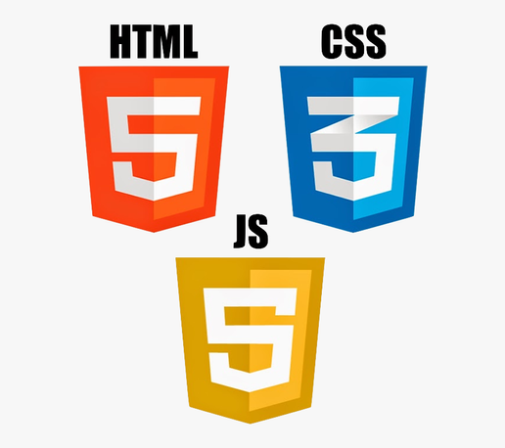
Tech Stack used
HTML
CSS
Javascript

Slide 8
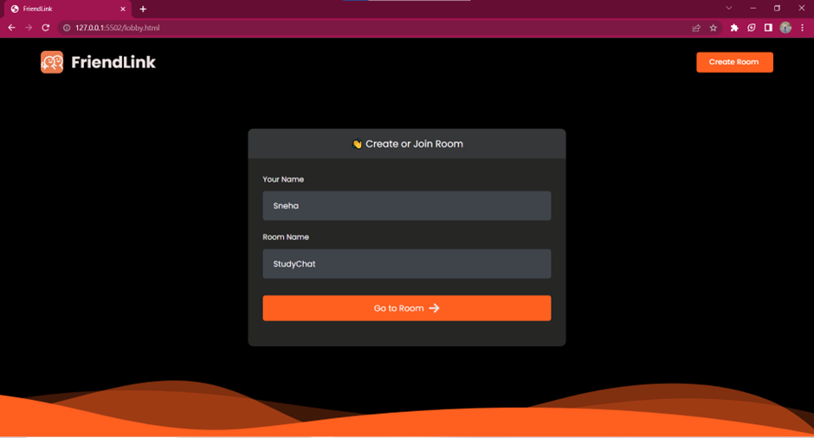
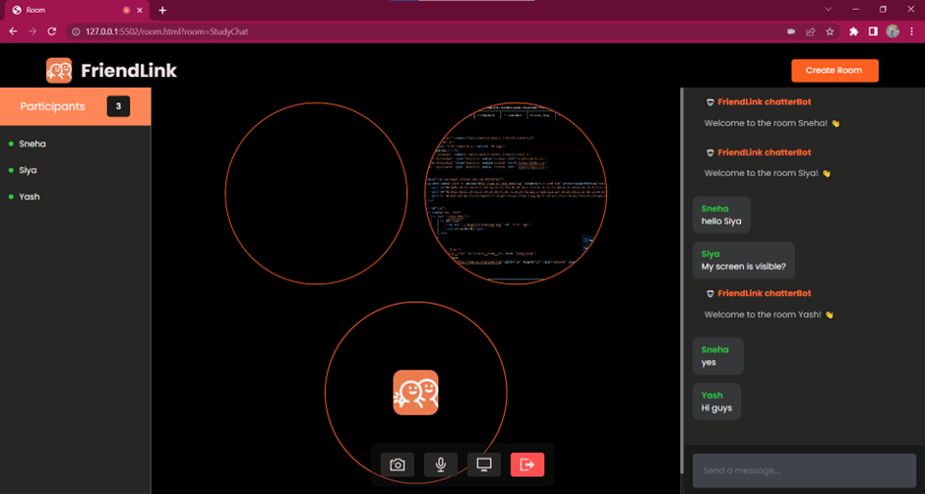
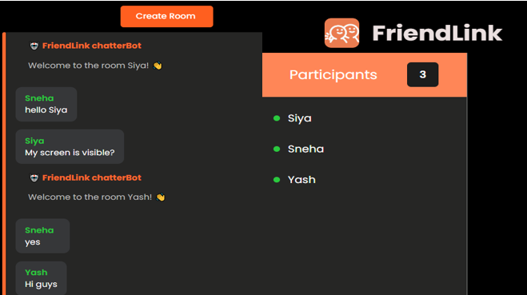
Implementation
Implementation Video

Slide 9
Conclusion
The development of FriendLink is a user-friendly video chat platform, throughout the development process, special attention was given to the platform's interface and design, ensuring that it remains accessible and enjoyable across different devices. The integration of cutting-edge technologies, such as WebRTC, allowed for high-quality video and voice communication, promoting fluid interactions among users during one-on-one or group chats. Additionally, the implementation of screen sharing and an interactive chatting bot enriched the communication experience, enhancing collaboration.

Slide 10

Thank You!

