Slide 1
MACHINE LEARNING MINI PROJECT
Customer Segmentation
Using K-Means Clustering
PRESENTED BY
Sneha Verma
B.Tech • Machine Learning

Slide 2
01 • OVERVIEW
Introduction
Customer segmentation
K = 5
is the process of dividing customers into groups based on shared characteristics and purchasing behavior.
OPTIMAL CLUSTERS
In this project we apply the K-Means Clustering algorithm to analyze customer data using Annual Income and Spending Score — enabling businesses to design personalized marketing strategies.
Unsupervised Learning
Mall Customers Dataset
Income • Spending Score
Customer Segmentation Using K-Means Clustering | Sneha Verma
2 / 15

Slide 3
02 • WHY THIS MATTERS
Problem Statement
Businesses face customers with diverse income levels and spending habits. Treating every customer the same reduces marketing effectiveness and revenue.
1
2
3
Identify
Analyze
Act
Discover distinct customer groups hidden in raw data.
Understand purchasing patterns and behavioral signals.
Enable targeted marketing and smarter business decisions.
Customer Segmentation Using K-Means Clustering | Sneha Verma
3 / 15

Slide 4
03 • GOALS
Project Objectives
01
Understand customer purchasing behavior
02
Apply the K-Means clustering algorithm
03
Determine optimal K using the Elbow Method
04
Group customers with similar traits
05
Visualize customer segments clearly
06
Generate insights for personalized marketing
Customer Segmentation Using K-Means Clustering | Sneha Verma
4 / 15

Slide 5
04 • TECH STACK
Technologies Used
Technology | Purpose
Python | Core programming language for implementation
Google Colab | Cloud-based development environment
Pandas | Data loading and manipulation
NumPy | Numerical computations
Matplotlib | Data visualization and plotting
Scikit-learn | Machine learning library implementing K-Means
K-Means Clustering | Unsupervised algorithm for grouping customers
Customer Segmentation Using K-Means Clustering | Sneha Verma
5 / 15

Slide 6
05 • MALL CUSTOMERS DATASET
Dataset Overview
Available Features
USED FOR CLUSTERING
CustomerID
Annual Income (k$)
Gender
Earning capacity of each customer
Age
Spending Score (1–100)
Annual Income (k$)
Customer engagement and purchase behavior
Spending Score (1–100)
These two features clearly capture customer purchasing behavior.
Customer Segmentation Using K-Means Clustering | Sneha Verma
6 / 15

Slide 7
06 • METHODOLOGY
Project Workflow
01
02
03
04
05
Import Libraries
Load Dataset
Explore Data
Select Features
Apply Elbow Method
10
09
08
07
06
Business Insights
Visualize Segments
Assign Clusters
Train K-Means
Choose K = 5
Customer Segmentation Using K-Means Clustering | Sneha Verma
7 / 15

Slide 8
07 • ALGORITHM
K-Means Clustering
An unsupervised algorithm that groups similar data points into K clusters by iteratively refining centroid positions.
HOW IT WORKS
WHY K-MEANS?
1
Choose number of clusters K
Fast and computationally efficient
2
Initialize K centroids randomly
Simple to implement and interpret
3
Assign each point to nearest centroid
Produces clearly separated groups
4
Recompute centroid positions
Scales well to larger datasets
5
Repeat until centroids stabilize
Customer Segmentation Using K-Means Clustering | Sneha Verma
8 / 15

Slide 9
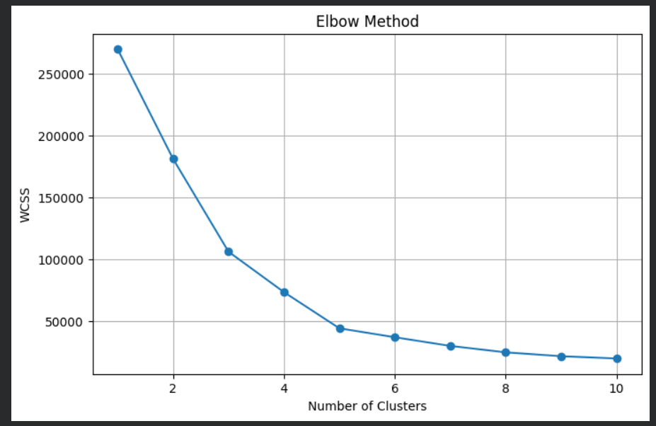
08 • CHOOSING K
Elbow Method
The Elbow Method plots WCSS (Within-Cluster Sum of Squares) against different values of K. The "elbow" — where the curve bends — marks the optimal number of clusters.
Selected K = 5
WCSS
The elbow point indicates five clusters as optimal.
Elbow (K=5)
As K increases, WCSS decreases — but after the elbow, gains become negligible.
Number of Clusters (K)
Insert Elbow Method Output Here
Customer Segmentation Using K-Means Clustering | Sneha Verma
9 / 15

Slide 10
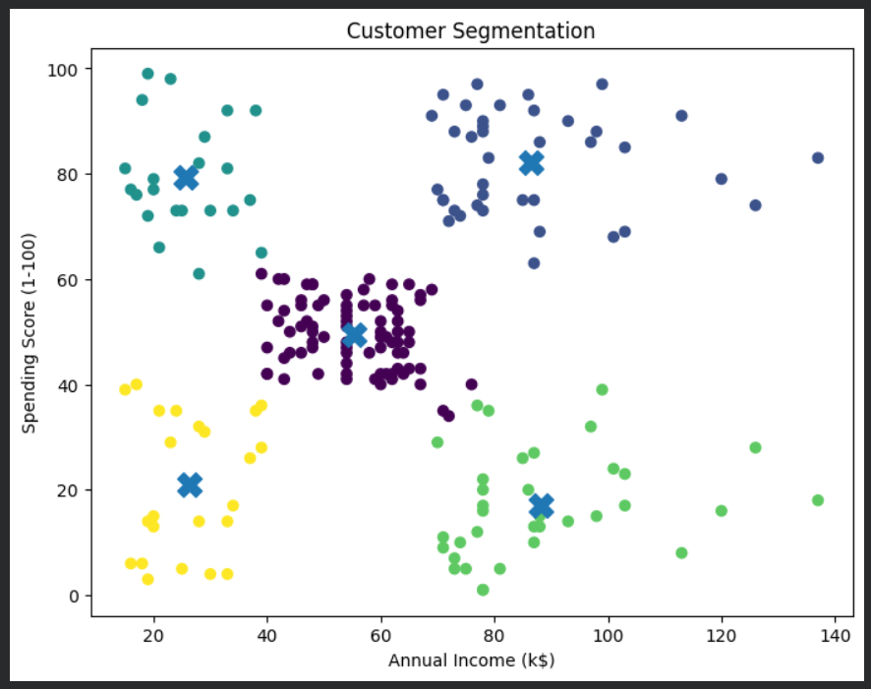
09 • SEGMENTATION RESULT
Cluster Visualization
The trained K-Means model groups customers into five distinct clusters based on Annual Income and Spending Score.
✕
✕
Cluster 1
Cluster 2
Spending Score
✕
Cluster 3
Cluster 4
✕
✕
Cluster 5
✕ Cluster centroids
Annual Income (k$)
Insert Cluster Visualization Here
Customer Segmentation Using K-Means Clustering | Sneha Verma
10 / 15

Slide 11
10 • FINDINGS
Results & Business Insights
CUSTOMER SEGMENTS
BUSINESS BENEFITS
High Income
High Income
✓
Targeted marketing campaigns
High Spending
Low Spending
✓
Personalized recommendations
Low Income
Low Income
✓
Customer retention strategies
High Spending
Low Spending
✓
Loyalty program planning
Moderate
Balanced
✓
Improved sales & revenue
Customer Segmentation Using K-Means Clustering | Sneha Verma
11 / 15

Slide 12
11 • STRENGTHS
Advantages
Simple
Efficient
Insightful
Easy to understand and implement
Fast even on large customer datasets
Reveals hidden patterns in raw data
Effective
Data-Driven
Scalable
Improves marketing precision and ROI
Supports informed business decisions
Adapts to growing customer bases
Customer Segmentation Using K-Means Clustering | Sneha Verma
12 / 15

Slide 13
12 • LOOKING AHEAD
Limitations & Future Scope
LIMITATIONS
FUTURE SCOPE
!
Requires choosing K in advance
→
Compare with DBSCAN or Hierarchical Clustering
Sensitive to outliers
→
Use additional customer features (age, gender)
!
→
Evaluate using Silhouette Score
!
Depends on centroid initialization
→
Deploy as a web application
!
Works best with numerical data
→
Build interactive Streamlit / Power BI dashboards
Customer Segmentation Using K-Means Clustering | Sneha Verma
13 / 15

Slide 14
13 • FINAL THOUGHTS
Conclusion
"
This project demonstrates how K-Means Clustering can effectively segment customers based on their spending behavior and annual income.
By identifying meaningful customer groups, businesses can design personalized marketing strategies, improve customer satisfaction, and make data-driven decisions — showcasing the practical power of unsupervised machine learning in solving real-world business problems.
Customer Segmentation Using K-Means Clustering | Sneha Verma
14 / 15

Slide 15
Thank You
For Your Attention & Time
PRESENTED BY
Sneha Verma
Customer Segmentation Using K-Means Clustering

