Slide 1




INTERNSHIP PROJECT · DATA ANALYTICS
Heart Disease Risk Analysis
using Exploratory Data Analysis
A Clinical Data Exploration Project on the UCI Heart Disease Dataset
Presented by: Sneha Verma
Domain: Healthcare Analytics
Tool: Python · Pandas · Seaborn · Numpy · Matplotlib
Internship Evaluation Presentation
Notes:
Good [morning/afternoon], everyone. Thank you for the opportunity to present my internship project: Heart Disease Risk Analysis using Exploratory Data Analysis. Over the course of this internship, I worked with the UCI Heart Disease dataset to understand how data analysis techniques can support early detection and risk assessment in cardiovascular health. In this presentation, I'll walk you through the problem statement, the dataset, the cleaning and preprocessing steps I performed, the exploratory analysis I conducted, the key insights I observed, and the future scope for extending this work into predictive modeling. My goal throughout this project was to apply a structured, methodical EDA process — the same process a data analyst would follow in a real healthcare analytics role. Let's begin with the problem statement and why this kind of analysis matters.

Slide 2

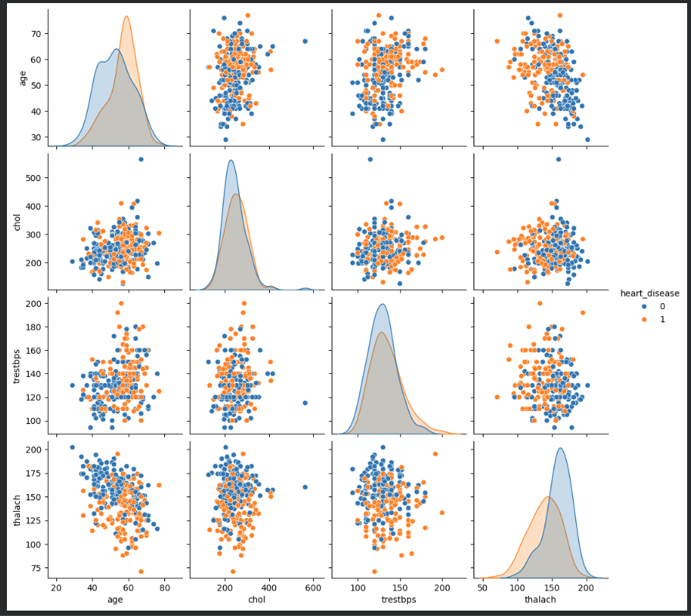




PROBLEM STATEMENT
Why Heart Disease Analysis Matters
What is Heart Disease?
A group of cardiovascular conditions affecting the heart's structure and function, including coronary artery disease, arrhythmias, and related disorders.
Why Early Analysis Matters
Cardiovascular disease often develops silently. Identifying patterns in clinical data early can support timely intervention before symptoms become severe.
How Data Analysis Helps
[ Insert Medical / Healthcare
Illustration Here ]
Structured analysis of patient data reveals relationships between clinical indicators, helping healthcare professionals prioritize risk factors worth monitoring.
Suggested: doctor reviewing patient vitals, ECG strip, or heart anatomy graphic
Business & Healthcare Significance
Data-driven risk profiling reduces diagnostic delays, supports preventive care strategies, and lays the groundwork for predictive clinical decision tools.
Cardiovascular disease remains a leading global health concern
Heart Disease Risk Analysis | EDA Internship Project
02
Notes:
Heart disease refers to a range of cardiovascular conditions that affect how the heart functions, and it remains one of the most significant health concerns worldwide. What makes it particularly dangerous is that risk often builds silently — many clinical indicators shift gradually before any noticeable symptoms appear. This is exactly where data analysis becomes valuable: by examining patient records systematically, we can uncover patterns and relationships between variables like cholesterol, blood pressure, and heart rate that might not be obvious through manual review alone. From a healthcare and business perspective, this kind of early, data-driven insight supports preventive care, reduces diagnostic delays, and lays important groundwork for predictive tools that clinicians can eventually use for decision support.

Slide 3




PROJECT OBJECTIVES
What This Project Aims to Achieve
01
02
03
04
Understand Patient Characteristics
Explore Variable Relationships
Identify Trends & Risk Indicators
Prepare Clean Data for ML
Examine demographic and clinical attributes to build a clear picture of the patient population represented in the dataset.
Investigate how features such as age, cholesterol, and heart rate relate to one another and to heart disease presence.
Surface patterns across the data that may point to clinically meaningful risk indicators worth deeper investigation.
Establish a clean, well-understood dataset that is ready to support future predictive modeling work.
Heart Disease Risk Analysis | EDA Internship Project
03
Notes:
This project is guided by four core objectives. First, I wanted to understand the patient population itself — who is represented in this dataset in terms of age, sex, and key clinical readings. Second, I aimed to explore relationships between variables, since heart disease risk is rarely driven by a single factor in isolation. Third, the goal was to identify visible trends and potential risk indicators that stood out during exploration — without making unsupported claims. Finally, every step of cleaning and exploration was done with an eye toward preparing this dataset for future machine learning work, ensuring the data is well-understood and analysis-ready before any predictive modeling begins.

Slide 4

DATASET OVERVIEW
The UCI Heart Disease Dataset
A widely used, well-documented clinical dataset combining demographic and diagnostic attributes for cardiovascular research.
Feature | Description
Age | Patient age in years
Sex | Biological sex of patient
Chest Pain Type | Category of chest pain experienced
Resting Blood Pressure | Blood pressure at rest (mm Hg)
Cholesterol | Serum cholesterol level (mg/dl)
Fasting Blood Sugar | Blood sugar after fasting
Resting ECG | Electrocardiographic results
Max Heart Rate | Maximum heart rate achieved
Exercise-Induced Angina | Angina triggered by exercise
ST Depression | ST depression induced by exercise
Major Vessels (0–3) | Vessels colored by fluoroscopy
Thalassemia | Blood disorder indicator
Target | Presence of heart disease
~303
13
1
Patient Records
Clinical & Demographic Features
Target Variable (Diagnosis)
Sourced from the UCI Machine Learning Repository — a trusted standard for cardiovascular ML research.
Heart Disease Risk Analysis | EDA Internship Project
04
Notes:
For this project, I used the UCI Heart Disease dataset, which contains approximately 303 patient records with thirteen clinical and demographic attributes plus a target variable indicating the presence of heart disease. The features span a mix of demographic information like age and sex, and clinical measurements such as resting blood pressure, cholesterol, fasting blood sugar, resting ECG results, maximum heart rate achieved, exercise-induced angina, ST depression, the number of major vessels visible on fluoroscopy, and thalassemia results. This dataset is widely used in cardiovascular machine learning research, which made it a reliable and well-documented foundation for this exploratory analysis.

Slide 5






DATA COLLECTION & UNDERSTANDING
Selecting and Understanding the Data
Why the UCI Dataset Was Selected
It is a peer-referenced, clinically grounded dataset frequently used in healthcare analytics and machine learning research, making it reliable for academic and internship work.
Data Source
UCI Repository
Importance of Metadata
Understanding what each column represents — units, value ranges, and encoding — is essential before any cleaning or analysis can begin safely.
Data Inspection
Feature Descriptions
Structure & types
Each clinical attribute was reviewed individually to understand its medical meaning and its likely relevance to cardiovascular risk.
Real-World Healthcare Relevance
These are the same categories of measurements clinicians routinely collect, which grounds the analysis in practical, real-world relevance.
Data Understanding
Meaning & context
Heart Disease Risk Analysis | EDA Internship Project
05
Notes:
Before any analysis began, it was important to understand exactly what this dataset contained. I selected the UCI Heart Disease dataset because it's a well-documented, widely cited resource in cardiovascular research, which makes it a credible foundation for this kind of project. The process followed a simple three-stage flow: starting with the data source itself, moving into structural inspection — checking column types, formats, and value ranges — and finally building a deeper understanding of what each feature actually represents clinically. This step matters because you can't clean or analyze data responsibly without first understanding what each variable means and how it connects to real-world patient care.

Slide 6





DATA CLEANING & PREPROCESSING
Preparing the Data for Analysis
1
2
3
Assign Column Names
Detect Missing Values
Replace '?' with NaN
Mapped raw dataset columns to clear, descriptive feature names for readability.
Scanned every column to identify gaps or inconsistent entries before proceeding.
Converted non-standard missing-value markers into a consistent, recognized null format.
4
5
6
Convert Data Types
Remove Incomplete Records
Create Binary Target
Ensured numeric fields were stored as numbers and categorical fields were correctly typed.
Dropped rows with unresolvable missing data to preserve analysis integrity.
Engineered a clean heart_disease (0/1) variable from the original multi-class target.
Heart Disease Risk Analysis | EDA Internship Project
06
Notes:
Before exploring the data, I carried out a structured cleaning and preprocessing workflow. This began with assigning clear, descriptive column names, since the raw dataset uses abbreviated headers. Next, I scanned for missing values across every column and found that some entries used a question mark to represent missing data, which I converted into a standard NaN format that Python recognizes. I then verified that each column had the correct data type — numeric fields as numbers, categorical fields as categories. Rows with unresolvable missing values were removed to preserve data integrity. Finally, I engineered a clean binary target variable, heart disease present or not, from the original multi-class diagnosis column, which simplified later analysis considerably.

Slide 7





EDA METHODOLOGY
Our Exploratory Data Analysis Approach
Univariate Analysis
Bivariate Analysis
Distribution Analysis
Examining each variable individually to understand its distribution and range.
Studying relationships between pairs of variables, including against the target.
Visualizing how values are spread across the patient population.
Outlier Detection
Correlation Analysis
Comparative Analysis
Identifying unusual values that may indicate data issues or genuine extremes.
Measuring the strength of relationships between numeric clinical features.
Comparing feature patterns across groups, such as by sex or diagnosis.
Heart Disease Risk Analysis | EDA Internship Project
07
Notes:
My exploratory data analysis followed six complementary techniques. I began with univariate analysis, examining each variable on its own to understand its distribution. From there, I moved to bivariate analysis, looking at how pairs of variables relate to each other and to the target outcome. Distribution analysis helped visualize how values like age or cholesterol spread across the patient population, while outlier detection flagged unusual values that needed closer attention. Correlation analysis measured the strength of relationships between numeric features, and comparative analysis let me examine how patterns differ across groups, such as between male and female patients. Together, these six techniques formed a comprehensive exploratory framework.

Slide 8
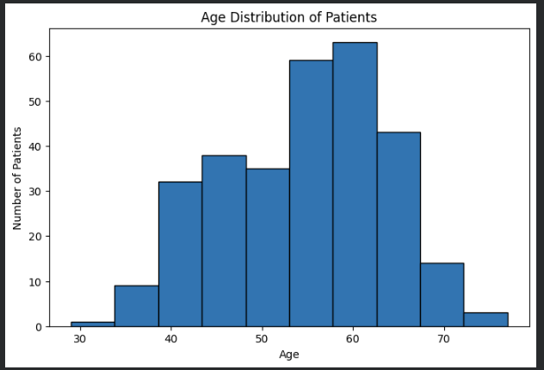
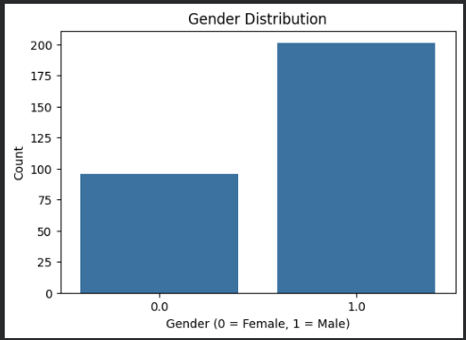


AGE & GENDER ANALYSIS
Demographic Patterns in the Dataset
[ Insert Age Distribution Histogram Here ]
[ Insert Gender Distribution Chart Here ]
Shows spread of patient ages
Shows male vs. female proportion
Why Age Matters
Gender Differences
Interpretation Methodology
Age is a well-established factor in cardiovascular risk profiles and a natural starting point for exploration.
Reviewing the male-to-female split helps contextualize whether observed patterns are consistent or vary by sex.
Histograms and count plots are read for shape, spread, and central tendency — not used to draw causal conclusions.
Heart Disease Risk Analysis | EDA Internship Project
08
Notes:
This slide focuses on two foundational demographic variables: age and gender. The age distribution histogram, once inserted, would show how patient ages are spread across the dataset, while the gender distribution chart shows the proportion of male versus female patients. Age is widely recognized as an important factor in cardiovascular risk, which makes it a natural starting point for exploration. Looking at gender differences helps contextualize whether any patterns we observe later are consistent across both groups or vary meaningfully by sex. It's important to note that at this stage we are only describing the shape and spread of these distributions — we are not yet drawing conclusions about cause and effect.

Slide 9
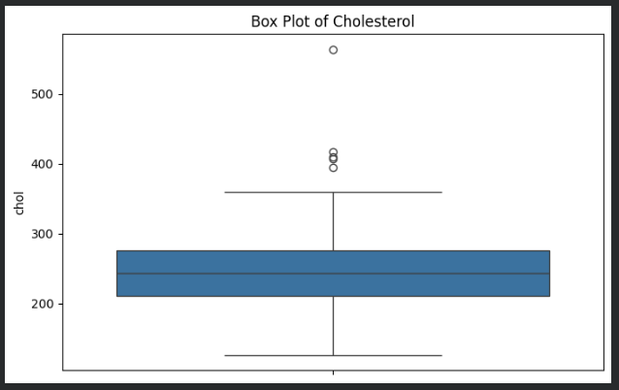
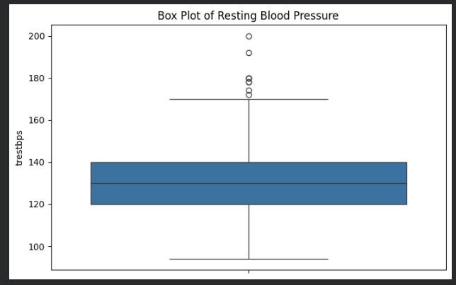


CHOLESTEROL & BLOOD PRESSURE ANALYSIS
Examining Two Key Clinical Markers
[ Insert Cholesterol Box Plot Here ]
[ Insert Blood Pressure Visualization Here ]
Highlights spread and potential outliers
Resting blood pressure distribution
Medical Significance
Outlier Interpretation
How EDA Helps
Cholesterol and blood pressure are two of the most clinically monitored cardiovascular risk markers.
Extreme values are reviewed carefully — they may reflect real clinical cases rather than data errors.
Box plots reveal spread and skew at a glance, helping flag ranges that warrant clinical attention.
Heart Disease Risk Analysis | EDA Internship Project
09
Notes:
Cholesterol and resting blood pressure are two of the most closely watched clinical markers in cardiovascular health, which is why they receive dedicated attention in this analysis. The cholesterol box plot, once inserted, would show the spread of values along with any outliers, while the blood pressure visualization shows a similar view for resting blood pressure readings. When outliers appear in box plots, I treat them carefully — extremely high cholesterol or blood pressure readings could reflect genuine high-risk patients rather than data entry errors, so they aren't simply discarded. This is exactly where exploratory data analysis earns its value: box plots make it easy to see spread, skew, and unusual values at a glance, helping highlight ranges that may deserve closer clinical attention.

Slide 10
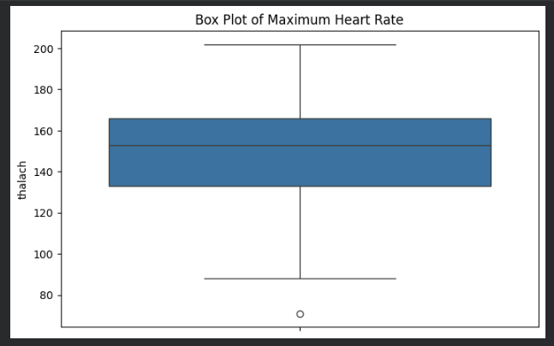
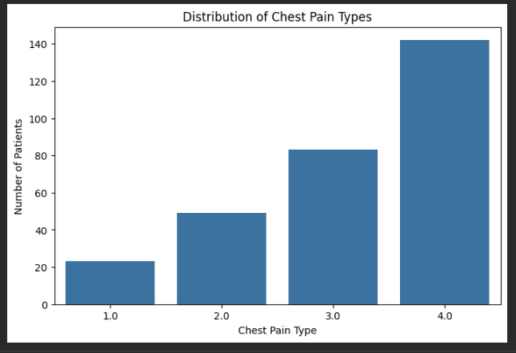

HEART RATE & CHEST PAIN ANALYSIS
Functional and Symptomatic Indicators
[ Insert Heart Rate Box Plot Here ]
[ Insert Chest Pain Count Plot Here ]
Maximum heart rate achieved
Distribution across chest pain types
Clinical Importance
Why These Variables Matter
Supporting Exploratory Insight
Maximum heart rate during exertion and chest pain type are both routinely used in cardiac risk assessment.
Both reflect how the heart responds under stress, offering functional insight beyond static measurements.
Comparing these distributions across diagnosis groups helps surface patterns worth deeper statistical testing.
Heart Disease Risk Analysis | EDA Internship Project
10
Notes:
This slide looks at two more clinically significant variables: maximum heart rate achieved during exercise testing, and chest pain type. The heart rate box plot would show how this functional measurement is distributed across patients, while the chest pain count plot shows how many patients fall into each chest pain category. Both variables are clinically important because they reflect how the heart performs under stress, which often reveals more than a single resting measurement could. By comparing these distributions across diagnosis groups — patients with and without heart disease — exploratory analysis can surface patterns that may be worth validating with more formal statistical testing later on.

Slide 11
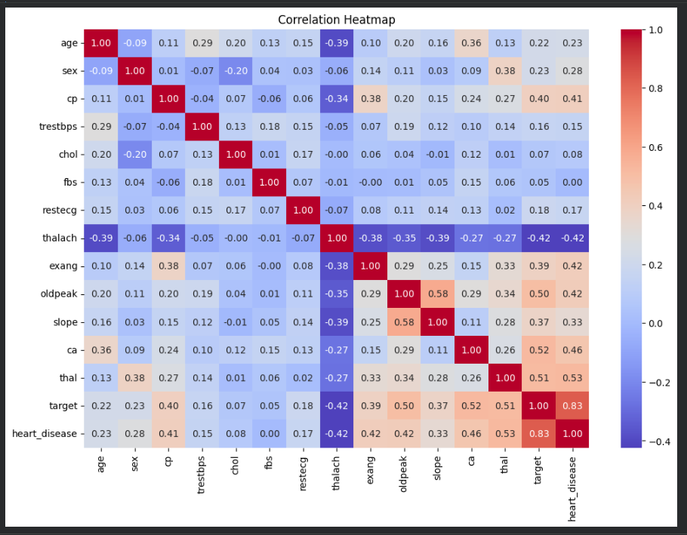
CORRELATION ANALYSIS
Correlation Heatmap
Correlation Coefficients
Each cell shows how strongly two variables move together, on a scale from -1 to +1.
Positive vs. Negative Relationships
Positive values indicate variables that rise together; negative values indicate inverse relationships.
[ Insert Correlation Heatmap Here ]
Correlation ≠ Causation
Pairwise correlation across numeric clinical features
A strong correlation shows association, not proof that one variable causes the other.
Why Heatmaps Help
They make it easy to scan dozens of relationships at once and flag which features deserve deeper review.
Heart Disease Risk Analysis | EDA Internship Project
11
Notes:
The correlation heatmap is one of the most information-dense visuals in this analysis. Each cell represents the correlation coefficient between two numeric variables, ranging from negative one to positive one. Positive values mean two variables tend to increase together, while negative values mean one tends to decrease as the other increases. It's important to stress that correlation does not imply causation — a strong relationship between two clinical features tells us they're associated, not that one is causing the other. What makes heatmaps so useful in exploratory analysis is that they let us scan many pairwise relationships at once, quickly flagging which feature pairs deserve a closer, more rigorous look.

Slide 12



KEY INSIGHTS
What the Exploratory Analysis Suggests
Age as a Contributing Factor
Chest Pain Type is Informative
Age appears to be an important factor worth analyzing in relation to heart disease risk.
Chest pain type provides meaningful information that may help differentiate patient groups.
Features Should be Read Together
EDA Precedes Prediction
Multiple clinical features should be interpreted together rather than in isolation.
Exploratory analysis helps identify patterns before any predictive modeling is attempted.
Heart Disease Risk Analysis | EDA Internship Project
12
Notes:
Based on this exploratory analysis, a few general observations stand out, and I want to be careful to present these as patterns worth further investigation, not as confirmed statistical findings. Age appears to be an important factor worth analyzing further in relation to heart disease risk. Chest pain type seems to provide meaningful information that may help distinguish between patient groups. More broadly, it's clear that multiple clinical features need to be interpreted together rather than in isolation, since heart disease risk is multifactorial. Most importantly, this stage reinforces why exploratory data analysis matters: it helps identify patterns and relationships before any predictive modeling is attempted, ensuring later modeling work is built on a solid understanding of the data.

Slide 13


CHALLENGES FACED
Obstacles Encountered During the Project
Missing Values
Data Preprocessing
Feature Interpretation
Outlier Handling
Domain Understanding
Some records contained missing or non-standard entries that required careful handling before analysis.
Aligning column names, types, and formats took deliberate, methodical effort across the full dataset.
Several clinical codes required research to correctly understand their medical meaning.
Deciding whether extreme values were genuine clinical cases or data errors required careful judgment.
Interpreting results responsibly required building a working knowledge of cardiovascular clinical context.
Heart Disease Risk Analysis | EDA Internship Project
13
Notes:
No analysis project is without its challenges, and I think it's valuable to be transparent about what came up during this work. Missing values were the first hurdle — some records used non-standard placeholders that needed to be identified and handled carefully. Data preprocessing itself required deliberate, methodical effort to align column names, types, and formats consistently. Several clinical codes, like thalassemia categories or chest pain types, required additional research to interpret correctly. Outlier handling also demanded judgment calls — deciding whether an extreme cholesterol or blood pressure reading was a genuine clinical case or a data quality issue. Across all of this, building a working understanding of the clinical domain was essential to interpreting the data responsibly.

Slide 14




FUTURE SCOPE
Extending This Work Toward Prediction
Logistic Regression
Random Forest
XGBoost
Model Evaluation
A natural first model for binary heart disease classification.
An ensemble approach to capture non-linear feature interactions.
A high-performance gradient boosting model for tabular clinical data.
Assessing accuracy, precision, recall, and AUC for clinical reliability.
Feature Engineering
Hyperparameter Tuning
Clinical Decision Support
Creating new derived features to strengthen predictive signal.
Optimizing model parameters for the best generalizable performance.
Packaging insights into tools that could assist real clinical workflows.
Heart Disease Risk Analysis | EDA Internship Project
14
Notes:
Having completed a thorough exploratory analysis, the natural next step is predictive modeling, and there are several promising directions to pursue. Logistic regression offers a natural, interpretable starting point for binary classification of heart disease presence. Random forest and XGBoost are ensemble methods that can capture more complex, non-linear relationships between clinical features. Any model built would need rigorous evaluation using metrics like accuracy, precision, recall, and AUC, since clinical reliability matters more than raw accuracy alone. Feature engineering and hyperparameter tuning would further strengthen model performance. Ultimately, the long-term vision is to package these insights into a clinical decision support tool that could meaningfully assist healthcare professionals in practice.

Slide 15

CONCLUSION
Bringing the EDA Process Together
This project walked through a complete EDA process — from raw clinical data to cleaned, well-understood patient records.
Exploratory analysis surfaced meaningful patterns across age, chest pain type, cholesterol, and heart rate without overstating conclusions.
Thank You
These findings prepare the dataset for the next stage: predictive modeling and clinical decision support.
.
Heart Disease Risk Analysis | EDA Internship Project
15
Notes:
To bring this presentation together: this project walked through a complete exploratory data analysis process, starting from raw clinical data and ending with a clean, well-understood dataset. Along the way, the analysis surfaced meaningful patterns across variables like age, chest pain type, cholesterol, and maximum heart rate, while being careful not to overstate conclusions beyond what the data actually supports. Most importantly, this exploratory work lays the foundation for the next phase of the project — predictive modeling and, eventually, tools that could support clinical decision-making. Thank you for your time and attention throughout this presentation. I'd now like to open the floor for any questions you may have.

