Slide 1

COMPILER FOR PROGRAMMING LANGUAGE- ORANGE
TEAM – 23
ABHISHEK NAGARAJ
DEEPAK PARAMESHWARAN
SNEHA VIDHYASHEKAR
Under The Guidance Of
Professor Ajay Bansal

Slide 2

TOOLS USED
SCANNER
FLEX
PARSER
BISON
RUNTIME
JAVA

Slide 3
COMPILER – DESIGN FLOW
SOURCE CODE
SCANNER (FLEX)
PARSER (BISON)
OUTPUT
RUNTIME (JAVA)
INTERMEDIATE CODE

Slide 4
OPERATORS | DESCRIPTION
“+” | Addition
“-” | Subtraction
“*” | Multiplication
“/” | Division
“AND” | AND
“OR” | OR
“NOT” | NOT
“->” | Assignment operator
“~” | delimiter
“->->” | Comparison operator
“!->” | Not Equal to
“->>” | Greater than equal to
“-><“ | Leasser than equal to
“>” | Greater than
“<” | Lesser than
“YES” | True
“NO” | False
“LP“ | Left parentheses
“RP” | Right parentheses
“{“ | Block begin
“}” | Block end

Slide 5
KEYWORDS
num | Number(int/float)
read | Input
write | output
nl | New line
is | if
isnot | else
loop | While loop

Slide 6

STEPS TO RUN “ORANGE” PROGRAMMING LANGUAGE
Command 1
bison –dy ORJ.y
To generate the parser which generates y.tab.c and y.tab.h files
Command 2
flex ORJ.l
This is the scanner which in turn generates lex.yy.c
Command 3
gcc –o xyz.orj lex.yy.c y.tab.c -lm
This generates xyz.orj file which helps to generate an intermediate code for the program
Command 4
xyz.orj test.orj
To generate an intermediate code by making use of xyz.orj file which has an extension “.int”
Command 5
javac Runtime.java
To run the java file which generates a class file to execute the program.
Command 6
java Runtime test.orj.int
To run/execute the program(Intermediate code) in the java environment and give the output.

Slide 7
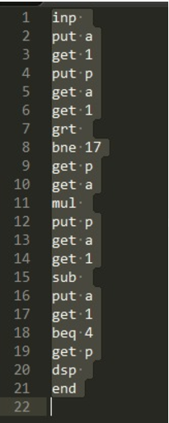
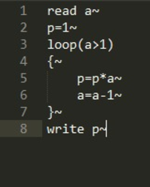
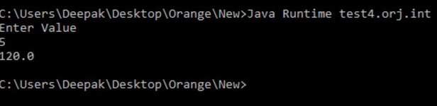
SOURCE INTERMEDIATE OUTPUT CODE CODE

