Slide 1
HIGH PERFORMANCE COMPUTING
Parallel PCA-Based Network-Wide Traffic Anomaly Detection Using OpenMP
Motif: Dense Linear Algebra • C++ with OpenMP
Team members: [Name 1] • [Name 2] • [Name 3] | Guide: [Faculty name]
Notes:
Introduce the project: PCA-based traffic anomaly detection (SPE residual scoring) with the dense-matrix kernels parallelised in OpenMP. Emphasise this talk is about the implementation and measured scaling.

Slide 2
Project Overview & Objectives
Input: traffic matrix with t time rows × m link columns (benchmark: t = 32768, m = 1024)
PCA splits traffic into normal and residual parts; the squared prediction error (SPE) per time row is compared to a threshold (delta2)
Output: per-row SPE scores, anomaly flags and an alarm count
An injection study runs many independent PCA fits to evaluate detection
Objective: measure how effectively OpenMP accelerates each kernel and the whole pipeline, and identify what limits scaling.
2
Notes:
The detector learns the normal correlation structure of traffic and flags time rows whose residual (SPE) exceeds a threshold. A high SPE means unusual, not automatically an attack. The HPC question is how well OpenMP accelerates this pipeline.

Slide 3
System Architecture / Workflow
Stage order inferred from function roles; eigen code not provided
column_means
center_columns
covariance
Eigen (serial)
mean per link
subtract mean
tiled C = YcᵀYc/(t−1)
22% of runtime*
project
max_sigma_deviation
spe_scores
apply_threshold
U = Yc·V
mean/std stats
residual per row
flags + alarm count
Outer level: run_injection_study runs independent full PCA fits in parallel (one level of parallelism)
* serial eigen fraction as drawn in the Amdahl line of the speedup chart
3
Notes:
Walk left to right through the kernels in namespace pca::omp. The order is inferred from the function roles; the eigen-decomposition and rank-selection code was not part of the provided files, but the Amdahl line in the performance chart treats eigen as serial at 22%. The injection study wraps whole PCA fits in an outer parallel loop.

Slide 4
Implementation Overview: Kernels, Constructs, Synchronisation
Function | Parallel dimension | Schedule | Synchronisation
column_means | columns j | static | none (one writer per mean(j))
center_columns | columns j | static | none
covariance | upper tiles k, then columns j | dynamic,1 / static | implicit barrier between loops
project | row blocks b | static | none
max_sigma_deviation | rows k, per column | static | reduction(+), reduction(max)
spe_scores | row blocks b | static | private per-thread buffers
apply_threshold | rows k | static | reduction(+ : count)
run_injection_study | experiments i | dynamic,1 | critical(injection_error)
4
Notes:
This table is the heart of the parallel design. Point out that almost everything is a worksharing loop over independent outputs. Reductions appear only for scalar results. The only critical section is for exception capture in the injection study.

Slide 5
Parallelisation Strategy & Sequential vs Parallel
Strategy (owner-computes)
Aspect | Sequential | OpenMP
Arithmetic | kernels_inl.hpp | same kernels
Execution | one thread | parallel for / region
Results | baseline | bitwise-identical*
Eigen step | serial | serial (22%)
Parallelise over independent outputs: columns, covariance tiles, row blocks
Per-element arithmetic is shared with the sequential code (kernels_inl.hpp)
Result: no locks, no atomics, no false sharing on accumulators
Reductions only for scalar results (alarm count, deviation statistics)
* except max_sigma_deviation: reduction(+) changes summation order, so mean/std may differ in the last bits. Tests check that the chosen r agrees.
5
Notes:
Key design rule from the source: parallelise over independent outputs, so each output element is computed by exactly one thread using the same arithmetic as the sequential kernels in kernels_inl.hpp. That gives no locks, no atomics, no false sharing on accumulators, and bitwise-identical results. The exception is reductions, which change summation order.

Slide 6
Code Deep Dive 1: column_means & center_columns
Code shown is from the project source; line breaks adjusted to fit the slide.
1
parallel for creates the team and splits the j loop over columns
Vector column_means(const Matrix& Y) {
const Index t = Y.rows(), m = Y.cols();
Vector mean(m);
#pragma omp parallel for schedule(static)
for (Index j = 0; j < m; ++j)
mean(j) = detail::column_sum(Y.col(j).data(), t)
/ static_cast<double>(t);
return mean;
}
void center_columns(Matrix& Y, const Vector& mean) {
const Index t = Y.rows(), m = Y.cols();
#pragma omp parallel for schedule(static)
for (Index j = 0; j < m; ++j)
detail::subtract_scalar(Y.col(j).data(), t, mean(j));
}
2
schedule(static): uniform work per column, lowest overhead
3
Contiguous column range per thread = contiguous memory
4
mean(j) and column j are each written by one thread only: no race
5
Same detail:: kernel as the sequential build
6
Notes:
Both loops go over columns j. Each column is independent, so there is no shared write. schedule(static) is used because work per column is uniform. The comment says each thread gets one contiguous range of columns, which is one contiguous region of memory.

Slide 7
Code Deep Dive 2: Tiled Covariance
Code shown is from the project source; line breaks adjusted to fit the slide.
1
One parallel region holds two worksharing loops (one team creation)
const Index m = Yc.cols();
Matrix C(m, m);
const std::vector<detail::Tile> tiles = detail::upper_tiles(m);
const Index n_tiles = static_cast<Index>(tiles.size());
const double scale = 1.0 / static_cast<double>(Yc.rows() - 1);
#pragma omp parallel
{
#pragma omp for schedule(dynamic, 1)
for (Index k = 0; k < n_tiles; ++k)
detail::covariance_tile(Yc, C,
tiles[static_cast<std::size_t>(k)]);
// implicit barrier: every tile is finished before mirroring
#pragma omp for schedule(static)
for (Index j = 0; j < m; ++j)
detail::finish_covariance_column(C, j, scale);
}
2
dynamic,1: unequal tile cost and P/E-core mix, so tiles go one at a time
3
Scheduling overhead per tile is negligible vs 64×64×t FMAs
4
Implicit barrier: all tiles done before mirroring
5
static loop finishes (mirrors/scales) each column
7
Notes:
This is the most important kernel. Upper-triangular tiles have unequal cost because diagonal tiles do half the work, and the CPU mixes P-cores and E-cores, so tiles are handed out one at a time with dynamic,1. With m = 1024 and 64×64 tiles there are 136 tiles (the source formula is (m/64)(m/64+1)/2). The implicit barrier at the end of the first omp for guarantees all tiles are finished before the mirroring step.

Slide 8
Code Deep Dive 3: project & spe_scores (Row Blocks)
Code shown is from the project source; line breaks adjusted to fit the slide.
1
Row blocks b are the parallel unit; blocks are independent
// project
const Index block = detail::rows_per_block(Yc.cols());
const Index n_blocks = (t + block - 1) / block;
#pragma omp parallel for schedule(static)
for (Index b = 0; b < n_blocks; ++b)
detail::project_rows(Yc, V, U, b * block,
std::min(t, (b + 1) * block));
// spe_scores
#pragma omp parallel
{
std::vector<double> z(static_cast<std::size_t>(
block * std::max<Index>(P.cols(), 1)));
std::vector<double> resid(static_cast<std::size_t>(block));
#pragma omp for schedule(static)
for (Index b = 0; b < n_blocks; ++b)
detail::spe_rows(Yc, P, spe.data(), state_norm2.data(),
b * block, std::min(t, (b + 1) * block),
z.data(), resid.data());
}
2
Block size comes from rows_per_block(Yc.cols())
3
z and resid declared inside the region = private per thread
4
Each block writes its own rows of spe and state_norm2
5
static: uniform work per block
8
Notes:
Time rows are processed in blocks. Every block is independent. In spe_scores the workspace vectors z and resid are declared inside the parallel region, so each thread has its own private buffers allocated once, with no sharing and no synchronisation.

Slide 9
Code Deep Dive 4: Reductions (max_sigma_deviation, apply_threshold)
Code shown is from the project source; line breaks adjusted to fit the slide.
1
Few columns (<= 8) but many rows: parallelise over rows k
// max_sigma_deviation (per column c)
double sum = 0.0;
#pragma omp parallel for schedule(static) reduction(+ : sum)
for (Index k = 0; k < t; ++k) sum += u[k];
const double mean = sum / static_cast<double>(t);
double ss = 0.0, max_dev = 0.0;
#pragma omp parallel for schedule(static) \
reduction(+ : ss) reduction(max : max_dev)
for (Index k = 0; k < t; ++k) {
const double d = u[k] - mean;
ss += d * d;
max_dev = std::max(max_dev, std::abs(d));
}
// apply_threshold
Index count = 0;
#pragma omp parallel for schedule(static) reduction(+ : count)
for (Index k = 0; k < t; ++k) {
const unsigned char f = spe(k) > delta2 ? 1 : 0;
flags[static_cast<std::size_t>(k)] = f;
count += f;
}
2
reduction(+ : sum/ss) and reduction(max : max_dev): private partials combined at the end
3
Floating-point reduction order differs from sequential
4
Integer reduction(+ : count) is exact
5
flags[k] has one writer, so no race
9
Notes:
These produce single scalars, so reductions replace shared accumulation. Each thread keeps a private partial and OpenMP combines them. The integer count in apply_threshold is exact, so the alarm count matches the sequential one. The floating-point sums in max_sigma_deviation change summation order, so last bits can differ; tests check the chosen r agrees. Note the pragma is split across two lines here only to fit.

Slide 10
Code Deep Dive 5: Injection Study (Coarse-Grained Parallelism)
Code shown is from the project source; line breaks adjusted to fit the slide.
1
Parallel unit: one complete PCA fit (~1 ms for 1008 × 60)
#pragma omp parallel for schedule(dynamic, 1)
for (Index i = 0; i < n; ++i) {
try {
outcomes[static_cast<std::size_t>(i)] =
run_one_injection(Y_clean, routing,
plan[static_cast<std::size_t>(i)], config);
} catch (...) {
// Exceptions must not cross the parallel-region boundary.
#pragma omp critical(injection_error)
if (!error) error = std::current_exception();
}
}
if (error) std::rethrow_exception(error);
2
dynamic,1 balances P-cores against E-cores
3
outcomes[i] has a single writer: no race
4
critical(injection_error) protects only the shared exception pointer
5
Inner kernels are sequential: one level of parallelism
10
Notes:
Here the parallel unit is a whole experiment. Each iteration is a complete PCA fit of about 1 ms for 1008×60, independent, writing only outcomes[i]. The inner kernels are the sequential ones, so there is exactly one level of parallelism and no nested parallel regions. The critical section only guards the exception pointer, so exceptions do not cross the parallel-region boundary.

Slide 11
Thread Execution & Work Distribution
Example: m = 1024, 4 threads
schedule(static): column_means, center_columns, project, spe_scores
schedule(dynamic, 1): covariance tiles, injection study
Thread 0
cols 0–255
Queue of 136 tiles (upper triangle, 64×64)
Thread 0 takes next free tile
Thread 1
cols 256–511
Thread 1 takes next free tile
Thread 2
cols 512–767
Thread 2 takes next free tile
Thread 3
cols 768–1023
Thread 3 takes next free tile
Static: lowest overhead, contiguous memory per thread, uniform work
Dynamic,1: balances unequal tile cost and fast P-cores vs slower E-cores
Implicit barrier after each worksharing loop that feeds the next step
11
Notes:
Left: schedule(static) without a chunk size divides iterations into one contiguous block per thread; with 4 threads and m = 1024 that is 256 columns each (illustrative thread count). Right: dynamic,1 puts the 136 covariance tiles in a queue and an idle thread takes the next one, so faster P-cores naturally take more tiles. Exact tile-to-thread mapping is decided at run time.

Slide 12
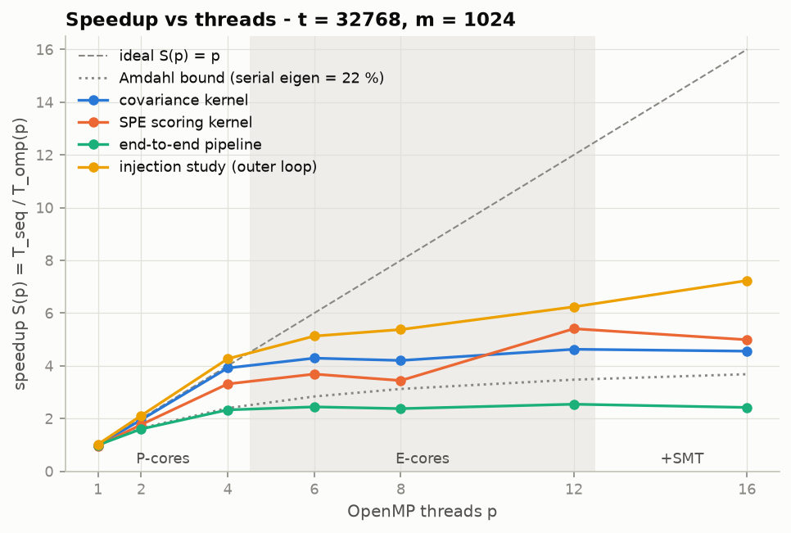
Performance Analysis: Speedup
t = 32768, m = 1024; values read from chart (approximate)
Kernel | p=4 | p=16
covariance | ≈3.9 | ≈4.6
SPE scoring | ≈3.3 | ≈5.0
end-to-end | ≈2.3 | ≈2.4
injection study | ≈4.3 | ≈7.2
Amdahl bound with 22% serial eigen: ≈3.7 at 16 threads (dotted line).
12
Notes:
Benchmark setup: t = 32768, m = 1024. Speedup S(p) = T_seq / T_omp(p). Covariance and the injection study scale best. The end-to-end pipeline is limited because eigen is serial (22% in the Amdahl line). The plateau begins after 4 threads, which the chart marks as the end of the P-cores; E-cores and SMT follow. Values quoted are read from the chart and approximate.

Slide 13
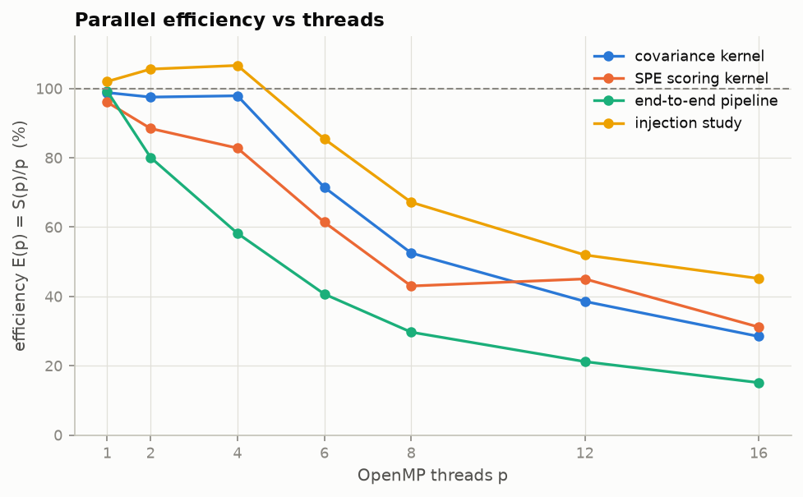
Performance Analysis: Parallel Efficiency
E(p) = S(p)/p; values read from chart (approximate)
Kernel | p=4 | p=16
covariance | ≈98% | ≈28%
SPE scoring | ≈83% | ≈31%
end-to-end | ≈58% | ≈15%
injection study | ≈106% | ≈45%
13
Notes:
Efficiency E(p) = S(p)/p × 100. Covariance holds about 98% up to 4 threads, then drops as threads move beyond the P-cores. The injection study exceeds 100% at 2 to 4 threads; the provided material does not explain why, so say it is a measured result whose cause (for example cache effects) would need to be verified.

Slide 14
Results & Observations, Bottlenecks and Limitations
What scales
Serial fraction
Covariance reaches ≈3.9× at 4 threads (≈98% efficiency). Coarse-grained injection study scales best: ≈7.2× at 16 threads.
Serial eigen (22%) caps the end-to-end speedup. Measured end-to-end ≈2.4× at 16 threads, below the ≈3.7× Amdahl line.
Heterogeneous CPU
Not yet measured
Scaling flattens beyond 4 threads, where the chart marks E-cores and SMT. Cause of the plateau is not established by the data.
Whether the kernels are compute- or memory-bandwidth-bound (Roofline), and the cause of >100% injection efficiency.
14
Notes:
Summarise what the measurements show and what they do not establish. Memory bandwidth versus compute was not tested in the provided material, so present it as a hypothesis for Roofline analysis. The end-to-end result is limited by the serial eigen step, which is exactly what Amdahl predicts.

Slide 15
Conclusion, Future Scope & Q&A
Parallelised every dense kernel over independent outputs with schedule chosen per workload (static vs dynamic,1)
Synchronisation kept minimal: implicit barriers, scalar reductions, one critical section for exceptions
Measured at t = 32768, m = 1024: covariance ≈98% efficient to 4 threads; injection study ≈7.2× at 16 threads; end-to-end ≈2.4×
Future scope
Address the serial eigen step (22%), the end-to-end bottleneck
Roofline analysis to separate compute from memory-bandwidth limits
Investigate the plateau beyond the P-cores
Questions?
15
Notes:
Conclude with the main technical points: owner-computes parallelism with schedules chosen per kernel, minimal synchronisation, measured scaling, and the serial eigen bottleneck. Future work targets the serial eigen step and Roofline analysis.

