Slide 1

WELCOME
PRESENTED BY
SNEHA C J

Slide 2
PROBABILITY
Topics:-
BASIC DEFINITIONS
MATHEMATICAL PROBABILITY(by Jacob Bernoulli)
SET TERMINOLOGY
VENN DIAGRAMS
FORMULAS USED
CONDITIONAL PROBABILITY
BAYES THEOREM

Slide 3
BASIC DEFINITIONS:
Random experiment: The experiment in which Possible result known in advance but experiment result is unknown and the result is called outcome. Result depend on chance. Ex: tossing of coin.
Trial: Single performance of random experiment.
Sample space: Set of all possible outcomes of a random experiment. Ex: when a coin thrown, S={H,T}
Event: Any possible result .Ex: when 2 coin tossed, getting 2 head is event. And when 2 coin tossed getting 2 heads is a simple event ( {HH} ), where getting a head is compound event ( {HT,TH} ), an event whose occurrence is inevitable is called sure event, event which never occur event is called impossible event, event which may or may not occur is called uncertain event.

Slide 4
Exhaustive cases: total outcomes in sample space of random experiment. Ex: when a coin tossed n times exhaustive cases=2^n.
Favourable cases: No. of outcomes favourable to happen an event. Ex: when a die thrown favourable cases for getting even number=3.
Equally likely outcomes: All of them have equal chance to occur. Ex: tossing a unbiased coin getting a head and tail is equally likely.
Mutually exclusive events: 2 or more event is mutually exclusive or disjoint if their simultaneous occurrence is impossible. Ex. getting even and odd numbers at same time when a die is thrown
Independent events: If the happening of any one of them is not affected by and does not affect the happening of any of others , otherwise the events are Dependent events. Ex. getting head and tail when a coin tossed

Slide 5
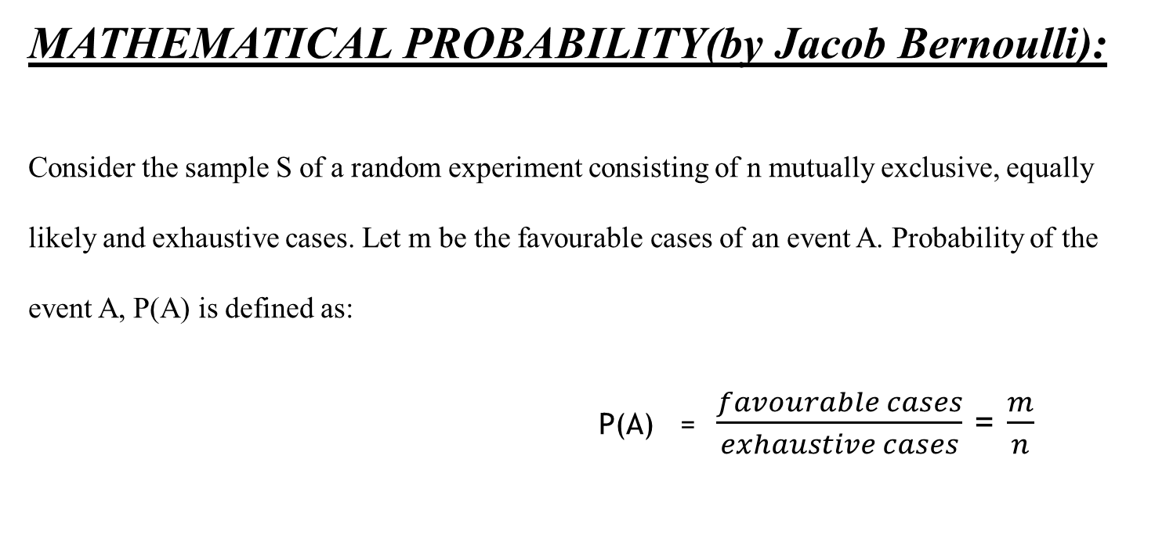
MATHEMATICAL PROBABILITY(by Jacob Bernoulli):
Consider the sample S of a random experiment consisting of n mutually exclusive, equally likely and exhaustive cases. Let m be the favourable cases of an event A. Probability of the event A, P(A) is defined as:
P(A) = $\frac{favourable cases}{exhaustive cases}$ = $\frac{m}{n}$

Slide 6
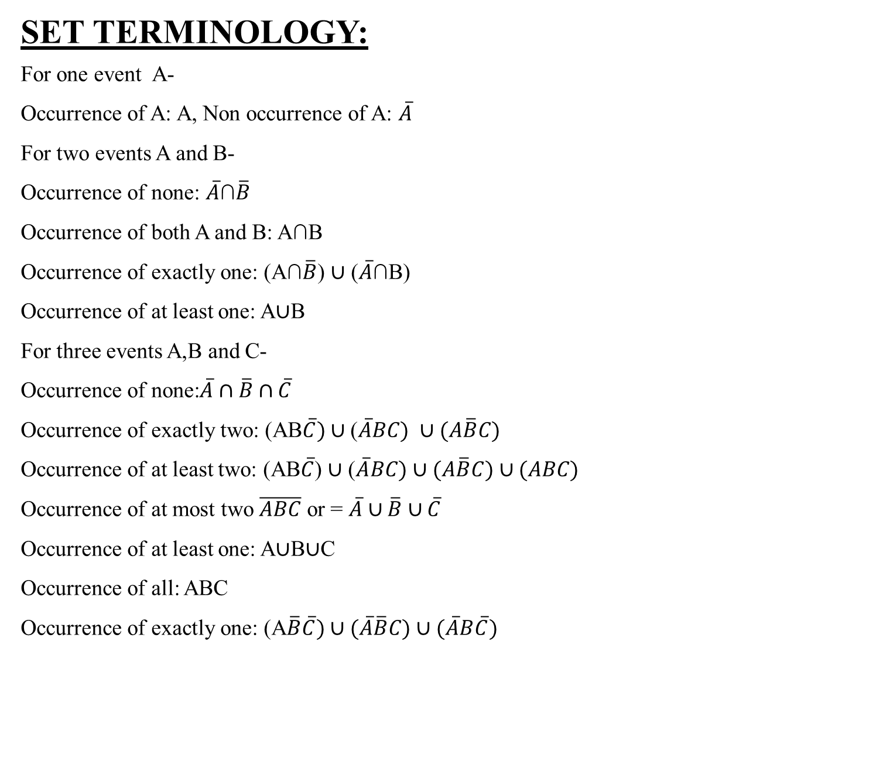
SET TERMINOLOGY:
For one event A-
Occurrence of A: A, Non occurrence of A: $\overline{A}$
For two events A and B-
Occurrence of none: $\overline{A}$∩$\overline{B}$
Occurrence of both A and B: A∩B
Occurrence of exactly one: (A∩$\overline{B}$) ∪ ($\overline{A}$∩B)
Occurrence of at least one: A∪B
For three events A,B and C-
Occurrence of none:$\overline{A}∩\overline{B}∩\overline{C}$
Occurrence of exactly two: (AB$\overline{C})∪$($\overline{A}BC) ∪(A\overline{B}C)$
Occurrence of at least two: (AB$\overline{C}$) ∪ ($\overline{A}BC)∪(A\overline{B}C)∪(ABC)$
Occurrence of at most two $\overline{ABC}$ or = $\overline{A}∪\overline{B}∪\overline{C}$
Occurrence of at least one: A∪B∪C
Occurrence of all: ABC
Occurrence of exactly one: (A$\overline{B}\overline{C})∪(\overline{A}\overline{B}C)∪(\overline{A}B\overline{C})$

Slide 7

VENN DIAGRAMS:-
A∪B A∩B (A∩$\overline{B})∪(\overline{A}∩B)$
$\overline{A}$ A∩$\overline{B}$ $\overline{A}∩B$
A∪$\overline{B}$ $\overline{A}∪\overline{B}=\overline{(A∩B)}$ $\overline{A}∩\overline{B}= \overline{(A∪B)}$
A B
A B
A
B
A
B
A
B
A
B
A
B
A
B
A
BB

Slide 8

FORMULAS USED:
∎ P(S)=1
∎ P($\overline{A}$)=1- P(A), Where $\overline{A}$ is the compliment of A.
∎ P(A∪$\overline{A}$)=1
∎ 0≤ P(A) ≤1
∎ P(∅)=0
∎ If A⊂B, then P(A) ≤ P(B)
∎ P(A∪B)=P(A)+P(B)-P(A∩B)
∎ P(S)=1

Slide 9
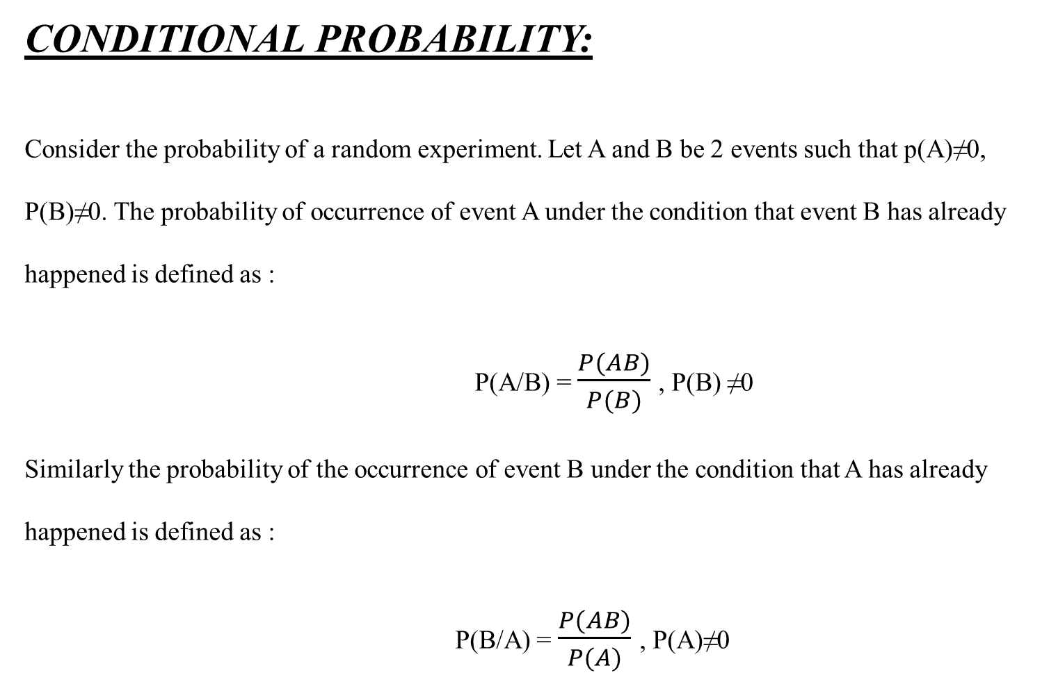
CONDITIONAL PROBABILITY:
Consider the probability of a random experiment. Let A and B be 2 events such that p(A)≠0, P(B)≠0. The probability of occurrence of event A under the condition that event B has already happened is defined as :
P(A/B) = $\frac{P(AB)}{P(B)}$, P(B) ≠0
Similarly the probability of the occurrence of event B under the condition that A has already happened is defined as :
P(B/A) = $\frac{P(AB)}{P(A)}$ , P(A)≠0

Slide 10
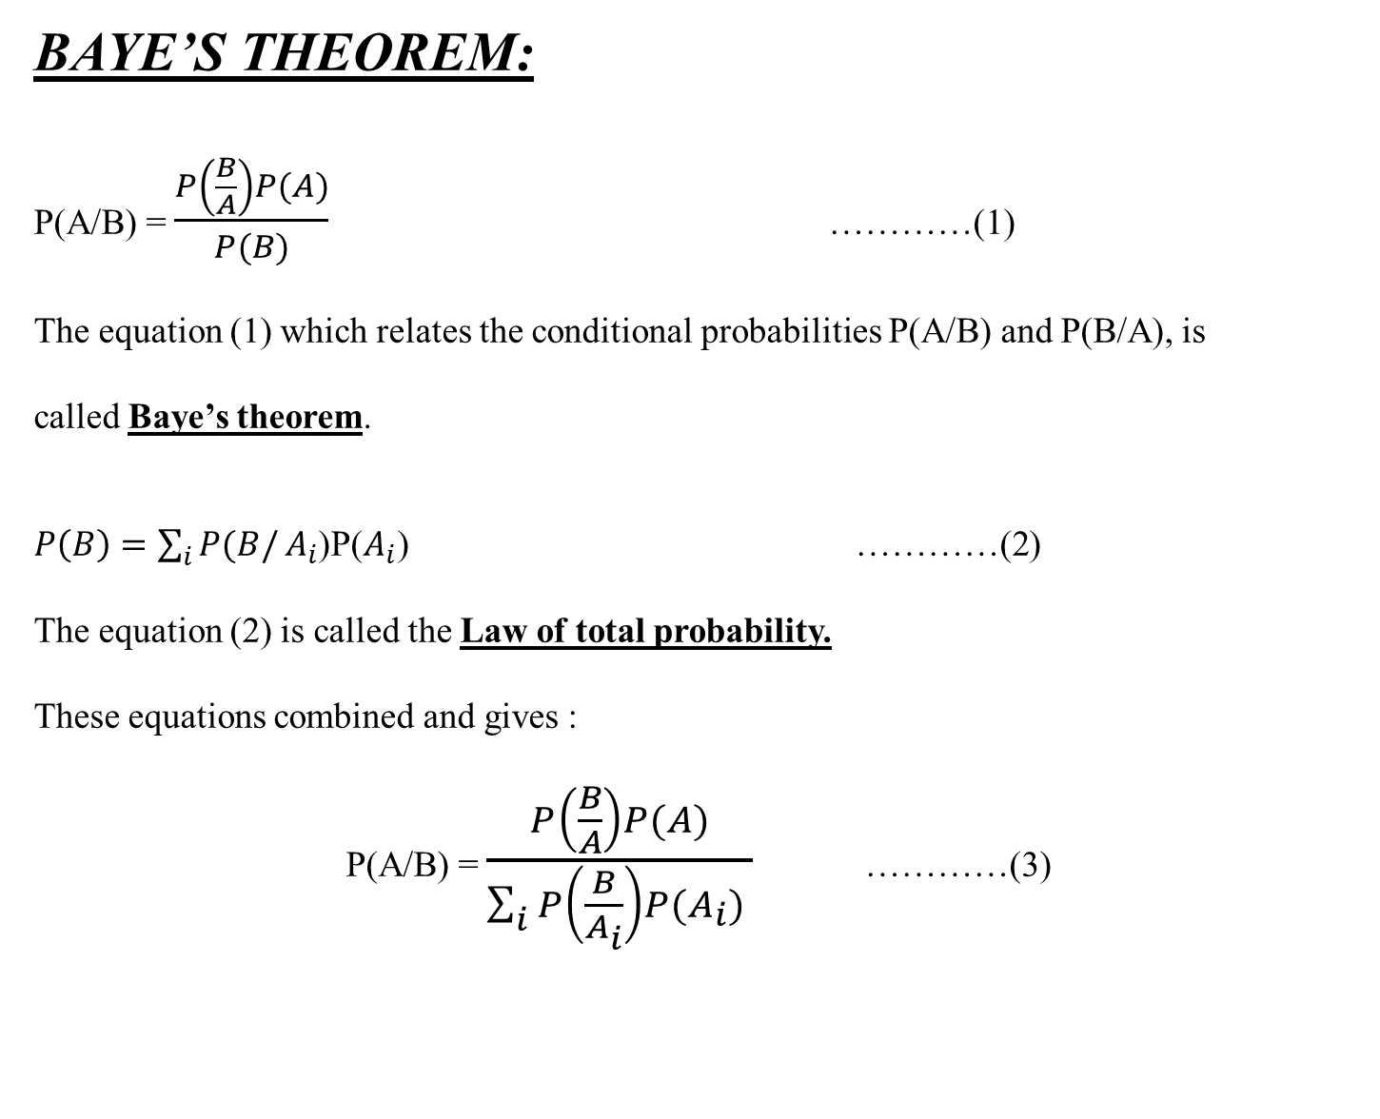
BAYE’S THEOREM:
P(A/B) = $\frac{P\left(\frac{B}{A}\right)P(A)}{P(B)}$ …………(1)
The equation (1) which relates the conditional probabilities P(A/B) and P(B/A), is
called Baye’s theorem.
$P\left(B\right)=\sum_{i}{P(B/}A_{i}$)P($A_{i}$) …………(2)
The equation (2) is called the Law of total probability.
These equations combined and gives :
P(A/B) = $\frac{P\left(\frac{B}{A}\right)P(A)}{\sum_{i}{P\left(\frac{B}{A_{i}}\right)P(A_{i})} }$ …………(3)

Slide 11


