Slide 1

Student Details
Employee Burnout Prediction
Name : Durvasula Sneha
Email ID : snehadurvasula2004@gmail.com
College Name : JNTUA College of Engineering, Pulivendula
College State : Andhra Pradesh
Internship Domain : AI/ML
Start date : 03/06/2024
End Date : 11/07/2024

Slide 2
PROJECT TITLE/Problem Statement
Employee burnout has become a significant concern for organizations worldwide, leading to high turnover rates, decreased productivity, and deteriorating mental and physical health of employees. Burnout, characterized by chronic workplace stress that has not been successfully managed, results in feelings of exhaustion, increased mental distance from one’s job, and reduced professional efficacy. To proactively tackle this problem, it is essential to leverage advanced technologies like Artificial Intelligence (AI) and Machine Learning (ML) to predict and mitigate burnout early on.
This project aims to develop a predictive model using AI/ML techniques to analyze various employee attributes and accurately forecast burnout risk, enabling organizations to implement timely interventions and foster a healthier, more productive workforce.

Slide 3
AGENDA
Project Overview
Who are the end users of this Project?
Your solution and it’s value Proposition
How did you customize the project and make it your own?
Modelling
Results
Links

Slide 4
PROJECT OVERVIEW
The project focuses on predicting employee burnout using linear regression, leveraging AI and machine learning techniques. The dataset used includes attributes such as Designation, Resource Allocation, Mental Fatigue Score, Burn Rate, Date of Joining, Gender, Company Type, and WFH Setup Available. The primary objective is to develop a model that can accurately forecast the burn rate of employees based on these features.
The analysis began with data cleaning and preprocessing, including handling missing values and encoding categorical variables. Feature engineering was applied to enhance the dataset, and principal component analysis (PCA) was used for dimensionality reduction, retaining 95% of the variance to simplify the model without losing significant information.
Linear regression was chosen for its simplicity and effectiveness in predicting continuous outcomes like burn rate. The dataset was split into training and testing sets to validate the model's performance. The model was trained on the training set, and its accuracy was evaluated on the testing set to ensure it generalizes well to unseen data.

Slide 5
WHO ARE THE END USERS of this project?
The end users of this employee burnout analysis project are diverse, encompassing various stakeholders within an organization who can benefit from predictive insights into employee burnout.
These include:
Management and Leadership Teams: Address issues proactively to maintain team productivity and morale.
Employee Assistance Programs (EAP) Providers: Target services more effectively to employees in need.
Corporate Wellness Programs Providers: Tailor wellness programs to address specific stressors and needs.
Data Analysts and Business Intelligence Teams: Integrate the analytical tool into broader business intelligence efforts.
Employees: Benefit indirectly through improved workplace policies and support systems.
Human Resources (HR) Departments: Identify employees at risk of burnout early for timely interventions.

Slide 6
YOUR SOLUTION AND ITS VALUE PROPOSITION
The solution involves:
Data Preprocessing: Collected and cleaned employee data, applied PCA for feature reduction.
Model Development: Trained a Linear Regression model, evaluated with R-squared, MSE, RMSE, and MAE metrics.
Visualization: Created plots to illustrate burnout trends across designations and genders.
The problems can be addressed as follow:
HR Departments:
Need: Early burnout detection.
Solution: Identifies at-risk employees for timely interventions.
Value: Enhances well-being, reduces turnover.
Management:
Need: Maintain productivity and morale.
Solution: Provides insights for proactive resource allocation.
Value: Sustains team performance and satisfaction.

Slide 7
How did you customize the project and make it your own
I enhanced the project by creating customized output plots to better visualize and interpret the data, which were not included in my mentor's code. These plots include:
Box Plots:
Mental Fatigue vs. Designation: This plot highlights the distribution of mental fatigue scores across different designations, revealing significant stress patterns among various job roles.
Burn Rate vs. Gender: Displays the variability in burn rates between genders, providing insights into gender-specific burnout trends.
Histograms and Line Plots:
Distribution of Key Features: Created histograms for various features such as Resource Allocation and Burn Rate to understand their distribution.
Burn Rate Trends: Developed line plots to visualize how burn rates vary across designations and genders over time, helping to identify high-risk groups.
Application of PCA:
I applied Principal Component Analysis (PCA) to reduce the dimensionality of the dataset, capturing the most significant features. This step was crucial for:
Improving Model Performance:
PCA helped in eliminating noise and reducing computational complexity, leading to a more efficient and accurate prediction model.

Slide 8
MODELLING
Techniques Utilized:
Linear Regression: Developed to predict employee burnout based on factors like designation and mental fatigue score, evaluated with R-squared, MSE, RMSE, and MAE.
Methodologies Applied:
Principal Component Analysis (PCA): Used for dimensionality reduction, focusing on key features to improve model performance.
Data Preprocessing: Ensured data quality through cleaning, handling missing values, and encoding categorical variables for effective model training.
Technology Principles:
AI and Machine Learning: Applied to build predictive models for analyzing complex datasets.
Data Visualization: Utilized tools like Plotly and Seaborn for creating informative visualizations.
Efficiency and Scalability: Implemented scalable solutions and efficient algorithms to manage large datasets effectively.
Training and Testing:
Split the data into training (75%) and testing (25%) sets.

Slide 9
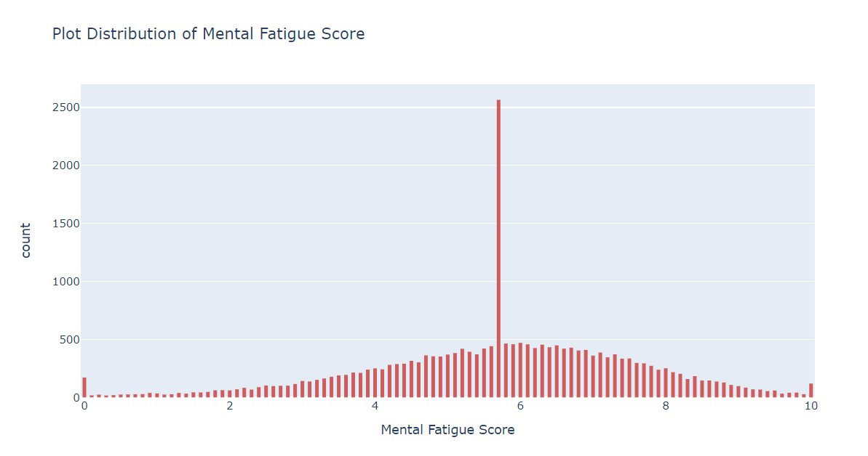
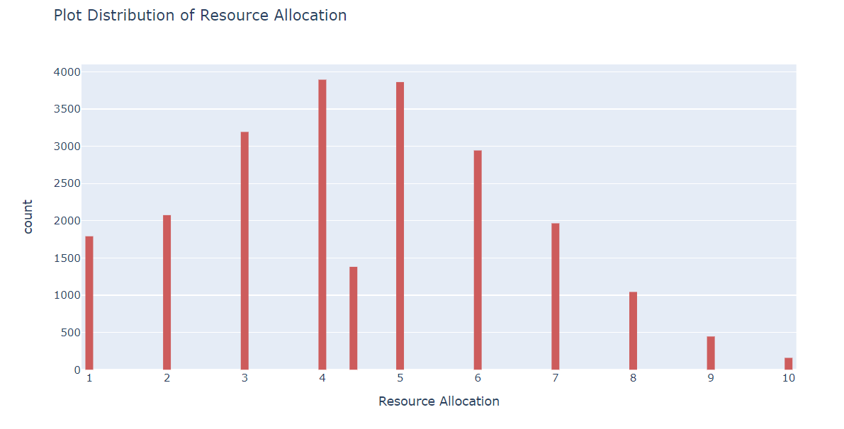
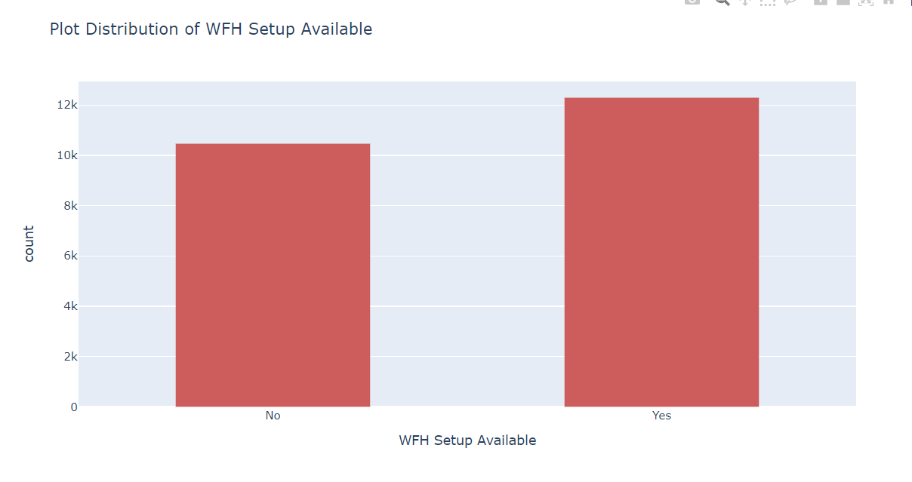
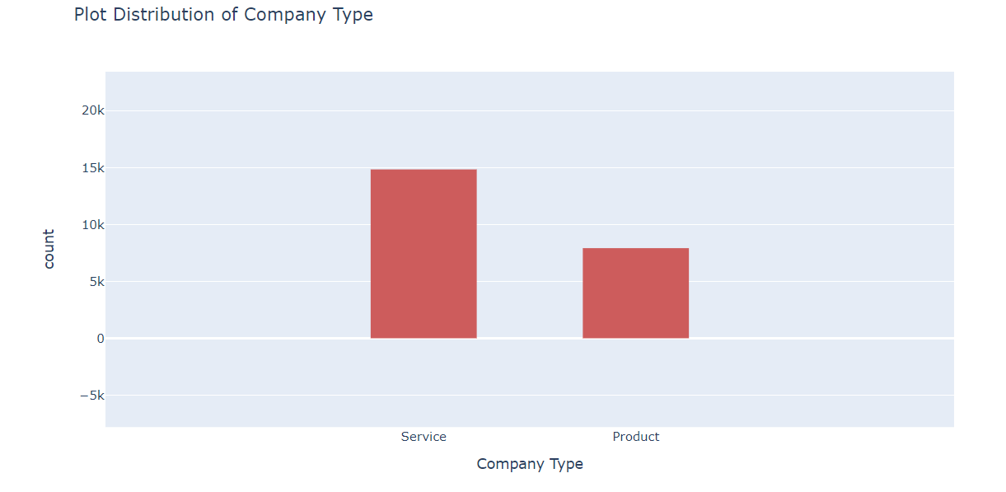
Data Visualised:

Slide 10
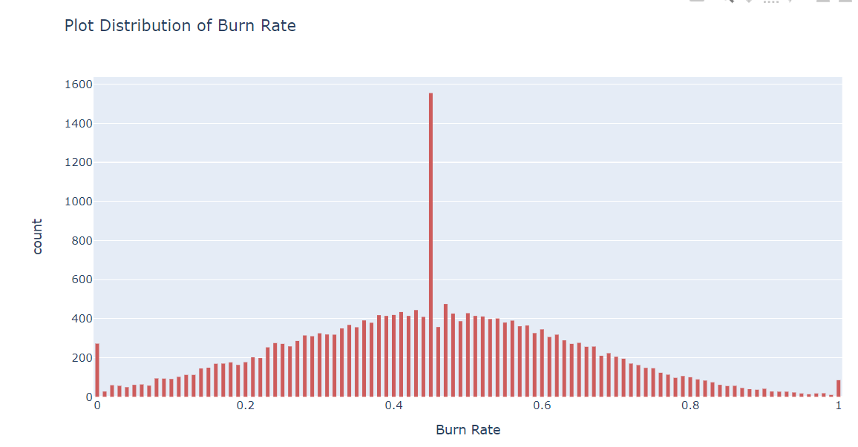
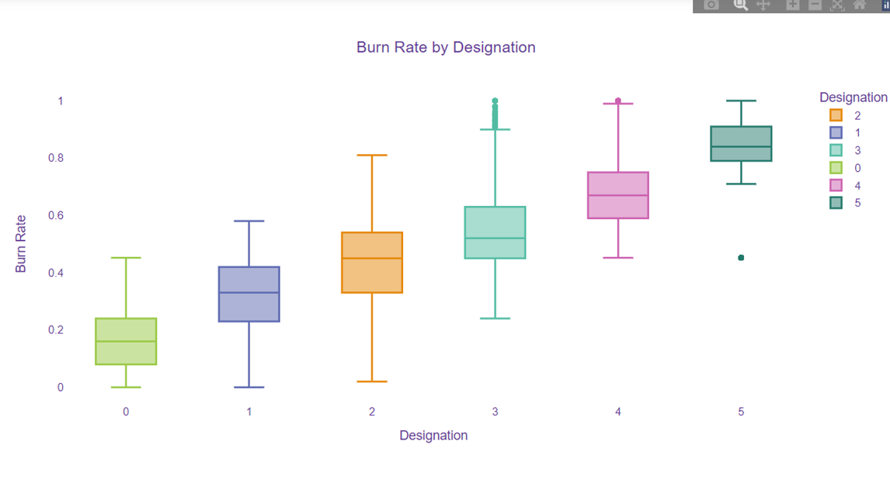

Slide 11
Results
Model Performance
while Training:
while Testing:
R-Squared: 0.831
Mean squared Error: 0.006
Root mean squared error: 0.080
Mean absolute Error: 0.058
Training Accuracy:83%
Testing Accuracy:82%
R-Squared: 0.829
Mean squared Error: 0.006
Root Meaned error squared: 0.080
Mean absolute Error: 0.058
Key Insights:
High Mental Fatigue Scores correlate with higher burn rates
Certain designations show higher burnout susceptibility compared to others
Female employees report higher burn rates than male employees, indicating potential areas for targeted interventions

Slide 12
links
Github Link: https://github.com/Snehadurvasula2004/employee-burnout-1/upload
Linkedin: https://www.linkedin.com/in/durvasula-sneha-276300230/

