Slide 1

V
VINASTRA AEROSPACE
AUTONOMOUS INDUSTRIAL
INFRASTRUCTURE FOR SPACE
Investor Pitch Deck 2026
AI-integrated autonomous robotics, additive manufacturing and ground-supervised construction systems for building factory-scale infrastructure beyond Earth.
ASCS Platform
Deep-Space Factory
Space Resource Economy
VINASTRA AEROSPACE PRIVATE LIMITED
01
From Earth to Asteroids — Building the Future of Space Industry

Slide 2

V
VINASTRA AEROSPACE
The problem
Space infrastructure cannot scale if every factory, station and structure must be launched complete from Earth.
The bottleneck is industrial capability beyond Earth.
Launch dependence
Large structures are limited by payload mass, fairing volume and launch cost.
The next leap is not only reaching space — it is building, repairing and manufacturing there.
Human construction limits
Deep-space construction cannot rely on astronauts for every assembly, inspection and repair task.
Robotic construction reduces dependence on human EVA and Earth-launched finished structures.
Additive manufacturing can convert feedstock into usable parts and structures.
Autonomy is required because deep-space communication delays prevent real-time manual control.
No local industry
Future Moon, Mars, asteroid and deep-space missions need local manufacturing, servicing and materials processing.
02
Investor Pitch Deck • Confidential • 2026

Slide 3
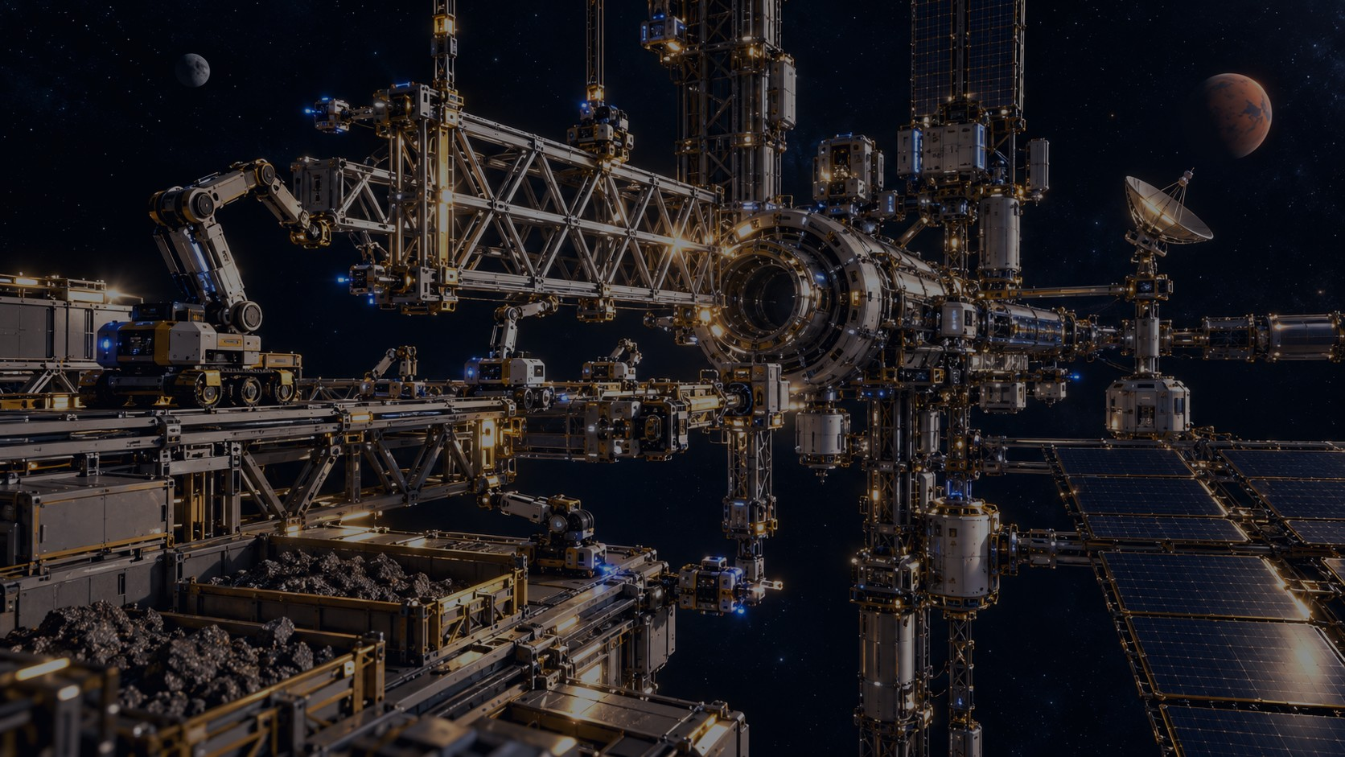
V
VINASTRA AEROSPACE
Our solution
Launch intelligent machines that can construct, inspect and expand the Vinastra Space Factory.
Vinastra is building the autonomous construction layer required before full-scale space factories can exist.
Digital factory
blueprint
AI robotic
construction fleet
3D-print +
assemble modules
Inspect, repair
and recover
Commission
space factory
Core thesis
Do not launch an entire factory. Launch the machines that can build, maintain and eventually expand the factory in space.
03
Investor Pitch Deck • Confidential • 2026

Slide 4
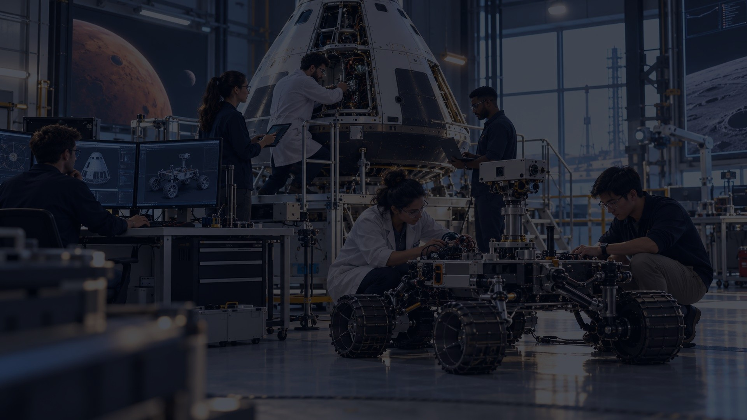
V
VINASTRA AEROSPACE
Core product: ASCS
Autonomous Space Construction System — the first investable technology platform.
ASCS is the AI + robotics + digital-twin stack for building the first factory modules beyond Earth.
AI mission planner
Digital twin
Robotic builders
Machine vision
Ground control
Task sequencing, replanning, anomaly response
Blueprint, simulation, progress comparison
Arms, mobile robots, 3D printing, joining
Metrology, inspection, alignment, QA
Supervisory commands and recovery actions
Autonomous-first • Human-supervised • Remotely recoverable
04
Investor Pitch Deck • Confidential • 2026

Slide 5
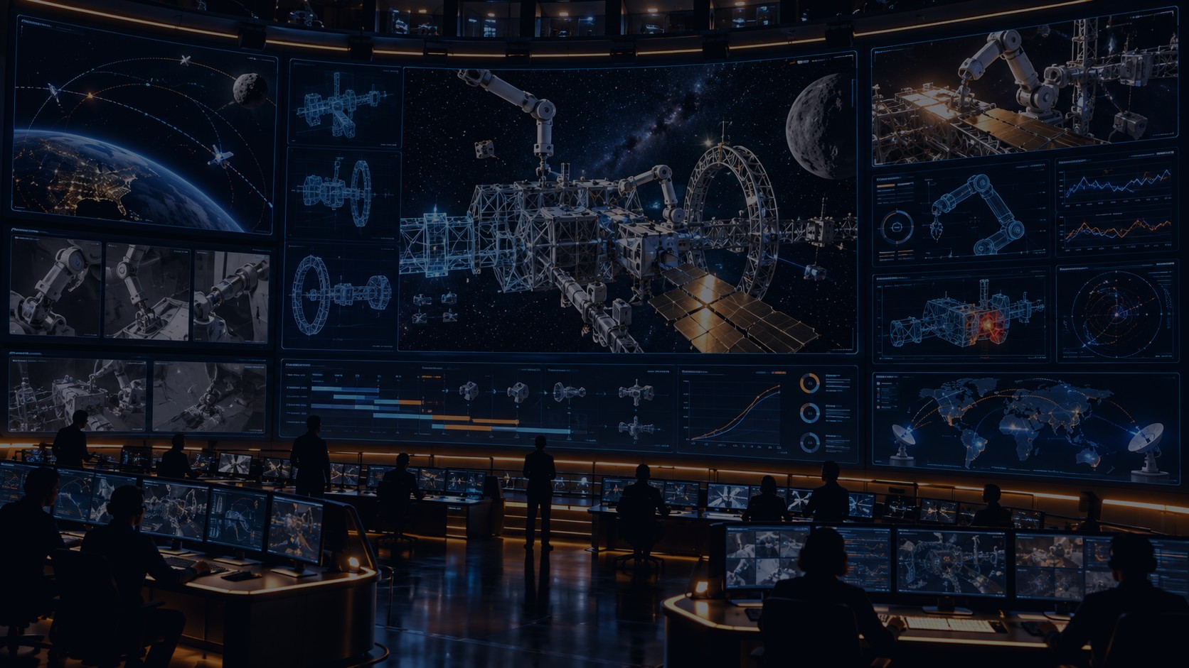
V
VINASTRA AEROSPACE
How ASCS works
The robot fleet follows a pre-installed construction plan but can recover through AI and ground supervision.
Plan
factory blueprint + robotic sequence
Position
navigation, docking and alignment
Print
additive manufacturing / feedstock use
Assemble
robotic joining and installation
Inspect
vision, sensors, metrology
Correct
AI re-plan or ground-control action
Normal mode: autonomous construction. Anomaly mode: AI executes recovery procedures. Critical mode: the system enters a safe state while Earth-based mission control analyzes telemetry and uploads revised instructions.
05
Investor Pitch Deck • Confidential • 2026

Slide 6
V
VINASTRA AEROSPACE
The Vinastra Space Factory
A modular autonomous industrial platform designed for operation beyond Earth orbit.
The long-term factory is envisioned as a modular, expandable industrial platform beyond Earth that receives resources, processes materials and manufactures useful products for space infrastructure or return to Earth.
Inside the factory
R&D labs • material processing • purification • refining • additive manufacturing • robotics maintenance • docking/logistics interfaces
Factory role
Support spacecraft servicing, deep-space logistics, lunar/Mars infrastructure, future fuel systems and commercial habitats.
06
Investor Pitch Deck • Confidential • 2026

Slide 7
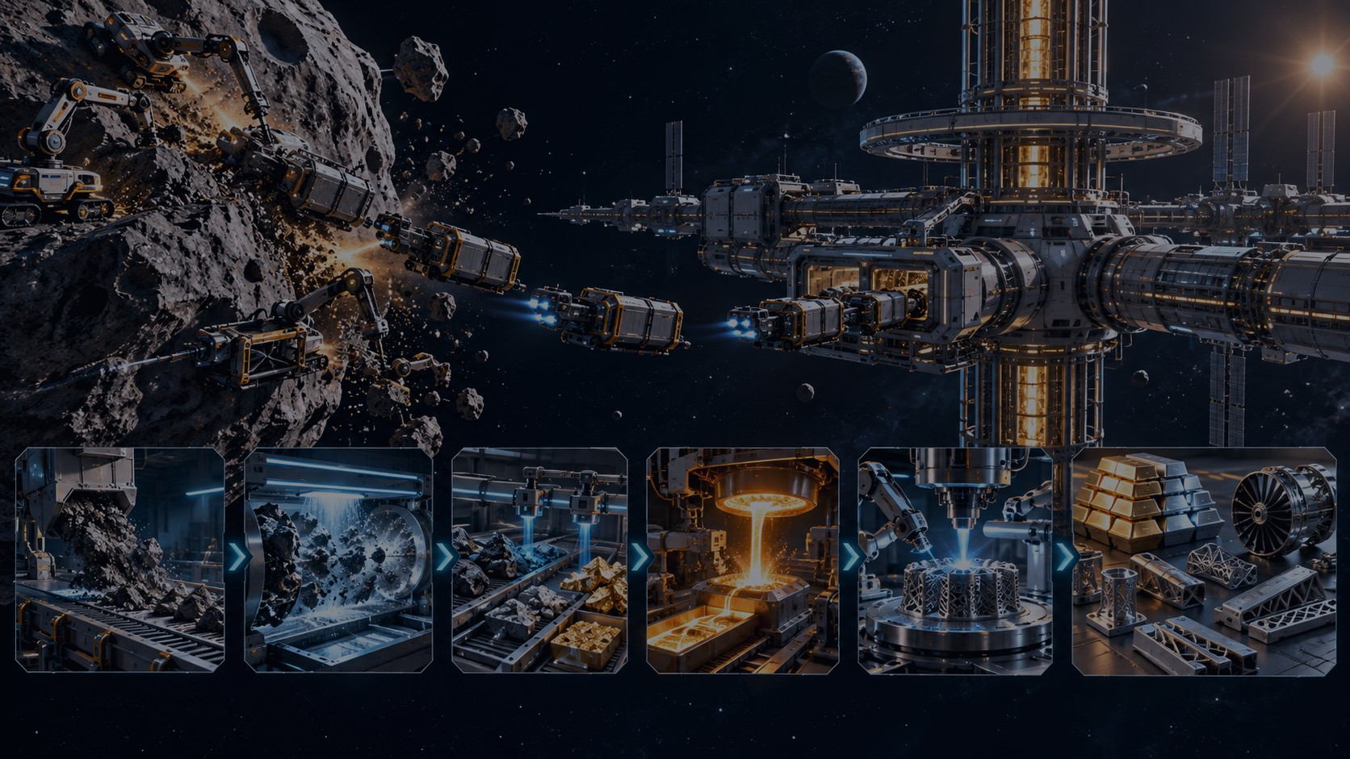
V
VINASTRA AEROSPACE
Future resource-to-product chain
Asteroid resources become manufacturing feedstock for space industry.
Asteroid
resources
Robotic
mining
Transport to
factory
Purification
& refining
3D-printed
products
Use in space
or return
First milestone: build the autonomous construction capability. Later milestone: integrate space-resource feedstock into the factory.
07
Investor Pitch Deck • Confidential • 2026

Slide 8

V
VINASTRA AEROSPACE
Prototype-1 plan
Build a ground-based ASCS demonstrator before attempting a space mission.
18-month objective: demonstrate robotic systems that read a digital blueprint, manufacture/handle components, assemble a factory-module structure, inspect it and recover from errors under ground-control supervision.
Autonomous assembly
Robotic 3D printing
Digital twin comparison
Robot positions and joins modular structural elements
Demonstrate additive manufacturing of test components
Compare built module against the approved model
Fault recovery
Mission control UI
Detect misalignment and trigger correction workflow
Earth-based monitoring and high-level intervention
08
Investor Pitch Deck • Confidential • 2026

Slide 9

V
VINASTRA AEROSPACE
Current status & technical assets
Early-stage company with a defined platform thesis and a developing R&D ecosystem.
Company formed
Vinastra Aerospace Pvt. Ltd. incorporated in 2026; founder-led early-stage DeepTech venture.
Technical direction
ASCS architecture, autonomous construction logic and deep-space factory concept defined.
Design assets
Preliminary factory architecture, construction sequence study and mission architecture under development.
Talent pipeline
Vinastra SpaceTech Research Fellowship to attract students, engineers and researchers.
Ecosystem connection
The Spark of Wisdom — an IIRS/ISRO Nodal Centre with 5+ years of space/STEM education activity.
Investor focus: convert current architecture into a working prototype with measurable technical milestones.
09
Investor Pitch Deck • Confidential • 2026

Slide 10
V
VINASTRA AEROSPACE
Market opportunity
The macro space economy is large, but Vinastra starts with a focused beachhead in autonomous space robotics, ISAM, digital-twin/autonomy software and robotic construction.
$630B
$1.8T
global space economy in 2023
projected by 2035
Beachhead markets
Space robotics
ISAM
Digital twin + autonomy
Space resources
Robotic arms, autonomous assembly and servicing tools
In-space servicing, assembly and manufacturing technology
Mission planning, monitoring and fault recovery software
Long-term processing and manufacturing infrastructure
Source: World Economic Forum / McKinsey “Space: The $1.8 Trillion Opportunity for Global Economic Growth”.
10
Investor Pitch Deck • Confidential • 2026

Slide 11
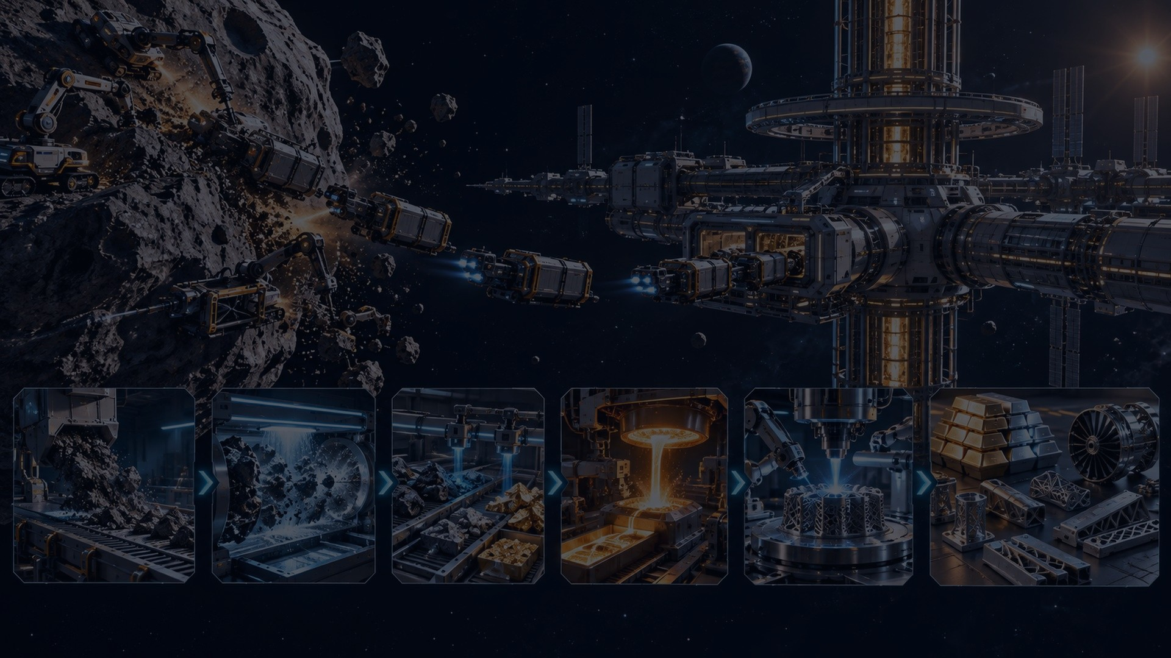
V
VINASTRA AEROSPACE
Business model
Revenue evolves from ground-demonstrable technology to space-factory services.
Now
Next
Space demo
Long term
R&D contracts
prototype development
software + simulation
Proprietary robotics technology
digital twin platform
construction-control systems
Payload partnerships
ISAM collaborations
licensing and joint missions
Factory services
manufacturing
resource processing
servicing + logistics
Important positioning: The Spark of Wisdom can support education, outreach and talent; Vinastra’s investor story should focus on DeepTech technology and industrial space infrastructure.
11
Investor Pitch Deck • Confidential • 2026

Slide 12
V
VINASTRA AEROSPACE
Go-to-market through partnerships
DeepTech space infrastructure must be developed with institutions, labs and strategic partners.
Universities & labs
Space agencies & grants
Industry partners
robotics testing, simulations, student research, publications
technology development programs, ISAM and autonomy research
robotics, additive manufacturing, sensors, embedded systems
Incubators & investors
Near-term + long-term customers
capital, mentorship, customer discovery, prototype validation
R&D programs, universities, labs, space-tech companies and ISAM technology partners; long-term: satellite operators, space stations, lunar/Mars logistics and manufacturing players
12
Investor Pitch Deck • Confidential • 2026

Slide 13
V
VINASTRA AEROSPACE
Roadmap
Technology milestones that make the moonshot investable.
2026
2027
2028
2029
2030+
Long term
Architecture + team
Ground demo
Integrated cell
Relevant-environment testing
Space demo
Deep-space factory
ASCS concept, design assets, fellowship, partner mapping
Factory-module autonomous construction demonstrator
Robotic 3D printing, inspection, re-planning and control UI
Vacuum/thermal/analog testing and partner payload planning
Small in-space construction/inspection experiment
Modular factory, resource processing and manufacturing services
13
Investor Pitch Deck • Confidential • 2026

Slide 14
V
VINASTRA AEROSPACE
Team & hiring plan
Founder-led vision with a multidisciplinary technical team to be built around the prototype.
Founder & CEO
Advisory gap
Vinay Jeedi — building Vinastra Aerospace around autonomous robotics, AI, space manufacturing and future space infrastructure.
Add senior advisors in robotics, space systems, manufacturing, fundraising and legal/IP before major investor outreach.
Required technical roles for Prototype-1
Talent engine
Robotics / mechatronics engineer
AI/ML and machine-vision engineer
Mechanical / CAD / CAE engineer
Embedded systems and control engineer
Additive manufacturing / materials specialist
Space systems advisor and mission architect
Vinastra Fellowship + The Spark of Wisdom (TSOW) network can help identify committed students, researchers and project collaborators.
14
Investor Pitch Deck • Confidential • 2026

Slide 15
V
VINASTRA AEROSPACE
Investment ask
Proposed seed raise to build the first ASCS prototype and produce investor-grade technical proof.
Proposed Seed Raise: ₹2.5 Cr | 18-Month Runway
Objective: deliver a validated ground-based ASCS Prototype-1 and prepare the first partner-led in-space technology demonstration.
35%
Prototype hardware
robotic arms, mobile base, sensors, printer/joining tools
25%
AI + software
digital twin, autonomy, mission control UI, machine vision
20%
Engineering team
core technical hiring and contractor specialists
10%
Testing & partnerships
labs, fixtures, materials and validation programs
10%
IP + operations
planned IP filings, compliance, documentation and company runway
Milestone at end of raise: working ground ASCS demonstrator + technical documentation + partner-ready space demo proposal.
15
Investor Pitch Deck • Confidential • 2026

Slide 16

V
VINASTRA AEROSPACE
Defensibility strategy
Build proprietary knowledge in the hardest layer: autonomous industrial construction in space.
1
Construction-control software
Mission logic, sequencing, re-planning and fleet coordination
2
Digital-twin architecture
Blueprint-to-reality verification and anomaly tracking
3
Robotic procedures
Additive construction, assembly, inspection and fault recovery workflows
4
Experimental data
Ground prototype data becomes the foundation for future autonomy models
5
Planned IP portfolio
Patentable inventions, proprietary design documentation and interfaces developed through ASCS
16
Investor Pitch Deck • Confidential • 2026

Slide 17
V
VINASTRA AEROSPACE
Partnership invitation
Join Vinastra in building the autonomous construction layer for future space factories.
Seeking seed investors, grants, technology partners and research collaborators for ASCS Prototype-1.
Autonomous Robotics → Space Construction → Space Factory → Resource Processing → Space Industrial Economy
Vinay Jeedi
Founder & CEO, Vinastra Aerospace Private Limited
Email: thesparkofwisdom@gmail.com • LinkedIn: Vinay Jeedi
Innovate. Research. Inspire. Build the Future.
17
Vinastra Aerospace • Investor Pitch Deck • Confidential

