Slide 1
Agri Price Prediction System
🏆 IDEATHON 2026 | NIT Durgapur
Agri Price Prediction System
🌾
AI-Powered Crop Market Forecasting for Smarter Farmer Decisions
Team AXILLA
Snehal Muduli
Shreyas Sahoo
Arnab Bhattacharya
Dharmanshu Kumar
Indian Institute of Technology, Kharagpur · SRM Institute of Science & Technology

Slide 2
01 THE REAL PROBLEM
What Is Actually Happening to Indian Farmers?
The Harvest Trap
📉 Price Crash at Harvest
Every harvest season, millions of farmers face the same invisible crisis.
When crops ripen, every farmer in a region sells at once — flooding the market. Prices collapse instantly.
Middlemen (arhtiyas) step in — buying cheap at harvest and selling weeks later at 2–4× the price.
Real Example:
Nashik, October 2023 — Onions sold at ₹1/kg at harvest. The same onions sold for ₹40/kg in Delhi just three weeks later.
The farmer earned ₹1. The middleman earned ₹40.
All farmers sell simultaneously, flooding the market. Prices hit rock bottom exactly when supply is highest.
🏦 Zero Forecasting Tools
No accessible, farmer-friendly price prediction tool exists. Farmers make critical selling decisions with zero data.
💸 Middleman Information Gap
Middlemen use market intelligence to buy low and sell high. Farmers have no equivalent advantage to counter this.
150M+ farmer families in India · ₹15,000–40,000 average income lost per season to poor market timing

Slide 3
02 WHY WE CHOSE THIS
A Problem That Demands a Solution
🌍
💡
📊
Scale of Impact
Solvable with AI/ML
Free Public Data Exists
Agriculture employs 42% of India's workforce. A solution here creates ripple effects across the entire rural economy.
Crop price patterns are seasonal, cyclical, and data-rich — a perfect ML problem. We had the skills to actually build this.
The Government of India's Agmarknet platform publicly provides daily mandi prices across 3,000+ markets — ready to use.
🤝
🚀
📱
Real Human Need
No Good Solution Exists
Accessible Technology
This isn't a hypothetical problem. Farmer debt, distress selling, and middleman exploitation are daily news in India.
Existing agri-apps assume smartphone access and fail at the last mile. There is a genuine gap in the market.
With SMS, IVR calls, and WhatsApp, we can reach farmers who have never used a smartphone — technology that already exists.

Slide 4
03 INITIAL APPROACH
How We Started Building KisanPrice
📦 Dataset Strategy
1
Feature Engineering
We used a synthetically generated dataset modelled on Agmarknet's schema — replicating real seasonal price patterns, mandi structure, and crop arrival data — as a proof of concept.
In production, the model will be trained on live Agmarknet data.
What the dataset includes:
Lag prices (1–4 weeks), month, season, rainfall, festival flag, arrival quantity, rolling average.
2
Multiple Models Trained
Linear Regression → SVR → Decision Tree → Random Forest → XGBoost. Compare MAE and R².
28,000+
10 Crops
3
Web Interface
Records generated
Tomato, Onion, Wheat...
Farmer selects crop + market + harvest date → model predicts Week 1–4 prices → recommendation displayed.
11 Mandis
5 Years
Across 5 states
2020–2024
4
Last-Mile Delivery
Seasonal
Features
Forecast sent via SMS, IVR voice call, or WhatsApp — no smartphone required.
Price crash at harvest
Spike at peak demand
Rainfall, arrival qty,
festival flags, lag prices

Slide 5
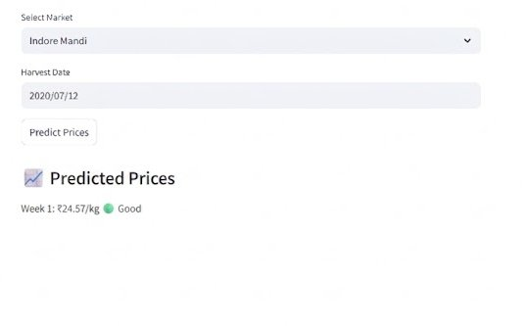
04 FIRST BUILD — V1 MODEL
We Built a 1-Week Prediction Model First
✅ The model worked — R² score was strong (0.92+)
Predicting only 1 week ahead is mathematically easy — the lag price is the strongest predictor.
⚠️ But It Did Not Solve the Farmer's Real Problem
📍 Farmer already knows Week 1 price
He can simply walk to the mandi and check. Our model added zero value for the immediate decision.
🏗️ Storage decisions need 3–4 week visibility
Cold storage costs ₹200–500/quintal/month. A farmer needs to know if waiting 3–4 weeks is worth it — not just one.
🧠 Middlemen think months ahead
Our 1-week model did not close the information gap. It gave the farmer only a marginal improvement over doing nothing.
Earlier Interface — V1 (1-Week Only)
📣 Weak pitch value
"Wait until next week — maybe earn a bit more?" is not compelling. We needed: "Wait until Week 3 — earn 72% more."

Slide 6
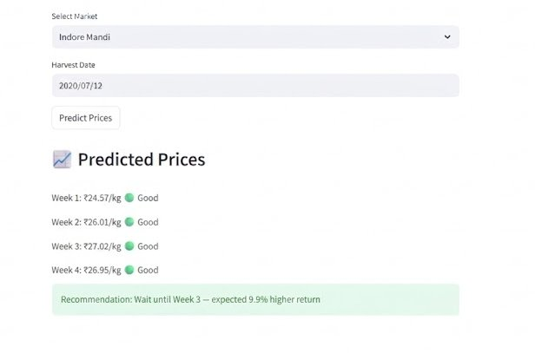
05 EXTENDING TO 4 WEEKS
We Extended the Same Model to Predict All 4 Weeks
The Accuracy Problem
When we fed Week 1 predictions back as inputs for Week 2, then Week 2 for Week 3, and so on — errors compounded rapidly.
❌ Week 4 R² = 0.51 — essentially a coin flip. The model was predicting future prices with only 51% accuracy by Week 4. This was unacceptable.
After Modification — 4-Week Output (Same Model)
➡ Solution: Build 4 separate, independent models — one for each week.

Slide 7
06 FOUR INDEPENDENT MODELS
We Built 4 Separate ML Models — One Per Week
Week 1
Week 2
Week 3
Week 4
XGBoost Model
XGBoost Model
XGBoost Model
XGBoost Model
R² = 0.94
R² = 0.89
R² = 0.83
R² = 0.77
MAE ₹82/qtl
MAE ₹124/qtl
MAE ₹167/qtl
MAE ₹198/qtl
✅ Acceptable
✅ Acceptable
✅ Acceptable
✅ Acceptable
⚠️ A Critical Bug Discovered — 2 Days Lost
🔍
🌧️
🛠️
The Problem
The Side Effect
The Fix
While validating with historical records, we realised the model was only using Commodity and Market as inputs — but completely ignoring the Harvest Date, which is the most critical input a farmer provides.
Since Harvest Date was missing, Rainfall_mm (a key training feature) was being defaulted to 0 mm in predictions — producing systematically wrong forecasts, especially for monsoon crops.
We rebuilt the data pipeline to correctly incorporate the harvest date into feature generation, ensuring rainfall and seasonal factors are computed from the actual target prediction window.

Slide 8
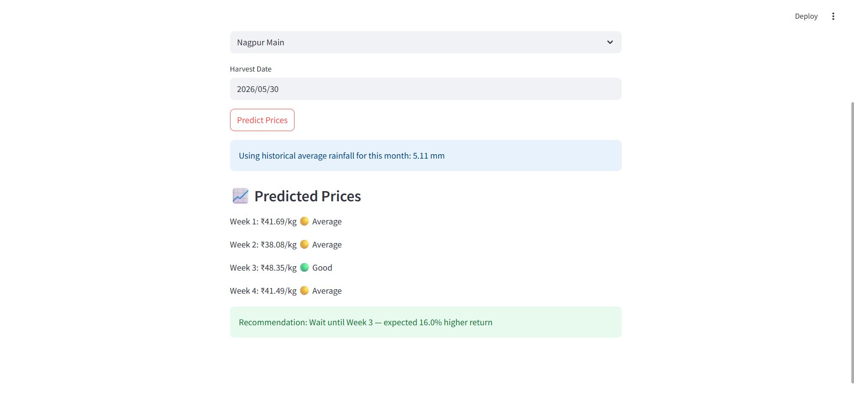
07 WEATHER API INTEGRATION
Solving the Rainfall Problem with Open-Meteo API
Free Weather API — Open-Meteo
1
We integrated the Open-Meteo API, which provides free 14-day rainfall forecasts. For predictions within 14 days, the model uses real forecasted rainfall data.
Historical Average for Future Dates
2
For harvest dates beyond 14 days (e.g., planning July production in May), we use the historical average rainfall for that month from our dataset. This is clearly shown to the user on the interface.
Rainfall Source Disclosed to User
3
The interface explicitly informs the farmer whether live forecast data or historical averages are being used — building trust and transparency into the system.
Model Now Performing Accurately
4
With Harvest Date correctly feeding rainfall and seasonal features, prediction accuracy improved substantially. The core technical challenge has been solved.
Future: Model accuracy will improve further with real-time Agmarknet data and CatBoost/XGBoost ensemble optimisation.
Current Interface — Live Rainfall-Aware Predictions

Slide 9
08 THE BIGGEST CHALLENGE
How Will Farmers Actually Know About This App?
Only 45% of rural India has smartphone access · Over 60% of farmers above 50 have never used an app · A "download our app" strategy reaches the wrong people
📞
🤖
🏪
📻
👨‍🌾
Missed Call + SMS
WhatsApp Chatbot
Mandi Notice Board
IVR Voice Call
Krishi Mitra Worker
Farmer calls a number → system detects district via telecom data → sends back SMS forecast in local language. Works on any ₹500 keypad phone. No internet required.
Farmer types crop name or sends a voice message on WhatsApp. Bot replies with price prediction. 70%+ of rural India uses WhatsApp — voice removes the literacy barrier.
Weekly forecast sheet auto-printed at local mandi offices and CSC centres. 5 lakh+ CSC centres across India. One person reads it → the entire village knows.
Automated Monday call in Hindi/Odia/Bengali: "Kisanbhai, wait until Week 3 — price expected at ₹35/kg." Farmer just picks up the phone. Cost: ~₹0.10 per call.
One trained extension worker per village uses the app and verbally informs 50 farmers. India already has KVKs and agri-extension workers in every block.

Slide 10
🌾
Thank You
Agri Price Prediction System
AI-Powered Crop Market Forecasting for Smarter Farmer Decisions
Team AXILLA
Snehal Muduli · Shreyas Sahoo · Arnab Bhattacharya · Dharmanshu Kumar
IIT Kharagpur · SRM Institute of Science & Technology
IDEATHON 2026 | National Institute of Technology, Durgapur
Open for Questions & Discussion

